Slide 1
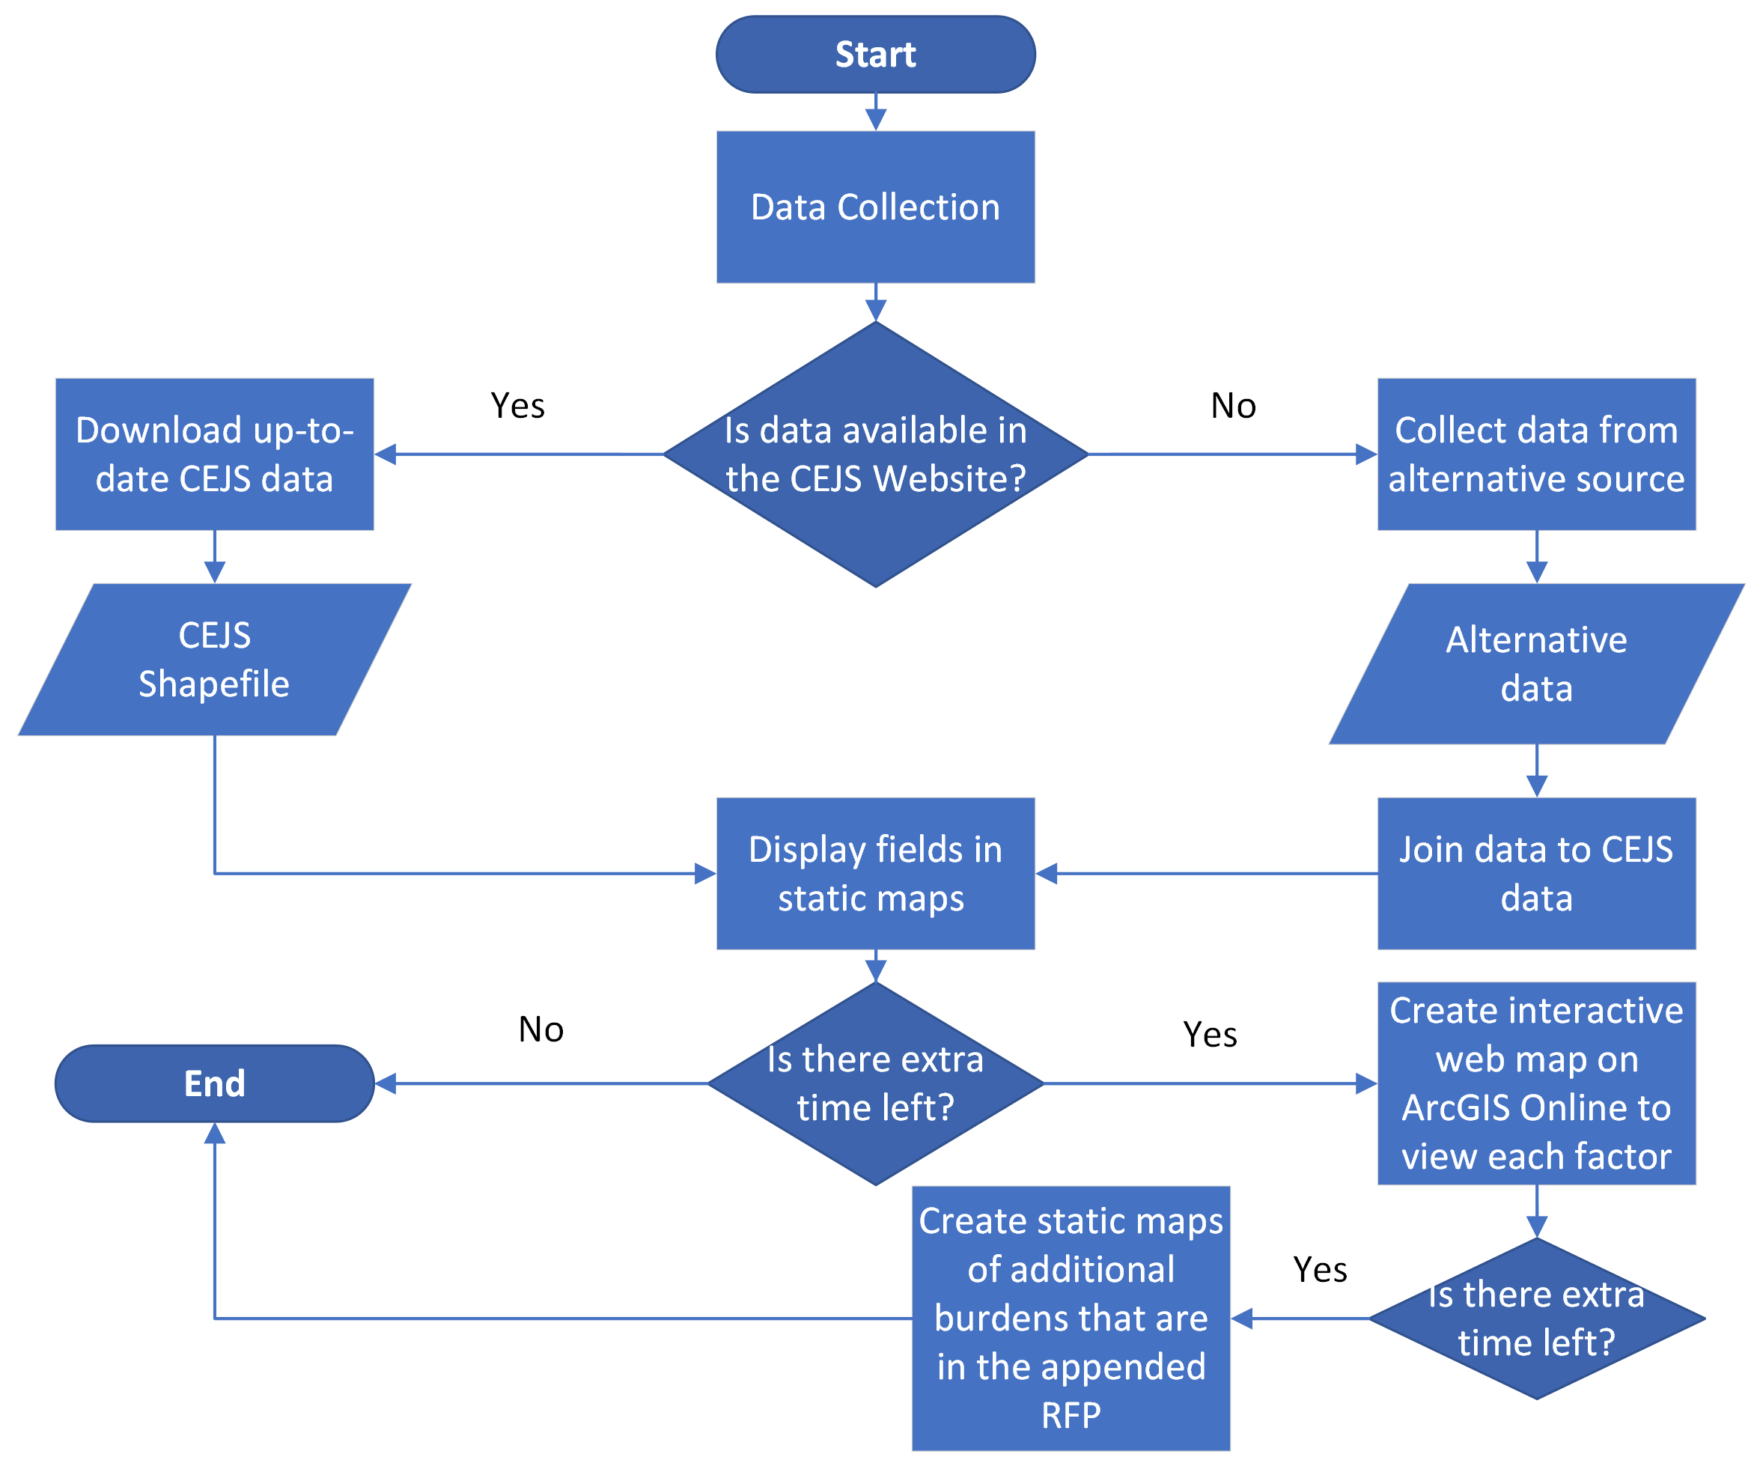
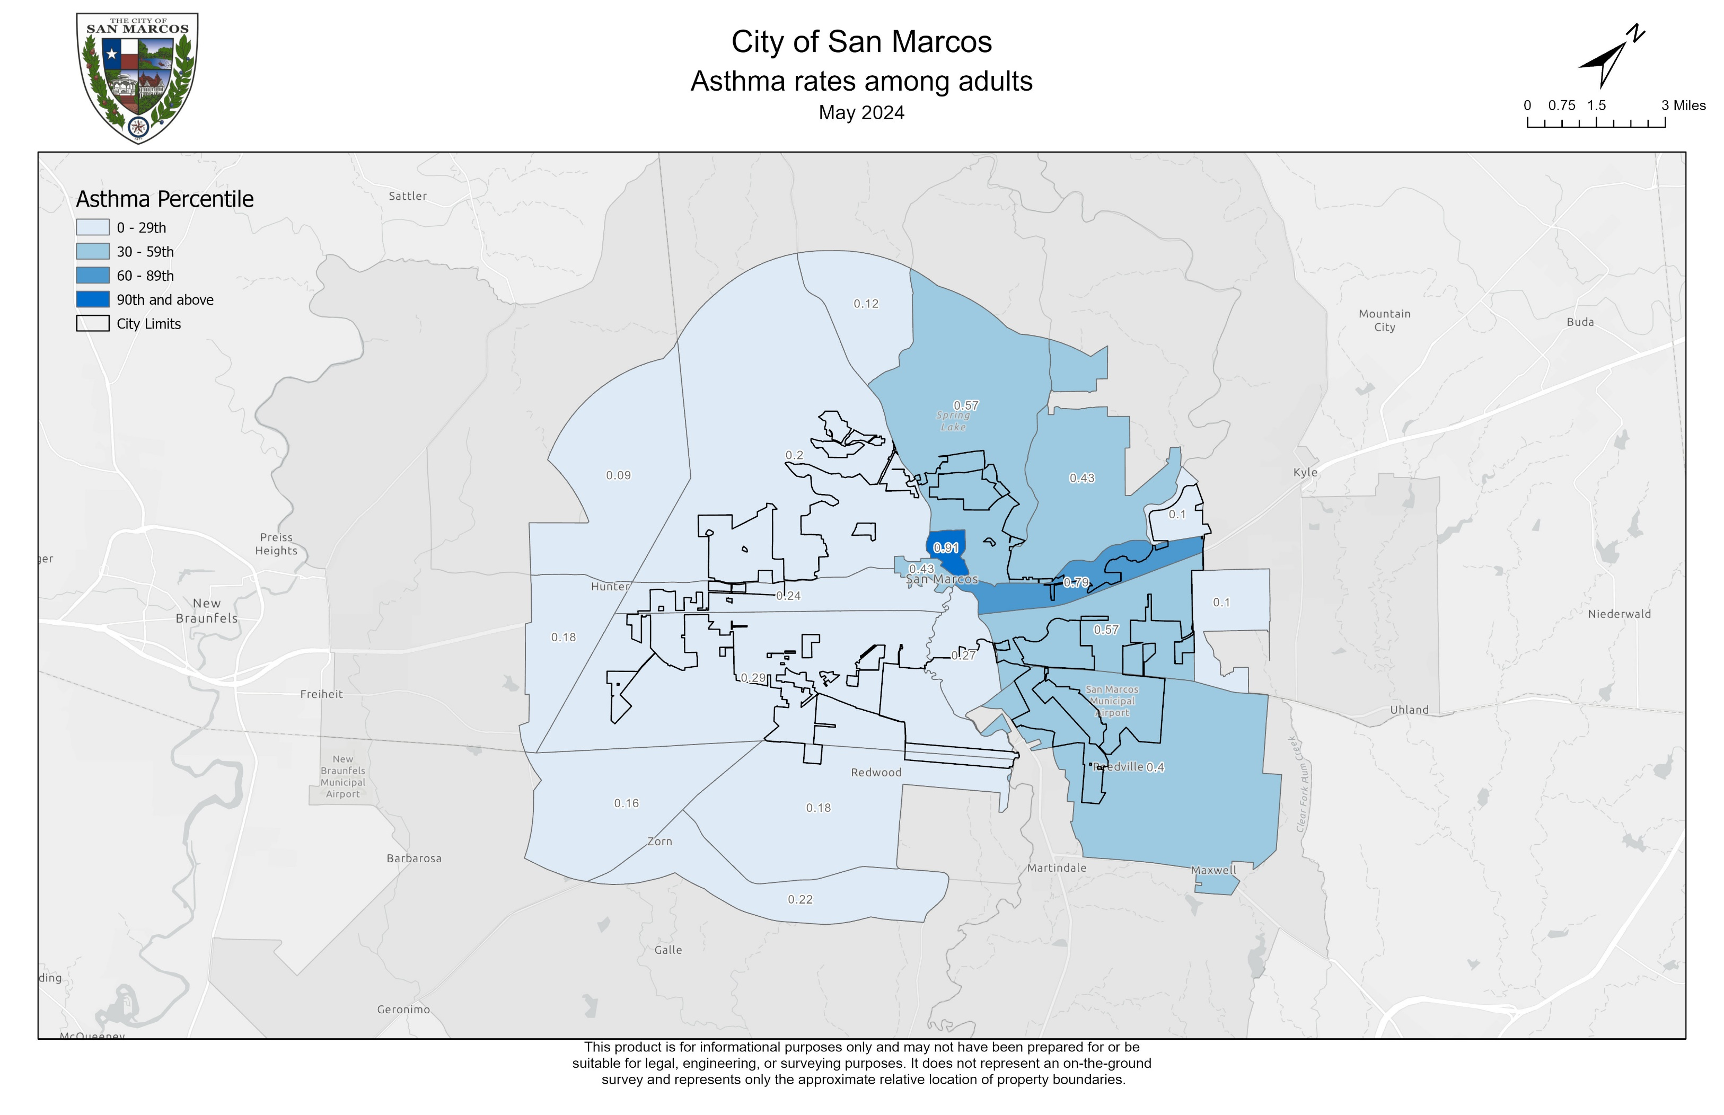
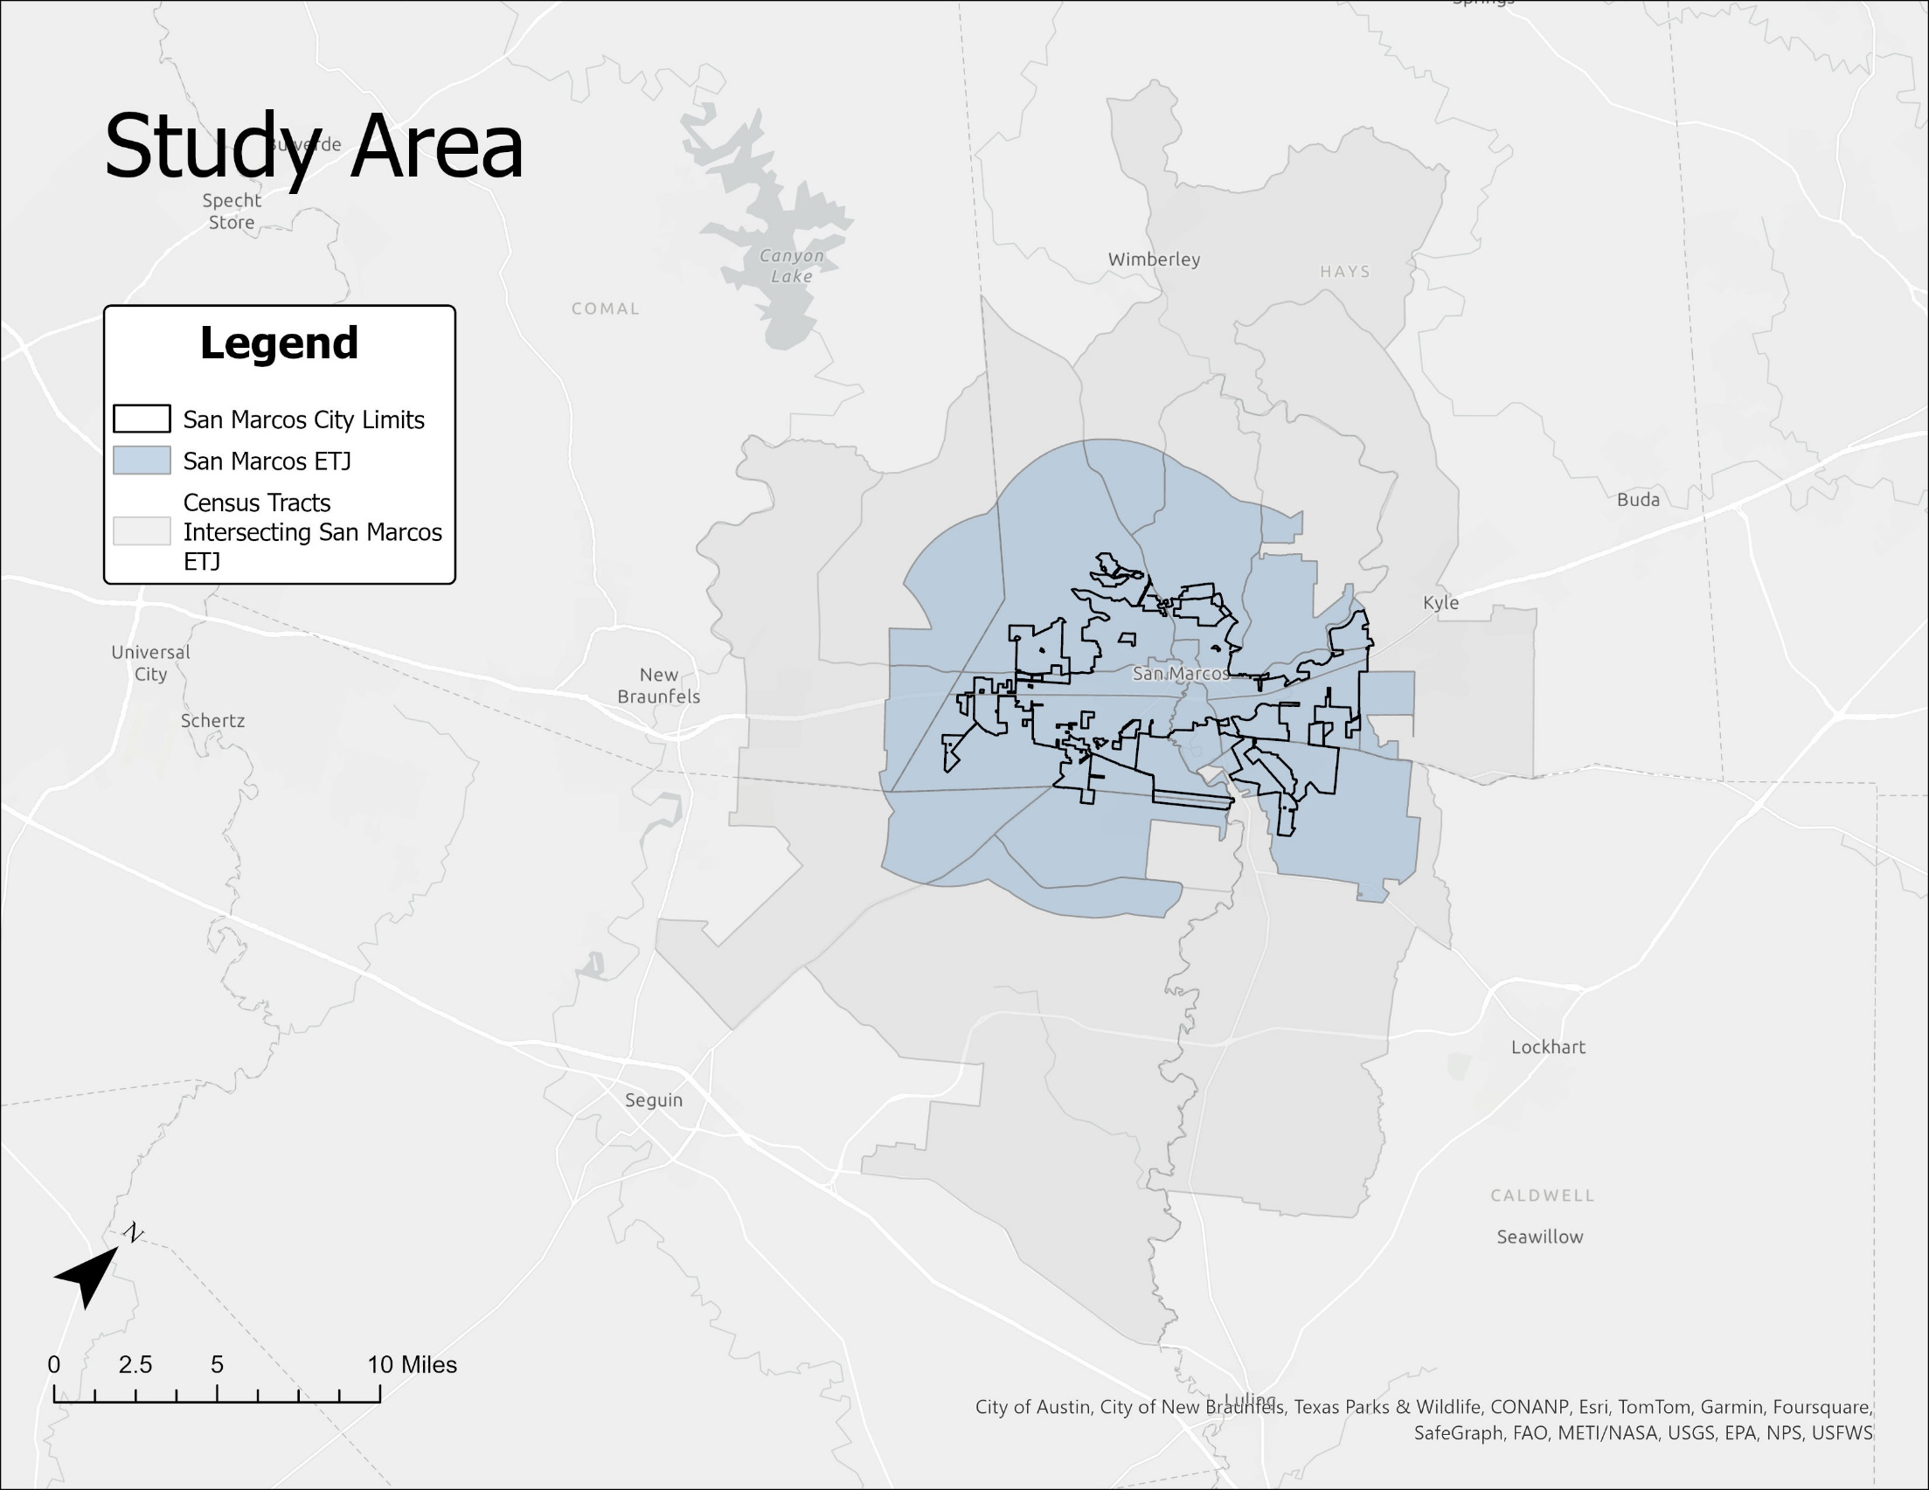
Identifying Burdened Areas in San Marcos, Texas
Pamela Boyd, Johnathan Knoll, Alee Sho, Devin Peters
Abstract
Data and Methodology
Flow Chart
Twenty maps that identify burdened areas in the city of San Marcos were produced in this project. These maps utilize data sourced from the Climate and Economic Screening Tool (CEJS Tool), which assesses socioeconomic health by identifying various 'burdens'. Intended as a resource for San Marcos policymakers, these maps facilitate the allocation of financial grants to areas in need. The analysis from these maps reveals that certain regions in San Marcos bear differing levels of burden, with some areas notably more impacted than others.
The CEJS Tool provides data on a census tract level about socioeconomic and climate burdens for the United States. Although the tool provides data on many burdens, this project covers the burdens of poverty, housing, health conditions, energy, air quality, pollution, traffic, natural disasters, education, and other man-made hazards.
This data was analyzed using ESRI’s ArcGIS platform. The CEJS tool provides a downloadable shapefile that can be uploaded to ArcGIS. When uploaded, the shapefile displays every census tract in the United States. For this project, only census tracts that intersect San Marcos city limits and the San Marcos ETJ were used. When the census tracts were isolated, analysts were able to display the data by each burden using a reference file provided by the CEJS tool. To be mindful of historical representations of marginalized communities, the analysts did not use a green or red color scheme when displaying this data on choropleth maps. This decision was made to ensure a more equitable representation of marginalized communities within San Marcos.
Background
The City of San Marcos is tasked with distributing financial grants during natural disasters and times of adversity, necessitating effective allocation strategies by policymakers. Accurate information products play a crucial role in this process, enabling policymakers to identify areas in need of financial assistance. In this project, census tracts were employed to partition San Marcos into distinct areas for analysis. The study area encompasses all census tracts intersecting the City of San Marcos and its extraterritorial jurisdiction (ETJ)
Example: Asthma Rates
Results
This project successfully identifies areas in San Marcos that are considered burdened as defined by the CEJS tool. Additionally, this project displays the degree to which census tracts are burdened.
Study Area
Conclusion and Future Work
Policymakers for the City of San Marcos can use these maps for the effective allocation of financial grants. This project is not difficult to repeat, however, it has many limitations. For example, much of the data is not being updated regularly enough for this study to be repeated on an annual or biannual basis. This also means that some maps are outdated and may not be representative of a census tract. Another limitation is that the data in some census tracts include areas that are not in the San Marcos ETJ. This may cause an area to be misrepresented in the final maps.
This project only covers some of the burdens that affect San Marcos. Given more time, researchers can use more burdens in the CEJS tool that may be useful for policymakers.
Asthma rates among adults as a percentile by census tract
References
“GIS | City of San Marcos, TX.” n.d. Www.sanmarcostx.gov. Accessed April 24, 2024.
https://www.sanmarcostx.gov/761/GIS.
2022. Geoplatform.gov. 2022.
https://screeningtool.geoplatform.gov/en/#3/33.47/-97.5.
The City of San Marcos city limits, the Extraterritorial Jurisdiction, and the intersecting census tracts

