Slide 1
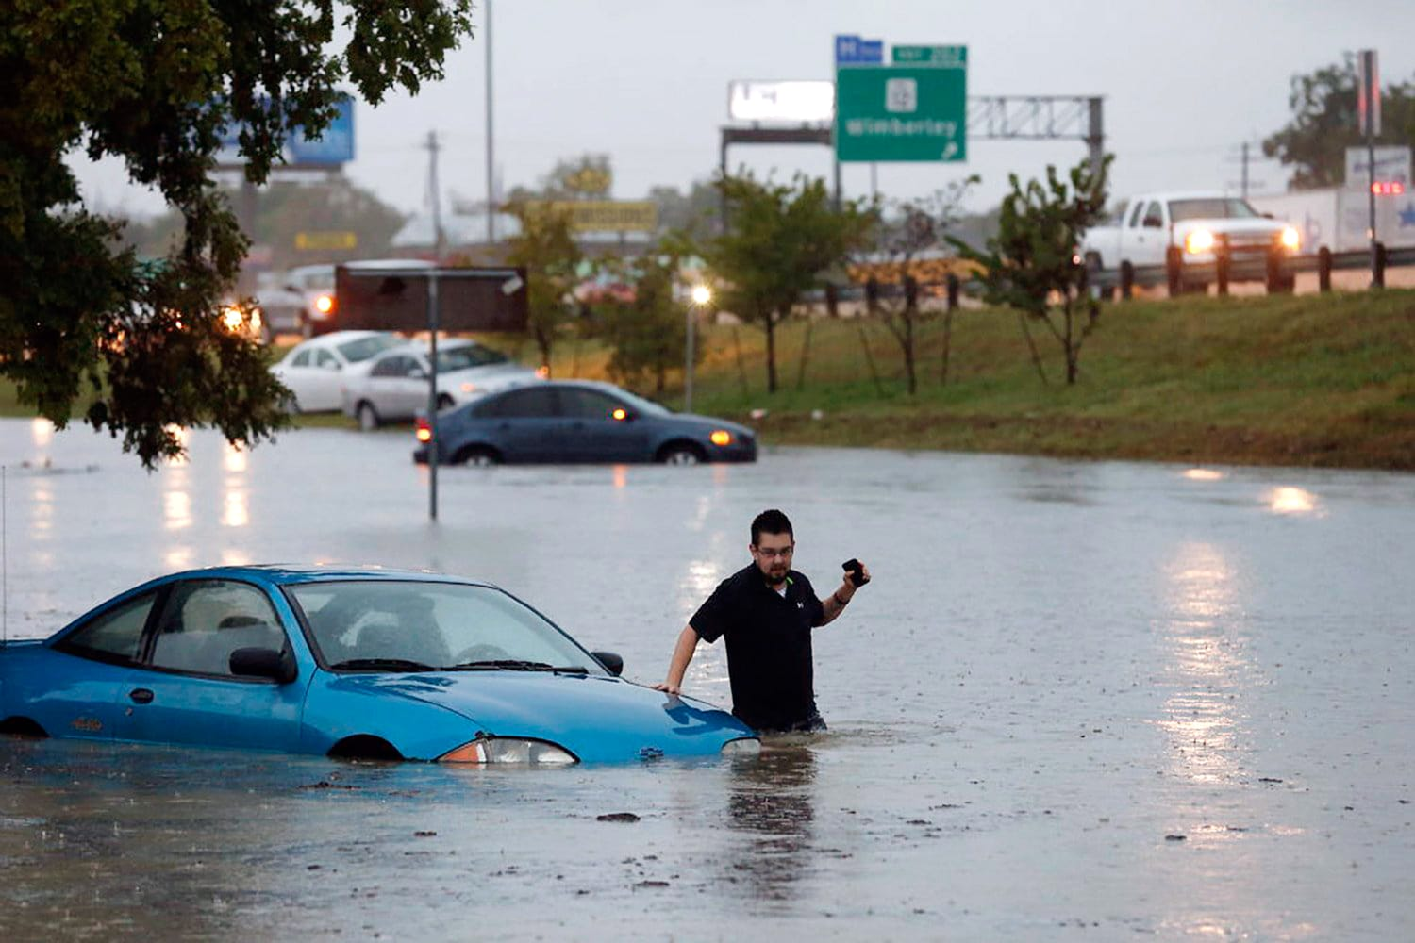
Community Insight Mapping: Unveiling Socioeconomic Dynamics for Informed Decision-Making
Photo Credit: Rodolfo Gonzales/AP
River City Socioeconomic Mapping Solutions
Project Manager: Pamela Boyd
Assistant Project Manager: Jonathan Knoll
GIS Analyst: Devon Peters
GIS Analyst: Alee Sho

Slide 2
Community Insight Mapping: Unveiling Socioeconomic Dynamics for Informed Decision-Making
River City Socioeconomic Mapping Solutions
Project Manager: Pamela Boyd
Assistant Project Manager: Jonathan Knoll
GIS Analyst: Devin Peters
GIS Analyst: Alee Sho
Photo Credit: Rodolfo Gonzales/AP

Slide 3
Outline
Introduction & Problem Statement
Data
Methods
Results & Discussion
Conclusions
Q & A
References

Slide 4
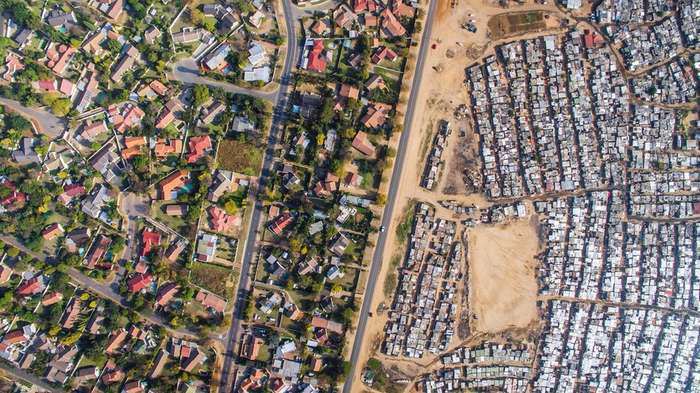
Introduction & Problem Statement
Photo Credit: Johnny Miller/Mediadrumimages.com

Slide 5
Introduction & Problem Statement
Community disparities
Targeted grant allocation
COMPREHENSIVE INFORMATION PRODUCTS

Slide 6
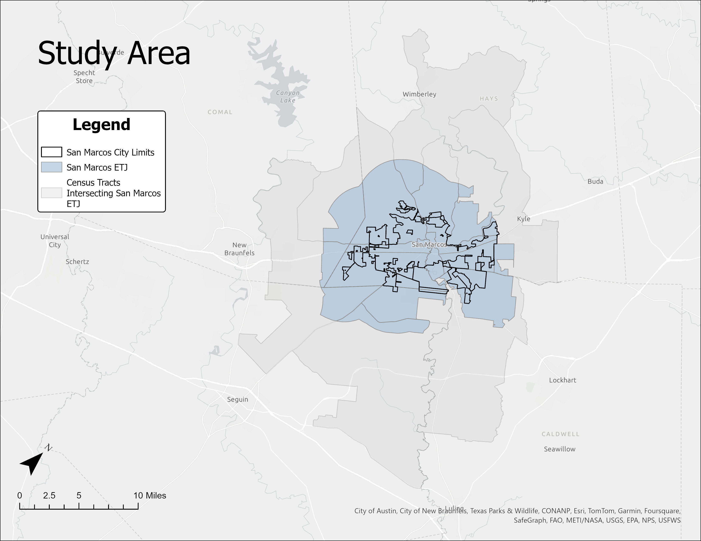
Study Area

Slide 7
Data

Slide 8
Data

Slide 9
Methods

Slide 10
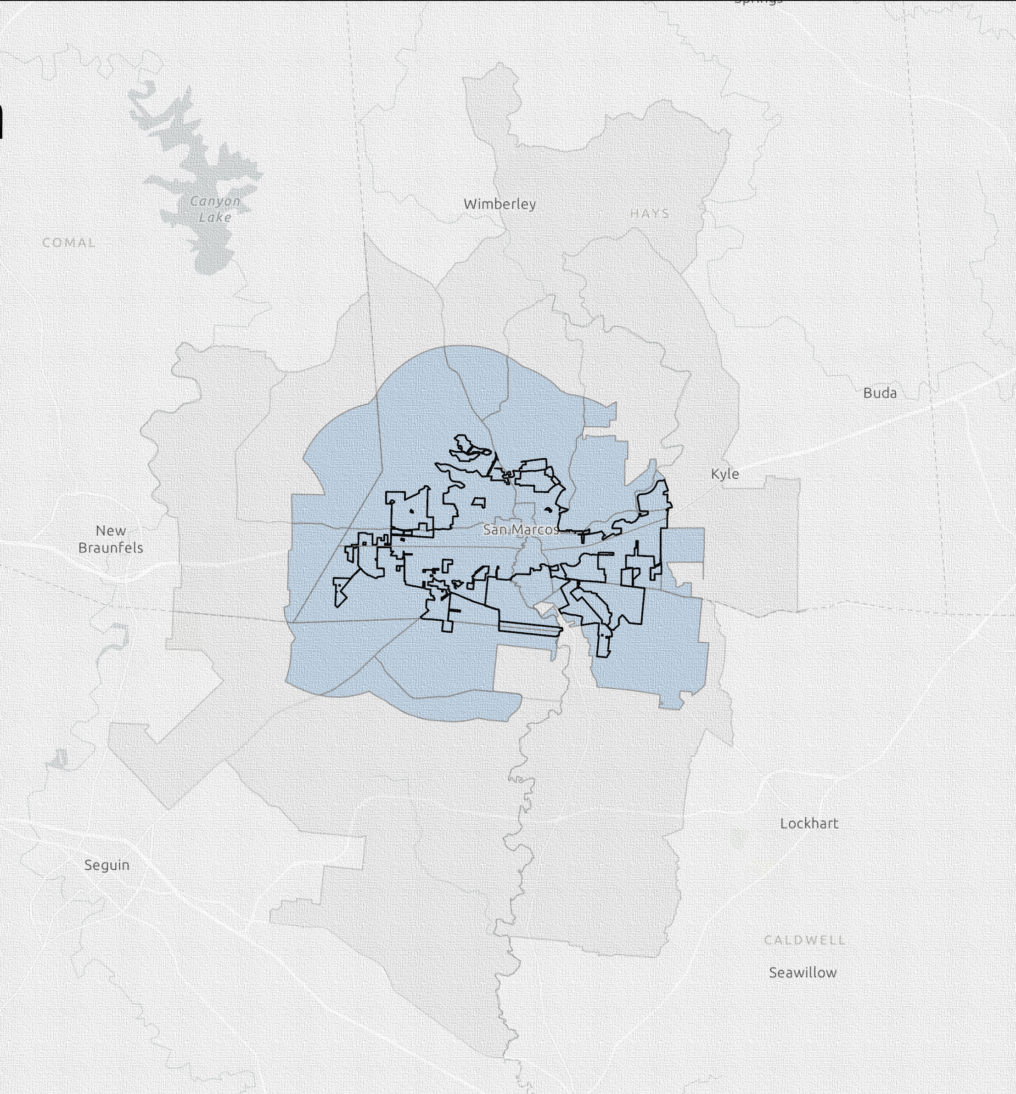
Methods
Process
INTERPRETATION
STANDARDIZATION

Slide 11
Results & Discussion
Information products
Limitations
&
opportunities

Slide 12
Results

Slide 13
Socioeconomic

Slide 14
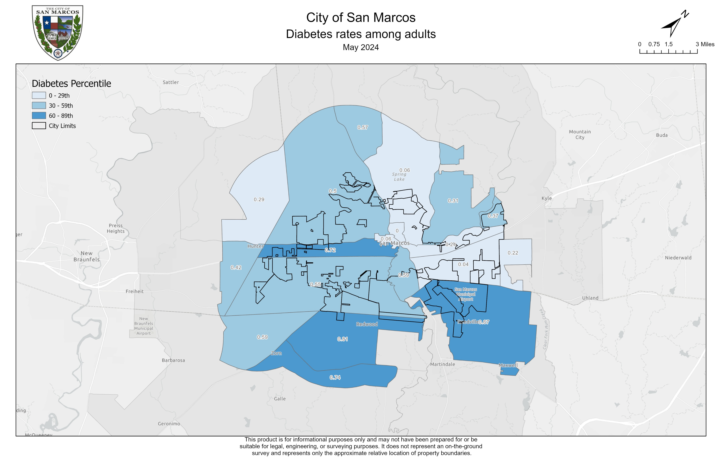
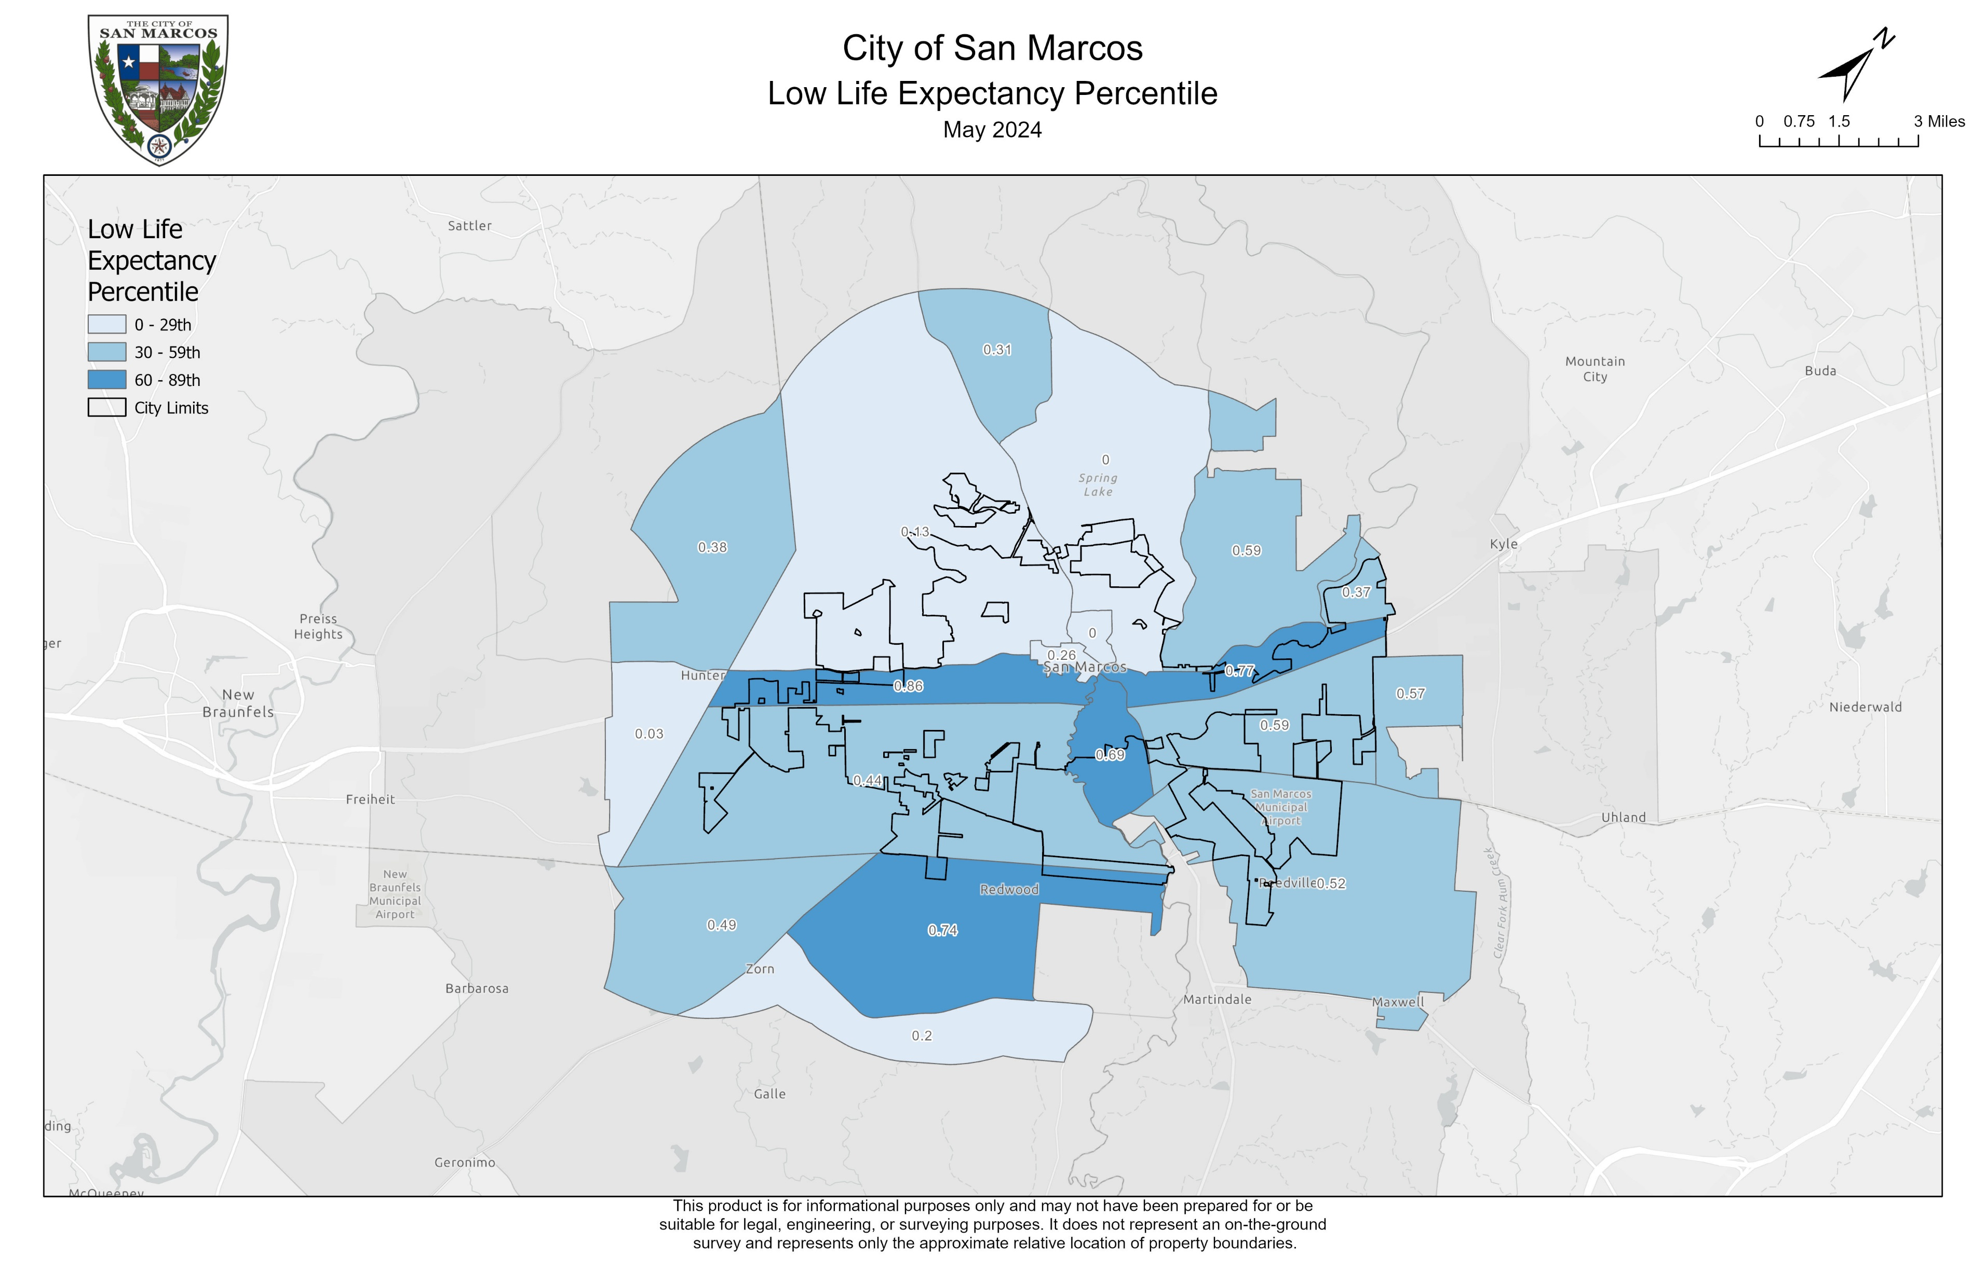
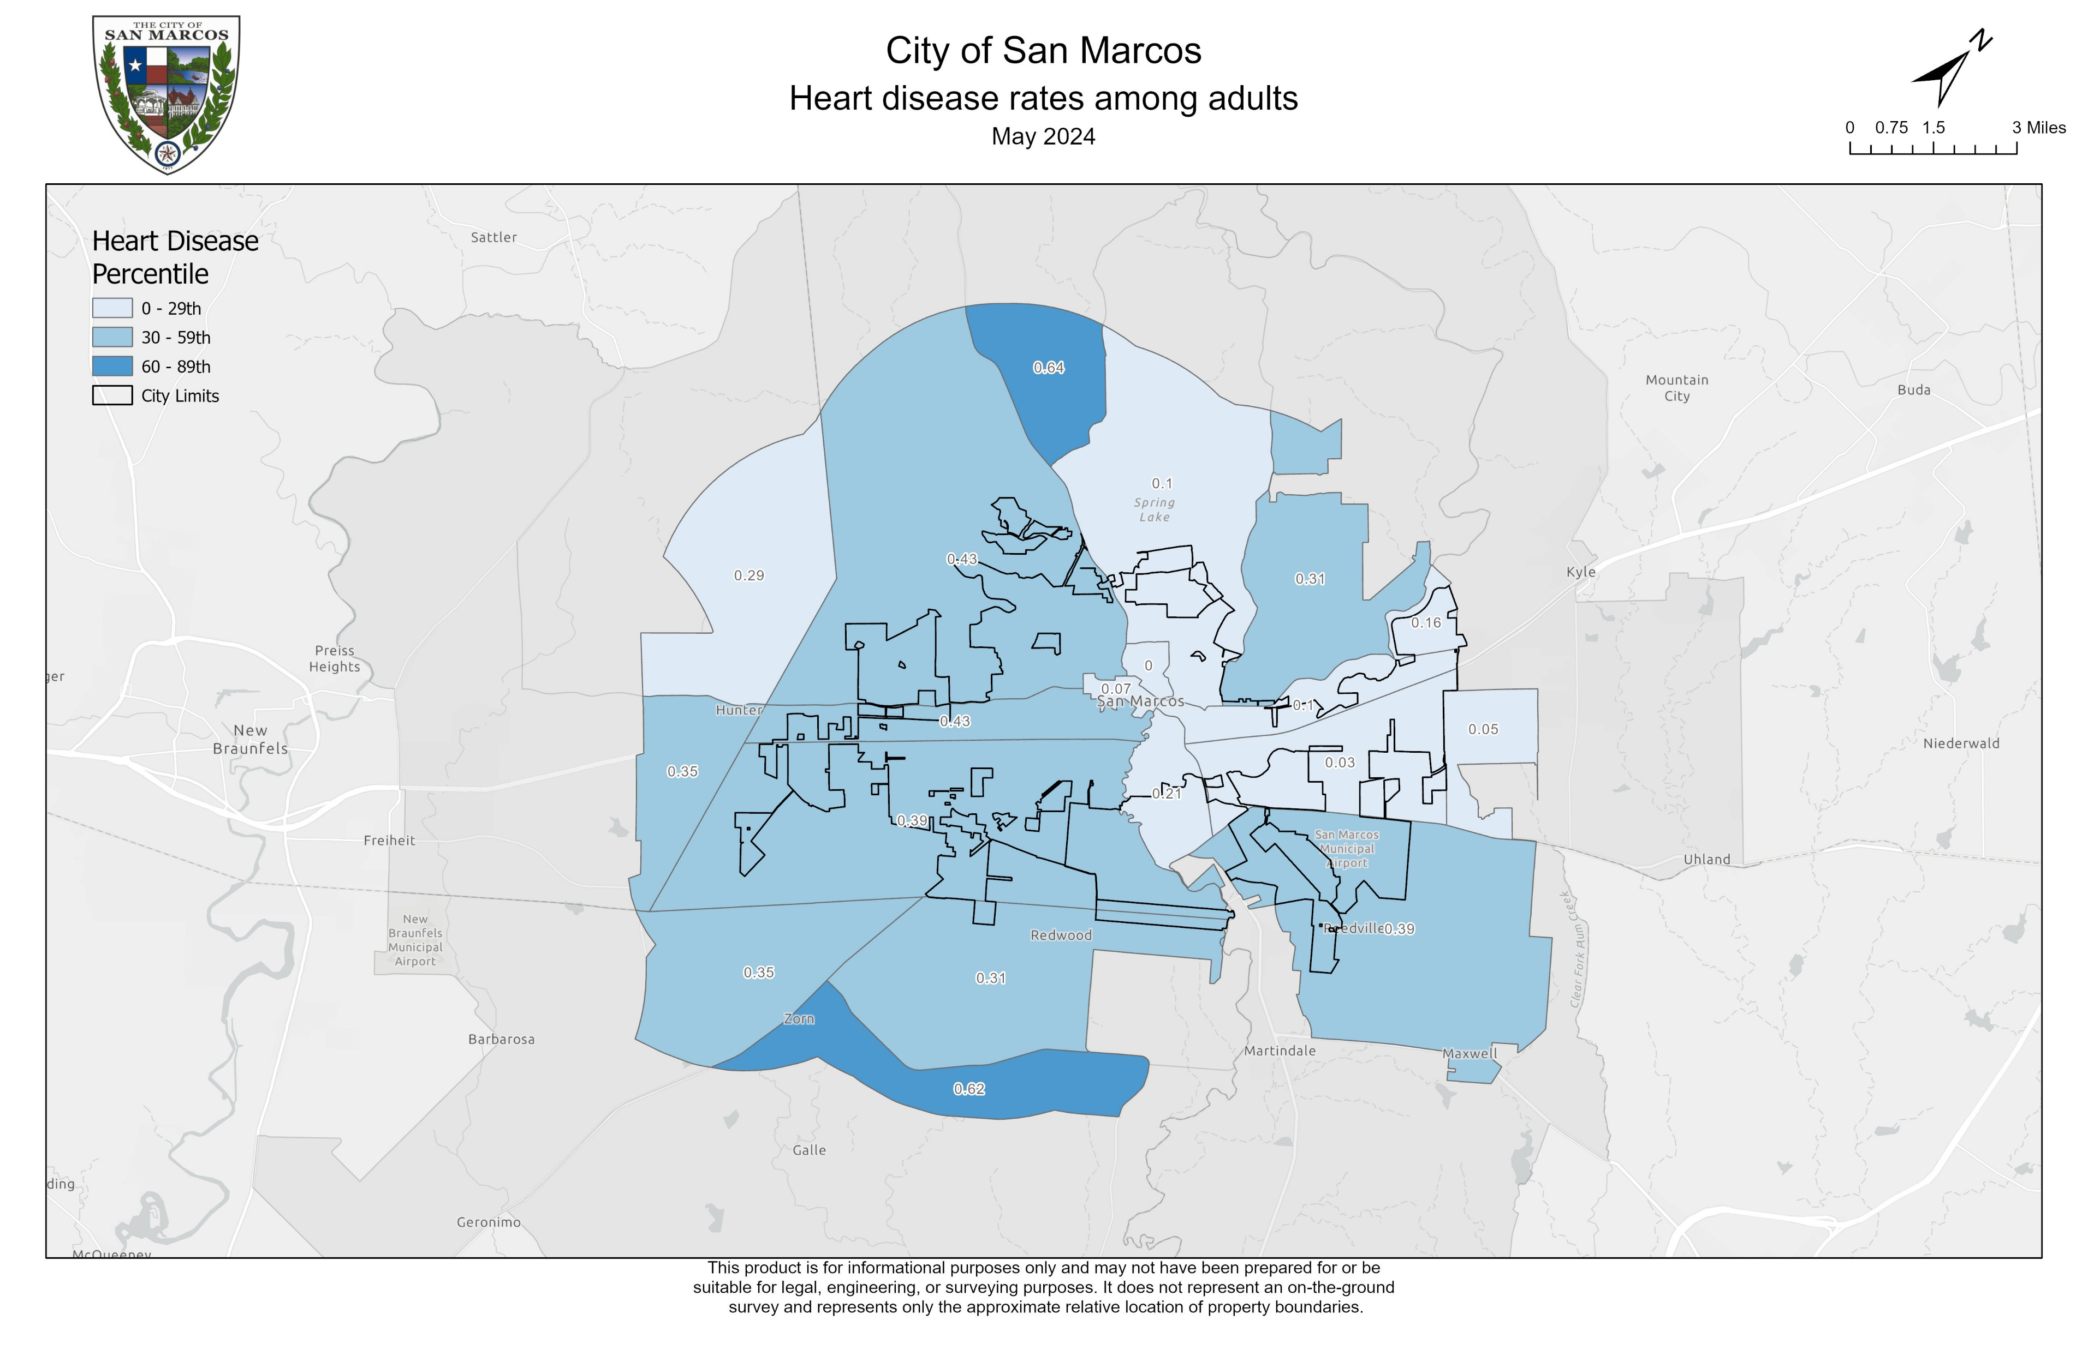
Health

Slide 15
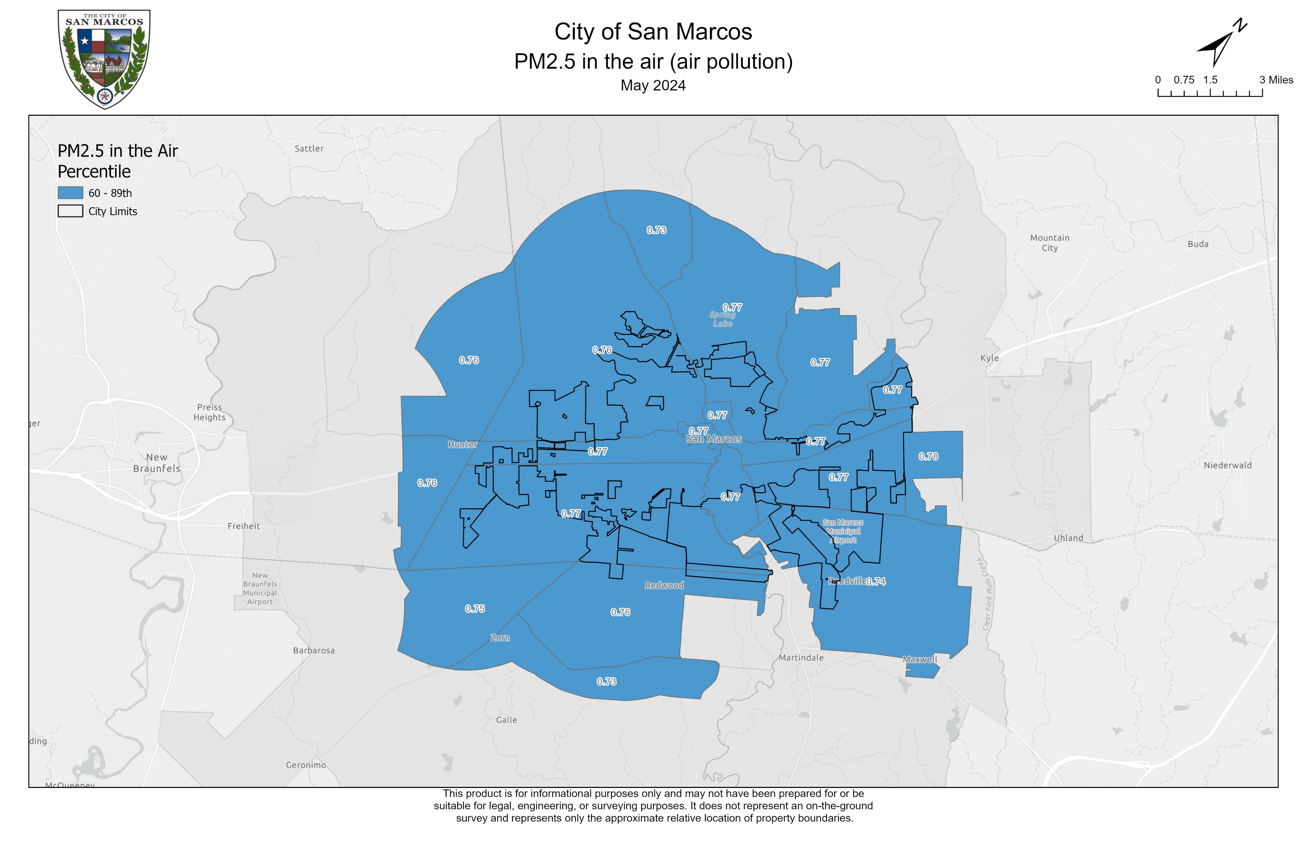
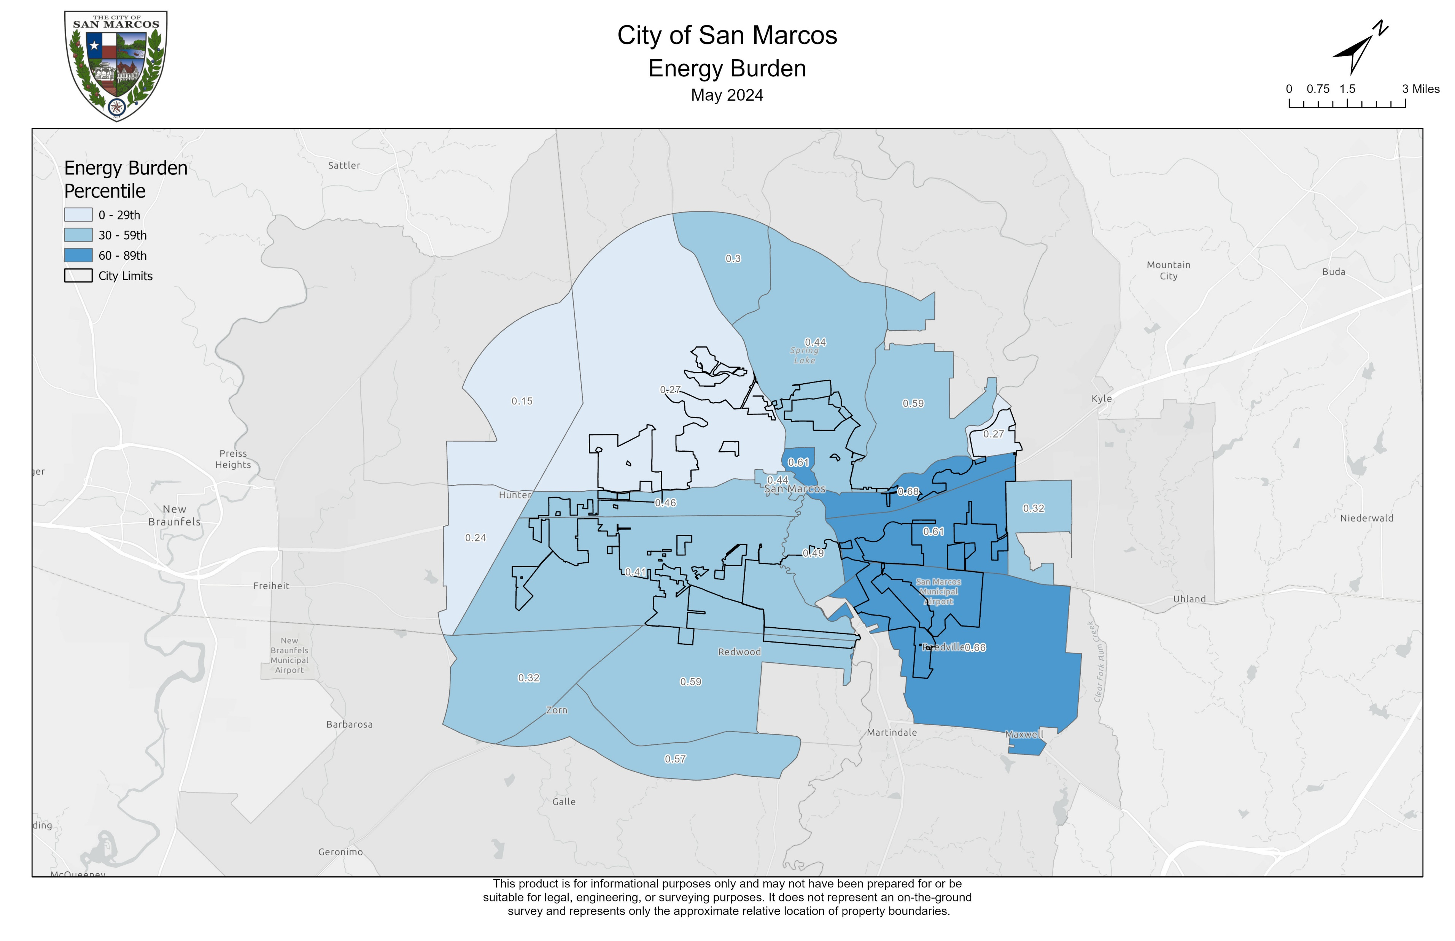
Energy

Slide 16
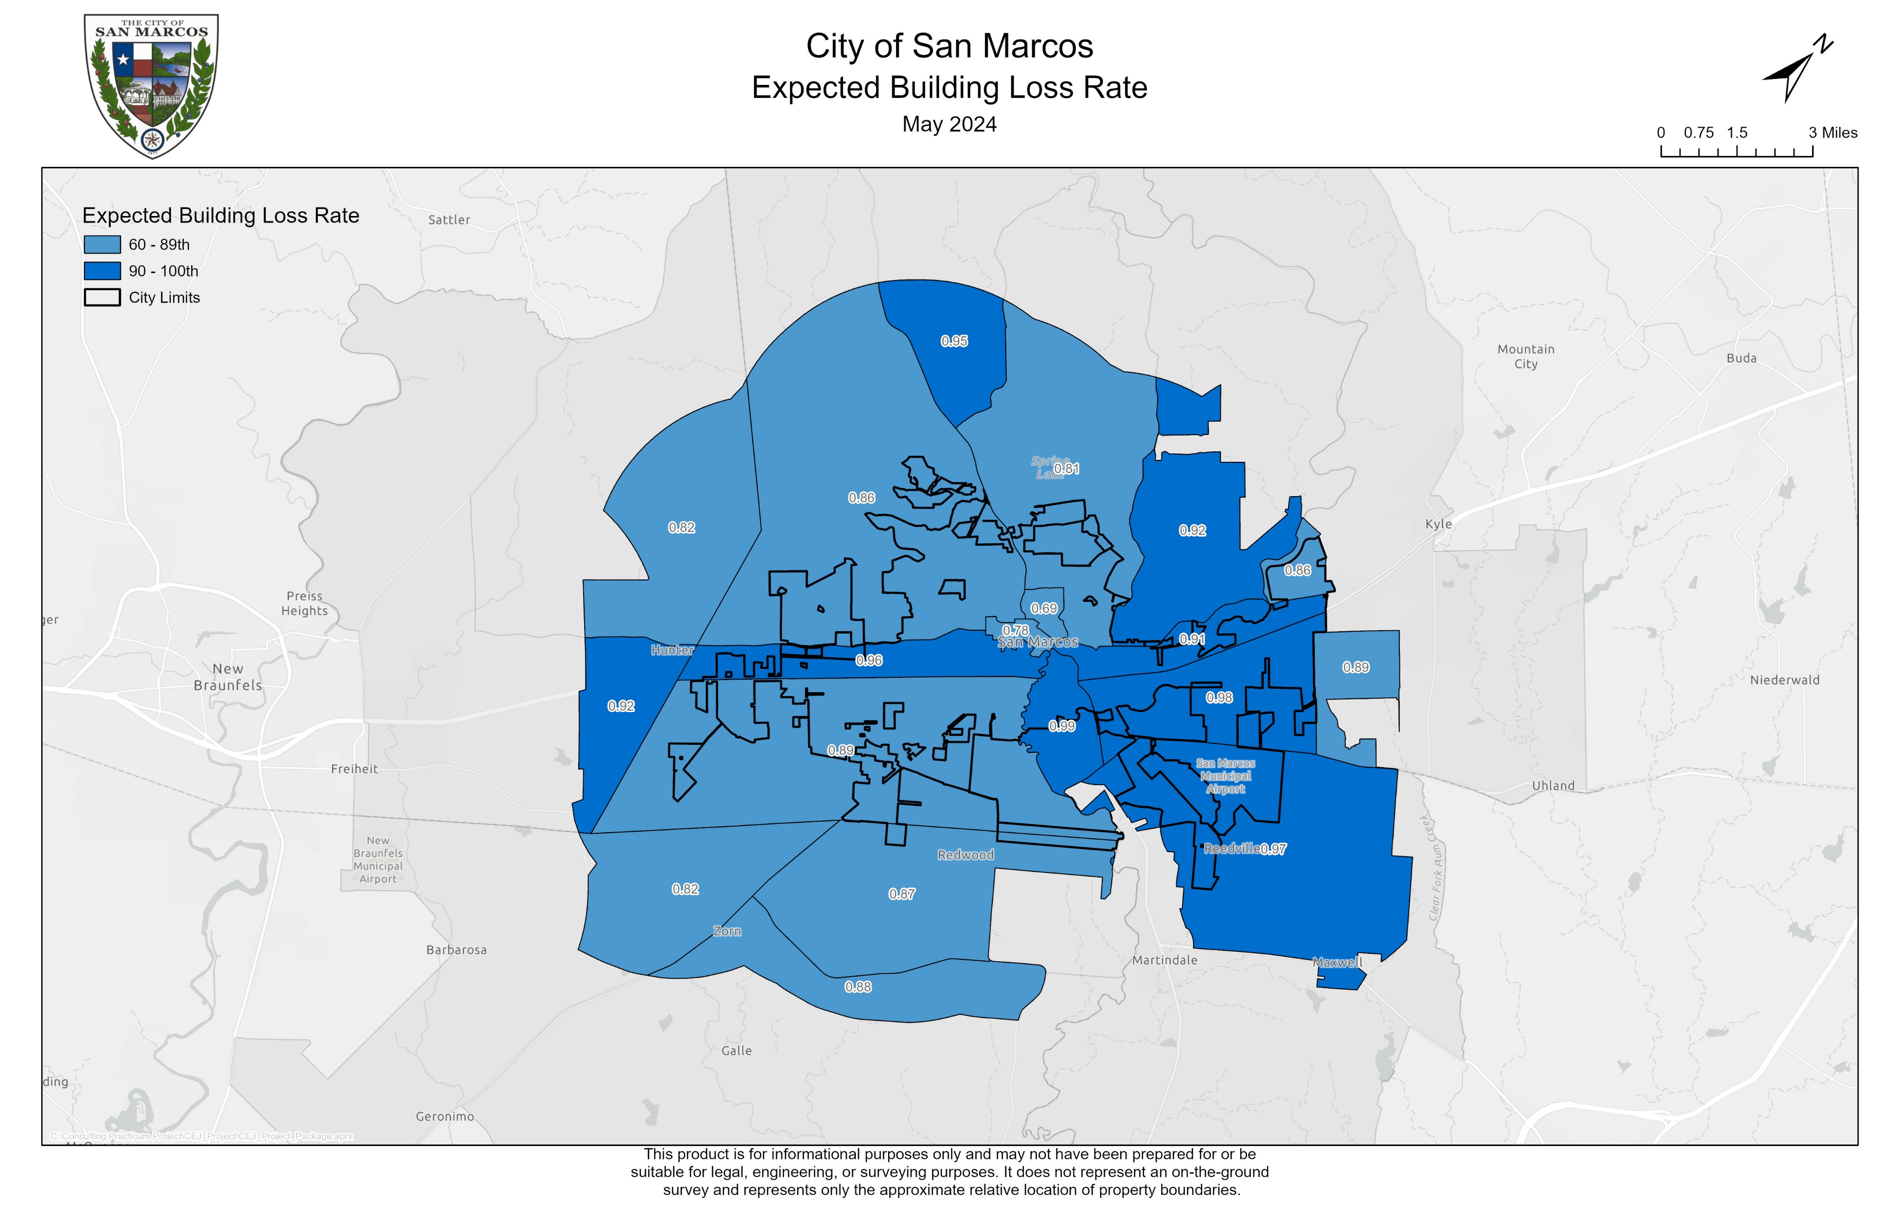
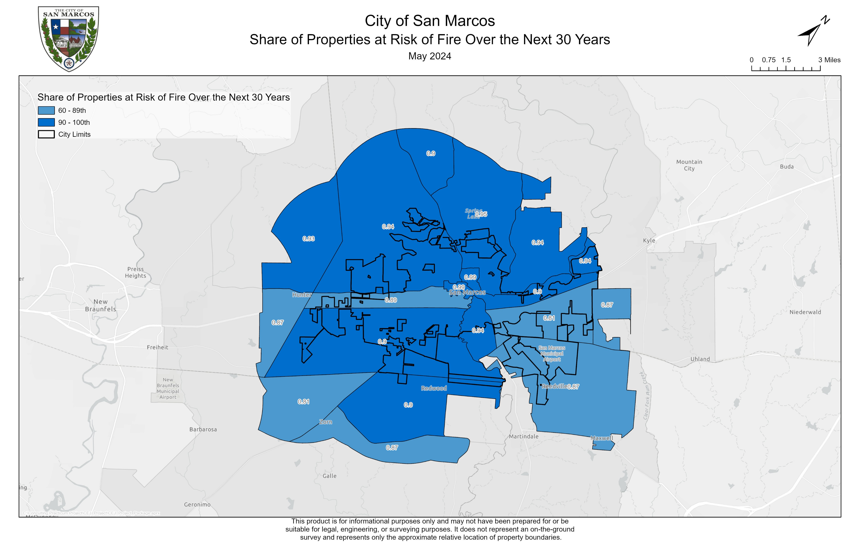
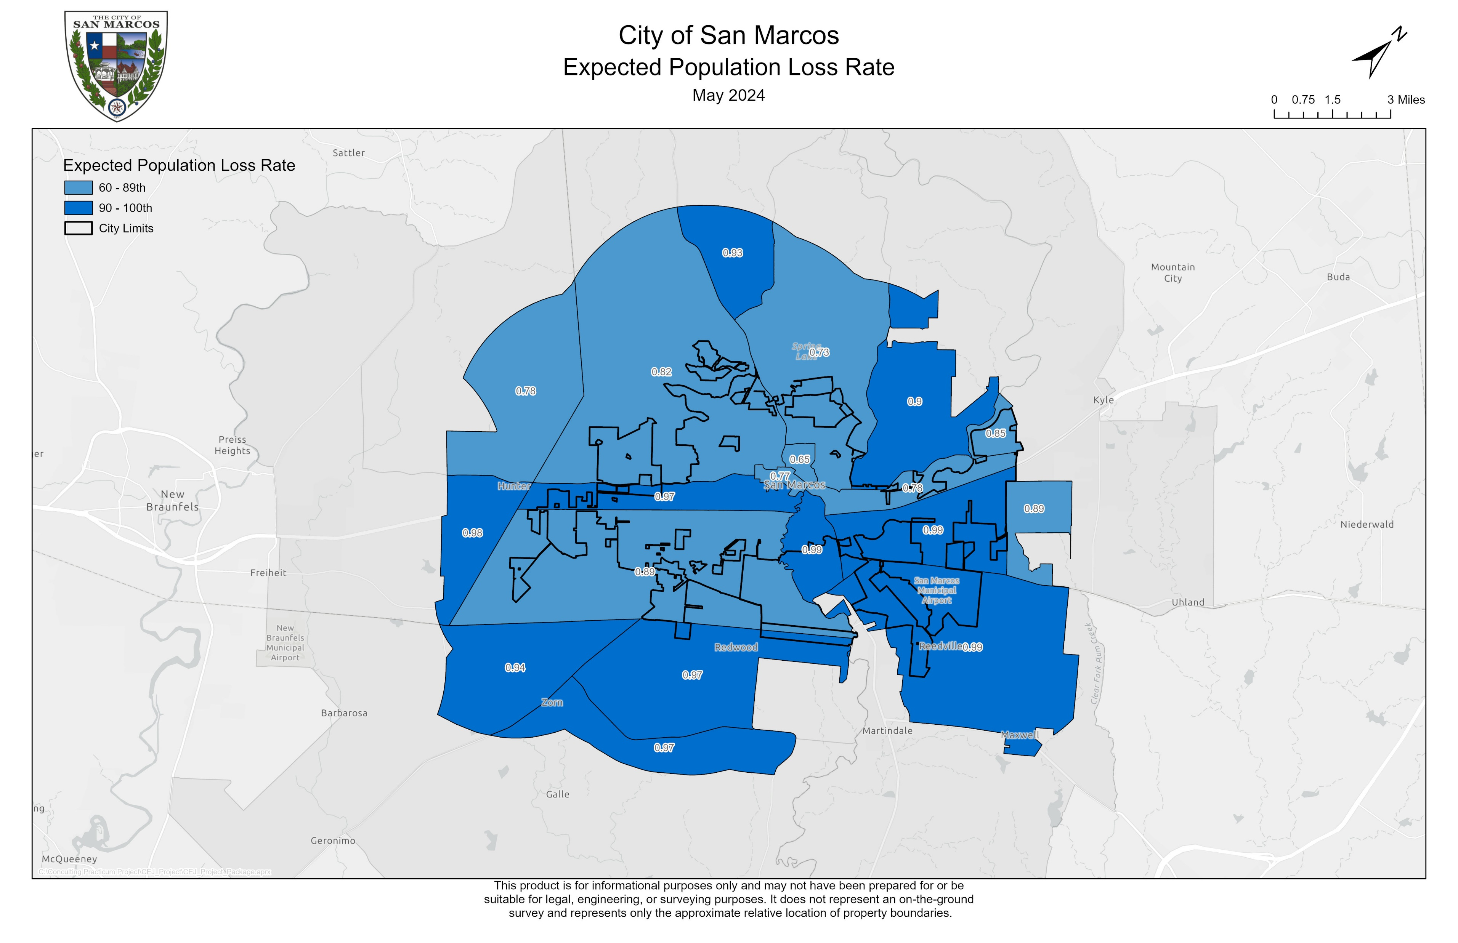
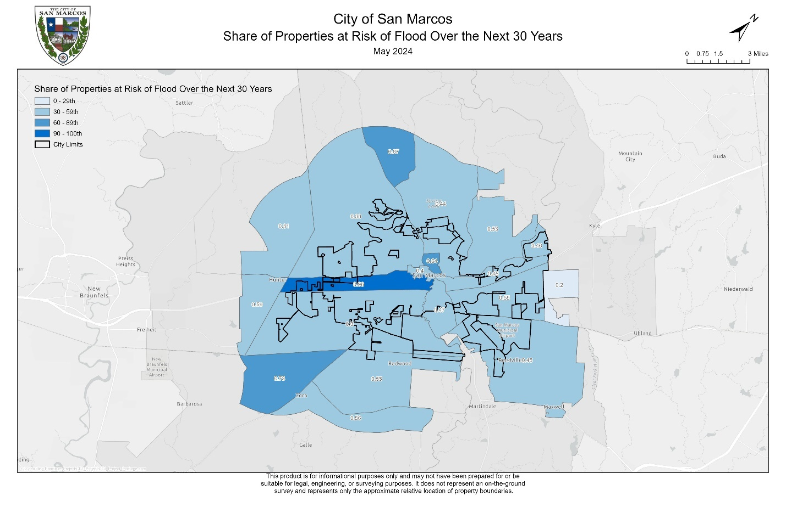
Climate
Change

Slide 17
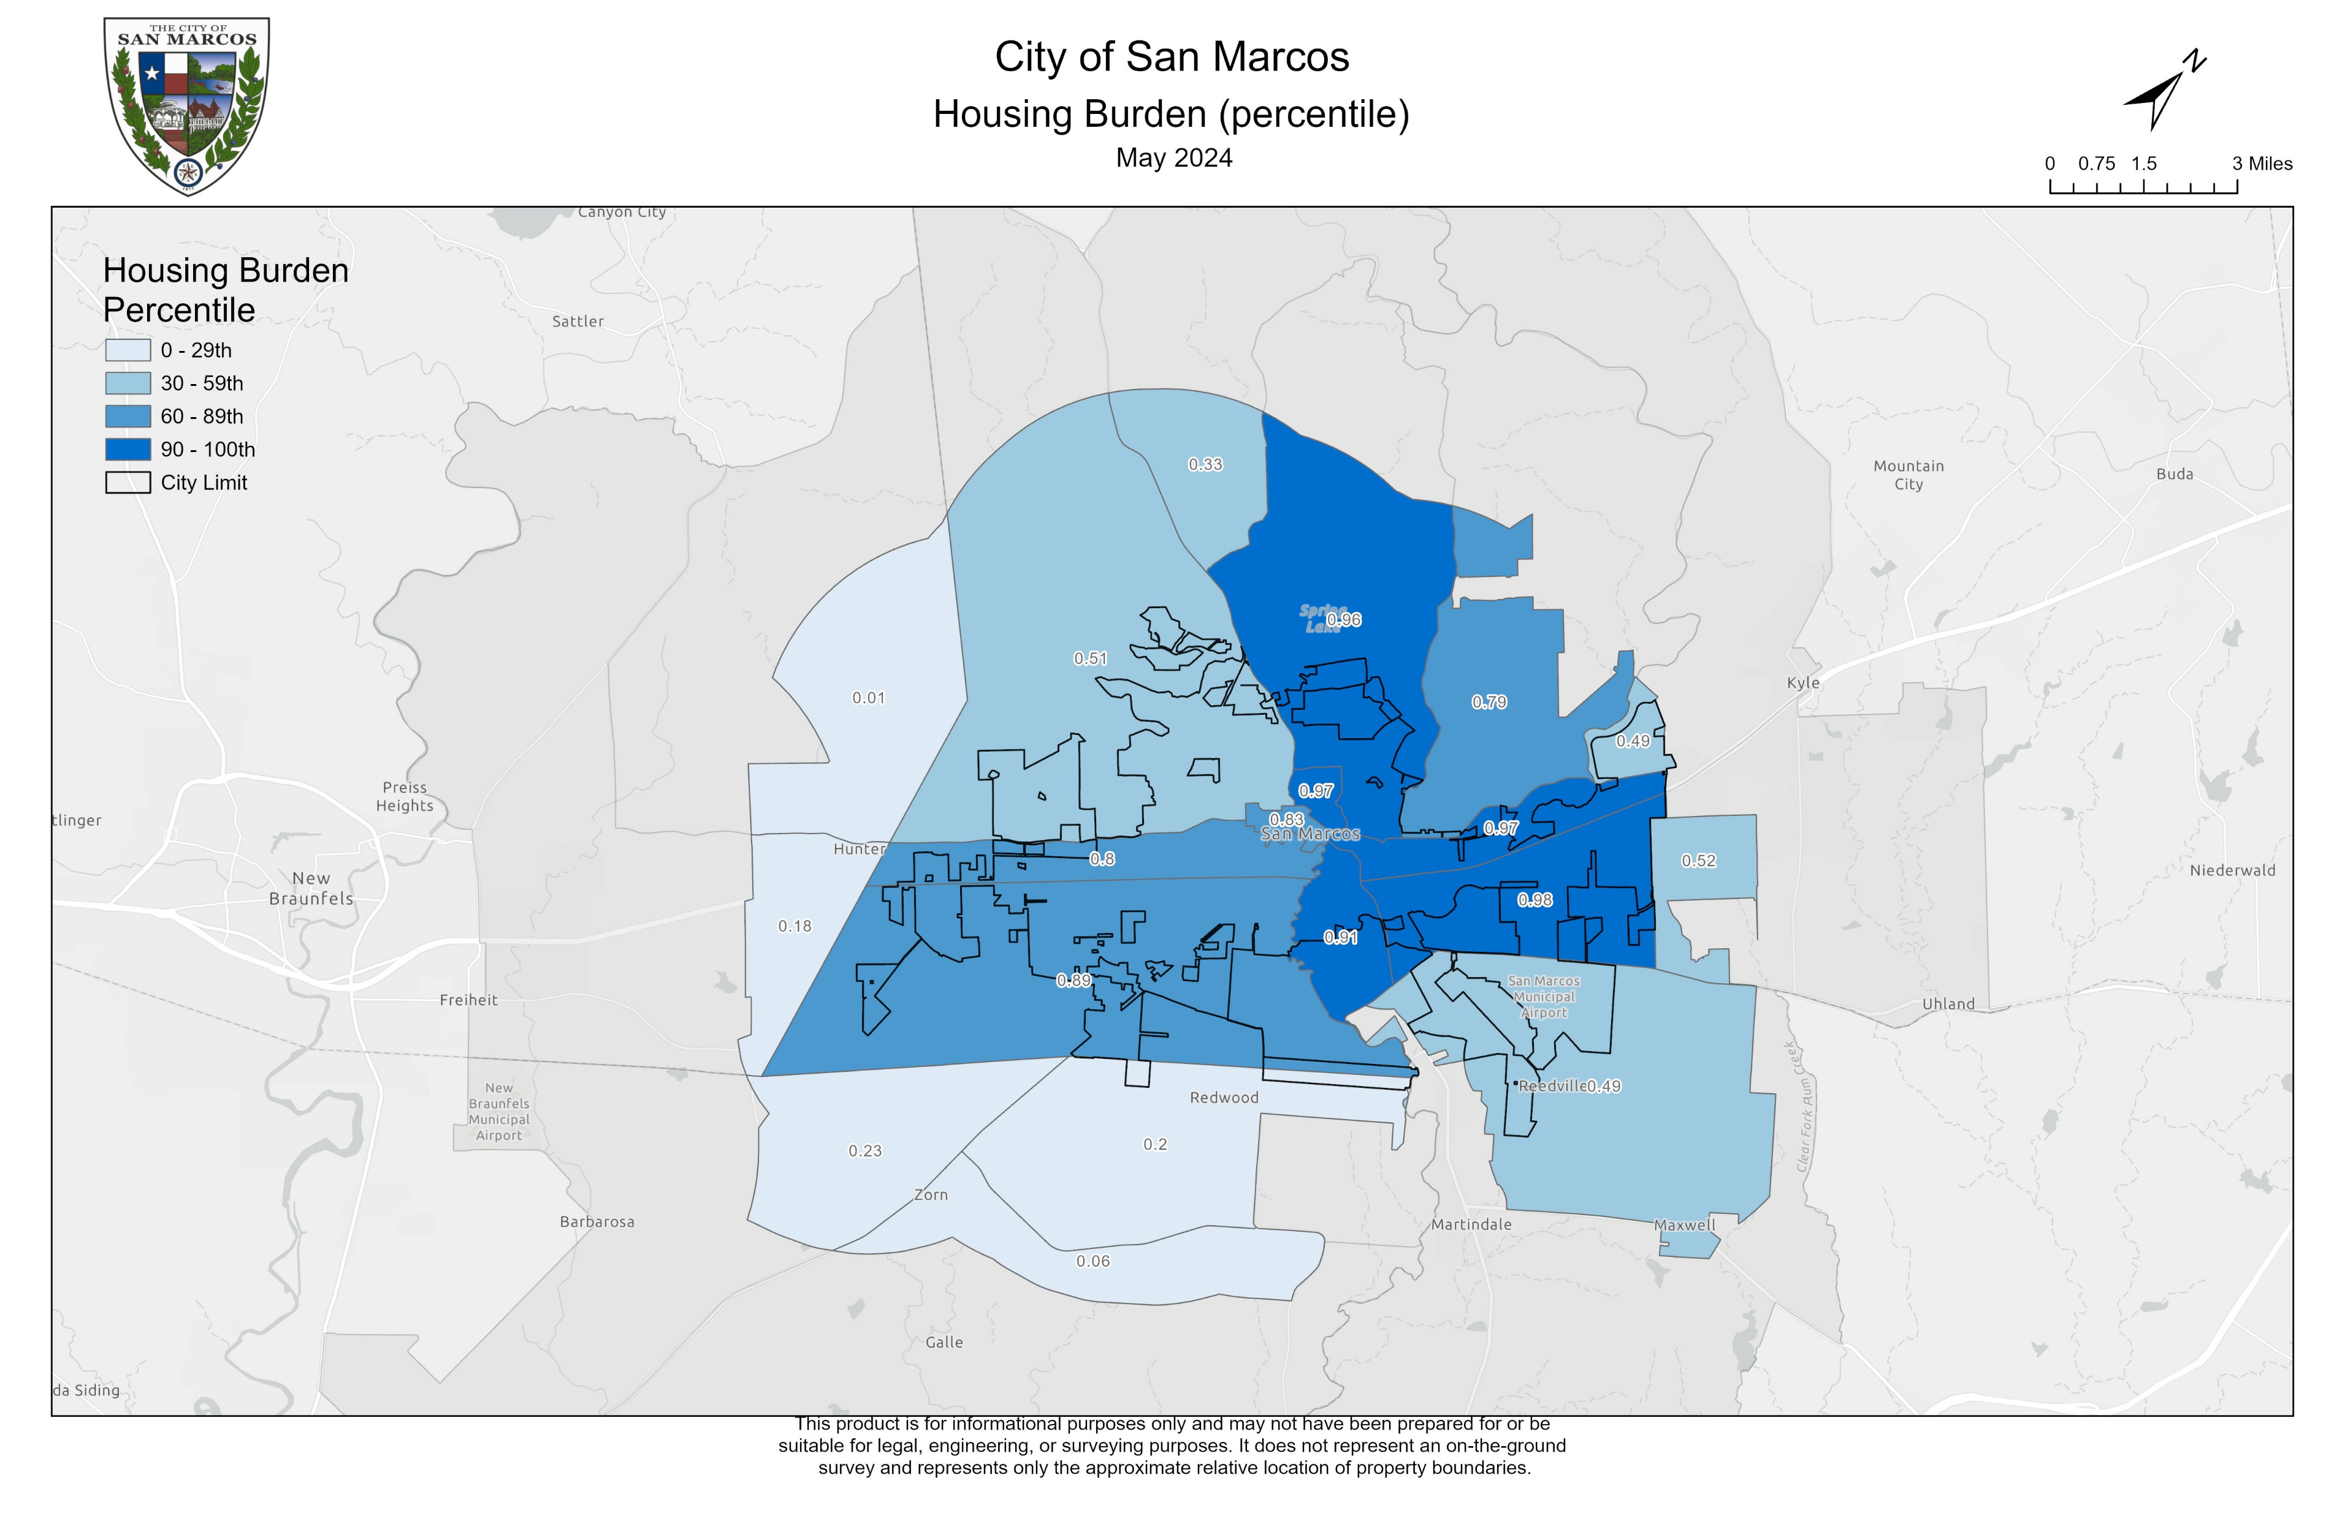
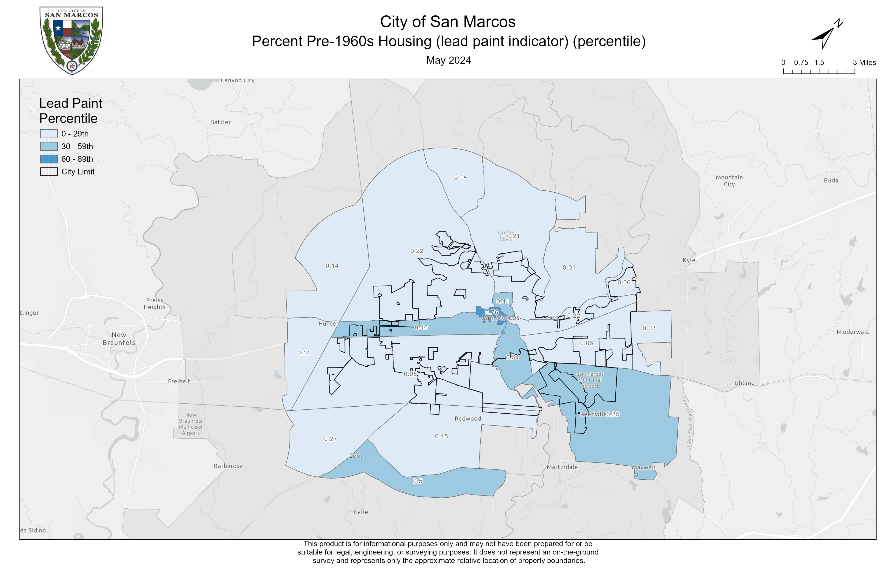
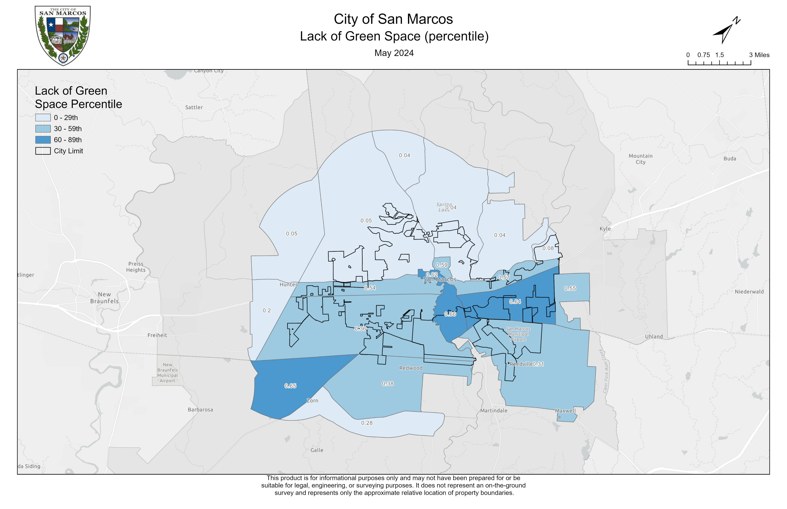
Housing

Slide 18
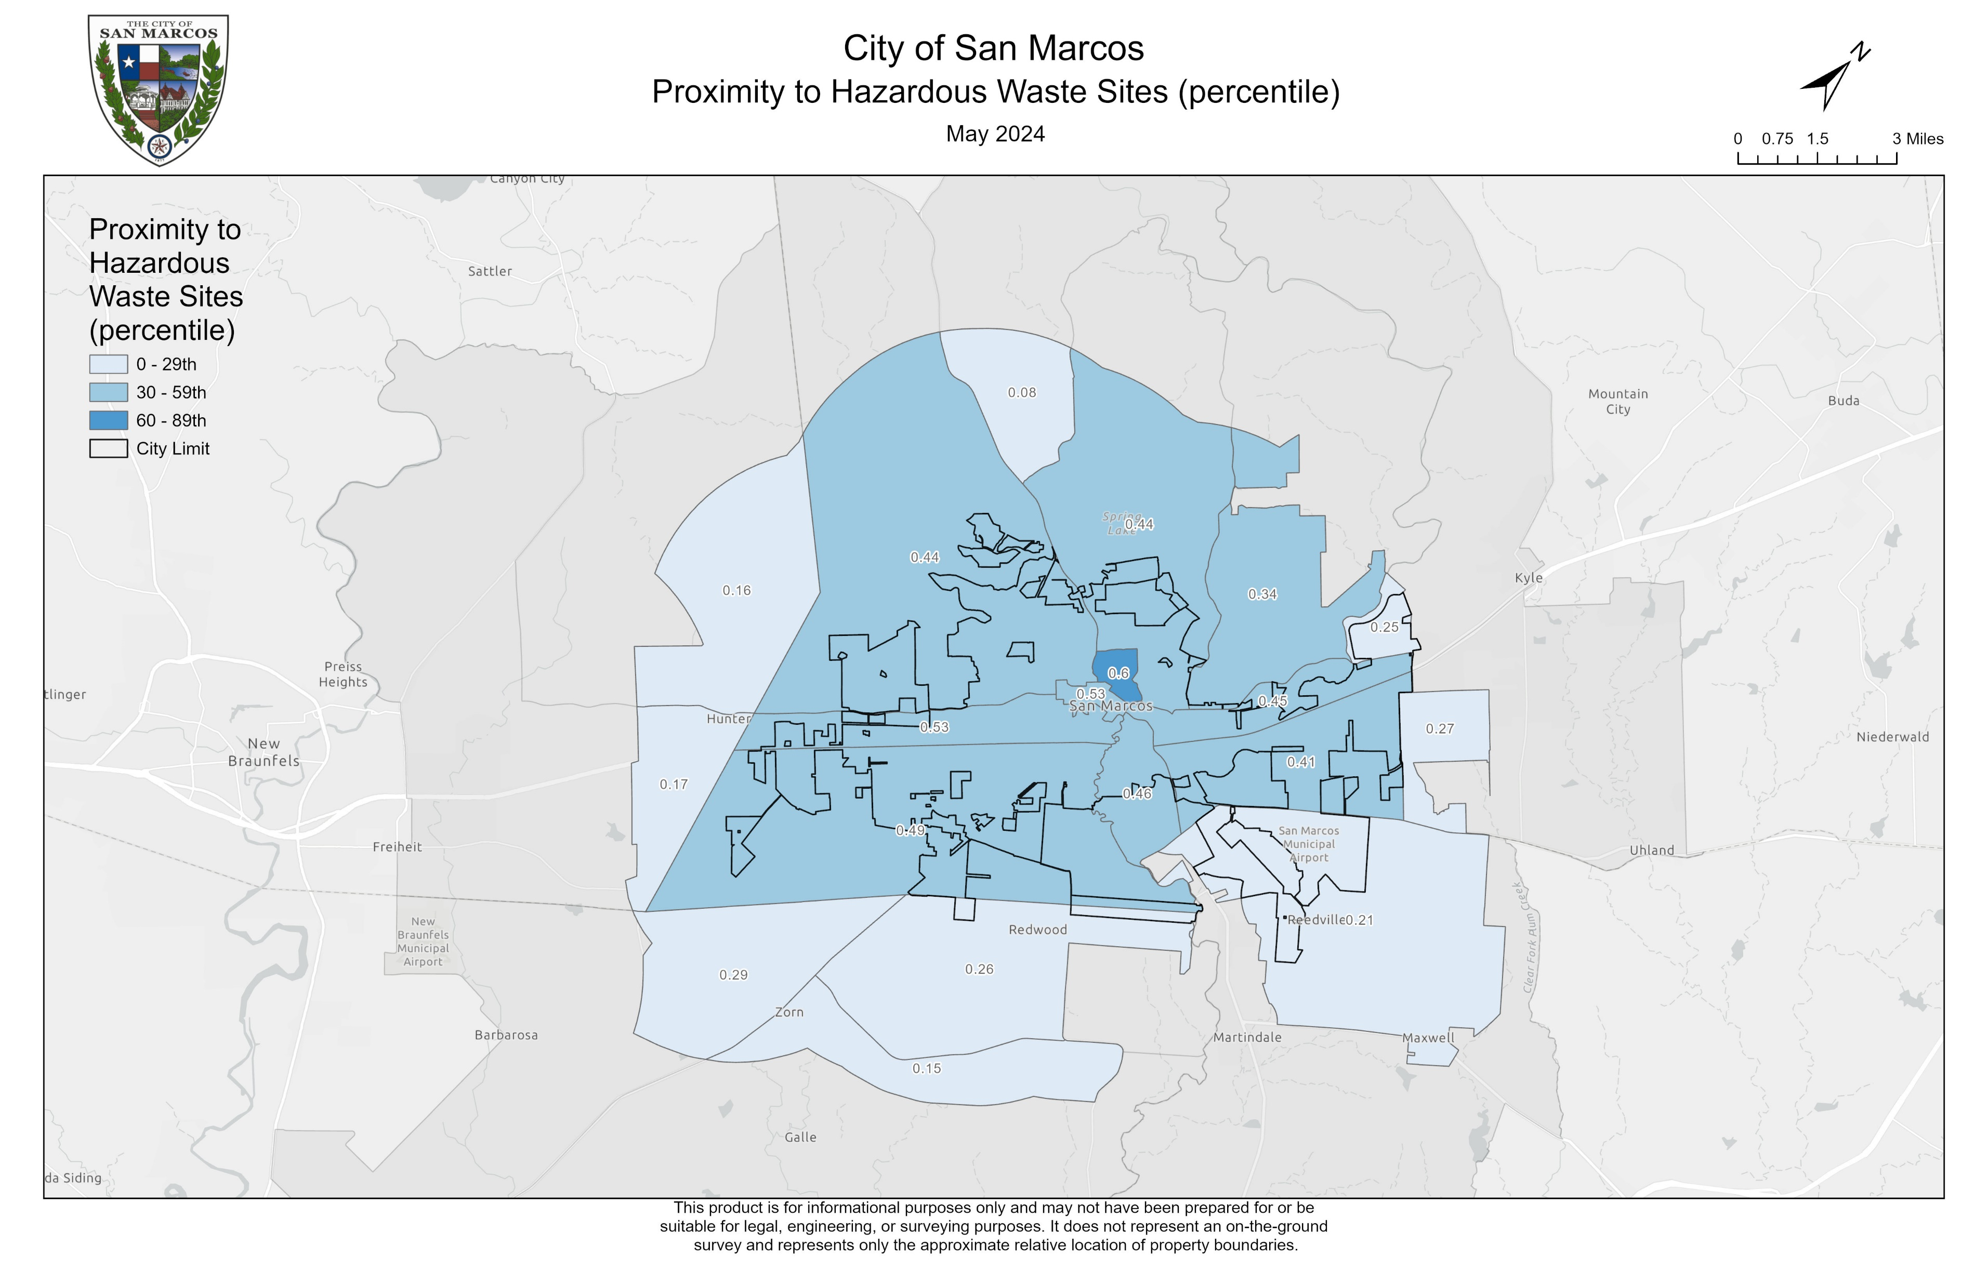
Legacy Pollution

Slide 19
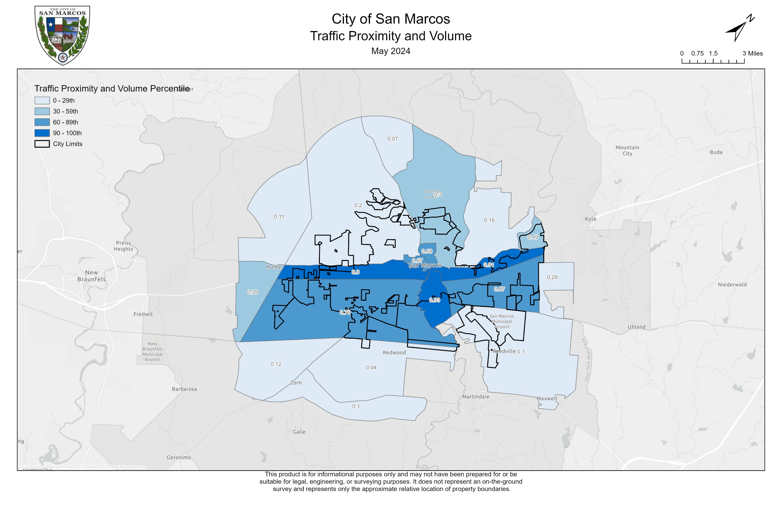
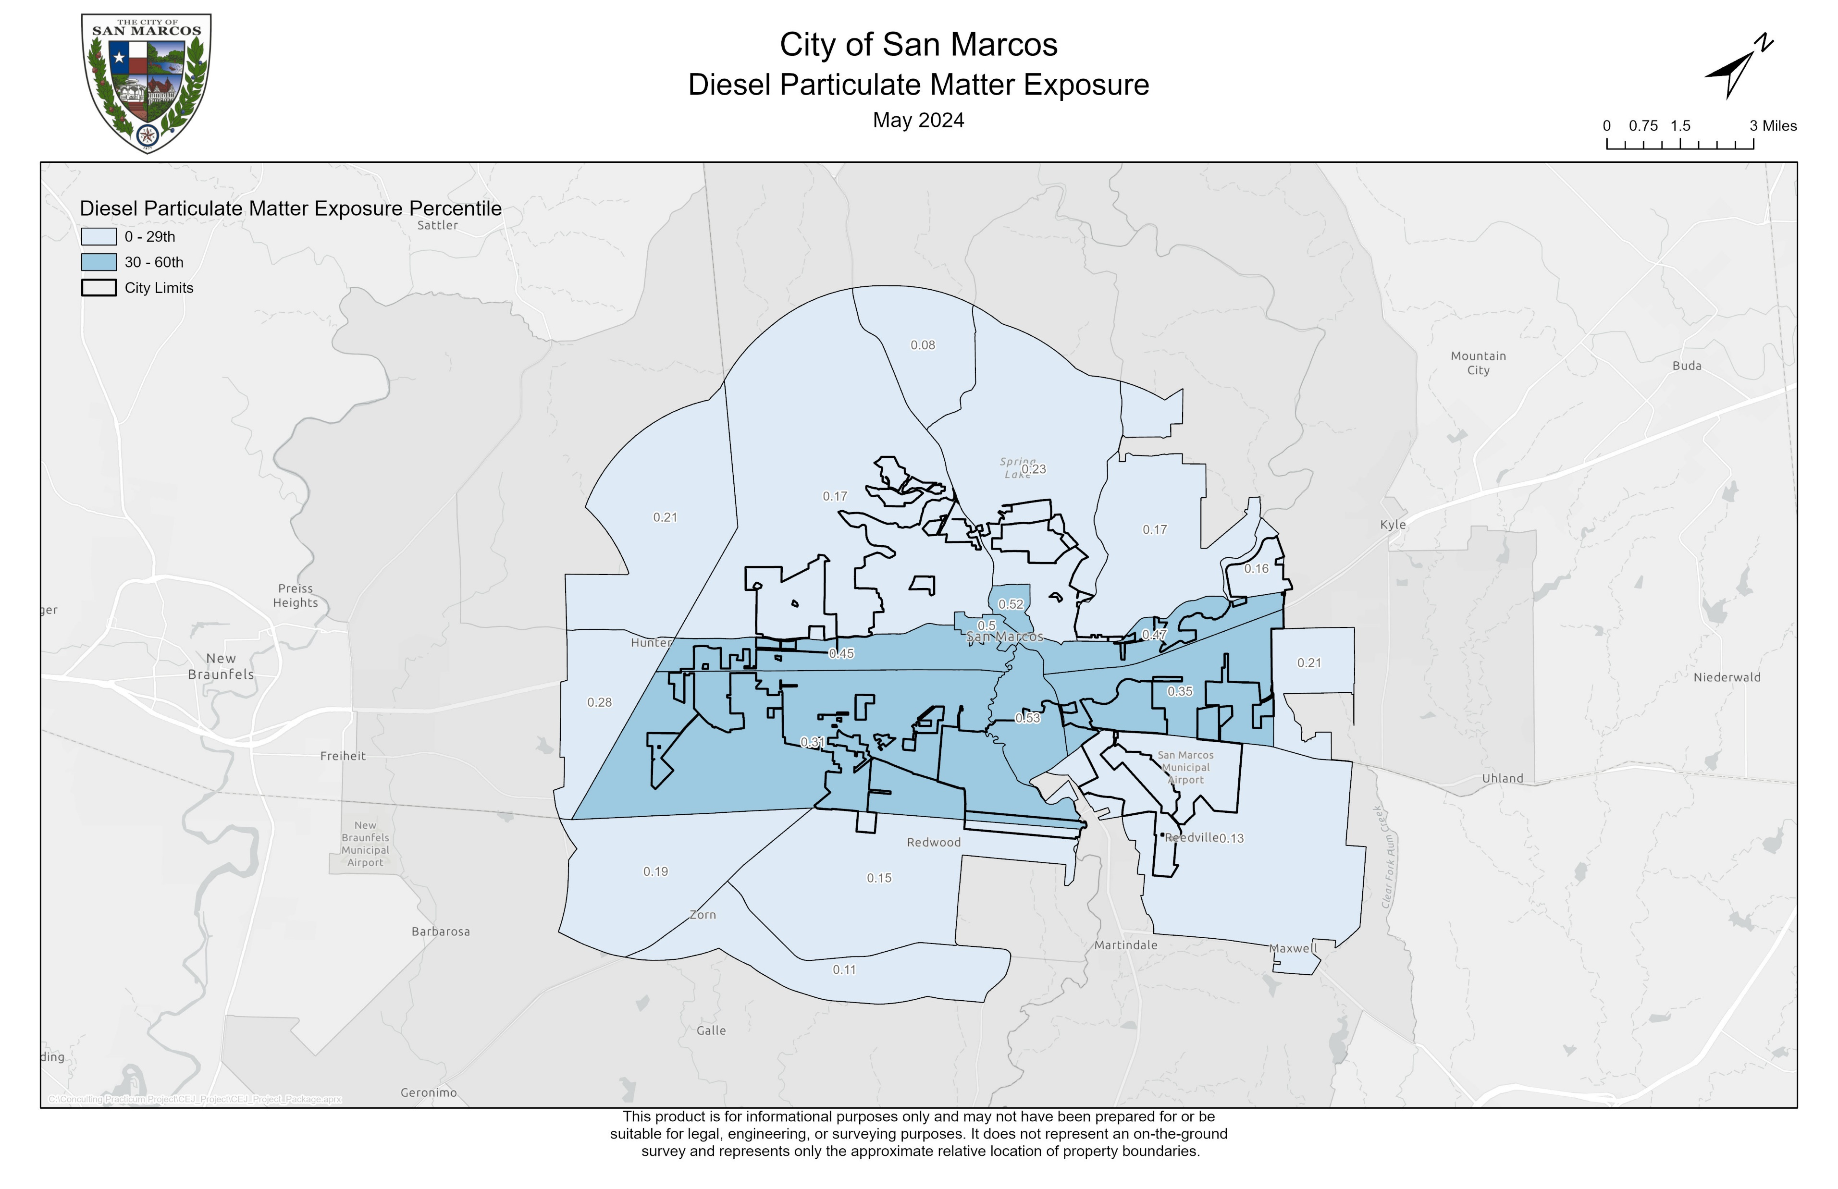
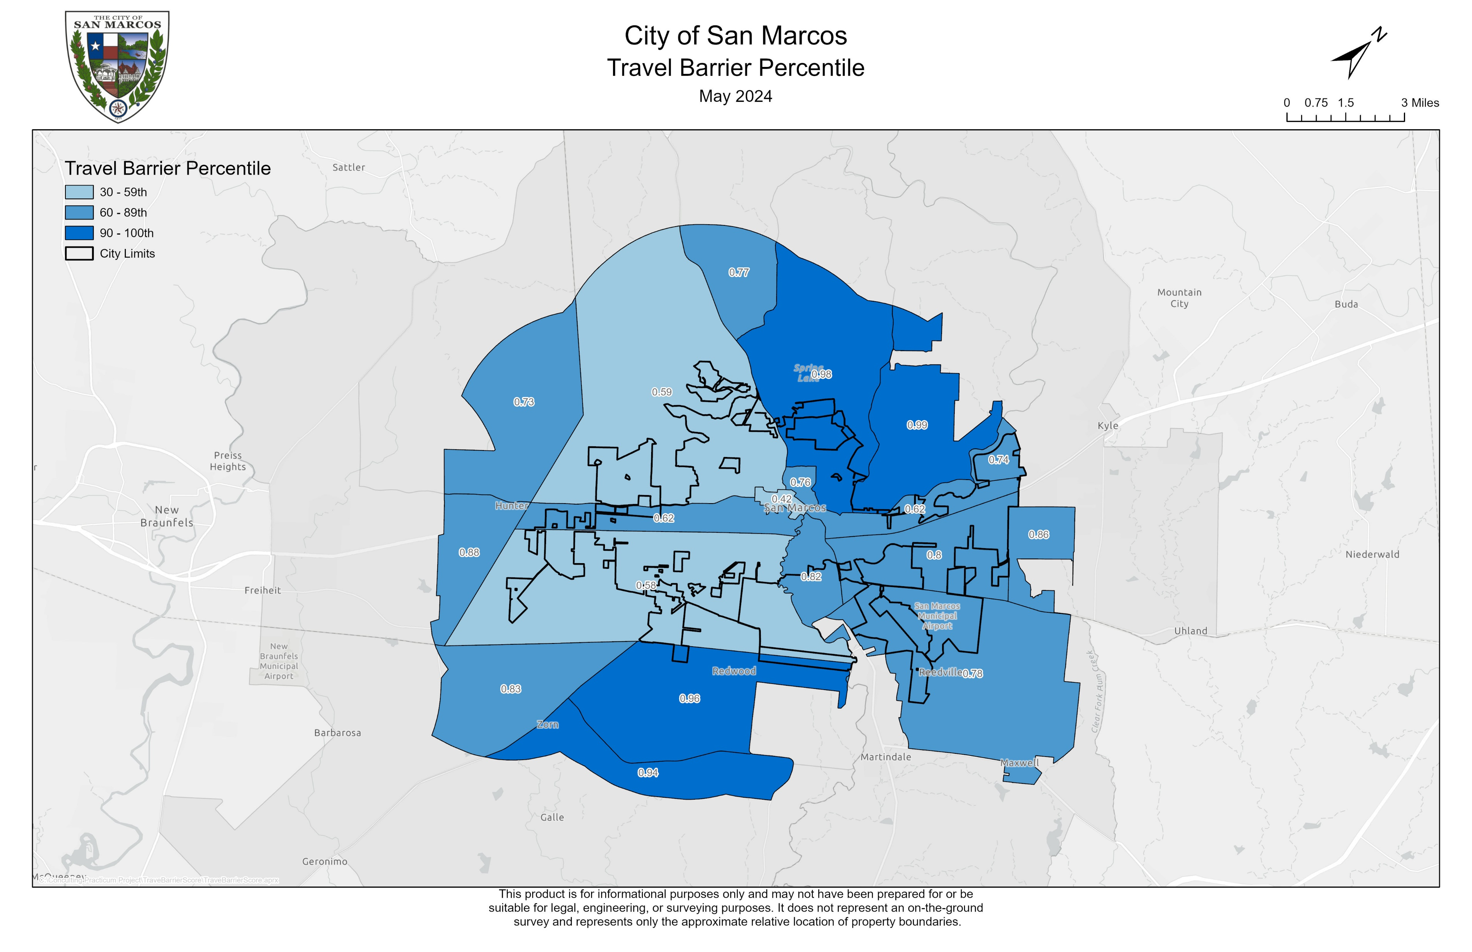
Transportation

Slide 20
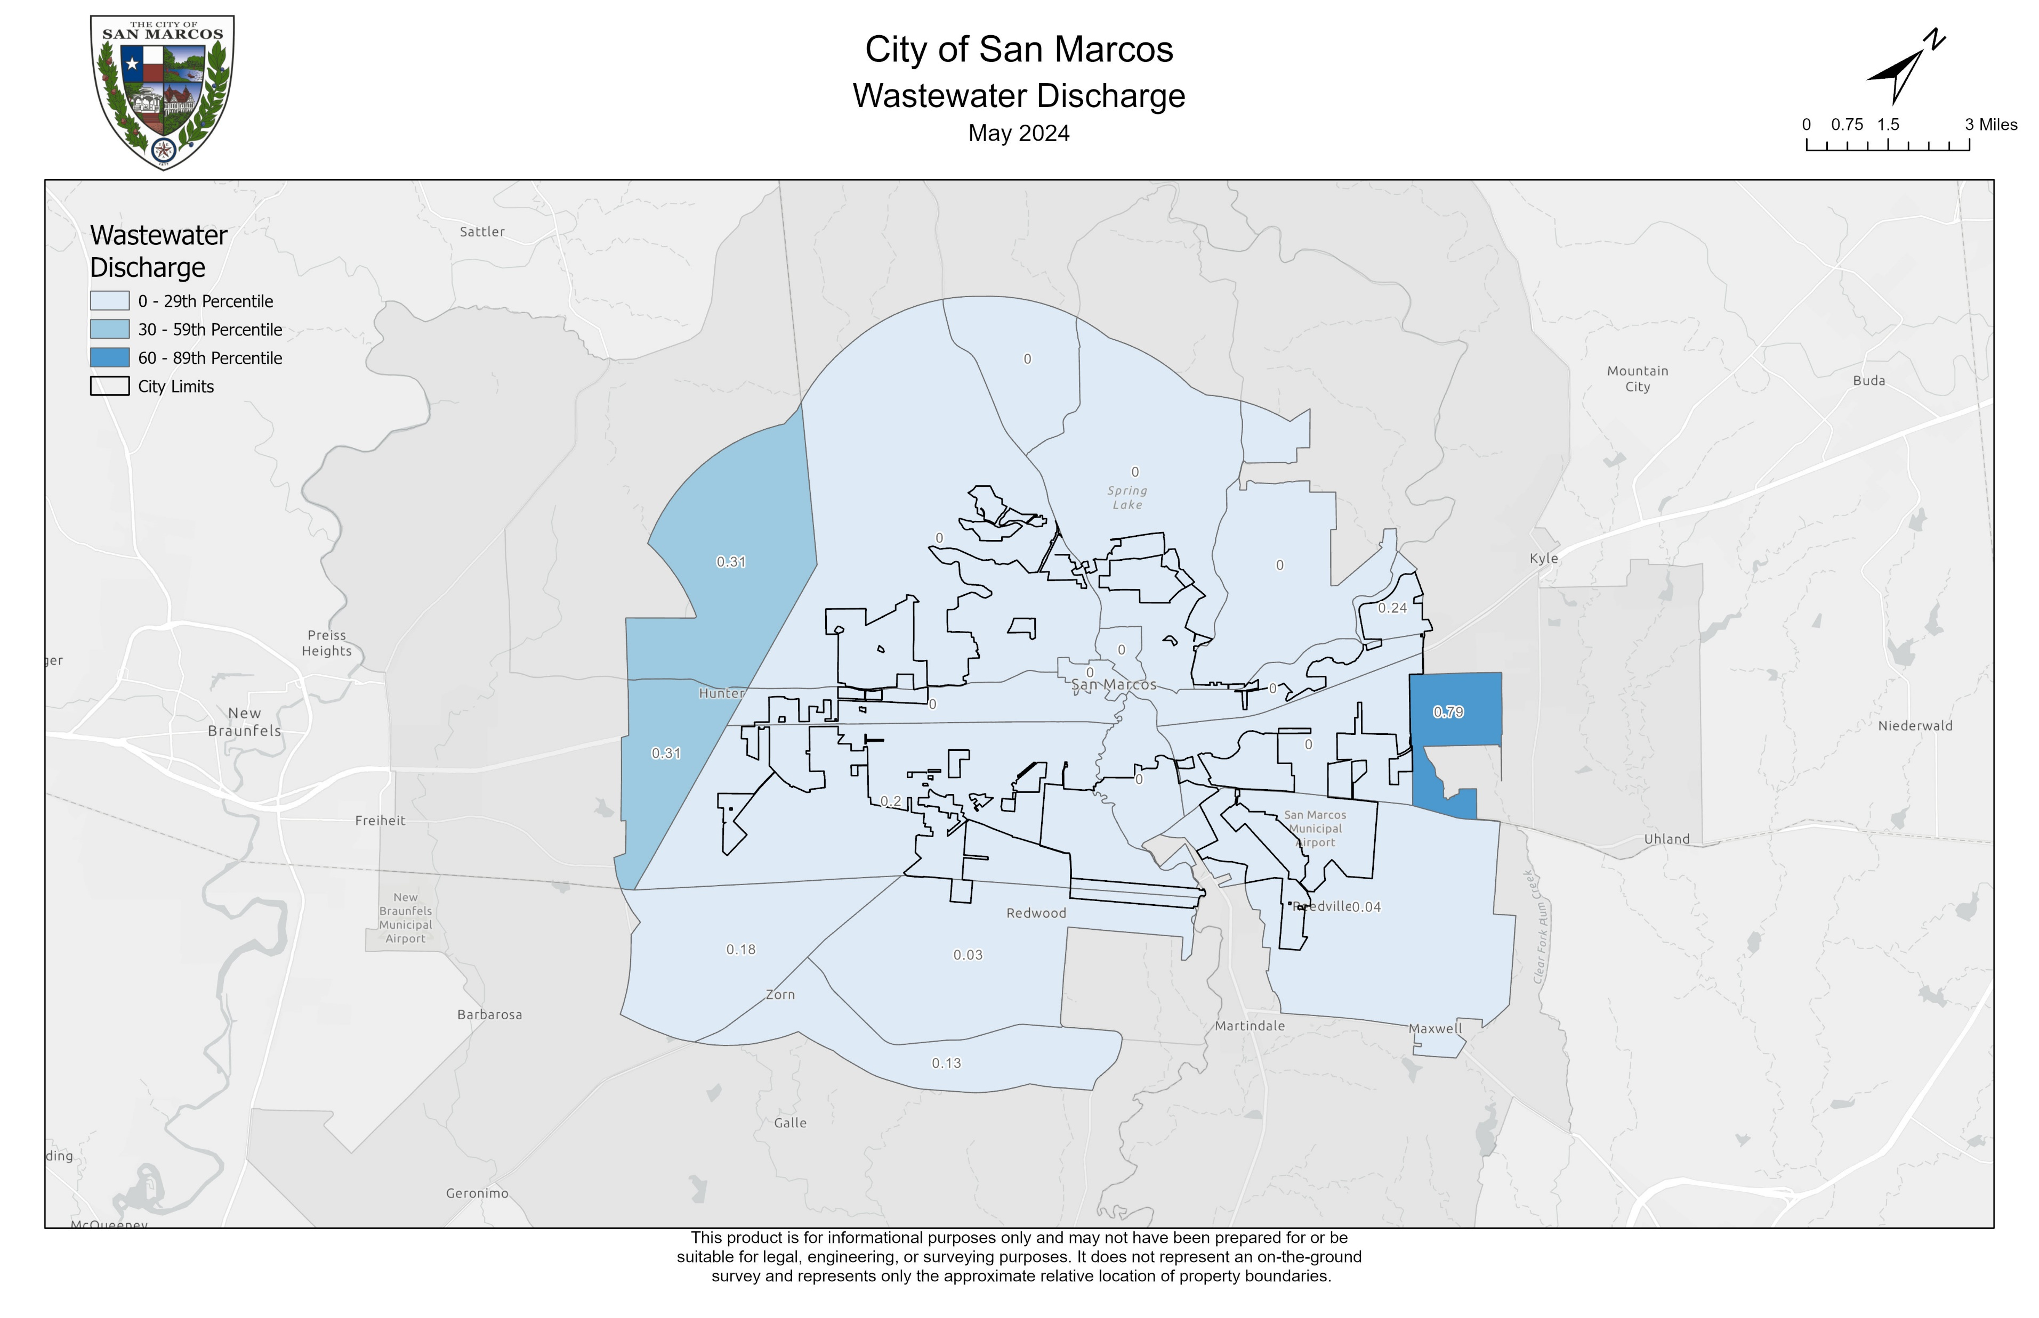
Wastewater

Slide 21
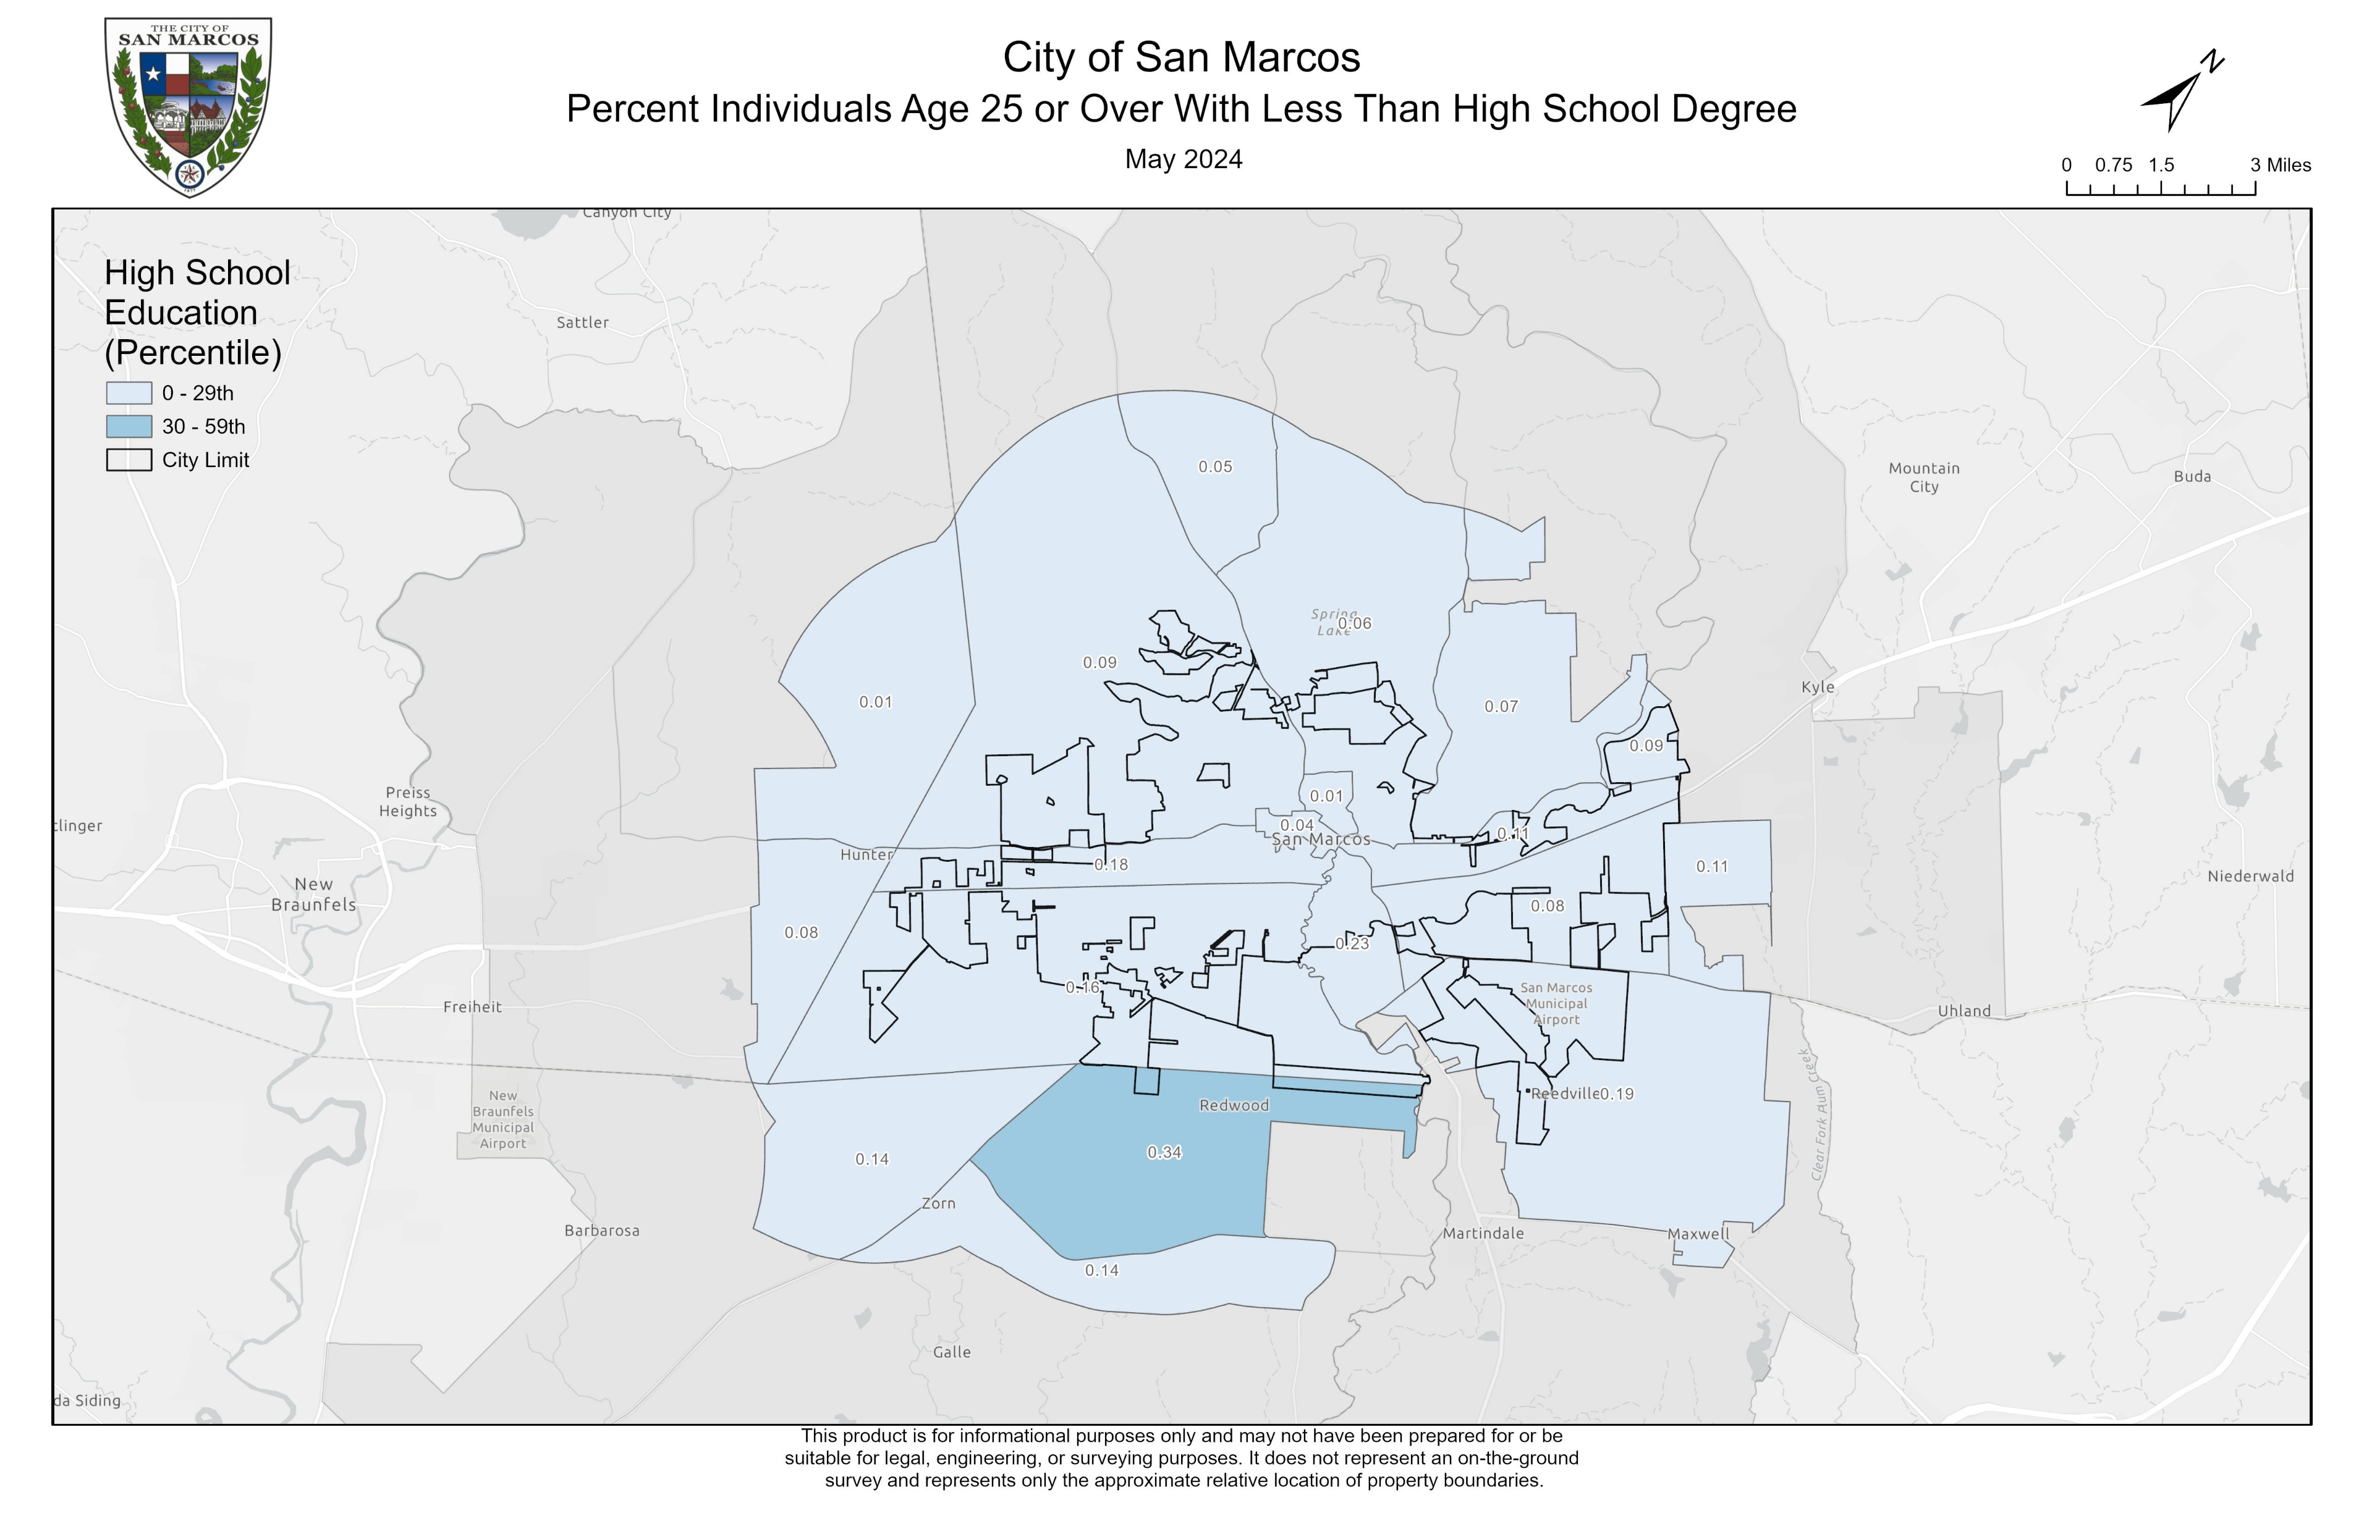
Workforce
Development

Slide 22
Discussion
Limitations
Opportunities
MAUP
Growth rate
Current data
Interpolation techniques
Block level

Slide 23
Conclusions
Overall impact
Future work
Web map
Additional factors
Collaboration

Slide 24
Questions?

Slide 25
References
American Lung Association. (2023, November 2). Disparities in the impact of air pollution. https://www.lung.org/clean-air/outdoors/who-is-at-risk/disparities#:~:text=First%2C%20groups%20may%20face%20greater,increasing%20exposure%20to%20harmful%20pollutants.
Climate and Economic Justice Screening Tool. (n.d.). Retrieved February 13, 2024, from https://screeningtool.geoplatform.gov/en/methodology#10.41/29.8686/-97.927
Gill, G., Fahnestock, L., De Vito, R., Somaiya, C. K., Streuli, S., Ramírez, D., Baker, R., Johnstone, A., Dyjack, D., & Randhawa, M. (2023c). Investing in retail food Safety: Assessing the NEHA-FDA Retail Flexible Funding Model Grant Program’s distribution through an SDOH lens. Journal of Food Protection, 86(12), 100181. https://doi.org/10.1016/j.jfp.2023.100181
Gutin, I., & Hummer, R. A. (2021). Social inequality and the future of US life expectancy. Annual Review of Sociology, 47(1), 501–520. https://doi.org/10.1146/annurev-soc-072320-100249
Leider, J. P., Meit, M., Mac McCullough, J., Resnick, B., Dekker, D., Alfonso, Y. N., & Bishai, D. (2020). The state of rural public Health: Enduring needs in a new decade. American Journal of Public Health, 110(9), 1283–1290. https://doi.org/10.2105/ajph.2020.305728
Petrović, A., Manley, D., & Van Ham, M. (2019). Freedom from the tyranny of neighbourhood: Rethinking sociospatial context effects. Progress in Human Geography, 44(6), 1103–1123. https://doi.org/10.1177/0309132519868767
Rogers, R. G., Hummer, R. A., Vinneau, J. M., & Lawrence, E. (2020). Greater mortality variability in the United States in comparison with peer countries. Demographic Research, 42, 1039–1056. https://doi.org/10.4054/demres.2020.42.36
Texas State University. 2023. Facts & data. https://brand.txst.edu/using-the-brand/writing/facts-and-data.html
United States Census Bureau QuickFacts. 2022. U.S. Census Bureau QuickFacts: San Marcos city, Texas. Census Bureau QuickFacts. https://www.census.gov/quickfacts/fact/table/sanmarcoscitytexas/PST045222
Wang, F. (2019). Why public health needs GIS: a methodological overview. Annals of GIS, 26(1), 1–12. https://doi.org/10.1080/19475683.2019.1702099

