Slide 1
Emerald Crown Trail Data Compilation and
Web Map Development
Parker Brockman- Project Manager
Michael Henry- GIS Analyst, Presenter
Daniel Vasquez- GIS Analyst
Isaac Brown- GIS Analyst
Chelsea Huggins- GIS Analyst

Slide 2
Outline
Summary
Data
Methodology
Deliverables
Budget
Timetable
Conclusion

Slide 3
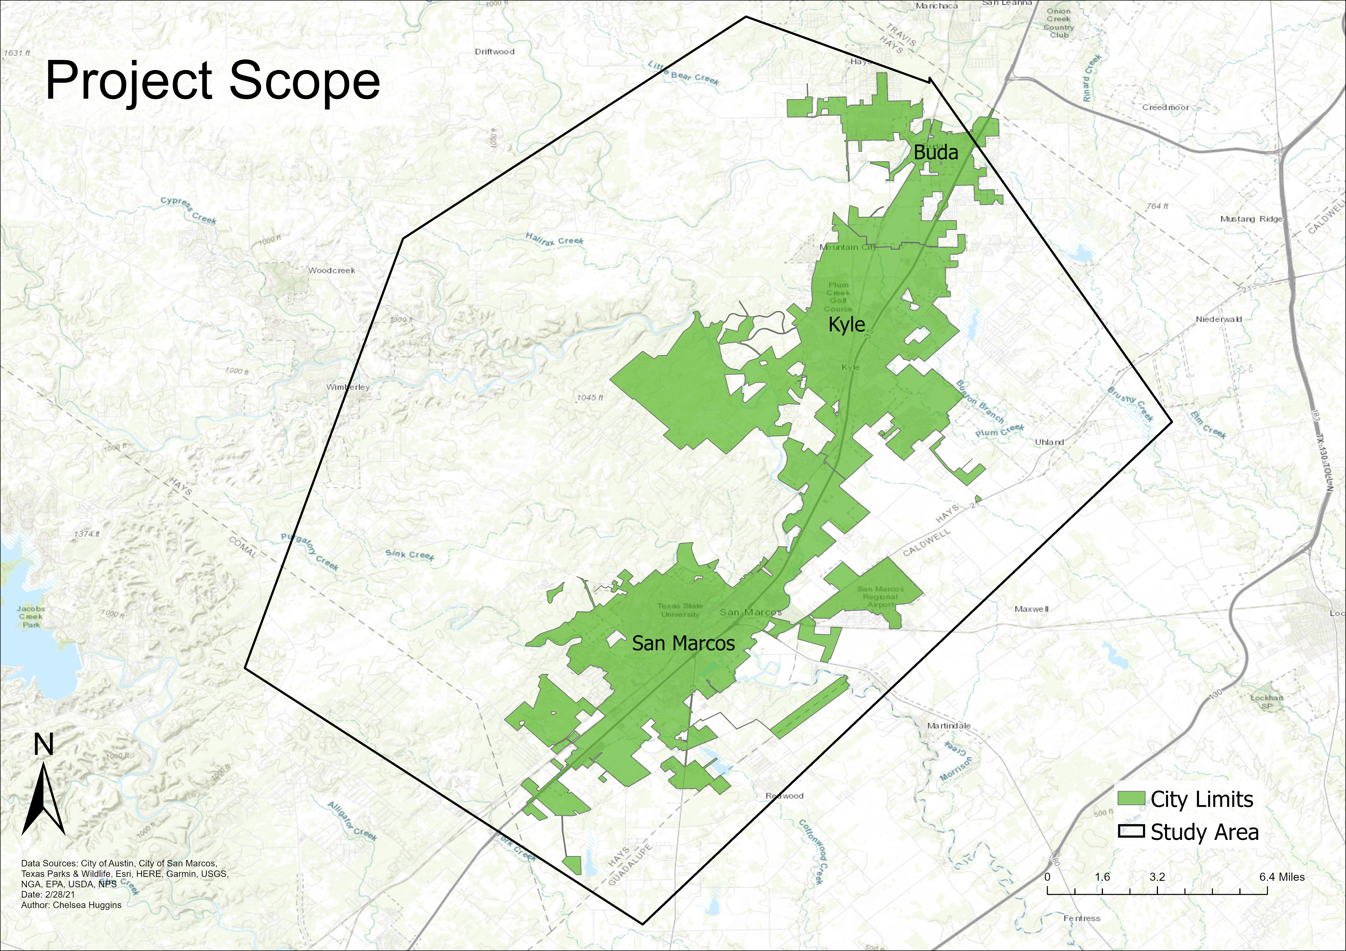
Summary The Emerald Crown Trail (ECT) is a proposed pedestrian/cycling trail that will connect San Marcos, Kyle, and Buda
Purpose
To compile data into a publicly-accessible web map displaying the development status of the Emerald Crown Trail, as well as trailhead information and other useful attributes. This will serve as a useful reference for both the public and ECT work group, as well as kindle community interest

Slide 4
Data
Entity | Attributes | Spatial Object | Status | Source | Year
Road | Roads by location | lines | available | SMGA box | 2016
Trail | Trail by segments | lines | available | SMGA box | 2020
Park | Parks in cities | polygon | available | SMGA box | 2017
Land Parcels | Land parcel lots by cities | polygons | available | SMGA box / City of San Marcos | 2017
Hays County DEM Raster | Elevation Data | raster | available | SMGA box | 2016
ESRI satellite imagery | Satellite imagery | raster | available | ESRI | 2020
LCLU | Land cover and land use | polygon | available | SMGA box / TNRIS | 2003, 2016
San Marcos Trails | Trail network | line | available | SMGA box | 2017
Kyle Trails | Trail network | line | available | SMGA box | 2017
Buda Trails | Trail network | line | available | SMGA box | 2017
Area of Interest | General area of interest | polygon | available | SMGA box | 2017
City Limits | City limits by cities | polygon | available | SMGA box / TXDOT | 2017
Jurisdiction | Territorial jurisdiction | polygon | available | SMGA box | 2017
Low Water Crossings | Low water crossing in the area | point | available | SMGA box | 2016

Slide 5
Methodology
Extensive data management with ArcGIS Pro to make the existing maps accurate and professional
Fix any inconsistency within the current data that was provided for us, look at verbal descriptions of the trails and match up incompatible shape files
Cross-reference ECT master plan and city trail and transportation plans to ascertain development status
Utilization of Esri App builder to make the maps easily accessible and readable, Whether that be through interactivity or cleanliness of the map layouts.
Analysis of trail difficulty with the data provided if time allows for it

Slide 6
Methodology Cont.
Ex: When it comes to inconsistency within our data the ETC final trail plan does not line up with the current trail files in Kyle and San Marcos, especially around Five Mile Dam

Slide 7
Final Deliverables
Publicly-accessible web map displaying development status of the Emerald Crown Trail, as well as trailhead info, and other useful attributes
Documentation of methods and processes used for the project
ESRI project file

Slide 8
Budget
Services
Data Collection | 147 hrs. | $3,601.50
Pre-Processing Data and Manipulation | 126 hrs. | $3,087.00
Data Analysis and Interpretation | 105 hrs. | $2,572.50
System Management | 96 hrs. | $2,172.00
Website Development | 24 hrs. | $600.00
Software and Supplies
Software Licensing | 240 hrs. | $1,370.40
Workstations | 3 months | $4,320.00
Totals
Services Subtotal | 498 hrs. | $12,573.00
Software and Supplies Subtotal |  | $5,690.40
Total Cost |  | $18,263.40

Slide 9
Timeline
January 27th - March 2nd: Data Collection
March 3- March 24: Data Preprocessing
March 24- April 9th: Data Processing/Analysis
April 12th- April 30th: Web Map Development
May 3rd: Final Presentation

Slide 10
Conclusion

