Slide 1
Emerald Crown Trail Final Report
Parker Brockman- Project Manager
Michael Henry- GIS Analyst
Daniel Vasquez- GIS Analyst
Isaac Brown- GIS Analyst
Chelsea Huggins- GIS Analyst

Slide 2
Outline
Introduction
Tasks
Data
Methods
Results and Discussion
Conclusion

Slide 3
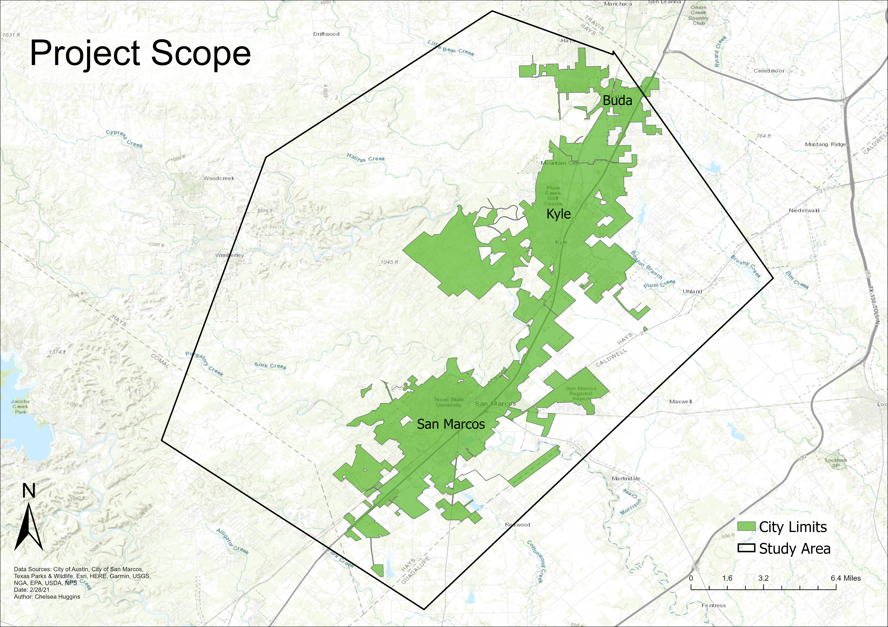
Introduction
The Emerald Crown Trail is a proposed multi-city trail system that will span from South Austin to just South of San Marcos.
Purpose
- Ignite the interest of stakeholders and provide a baseline for future updates to the digitized Emerald Crown Trail
- Accurately correct and consolidate the data given
- Compile data into a publicly-accessible web map to display the development status, as well as trail access point information and other useful attributes.

Slide 4
Tasks
Completed Work
Initial review of data
Cleaned-up Emerald Crown Trail shapefile
Attended Emerald Crown Trail Work Group meeting
Merged separate Emerald Crown Trail shapefiles
Classified trail segments
Created trailhead file and trailhead attributes
Researched how to create our Web App platform
Created a Web App with working functions

Slide 5
Data
The data provided by the SMGA included a rough proposed trail, as well as all the relevant data needed to analyze the area
Some data includes jurisdiction, land-use, land-cover, and construction status of the trails
This was used to create the shapefiles with updated trail data and create the web app

Slide 6
Data

Slide 7
Methodology
Data acquisition/organization
Most data needed was provided
Other data
Data clean up
Shapefile Clean up
Compiling of the data
Organized Data
Combined attributes that were appropriate
Merged Shapefiles
Emerald Crown Trail Final Layer

Slide 8
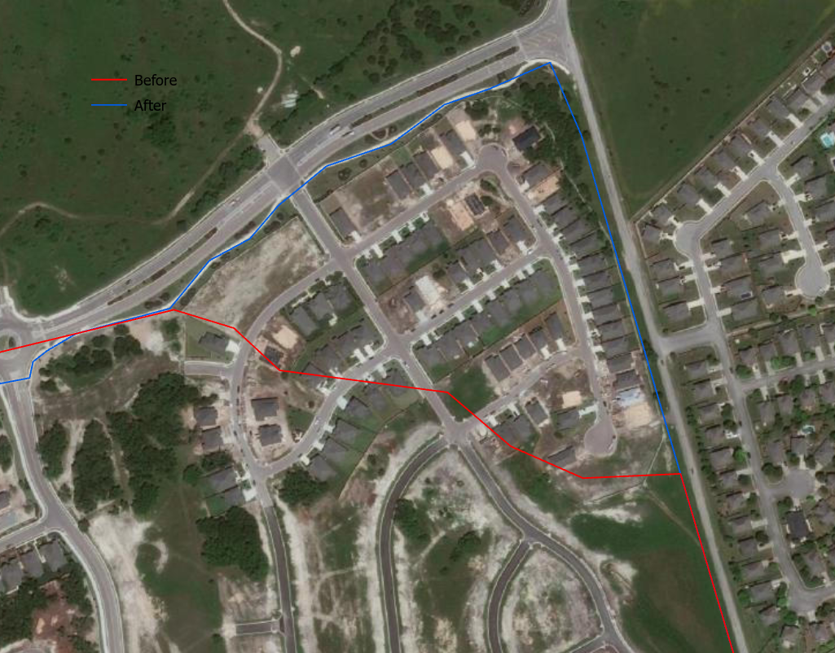

Slide 9
Methodology (cont.)
Web Map Implementation
Compiled data and shapefiles on ArcGIS Online group.
Created the Web Map to be hosted
Web App Creation
Web App interface set up

Slide 10
Results and Discussion
Our final product consists of a web app with:
A refined Emerald Crown Trail shapefile
Trail segment with the development status
Trail segment with corresponding jurisdiction
Land use land cover data
Proposed access points
Our web app is a resource that may be used to ignite stakeholder interest and inform the public of ECT construction status
Final WebMap
https://txst.maps.arcgis.com/apps/webappviewer/index.html?id=f921d496492542cabc46720483c8a167

Slide 11
Problems Encountered
Web App Issues
Trouble creating the Web App
Used the ArcGIS Online group to share data and make changes
Web App currently hosed on the Texas State Server

Slide 12
Conclusion

