Slide 1
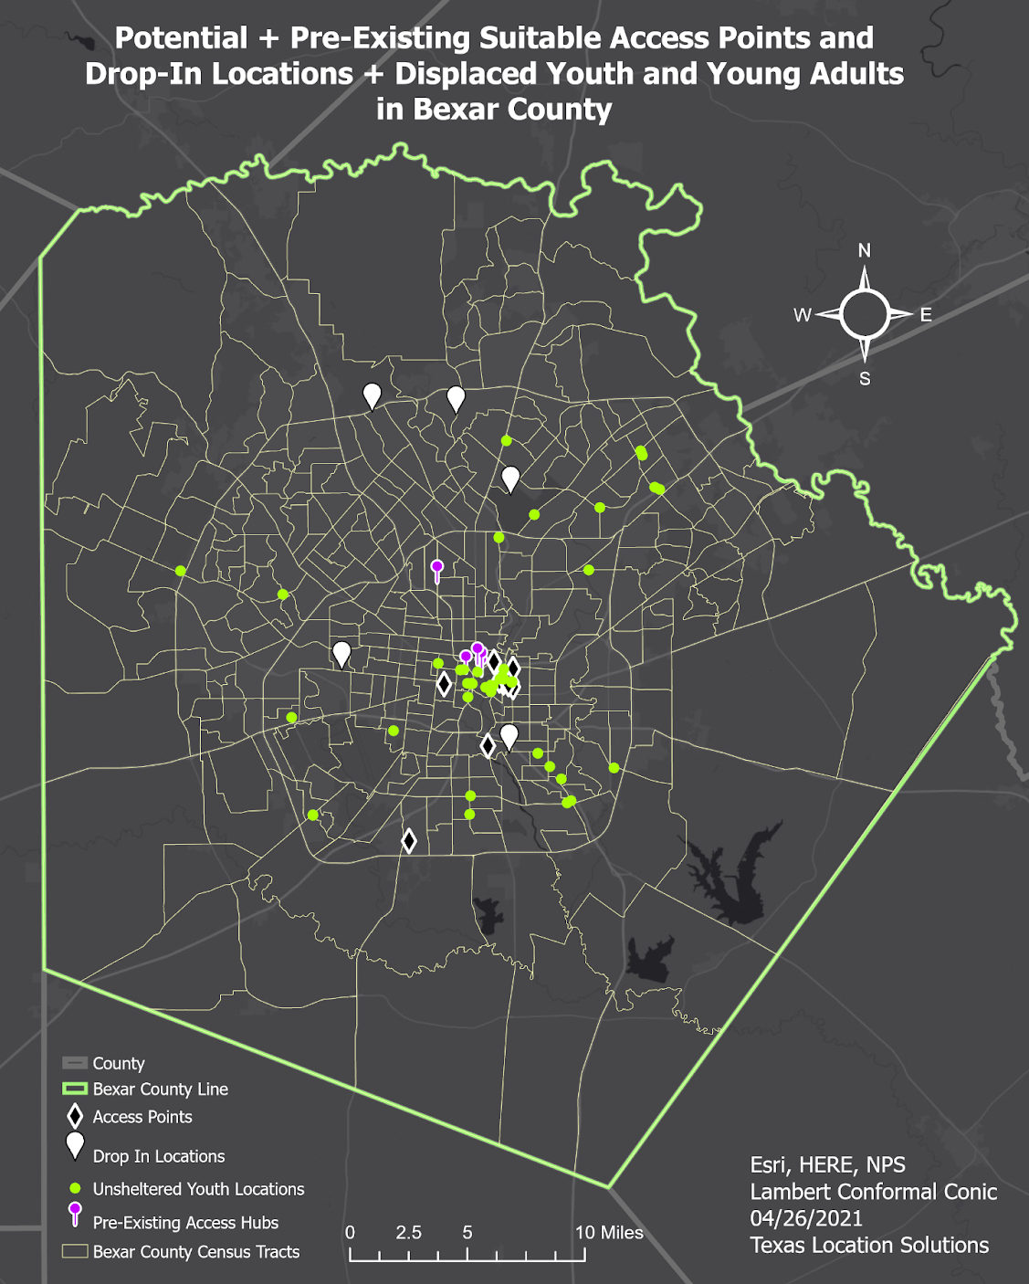
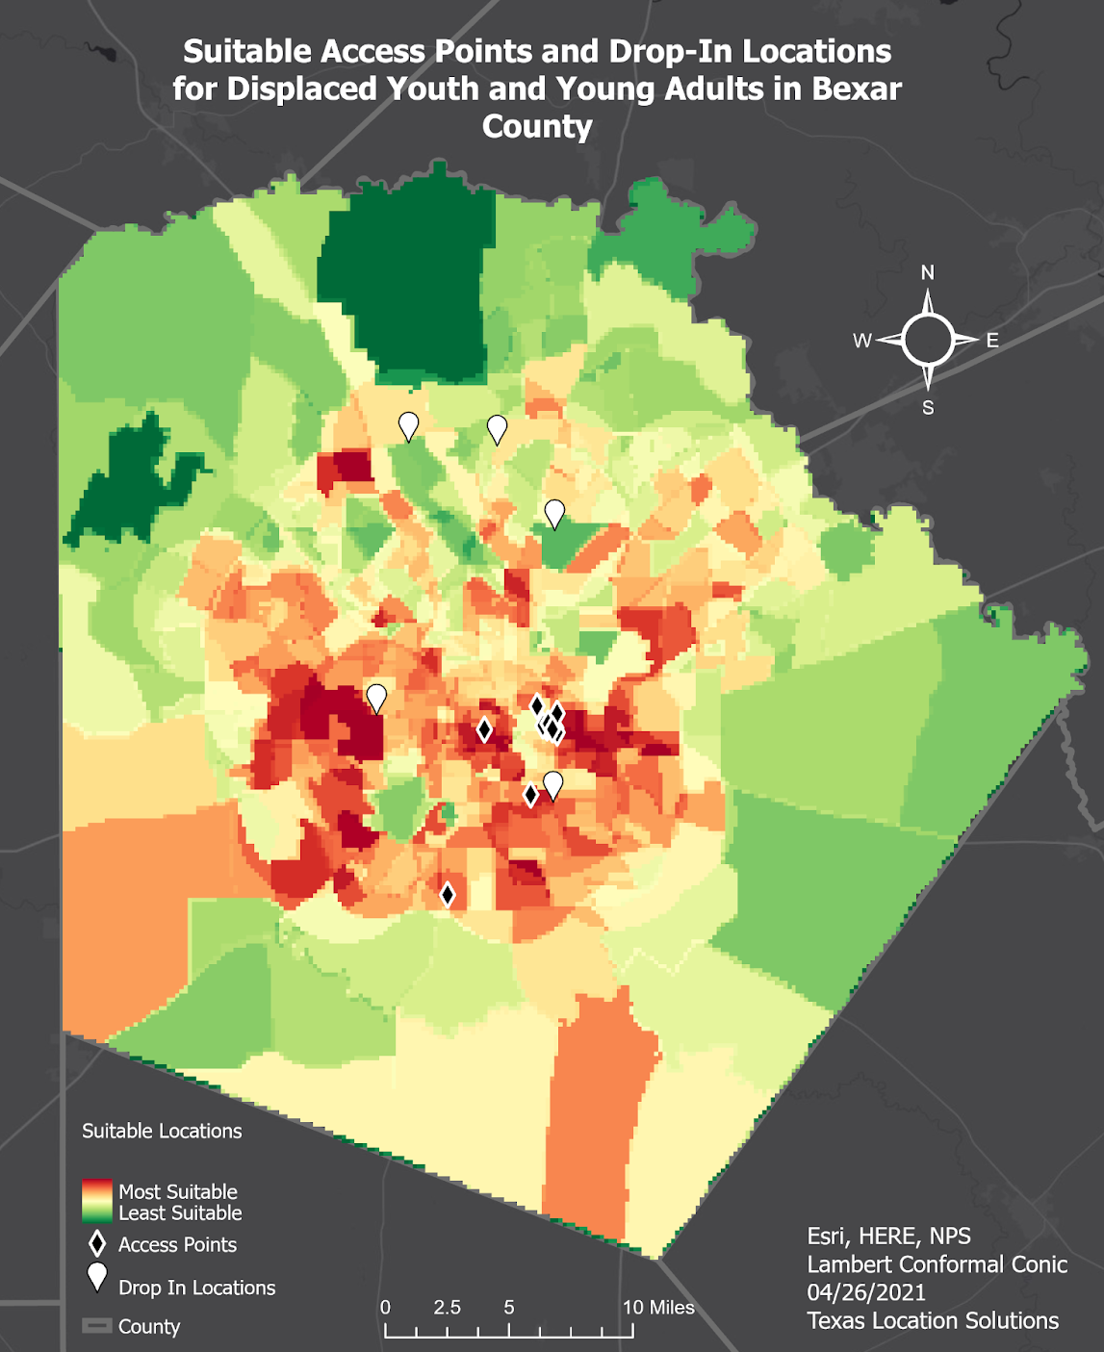
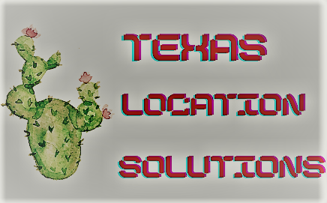
Expansion Project for South Alamo Regional Alliance for the Homeless
Texas Location Solutions (TLS): Darrin Speer, Stancil Barton, Brandon Trevino, & Kennedy Watson
Department of Geography, College of Liberal Arts, Texas State University,
South Alamo Regional Alliance for the Homeless (SARAH)
Abstract
Methodology
Results
Access to resources for homeless youth and those at risk of homelessness in the San Antonio area is not as readily available as it should be. In an effort to rectify this problem, this study aims to identify locations within Bexar County that have the highest population of at-risk and homeless youth. The final result is a map of suitable locations for new drop-in centers and access points that have the capability of providing services such as food, water, showers, recreation, and community outreach.
In combination with the locations of displaced youth that SARAH provided, we established a list of risk factors that contribute to youth homelessness. After obtaining and processing the risk factor data from the Census Bureau, we weighed our risk factors in order to properly portray the magnitude of each factor. Using the ‘weighted sum tool’, we created a proper result for our combined risk factor data that is as follows:
Lack of Nearby Needed Services: 0.10
Race (Youth): 0.10
- A/A (Non-Hispanic): .0034
- White (Hispanic): 0.078
- White (Non-Hispanic): 0.017
- Two or More Races: 0.0016
Income: 0.15
Unsheltered: 0.2
Poverty: 0.15
Education: 0.15
Unemployment: 0.15
TOTAL = 1.00
The results show that Western and Eastern sections of downtown San Antonio as well as the area close to the University of Texas-San Antonio are very suitable locations for more homelessness services; this proved our prediction of the areas of highest risk being in southern Bexar County to be false. It should be noted that while the center of San Antonio is also dark red, we believe the data is slightly skewed because that is where the majority of services currently are. Therefore, more people experiencing homelessness will spend a majority of their time in this area.
Introduction
Figure 1. Shows the vulnerability analysis depicted on a map created in ArcGIS Pro
Figure 3. Map of suitable access points and drop-in locations for displaced youth and young adults in Bexar County.
Conclusion
(Figure 1) Portrays the potential suitable access points and drop-in locations we are proposing to SARAH and the already existing access hubs in relation to the locations of unsheltered youth and young adults within Bexar County. Note that several groups of unsheltered youth are heavily clustered in the center of the county, we believe this is due to available access points being clustered in that same area.
(Figure 3) Shows the combined raster layers of each weighted risk factor to display what areas would be impacted by SARAH’s expansion project and the currently available potential drop-in centers and access points that are suitable for their needs.
This analysis has the potential to be used as a “model” for other urban areas to display locations of high risk of homelessness, and to help influence policy to improve life for displaced people. The process would remain relatively the same, but risk factor research and social data should be altered to reflect the study area. Additionally, we hope for improved data collection on people in the LGBTQ+ community, veterans, and/or people experiencing mental illness in order to become a more relevant factor in these discussions and analyses.
Rapid population growth in Bexar County, Texas has caused increasing homelessness and the need for resources and information regarding homelessness. The South Alamo Regional Alliance for the Homeless (SARAH) is an organization that looks to combat this problem by establishing access points that provide necessary resources to displaced youth and drop-in centers that provide information to those “at-risk” of homelessness in Bexar County. Texas Location Solutions (TLS) has collaborated with SARAH in an expansion project that will provide four to five potential access point locations, two of which will be drop-in centers for youth and young adults. These facilities will provide resources and services based on a multitude of data, such as weighted risk factors that include poverty level, race by age, education level, lack of nearby needed services, unsheltered youth locations, and unemployment.
Figure 2. Flowchart representing raster analysis.
(Figure 2) Shows the extraction of risk factors from ‘Bexar County Census Tracts’. Those polygons were then converted to rasters. The vector locations data was then buffered and converted into raster layers. All of the raster files were then ‘Reclassified’ on a scale of 0 (least desirable) to 5 (most desirable); the value of 0 was necessary for producing accurate results due to multiple Census Tracts having incomplete data. We then combined all of the ‘Reclassified’ rasters into a single raster file in order to display areas deemed ‘most suitable’ for SARAH’s new locations.
Acknowledgements
Special thanks to Dr. Yuan, Dr. Kamal, Khan Bin Asad and the Department of Geography for giving us the opportunity to work on this project, and to assist SARAH in their efforts to better the lives of homeless youth and young adults within Bexar County and the greater San Antonio area.

