Slide 1
Expansion Project for Homeless Accessibility:
South Alamo Regional Alliance for the Homeless (SARAH)
Team Manager: Darrin Speer
GIS Consultants: Stancil Barton, Brandon Trevino, Kennedy Watson

Slide 2
Table of Contents
Introduction
Problem Statement / Project Goals …………3
Client Criteria ………………………………….4
Results
Final Results Map …………..10
Data
Data and Acquisition ………………………....5
Data Table ……………………………………..6
Limitations …………………………..11
Exclusions …………………………..12
Conclusion …………………………..13
References ………………………......14
Methodology
Final Risk Factor Weights …………………..7
(Methodology title) …………………………..8
(Methodology title) …………………………..9
Flowchart ………………………………….....10

Slide 3
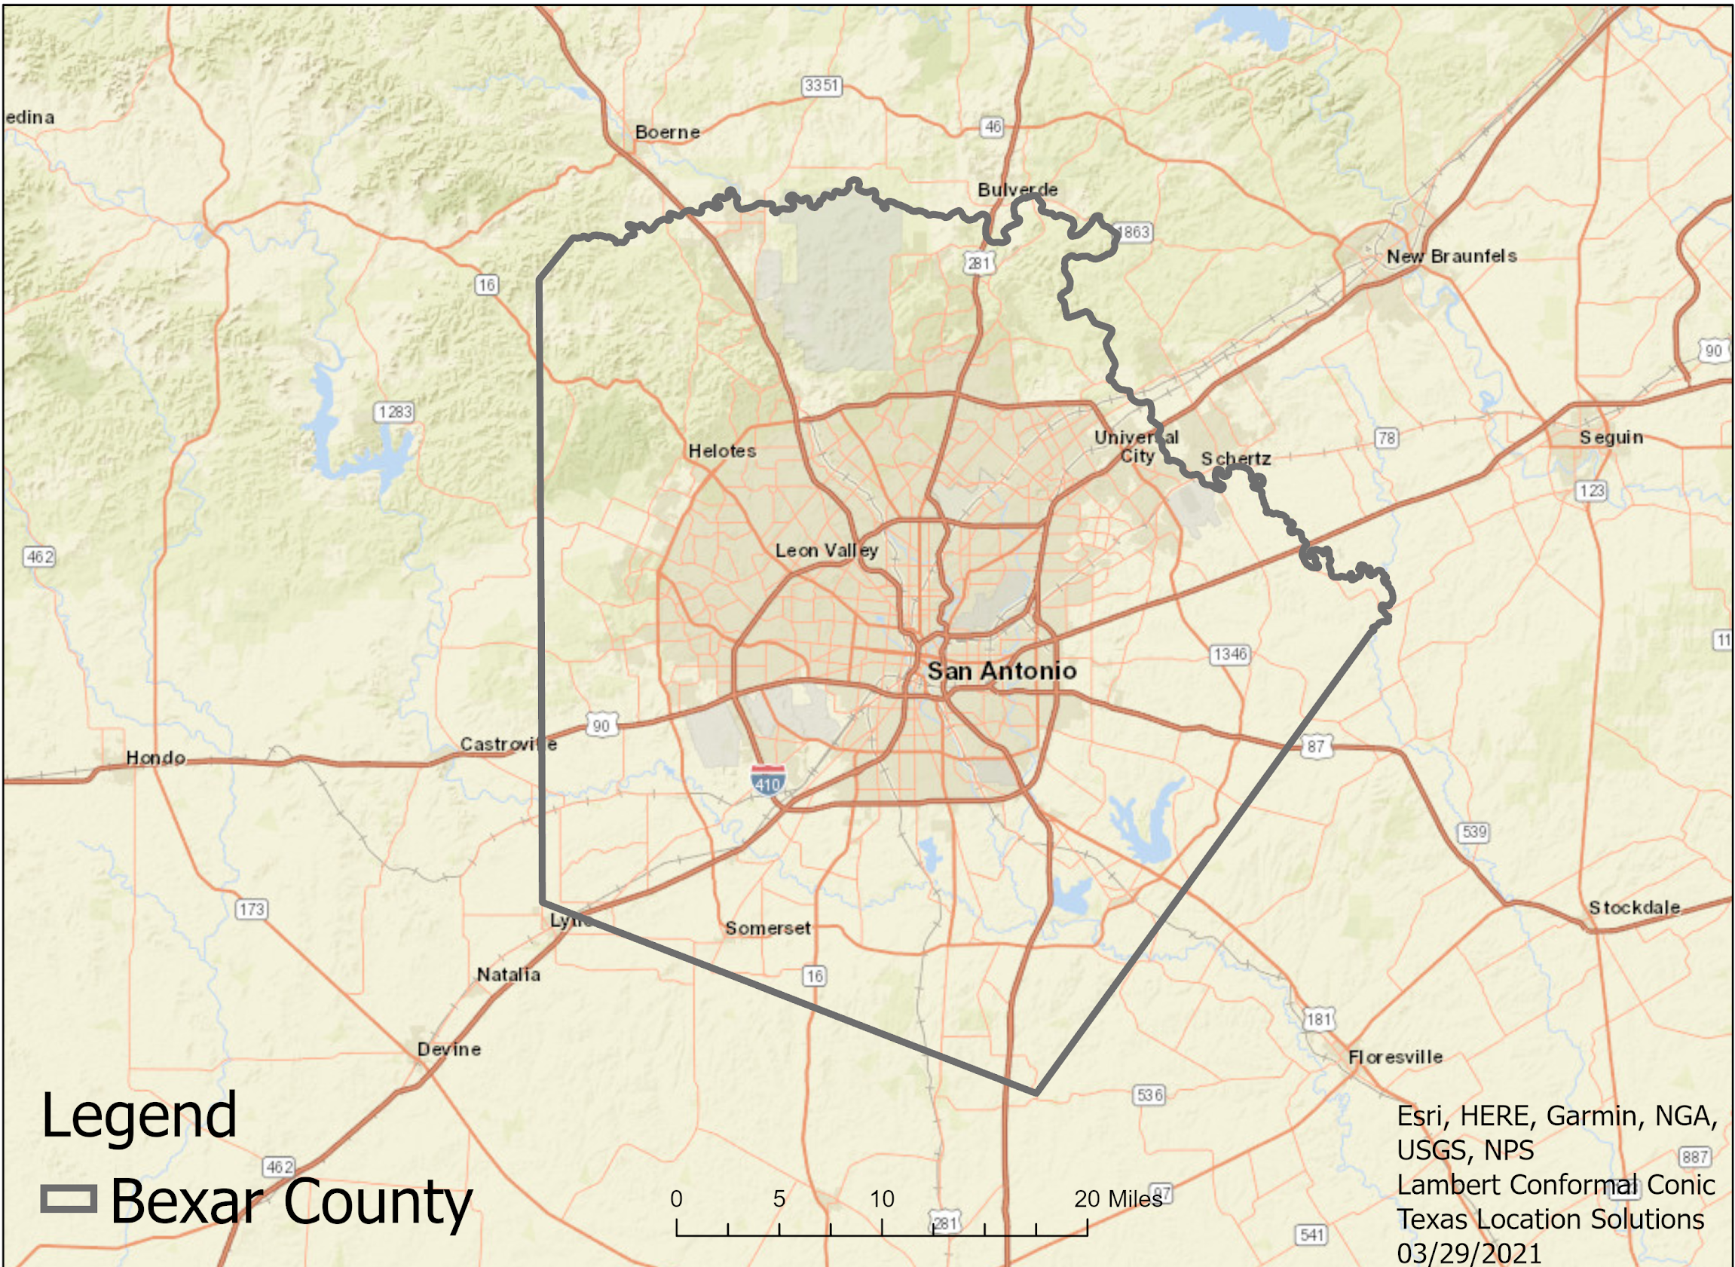
Introduction
Problem Statement:
San Antonio is one of many rapidly growing cities experiencing homelessness amongst youth and young adults. And unfortunately resources aren’t as readily available for assistance as they should be.
Project Goals:
Determine and Weight Risk Factors
Create Map Displays for Each Factor
Locate Ideal Locations for New Drop-In Centers and Access Points

Slide 4
Client Criteria
Access Points
Must be an existing organization that provides service to the homeless population
They must be in walkable range to most at-risk youth and young adults
Identified locations need to be further away from other homeless service and housing campuses in San Antonio.
Drop-In Centers
Estimated needed space is ~6,000 to 8,000 sq ft.
Locations must be further away from other homeless service and housing campuses in San Antonio.
They must be close to where most youth experiencing homelessness congregate
Indoor space and outdoor spaces are required.
The outdoor space should have potential for green space, playgrounds, basketball courts, etc.

Slide 5
Data and Acquisition
Data Sources: Bexar County GIS Data, SARAH, US Census - American Community Survey, San Antonio GIS Portal, LoopNet, and OpenStreetMap.
Data Created: Access Points, Lack of Nearby Needed Services, and Available Locations
PCS: Lambert Conformal Conic (Texas_South_Central_StatePlane_4204)
GCS: “WGS 1984”
since we weighed our risk factors, we were required to use tools that only raster inputs can utilize.

Slide 6
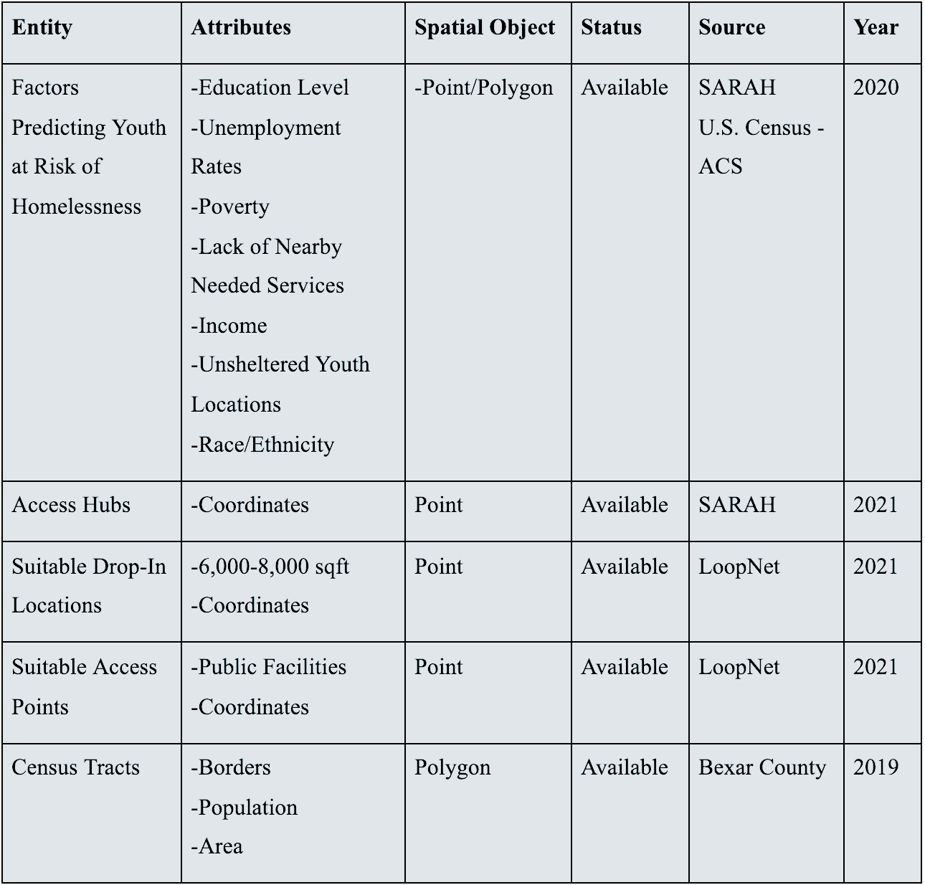
Data Table

Slide 7
Final Risk Factor Weights
Lack of Nearby Needed Services: 5
Income: 0 - 5
Unsheltered: 5
Poverty: 0 - 5
Education: 0 -5
Unemployment: 0 – 5
Race (Youth): 0 - 5
A/A (Non-Hispanic) Population:
NoData = 0
0 - 1 = 1
2 - 18 = 2
19 - 53 = 3
54 – 77 = 4
78 – 110 = 5
White (Hispanic) Population:
NoData = 0
14 – 229 = 1
230 – 409 = 2
410 – 595 = 3
596 – 867 = 4
868 – 1466 = 5
White (Non-Hispanic) Population:
NoData = 0
0 – 192 = 1
193 – 390 = 2
391 – 738 = 3
739 – 1408 = 4
1409 – 3099 = 5
‘Two or More Races’ Population:
NoData = 0
268 – 550 = 5

Slide 8
Methodology
Data Preparation
Creating Polygons for each Risk Factor
Convert each polygon to a raster
Suitability Analysis (Combined all rasters to one map)
Utilizing Raster Analysis to Determine Suitability of Service Locations
Polygon to Raster Conversion
Reclassification of Raster Values
Combining Rasters to Produce Final Results

Slide 9
FLOWCHART
Flowchart

Slide 10
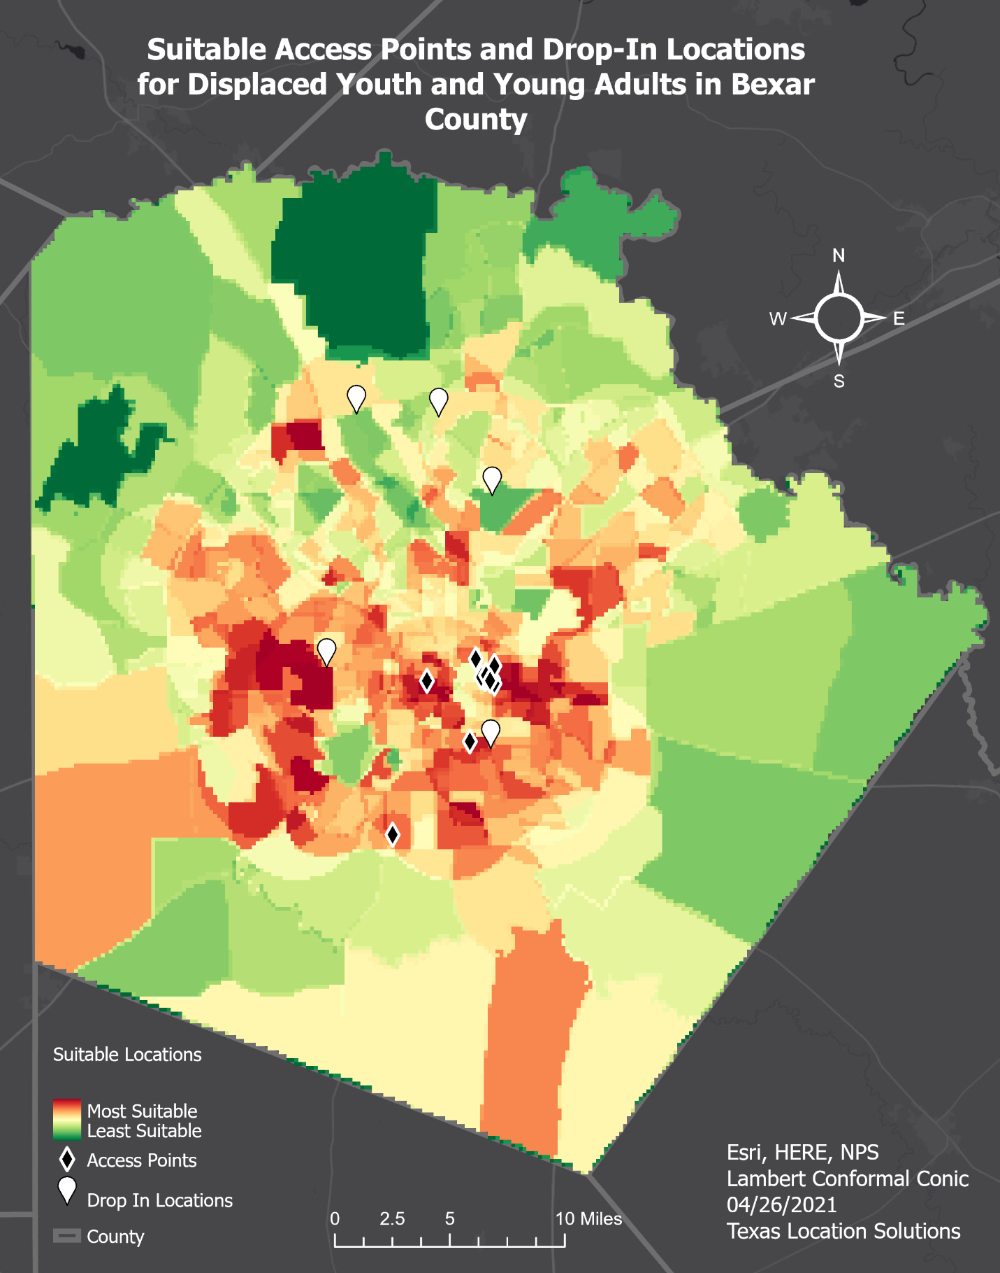
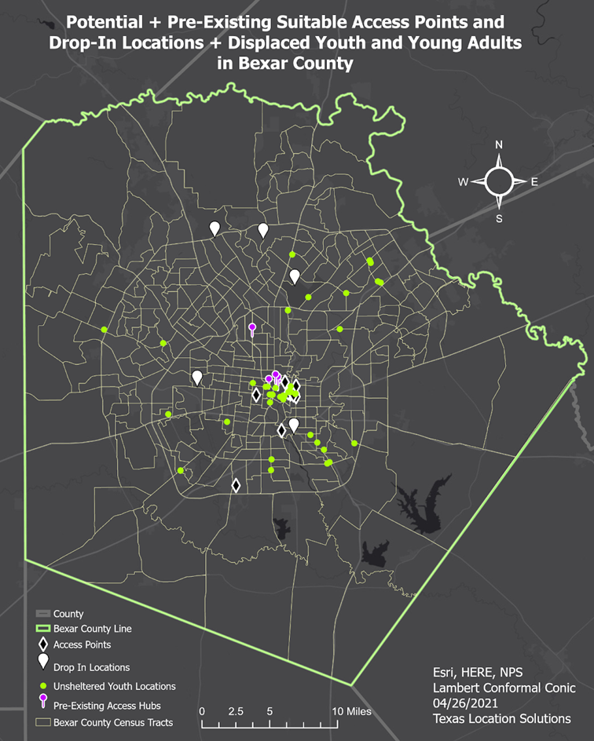
Final Result Maps

Slide 11
Missing Data
Point density rasters heavily skewed the final results
Exclusions (next slide)

Slide 12
Exclusions
LGBTQ+ Community
Military Veterans
Mental Illness

Slide 13
Conclusion
We are happy!
This analysis could be used as a “model” for other urban areas and to help influence policy to improve life for displaced people.
Future data inclusion of LGBTQ+ community, veterans, those with cognitive disabilities.
Compared to our original predictions which we found were relatively inaccurate, the areas of highest risk in Bexar county were not the south east but mostly central.
Link to StoryMap: https://txst.maps.arcgis.com/apps/Cascade/index.html?appid=1053716635bb49ae9603493282c19790

Slide 14
References: Data Sources
ata.census.gov. (n.d.). Retrieved March 01, 2021, from https://data.census.gov/cedsci/table?t=Official+Poverty+Measure%3APoverty&g=0500000US48029.140000&tid=ACSST5Y2019.S1701&hidePreview=false
Data.census.gov. (n.d.). Retrieved March 01, 2021, from https://data.census.gov/cedsci/map?t=Employment&g=0500000US48029.140000&tid=ACSST5Y2019.S2301&hidePreview=false&vintage=2019&layer=VT_2019_140_00_PY_D1&cid=S2301_C01_001E&palette=Teal&break=5&classification=Natural+Breaks&mode=thematic
Data.census.gov. (n.d.). Retrieved March 01, 2021, from https://data.census.gov/cedsci/map?t=Veterans&g=0500000US48029.140000&tid=ACSST5Y2019.S2101&hidePreview=false&vintage=2019&layer=VT_2019_140_00_PY_D1&cid=S2101_C01_001E&palette=Teal&break=5&classification=Natural+Breaks&mode=thematic
SARAH. (2021, January). [Unsheltered Youth Locations and Characteristics]. Unpublished raw data.
SARAH. (2021, January). [Access Hubs Providing Services to Homeless Youth]. Unpublished raw data.
(n.d.). Retrieved February, 2021, from https://www.loopnet.com/search/industrial-space/san-antonio-tx/for-lease/?sk=e8cfad6199b9a50493a0bb51363b1196
Google search. (n.d.). Retrieved February 28, 2021, from https://www.google.com/search?tbs=lf%3A1%2Clf_ui%3A2&tbm=lcl&sxsrf=ALeKk00SeOoY_UvTtyBShUKxxymlAUpxxg%3A1614572561007&q=homeless%2Bshelters%2Bsan%2Bantonio%2Btx&rflfq=1&num=10&sa=X&ved=2ahUKEwjlvNm_n47vAhUOM6wKHd64BNwQjGp6BAgSEGw&biw=1474&bih=790#rlfi=hd:;si:;mv:[[29.7384064,-98.4605091],[29.306454900000002,-98.5743366]];tbs:lrf:!1m4!1u3!2m2!3m1!1e1!1m4!1u2!2m2!2m1!1e1!2m1!1e2!2m1!1e3,lf:1,lf_ui:2
Bexar County open data portal. (n.d.). Retrieved February 24, 2021, from https://gis-bexar.opendata.arcgis.com/
Bus stops and stations in San Antonio. (n.d.). Retrieved February 24, 2021, from https://mygeodata.cloud/data/download/osm/bus-stops-and-stations/united-states-of-america--texas/bexar-county/san-antonio
City of San ANTONIO open data. (n.d.). Retrieved February 24, 2021, from https://opendata-cosagis.opendata.arcgis.com/search?tags=Transportation
GIS (geographic Information Services). (n.d.). Retrieved February 24, 2021, from https://www.sanantonio.gov/GIS/GISData
Sidewalks. (n.d.). Retrieved February 24, 2021, from https://opendata-cosagis.opendata.arcgis.com/datasets/sidewalks
Data.census.gov. (n.d.). Retrieved March 01, 2021, from https://data.census.gov/cedsci/map?t=Educational+Attainment&g=0500000US48029.140000&tid=ACSST5Y2019.S1501&hidePreview=false&vintage=2019&layer=VT_2019_140_00_PY_D1&cid=S1501_C01_001E&palette=Teal&break=5&classification=Natural+Breaks&mode=thematic
ata.census.gov. (n.d.). Retrieved March 01, 2021, from https://data.census.gov/cedsci/table?t=Official+Poverty+Measure%3APoverty&g=0500000US48029.140000&tid=ACSST5Y2019.S1701&hidePreview=false

