Slide 1
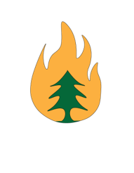
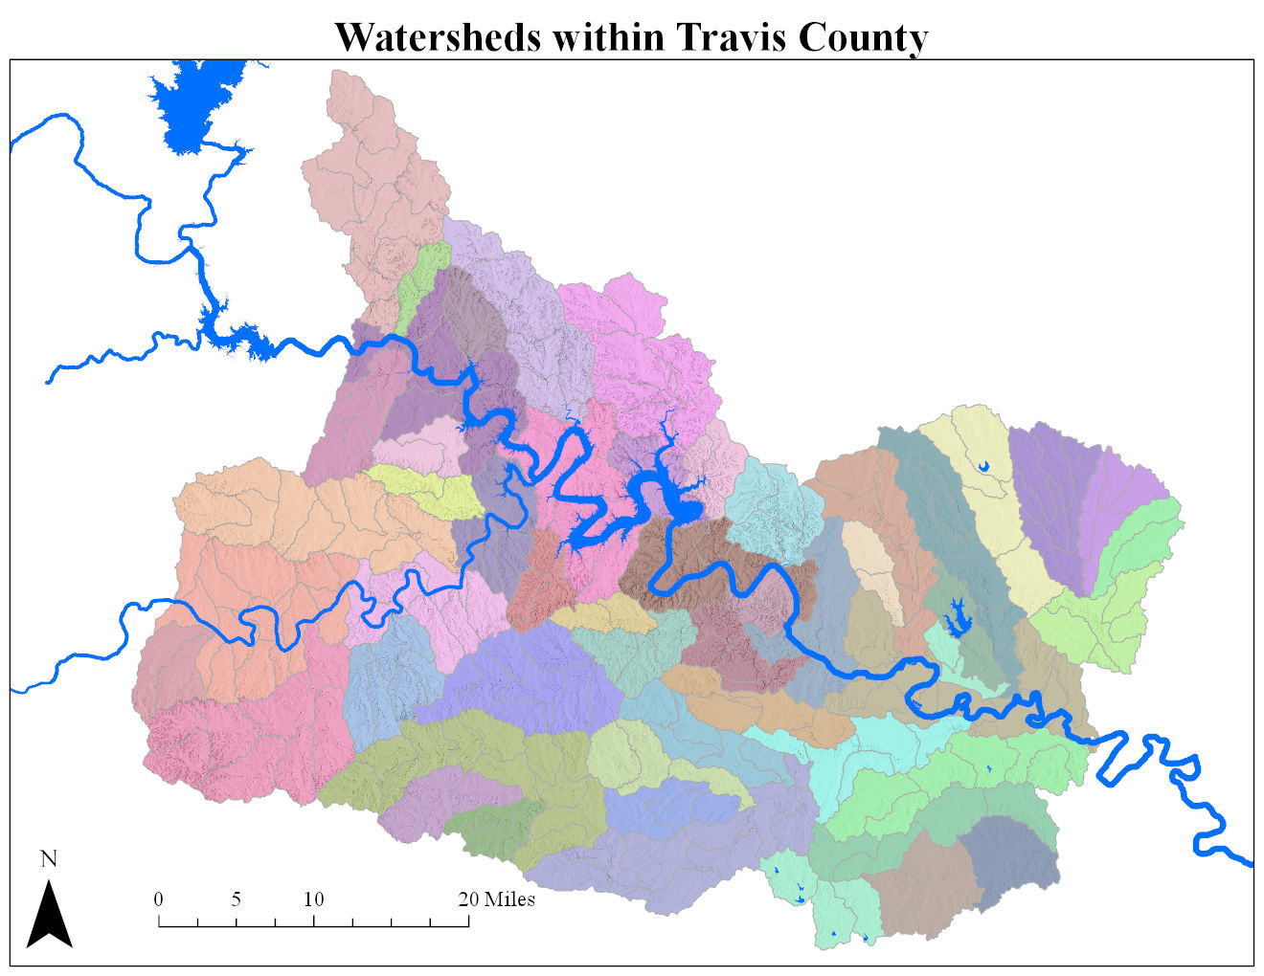
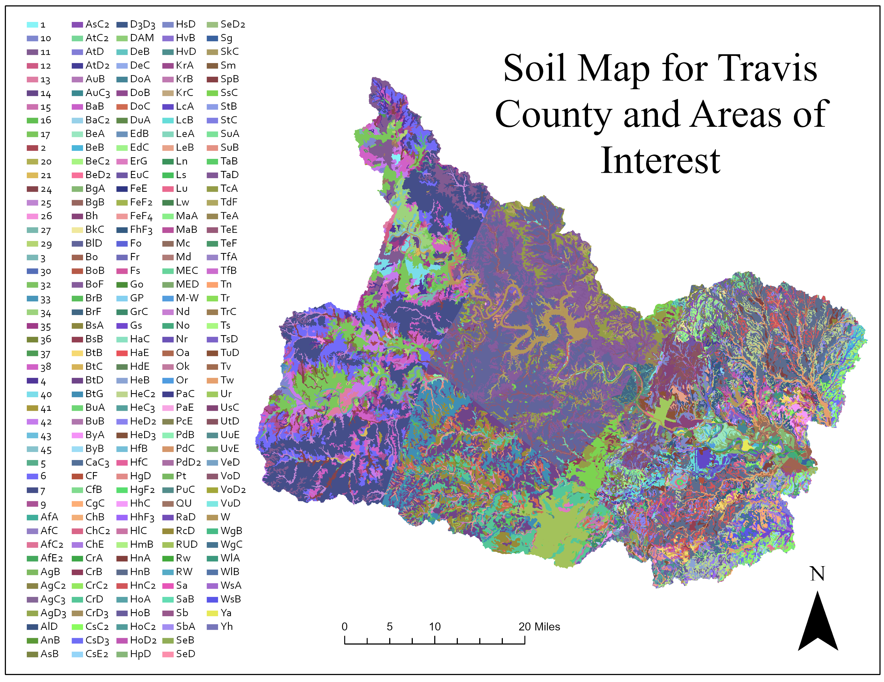
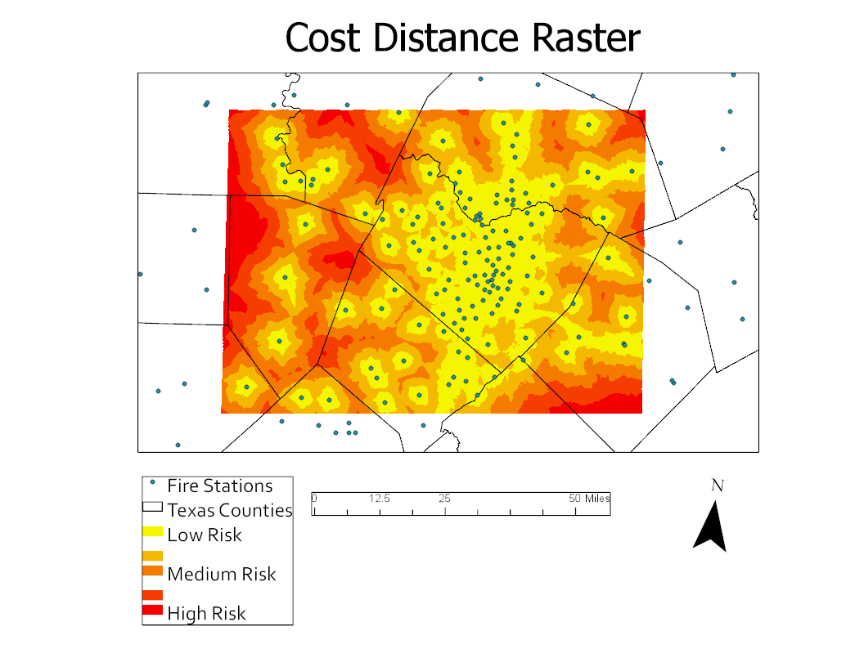
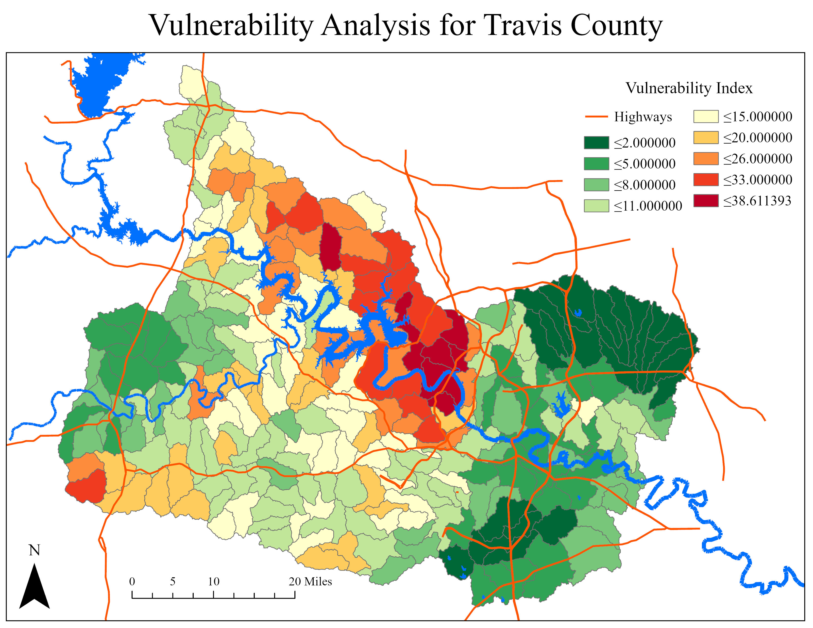
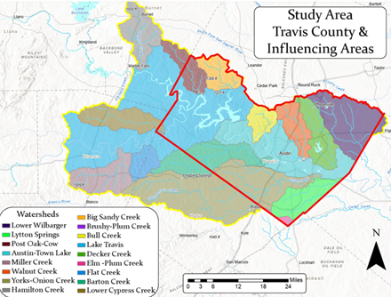
Travis County Watershed Vulnerability Index
City of Austin Fire Department – Wildfire Division
Inferno Analytics: Syrus Borders, Clayton Buehring, Melanie Butler, Corban Rosenauer, Kenny Satchell
Department of Geography, College of Liberal arts, Texas State University
Abstract
Methodology
Results
Inferno Analytics has produced a model to identify high-risk areas within Travis County that are likely to go through land and watershed degradation due to spreading wildfires. Austin Fire
Department - Wildfire Division will use this model to create procedures that will be implemented in the event of a fire to best preserve the land and surrounding watersheds
The cost distance analysis represents areas that are more difficult to get to from a fire station because of the terrian. This means in the event of a fire; high-risk areas are likely to suffer more damage, because it will take more time for emergency vehicles to respond. The vulnerability analysis shows areas near west lake hills, bull creek, lower part of Barton Creek, and the Balcones Wildlife preserve are high-risk for watershed degradation in the event of a fire. These are areas Austin Fire Department wanted inferno Analytics to identify, so planning could be done to alleviate the potential damage high-risks areas could face.
Introduction
Travis county is the 5th largest county in Texas. Due to its large and evergrowing population, Austin Fire Department – Wildfire Division is working on assessing Austin's land to identify potential areas with high-risk factors for wildfire ignition and spread. Inferno analytics will be aiding them in this project by creating a model to look at how watersheds are affected by wildfires and what kind of degradation can occur. This model will include a vulnerability index based on the land cover, slope, aspect, and soil type. This model will aid the Austin fire Department – Wildfire Division in implementing sustainable procedures for high-risk areas. The scope of this project is Travis County with surrounding areas, as shown in (figure 1) below.
Figure 2. Map is displaying all the watersheds in Travis county and surrounding areas
Figure 3. Map of soil types for Travis county and areas of interest
(Figure 2) represents all the watersheds within Travis County and surrounding areas. It is important to include surrounding areas in this project because nature does not have a boundary line. Watersheds connect through this area and whatever happens to one can have effects on surrounding watersheds. This map is important because it is going to be used in the vulnerability analysis.
(Figure 3) displays a map representing the soil types for Travis County and surrounding areas. This data was downloaded from USDA and clipped to the extent of the study area. The data was then put into an excel sheet and given attributes like name, grain size, water table depth, etc. The table was imported into ArcGIS Pro and changed to a raster layer to be used for the vulnerability analysis.
Conclusion
This project will allow the Austin Fire Department – Wildfire Division insight on watershed vulnerability and will help in the development of best practices for post-wildfire event recovery and for prioritizing wildfire mitigation activities.
Figure 4. Map of the cost distance analysis
Figure 5. Shows the vulnerability analysis depicted on a map created in ArcGIS Pro
Acknowledgements
Inferno Analytics would like to thank the Austin Fire Department – Wildfire Division for the opportunity and success of this project. We would also like to thank Dr. Yuan for her knowledge and support throughout this semester.
(Figure 4) is a map depicting the cost distance analysis to show how hard it is for a fire to theoretically cross certain terrain. To produce this map, the road network and land cover were reclassified to create the cost distance. Fire station data was used as points of origin.
(Figure 5) represents the Vulnerability Analysis. To create the vulnerability index, the risk value of a given cell needed to be determined first. The raster calculator function was used to create the risk value. Biomass, slope, and soil grain size was used in the calculation. A zonal statistics tool was used to calculate the sum of the cells within each watershed. The data was then converted to a polygon. Finally, a square toom transformation was used to normalize the data.
Figure 1. Map of study area with study area in red and influencing areas in yellow

