Slide 1
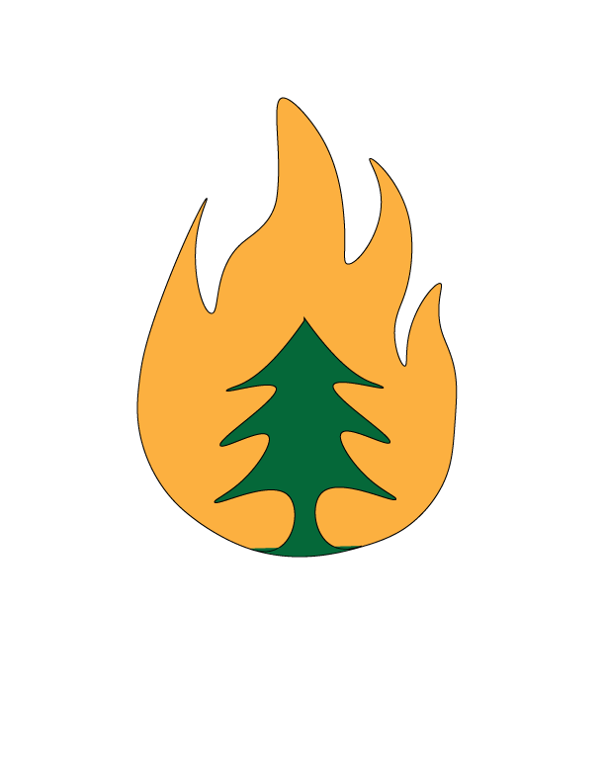
Inferno Analytics City of Austin Fire Dept Watershed Vulnerability Indexing
Syrus Borders, Clayton Buehring, Melanie Butler, Corban Rosenauer, Kenny Satchell

Slide 2
Table of Contents
Introduction
Data
Methodology
Results
Conclusions
References

Slide 3
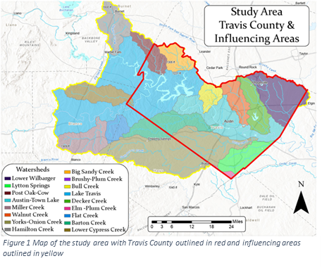
Introduction
Summary
Inferno Analytics created a watershed vulnerability index model and cost distance analysis for the City of Austin Fire Department.
Purpose
City of Austin Fire Department Wildfire Division was interested in knowing which watersheds would be the most vulnerable to pollution.
Scope
Travis county and surrounding areas of influence.
Problem Statement
Having the 5th largest population Travis wants to ensure its residents are safe and protecting the watersheds.

Slide 4
Data
Entity | attribute | Spatial object | Status | Source
County Soil data | Soil type & depth | polygon | available | https://websoilsurvey.sc.egov.usda.gov/App/HomePage.htm
Austin Fire Department Wildfire Div. | Wildfire and Mitigation |  | Not | http://www.austintexas.gov/department/wildfire-division
Austin Texas Government | Austin Watershed |  | available | http://www.austintexas.gov/department/watershed-protection-master-plan
Travis watershed | Travis Watershed | polygon | available | https://data.tnris.org/
Slope data/Travis | Percent gradient | polygon | available | https://data.tnris.org/
Travis county data | Biomass | polygon | available | ArcGIS online add data
USGS | Land Cover | Raster | available | https://data.tnris.org/

Slide 5
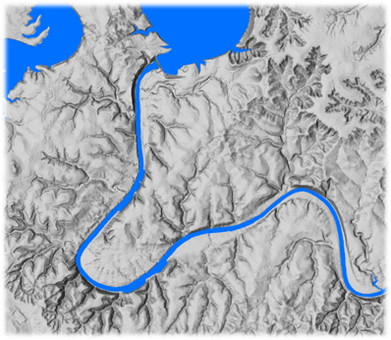
Methodology
Pre-processing Data
Digital Elevation Model

Slide 6
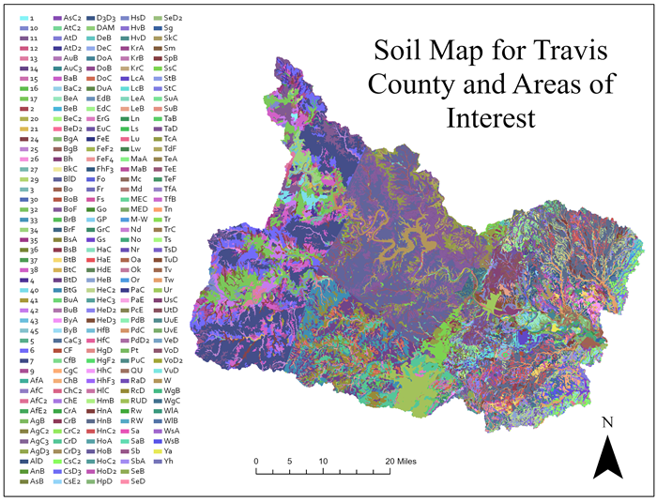
Methodology
Pre-processing Data
Soil Data

Slide 7
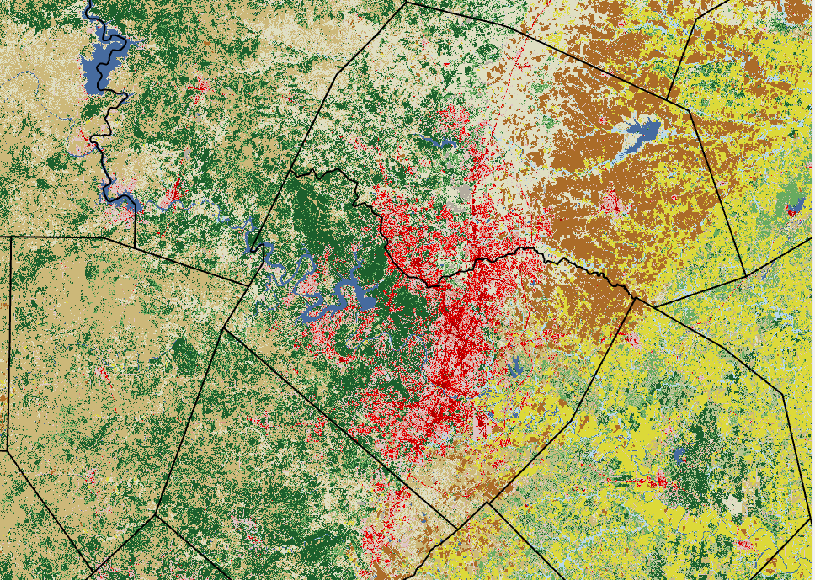
Methodology
Pre-processing Data
Land Cover

Slide 8
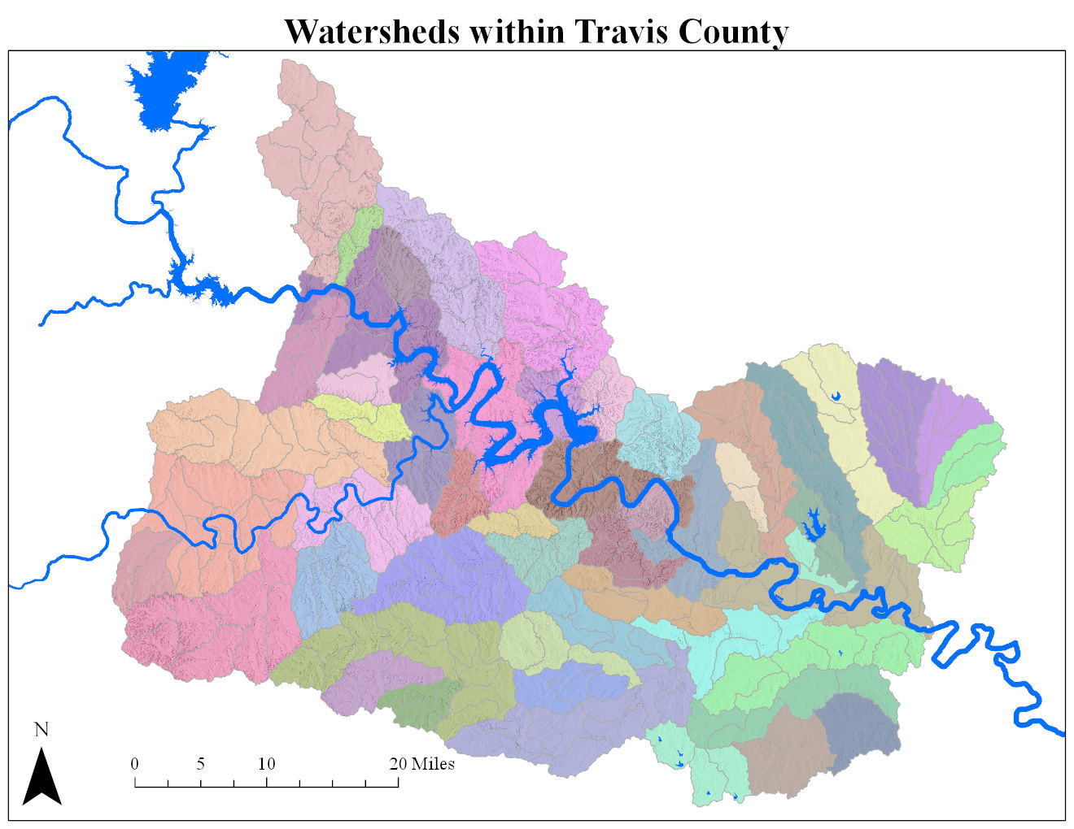
Methodology
Pre-processing Data
Watersheds

Slide 9
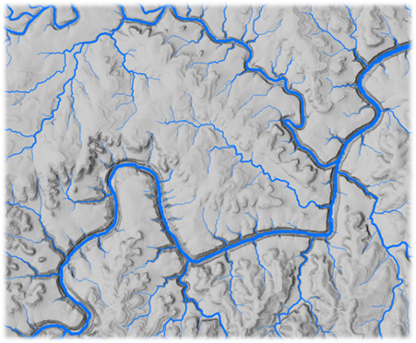
Methodology
Pre-processing Data
Rivers

Slide 10
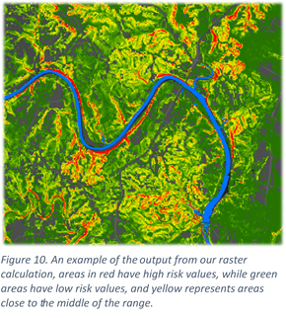
Methodology
Vulnerability Analysis

Slide 11
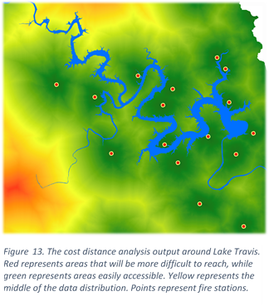
Methodology
Cost Distance Analysis

Slide 12
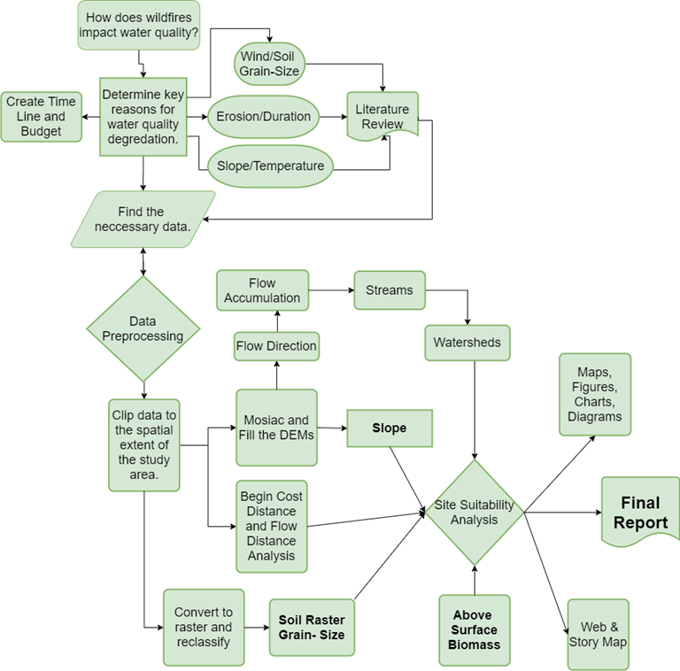
Methodology
Flowchart

Slide 13
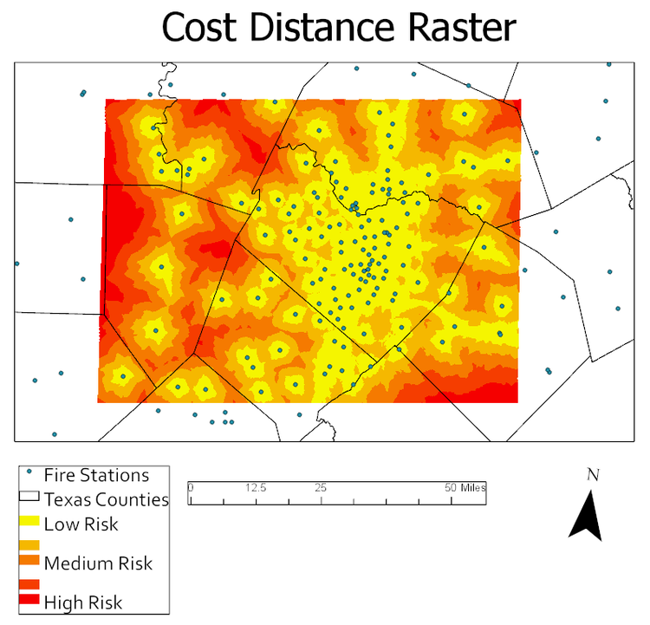
Results
Cost distant analysis shows which areas are more difficult to get to from the fire stations.

Slide 14
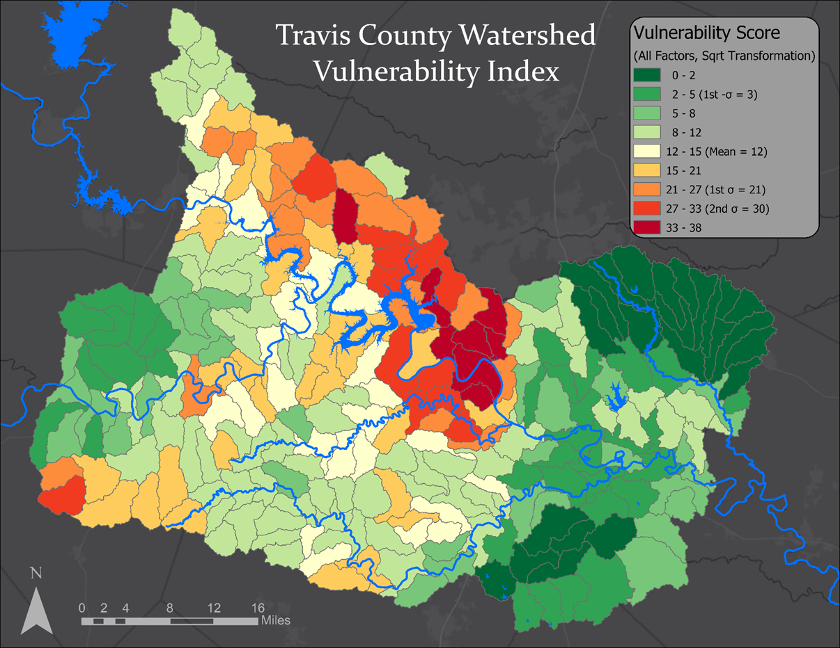
Results
Vulnerability analysis shows areas near West Lake Hills, Bull Creek, lower part of Barton Creek, and the Balcones Wildlife preserves are at the highest risk.

Slide 15
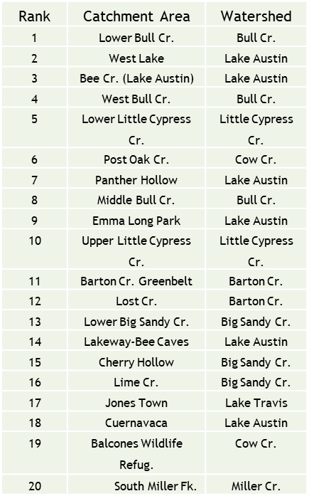
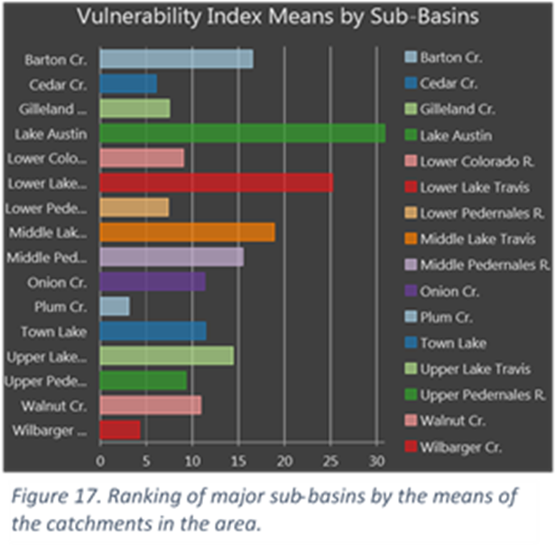
Conclusions
We were able to determine which areas were the most vulnerable to degradation of the water supplies. Based on slope, biomass, and soil factors.

Slide 16
Questions/Comments

