Slide 1
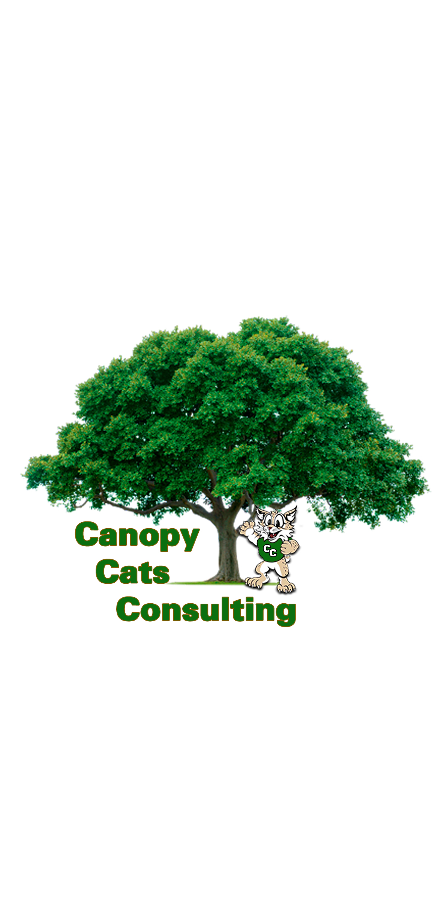
UTC – Austin Final Report
Zane White, Morgan Linsey, Kevin Crock, Rodrigo Ramirez, Abigail Chace

Slide 2
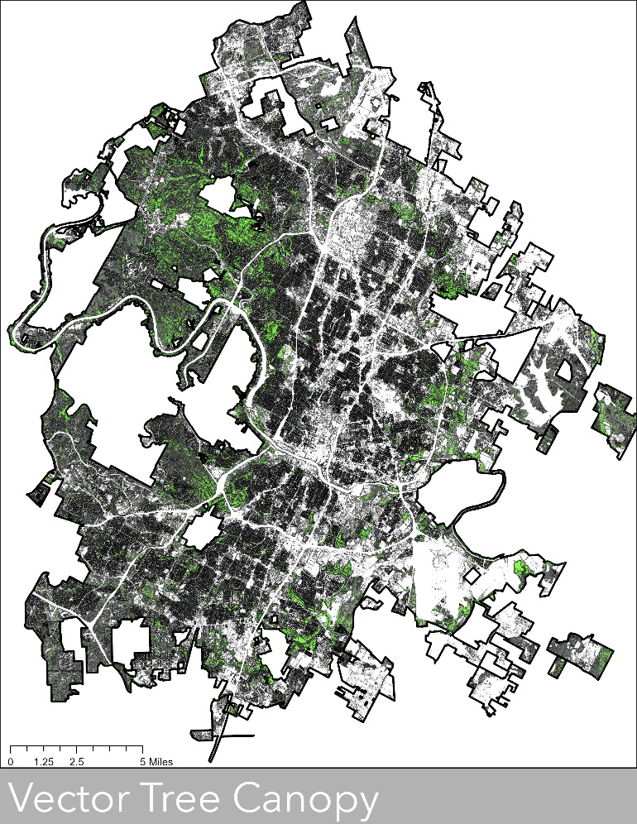
Agenda
Introduction
Data
Methodology
Weighting Matrix
Findings
Challenges
Limitations
Conclusion
Q&A Sessions

Slide 3
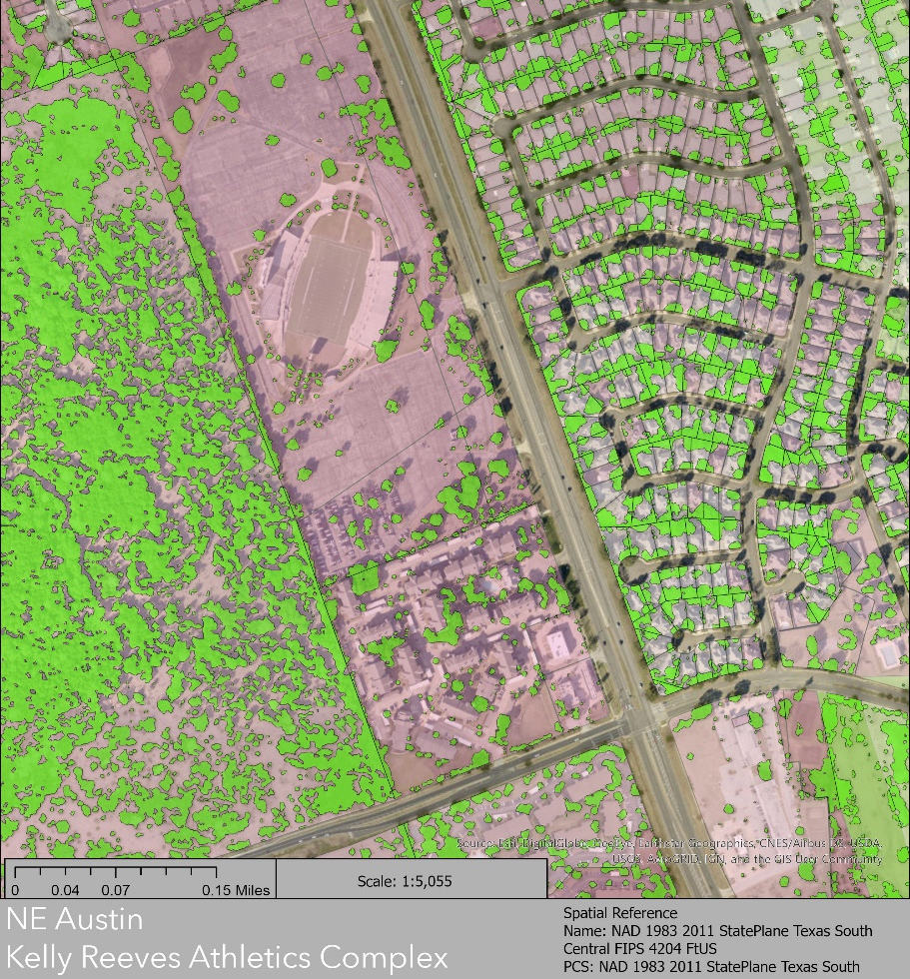
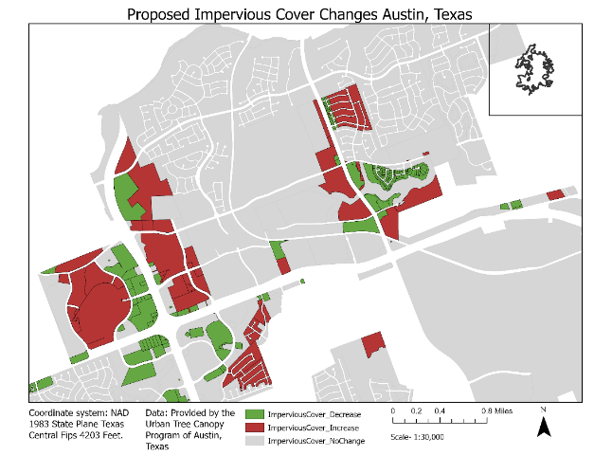
Introduction
Austin has the need for an urban tree canopy vulnerability index
The index allows city officials to visualize and locate areas for tree development and tree loss
Vulnerability index created from environmental constraints and impervious cover data

Slide 4
Data
Boundaries
Environmental Constraints
Planning Cadastral
Risk Indices
Tree Canopy Vulnerability index
Entity | Spatial Objects | Status | Source
Austin Tree Canopy Data | Cellular Raster | Available | City of Austin
Current Austin Zoning | Polygon | Available | City of Austin
Proposed Austin Zoning | Polygon | Available | City of Austin
Austin City Limits Boundary | Polygon | Available | City of Austin
Creek Buffers | Polygon | Available | City of Austin
Critical water quality zones | Polygon | Available | City of Austin
Edwards Aquifer Zone | Polygon | Available | City of Austin
Floodplains | Polygon | Available | City of Austin
Erosion hazard zone | Polygon | Available | City of Austin
Wetlands | Polygon | Available | City of Austin
Social Vulnerability Index | Polygon | Available | City of Austin
Community Wildfire Risk | Polygon | Available | City of Austin
Climate Vulnerability Index | Polygon | Available | City of Austin
Zoning Proposed | Polygon | Available | City of Austin
Transit priority network and LA corridors centers | Polygon | Available | City of Austin
Impervious Cover 2017 | Polygon | Available | City of Austin
Steep Slopes | Polygon | Available | City of Austin

Slide 5
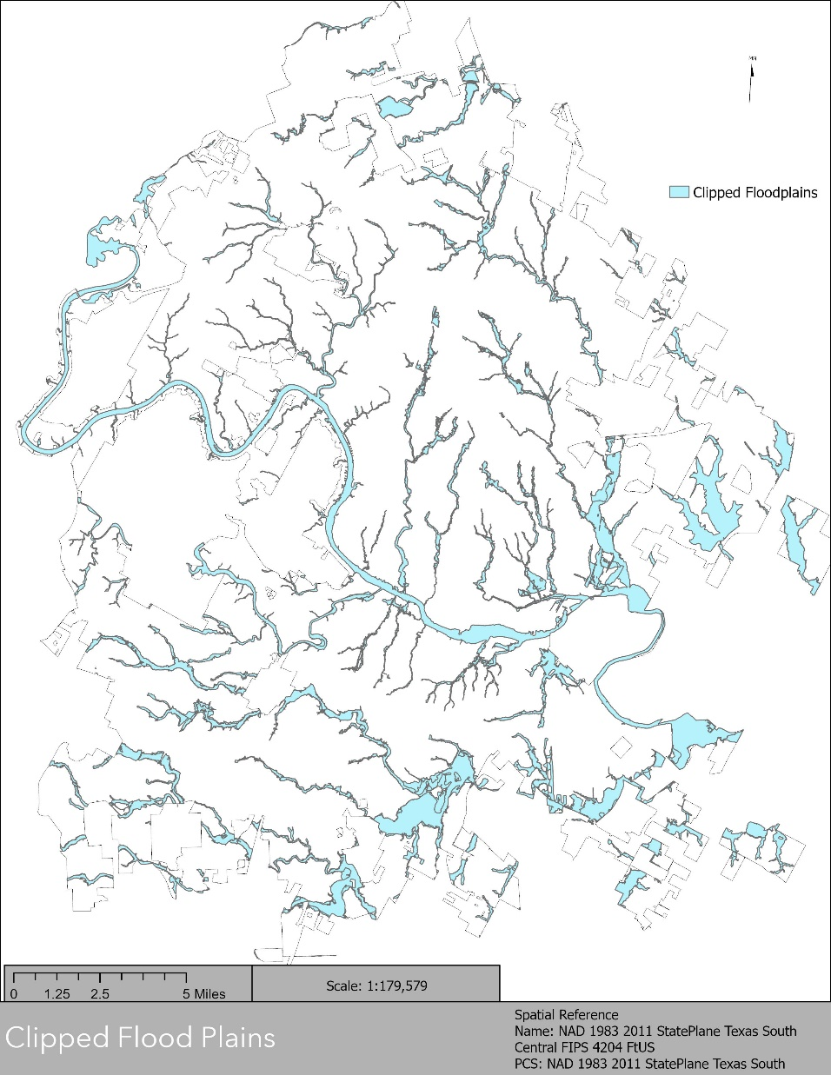
Methodology
Clipped all data
Necessary Raster-to-Vector Conversion
Intersect all data
Calculated Percentages of Intersection for all environmental constraints

Slide 6
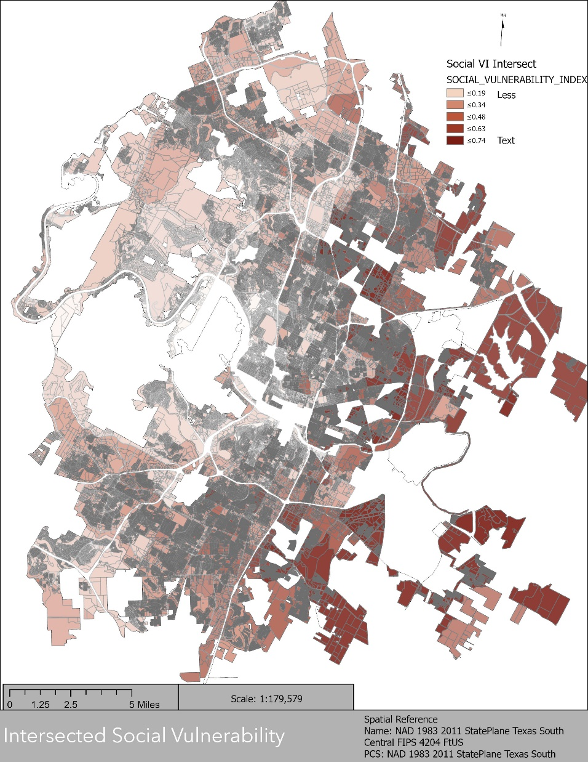
Methodology
More
Merged Duplicates
Data Repair
Spatial Join all files to Zoning File / Boolean Calculation
Multiple weights to percentages
Summarize weighted fields = VI
Source: ResourcesEsri.com

Slide 7
Weighting Matrix
Variables were weighted from a -5 to 5 scale based on literature review
Values were multiplied by percent coverage of each variable per parcel
Addition of sums used to create index
Variables | Weighted Value
Impervious Cover | -5
Transit Priority Network | -5
Rock Outcrops | -5
Critical Water Quality Zones | -4
Erosion Hazzard Zones | -4
Steep Slopes | -3
Seeps and Springs | 2
Edwards Aquifer Zones | 2
Creek Buffers | 4
Floodplains | 4
Wetlands | 5
Tree Canopy | 5

Slide 8
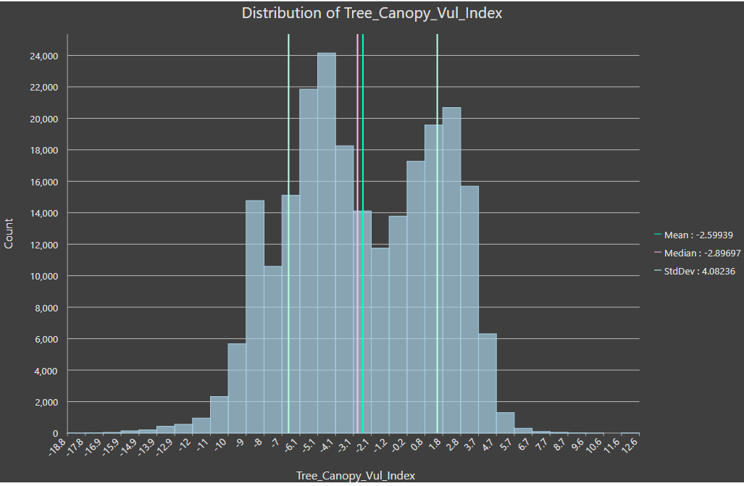
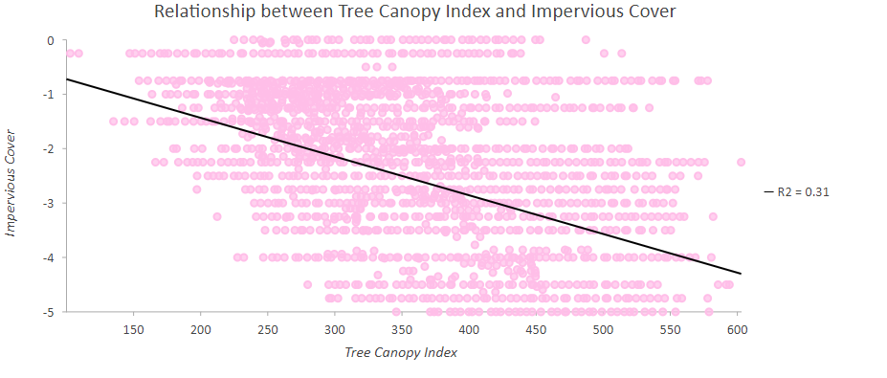
Findings
Regression Analysis
Relationship between Tree canopy Index and Impervious cover
R2 = .31
Standard Deviation
Bimodal
Very Little Skew

Slide 9
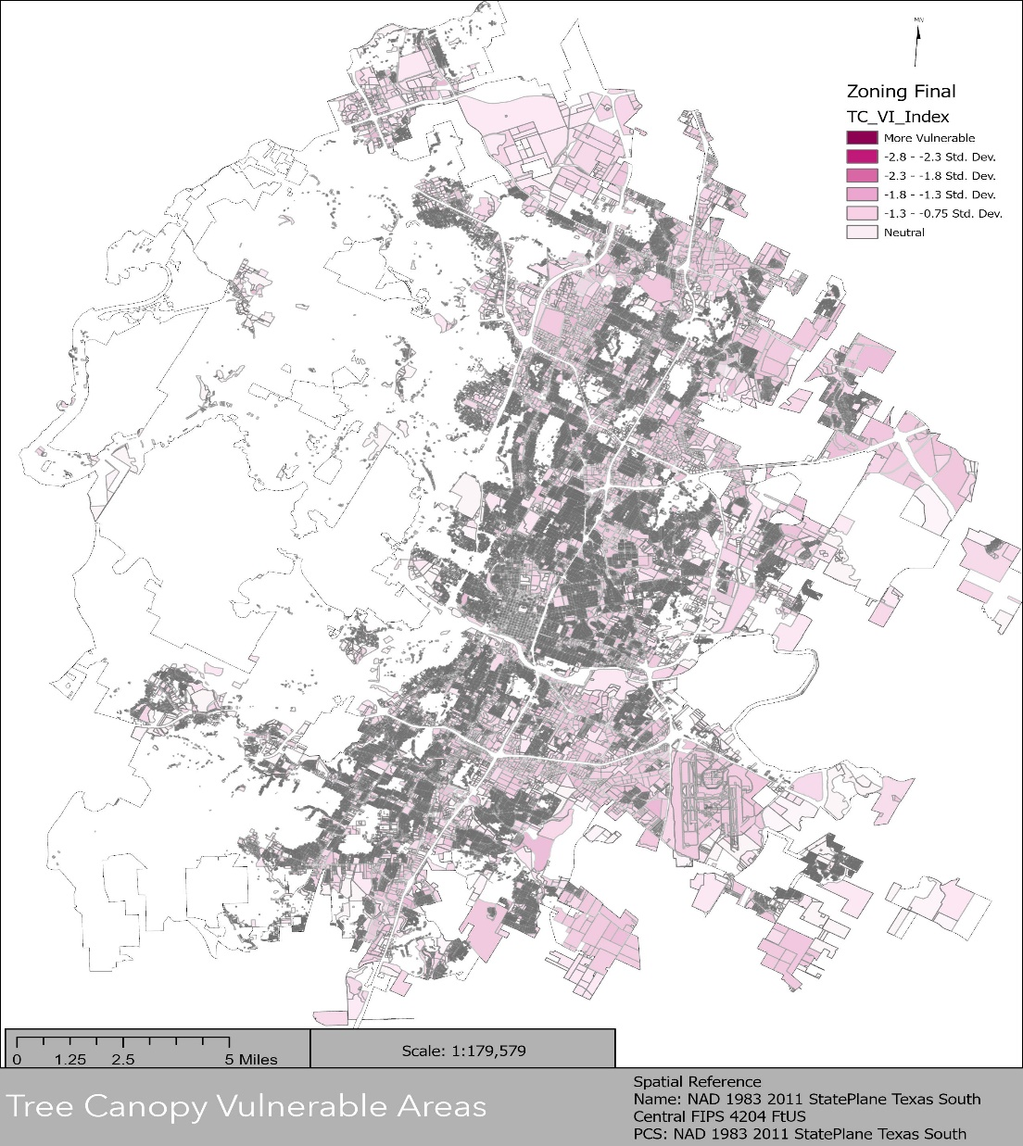
Implications
Zoning R2A and R2C
Residential with 2 units
Transit Priority Network
Centered around IH-35
Commercial Development

Slide 10
Challenges
Godzilla Dataset
Tree Canopy File Over 1 Million Rows & Over 2 Million Polygons
Processing Power
Switching To Personal Computers
Crashes, Errors, Incorrect Outputs
Calculations
Data Management & Sharing
Layer Files
Joined Fields
Passing Of Large Dataset Files
https://ak0.picdn.net/shutterstock/videos/7675090/thumb/5.jpg

Slide 11
Limitations
Data Inconsistency
Tree Canopy File 2014
Soil Data
Remote Sensing Data
Rich Soils Vs. Poor Soil
Additional Data
Air Pollutants
Land Cover Types
Rainfall
https://kofirm.com/wp-content/uploads/2019/06/iStock-1094790212-Cropped-e1560895210306.jpg

Slide 12
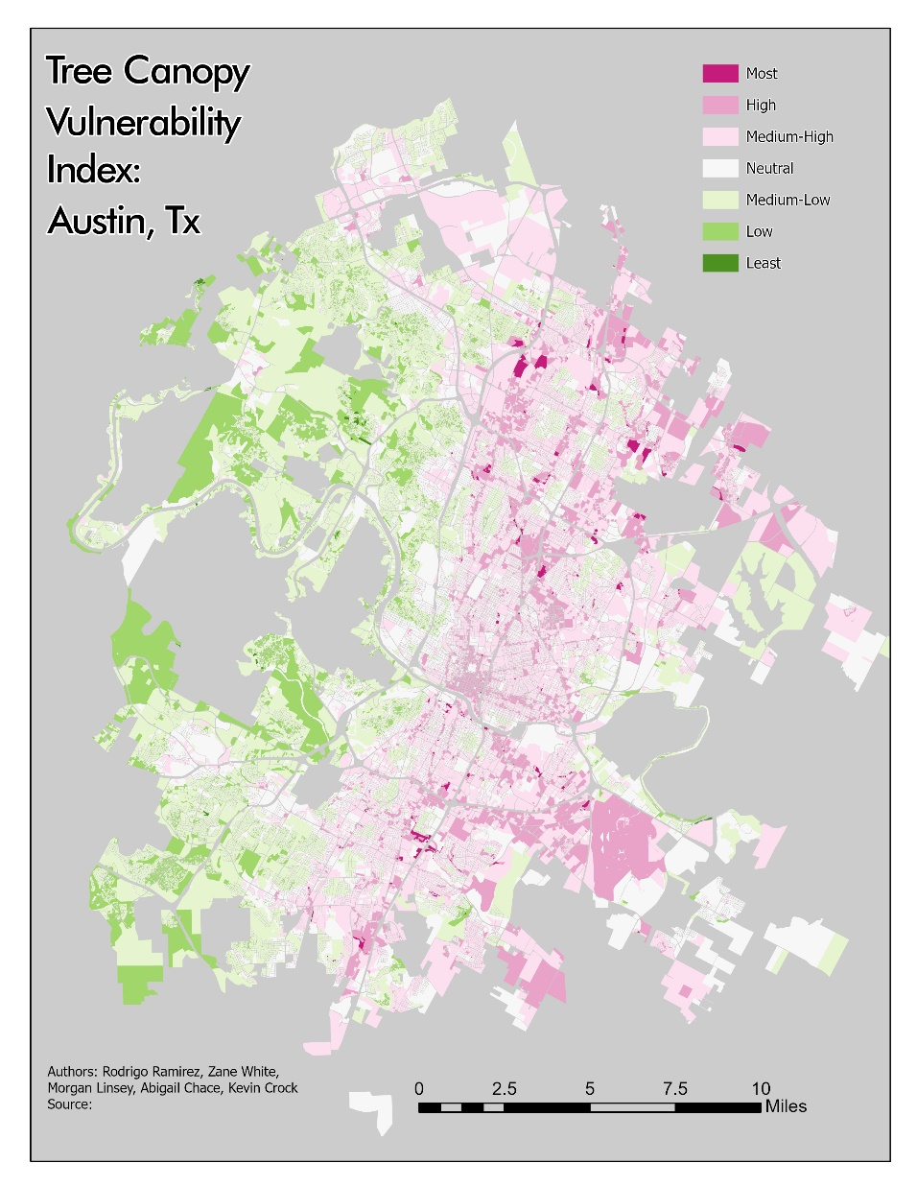
Conclusion
Developed the Tree Canopy VI
Located where tree canopy is vulnerable to decline regarding current and proposed zoning policies
Made a Tree Canopy VI Webmap for the Public

Slide 13
Q&A Session
?

Slide 14
References
Armson, D., et al. “The Effect of Street Trees and Amenity Grass on Urban Surface Water Runoff in Manchester, UK.” Urban Forestry & Urban Greening, Urban & Fischer, 17 May 2013, www.sciencedirect.com/science/article/pii/S1618866713000460.
Greene, Christopher S., and Peter J. Kedron. “Beyond Fractional Coverage: A Multilevel Approach to Analyzing the Impact of Urban Tree Canopy Structure on Surface Urban Heat Islands.” Applied Geography, Pergamon, 19 Apr. 2018, www.sciencedirect.com/science/article/pii/S0143622817301935.
Hill, Elizabeth, et al. “Evaluating the Impact of Government Land Use Policies on Tree Canopy Coverage.” Land Use Policy, Pergamon, 2 July 2009, www.sciencedirect.com/science/article/pii/S0264837709000647.
Halter, Alan Dale. “Determining Existing, Possible, and Preferable Urban Tree Canopy for Austin, Texas.” TexasScholarWorks, University of Texas at Austin, 1 May 2013, hdl.handle.net/2152/22682.
Weissmann, Jordan. “Austin, Texas, Is Blowing Away Every Other Big City in Population Growth.” Slate Magazine, Slate, 21 May 2015, slate.com/business/2015/05/population-growth-in-u-s-cities-austin-is-blowing-away-the-competition.html.
“Urban Population Growth.” World Health Organization, World Health Organization, 16 Mar. 2015, www.who.int/gho/urban_health/situation_trends/urban_population_growth_text/en/.

