Slide 1
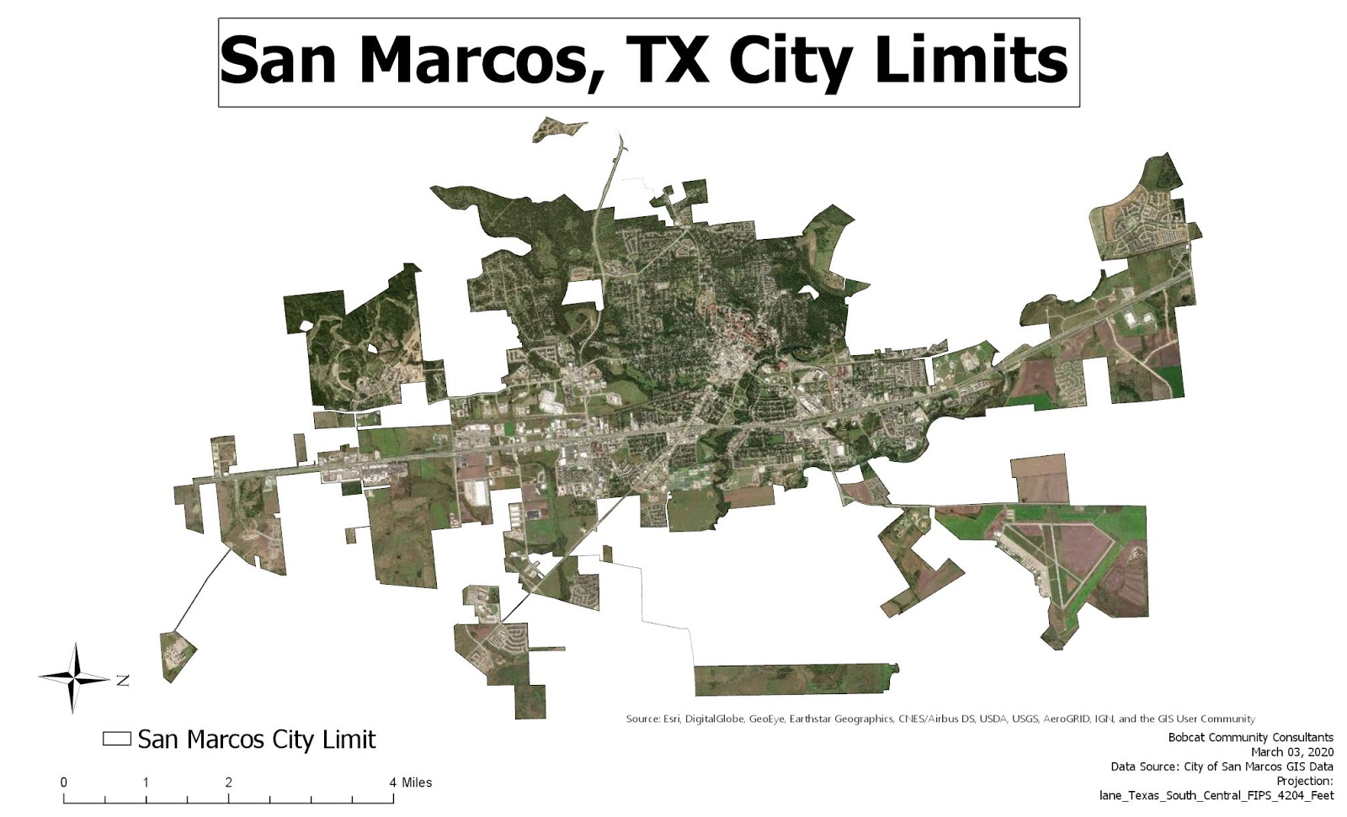
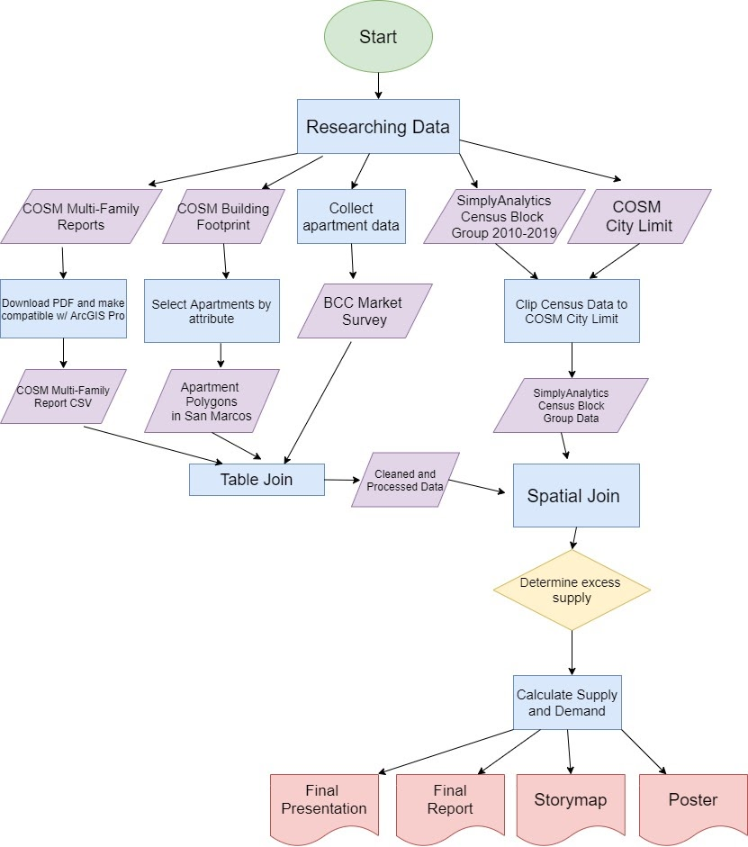
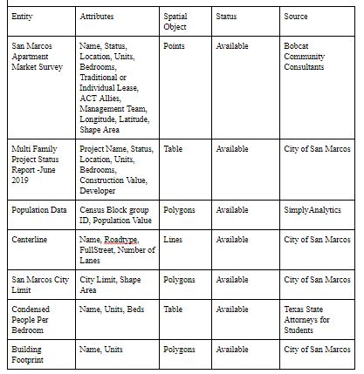
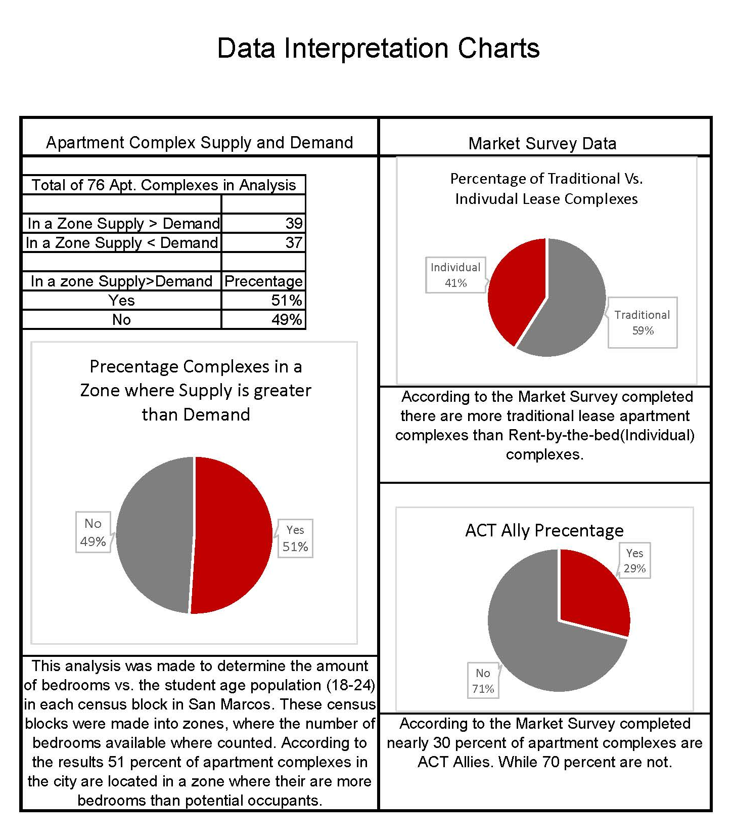
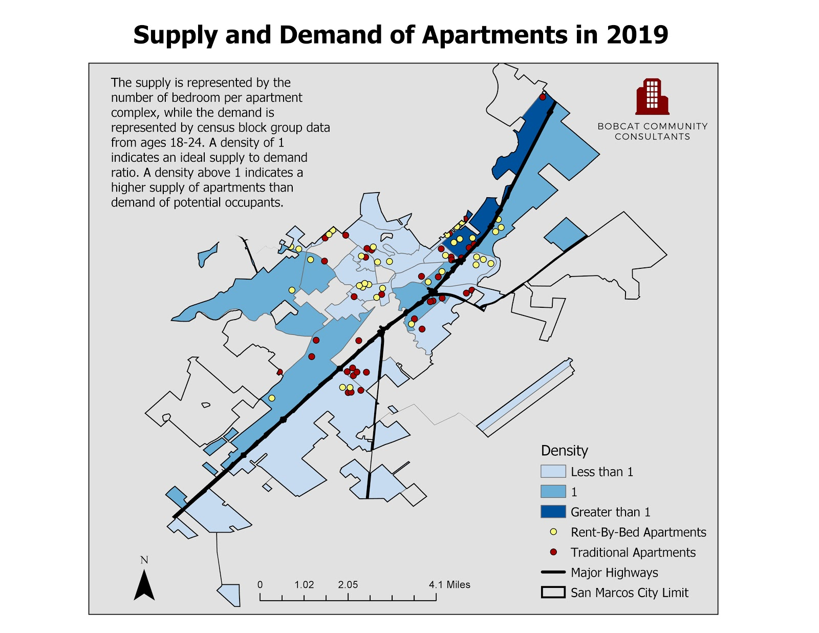
Authors:
Supply and Demand Analysis of Apartment Complexes in San Marcos
Maximilian Stuart, Analie Armendariz, Jordan Monaghan, Kyle Shorter, and Robbie Starke
Abstract
Background
Methodology
This project analyzed the need for the City of San Marcos to continue building large apartment complexes aimed at college age students (18-24) attending Texas State University. Over the last few years, San Marcos has experienced a jump in the number of large rent-by-the bed apartment complexes changing the previous rental market and gentrifying neighborhoods. Although San Marcos historically had a higher percentage of renters than homeowners, residents and University staff alike are concerned about the character of their city, previously balanced as a retirement and working class community. For the needs of the City of San Marcos and it’s student population alike, the Bobcat Community Consultants (BBC) has conducted research on the density of Apartment complexes and a time-line of how the number of Apartments have increased since the year 2000, and a quick projection to the future with the complexes currently approved by the city and under construction. It is our hope that with this project, the city of San Marcos planning department and community leaders can make an informed decision about the development of further apartment complexes.
This project was initially proposed when local residents and faculty at Texas State University were concerned about the character of San Marcos, Texas. A series of apartment complexes in came to San Marcos in the last few years, causing rents to rise and gentrification to occur in some established neighborhoods.
Once the market survey table was formatted, it was imported into ArcGISPro and displayed as XY data to ensure that the points were compatible to be joined with census data. After our shapefiles were categorized by year, we used the corresponding year of census block group data to create a spatial join. Before running the tool, we had to make sure that the Merge Rule was set to “SUM” for the field num_beds. Instead of using point data for this analysis, we used polygons.
We joined the market
survey to building footprints
polygon shapefile based off
like-attributes, in this case
we used the field “Name”.
Once the join was complete,
we separated each year
using the select by attributes
tool. We categorized the
type of apartments by
Rent-By-Bed, Traditional,
or Under Construction.
Figure A –Scope Map
The City of San Marcos Planning Dept. passed on this research opportunity to the Bobcat Community Consultants (BCC) to determine what effect these apartment complexes having and the time-line of when these complexes were developed.
Data
Results
The market survey started off as an excel sheet with a compiled list of 104 apartment complex names and locations. Only a total of 76 out of the 104 apartments were used for analysis because only 76 had attributes for the status field. This point data has the GCS WGS 1984 geographic coordinate system. The census block group data was downloaded from Simply Analytics for the state of Texas and only from ages 18-24. This data was obtained so we could use the population data per census block group to act as the “demand” for our analysis.
The objective of this project was to give an accurate representation of the development of apartment complexes in San Marcos ,Texas and compare the potential number of occupants to the number of bedrooms available. After weeks of collecting data and working with the Attorney for Students office at Texas State, BCC has completed an analysis on the apartment complexes in San Marcos, and made a short timeline of the apartment available from 2000- 2019 (Present). BCC also made a projection of Apartment complexes to be built between now through 2021, based off the complexes currently under construction. For the main part of our Analysis made a comparison of Rent-by-bed and Traditional lease complexes vs. the student age population in the Census blocks from 2010-2019. The Pie charts below in figure D show the final outcome, that over 50 percent of apartment complexes are in a zone where there are more bedrooms than potential occupants.
Figure B- Flow Chart
References & Acknowledgments
ACT-Ally. “ACT Members and Affiliates.” Department of Housing and Residential Life : Texas State University, Texas State University, 5 Sept. 2019, www.reslife.txstate.edu/OffCampusLiving/ACT/ACT-Ally.html.
Clapp, John & Rodríguez, Mauricio. (1998). Using a GIS for Real Estate Market Analysis: The Problem of Spatially Aggregated Data. Journal of Real Estate Research. 16. 35-56.
Couclelis, H. Requirements for planning-relevant GIS: A spatial perspective. Papers in Regional Science 70, 9–19 (1991). https://doi.org/10.1007/BF01463440
“Geography 4422/5408 Projects.” GeoSites - Dept. of Geography Course and Project Serv“Multifamily Reports.”
“Hot Spot Detection.” Search the Website, 2019, www.mailman.columbia.edu/research/populationhealth-methods/hot-spot-detection.
Kashef, M. Residential developments in small-town America: assessment and regulations. City Territ Archit 4, 14 (2017). https://doi.org/10.1186/s40410-017-0070-4
Multifamily Reports | City of San Marcos, TX, 2019, www.sanmarcostx.gov/1311/MultifamilyReports.er, sites.geo.txstate.edu/.
“Texas State Master Plan.” Texas State Master Plan, gato-docs.its.txstate.edu/jcr:4d245c84-3419-4593-b840-80e6d7d9df60/UNIV_Master%20Plan_Final_8_23_web.pdf.
“Vision San Marcos Comprehensive Plan.” User, Made with FlippingBook Online Newsletter, 2019, user-3vpeqil.cld.bz/Vision-San-Marcos-Comprehensive-Plan/44/.
Yeh, A G-O. Urban Planning & GIS. www.geos.ed.ac.uk/~gisteac/gis_book_abridged/files/ch62.pdf
Review, World Population. “San Marcos, Texas Population 2020.” San Marcos, Texas Population 2020 (Demographics, Maps, Graphs), 2020, worldpopulationreview.com/us-cities/san-marcos-tx-population/.
Figure C- Master Data List
Figure C- Pie Charts
Figure D- Current Supply and Demand (2019)
Conclusion and Future Work
In conclusion, Bobcat Community Consultants (BCC) has compiled research on these Apartment complexes located in San Marcos in order for community leaders to make an informed decision about developing further complexes. Using GIS analytical tools such as the calculate field tool, the division tool, and spatial join we are able to display the expansion of apartment growth in San Marcos, Texas. With this collected data BCC is able to provide temporal maps with projections showing that more apartment complexes are expected to be built and completed.

