Slide 1
Supply and Demand Analysis of Apartment Complexes in San Marcos
Final Report
By: Max Stuart, Analie Armendariz, Jordan Monaghan, Kyle Shorter, and Robbie Starke

Slide 2
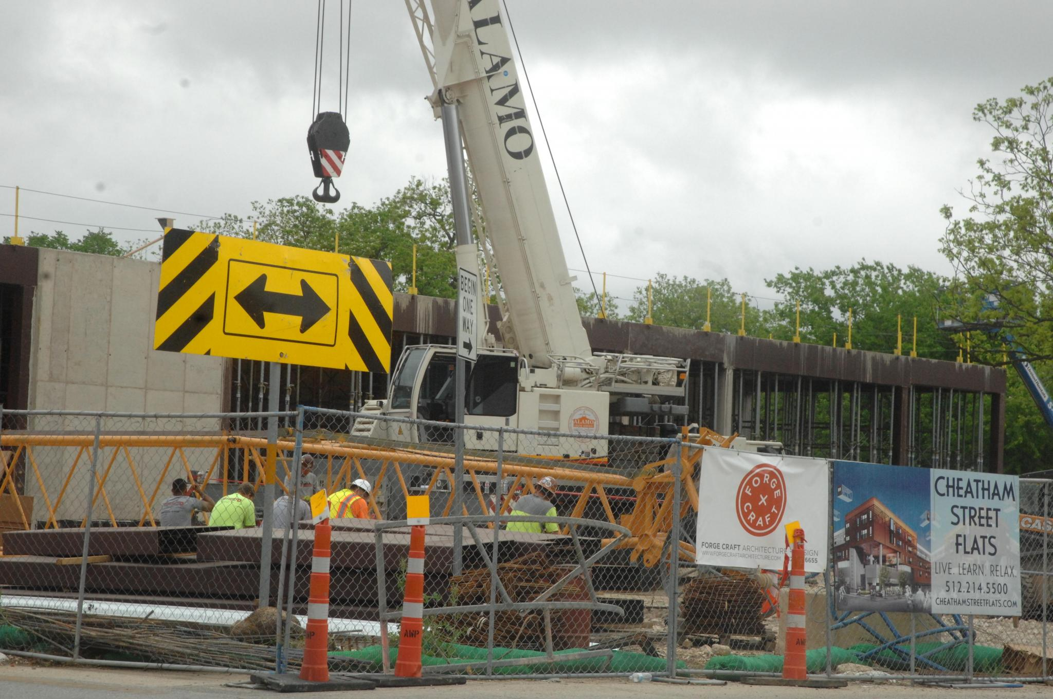
Introduction
Background
This project was inspired by Local residents and Faculty staff at Texas State
The city of San Marcos Planning Department assigned a group of students to research this issue.
Problem statement
Using GIS tools, make a visualization of Apartment complexes in San Marcos.
Determine if the hypothesis is correct:
There are more Bedrooms available than potential occupants. A.K.A. Students

Slide 3
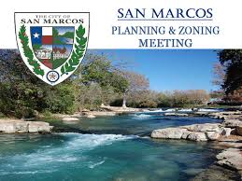
Clients
Point of interest
Talking Points
Shannon Fitzpatrick (Attorney for Students)
&
COSM Planning Department
Timeline of project
Data & Methodology
Results & Discussion
References
Conclusion

Slide 4
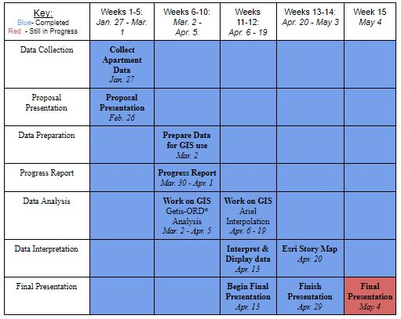
Time Table
15 week Timeline
Currently week 15 - Final Presentation
Final Presentation - May 4th (Today)
Work Scheduled

Slide 5
Data
Data Collection
Used simply Analytics census block group data from 2010-2019
Took marketing survey of Apartment complexes currently operating in San Marcos
Multi Family Project Status Report- City of San Marcos
Data Preparation
Identified Apartment complexes in COSM building shapefiles and finding Lat. and Long. with “Geocode by Awesome Table.”
The Centerline and San Marcos City Limit shapefiles were both downloaded from the City of San Marcos GIS Portal.
Data Analysis
Visual representation of apartment growth in San Marcos, TX
Supply and Demand of apartments
Link 1
https://www.sanmarcostx.gov/1311/Multifamily-Reports
Link 2
https://storymaps.arcgis.com/stories/48c6c78ae9434aa2a28ba44bee8201c3
Notes:
Reference Link
Overlay - data represented spatially over the map
Visualization and digitization of corresponding data
Space - real world vs GIS represented
Market Demand analysis
(what is the demand in development with current and future population trends)
Using census data - most research used census data for population
Spatial analysis - conducted using correlating data with scope of project and census data.

Slide 6
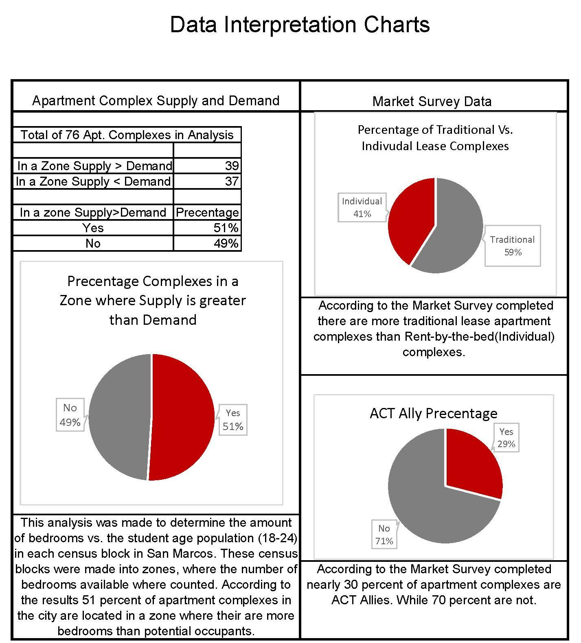
Data
Pie Charts
Percentage of complexes in a zone/census block with more supply than demand
In the year 2012, 24 out of the 63 (38.1%)
In the year 2013, 32 out of the 63 (50.8%)
In the year 2019, 39 out of the 76 (51.3%)
Market Survey Data
Traditional lease complexes vs. Rent-by-the-bed
Percentage of ACT Ally Complexes
Achieving Community Together
Figure A - Data Charts
Notes:
Reference Link
Overlay - data represented spatially over the map
Visualization and digitization of corresponding data
Space - real world vs GIS represented
Market Demand analysis
(what is the demand in development with current and future population trends)
Using census data - most research used census data for population
Spatial analysis - conducted using correlating data with scope of project and census data.

Slide 7
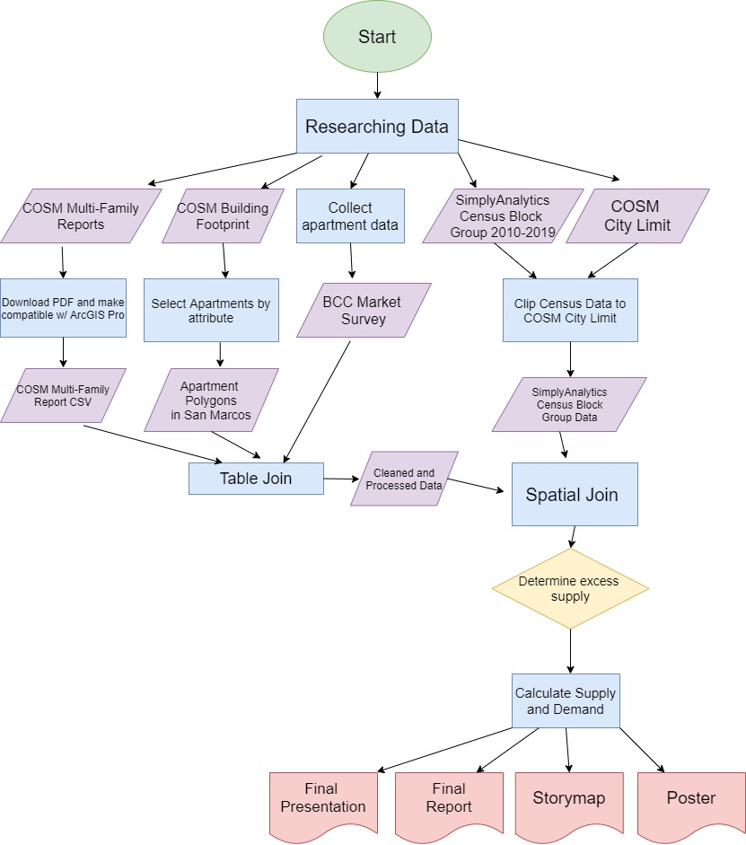
Methodology
Data Visualization
Esri Story Map
Interactive Map
Steps in Data Analysis
Table Join
Spatial Join
Supply and Demand
Figure B - Flow Chart
Notes:
Reference Link
Overlay - data represented spatially over the map
Visualization and digitization of corresponding data
Space - real world vs GIS represented
Market Demand analysis
(what is the demand in development with current and future population trends)
Using census data - most research used census data for population
Spatial analysis - conducted using correlating data with scope of project and census data.

Slide 8
Results
Objectives
To collect data on Apartment complexes serving the population attending Texas State (Ages 18-24)
Give an accurate picture of development of Apartment complexes in San Marcos since 2000.
Maps Completed
A short timeline of the apartment available from 2000, 2005, 2010, 2015, and 2019 (Present)
Analysis showing the apartment complex bedrooms vs. potential occupants (Age 18-24) from 2010-2019.
Projection to 2021 showing apartments under construction
Notes:
-In the story map we will include the Affordability map that will show some of the outlandish prices of these rent by the bed apartments
-We will also include a Hot Spot Analysis that will analyze the spatial patterns where we see these RBB apartments
-We will find the student population data in San Marcos and analyze the supposed growth of students
-Finally relate the correlation of student growth to the number of population
-Problems: Data only goes back to 2012, We had to collect primary data from 106 different complexes,

Slide 9
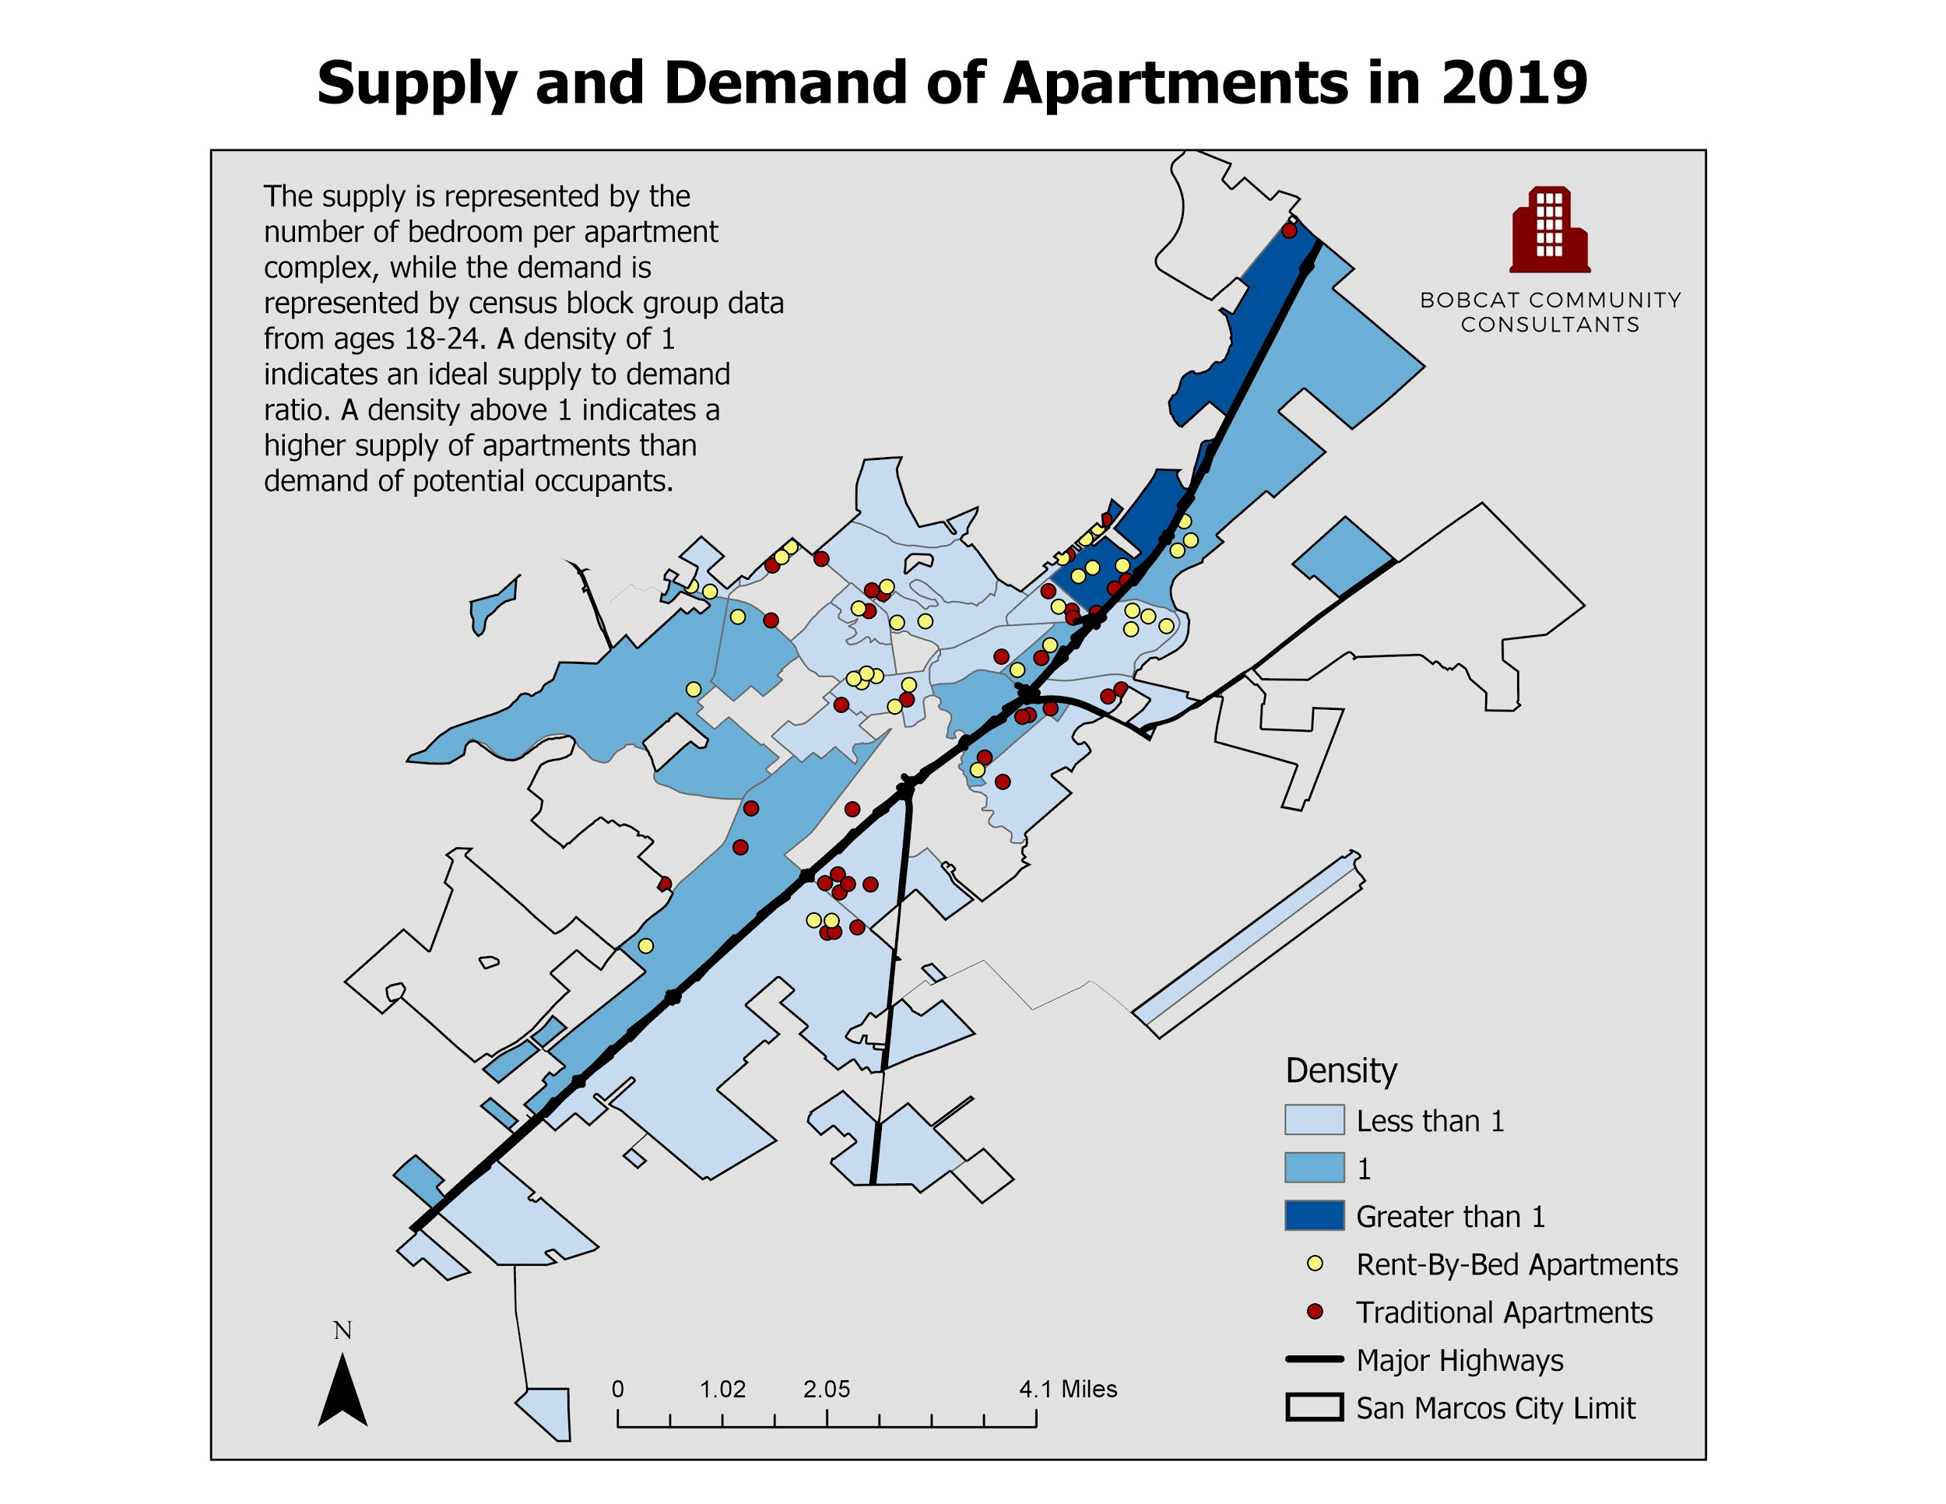

Slide 10
Discussion
Limitations
Census block data
Not a complete record of Apartment complex development
Access to proper hardware to complete Analysis since moving to remote classes due to COVID-19.
Improving the Results
During our research more questions were raised than answered
The next analysis should have a smaller area of study
If we had more time include
More refined data set
A better interactive map

Slide 11
References & Acknowledgement
References
ACT-Ally. “ACT Members and Affiliates.”
“Using a GIS for Real Estate Market Analysis”
“Requirements for planning-relevant GIS”
“Geography 4422/5408 Projects”
“Hot Spot Detection”
“Residential developments in small-town America”
“Texas State Master Plan”
“Vision San Marcos Comprehensive Plan”
“Yeh, A G-O. Urban Planning & GIS”
Special Thanks to Dr. Dede-Bamfo
For
Helping with Data Analysis
Data Interpretation
Data Visualization
Notes:
1. ACT-Ally. “ACT Members and Affiliates.” Department of Housing and Residential Life : Texas State University, Texas State University, 5 Sept. 2019, www.reslife.txstate.edu/OffCampusLiving/ACT/ACT-Ally.html.
2. Clapp, John & Rodríguez, Mauricio. (1998). Using a GIS for Real Estate Market Analysis: The Problem of Spatially Aggregated Data. Journal of Real Estate Research. 16. 35-56.
3. Couclelis, H. Requirements for planning-relevant GIS: A spatial perspective. Papers in Regional Science 70, 9–19 (1991). https://doi.org/10.1007/BF01463440
4. “Geography 4422/5408 Projects.” GeoSites - Dept. of Geography Course and Project Serv“Multifamily Reports.”
5. “Hot Spot Detection.” Search the Website, 2019, www.mailman.columbia.edu/research/populationhealth-methods/hot-spot-detection.
6. Kashef, M. Residential developments in small-town America: assessment and regulations. City Territ Archit 4, 14 (2017). https://doi.org/10.1186/s40410-017-0070-4
7. Multifamily Reports | City of San Marcos, TX, 2019, www.sanmarcostx.gov/1311/Multifamily Reports.er, sites.geo.txstate.edu/.
8. “Texas State Master Plan.” Texas State Master Plan, gato-docs.its.txstate.edu/jcr:4d245c84-3419-4593-b840-80e6d7d9df60/UNIV_Master%20Plan_Final_8_23_web.pdf.
9. “Vision San Marcos Comprehensive Plan.” User, Made with FlippingBook Online Newsletter, 2019, user-3vpeqil.cld.bz/Vision-San-Marcos-Comprehensive-Plan/44/.
10. Yeh, A G-O. Urban Planning & GIS. www.geos.ed.ac.uk/~gisteac/gis_book_abridged/files/ch62.pdf.

Slide 12
Conclusion
What we learned
Make and follow a timeline
Identify data collection tools
Convey the use of GIS tools and analysis to professionals
How to use academic references in a hands-on project
Use remote access tools to coordinate and complete this project.
Future for this project
It is BCC’s hope that future researchers take this project to
Answer further questions about about bedroom counts.
How to use this data to improve the quality of life of students attending Texas State.

Slide 13
Questions?
Checkout our interactive map with this link:
https://txst.maps.arcgis.com/apps/opsdashboard/index.html#/b289c5f3dd7440c4b77221c46d3d092e

