Slide 1
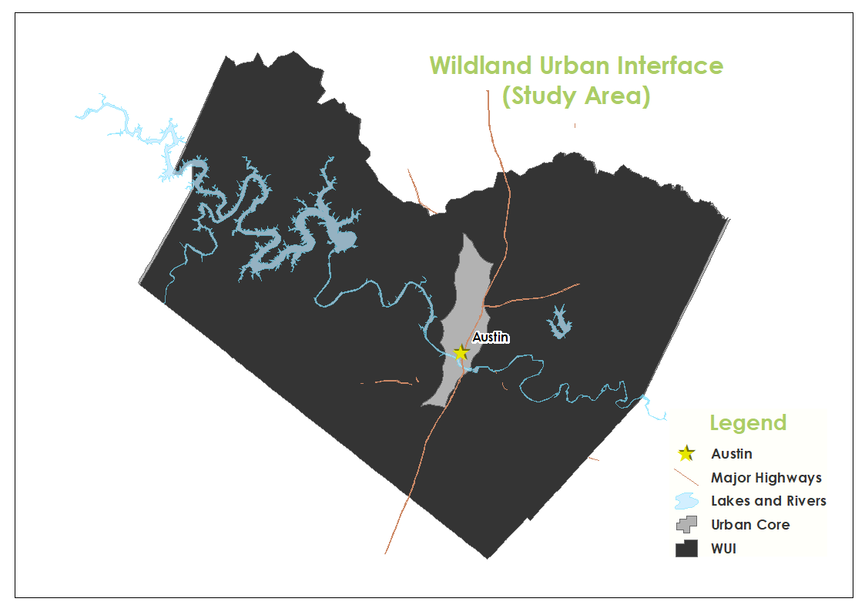
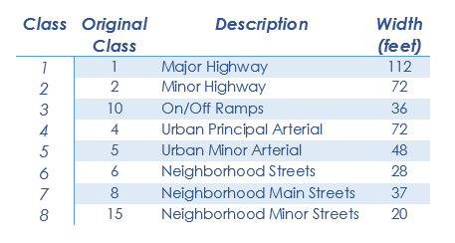
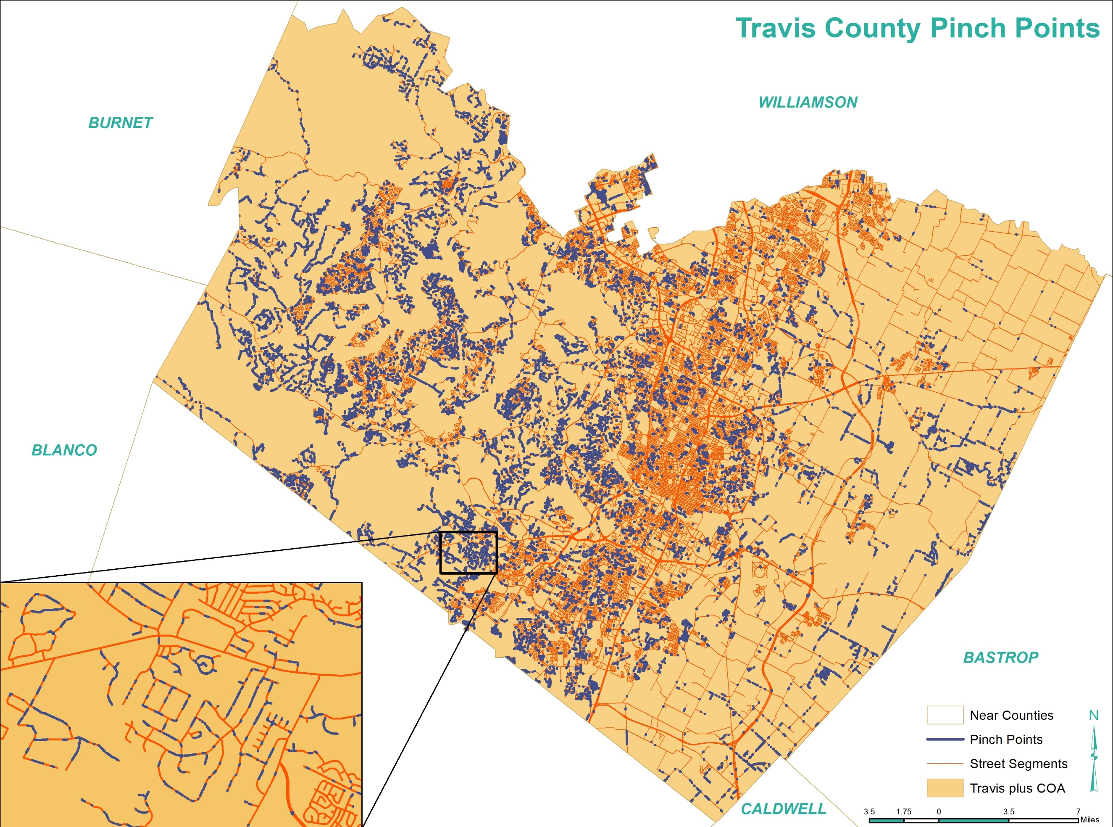
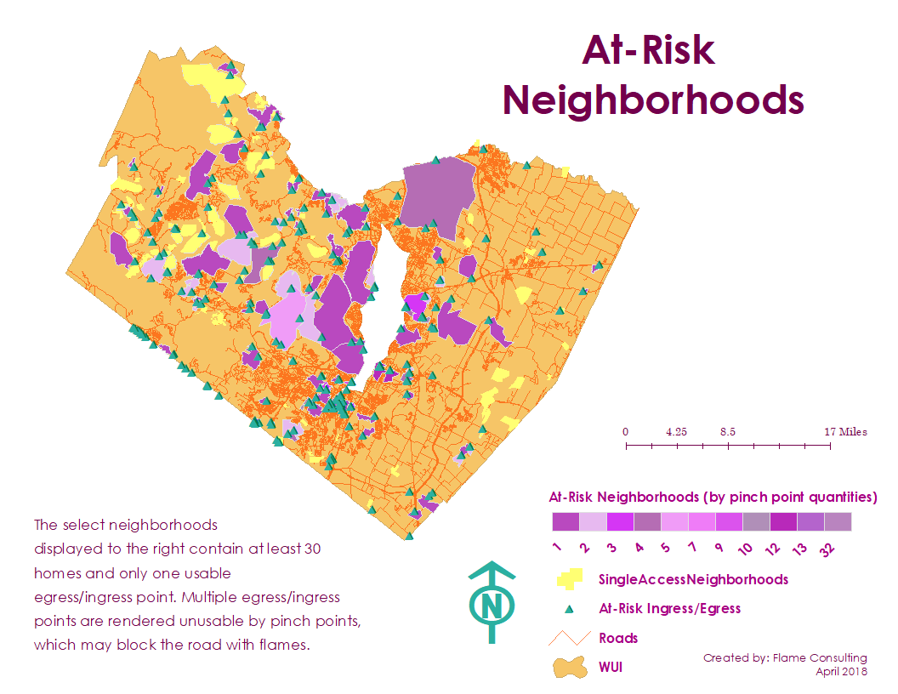
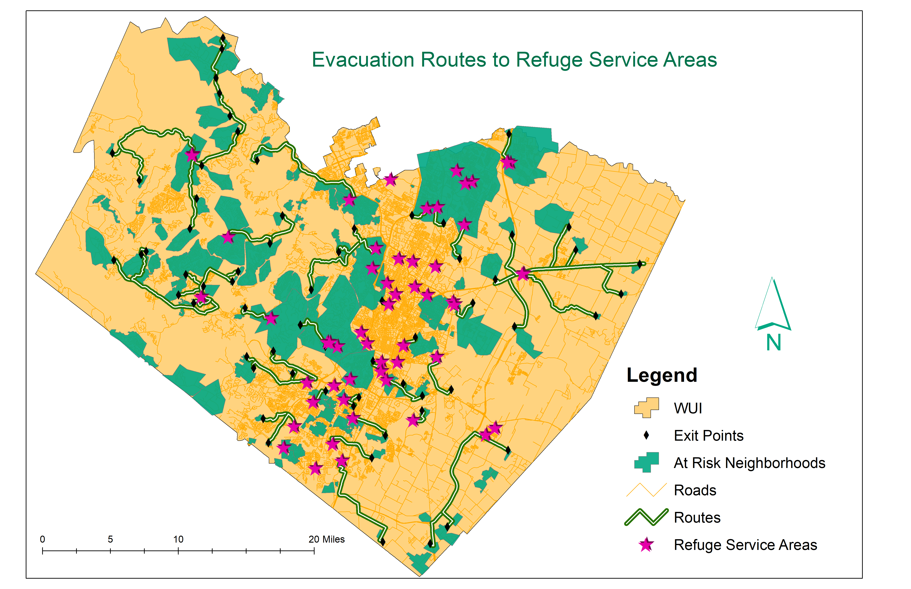
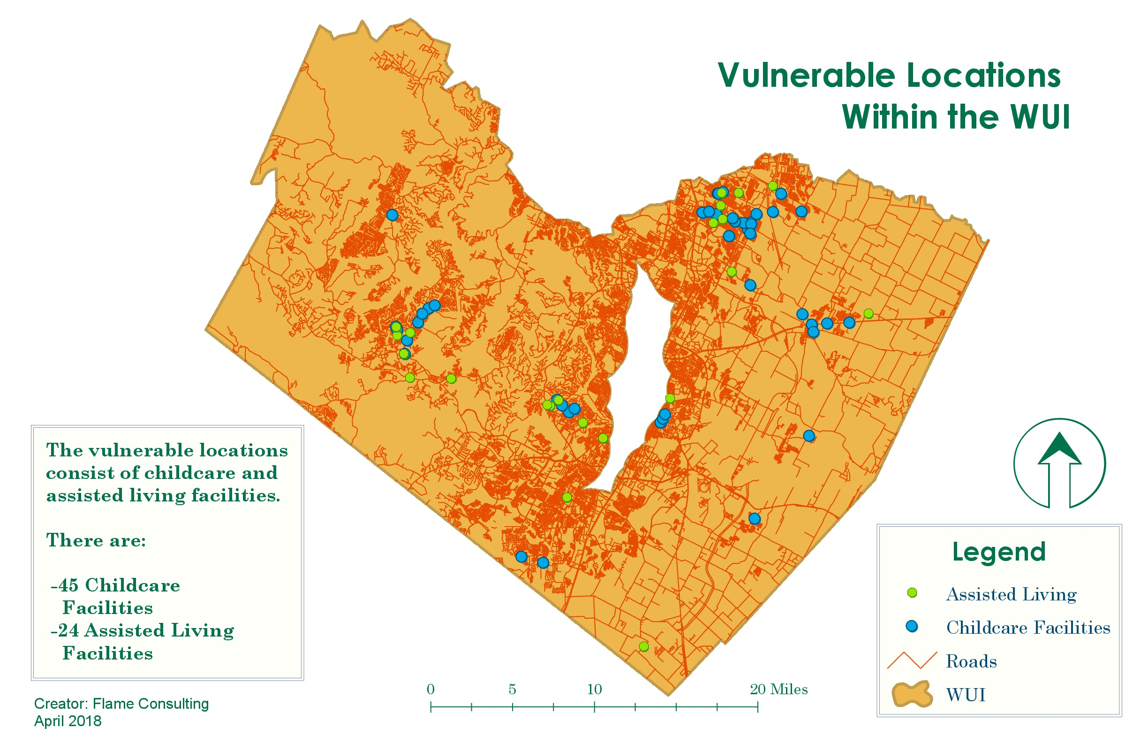
Wildfire Evacuation Analysis in the Travis County Wildland Urban Interface
Flame Consulting: Jade Gonzaba, Catherine Hodde-Pierce, Bradley Johnson, Corinne Kimper, Dereion Toussaint
Texas State University Department of Geography
Background
Study Area
Discussion
Due to the dramatic increase of the population within Travis County, wildfire mitigation has been a key focus for the city of Austin. Flame Consulting teamed up with the Austin Fire Department - Wildfire Division and Steven Casebeer, Geographic Information Systems (GIS) Analyst, to identify areas within the Wildland Urban Interface (WUI) that are at risk to wildfires and locating the nearest refuge facilities to those affected.
We will focus our analysis of wildfire pinch points and at-risk communities solely in the Travis County WUI, where manmade environments intermingle with the natural environment. Some additional analysis is done within the Travis County boundary including the whole City of Austin boundary, such as the pinch points and the evacuation routes.
There are a total of 10,925 pinch points that add up to a total of 7.886742 miles of pinch points. We have found that the vast majority of these pinch points are derived from the sixth road class, which is neighborhood streets and has a width of 28 ft. They account for 9,862 of the pinch points and 7.726301 miles.
We identified 45 childcare facilities and 24 assisted living facilities for the vulnerable facilities.
Results
Methods
We identified eight road classes that are different from the road classes described in the shapefile we got from the City of Austin Open Data Portal, so we have included the original class number and the new class number along with the width of the road in this table for clarification.
We’ve identified the following:
Road Classes – outside research to find standard road classes and corresponding road widths
Pinch Points – segments of road in which the adjacent vegetation hazard flame lengths meet or exceed half of the width of the road
At-Risk Communities – a neighborhood containing 30 or more homes with a single access point uninhibited by a pinch point
Refuge Service Areas – area demonstrating the closest refuge facility to the at-risk communities
Vulnerable Facilities – day cares and assisted living center in the WUI
Conclusion
This project was successful in identifying all of our major datasets. We enjoyed having the opportunity to work on this project because it allowed us to put our prior GIS knowledge to the test and apply it as individuals and as a team to a real-world situation. We believe this project will be useful in our future endeavors on how to apply what we know to real-world situations as well as how to work on a team. After completing this project, we are confident we provided our client with groundwork to someday aid them in the future of wildfire evacuation analysis.
Acknowledgements/References
Data
We collected most of our data from the Austin Fire Department - Wildfire Division (WUI, Vegetation Hazard, Verified Emergency Shelters) while we also collected our roads and structures data from the City of Austin. The rest of our data (pinch points, at-risk communities, refuge service areas, and vulnerable locations) were derived by us, Flame Consulting.
City of Pflugerville. 2010. Pflugerville 2030 Comprehensive Master Plan. Design Workshop Inc.
Pierce, C. R. 2018..
Flame Consulting would like to thank Austin Fire Department – Wildfire Division for their assistance with and the opportunity for this project.

