Slide 1
Flame Consulting
Wildfire Evacuation Analysis in the Travis County WUI
Bradley Johnson, Jade Gonzaba, Catherine Hodde-Pierce, Corinne Kimper, & Dereion Toussaint

Slide 2
Outline
Introduction
Data
Road Classes
Pinch Points
At-Risk Communities
Refuge Service Areas
Vulnerable Facilities
Conclusion

Slide 3
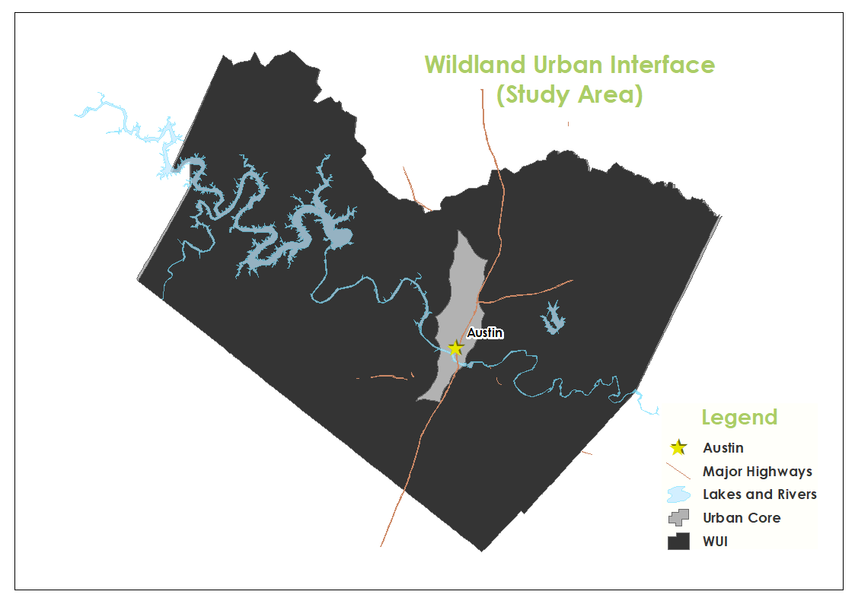
Introduction
Growth of central Texas
We will provide:
Pinch points
At-risk neighborhoods
Refuge areas for each neighborhood
Vulnerable locations (daycares & assisted living facilities)

Slide 4
Data
Entity | Attributes | Spatial Object | Status | Source
WUI | none | Polygon | Available | AFD - Wildfire Division
Roads | full_stree, road_class | Line | Available | City of Austin
Vegetation Hazard | none | Raster | Available | AFD - Wildfire Division
Verified Emergency Shelter | Name, Address | Point | Available | AFD - Wildfire Division
Travis plus COA | none | Polygon | Available | AFD - Wildfire Division
Near Counties | none | Polygon | Available | AFD - Wildfire Division
Structures | FEATURE, Shape_Area | Polygon | Available | City of Austin
Pinch Points | Width, road_class, ClassName, Shape_Length | Line | Available | Flame Consulting
At-Risk Neighborhoods | none | Polygon | Available | Flame Consulting
Refuge Service Areas | none | Line | Available | Flame Consulting
Assisted Living | Name, Address | Point | Available | Flame Consulting
Childcare Facilities | Name, Address | Point | Available | Flame Consulting

Slide 5
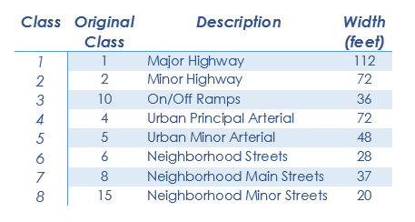
Road Classes
Road widths were obtained from city Master Plans
Each road layer was examined and classes assessed for type
Classes were combined as needed, and eight total classes were created
Each type was assigned a width based off of city averages or common widths (in the case of highways)

Slide 6
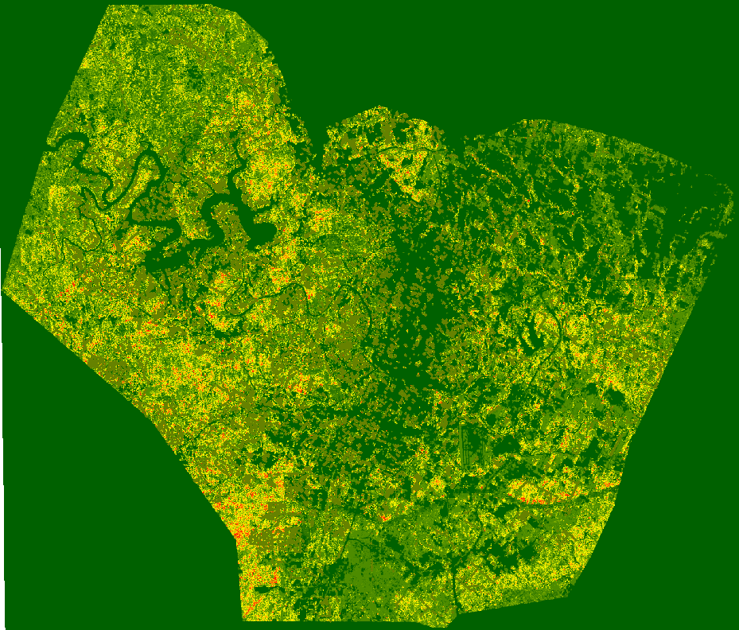
Pinch Points Methods
Reclassification
Extraction
Raster to Vector Conversion
Intersection
Clip
Merge

Slide 7
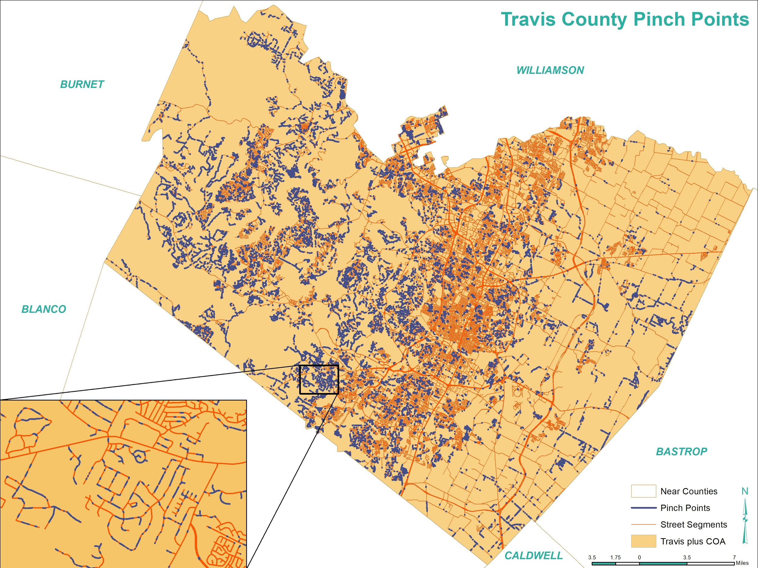
Pinch Points Results
10,925 pinch points for a total length of 7.89 miles
Road class 1 has no pinch points
Road class 6 (neighborhood streets) has 9,862 pinch points for a total length of 7.73 miles
Special attention needs to be paid to road class 6

Slide 8
At-Risk Communities Methods
Define neighborhood boundaries
Buffer + manual inspection
Filter out neighborhoods containing under 30 homes
Join house points to polygons, select by attributes
Find ingress/egress points of each neighborhood
Intersect street segments with polygons
Find where ingress/egress points are blocked by pinch points
Intersect ingress/egress points with pinch points
Find neighborhoods with only one usable exit
One exit total, or one exit which isn’t blocked by pinch points

Slide 9
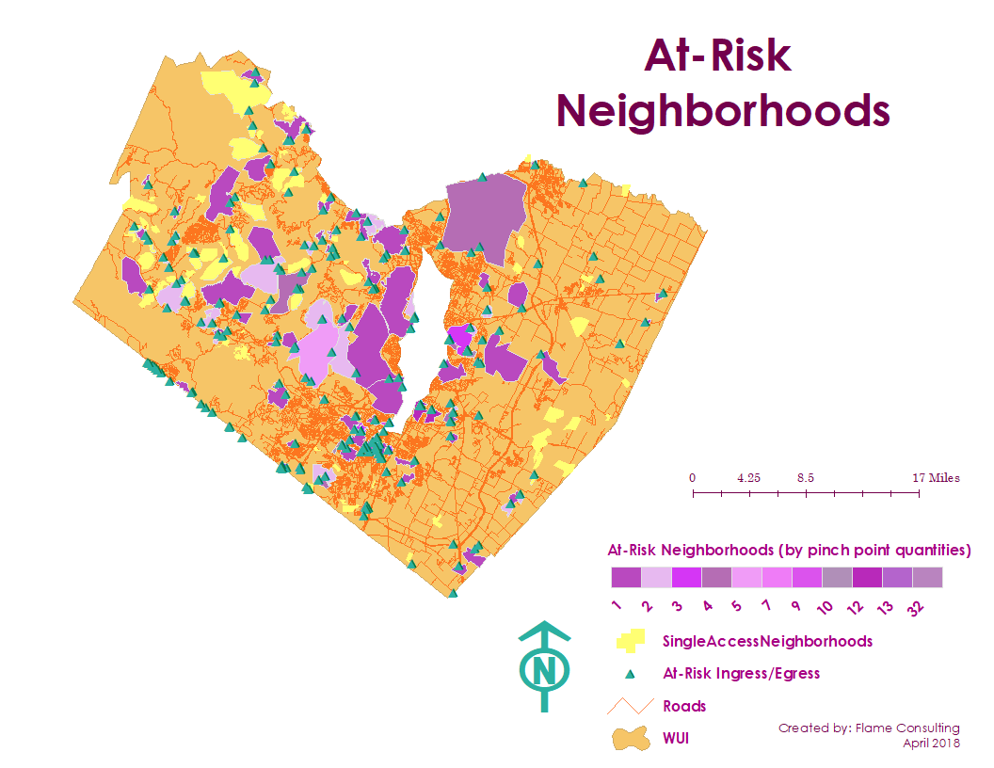
At-Risk Communities Results
The select neighborhoods displayed to the right contain:
at least 30 homes
only one usable egress/ingress point
or multiple egress/ingress points that are rendered unusable by pinch points
Blocked exits can pose a major threat.

Slide 10
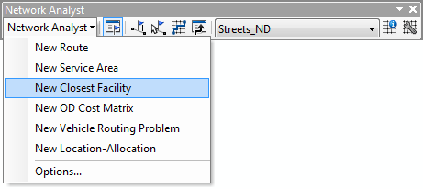
Refuge Service Areas Methods
Network Analysis
roads shapefile from the City of Austin
Refuge Service Areas
Obtained service areas from the AFD
At- Risk Neighborhoods
Neighborhoods that have 30 homes or more,
with few exit/ entrance points
Closest Facility tool
Identifies the quickest route from the incident to nearest facility
selected the refuge service areas as the facilities
Located the incidents which is the exit/ entrance roads from the at- risk neighborhoods
Solved the network which resulted in the quickest route from the neighborhoods to the service areas

Slide 11
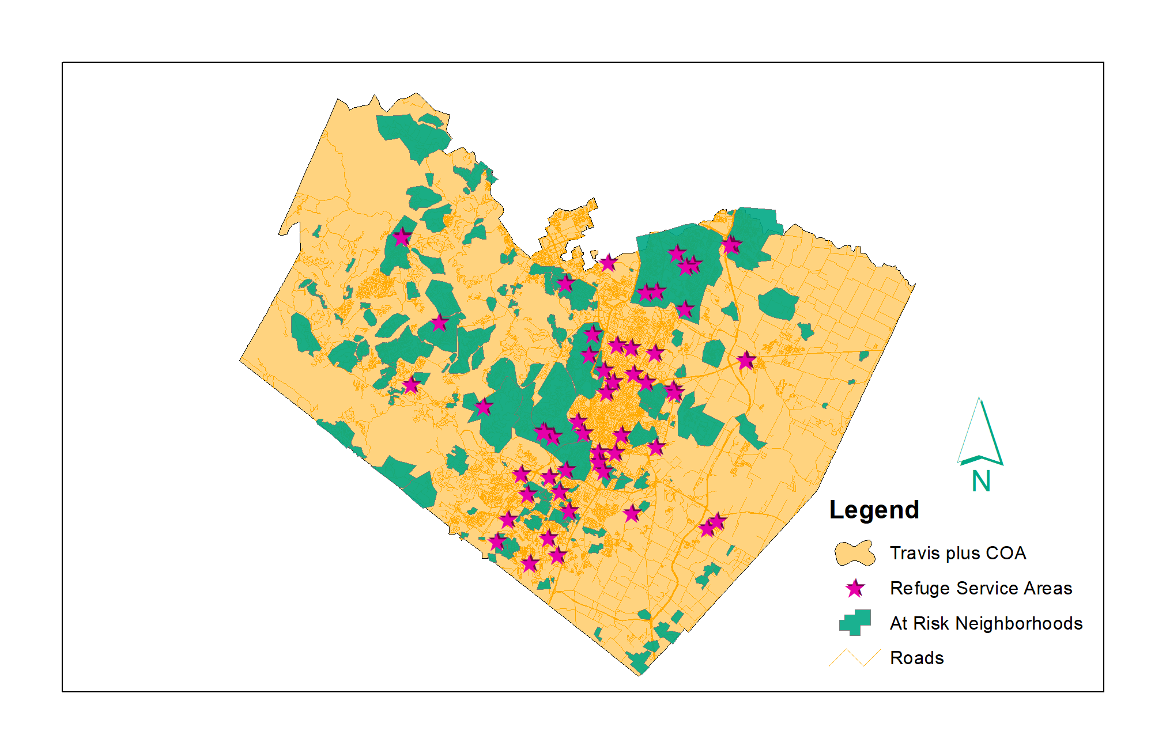
Refuge Service Areas

Slide 12
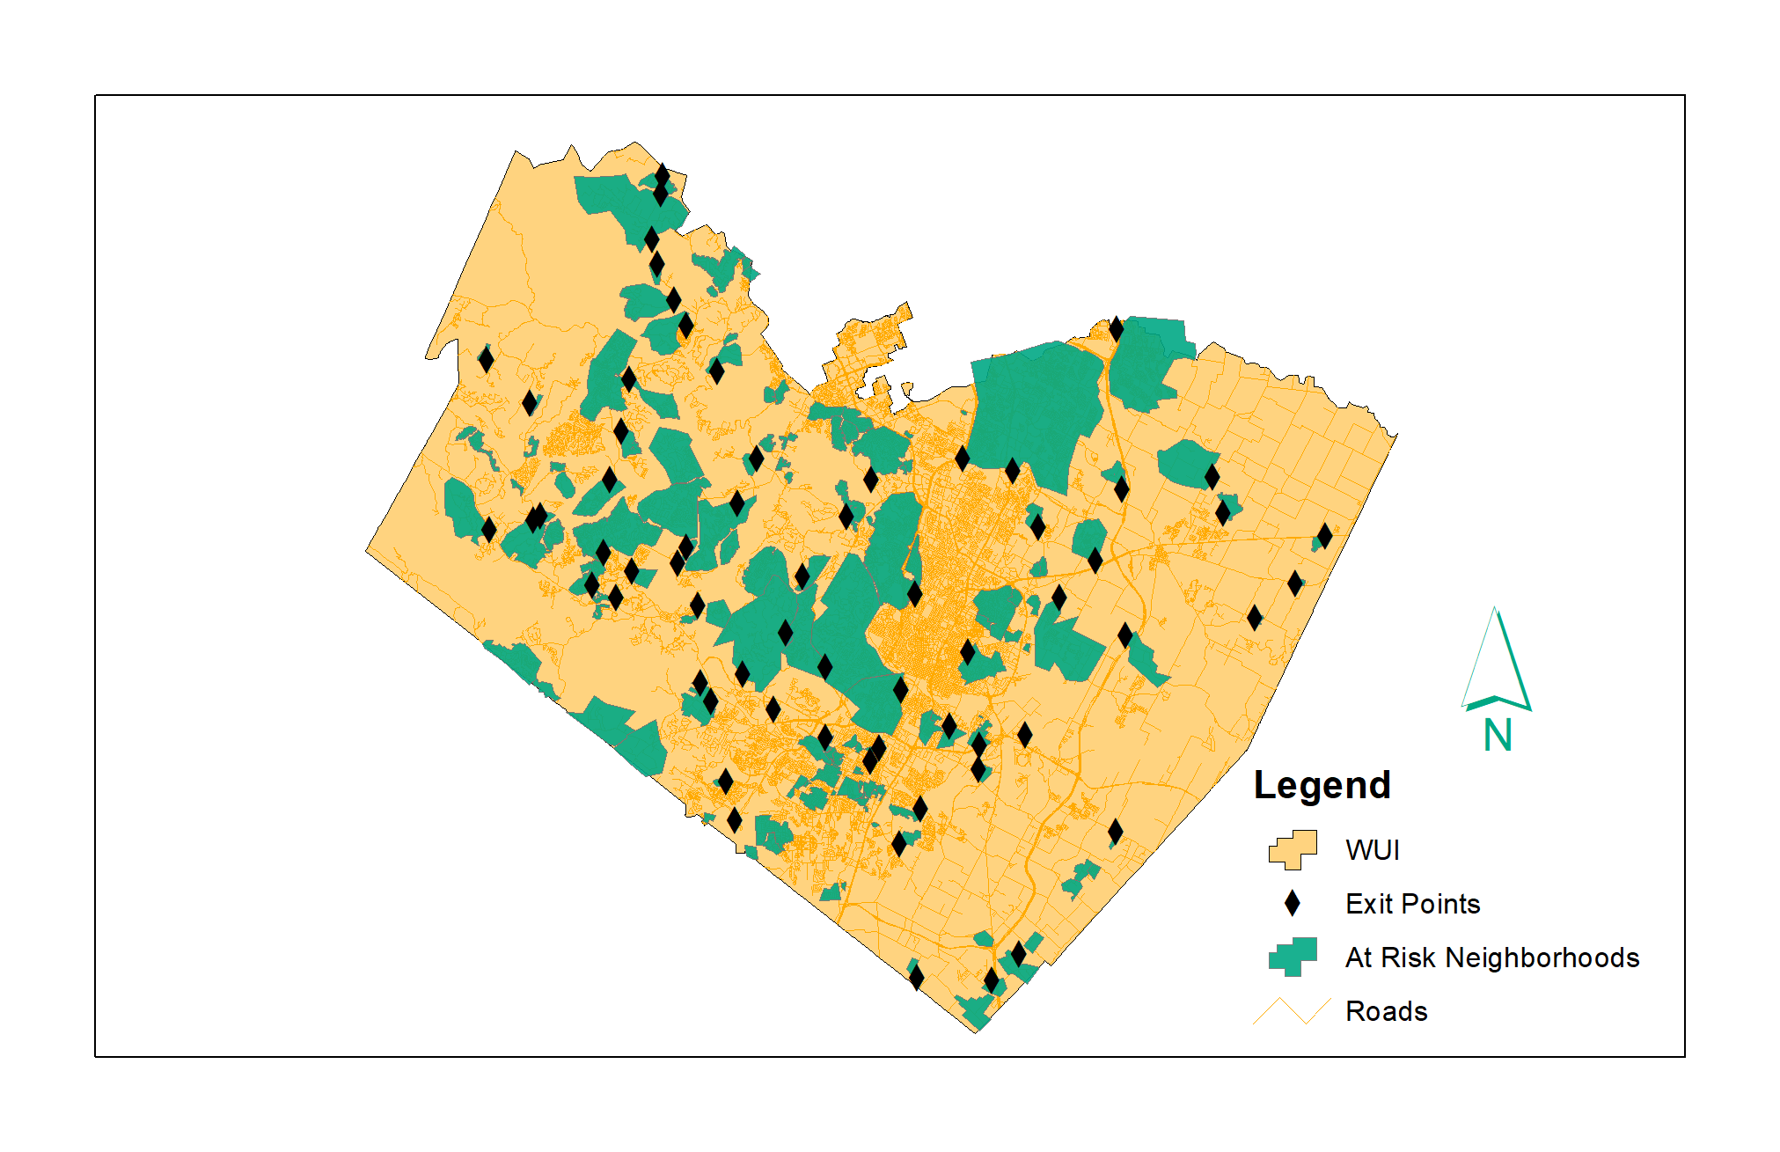
At-Risk Communities: Exit Points

Slide 13
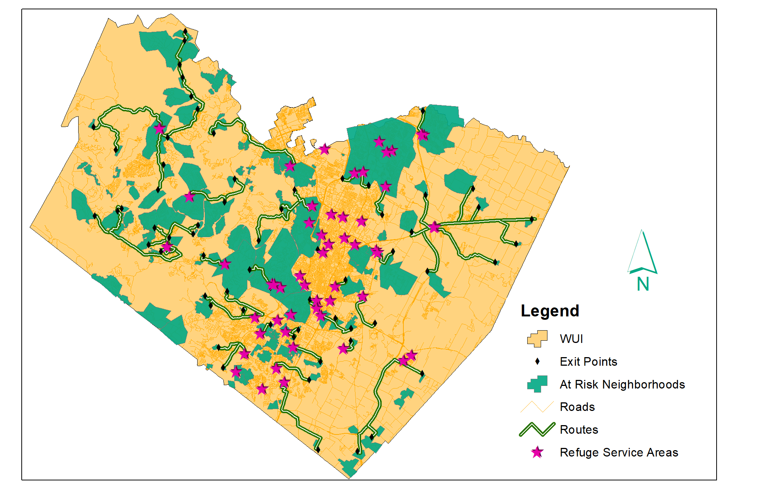
Routes from Exit Points to Refuge Facilities

Slide 14
Vulnerable Locations Methods
Identifying suburbs/surrounding areas within the WUI
Putting WUI on ArcMap and projecting it with Travis County Map
Classifying what a vulnerable location is
“Child-care Facility” and “Assisted Living Facility”
Find vulnerable locations in surrounding areas
Google Maps
Records of findings
Word document listed with “childcare facilities in the WUI” & “Assisted Living Facilities within the WUI” with their addresses.
Point plotting of exact location
Network Analysis tool

Slide 15
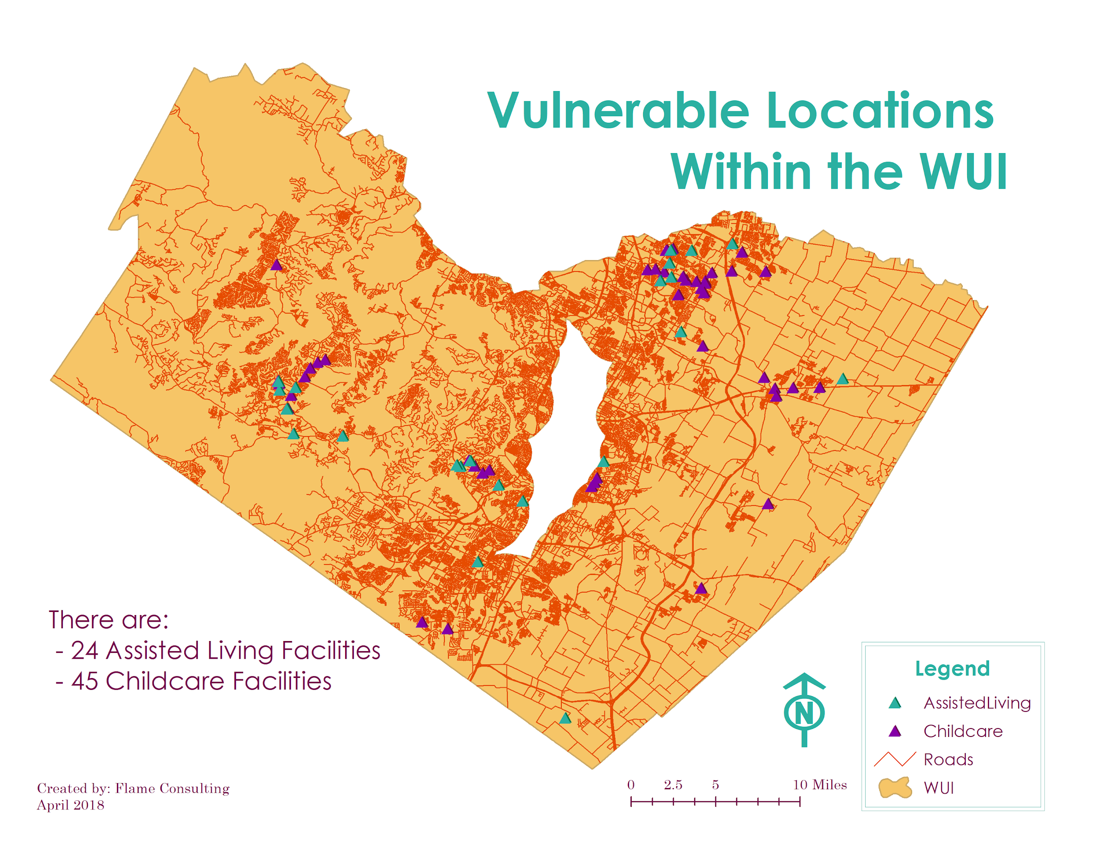
Vulnerable Locations Results
24 Assisted Living facilities
45 Child-care facilities
Higher facility volumes in more highly populated areas
Facilities among the major road networks within that area

Slide 16
Conclusion
Project was successful, Flame Consulting was able to find the pinch points within the WUI and the Travis County Corridor.
Successful in identifying at risk neighborhoods/refuge areas.
This project will set the groundwork for Austin Fire Department’s future evacuation plans.
The project allowed us to put our prior GIS knowledge to the test to be able to create the final result.

Slide 17
Questions?

