Slide 1
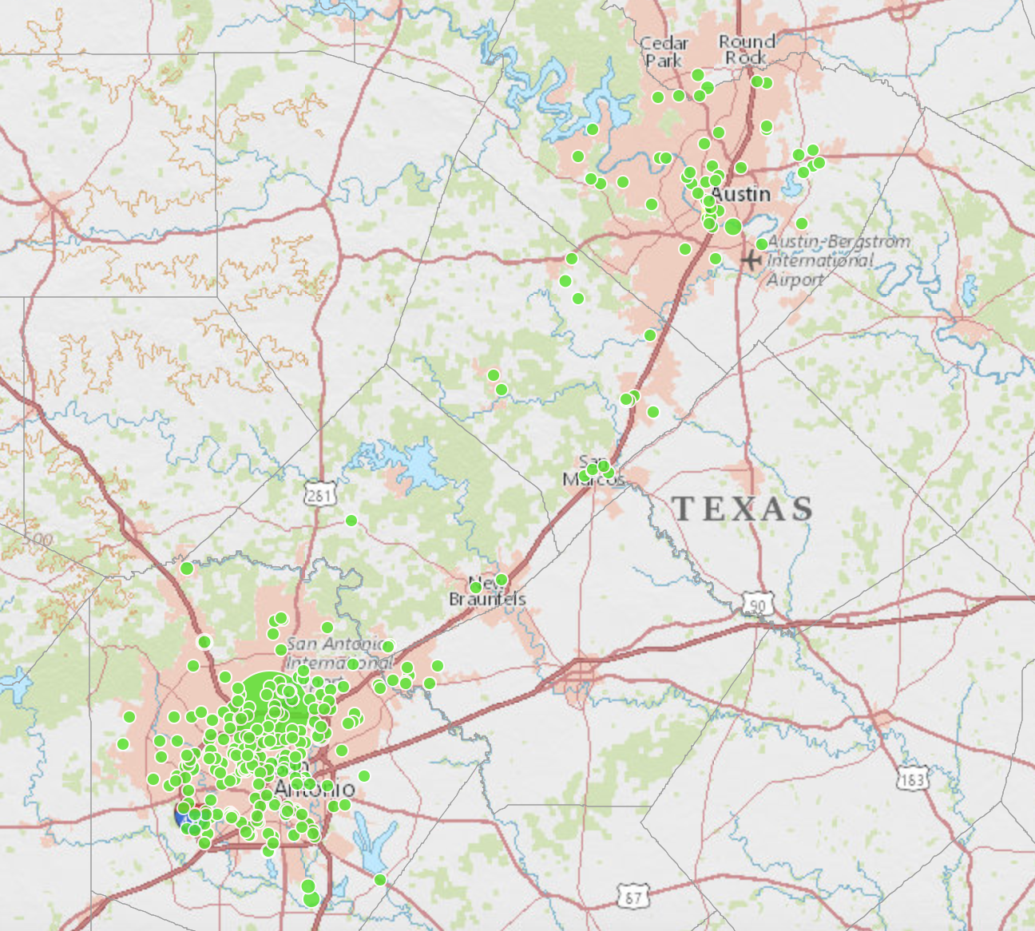
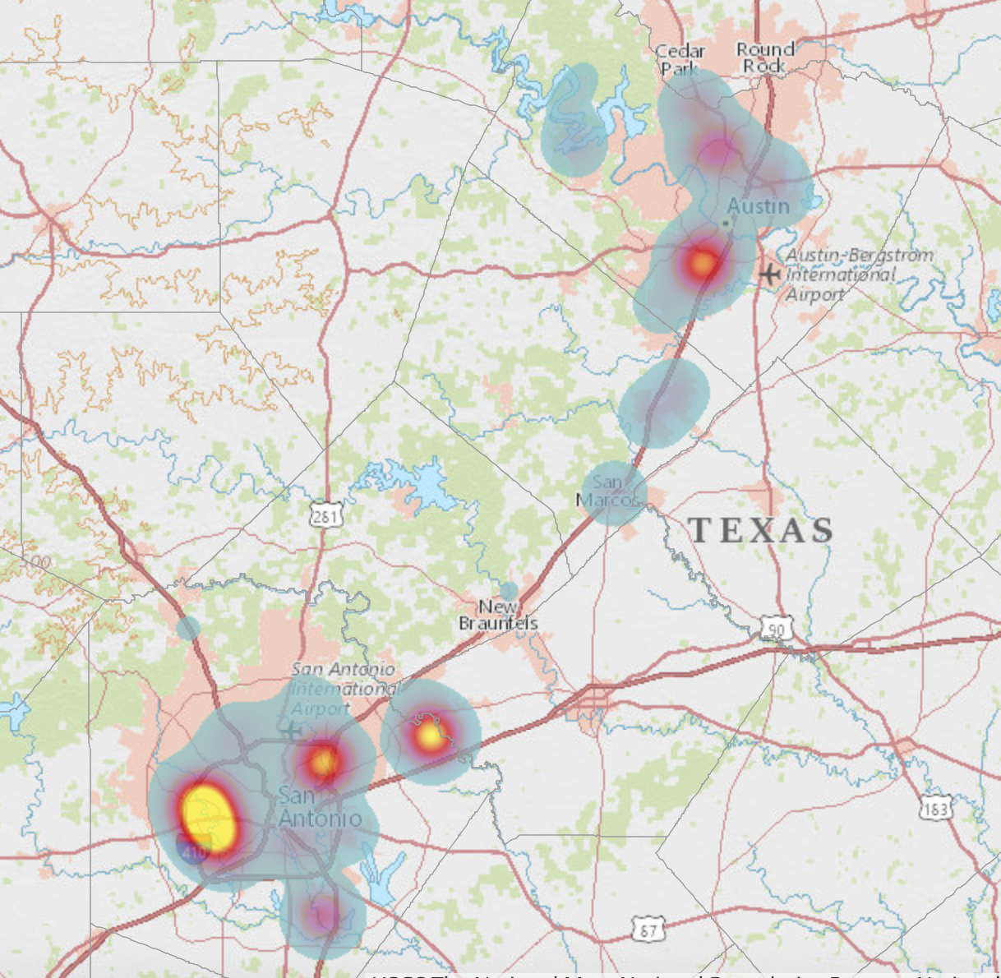
Vulnerability Analysis and Visualization of Sewage Spills
on Edwards Aquifer TCEQ Regions 11 and 13 from 2012 – 2017
Haylea Elliff, Joseph Berenji, Jasi Mitchell, Alexandra Thompson, Justin Williams
Department of Geography, College of Liberal Arts, Texas State University
Background
Previously, a Texas State GIS Design and Implementation project had been conducted on the visualization of raw sewage spills in TCEQ Regions 11 and 13 for years 2006 through 2012. Our first goal was to update the existing interactive map with spill location and attributes they made, including years from 2012 through 2017. Our second goal was to conduct a vulnerability analysis, visualizing areas of the Edwards Aquifer that are sensitive to pollution from sewage spills. Our final goal was to make recommendations for future data collection and updating these maps.
Methods
Spill Sites
The excel document received from TCEQ consisted of 3,094 spill incidents. There were major inconsistencies in data entry between employees. For example, addresses were entered in different fields, there was no formatting standard so some spills causes and remediation were very detailed and others were explained in one word. Due to these inconsistencies, the data underwent several stages of sorting, cleaning, and batch geocoding before it could be projected:
Records were sorted by years and assigned to group members
Created a new address column and separated out addresses or relative locations
Doogal Batch Geocoder to acquire latitude and longitude
Created and filled in cause, remediation, and description fields
Displayed in ArcMap and ArcGIS Online’s Interactive Story Map
Interactive Story Map
Projected from the latitude and longitude coordinates through ArcMap’s “display xy” function
Exported displayed spill sites as a shapefile
Uploaded shapefile into The ArcGIS Online Story Map Platform
Displayed gallons spilled with graduated symbols
ArcGIS Online generated a heat map of spill sites
Vulnerability to Pollution Analysis
The DRASTIC Method was developed by the EPA and models the vulnerability to pollution of groundwater resources based on hydrogeologic parameters, evaluating an area using open source data without the need for extensive field investigation. These parameters are in a raster file format, which are ranked and weighted, and inputted into raster calculator. Weights involve the impact of the hydrogeologic features with respect to one another, and ranks classified into ratings, comparing like features with one another. This is chiefly a tool for comparative assessment, calculating DRASTIC index locates areas that present a greater risk for groundwater contamination relative to all other locations in a study area. Data preparation for the DRASTIC analysis is detailed in Table 1.
DRASTIC = DwDr + RwRr + AwAr + SrSw + IrIw + CrCw
Where:
D: Depth to Groundwater
R: Net Recharge
A: Aquifer Media
S: Soil Media
T: General Topography or Slope
I: Vadose Zone
C: Hydraulic Conductivity of the Aquifer
w: assigned weights
r: assigned ranks
Results
Web Map
The improved and updated story map allows communities dependent upon the Edwards Aquifer to have direct access to a detailed assessment of wastewater infrastructure. Additionally, we have created a heat map visualizing the concentration of spill sites (Figure X) Comparison of the up to date web map can also give valuable insight on any improvements or exacerbation from the previous project in 2012.
Vulnerability Analysis
The results of the DRASTIC Method (shown in Figure 1) show that 1.07% of the study area has a low pollution potential, 64.73% has a moderate pollution potential, 34.18% has a high pollution potential, and 0.02% has a very high pollution potential. The results of this study can be used in managing groundwater resources, and can be used as a screening tool prior to applying more in-depth analysis. For future spills events, the locations could be plotted on this vulnerability map to assess the severity in terms of potential pollution.
Recommendations
It was requested we make recommendations on improving data quality from a geographer’s perspective.
Complete map of sewage pipelines within every service area, with depths and sizes of pipes as attributes.
Use GPS units on site to record exact locations of spills, and create waypoints to update the map easily.
Utilize our list of standardized spill causes. This step would be beneficial in mapping or statistical analysis on the causes of spills.
Utilization of our Standard Spill Event Category Ranking System. This will clear up any reporting inconsistencies amongst Environmental Investigators.
Purpose
The Edwards Aquifer provides drinking water for approximately 2 million people and significantly contributes to the Texas economy by means of irrigation and agriculture. The aquifer is naturally relatively clean and requires little maintenance other than mild treatment, unless contaminated. Sewage spills that occur on the surface and from underground sewage lines could make their way into the stream and springs that feed into the aquifer. Contamination of the Edwards Aquifer would pose health risks the local community, affect endangered species, harm crops and livestock, and raise the cost of water maintenance that directly affects consumers.
Conclusion and Discussion
This project was successful in mapping sewage spills from 2012-2017, and in making this data publicly available through an online interactive map. We would like to see this project evolving into a live, publicly available sewage spill webpage. The DRASTIC Method was successful in visualizing the potential for pollution across our study area.
Data | Source | Preparation
Sewage Spill | TCEQ through an open records request | Received in an excel spreadsheet, geocoded and cleaned up attributes.
Depth to Groundwater | Water elevation data from Texas Water Development Board's Groundwater Database | Water well data and the Geostatistical Analyst Toolset were used to interpolated by means of Empirical Bayesian Kringing (EBK).
Net Recharge | Precipitation: National Oceanic and Atmospheric Administration, Land Use/cover: National Land Cover Database, Soil: Natural Resources Conservation Service | Q = (P − 0.2S)2 / (P + 0.8S) S= 1000/CN Q: Depth of runoff (in) P: Depth of rainfall (in) S: Maximum potential retention (in) CN: Curve number (dimensionless)
Aquifer Media | Texas Geologic Database | Ratings were applied to rock unit data based on the porosity and permeability.
Soil Media | Natural Resources Conservation Service | Percent sand, silt, and clay used to classify soil textures.
Topography | The National Map from The United States Geological Survey | Topography raster was generated by altering DEMs to visualize percent change in elevation for a given distance (10 m).
Impact of Vadose Zone | TCEQ | Classified similar to soil media by texture. Thickness of horizon was integrated in the development of vadose zone to account for distance to water table.
Hydraulic Conductivity | Natural Resources Conservation Service | Hydraulic conductivity in this study represents the ease at which water can reach the aquifer by using ksat rates (a soil’s ability to transmit water).
Study Area
This project focused on raw sewage spills that have occurred in the Texas Commission on Environmental Quality (TCEQ) Regions 11 and 13 on the Edwards Aquifer. The counties included were Bexar, Travis, Hays, Comal, Medina, Uvalde (shown in the inset map in Figure 1)
Acknowledgements
WASSP would like to thank the Greater Edwards Aquifer Alliance for this experience, and Annalisa Peace for all of her help. We would also like to extend our gratitude to our professor, Dr. Yuan for her guidance, support, and advice throughout this semester.
Figure 2: Screenshot of web map, 2015 Sewage Spills
Figure 3: Screenshot of web map, 2017 Heat Map
Figure 1: Results of Vulnerability Analysis using The DRASTIC Method
Table 1: Results of Vulnerability Analysis using The DRASTIC Method
Notes:
Study area
counties

