Slide 1
Susceptibility to Change Analysis
A temporal analysis of occupancy characteristics and land to improvement ratios in San Marcos
Wyatt Ellison-Hunter Harrison-James Corson-Spencer Cardwell

Slide 2
Overview
Background
Data
Data Quality
Methodology
Final Results
Discussion
Conclusions

Slide 3
Background
Who we're working with
What we hope to accomplish
Where our study focused
Why it is important

Slide 4
Data
Entity​ | Attributes​ | Spatial Object​ | Status​ | Source​
San Marcos GIS Shapefiles​ | Land Parcels, Neighborhoods, Buildings, Zoning​ | Polygons​ | Available​ | City of San Marcos​
Hays County Appraisal District Tabular Data​ 2001-2017​ | Address of Land plots, Address of Owner, Total Market Value​ | Excel Worksheets​ | Available​ | Hays County Appraisal District​

Slide 5
Data Quality
Ground Proofing Our results
Missing 2008 data
Substitutes end of 2007
No 2010 Exemption List
Used Owners city of residence
Occupancy appears higher for 2010
Scarcity of data for 2012
Unusual values in 2015
Flooding events?

Slide 6
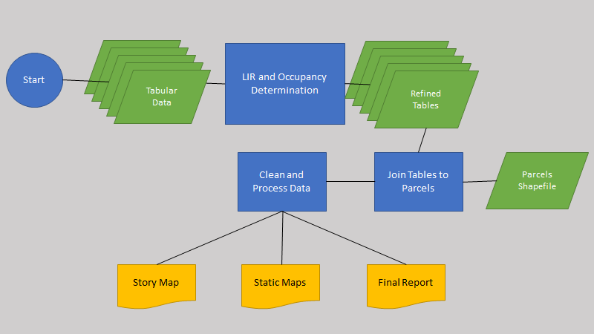
Methodology: Overview

Slide 7
Methodology: LIR and Occupancy Automation
Land to Improvement Ratios Based on Formula:
LIR=Land Value÷(Land Value + Improvements Value)
Owner Occupancy based on Homestead Exemptions
Requirements for an HS exemption
Owned by an Individual
Primary Residence at the start of the tax year
Assigned "Yes" for Exempt Properties "No" for Unexempt
"1" and "0" integers for difference mapping
LIR=L/(L+I)
+
Exemption List
LIR Attribute
+
Occupancy Attribute

Slide 8
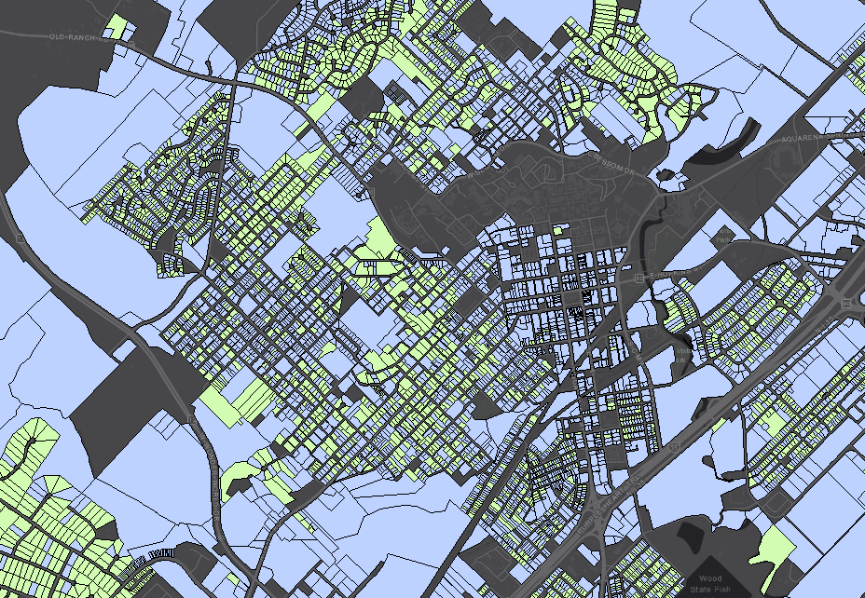
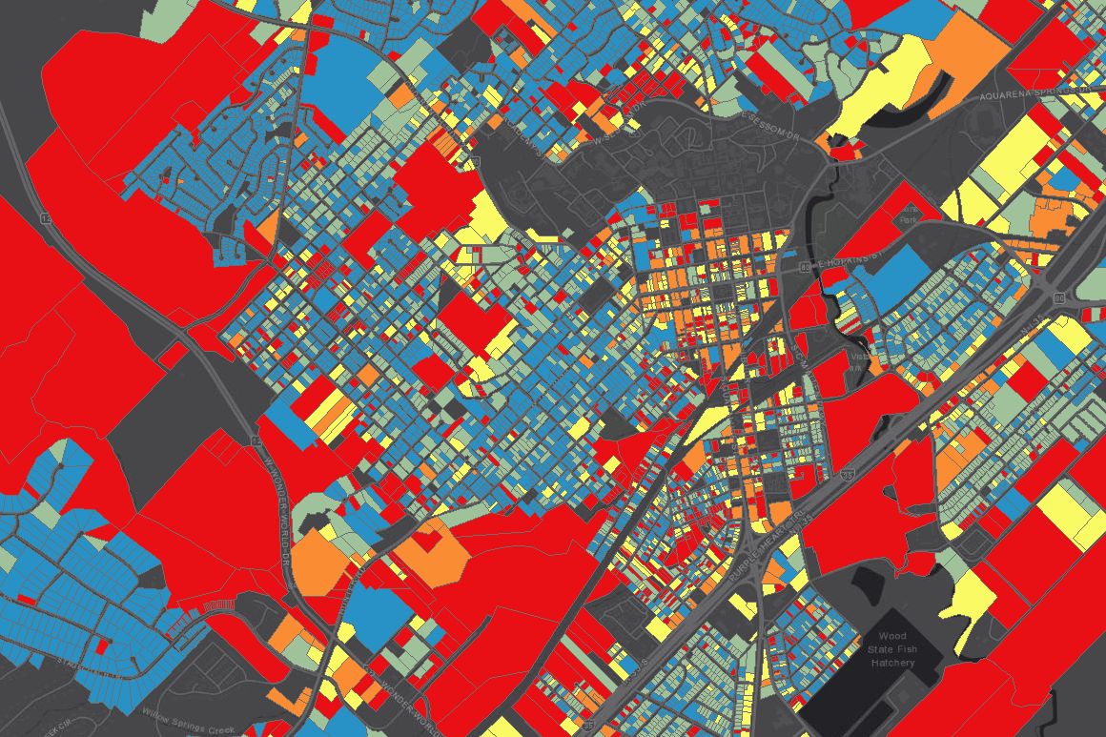
Methodology: Geographic Processing
Added LIR and Occupancy to Tables
Joined updated tables to San Marcos Parcels
Deleted Null Values

Slide 9
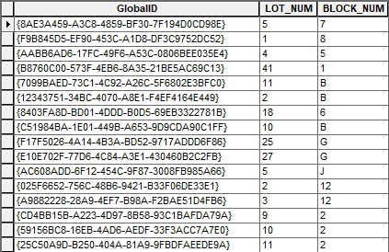
Methodology: Post processing
Deleted Unwanted Attributes
Kept LIR, Occupancy, Exemptions and Identifiers
Optimized our Data For web-Mapping
End Result: 10 map Layers for 2008-2017

Slide 10
Methodology: Analysis for Final Products
Story Map
Ten Web Maps combined into one Story Map
Temporal Trends Analysis
Difference Mapping
Charting and Comparing Trends
Comparison between the whole city, Heritage Areas, and other Neighborhoods
Hot Spots

Slide 11
Results & Discussion: Owner Occupancy

Slide 12
Results & Discussion: Owner Occupancy

Slide 13
Results & Discussion: Land to Improvement Ratio

Slide 14
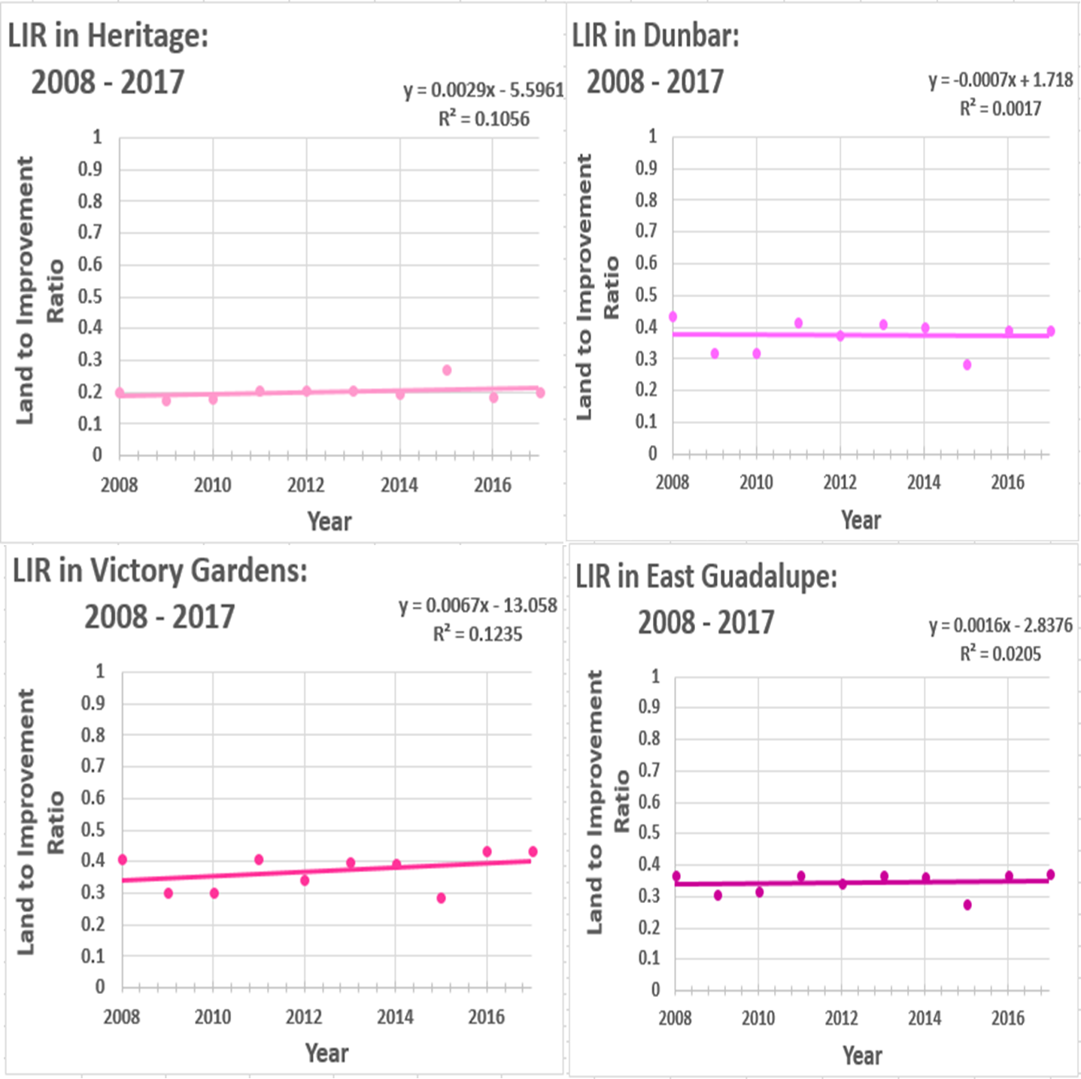
Results & Discussion: Land to Improvement Ratio

Slide 15
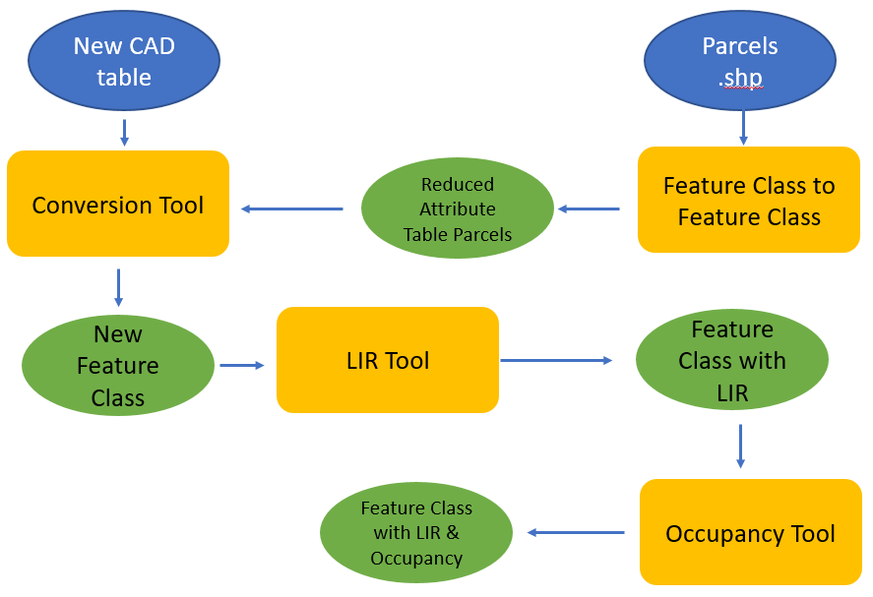
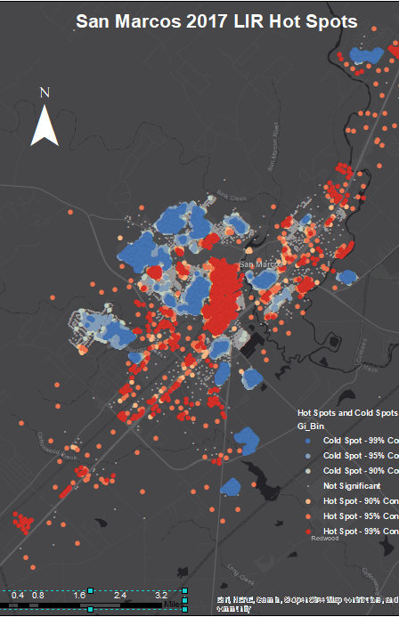
Discussion
LIR as a metric of susceptibility to change
Suggested preprocessing algorithm for new data
Going forward
Hot Spot Analyses
Hot Spot map temporal differencing

Slide 16
Conclusions
LIR increasing in Heritage, Victory Gardens, and East Guadalupe.
LIR is steady in Dunbar.
Overall Owner occupancy is decreasing in all neighborhoods.
LIR
Occupancy

