Slide 1
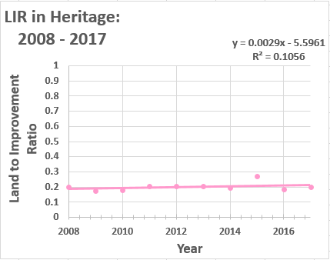
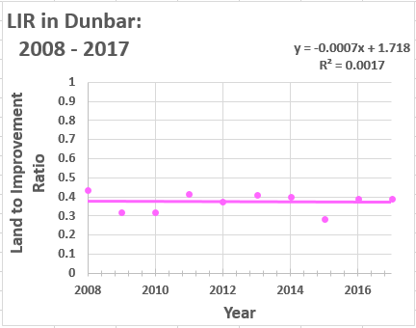
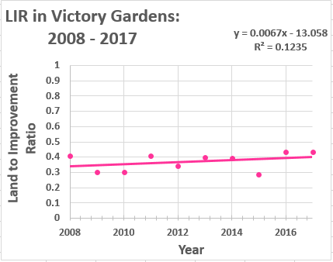
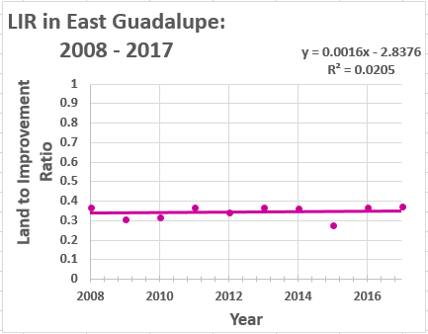
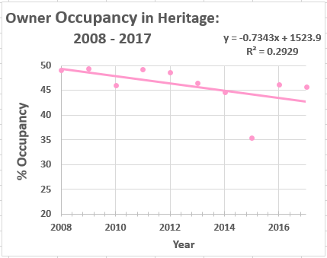
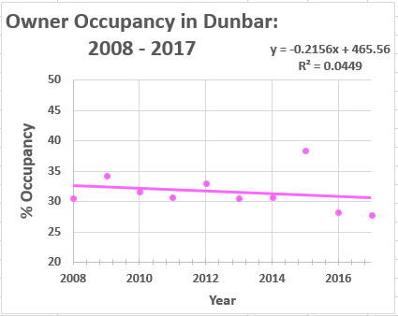
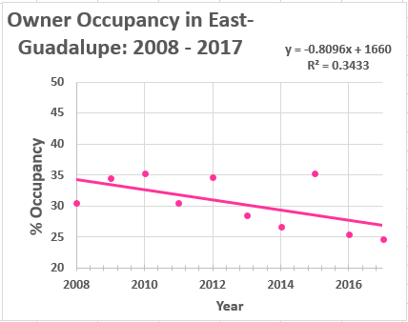
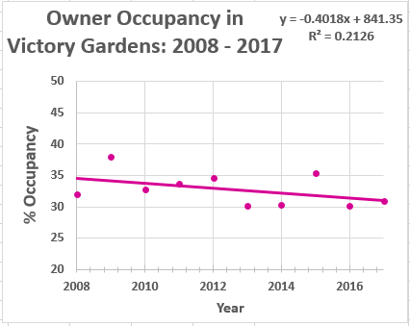
Temporal Analysis of Occupancy Characteristics and Land to Improvement Ratio in the
Heritage Neighborhoods of San Marcos, TX
James Corson, Wyatt Ellison, Spencer Cardwell & Hunter Harrison
Susceptibility to Change
A characterization of an area’s sensitivity to new development or redevelopment. For our purposes, we will delineate a neighborhood’s susceptibility to change as a function of Owner Occupancy and Land to Improvement Ratio.
Owner Occupancy
Whether or not property owners reside at their own properties contributes to the susceptibility to change of an area. If a significant proportion of an area is abandoned or being rented, the area is more likely to be developed upon.
Land to Improvement Ratio
An index of property value that juxtaposes a parcel’s land market value with the total market value of improvements made on that parcel. A concentration of high “LIR” values increases prospect of development.
Our Question
How have rates of owner occupancy developed in the study area over the past decade? Are there any perceptible trends in standard LIR values for parcels within the study area?
Map Products
Data & Methods
Discussion
We utilized 10 years worth of Hays County Appraisal District tabular data, as well as parcel and neighborhood shapefiles found on Texas State University’s Geography Department’s data drive.
We began by cleaning our 30+ Excel data tables. We then focused our efforts on joining our tables to shapefiles and transforming those feature classes for difference mapping. Concurrently, our programming team worked to develop custom Python Script Tools for ArcMap which would assist in expediting our processing going forward. Once we produced those difference maps, we conducted some simple univariate statistics and linear regressions to quantitively summarize our findings.
Our results suggest that three of our study neighborhoods (with the exception of Dunbar) have experienced a very slight positive growth trend in average LIR values. Meaning that the parcels in these neighborhoods have collectively faced a small decrease in total property market value over the last decade. As for occupancy, all four neighborhoods express an ebbing proportion of parcels claiming a Homestead Tax Exemption. The two “wealthier” neighborhoods, Heritage and East Guadalupe, present markedly steep negative trends in owner occupancy.
It is worth noting that the year 2015’s reported tax exemptions and land/property appraisal values presented clear outliers in our statistical analyses, but in the absence of convincing evidence for data inaccuracy, we made no effort to mitigate the effects of these outliers.
Custom Script Tools for ArcMap:
The scripts and tools we developed over the course of this project are intended to serve future analyses of a similar nature. A collection of useful pre-existing, ancillary tools and a suggested model for preprocessing of new data are provided in our CD deliverable.
Conversion Tool
Accepts tabular input of type .xlsx, .xls, .csv, .dbf, INFO, or VPF, converts to .dbf, and conducts a join field transformation to join the new table to a parcel shapefile.
LIR Tool
Calculates a field describing Land to Improvement Ratio for all rows in
a feature class. Input tables must include fields for land market value and property market value.
Occupancy Tool
Creates new field in a feature class that distinguishes owner occupied parcels from rented or abandoned parcels based on an input field for Homestead tax exemptions.

