Slide 1
San Marcos Fire Station Location Analysis
Andrea Nieto, Bryan Heisinger, Nadine Oliver Matthew Mitchell

Slide 2
Introduction
To meet the demand of an increasing growth trend, the City of San Marcos is proactively developing a plan to construct a new fire station.
We will analyze the grid cells to determine where the social and economic conditions of the city justify the construction of a new fire station
A GIS implementation would enable the San Marcos Fire Department to provide an even distribution of fire response services across the city.

Slide 3
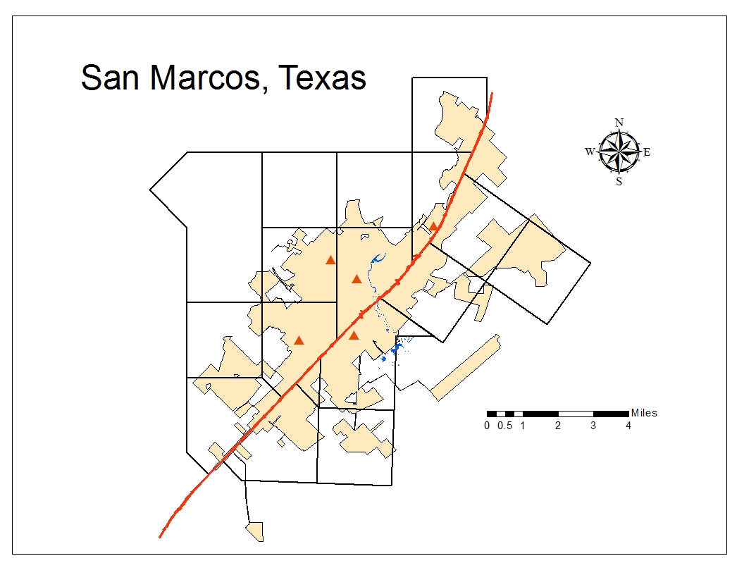
Scope
San Marcos, Texas is located along the I-35 corridor between San Antonio and Austin.
It is approximately 30 square miles and contains about 1500 people per square mile (United States Census Bureau).

Slide 4
Data
All of the data we used was provided to us by the City of San Marcos. The only data we obtained from outside sources was the 2010 San Marcos block population for 2010 from the US Census Bureau website. Our data is listed as followed:
• San Marcos Parcels
• San Marcos Buildings
• San Marcos Existing Fire Stations
• Texas State University San Marcos
• San Marcos City Limits
• San Marcos Railroads
• San Marcos Street Centerlines
• San Marcos ETJ (Extra-Jurisdictional Territory)
• San Marcos Park Boundaries
• San Marcos City Grid Cells
• San Marcos Block Population for 2010

Slide 5
Methods
With the exception of the conflagration index, our methodology mainly consisted of locating data in the attribute tables of the 16 grid cells and condensing it in Microsoft Excel.
All of our results were recorded in a master spreadsheet that helped us determine which of city’s grid cells met the greatest need for potential fire station services.

Slide 6
Methods – Initial Problems
Population Data
Developed vs. Undeveloped Parcels

Slide 7
Methods
We ran the initial test of our methodology on grid cell 08 – the largest of 16 grid cells.
After completing grid cell 08, we revised our methodology and applied our procedures to the remaining 15 grid cells.
A weighted sum index was used to help us determine the conflagration index.

Slide 8
Conflagration Weighted Sum Model
GRID ID | Conflagration Area Acreage | Number of Buildings Affected in Confl. | Wildlife-Urban Interface in Miles | WUI Weight | Confl. Weight | Buildings Weight | WUI Result | Confl. Result | Build Result. | Total Sum of Factors
1 | 12.33 | 3100 | 60.37 | 0.2 | 0.4 | 0.4 | 12.07 | 4.932 | 1240 | 1257.01
2 | 108.93 | 4457 | 52.19 | 0.2 | 0.4 | 0.4 | 10.44 | 43.572 | 1782.8 | 1836.81
3 | 28.54 | 11669 | 52.38 | 0.2 | 0.4 | 0.4 | 10.48 | 11.416 | 4667.6 | 4689.49
4 | 83.88 | 1501 | 48.88 | 0.2 | 0.4 | 0.4 | 9.78 | 33.552 | 600.4 | 643.73
5 | 36.73 | 450 | 12.39 | 0.2 | 0.4 | 0.4 | 2.48 | 14.692 | 180 | 197.17
6 | 7.98 | 35 | 17.19 | 0.2 | 0.4 | 0.4 | 3.44 | 3.192 | 14 | 20.63
7 | 5.52 | 139 | 56.70 | 0.2 | 0.4 | 0.4 | 11.34 | 2.208 | 55.6 | 69.15
8 | 5.26 | 72 | 9.84 | 0.2 | 0.4 | 0.4 | 1.97 | 2.104 | 28.8 | 32.87
9 | 11.93 | 190 | 24.82 | 0.2 | 0.4 | 0.4 | 4.96 | 4.772 | 76 | 85.74
10 | 16.77 | 515 | 19.80 | 0.2 | 0.4 | 0.4 | 3.96 | 6.708 | 206 | 216.67
11 | 68.85 | 1268 | 69.52 | 0.2 | 0.4 | 0.4 | 13.90 | 27.54 | 507.2 | 548.64
12 | 5.7 | 214 | 12.79 | 0.2 | 0.4 | 0.4 | 2.56 | 2.28 | 85.6 | 90.44
13 | 2.97 | 72 | 28.83 | 0.2 | 0.4 | 0.4 | 5.77 | 1.188 | 28.8 | 35.75
14 | 2.39 | 212 | 11.24 | 0.2 | 0.4 | 0.4 | 2.25 | 0.956 | 84.8 | 88.00
15 | 15.24 | 158 | 10.51 | 0.2 | 0.4 | 0.4 | 2.10 | 6.096 | 63.2 | 71.40
16 | 3.48 | 91 | 5.07 | 0.2 | 0.4 | 0.4 | 1.01 | 1.392 | 36.4 | 38.81
Sum of Factors
Factor Values
Weights
Preliminary Results

Slide 9
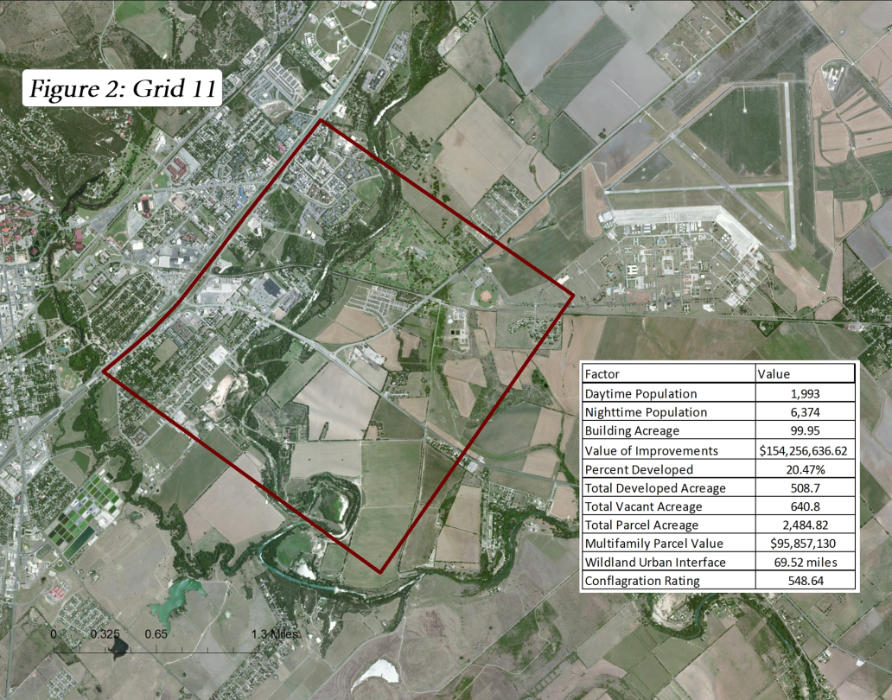
Results
The grid cells currently containing a fire station consistently ranked the highest in all factors.
Out of the grid cells currently without a fire station
grid 11 ranked highest in the following factors:
Daytime Population
Nighttime Population
Building Acreage
Value of Improvements
Wildland-Urban Interface
Percent Developed
Total Developed Acreage
Total Developed Parcel Value
Total Parcel Value
Total Multifamily Value
Conflagration Rate

Slide 10
Discussion
Our data indicates that grid cell 11 is the most suitable area for the construction of a new fire station.
This area features relatively dense development, a high population rate, expensive parcel values, and a high conflagration potential.
Our team recommends that this grid cell be considered for the construction of a new fire station.

Slide 11
Conclusion
In our study, we have successfully highlighted the city grid cells that indicate a need for future firefighting services. Our team has also created a map book for our client that provides a visual reference to our research, and a master spreadsheet that summarizes our calculations.

Slide 12
Questions?

