Slide 1
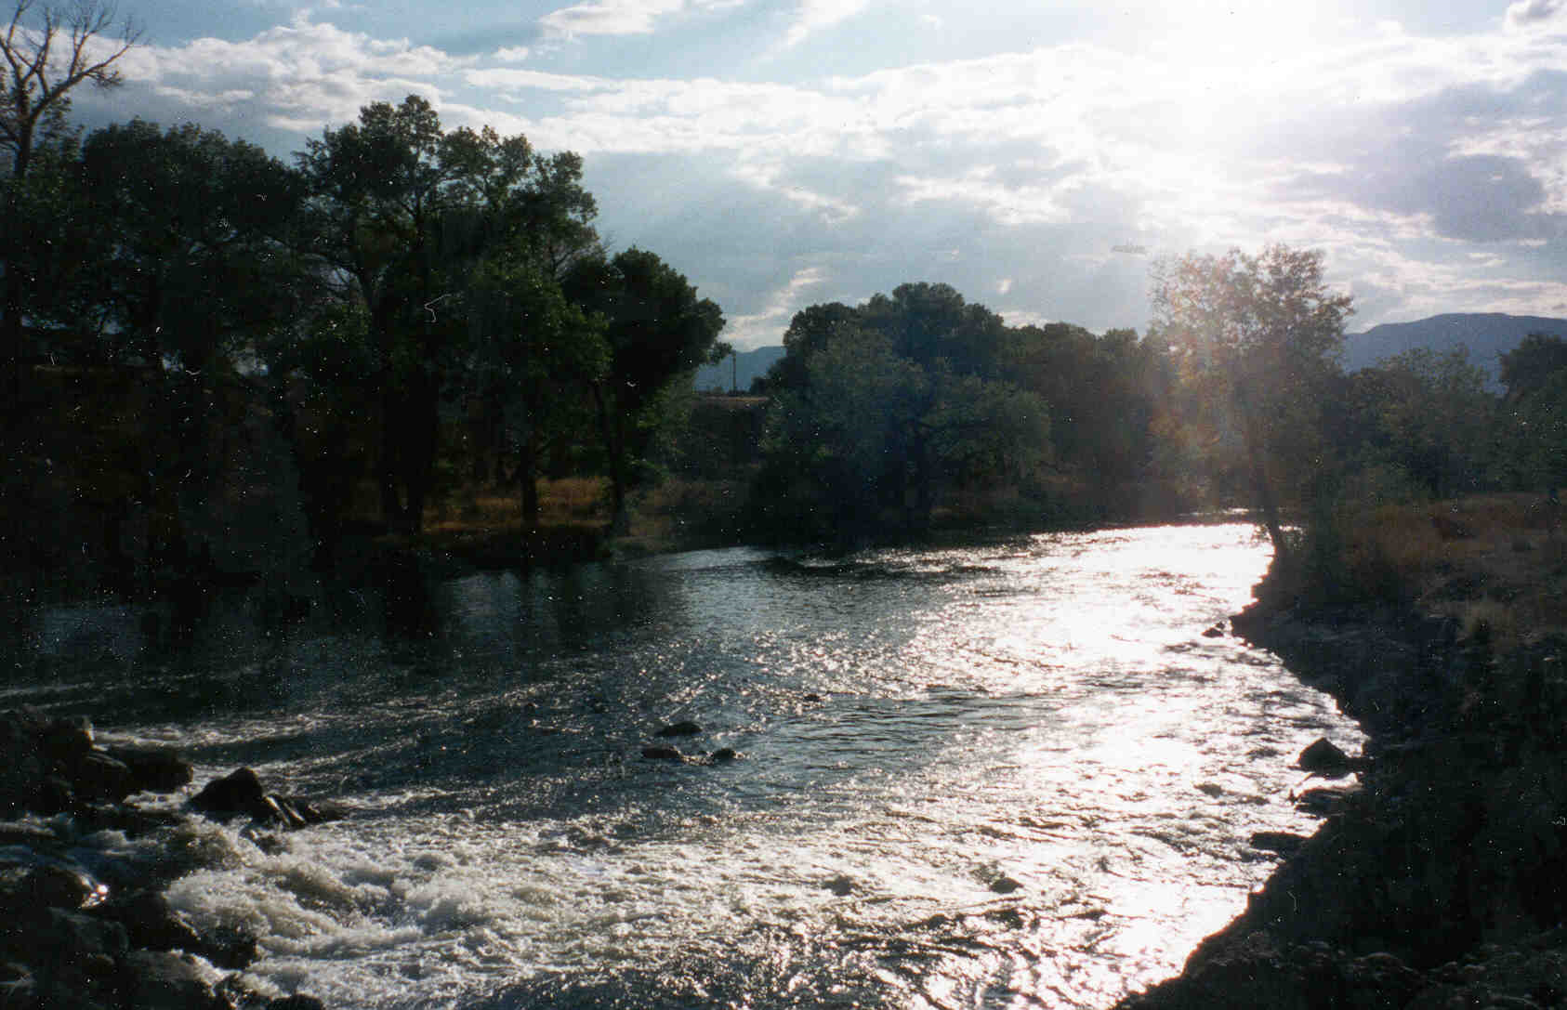
Watershed Mapping Project Public Interest G.I.S. Mapping Project for the Guadalupe Blanco River Authority – 2009

Slide 2
Geo-Tex Spatial
Solutions
CONSULTANTS:
Jennifer Zingery | Abel Avilez | Katie Kunz | Aya Udagawa

Slide 3
Introduction: Summary
More and more, companies across the nation are turning to Geographic Information Systems (GIS) to distribute information, answer problems, and communicate more effectively - both within their organizations, as well as to the public who seek to utilize that data.
One way to share this information is to publish interactive maps, which allow users to access manipulate and gain specific information via the internet.
We have been contacted by the GBRA to create interactive maps for the organization’s web site. This new resource will further accomplish the goal of the mission statement of the GBRA - “to protect, conserve, reclaim, and steward the resources” of the water conservation district it oversees.

Slide 4
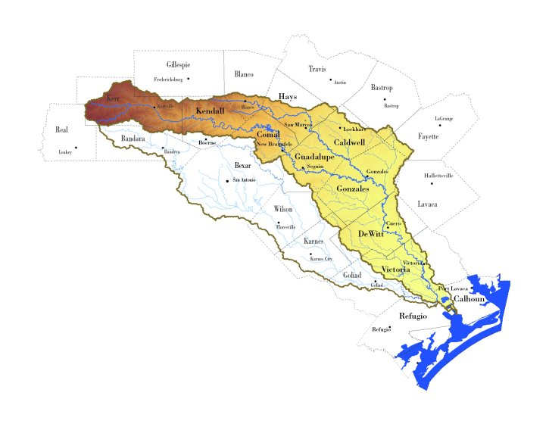
Introduction: Problem Statement
GBRA website has a single “Main Basin Map” which is a static map that shows the contiguous boundaries of the ten-county statutory district that the GBRA oversees, with no additional data about the district provided.
Production of these interactive maps will allow the GBRA to better serve the public, and will provide a valuable data resource for educational purposes and recreational use of the 10-county water conservation district they oversee.

Slide 5
Purpose
The purpose of this project is to create web-accessible public interest maps to be included on the GBRA’s web site.

Slide 6
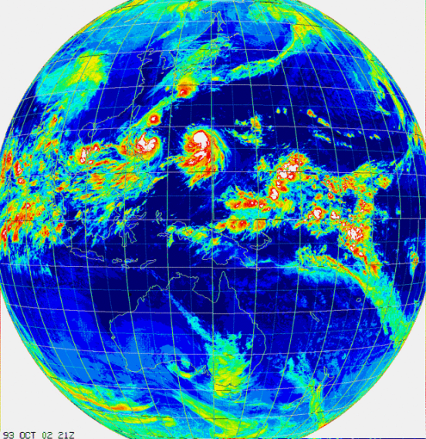
Scope
The scope of this project is comprised of 10 of the 11 watersheds the GBRA oversees. These 10 contiguous watersheds originate at the headwaters of the Guadalupe River in Kerr County above Comfort, Texas, and extend southeastward across the state, culminating in the terminus of the Guadalupe River near Port Lavaca, Texas.

Slide 7
Data: Collection
GBRA WATERSHED MAPPING PROJECT - DATA TYPE / SOURCE
GBRA Data: | GIS Watershed Data from GBRA’s 2007 Basin Highlights Report (CD)
Third-Party Data: | GIS Data from USGS, TX Parks & Wildlife, Edwards Aquifer Authority, National Atlas, Federal Emergency Management Agency (FEMA)
Data Created by Geo-Tex: | Raw data (ex: latitude & longitude coordinates) which had to be assigned spatial qualities/attributes in order to be usable in a GIS.

Slide 8
Data: Quality
All of the data was subjected to an extensive review process before it was determined suitable for use.
During this review process, all data was closely examined by our team in order to determine the best documented and most accurate data for the project. All the third-party data sources used in the project are considered reliable and fit for use for this project.

Slide 9
Data: Creation
It was necessary to create data sets – in this case the “paddling trails” data - from raw data acquired from Texas Parks and Wildlife.
In order to turn this raw data into a form that could be utilized by the software, it was necessary to convert the GPS coordinates into decimal degrees, then input the newly created latitude/longitude values into an excel spreadsheet for import into the Arc-GIS software.

Slide 10
Metadata
The metadata follows the Federal Geographic Data Committee (FDGC) standards, as well as the standards provided for geographic information by the International Organization for Standardization (ISO).

Slide 11
Methodology
DATA MUST UNDERGO THE FOLLOWING STEPS
Phase 1: Data Collection and Development
Phase 2: Data Assembly (Arc-GIS Software)
Phase 3: Web-GIS Assembly (Manifold Software)

Slide 12
Budget
WATERSHED MAPPING PROJECT BUDGET (REVISED)
DATA COLLECTION
Consultants | Total Hours | (10 Hrs/Week x 5 Weeks x 2 Consultants) | 100 Hrs @
 | Rate of Pay |  | $15.00/Hr
 | Total Consultant Pay |  | $1,500
Assistant | Total Hours | (14 Hrs / Week x 5 Weeks x 1 Asst. Mgr.) | 70 Hrs @
Manager | Rate of Pay |  | $40.00/Hr
 | Total Asst Mgr. Pay |  | $2,800
Project | Total Hours | (14 Hrs/Week x 5 Weeks x 1 Proj. Mgr.) | 70 Hrs@
Manager | Rate of Pay |  | $50.00/Hr
 |  |  | $3,500
 |  | DATA COLLECTION TOTAL: |  | $7,800
DATA ASSEMBLY & WEB-GIS(MANIFOLD) ASSEMBLY
Consultants | Total Hours | (14 Hrs/Week x 7 Weeks x 2 Consultants) | 196 Hrs@
 | Rate of Pay |  | $40.00/Hr
 | Total Consultant Pay |  | $7,840
Assistant | Total Hours | (14 Hrs / Week x 7 Weeks x 1 Asst. Mgr.) | 98 Hrs@
Manager | Rate of Pay |  | $40.00/Hr
 | Total Asst Mgr. Pay |  | $3,920
Project | Total Hours | (14 Hrs/Week x 7 Weeks x 1 Project Mgr.) | 98 Hrs@
Manager | Rate of Pay |  | $50.00/Hr
 |  |  | $4,900
 |  | DATA / WEB GIS ASSEMBLY TOTAL: |  | $16,660
EQUIPMENT COSTS |  | N/A (Provided by Texas State) | N/A | $0
DATA |  | Purchased Data | $0.00 | $0
EXPENSES |  | None | $0.00 | $0
 |  | PROJECT TOTAL: | $25,460

Slide 13
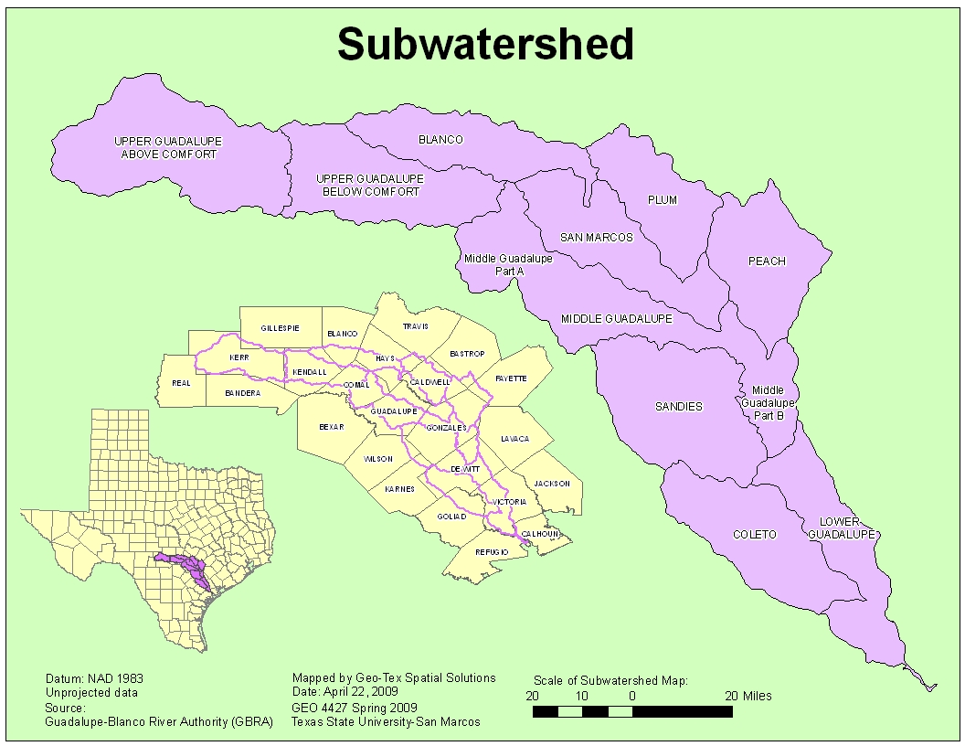
Result
We produced the final interactive maps which were the goal of this project.

Slide 18
Result
This new resource will allow the GBRA to further its goal of educating the public by providing an interactive map that will allow users to manipulate and gain specific information via the internet.
The inclusion of interactive maps on the GBRA web site not only provides users with a visual representation of the existing resources within the boundaries of the 10-county statutory district, but allows users to see how those resources are related to each other.

Slide 19
Result
Website:
http://geo-305592.evans.txstate.edu/index.htm
Web Map:
http://localhost/IMS/default.asp

Slide 20
Discussion/Data Collection
1) data received directly from the GBRA
2) data retrieved from outside sources
3) original data, which was created by our team

Slide 21
Discussion/Data Assembly
1) importing the data into GIS software (Arc-GIS ver. 9.3)
2) creating the metadata for the project

Slide 22
Issues Encountered During Data Assembly

Slide 23
Discussion/Web GIS Assembly
Over the course of the Web GIS assembly, we continually worked to locate and identify bugs, optimize user performance, and increase page download times.

Slide 24
Discussion/Web Site Assembly
The web site includes hyperlinks to all documents and PowerPoint created during this project, as well as all static maps and the interactive map.

Slide 25
Conclusion
We, Geo-Tex Spatial Solutions, believe that this project will achieve the needs of GBRA. The interactive Web-GIS map will provide the user with valuable information about the recreational and educational resources in the watershed. This new resources will further enable GBRA to “protect, conserve, reclaim, and steward the resource,” that they oversee.
In the course of this project, we have learned how to work with the private sector, time management, and work as a group. This was a valuable experience that we will be able to take with us as we move into looking for jobs and enter the working force. We have been able to learn from your mistakes and come to understand that everything will not work as planned, so it is best to set aside extra time to reorganizes initial ideas and plans. Overall, this was a valuable experience that we thank Dr. Giordano and Cinde Thomas-Jimenez for letting us be a part of.

Slide 26
Question?

