Slide 1
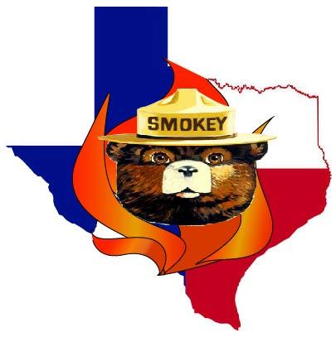
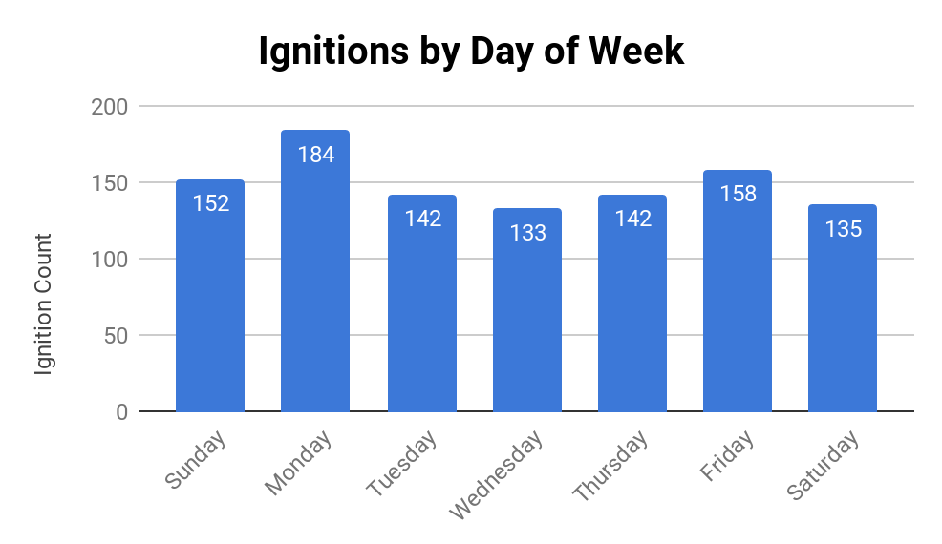
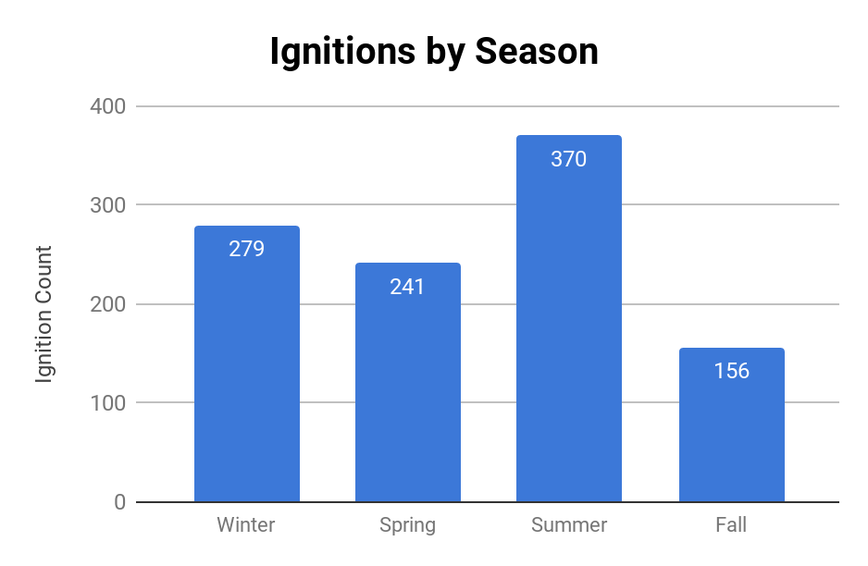
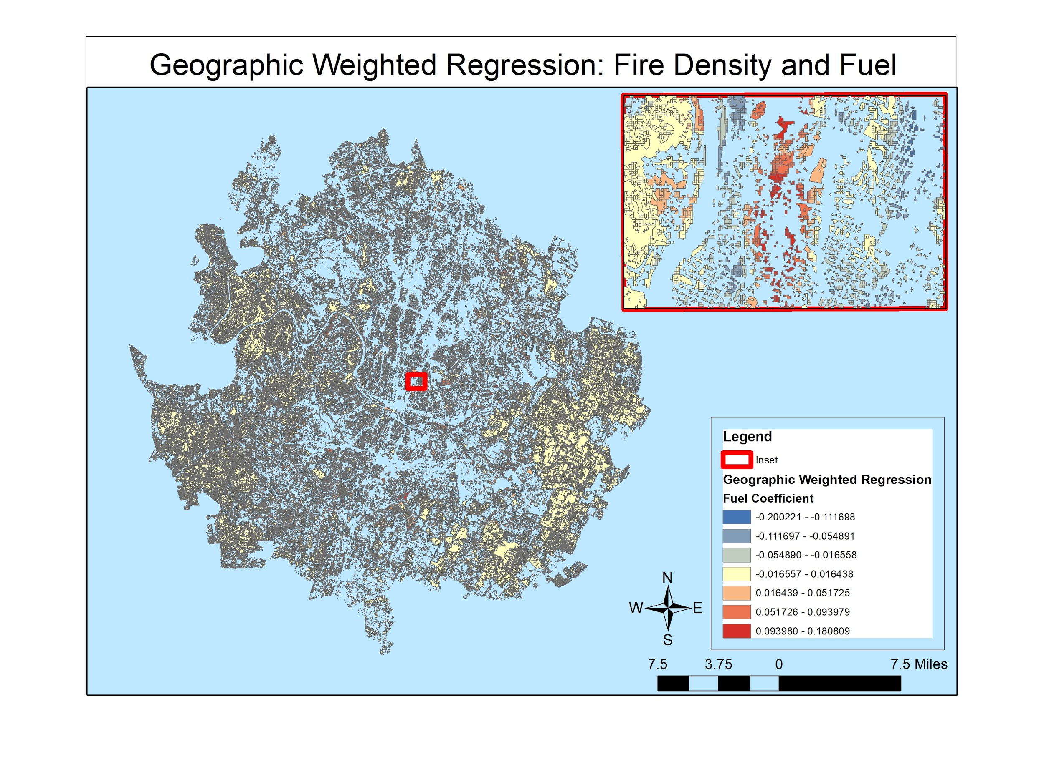
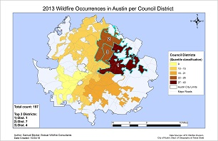
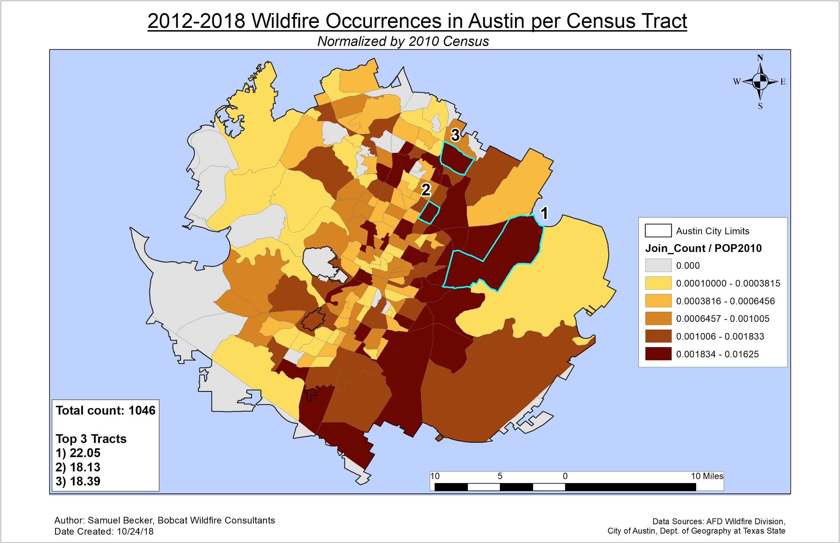
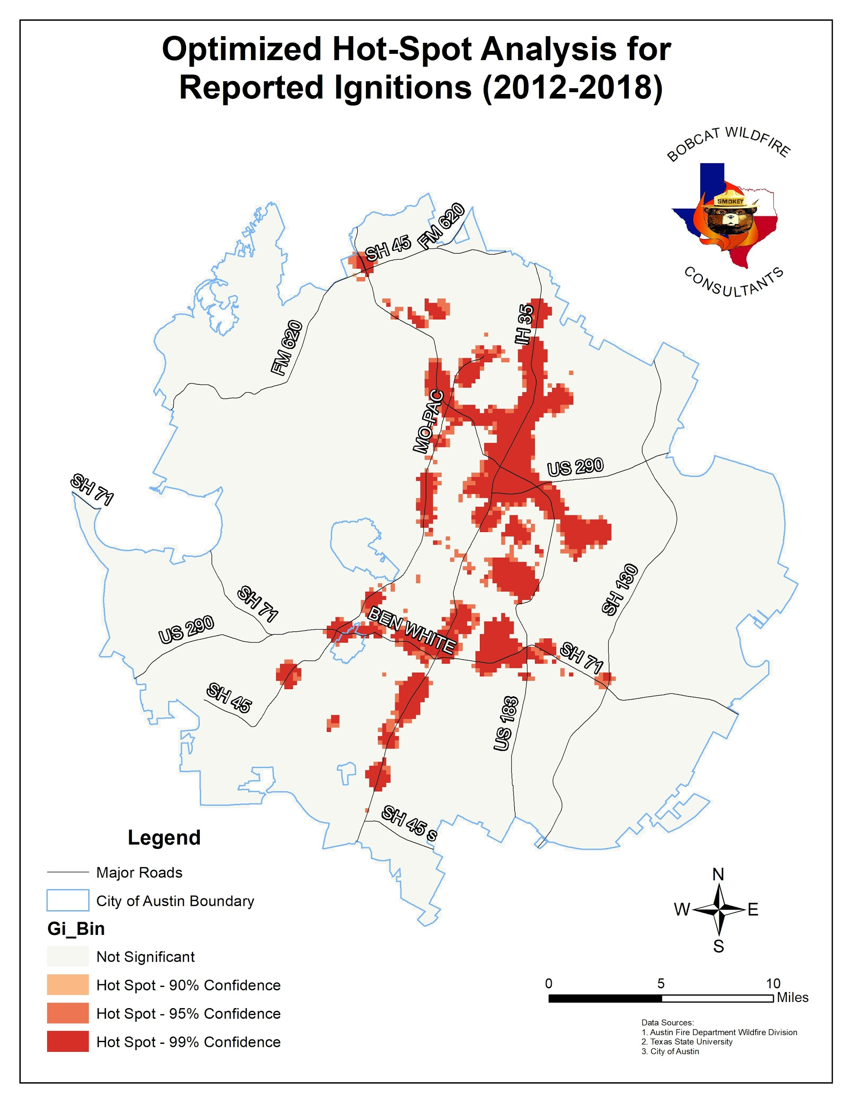
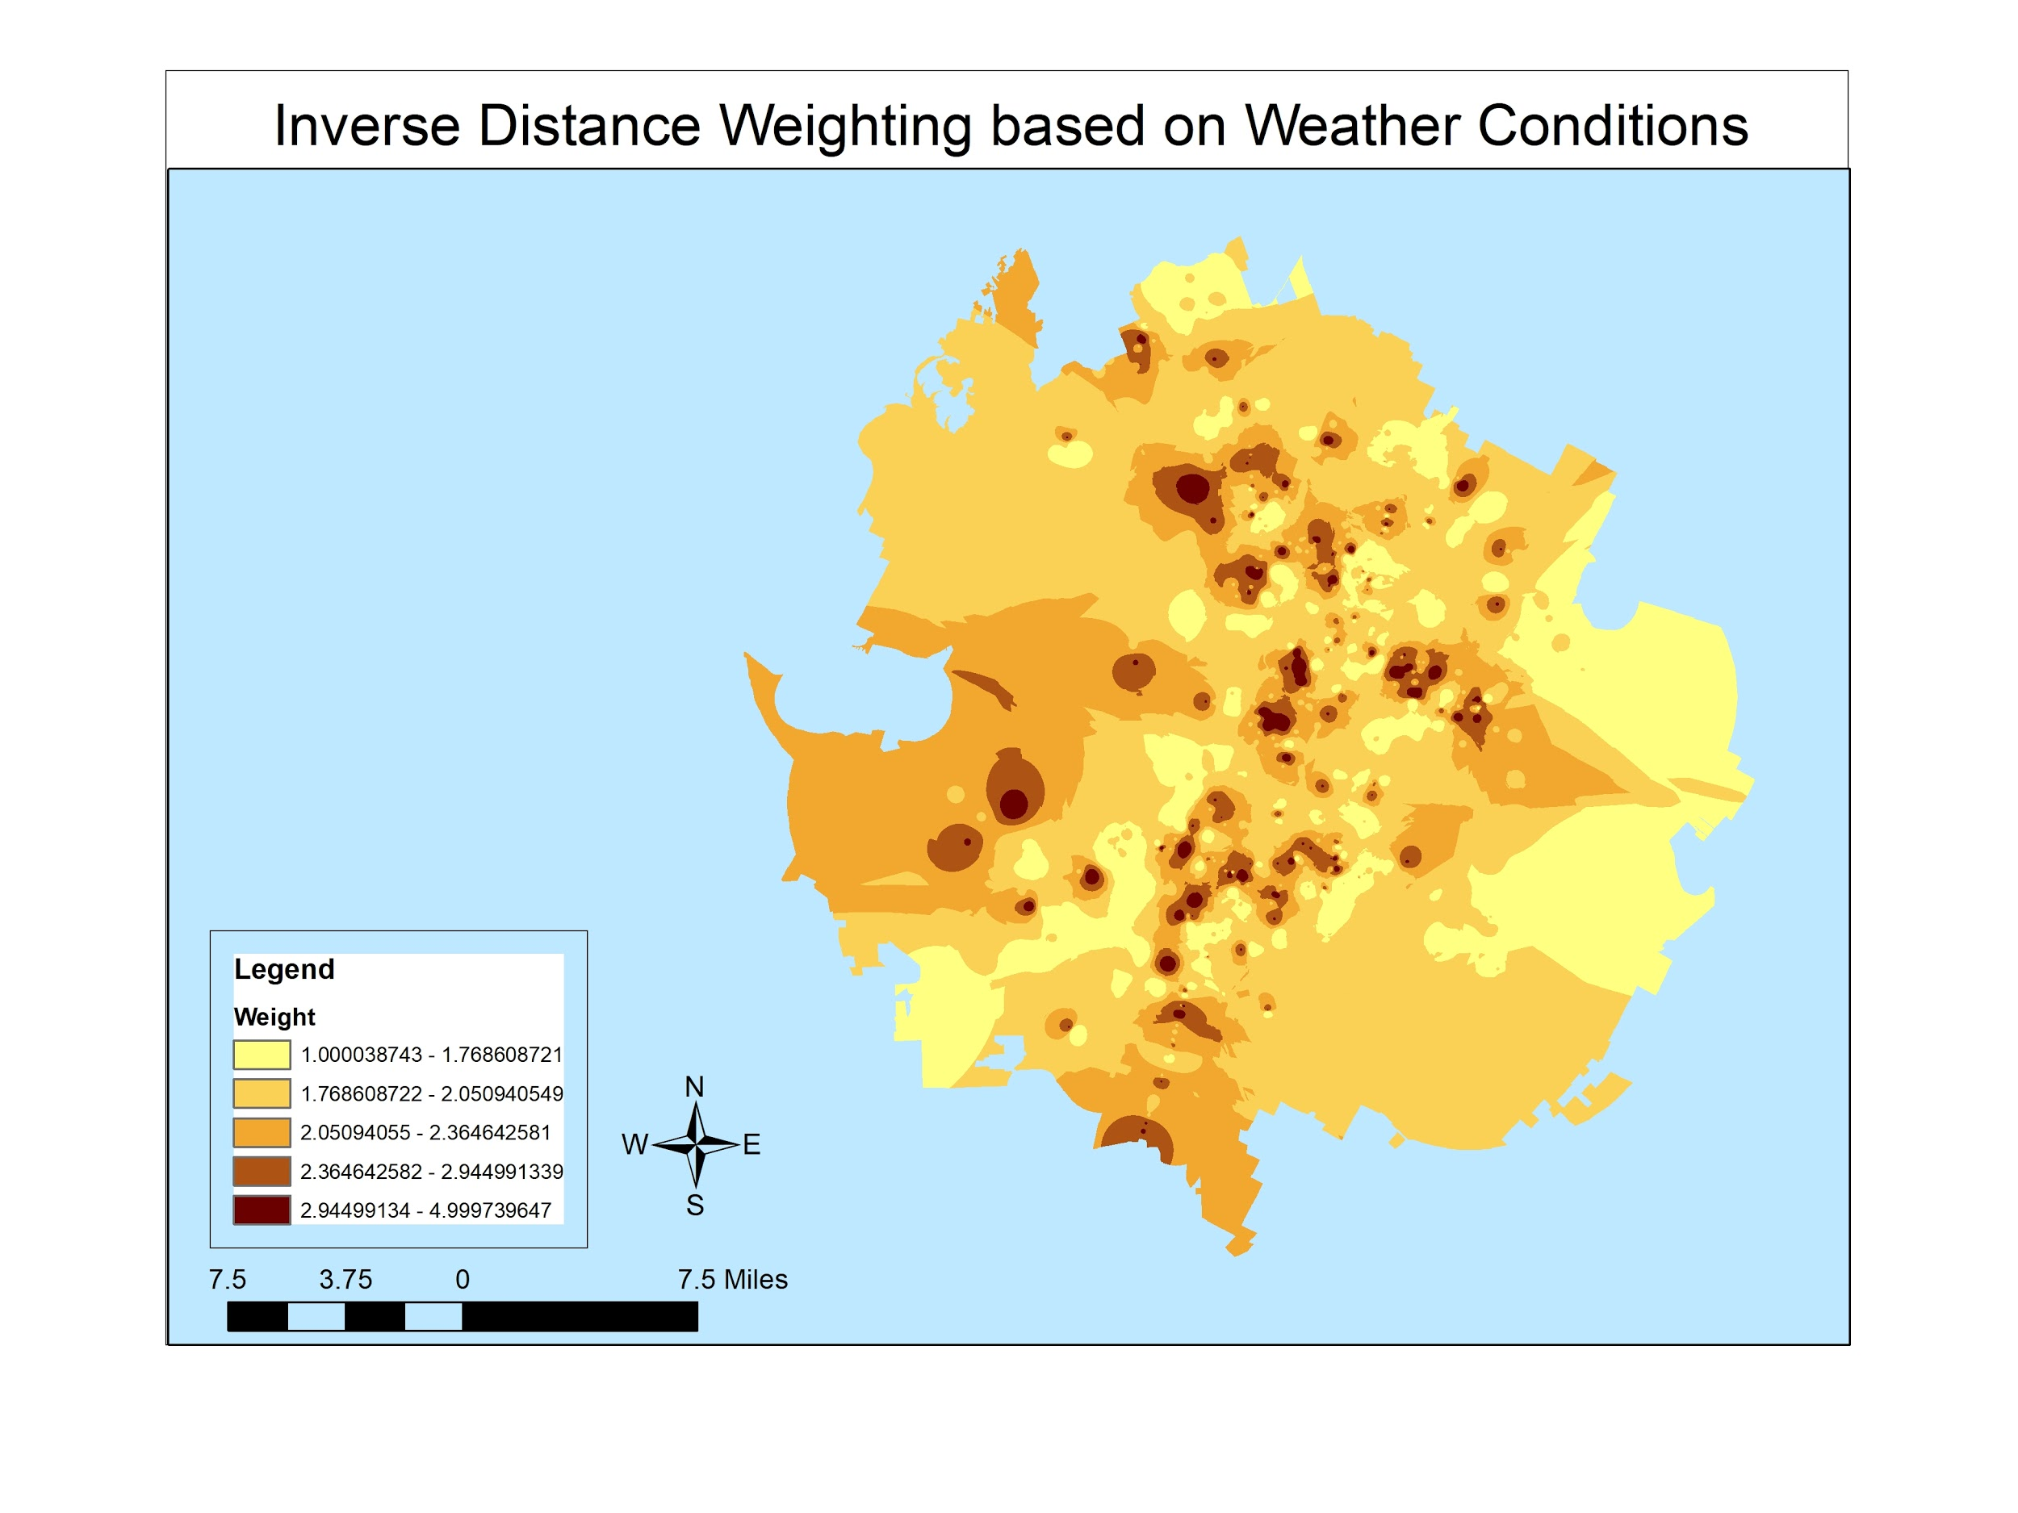
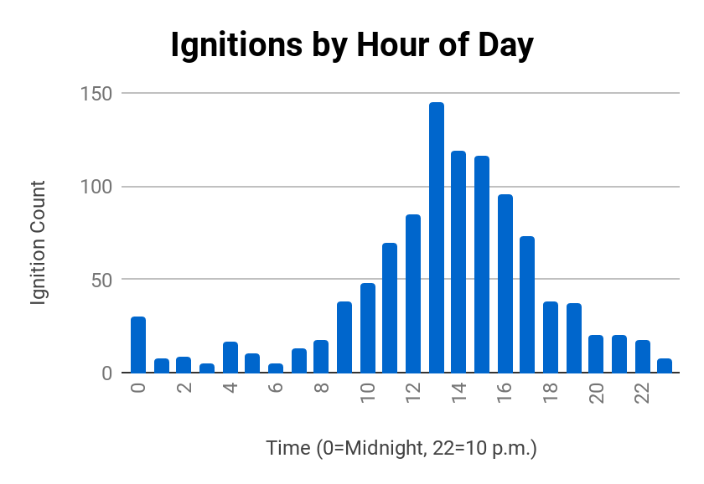
Spatiotemporal and Regression Analysis of Austin Fire
Department Wildfire Division’s Reported Ignitions
From January 2012 to July 2018
Background:
The Austin Fire Department Wildfire Division (AFDWD) documents hundreds of reported fire ignitions a year. Because of this there’s an imminent need to geographically understand the factors involved in the production of these human-created incidents. This study looks at a 6-1/2 year window of 1,046 reported ignitions that occurred within Austin’s municipal boundary from January 2012 to July 2018. Bobcat Wildfire Consultants have conducted a spatial and temporal analysis of wildfire trends by looking at various factors that contribute to these fires. In addition, we created a fire density prediction model through a geographically-weighted regression analysis.
Results and Findings:
Wildfires by year revealed that 2013 saw the most fires with 197. Our spatial analysis revealed that the top two census tracts that contained the most reported ignitions were tract 22.05 and 18.13, both located in Austin’s eastern region. Austin Council District 1 was the most active district in terms of wilfire reports; this district is also located in Austin’s eastern region. Our hot-spot analysis revealed that most concentration of wildfires occur near the intersection of IH-35 and US 183, and also near the intersection of Cameron Road and Rundberg Lane, both in northeast Austin. The road density data we looked at of this same area indicated that this intersection is a heavily traveled roadway.
Methodology:
We conducted our work using Microsoft Excel and ArcMap 10.6.1. Our spatial analysis consisted of three different methods. In order to report how many fires occurred in a particular council district or census tract we used the spatial join tool to count and classify our results. We categorized our council district results into classes using the Quantile method. For our census tracts we normalized the data to more accurately represent the number of fires as a percentage of each tract’s population. Our second method was to run a hot-spot analysis of wildfires for all years in the dataset. We mapped the hot spots plus verified the z-scores and p-values which would give us our confidence level. For our temporal analysis we graphed the wildfire data to show a wildfire count by hour of day, day of week, and by season. Our last analysis consisted of using both Ordinary Least Squares (OLS) and Geographically Weighted Regression (GWR) to help identify a known variable that contribute to wildfires. Our approach was to assign fire density as the dependent variable and use available fuels as the explanatory, or independent variable. This required us to classify all of our input rasters using the same classification scale. Once we achieved this step, we converted our data to vector format and joined attributes based on a common field.
Conclusion:
Our analysis indicates that Austin’s eastern areas pose just as great risk, if not more, than the heavy forested areas of the western region, but both areas are equally susceptible to wildfire occurrence.
Summary:
The threat of wildfires is a never-ending serious concern to people and property, and the better we can understand the factors that play a role in their occurrence the more informed our decisions and behaviors will be in controlling them.
References:
Bowman Consulting Group, Ltd. 2014, June 30. Austin/Travis County Community Wildfire Protection Plan. United States, City of Austin, Office of Homeland Security and Emergency Management. Retrieved September 1, 2018, from http://www.austintexas.gov/wildfireprotectionplan
Headwaters Economics. September 2018. Wildfire & Vulnerable Populations in Austin, Texas. https://headwaterseconomics.org/wildfire/homes-risk/austin-wildfire-population-risk.
Poster board prepared on December 3, 2018, by:
Bobcat Wildfire Consultants (David Olguin, Rhodes Smartt, Sam Becker, Thanh Nguyen, Jorge Perdomo)

