Slide 1
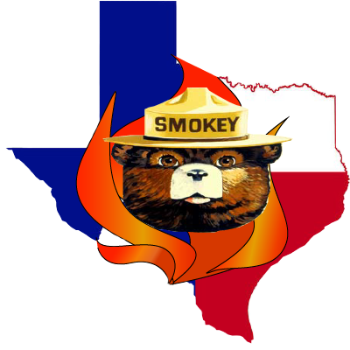
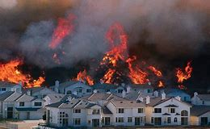
Geographical Analysis of Austin Fire Department Wildfire Division’s Reported Ignitions from January 2012 to July 2018
Bobcat Wildfire
Prepared by:
Bobcat Wildfire Consultants
David Olguin (Manager)
Thanh Nguyen
Rhodes Smartt
Jorge Perdomo
Sam Becker
December 5, 2018
Consultants
Image courtesy of globalchange.gov.

Slide 2
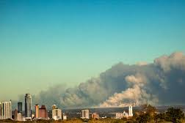
Purpose & Scope
Who is this for?
City of Austin
Austin Fire Department Wildfire Division (AFDWD)
Residents living in the Wildland Urban Interface (WUI)
General Public
Why are we doing this?
Wildfires are a threat in Central Texas.
To mitigate wildfire damage to people and property.
To guide Austin’s citizens through wildfire education and awareness.
Image courtesy of CNN.com
Hypothesis: Wildfires most commonly occur in forested areas, where vegetation is most dense and at the hottest times of the year.

Slide 3
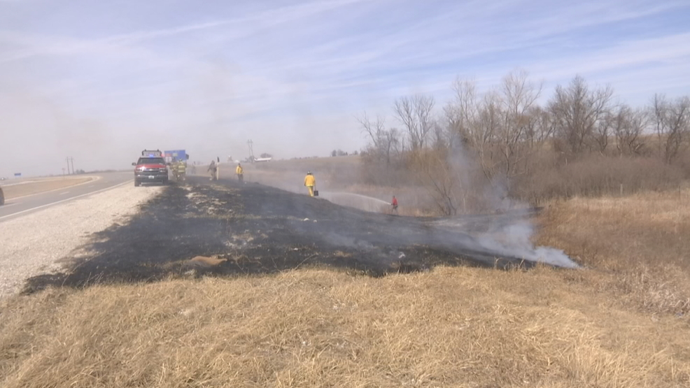
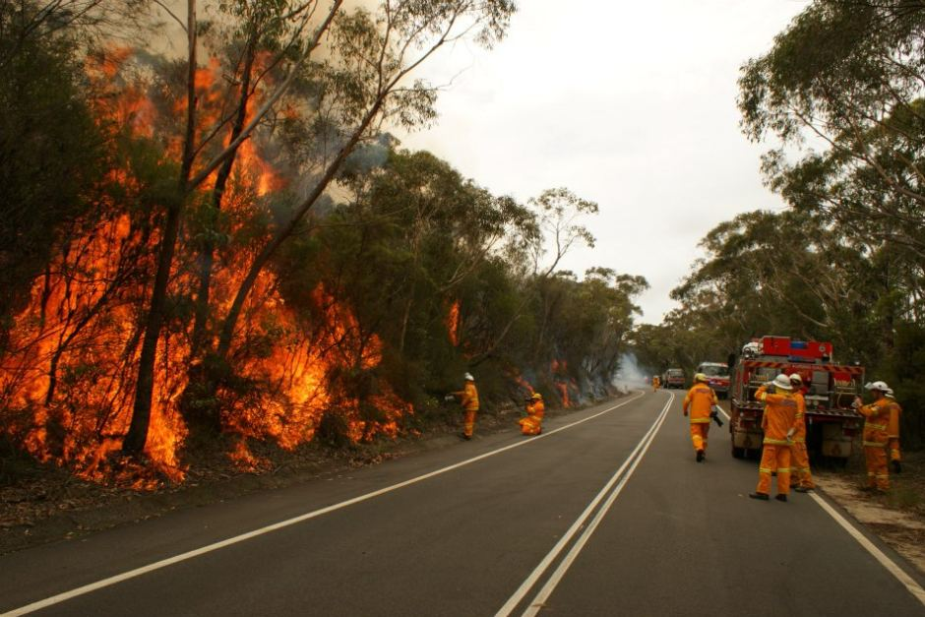
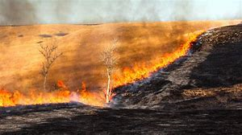
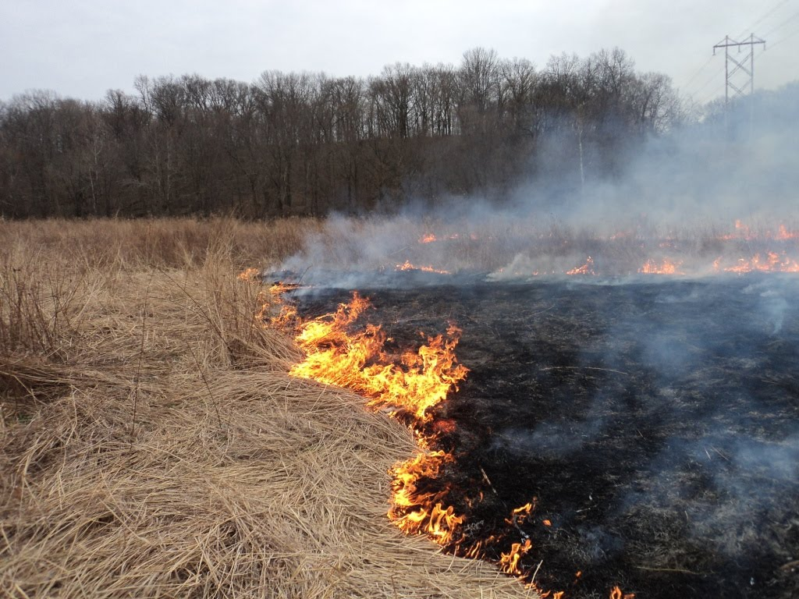
Where is the threat?
Near the wildland urban interface.
Along roadsides, where grass is abundant.
In forested areas and open prairielands.
Over 88% of the reported fires were brush, grass, or mixture of both.
Less than 2% of reported fires were in forested or wooded vegetation.
Image courtesy of ktvo.com
Image courtesy of abc.net.au
Image courtesy of npr.org
Image courtesy of thediaryofalakenerd.blogspot.com

Slide 4
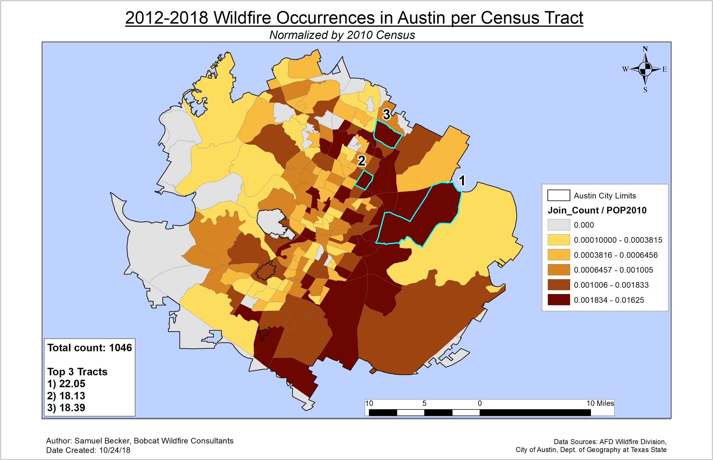
Spatial Analysis: Political Boundaries
Census Tracts
Normalized density data by 2010 Census’ population figures
Most occurrence density directly east and along I-35, particularly the Rundberg area
Tract 22.05 had most occurrences for 6 and ½ year study period

Slide 5
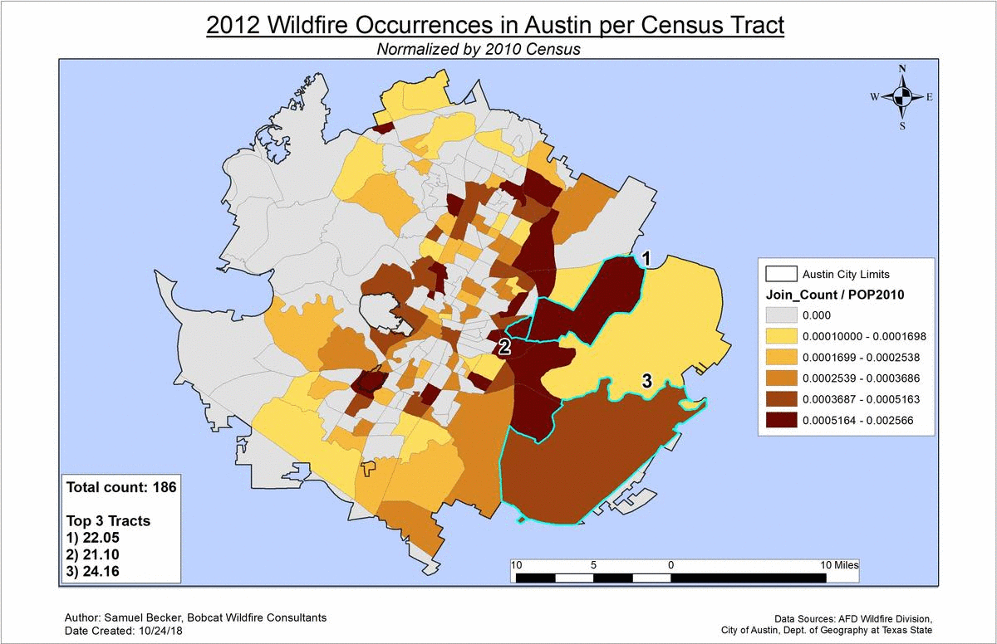

Slide 6
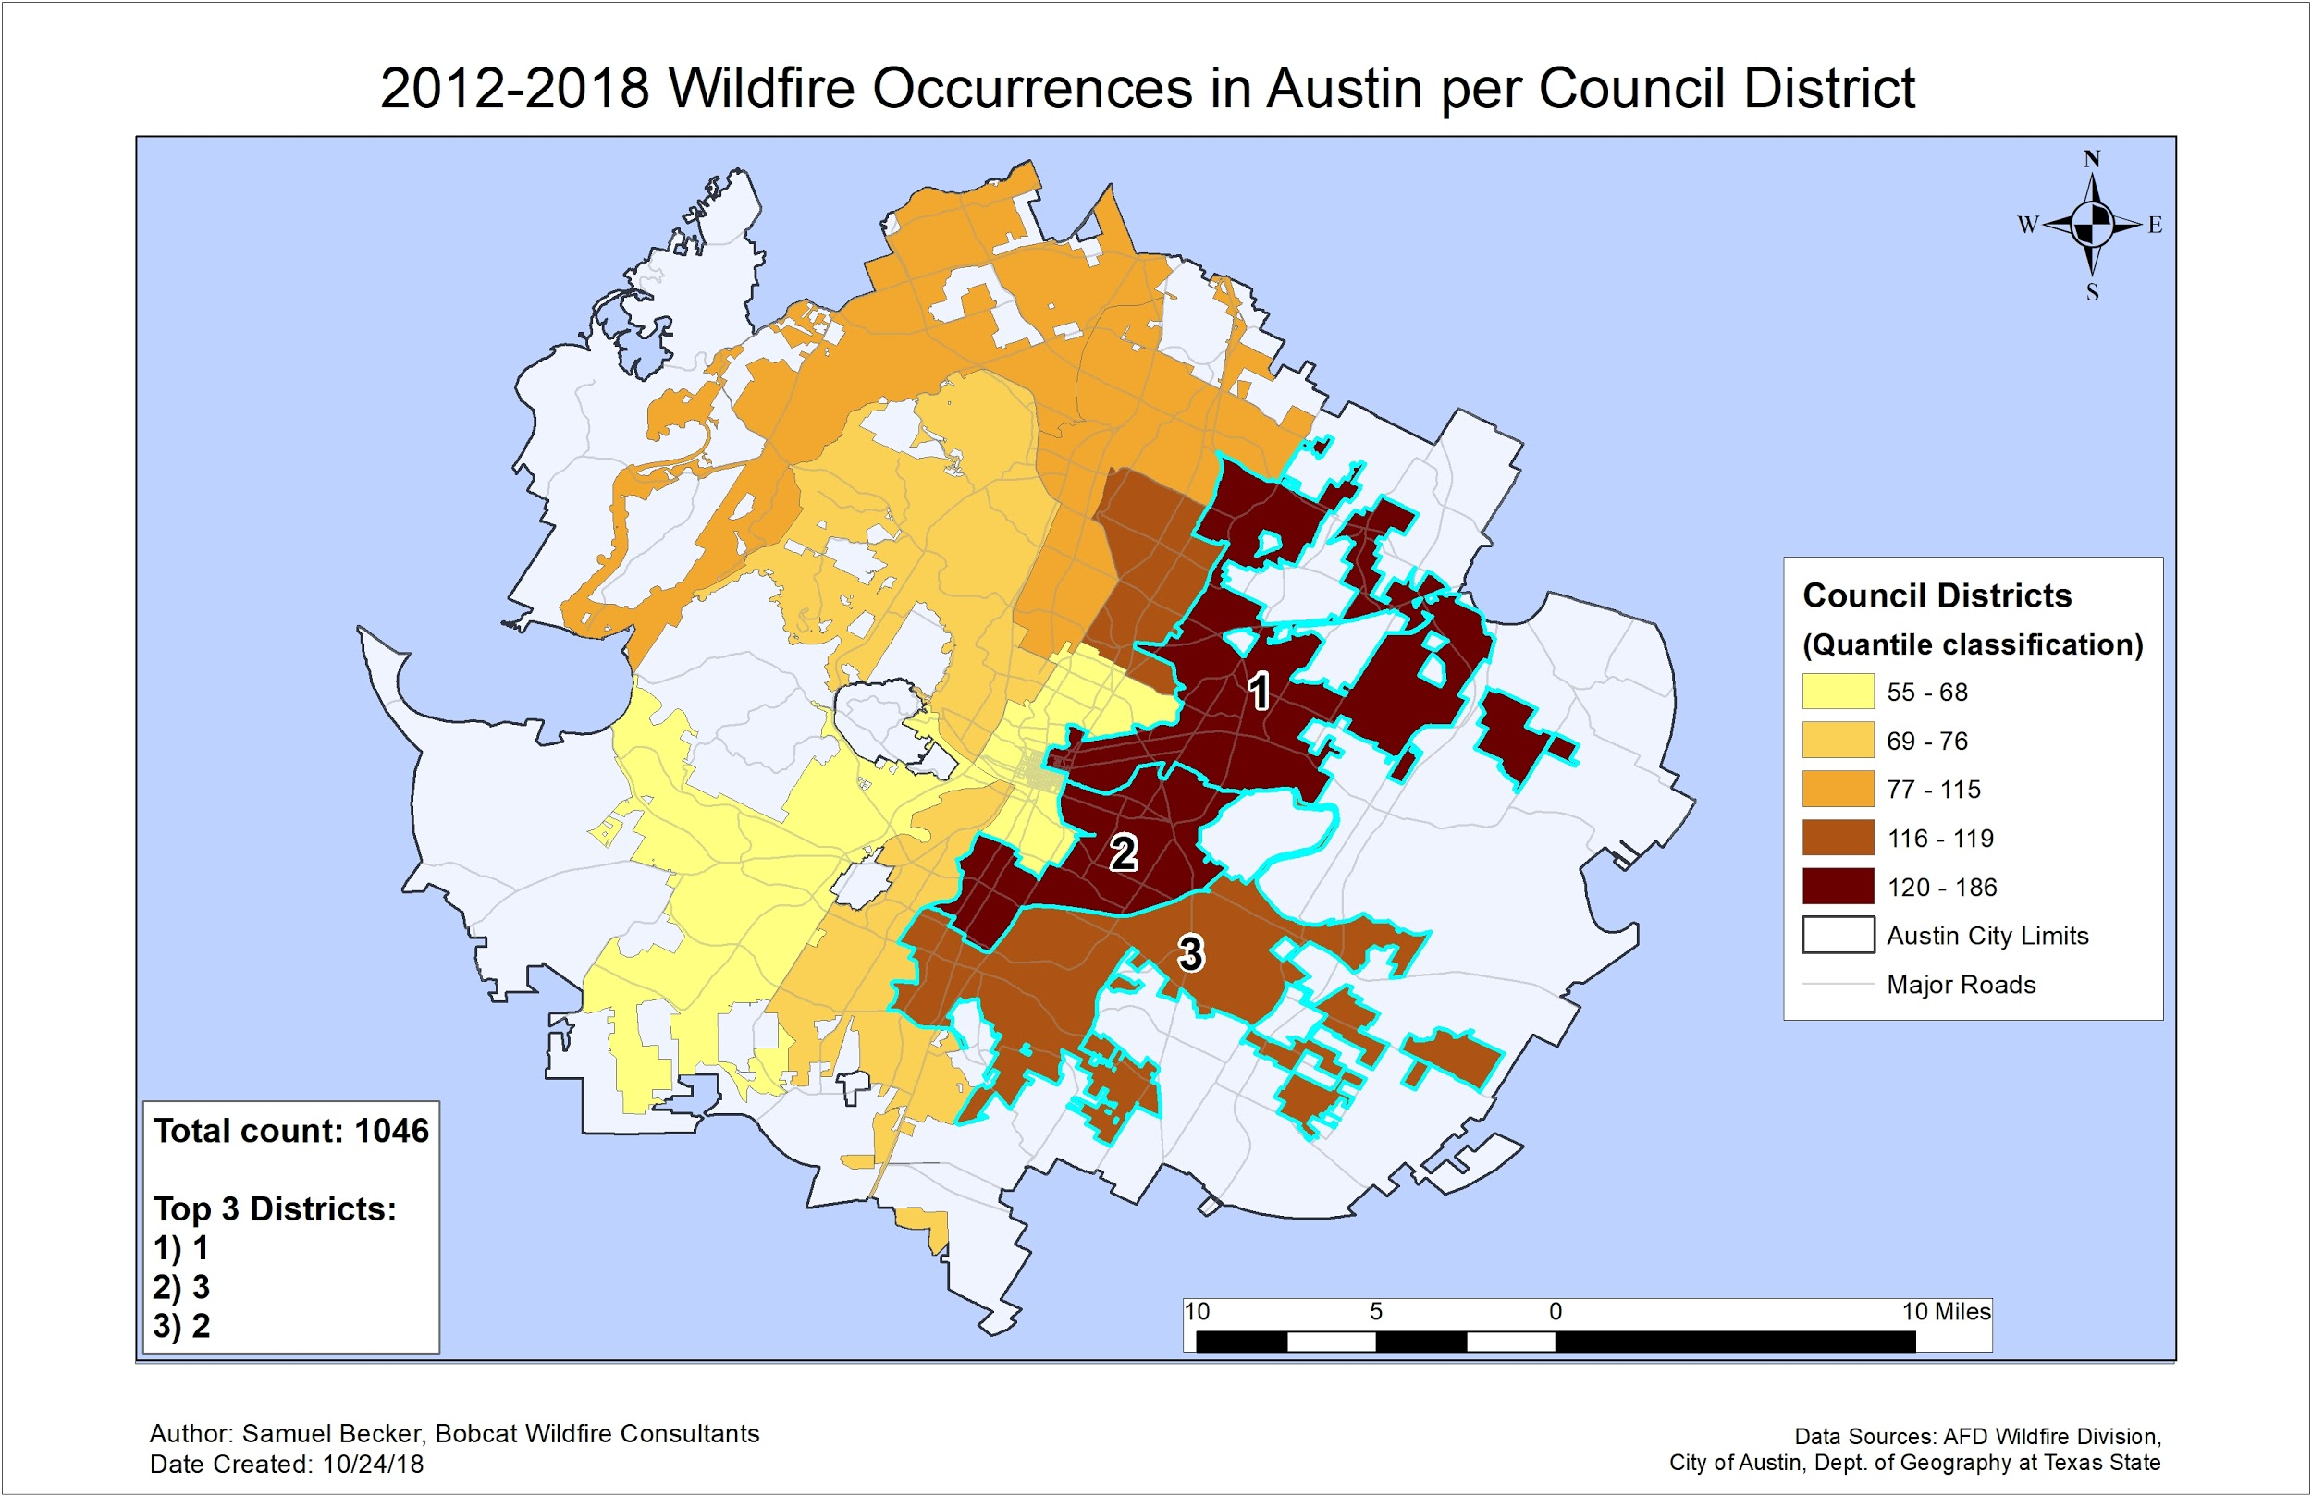
Spatial Analysis: Political Boundaries
Council Districts
No data available for normalizing this density analysis → is a definite limitation
Most occurrences for 6 and ½ year study period in District 1, Rundberg and surrounding area
Overall clustering directly east and along I-35

Slide 7
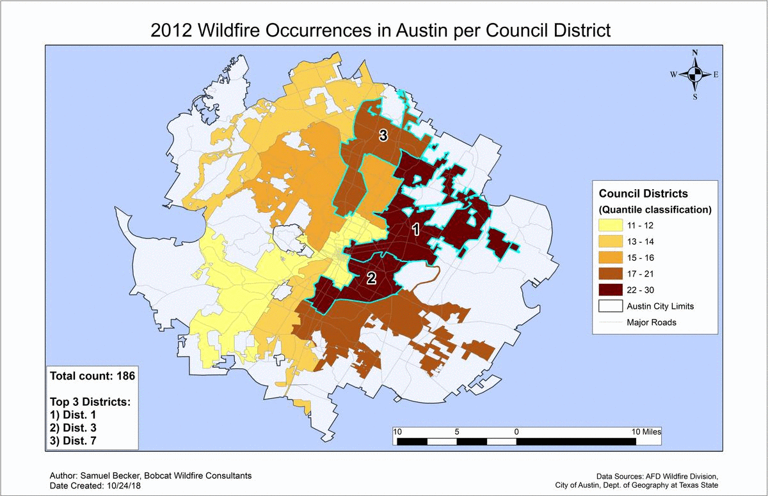

Slide 8
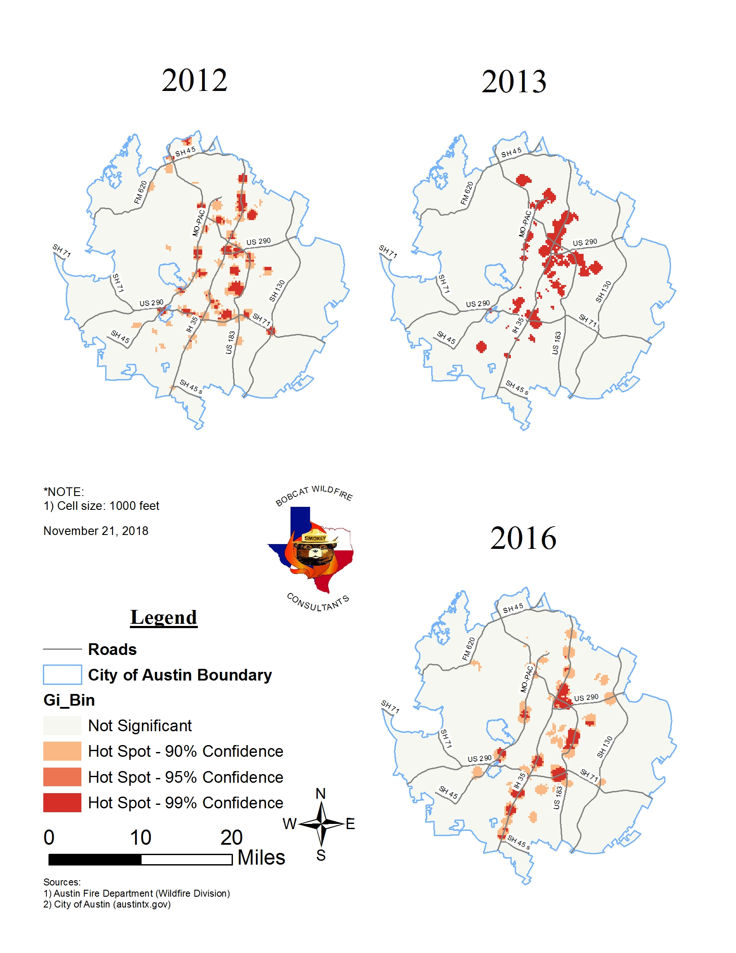
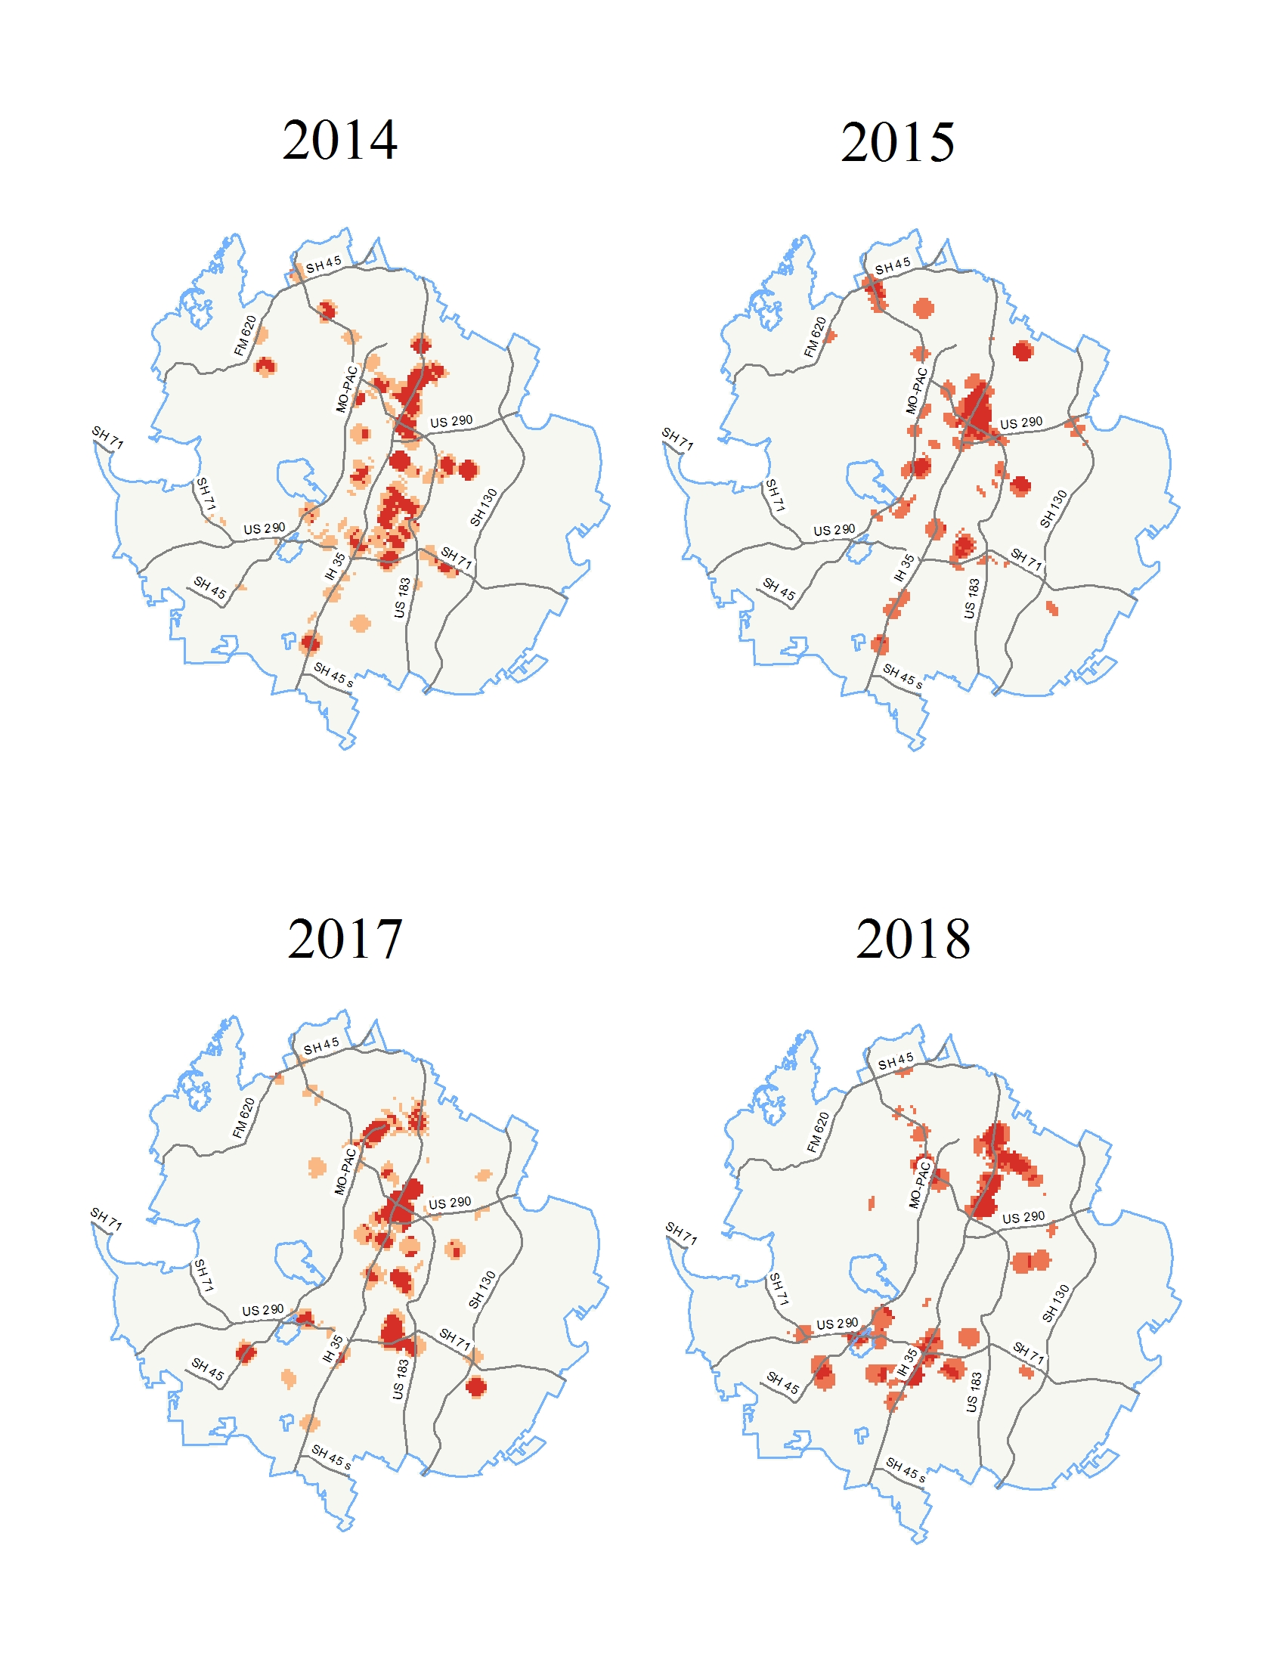
Spatial Analysis: Optimized Hot-Spots
Output hot-spots resulted in high z-scores, low p-values.
highest z-score: 17.99
lowest p-value: 0.01
99% confidence level
Fires are clustered near major road intersections, i.e. IH-35 and US 183.

Slide 9
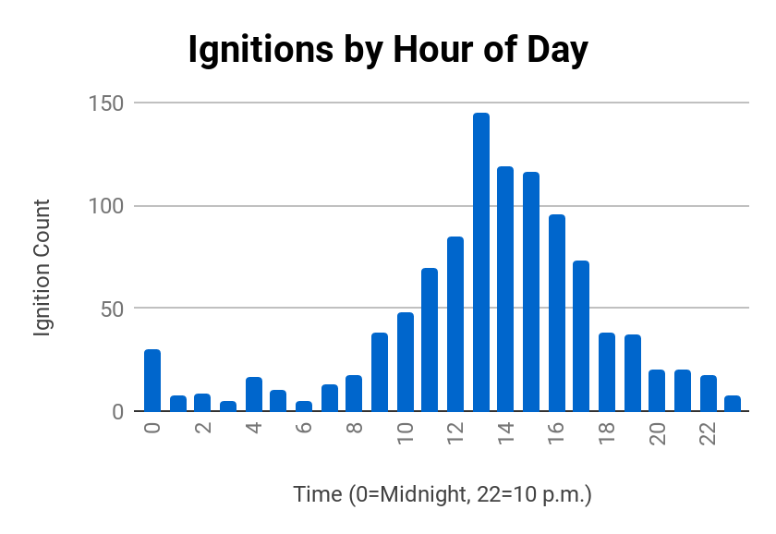
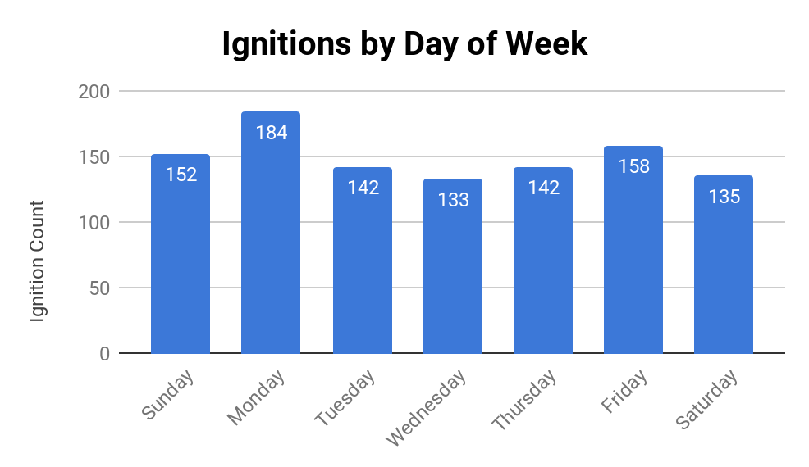
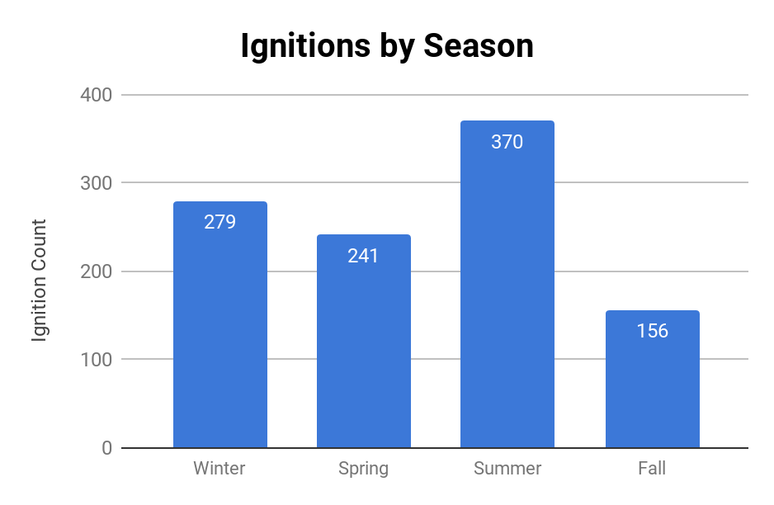
Temporal Relationships
145 fires
Almost 14% of reported ignitions occurred between 1 and 2 in the afternoon.
Over 17% of reported ignitions occurred on a Monday.
Over 35% of reported ignitions occurred during the summer.

Slide 10
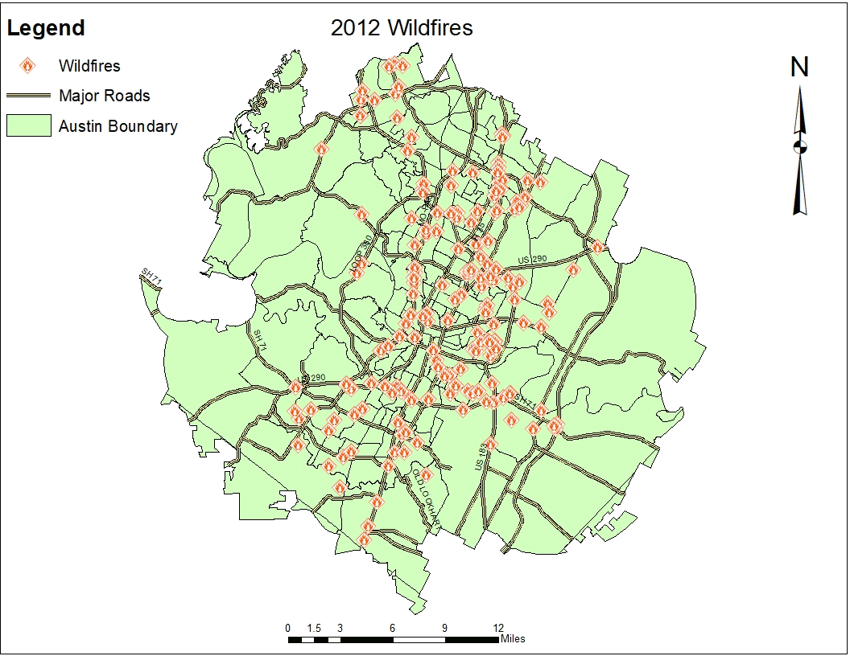
Temporal Maps- Yearly Total Occurrences
Animated Maps
Produced Monthly Layers
Formatted Attributes
Enabled “Time” Function
Ran Animation Tool
Exported Sequential JPEG’s
Converted to GIF
*Please note, the displays for August to December does not include any 2018 fires because our dataset ended in July 2018.

Slide 11
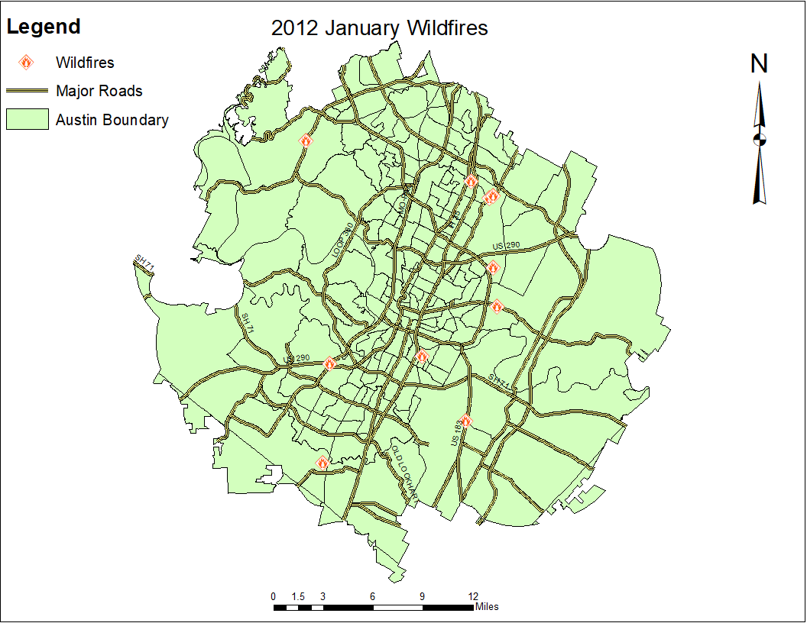
Temporal Maps- Monthly Occurrences by year
*Please note, the displays for August to December does not include any 2018 fires because our dataset ended in July 2018.

Slide 12
Temporal Maps- Chronological Occurrences
*Please note, the displays for August to December does not include any 2018 fires because our dataset ended in July 2018.

Slide 13
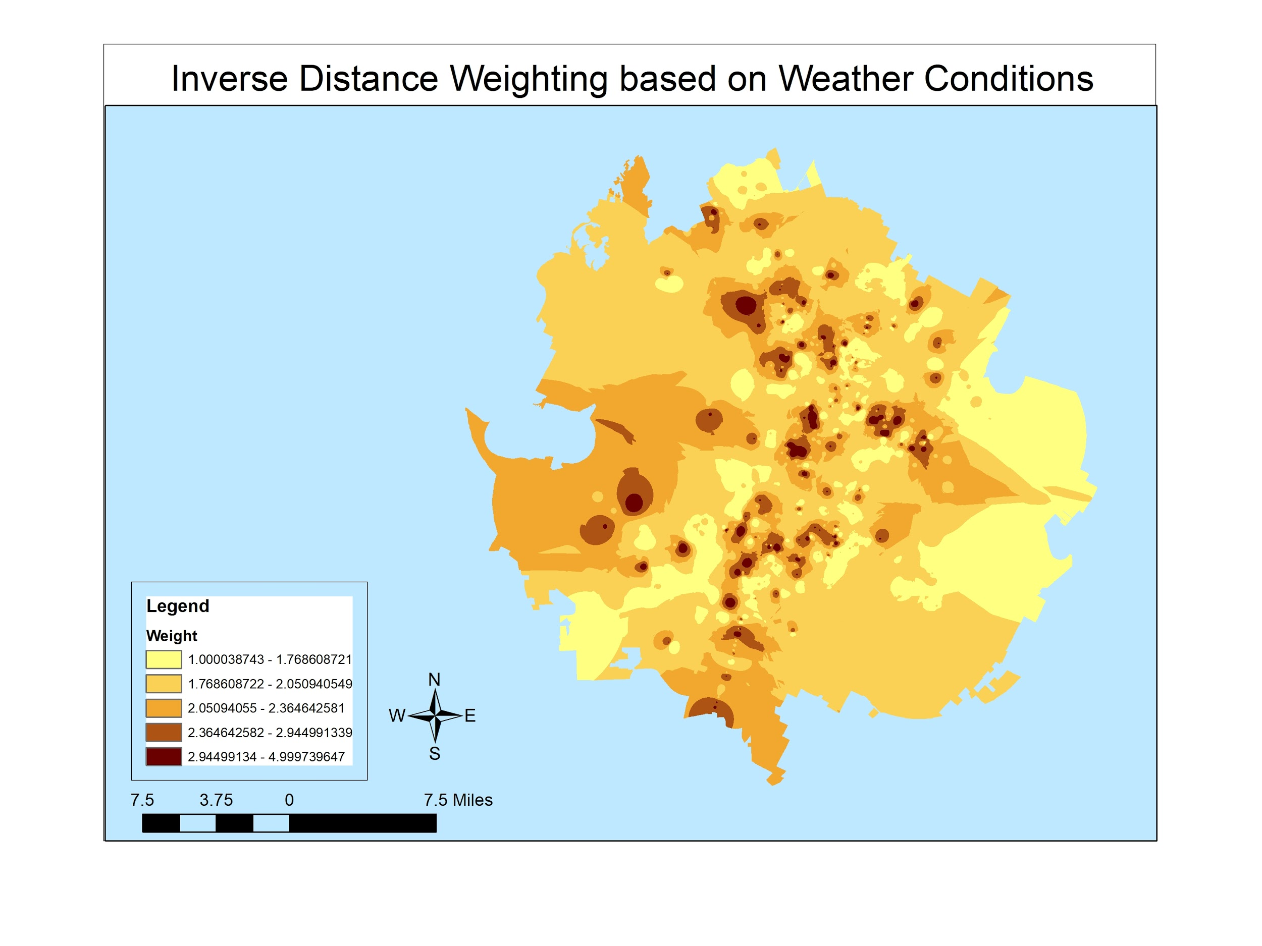
Weather Conditions
Used Excel to enter in weather conditions for attribute table (1-5 with 5 being the most extreme days)
Joined with fire locations based on date they occured
Created inverse distance weighting map having 5 have the most weight.

Slide 14
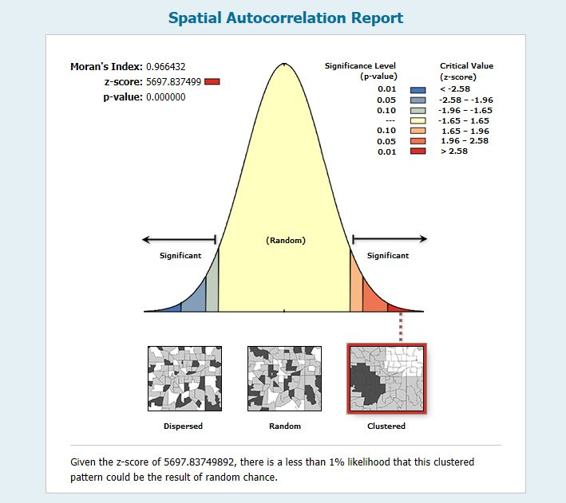
Regression Analysis
Variables:
Dependent- Fire Density
Exploratory- Fuel Type
Road Density
Ordinary Least Squares Analysis (OLS)
Positive coefficient for vegetation(fuel load)
Negative coefficient for road density
Low VIF for both

Slide 15
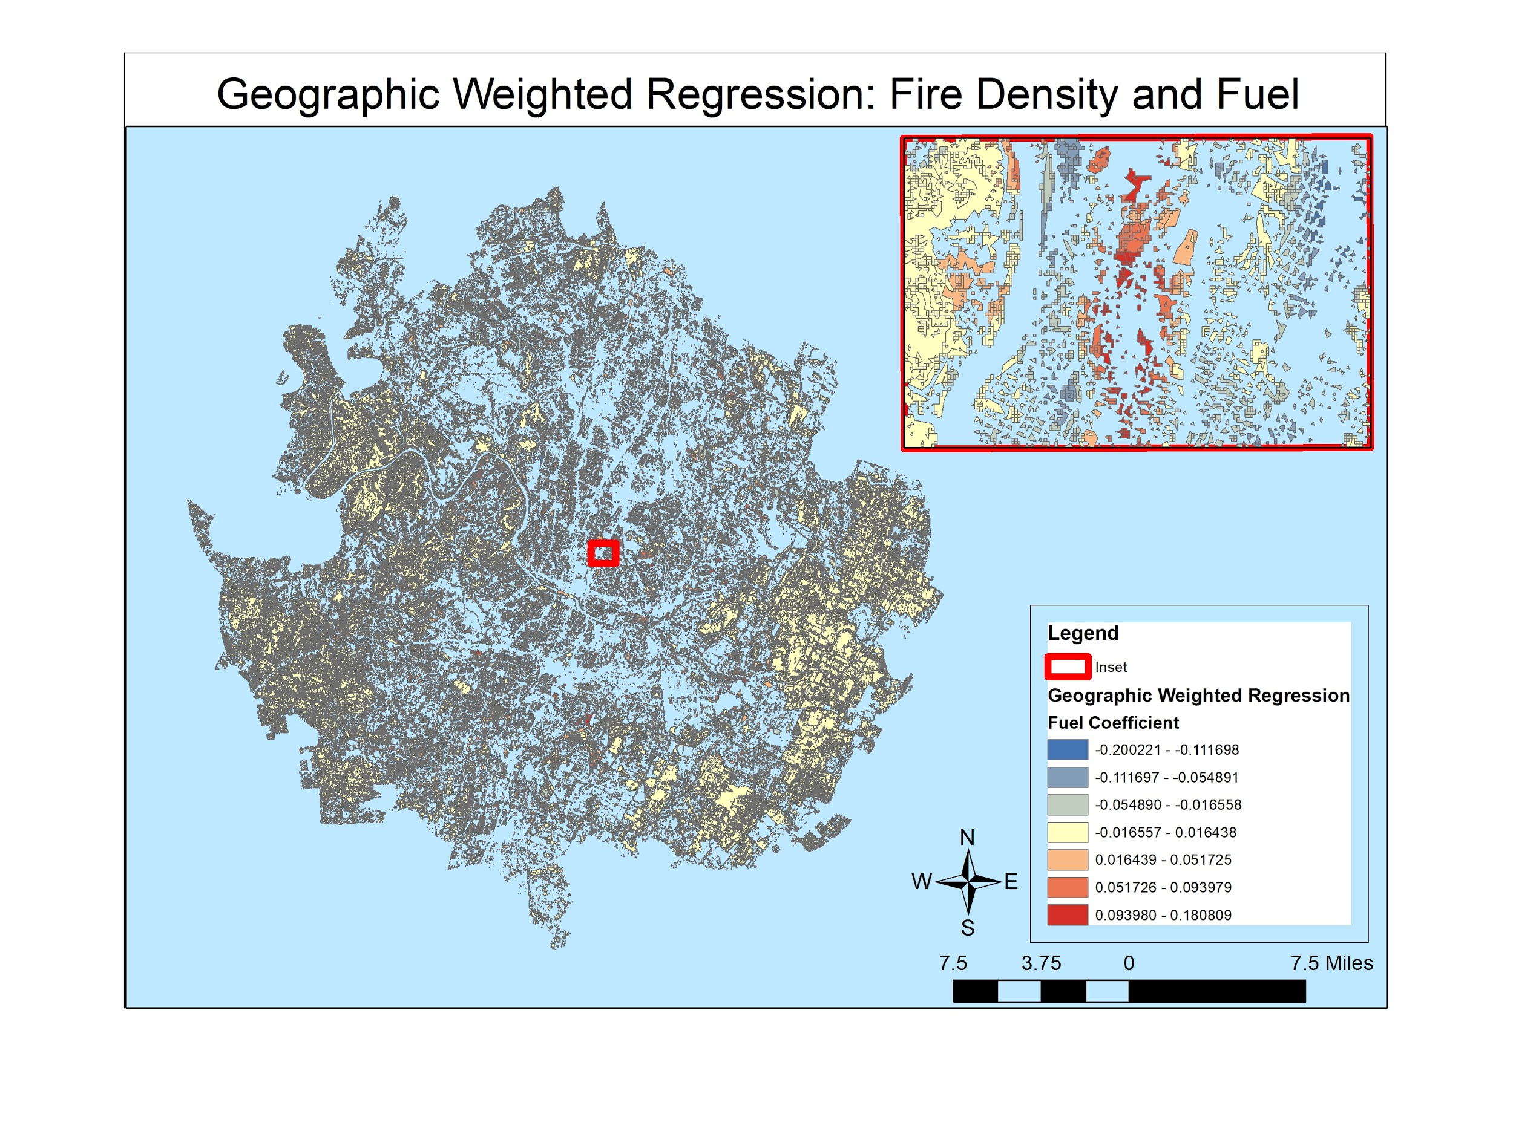
Regression Analysis (Continued)
Geographic Weighted Regression
Kernel Density fire location
Cell size of 98.5 feet
Raster to vector (polygon)
Spatial Join between variables
Map showing a geographic weighted regression for the variables of fire density and fuel load

Slide 16
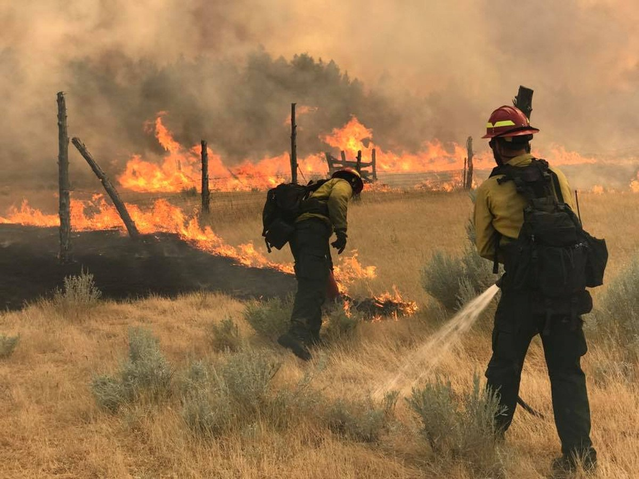
Summary & Conclusion
Contribute to Austin’s CWPP
Conducted Wildfire analysis
Determined risk:
Built analytical model
Photo Credit: www.wired.com “The Science of Firefighting”

Slide 17
Questions?
Bobcat Wildfire
Consultants

