Slide 1
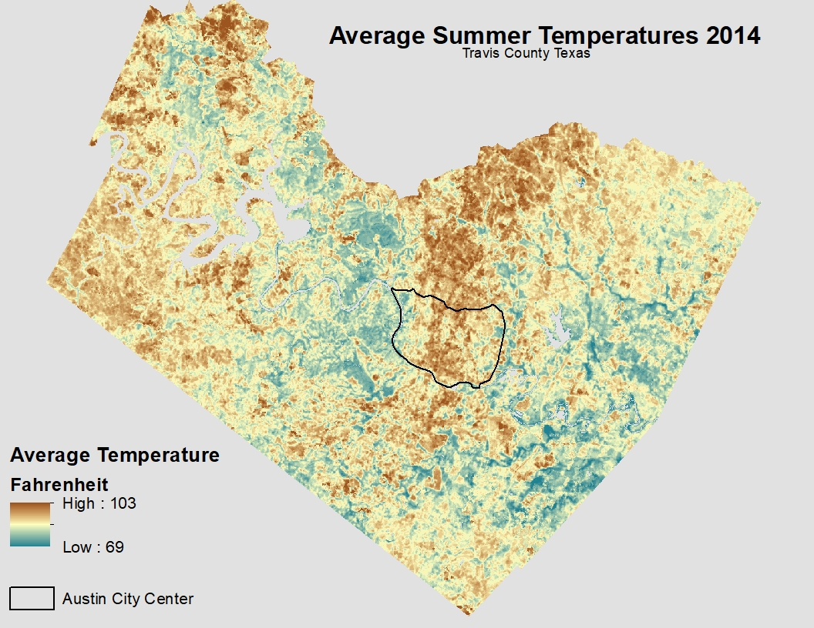
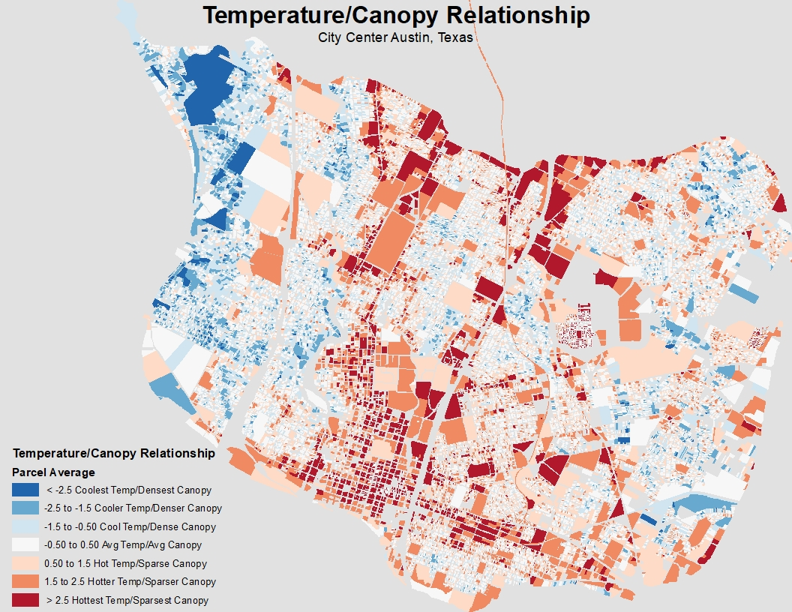
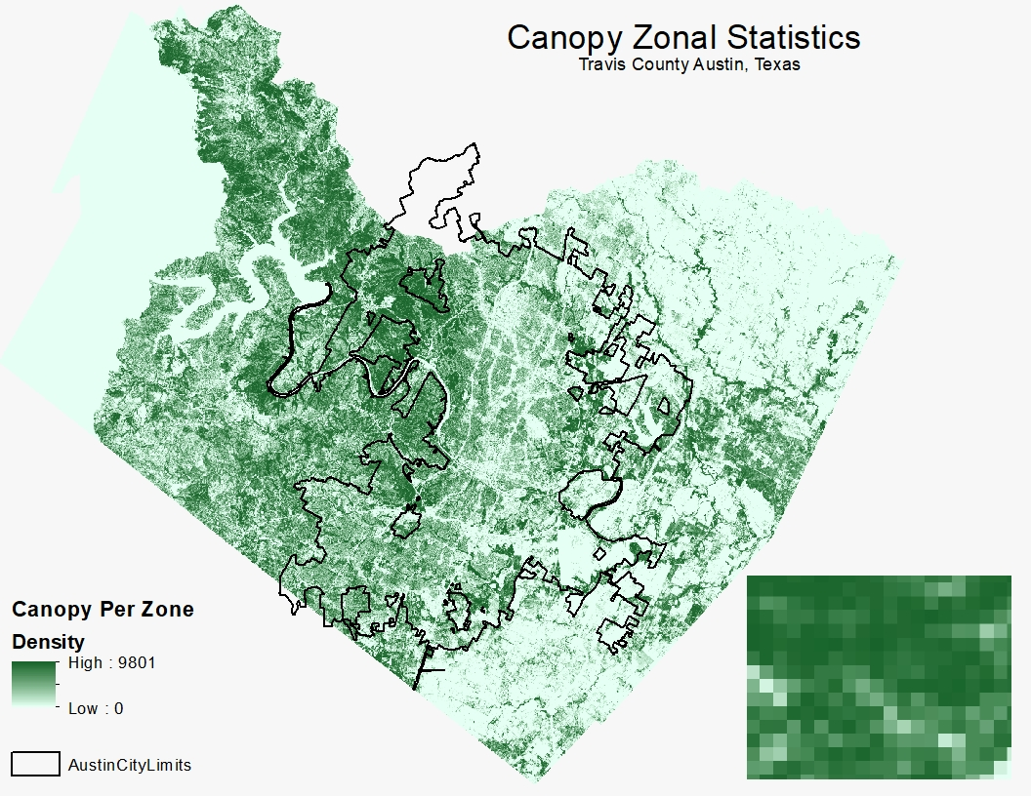
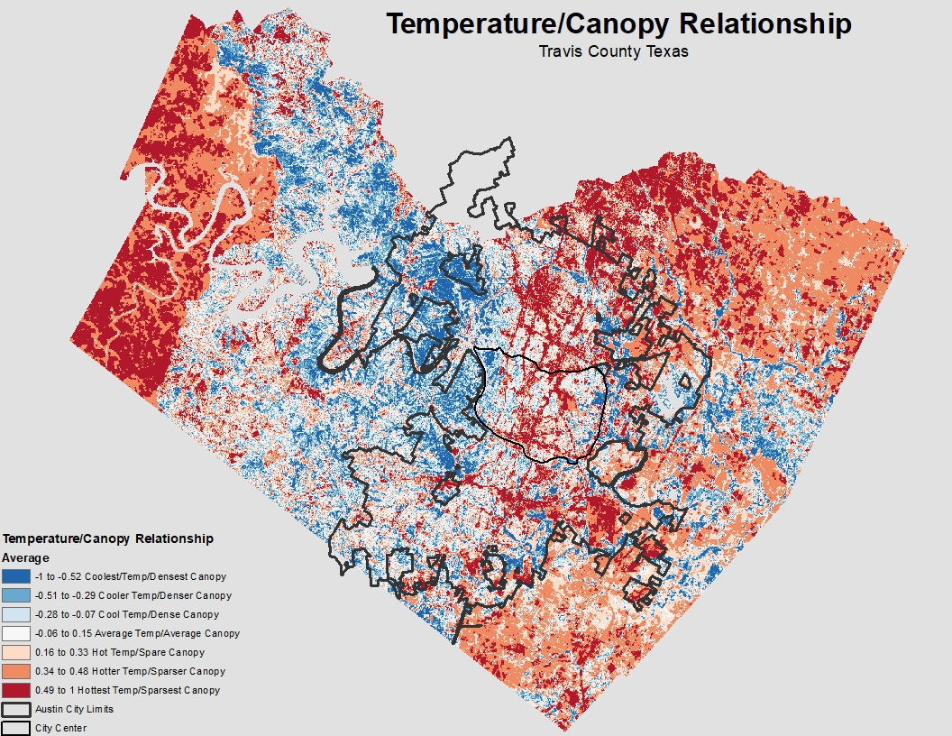
Examining the Relationship Between Urban Heat Islands and the Tree Canopy in Austin, TX
Alexis Ramirez, Gabrielle Allen, Kallie Hallmark Bradley, Rance Parker, Zachary Mayer
GEO 4427 - Fall 2018, Texas State University, San Marcos, TX
INTRODUCTION
The Urban Heat Island effect (UHI) is when impermeable materials that make up buildings such as pavement, concrete, parking lots, and roads absorb and radiate more heat than in surrounding rural country areas. This causes dense urban areas to be significantly warmer and potentially coinciding with heat waves. This phenomena causes health problems such as heat stress and heat stroke, or air pollution to intensify.^{[3]} During the summer months where temperatures reach extreme highs, energy usage has been recorded to increase 5-10%.^{[1]} The science behind UHIs and the impact of the urban tree canopy (UTC) has been observed and studied for decades. In California and Florida, some solutions to UHIs have been implemented including increasing tree shade around buildings, which has resulted in reduced utility cooling demand of the shaded buildings.^{[2]} Trees provide shade and transpiration which causes cooling as much as four to six degrees farenheit difference from areas without trees, when they are fully grown.^{[3]} UHIs are a public health risk and a utility burden on cities, therefore mitigating them is in the best interest of general public. A great way to possibly reduce the phenomena is by planting trees in warmer locations in the city to shade the area and potentially reduce the temperature.^{[3]} The combination of Geospatial Modeling Environment software, such as ArcGIS, and remote sensing techniques can be applied to locate where trees can be planted to mitigate the UHI.
MATERIALS AND METHODS
RESULTS
In the normalized relationship raster, there is a clear correlation between the tree cover in Austin and the land surface temperatures. City and suburbs show high temperatures with very sparse tree canopy, as opposed to more rural areas where the temperatures are lower due to higher tree density.
In addition, the normalized data of the Austin city parcels were used to visualize and specify areas with extreme temperatures. This allows us to be able to identify where the City could consider increasing their tree coverage to lower temperatures to a more reasonable level. Many of the coolest parcels were parks and recreational areas, while most of the hottest were schools, offices, and city infrastructure such as the airport and parking spaces.
Remote Sensing
Seven different Landsat 8 scenes from the Summer of 2014 (April - September) were downloaded and converted to Land Surface Temperature using model builder in ArcMap. Cloud cover was accounted for and masked out of each scene. Rasters were averaged and temperatures in Travis County ranged from 69° to 103° F.
Figure 1: Calculated average Land Surface Temperature of seven Landsat scenes.
Urban Tree Canopy
The resolutions between the UTC and LST raster differed, therefore, Zonal Statistics were used to equalize the data. A sum of how many 1ft x 1ft canopy pixels were calculated in the new resolution of 100ft x 100ft. This provided a spectrum of canopy density; the more canopy pixels in the larger resolution results in denser pixels.
Figure 4: Parcels in the Austin city center that show relationship between UTC and LST.
Figure 2: Calculated sum of UTC pixels within the larger LST resolution dataset.
Relational Analysis
The UTC and LST rasters were converted to float to be inputted into the Raster Calculator tool. The two outputs were then subtracted to provide normalized relationship values.
(“tempoutput”) - (“UTCoutput”)
This showed the locations where the LST values were the highest and the tree canopy were the lowest, and vice versa.
OBJECTIVE
★ To analyze the relationship between the Austin, Texas urban tree canopy (UTC) and the Urban Heat Islands (UHI) of the city. ★
REFERENCES
Feyisa, G.L., K. Dons, and H. Meilby. 2014. Efficiency of parks in mitigating urban heat island effect: An example from Addis Ababa. Elsevier B. V. 123:87-94.
Klinenberg, E. 2002. Heat Wave, A Social Autopsy of Disaster in Chicago. University of Chicago Press, Chicago.
Loughner, C.P. et al. 2012. Roles of Urban Tree Canopy and Buildings in Urban Heat Island Effects: Parameterization and Preliminary Results. American Meteorological Society Journal of Applied Meteorology and Climatology 51: 1775-1784. (Last accessed 26 September 2018).
Calculate average land surface temperature of summer 2014.
Perform a zonal statistic analysis with the UTC and LST raster resolutions.
Execute correlational analysis of temperature and canopy relationship.
Figure 3: Relationship between the LST and UTC with positive correlations in red and negative correlations in blue.

