Slide 1
Examining the Relationship Between Urban Heat Islands and the Tree Canopy in Austin, TX
Prepared by:
Zachary Mayer
Rance Parker
Kallie Hallmark
Gabrielle Allen
Alexis Ramirez
DATE: 5 December 2018
Bobcat Urban Foresters
For
City of Austin Urban Forestry Department
Notes:
Zach -0:40

Slide 2
Outline
Introduction
Data
Methodology
Results
Conclusion
Notes:
Zach -0:20

Slide 3
Introduction
The Bobcat Urban Foresters created maps and analyzed data about the relationship between the Urban Heat Island (UHI) effect and the Urban Tree Canopy (UTC).
Our goal is to measure and compare the amount of canopy within land surface temperature hotspots.
Notes:
Zach

Slide 4
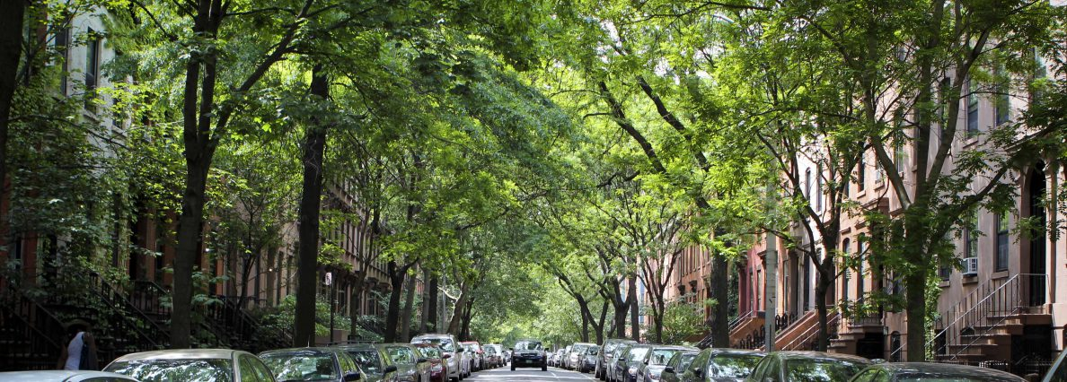
What is the UHI and UTC?
The UHI occurs when the impermeable materials that make up buildings, pavement, parking lots and roads, absorb and radiate more heat than in rural country areas causing dense urban areas to be unnaturally warmer.
The UTC is the entirety of the tree coverage area in an urban area.
We measured the exact locations where the UTC is the least dense and the ground is the warmest on the parcel level.
TreePennsylvania.org
Notes:
Lexie

Slide 5
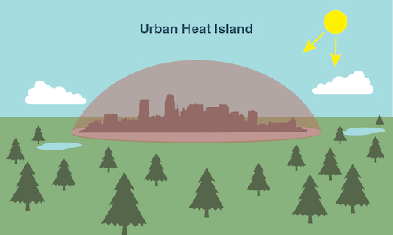
Significance
UHIs are a public health risk and a utility burden on cities, therefore mitigating them is in the best interest of general public, and a great way to reduce the phenomena is a healthy expanded canopy.
Using GIS and remote sensing is a good way to locate the most intense heat islands and where more trees could be planted.
climatekids.nasa.gov/heat-islands/
Notes:
Gabby

Slide 6
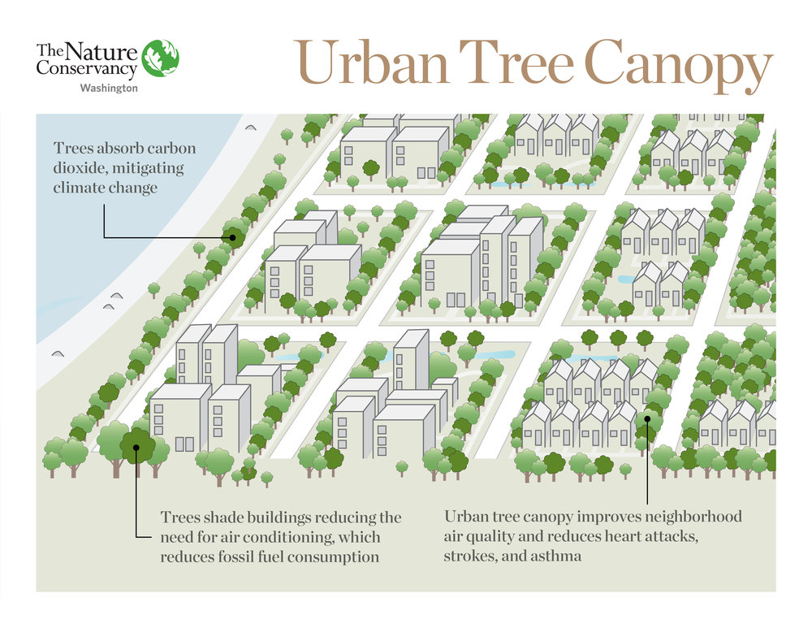
Hypothesis
We expected Urban Heat Islands in denser urban areas with sparse canopy density, mostly around the downtown area, major shopping centers, and around major roads and highways.
washingtonnature.org
Notes:
Gabby

Slide 7
Data
Notes:
Lexie

Slide 8
Landsat Methodology
Preparing Rasters
Conversion to LST
Removing Features
Acquisition of Landsat scenes.
All scenes are reprojected and clipped to Travis County.
Preparation of model used for conversion.
Model created to convert raw images to Land Surface Temperature in Fahrenheit.
Average summer temps ranged from 69° to 103° F. in Travis County.
Clouds and water were identified and removed from scenes.
Calculation of average temperatures for all scenes.
Notes:
Lexie/Gabby
The land surface temperature value ranged from 69 to 103 degrees Fahrenheit. To simplify our results we put our data through steps that would create a normalized value that represented both UTC density and average temperature.

Slide 9
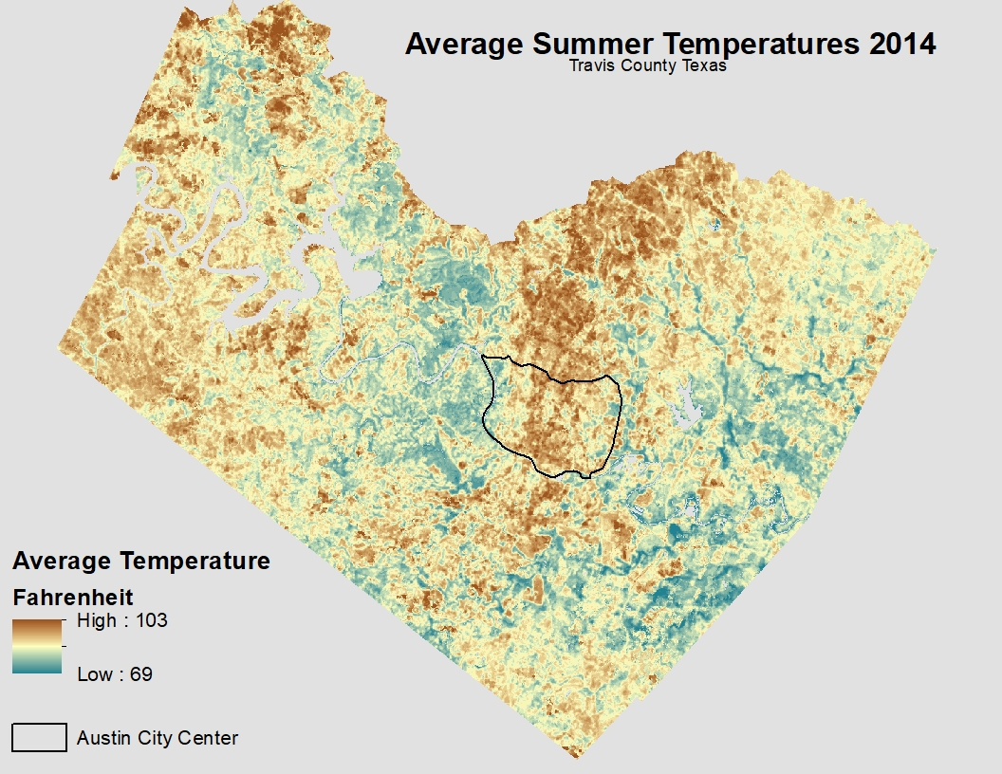
Land Surface Temperature
Notes:
Lexie/Gabby

Slide 10
Urban Tree Canopy Methodology
County shapefile and raster aligned to NAD_1983_StatePlane_Texas_Central_FIPS_4203_Feet
UTC raster extracted by mask of Travis County shapefile
UTC raster reclassified:
1 = Canopy, 3 = NoData
UTC unique identifiers created using Raster to Point tool
Points converted to polygons to create a zones
Zonal Statistics used to create vector shapefile
Vector converted to raster resulting in 30m resolution
Kallie Hallmark Bradley
Notes:
kal
The reclassification created a new raster of only the tree canopy or value one from the original UTC raster. Syncing the UTC data with the LST raster, and converting the UTC raster resolution, which give a sum of how many 1 foot by 1 foot canopy pixels were in the new resolution of 100 by 100 feet. This provided a spectrum of canopy density; the more canopy pixels in the larger resolution the denser the pixel.

Slide 11
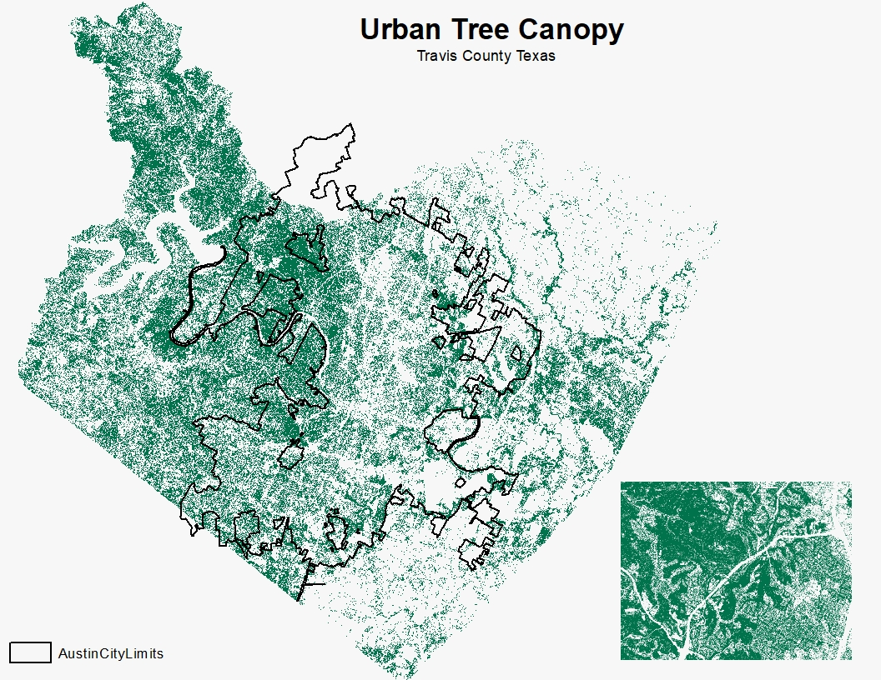
UTC
Notes:
Kallie

Slide 12
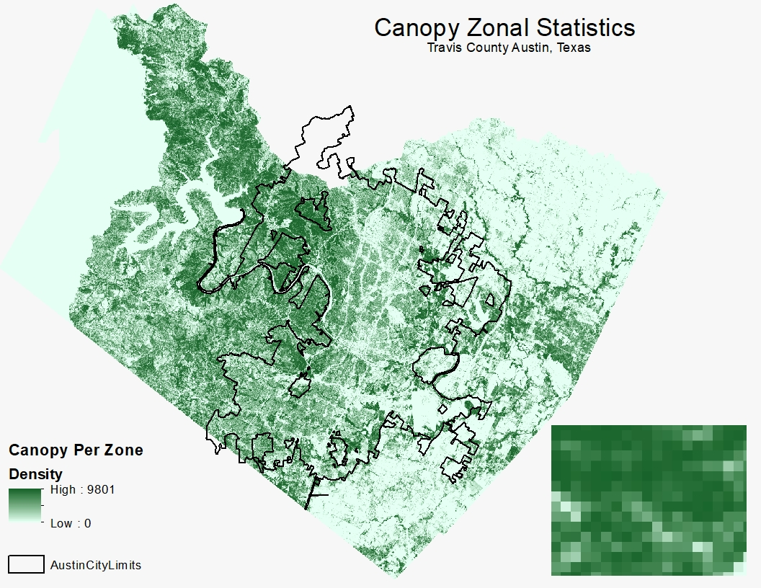
Zonal Statistics Analysis
Notes:
Kallie
1 Foot Canopy Pixel Count Per Zone (one Landsat Pixel)

Slide 13
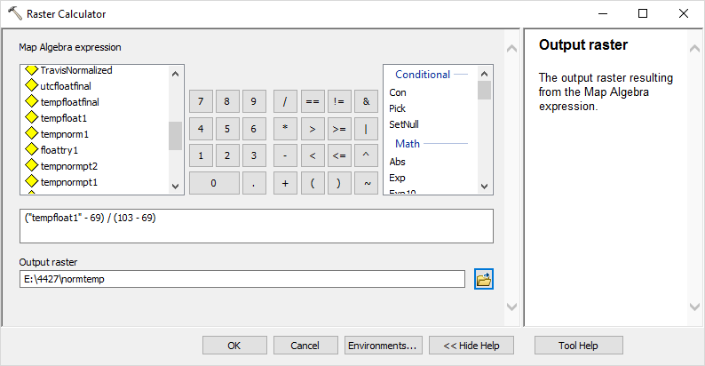
Relational Analysis Methodology
Converted two rasters to float.
Normalized rasters
(“raster” - min. value) / (max. value - min. value)
Subtract (“tempoutput”) - (“UTCoutput”)
Notes:
Rance
The land surface temperature value ranged from 69 to 103 degrees Fahrenheit. To simplify our results we put our data through steps that would create a normalized value that represented both UTC density and average temperature.

Slide 14
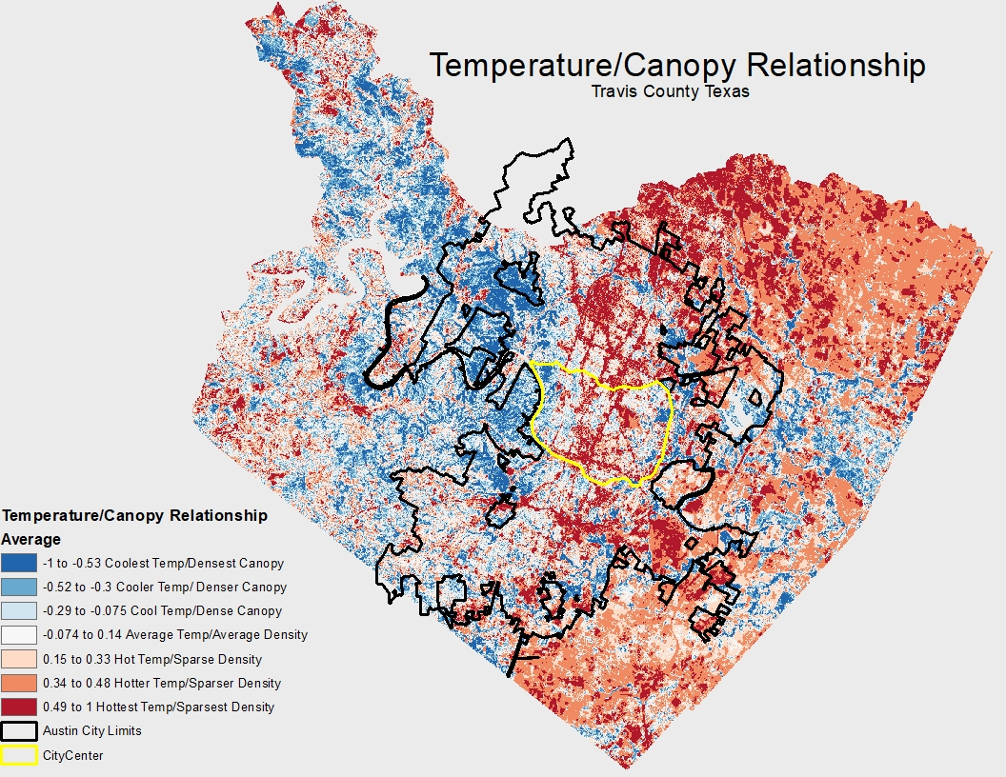
Results
Relative Value Data
Austin City Limits
Austin City Center
Notes:
Rance
Change

Slide 15
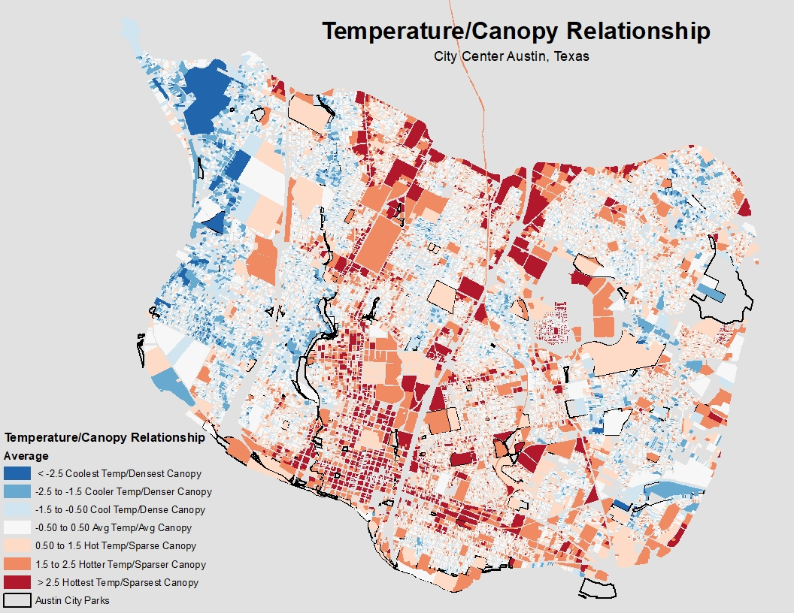
Results
Relative Value Data
Austin City Center
Parks & Open Spaces
Notes:
Rance

Slide 16
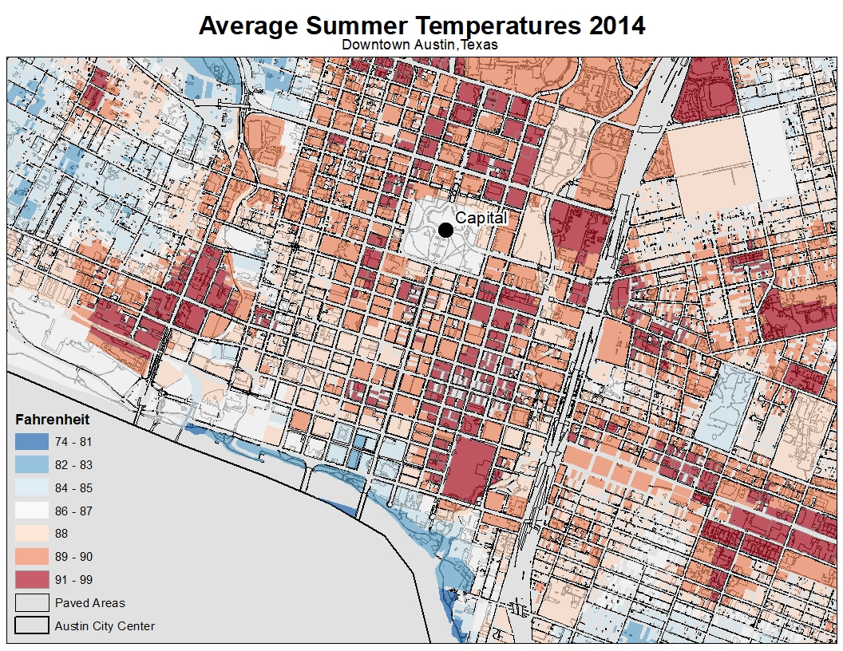
Results
Land Surface Temperatures
Paved Areas
Notes:
Kal

Slide 17
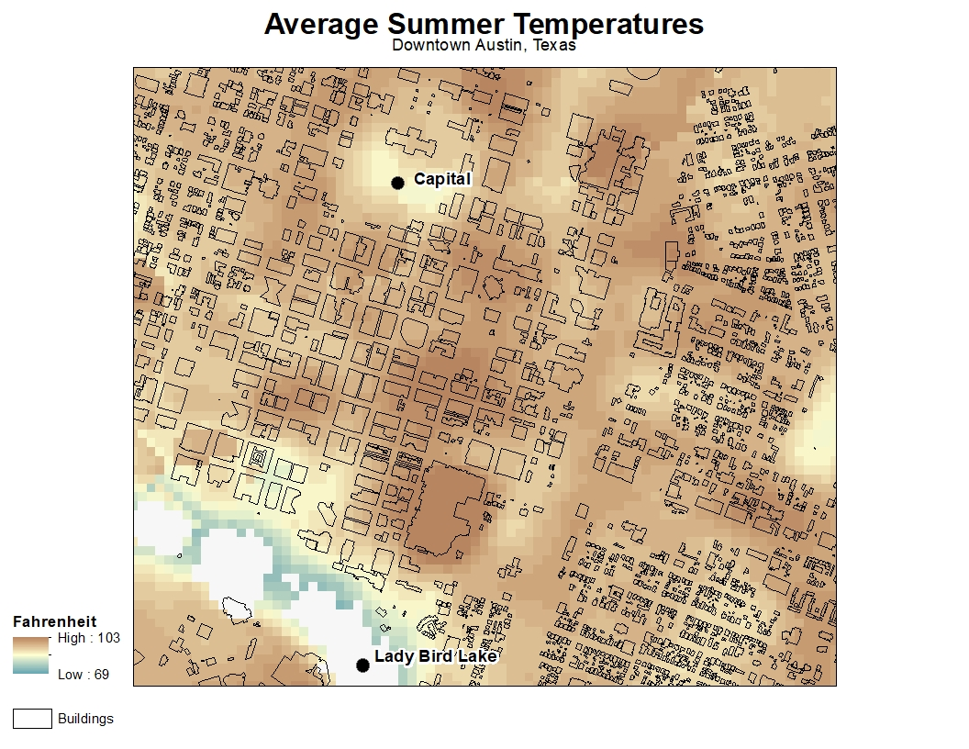
Land Surface Temperatures
Building Footprints
Results
Notes:
Kal

Slide 18
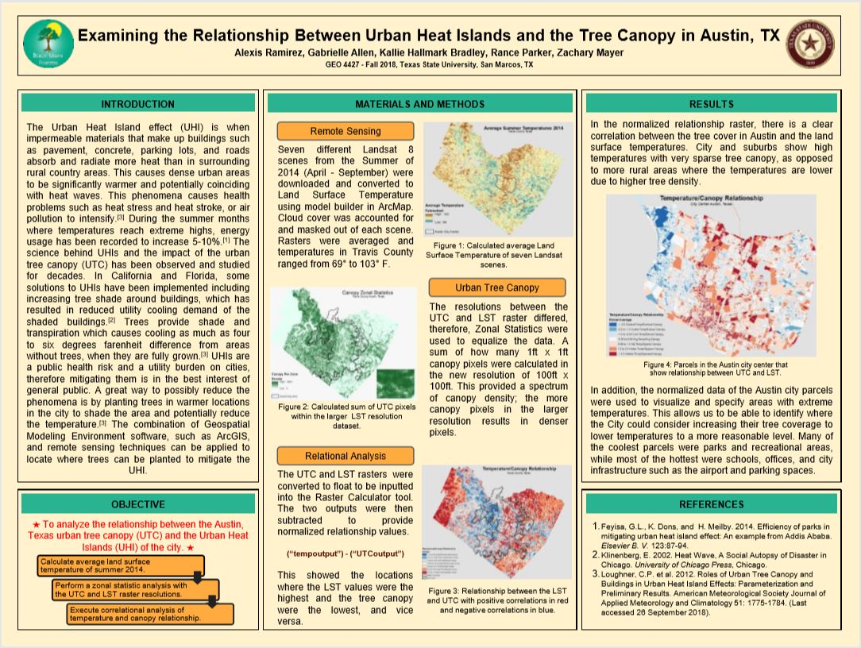
Public Deliverables
ESRI Shortlist Story Map
https://www.arcgis.com/apps/Shortlist/index.html?appid=73f5dfa8d4e24c48a6505c09a9489564
Poster
Notes:
Rance will present don’t you worry partners - LOLOL

Slide 19
Conclusion
The urban foresters of the City of Austin now have access to this tool to assist them in identifying hotspot locations and to construct urban forestry projects accordingly.
The final results of this project found the exact parcels in Austin.
Some of warmest areas with the low canopy density included the downtown area, on major roads within the urban core of Austin, and around shopping centers. One of the warmest parcels in the downtown area was where the Austin convention center was located.
Notes:
Zach

