Slide 1
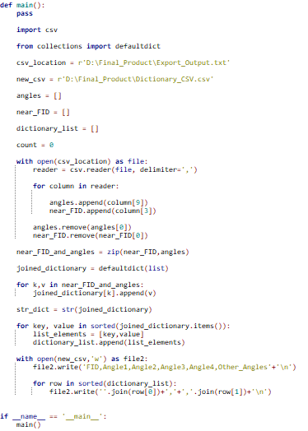
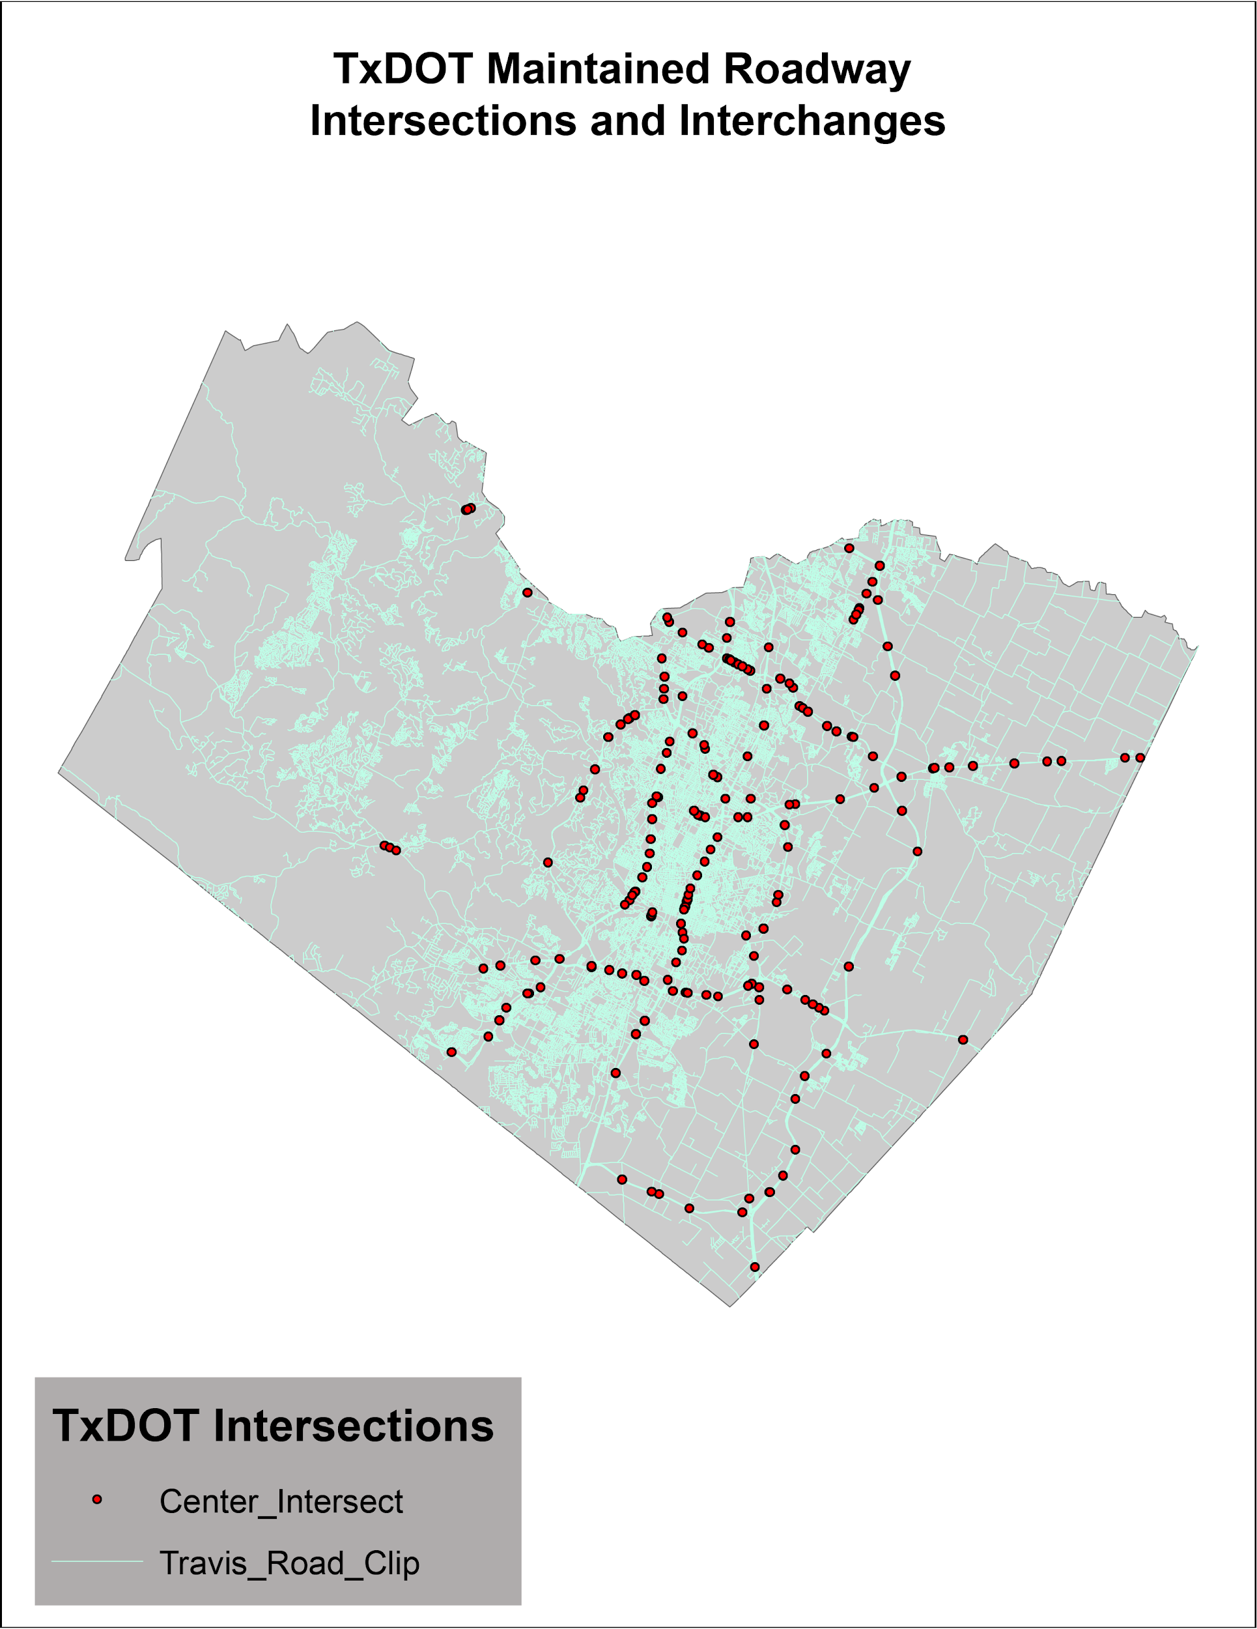
Extracting and Classifying Intersections and Interchanges
Patrick Sullivan, Andrew Goin, Sam Johnston, Tyler Armstrong
Abstract
Methodology
Results
Conclusions
This article will examine a set of programs that will categorize roadway intersections based off of their intersection angle. The analysis outlined in this paper is critical for MIRE classifications for interchanges and intersections. Implementing these programs will aid in identifying MIRE classifications.
In the introduction, we outlined how the is program is crucial for identifying highway intersections and interchanges and that the MIRE intersections identified in the program are important for the Moving Ahead for Progress in the 21st Century (MAP-21) Act. Next, we describe the shapefiles that were provided to us by TxDOT in the Data section. After discussing the data we dive straight into the methodology. In the methodology, we describe how we created a data filter for on ramp intersections using a selection tool, the python script and methodology behind the on/off intersection tool, and a series of model builder tools that along with a python script that identifies the interchanges and intersections based off of the MIRE regulations. Afterwards, we explain our deliverables in a toolbox that contains all of the tools, model builders, and python scripts in the project. The results and describe the output of the toolbox in more detail and we identify mishaps that occurred during the journey of our project. Finally, the conclusion paragraph describes what we achieved in the project.
-False Intersections:One of the first steps in this project was using the Intersect tool to calculate the points of intersection of road centerlines. The Intersect tool does not consider the physical realities that govern the actual roads represented by polylines. In the case of interchanges, the Intersect tool will produce intersection points where two or more grade separated roads cross despite there being no actual link.
-Angle Geometry: One major contributor to identify different intersections is the angle at which two angles intersect. By counting the number of legs and by selecting the angles at which the intersection occured, the type of intersections can be classified for the MIRE regulations using these methods. To calculate the angle geometry, we created a series of model builders and a python script to classify the intersections.
-The cumulative output of this set of tools is a point layer associated with the intersections of TxDOT maintained roads, in the form of standard roadway
intersections and highway interchanges. Attributed to these points is a geometry identifier, derived from the angles between the intersecting roads, and unique identifiers for each route comprising the intersection. These attributed fields all meet the Model Inventory of Roadway Elements data standards required for roadway intersections and interchanges.
Overall, this project proved to be a slight challenge for Spatial Solutions. The TxDOT problem really helped us focus on our coding skills and manipulating the attributes of the data and using them in our favor for locating and identification purposes. Spatial Solutions hopes that the tools and processes used are of use to TxDOT in completing the MAP-21 act and identifying intersections and interchanges all over Texas. If the tools created help make the roads even a little bit safer, then it was a success.
Working with TxDOT has been fantastic and they have been a huge help whenever we encounter a problem and I believe one of our associated m have inquired about future work with them. TxDOT has been excellent clients and Spatial Solutions is thankful for consideration of this task.
References
Help. What is SQL?-Help | ArcGIS Desktop. http://desktop.arcgis.com/en/arcmap/10.3/tools/analysis-toolbox/how-intersect-analysis-works.htm. (last accessed 2 December 2018).
SearchCursor. What is SQL?-Help | ArcGIS Desktop. http://desktop.arcgis.com/en/arcmap/10.3/analyze/arcpy-data-access/searchcursor-class.htm (last accessed 2 December 2018).
What is SQL selection? . What is SQL?-Help | ArcGIS Desktop. http://desktop.arcgis.com/en/arcmap/10.3/map/working-with-layers/sql-reference-for-query-expressions-used-in-arcgis.htm (last accessed 2 December 2018).
Data
-All of the data that we used was provided by TxDOT. It was given to us as a file geodatabase that included two feature classes: polyline feature class of road centerlines and polygon feature of county boundaries. According to the client the accuracy of the data was within about 5 feet. The projected coordinate system used by the client was the NAD 1983 Texas State Mapping System. We used the same projected coordinate system for all other tasks of the project.

