Slide 1
Identifying Interchanges and Intersections
By: Spatial Solutions

Slide 2
Associates
Tyler Armstrong
Andrew Goin
Sam Johnston
Patrick Sullivan

Slide 3
Overview
Introduction
Data
Methodology/Tools
Results and Discussion
Conclusion
Figures

Slide 4
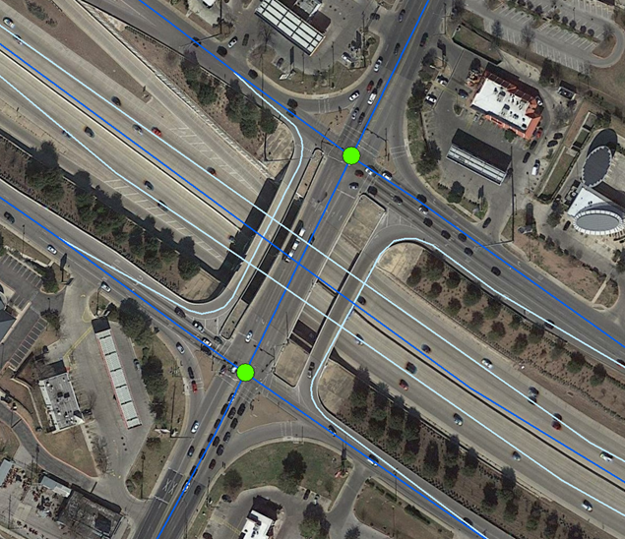
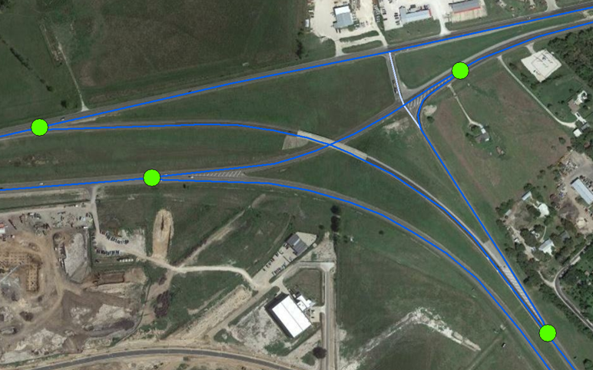
Introduction
Goal
Locate, Identify, and Attribute
Scope
Purpose

Slide 5
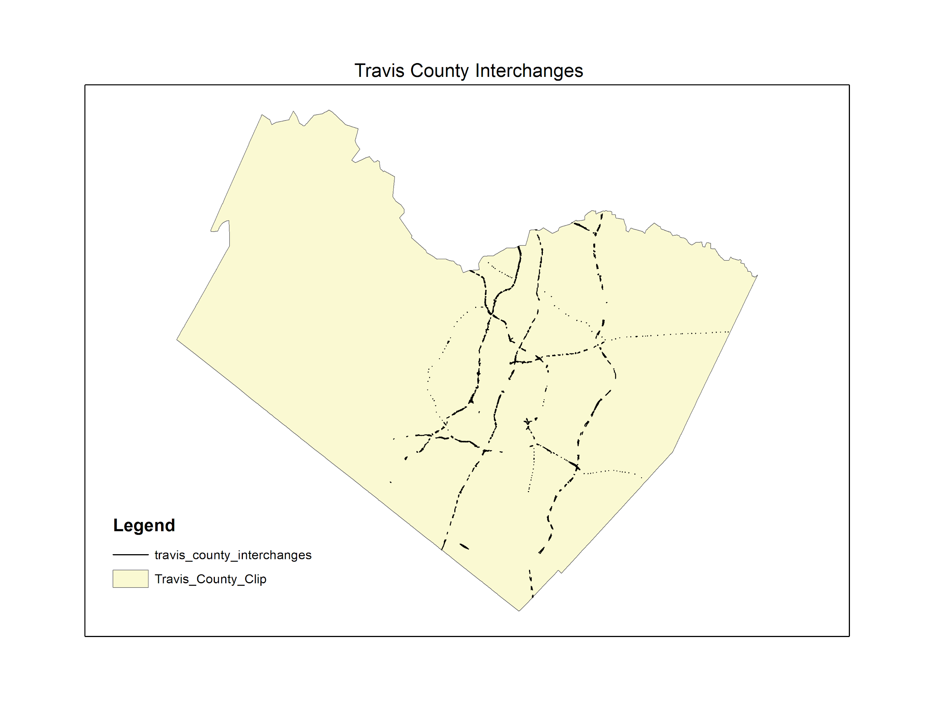
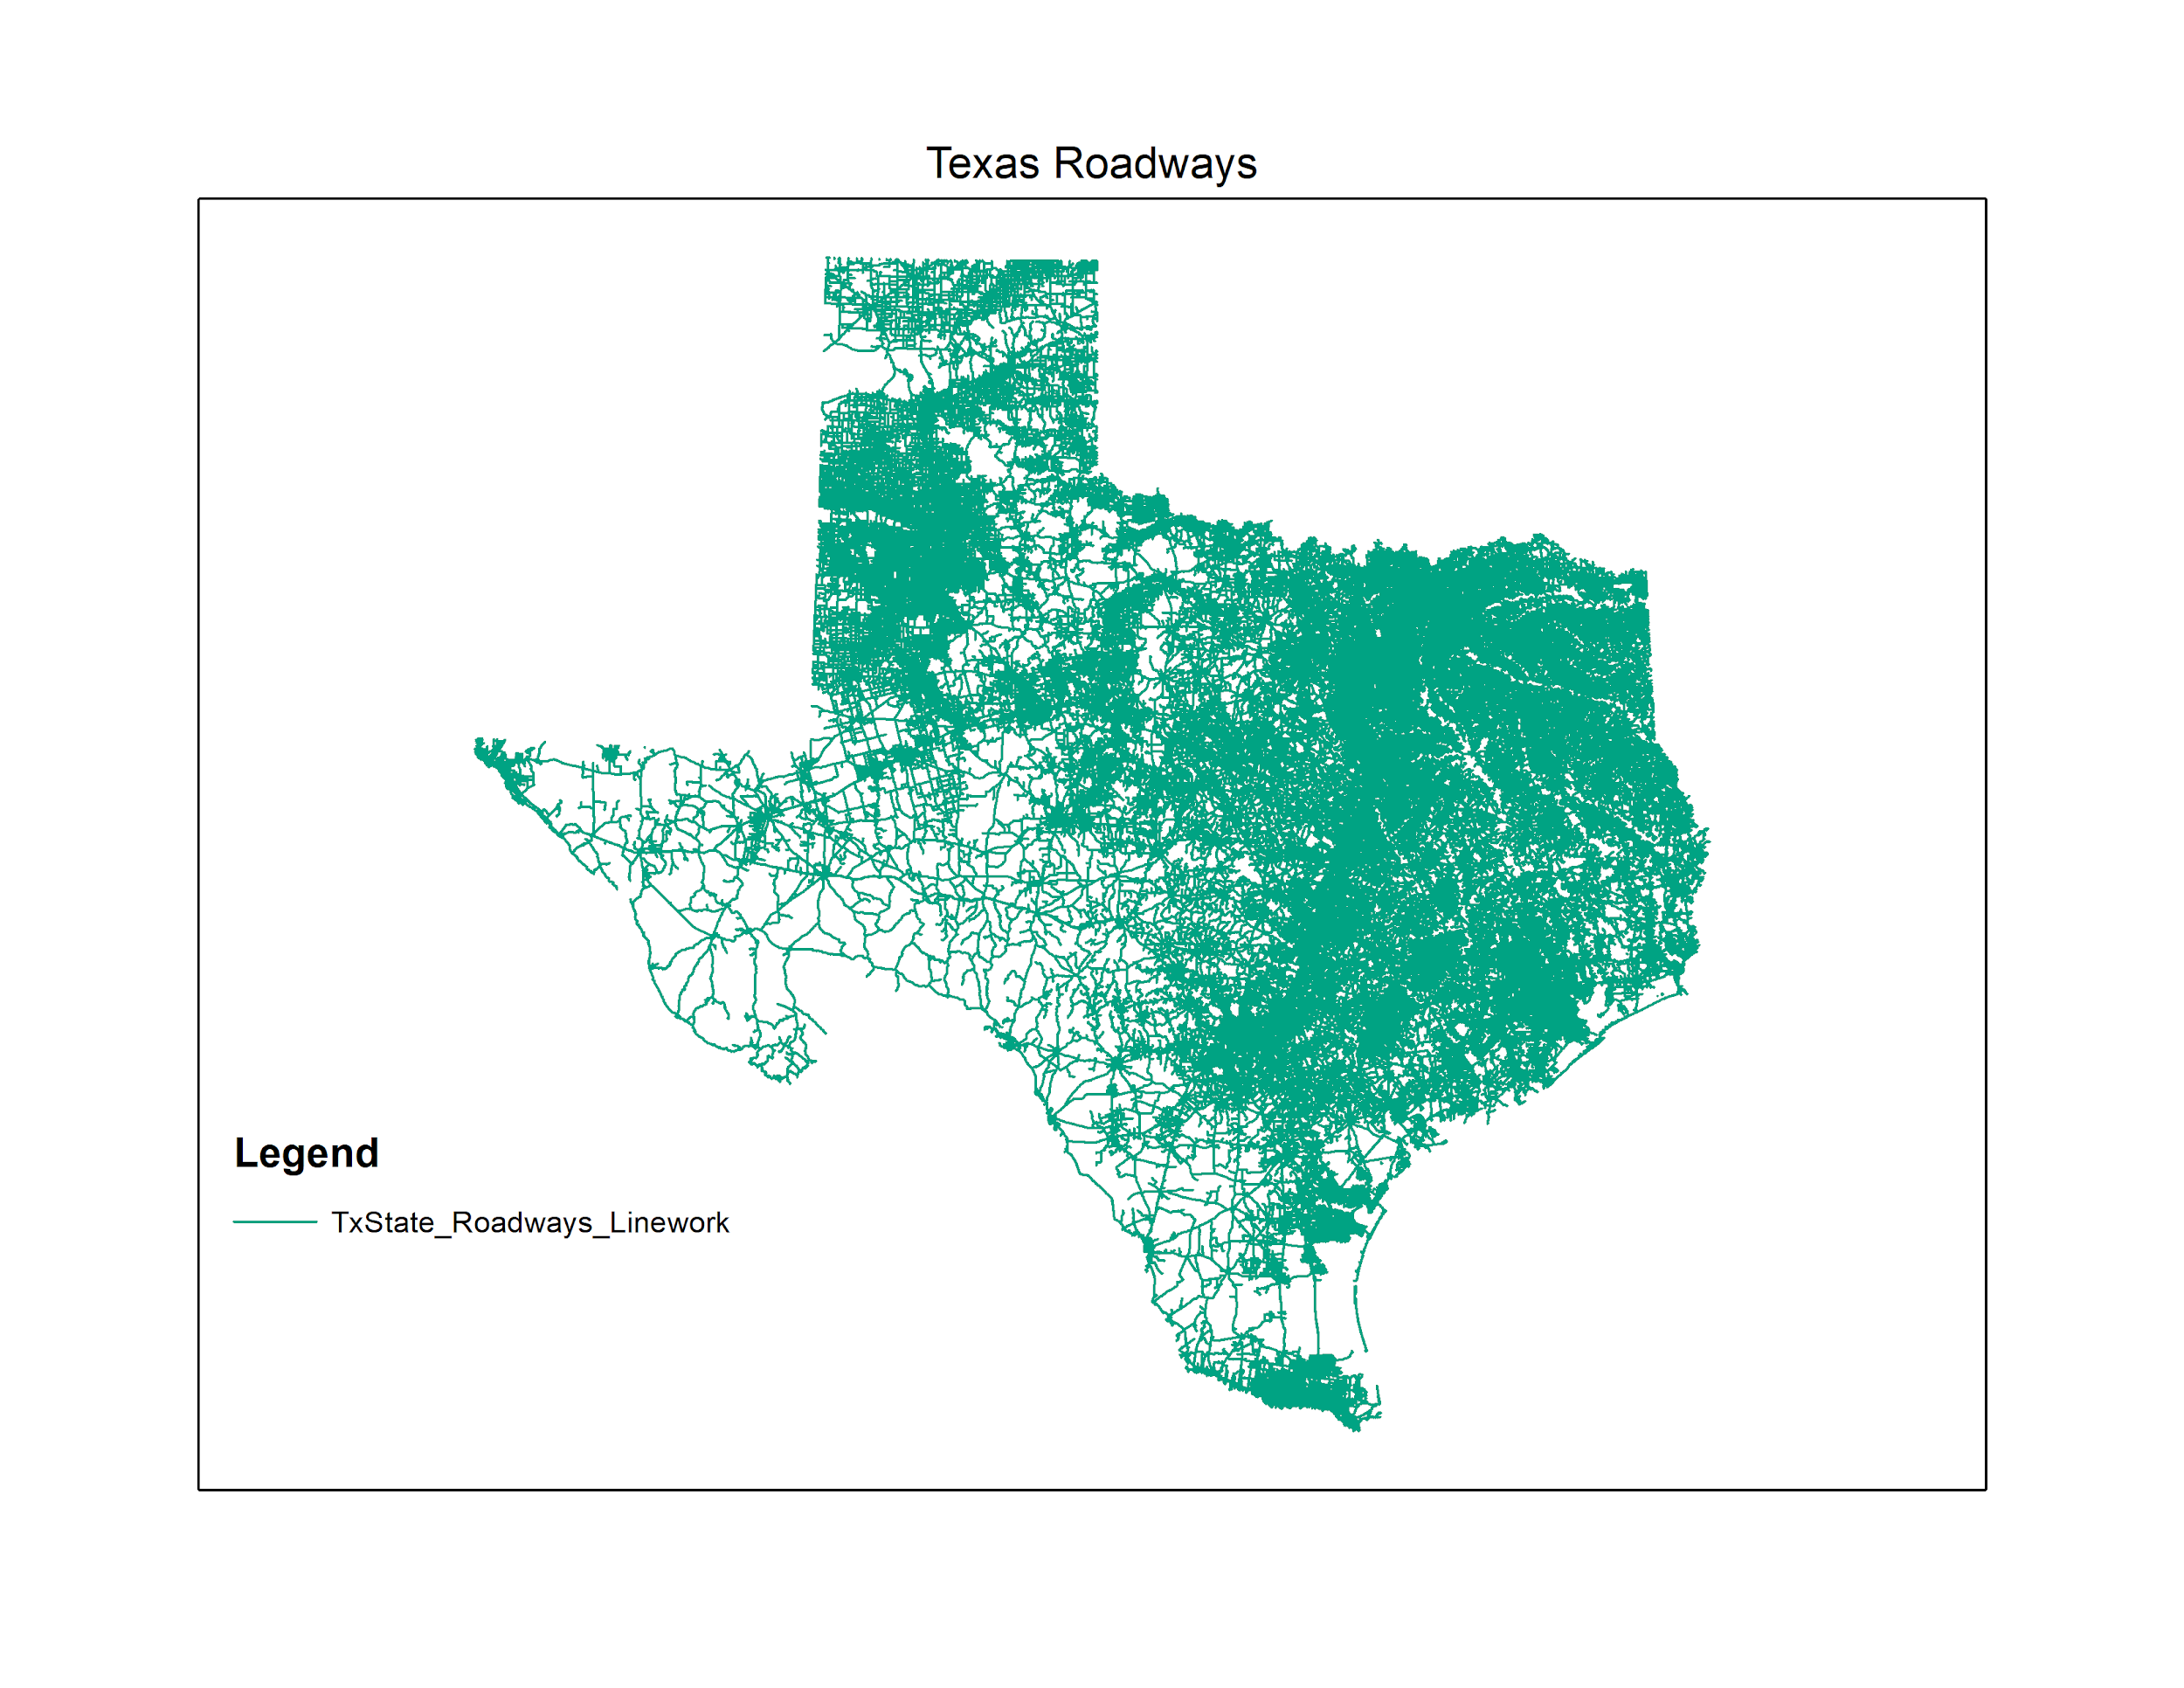
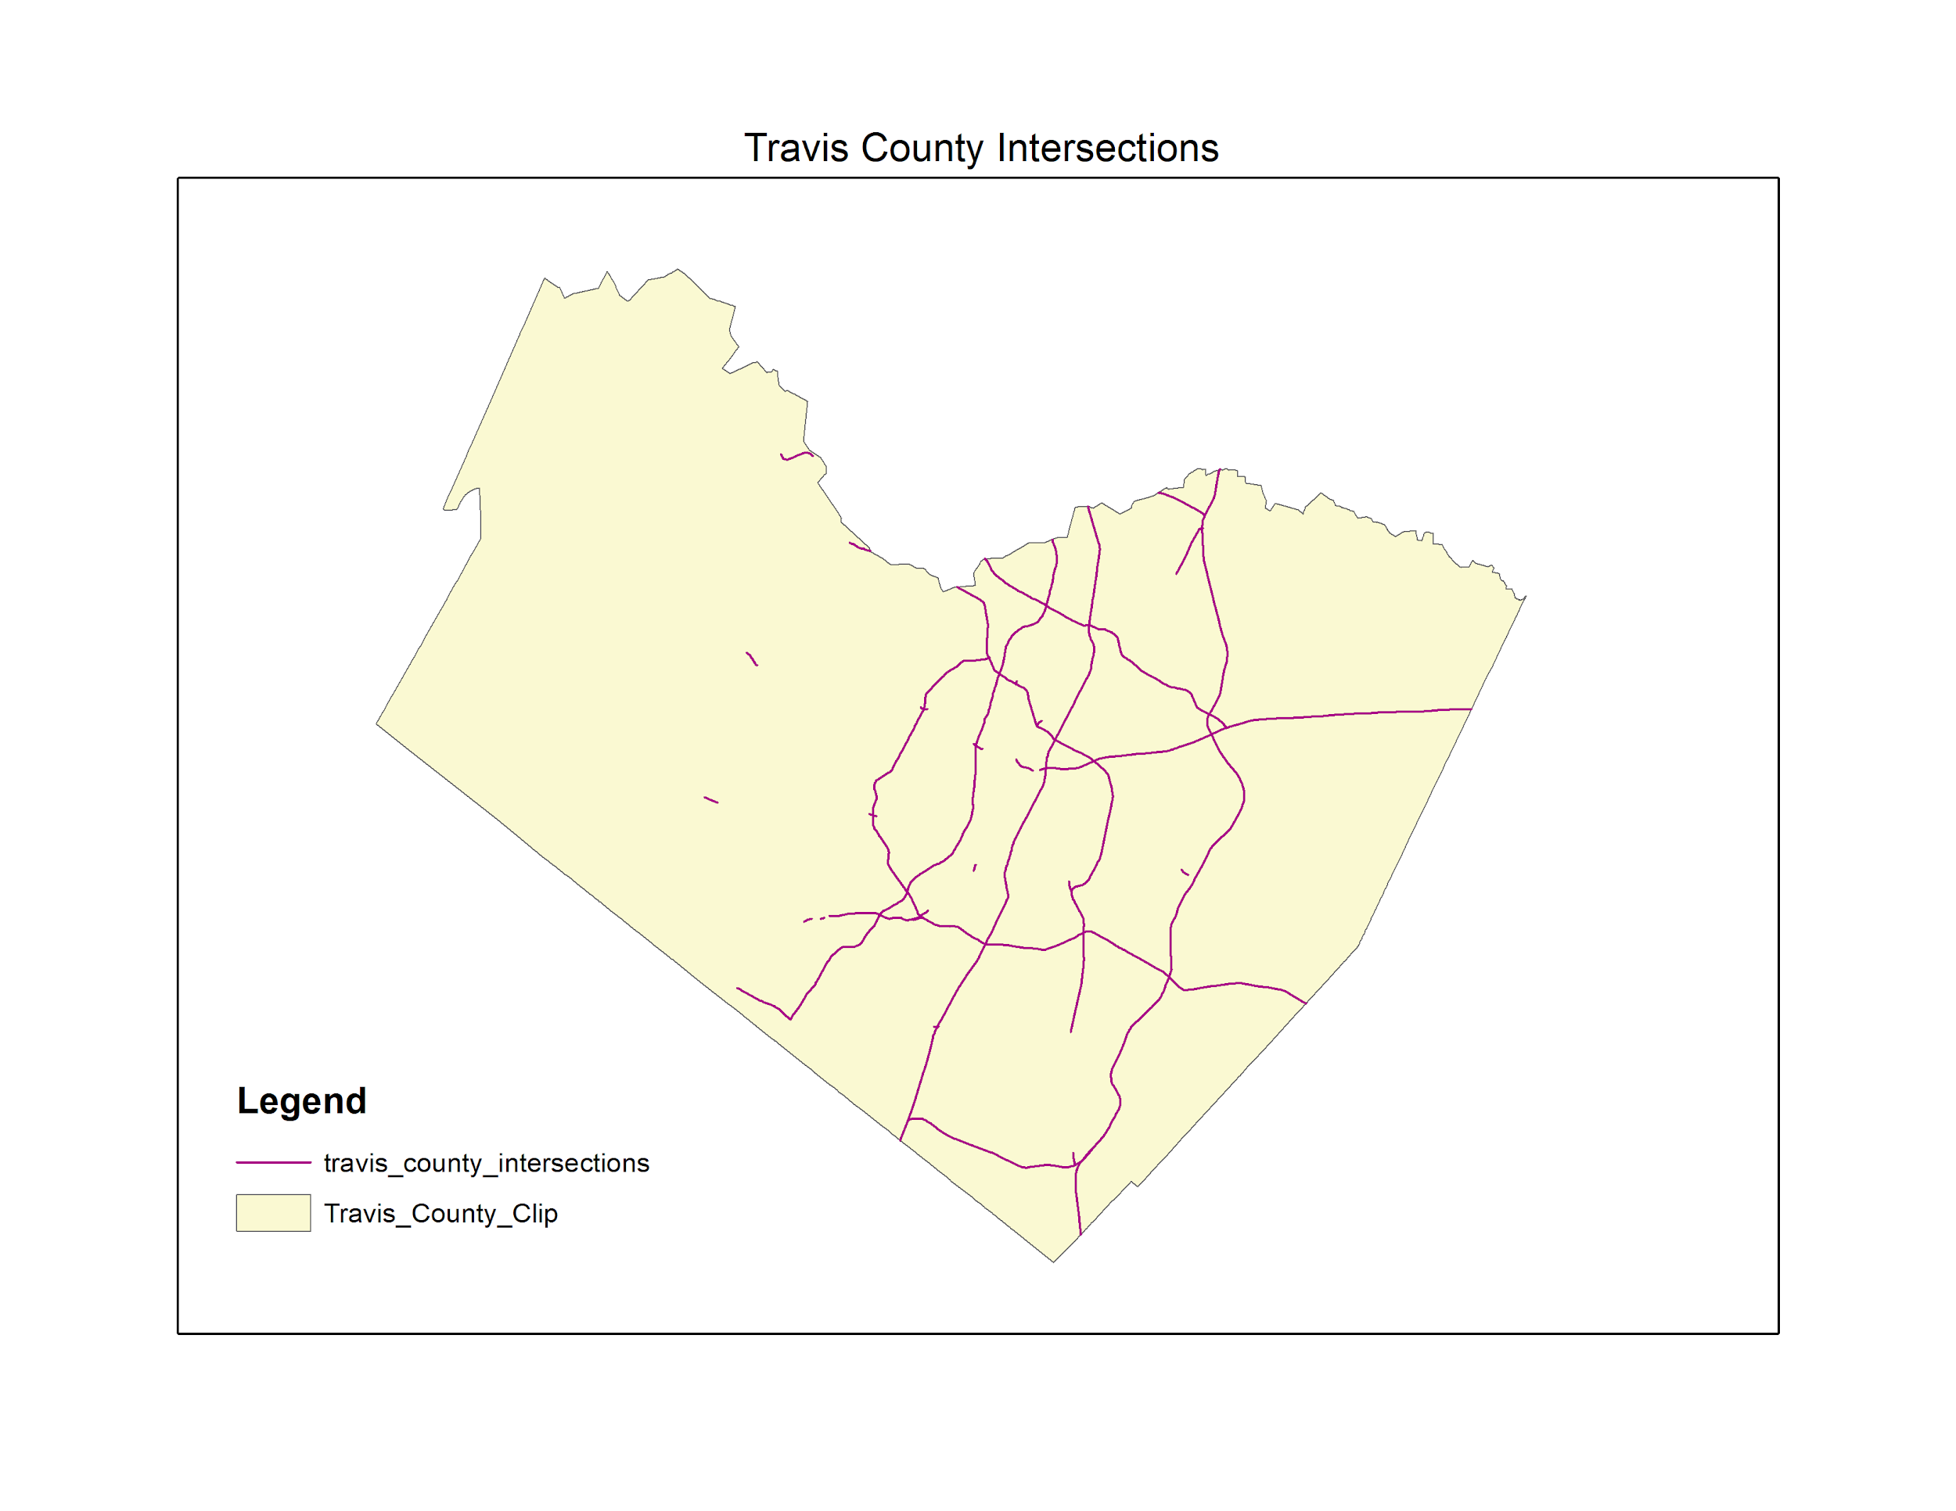
Data
Line Roadway Network
Noise
Preparation

Slide 6
Data Filters

Slide 7
Intersection Model Builder

Slide 8
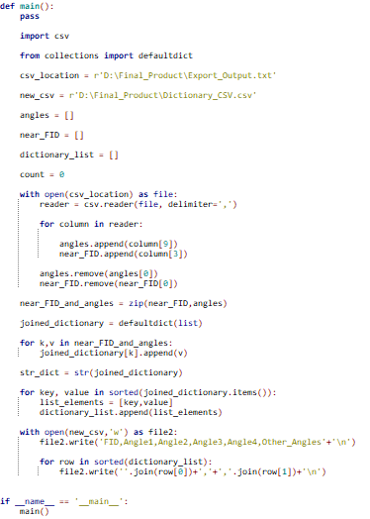
Angle Rearranger Program

Slide 9
Final Selection

Slide 10
Real Intersection Rules
RDBD_TYPE for Road A | RDBD_TYPE for Road B | MDN for A and B
% Frontage | % Frontage | ‘None’ or ‘Unknown’
% Frontage | Single Roadbed | ‘None’ or ‘Unknown’
% Frontage | Connector | ‘None’ or ‘Unknown’
Grade Separated Connector | % Roadbed | ‘None’ or ‘Unknown’
Single Roadbed | Single Roadbed | ‘None’ or ‘Unknown’

Slide 11
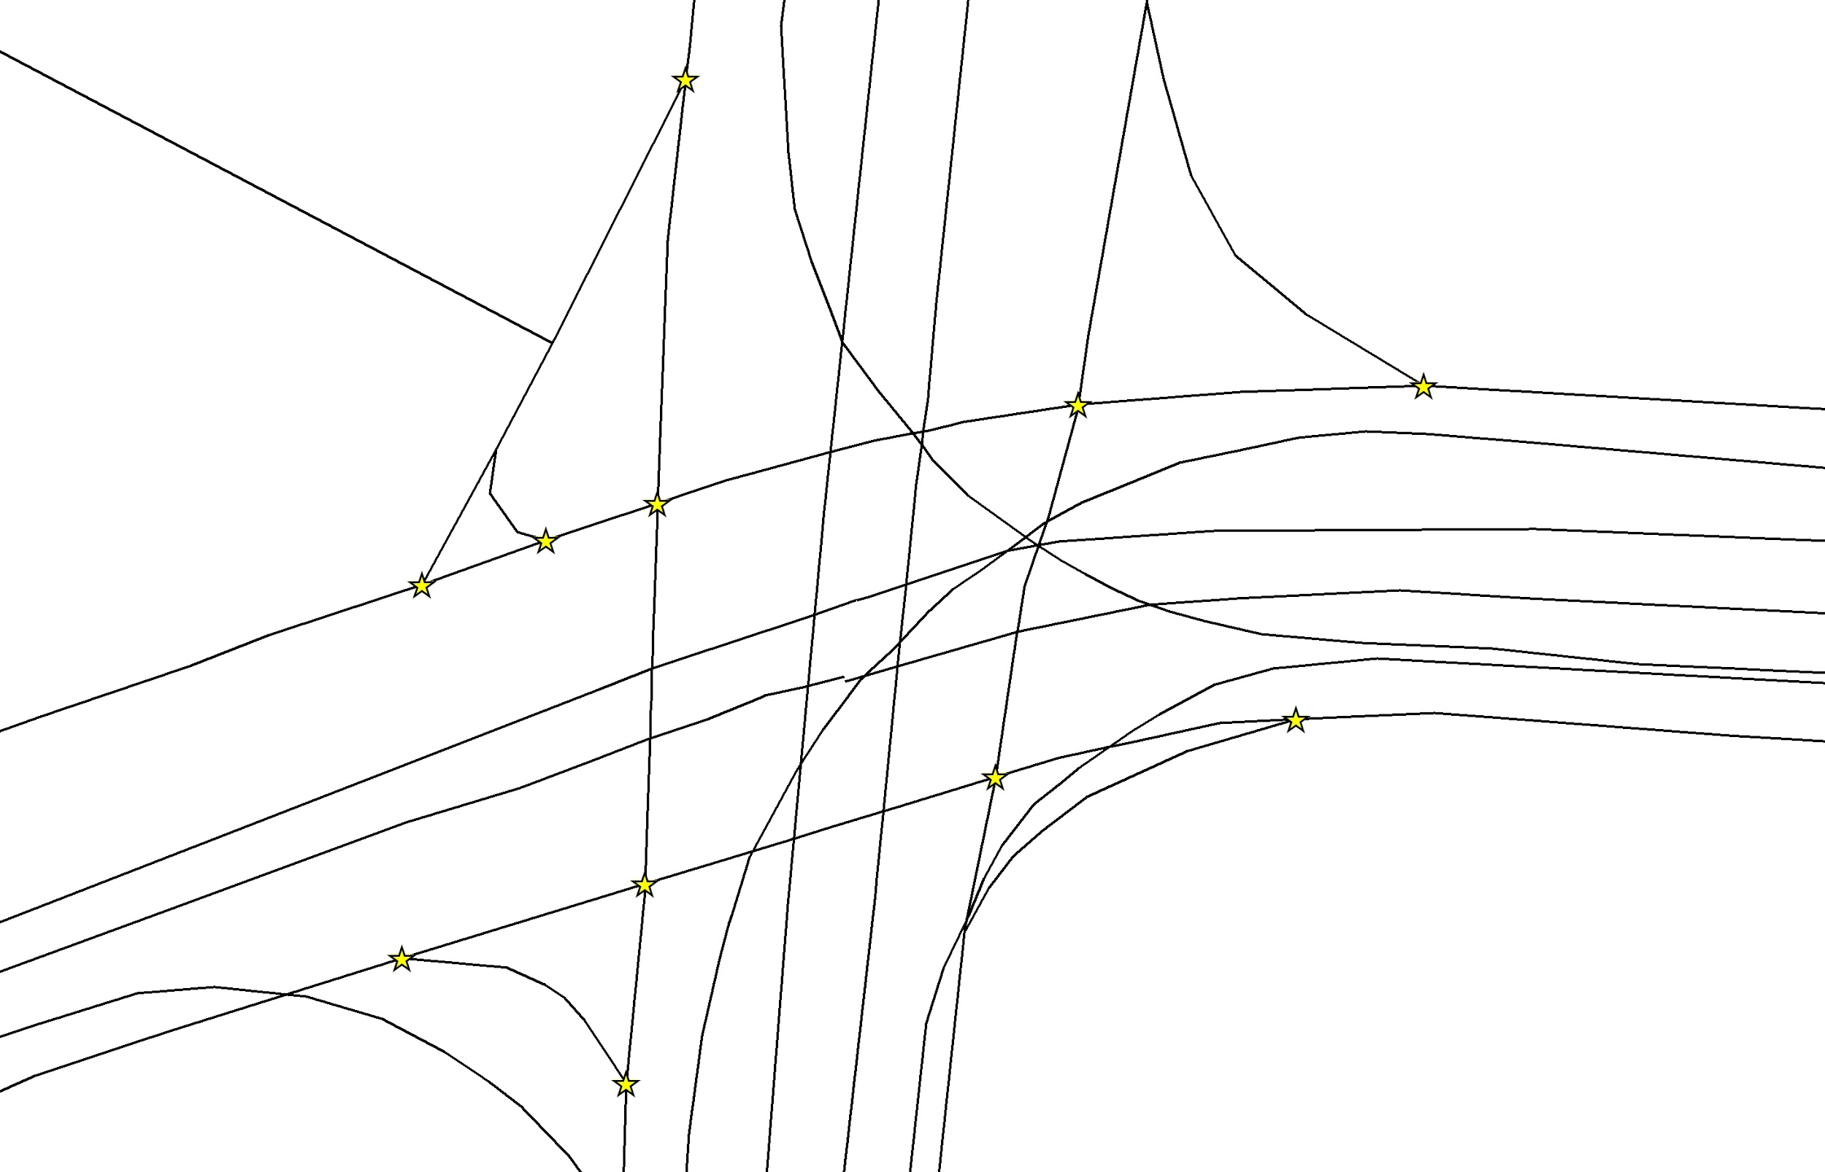
Real Intersection Output

Slide 12
Discussion and Issues
Research
TxDOT clients help
Github issues
Input discrepancies

Slide 13
Conclusion
We were able to develop a program that identifies MIRE intersections based on their angles with a series model builders and python scripts.

