Slide 1
Development of the Emerald Crown Trail
In Conjuction
San Marcos GreenBelt Alliance & TrailBlazers Consulting

Slide 2
Project Manager: Lucas Chavez
GIS Analyst: Emma Highberger
GIS Analyst: Julian Emerson

Slide 3
Overview
Introduction
Purpose of our project
Scope of our project
Methodology
Results
Time Table
Conclusion

Slide 4
Introduction
San Marcos Greenbelt Alliance and other stakeholders
Includes the City of San Marcos, Kyle, and Buda
“Emerald Crown Trail”
This will be the connecting trail with the development of the Violet Crown in Austin, Texas
The Emerald Crown will connect the cities of San Marcos, Kyle, and Buda.
Notes:
Stick with the theme for Violet Crown Trial

Slide 5
Purpose
Transportation and recreation trail from Buda to San Marcos
Obtain funding from local partners and stakeholders in order to receive resources for development
Promote community cohesiveness

Slide 6
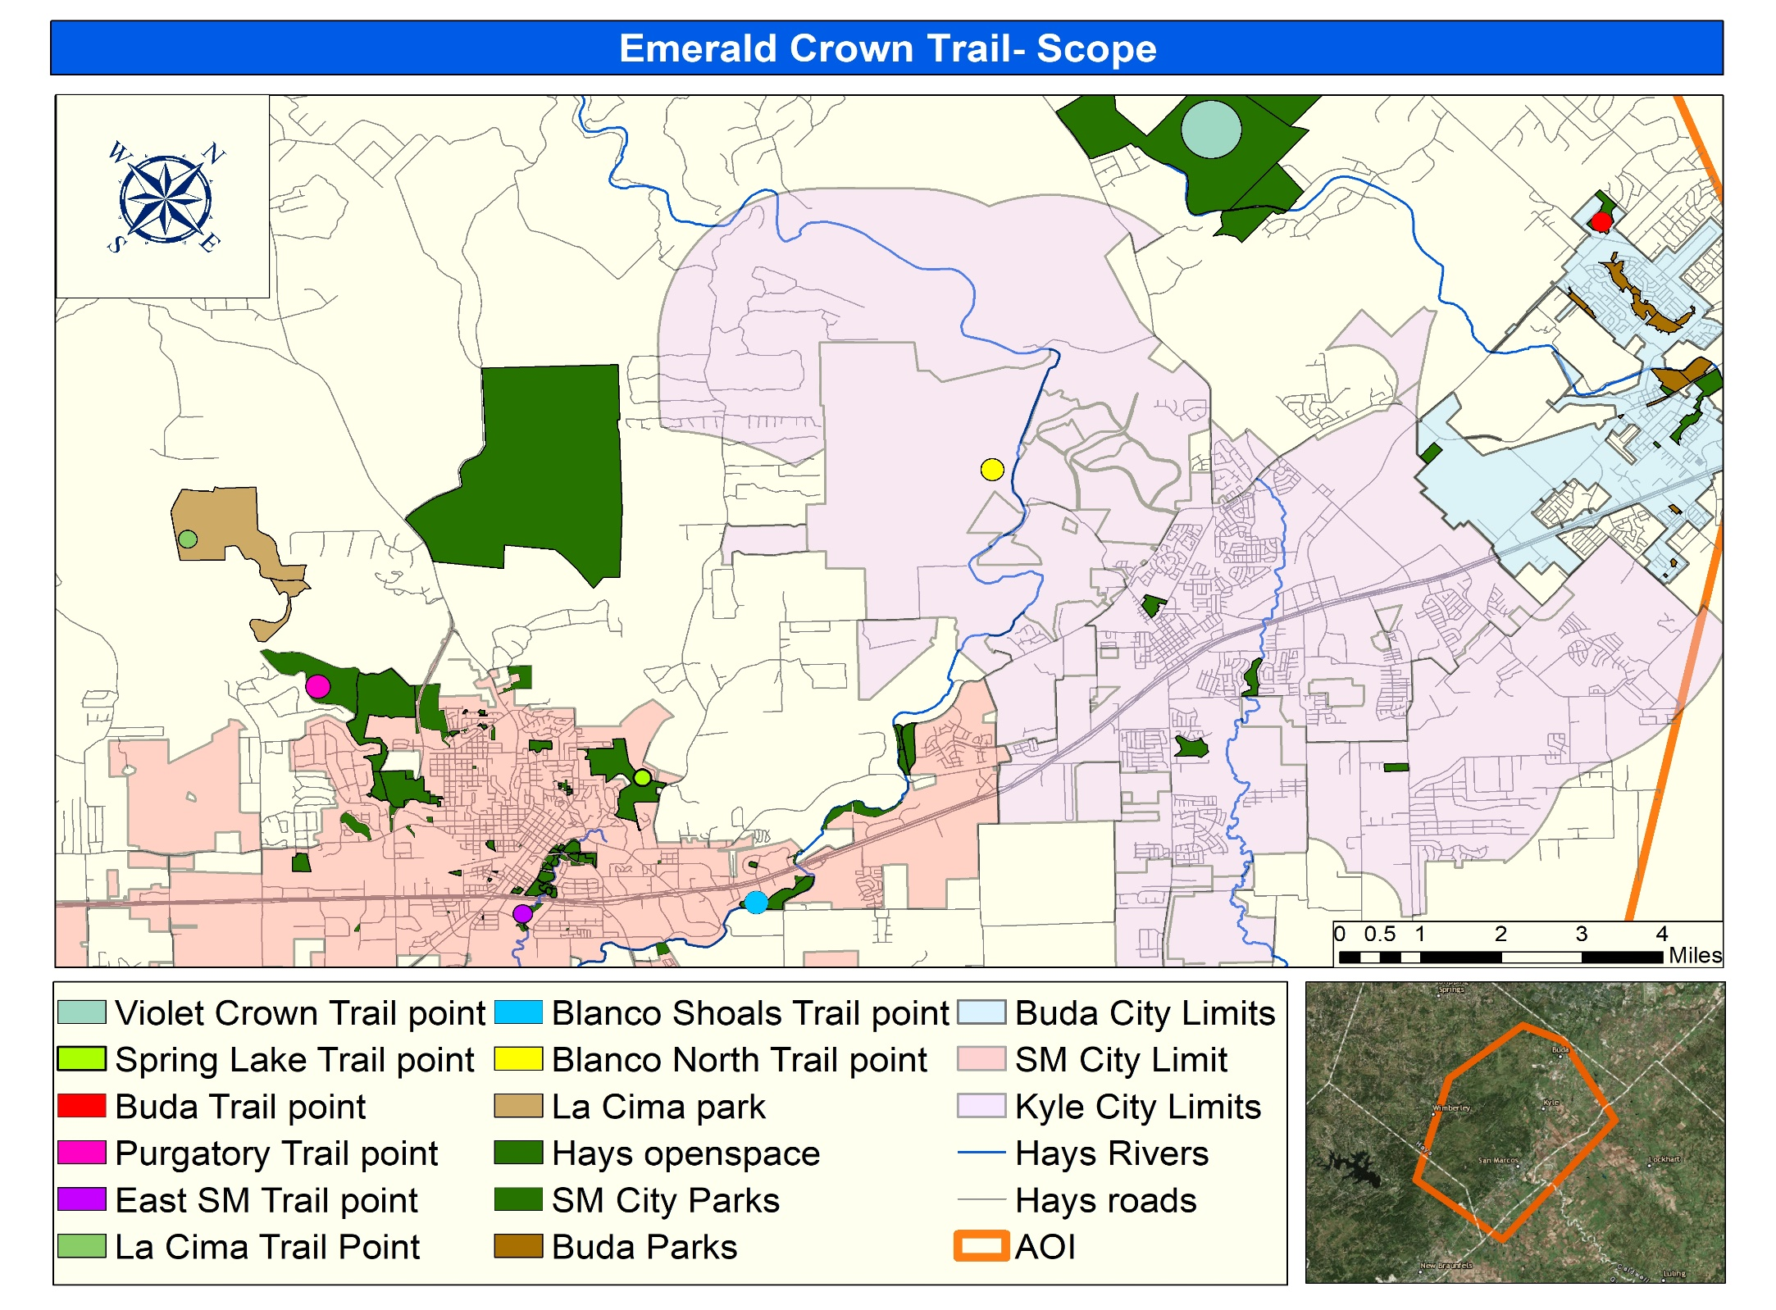
Scope
Scope pans from the upper north of Buda down to the City of San Marcos
We have designated 8 potential locations for trail development

Slide 7
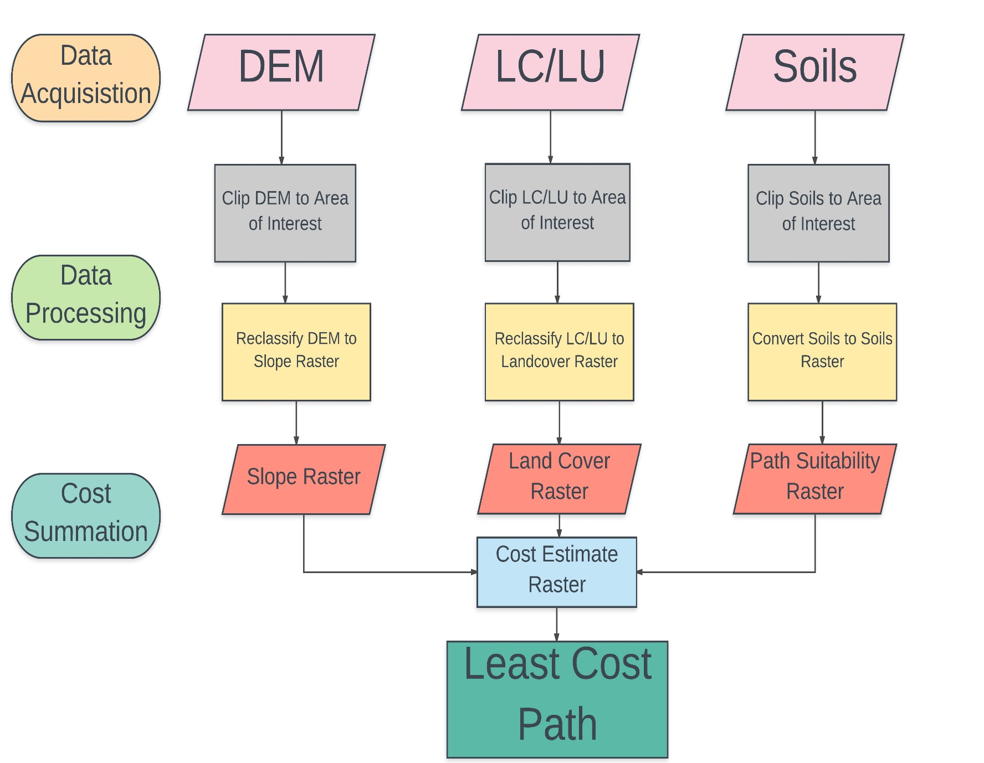
Methodology
Data Acquisition
Digital Elevation Model (DEM)
Land Cover/ Land Use (LC/LU)
Soils dataset
Data Processing
Reclassify layers to run a weighted overlay
Cost Summation
The weighted overlay with the reclassified layers; allowed us to assign weights to each
LC/LU- 55% ; DEM- 40% ; Soils- 5%
This will provide a cost surface
Production of Least Cost Paths

Slide 8
Results
Once the cost surface was developed we were able to implement our specified trail point locations to produce our least cost paths.
We developed 12 trails throughout our area of interest stretching from San Marcos out towards Buda
We were able to incorporate our developed trails with parcel data to account for potential areas of development
The trails were also joined with our Land Cover dataset

Slide 9
Trails Developed
12 Trails- Conceptual routes developed
8 potential trail connecting points

Slide 10
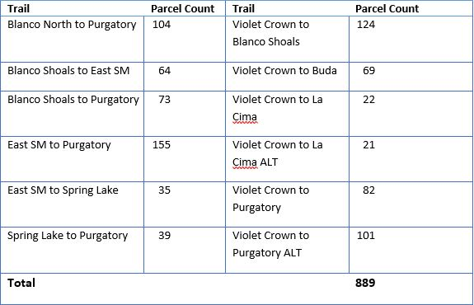
Trails incorporated with Parcel data
Each trail developed was joined with parcel data to allow for an accurate parcel count
We also provided SMGA excel sheets of the data we collected from this join.
Includes addresses, parcel number, and land owners

Slide 11
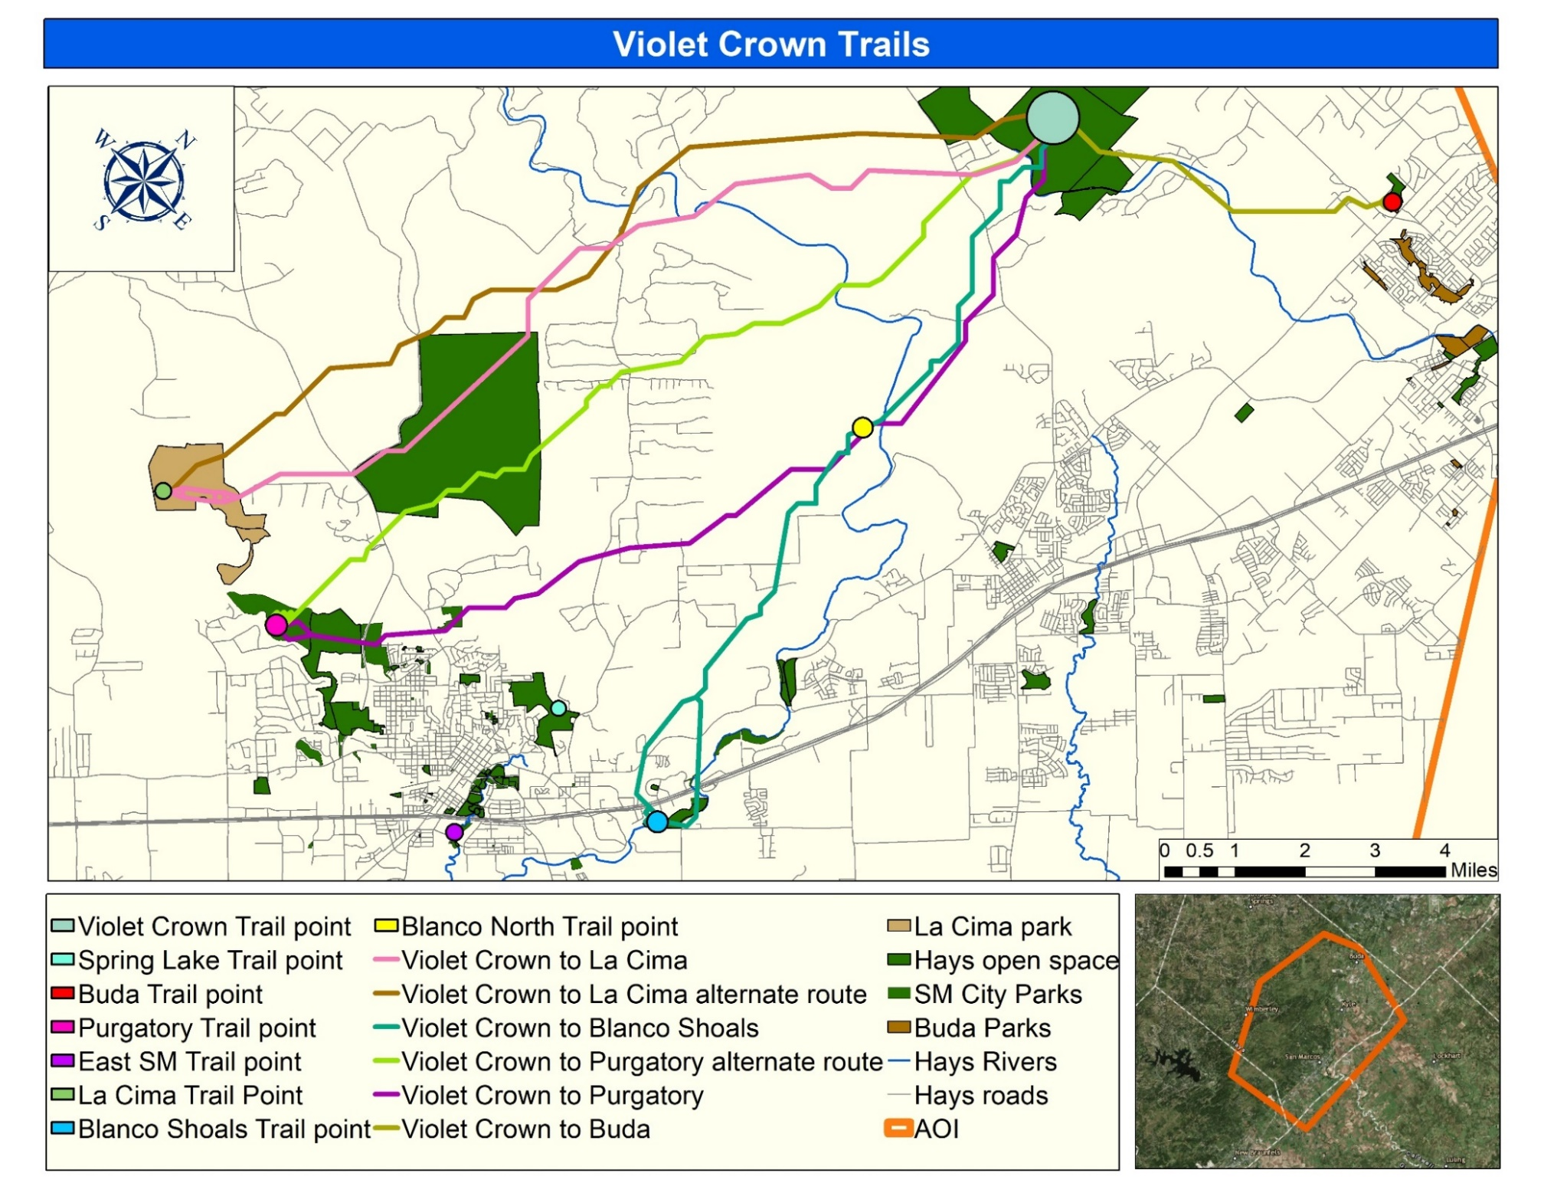
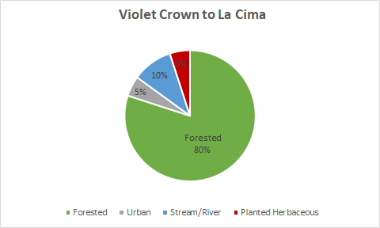
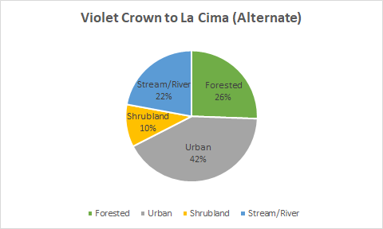

Slide 12
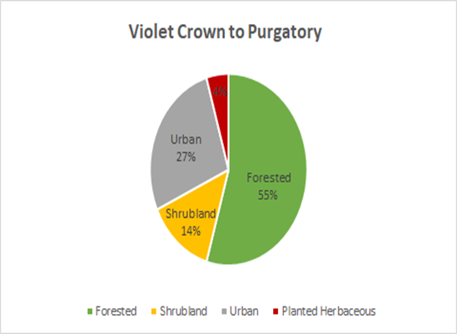
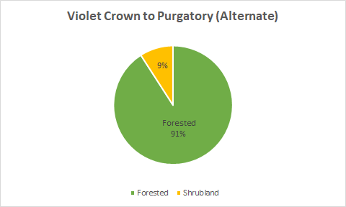

Slide 13
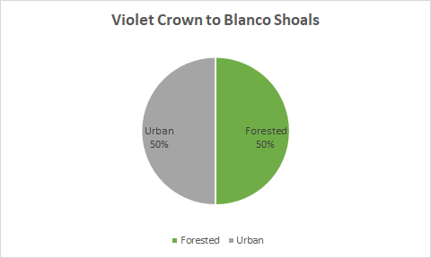
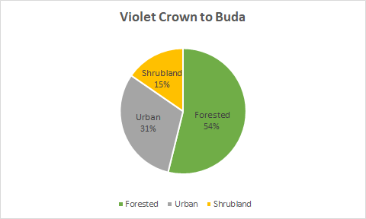

Slide 14
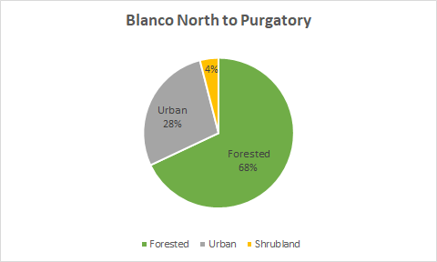
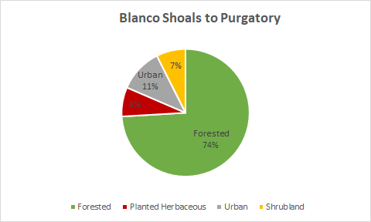

Slide 15
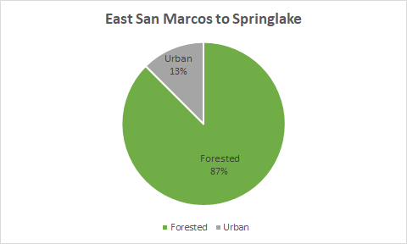
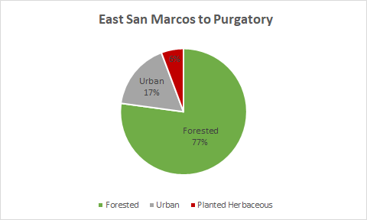

Slide 16
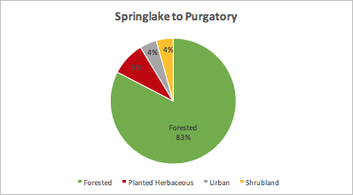

Slide 17
Project Phase | Starting | Ending
Data Processing | 9/11/2017 | 9/15/2017
Data Analysis | 9/18/2017 | 9/29/2017
GIS and Map Development | 10/2/2017 | 11/17/2017
Data Interpretation | 11/20/2017 | 11/24/2017
Presentation | 12/6/2017 | 12/6/2017
September
M | T | W | T | F | S | S
 |  |  |  | 1 | 2 | 3
4 | 5 | 6 | 7 | 8 | 9 | 10
11 | 12 | 13 | 14 | 15 | 16 | 17
18 | 19 | 20 | 21 | 22 | 23 | 24
25 | 26 | 27 | 28 | 29 | 30
October
M | T | W | T | F | S | S
 |  |  |  |  |  | 1
2 | 3 | 4 | 5 | 6 | 7 | 8
9 | 10 | 11 | 12 | 13 | 14 | 15
16 | 17 | 18 | 19 | 20 | 21 | 22
23 | 24 | 25 | 26 | 27 | 28 | 29
30 | 31
November
M | T | W | T | F | S | S
 |  | 1 | 2 | 3 | 4 | 5
6 | 7 | 8 | 9 | 10 | 11 | 12
13 | 14 | 15 | 16 | 17 | 18 | 19
20 | 21 | 22 | 23 | 24 | 25 | 26
27 | 28 | 29 | 30
December
M | T | W | T | F | S | S
 | 1 | 2 | 3 | 1 | 2 | 3
4 | 5 | 6 | 7 | 8 | 9 | 10
11 | 12 | 13 | 14 | 15 | 16 | 17
18 | 19 | 20 | 21 | 22 | 23 | 24
25 | 26 | 27 | 28 | 29 | 30 | 31

Slide 18
Conclusion
This project produced:
12 Conceptual trails connecting to 8 specified location's
3 more-experienced GIS analysts
3 friendships
Great Collaborative work with San Marcos Greenbelt Alliance

