Slide 1
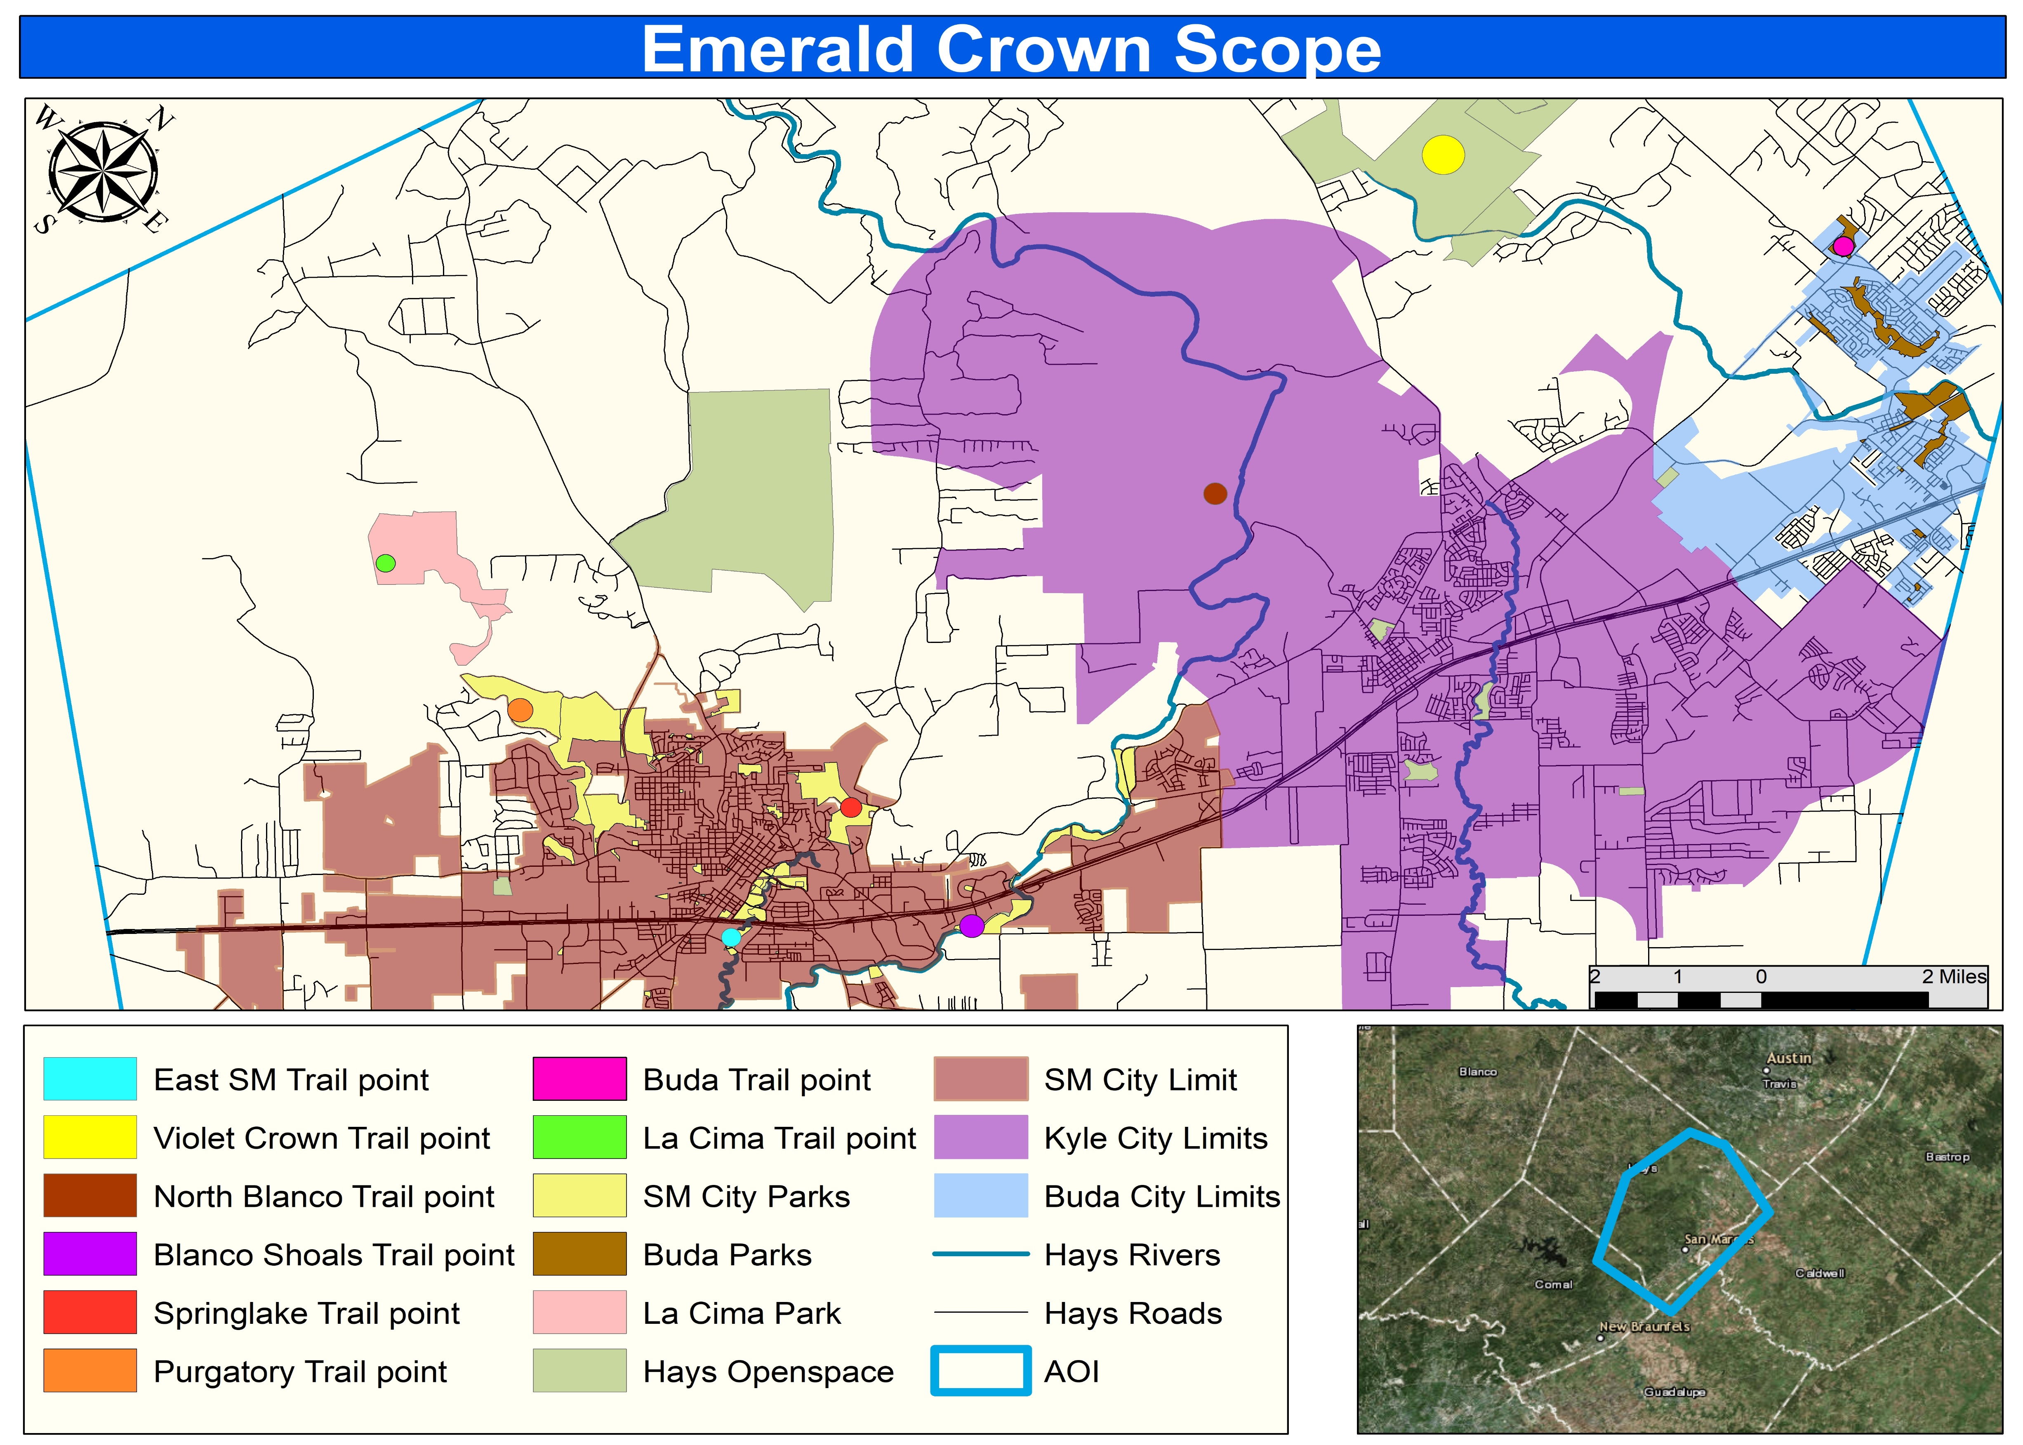
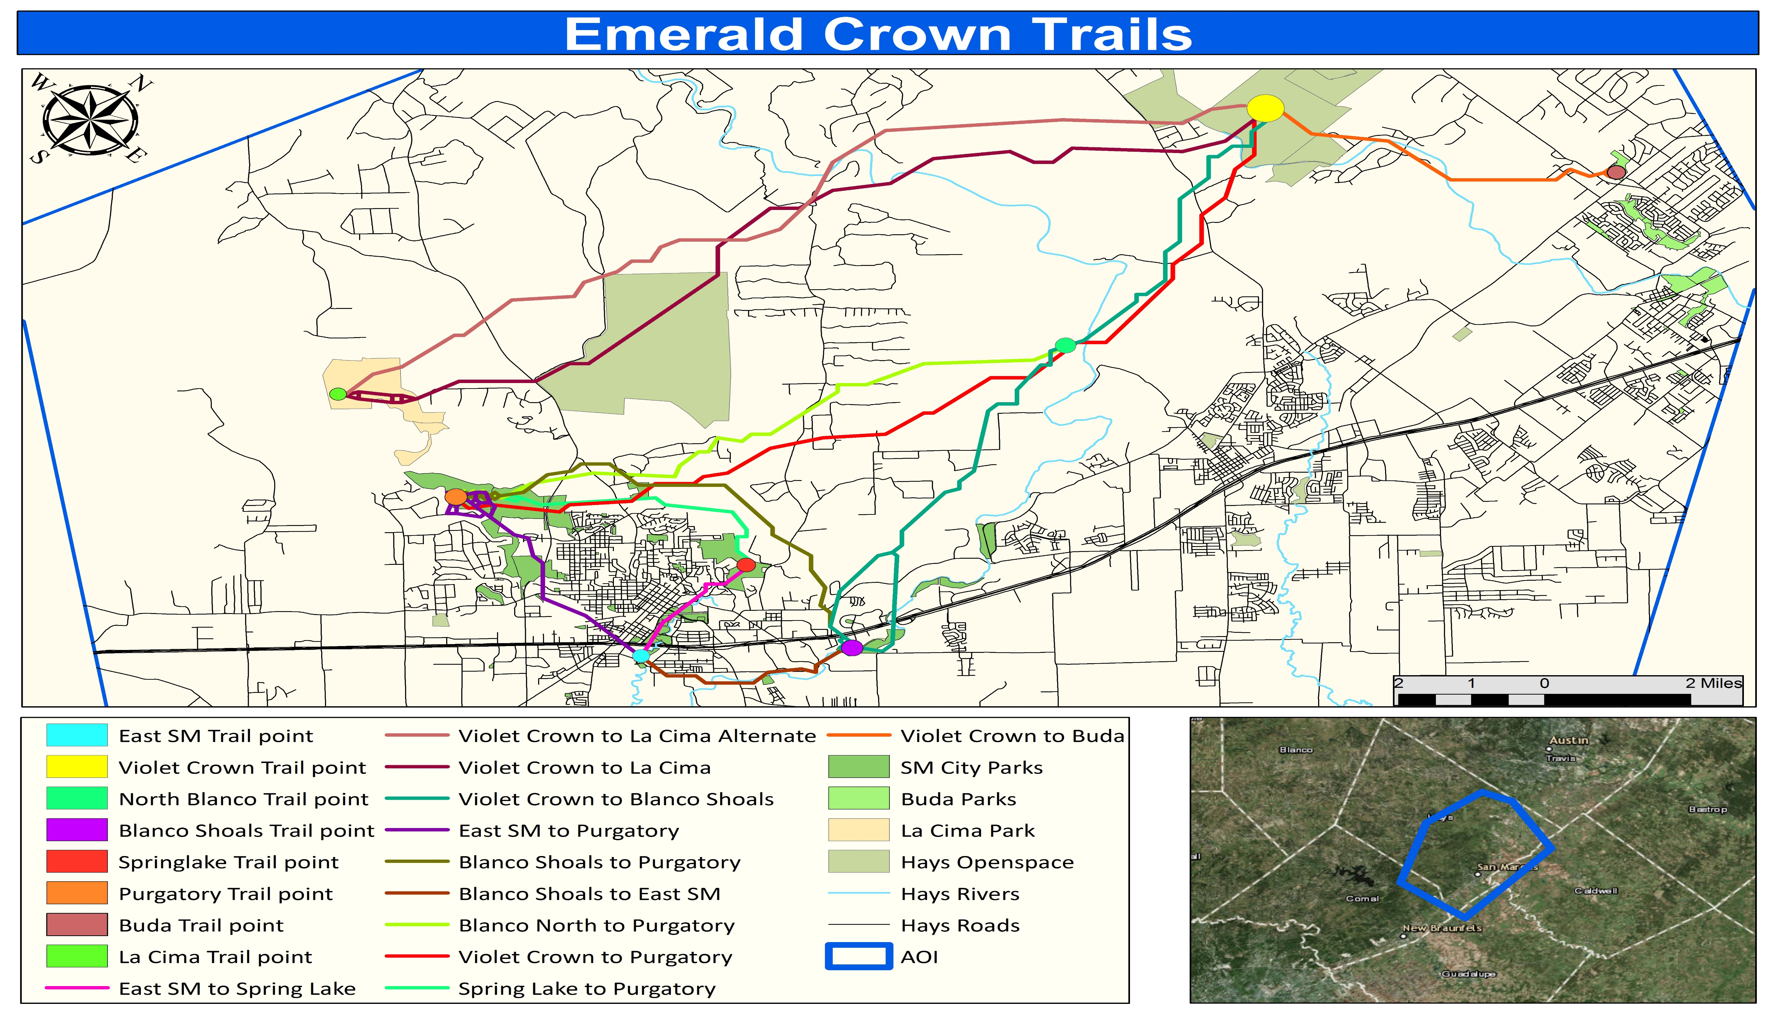
Development of the Emerald Crown Trail
In Conjunction with San Marcos Greenbelt Alliance & Trailblazers Consulting
Lucas Chavez, Project Manager; Emma Highberger, Analyst; Julian Emerson, Analyst
Texas State University, Evans Liberal Arts- Geography Department
Abstract
Methodology
Table 1: Parcel count per Specified Trail
Our project focused on the development of potential trail routes that would connect the cities of Buda, Kyle, and San Marcos. Using a least cost analysis would allow us to create these trails, and to provide SMGA with an understanding of why these trails could be built in certain areas based on our specific criteria.
Specify Area of Interest (AOI)
Data Acquisition to develop Cost Surface
Digital Elevation Model (DEM)
Land Cover/ Land Use (LC/LU)
Soils
Data Processing
Reclassify layers to allow the development of a weighted overlay cost surface
Cost Summation
Run Weighted Overlay Tool with specified data
Specify weight of each layer
LC/LU: 55% ; DEM: 40% ; Soils: 5%
Specify Locations where the trail will connect to and from
8 specified locations for trail connectivity
Violet Crown Trail Point; Buda Trail Point; North Blanco Trail Point; East SM Trail Point; Blanco Shoals Trail Point; Spring Lake Trail Point; Purgatory Trail Point; La Cima Trail Point
Develop Least Cost Path based on Cost Surface
12 Trails Developed
Configure Parcel data
Merge parcel data of Kyle and San Marcos
Perform spatial join between specific trails and the merged parcel data to count the parcels that the selected trail passes through
Table 1- Shows specific trails and their parcel count
Trail | Parcel Count | Trail | Parcel Count
Blanco North to Purgatory | 104 | Violet Crown to Blanco Shoals | 124
Blanco Shoals to East SM | 64 | Violet Crown to Buda | 69
Blanco Shoals to Purgatory | 73 | Violet Crown to La Cima | 22
East SM to Purgatory | 155 | Violet Crown to La Cima ALT | 21
East SM to Spring Lake | 35 | Violet Crown to Purgatory | 82
Spring Lake to Purgatory | 39 | Violet Crown to Purgatory ALT | 101
Total |  |  | 889
Introduction
The San Marcos Greenbelt Alliance (SMGA) is a non-profit organization founded in 1998 to provide non-motorized travel throughout San Marcos and other communities. Trailblazers Consulting was hired to create routes for SMGA that would connect the cities of Buda, Kyle, and San Marcos with a transportation trail for non-motorized vehicle travel. Trailblazers Consulting implemented a GIS to produce multiple transportation routes connecting the associated cities.
Table is showing the amount of parcels that each individual trail goes through. This will provide SMGA an account of which trails will require more attention to land ownership when developing trails.
Scope
The scope of our project spans from La Cima Park which is southwest of San Marcos city limits towards the outer reaches of Kyle and Buda city limits ( see Figure 1). The main focus of the trail design is focused on the west side of I-35 since a majority of our trail points are located there.
Conclusion & Results
In conclusion, with the implementation of GIS we were able to run our least cost path analysis to develop 12 trails in total. These 12 trails were developed by the manipulation of our cost surface which allowed us to create multiple paths to different locations based on certain criteria we set (See Figure 2).
Figure 1: Map of Scope
Figure 2: Map of designed trails

