Slide 1
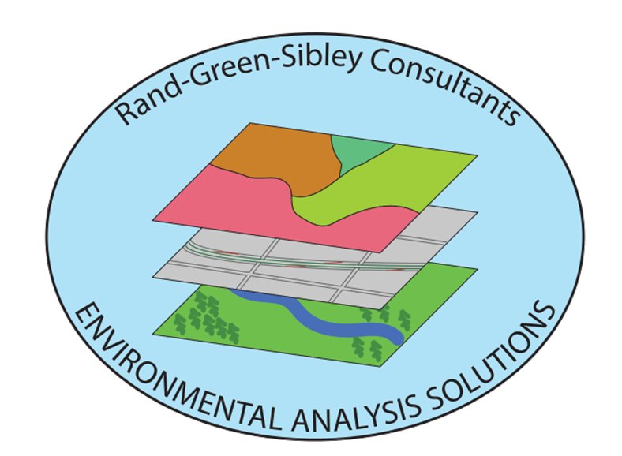
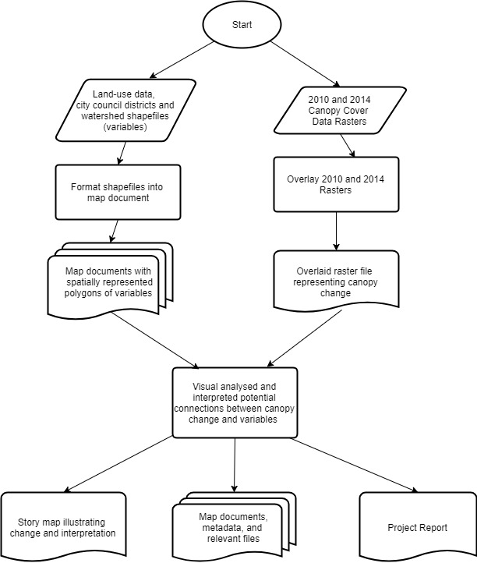
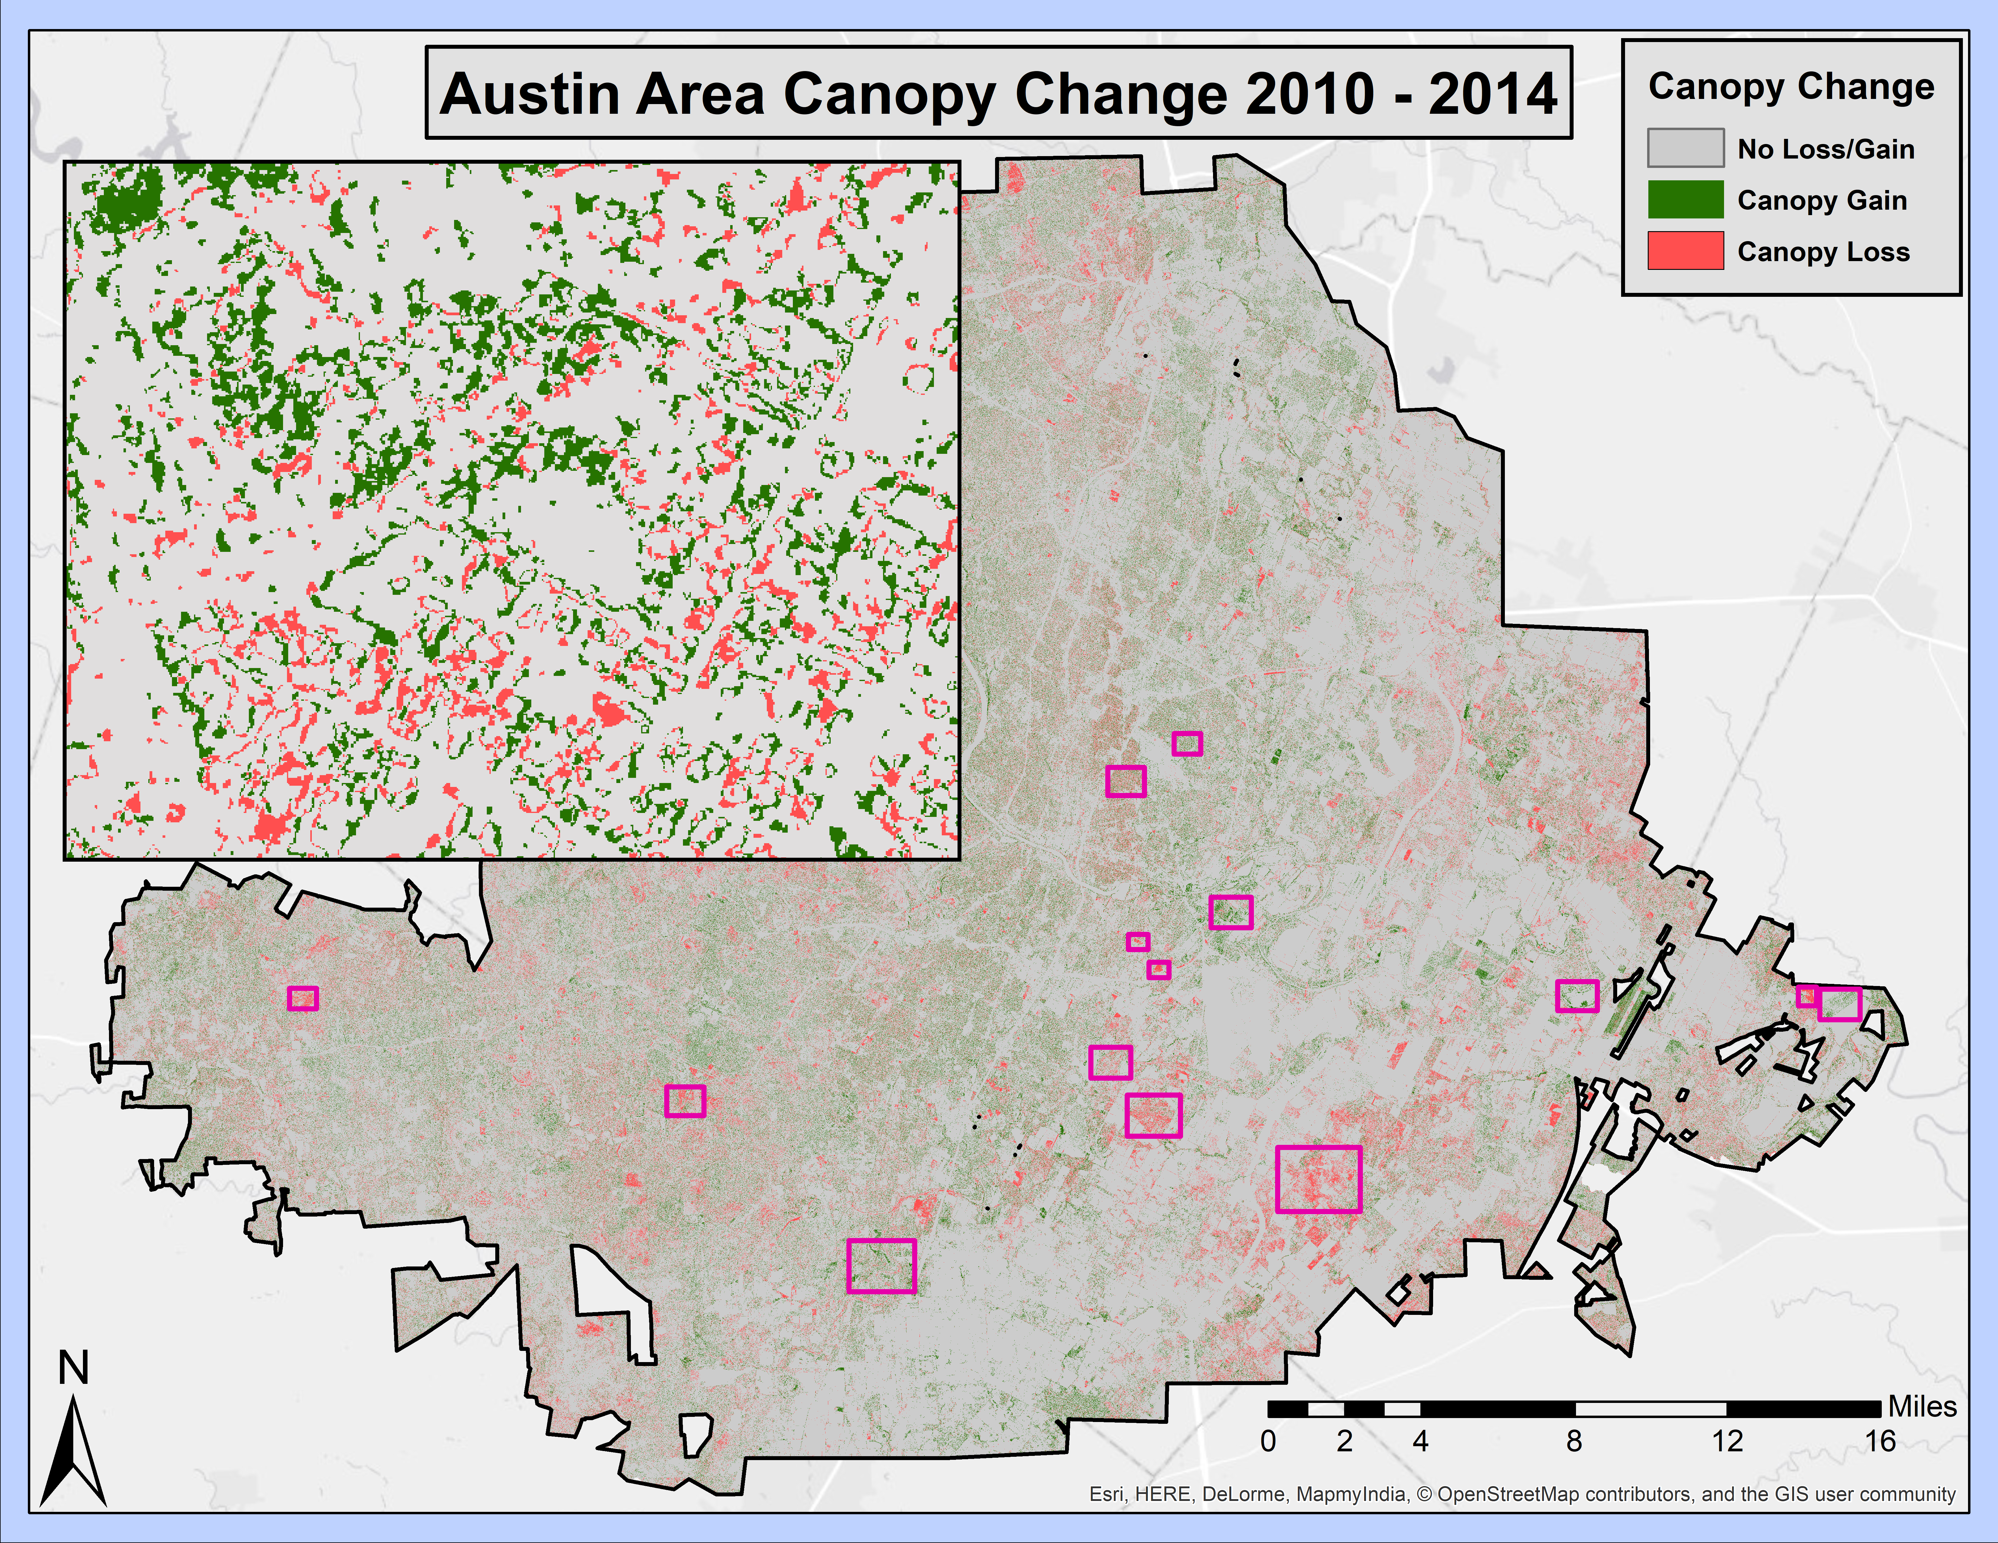
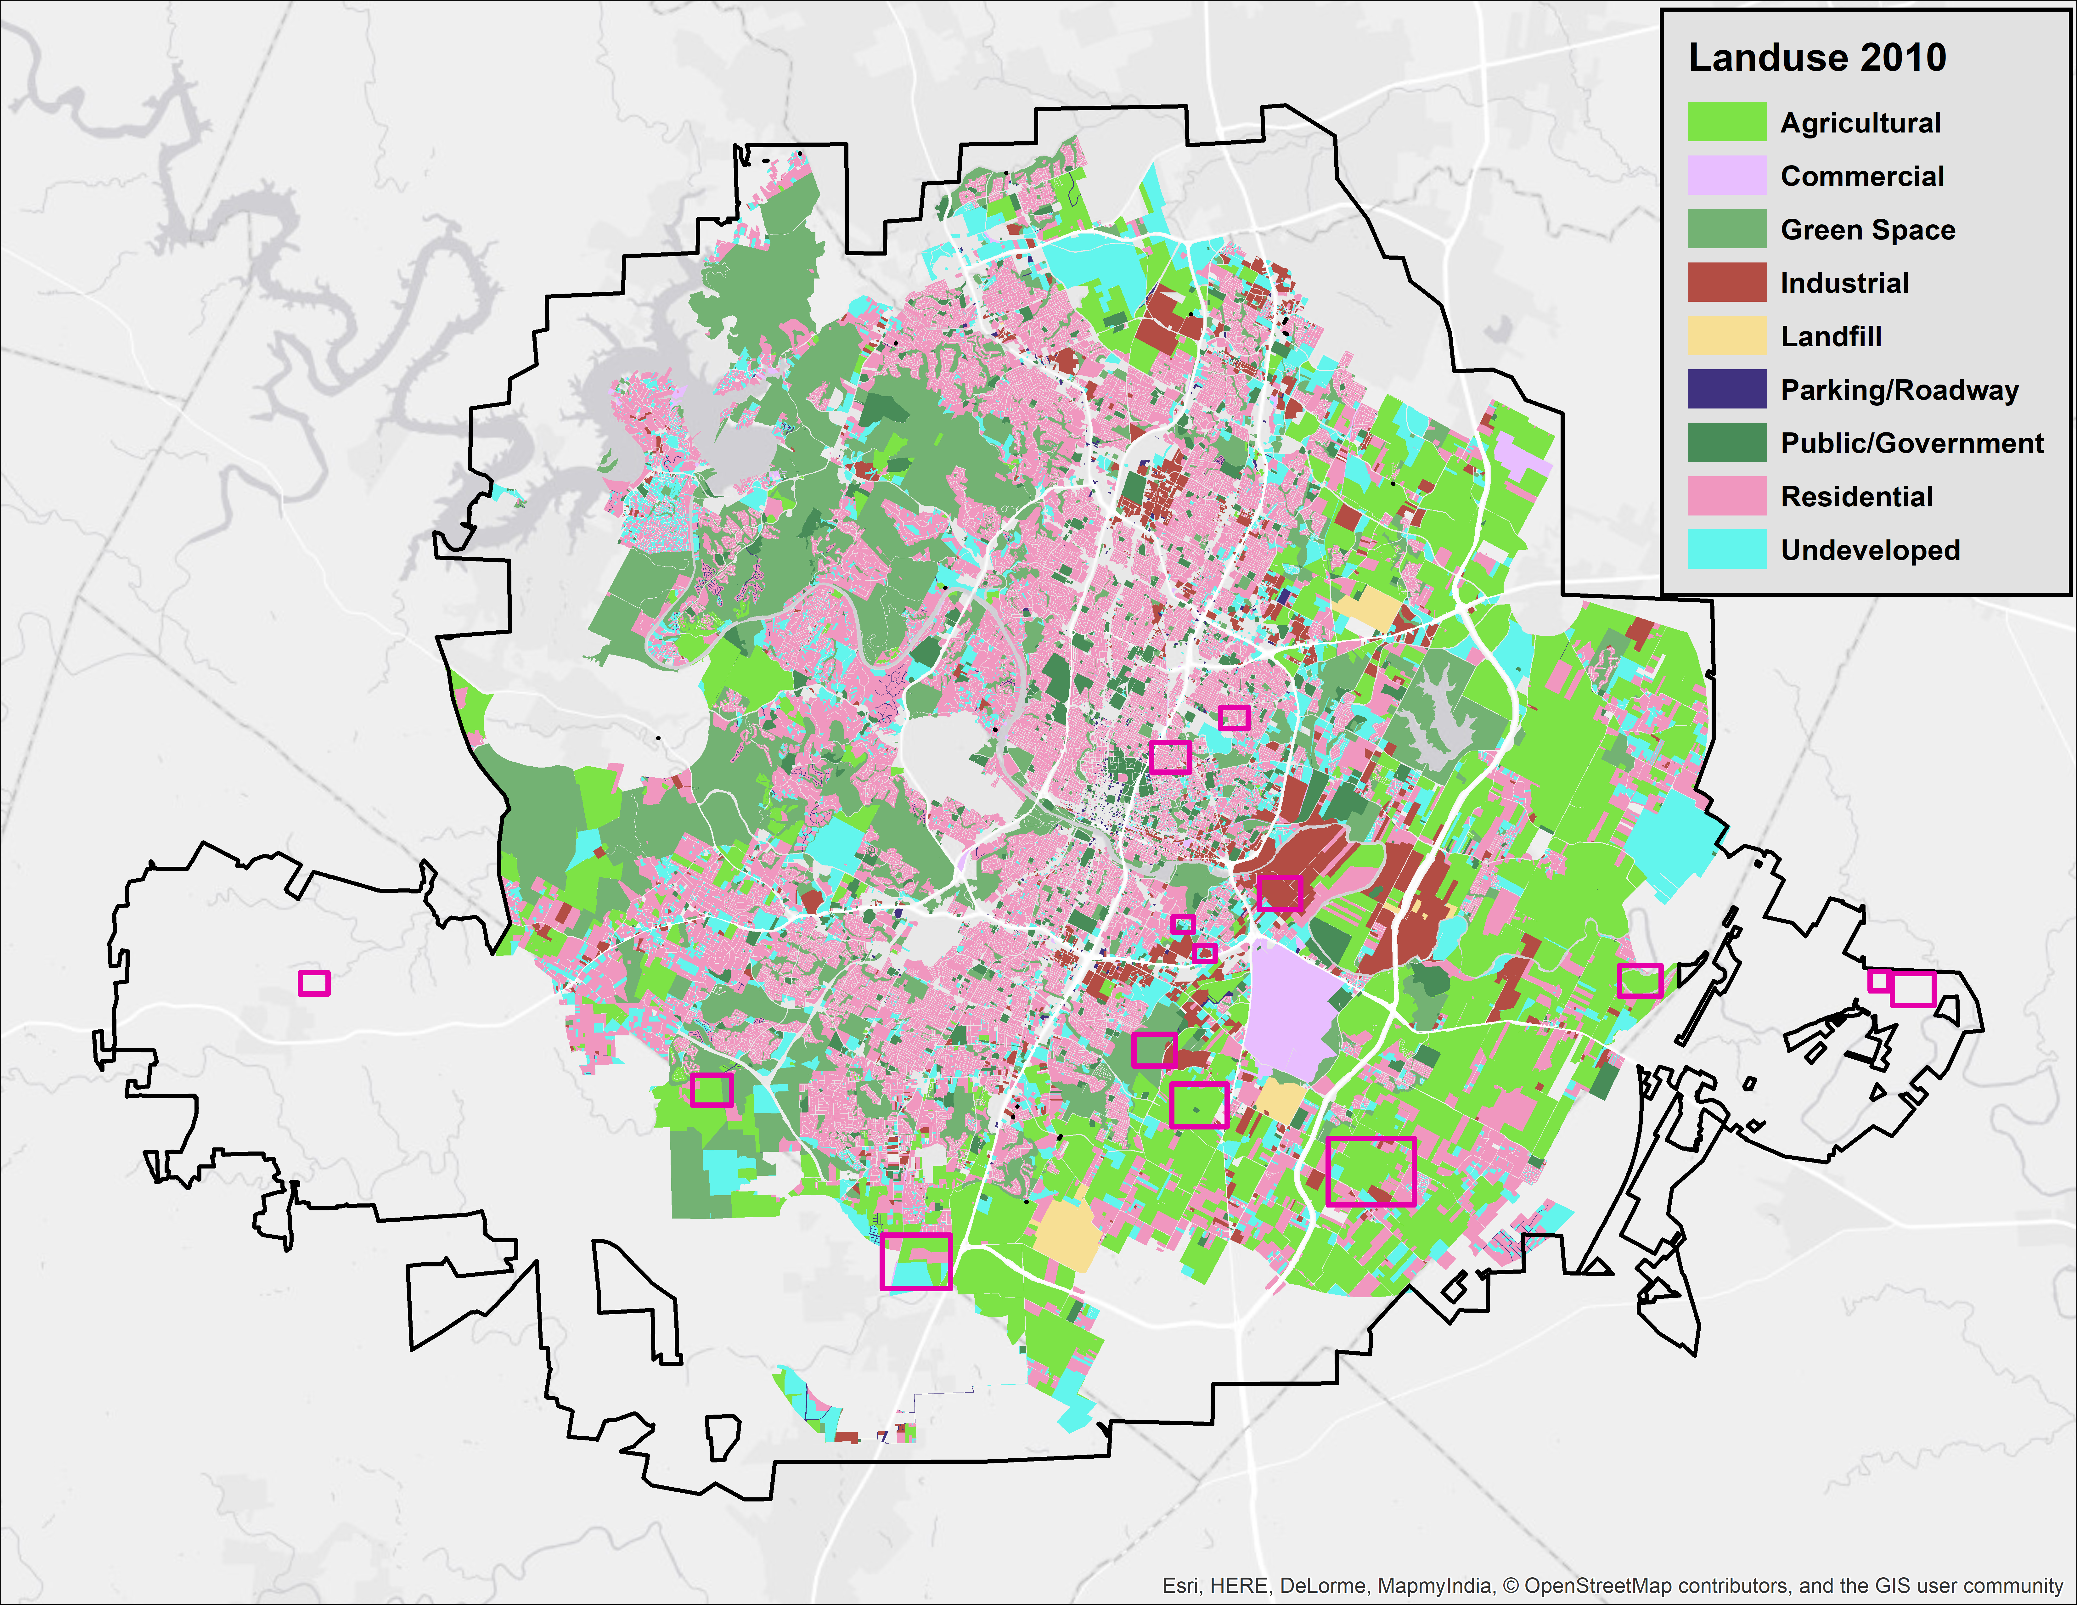
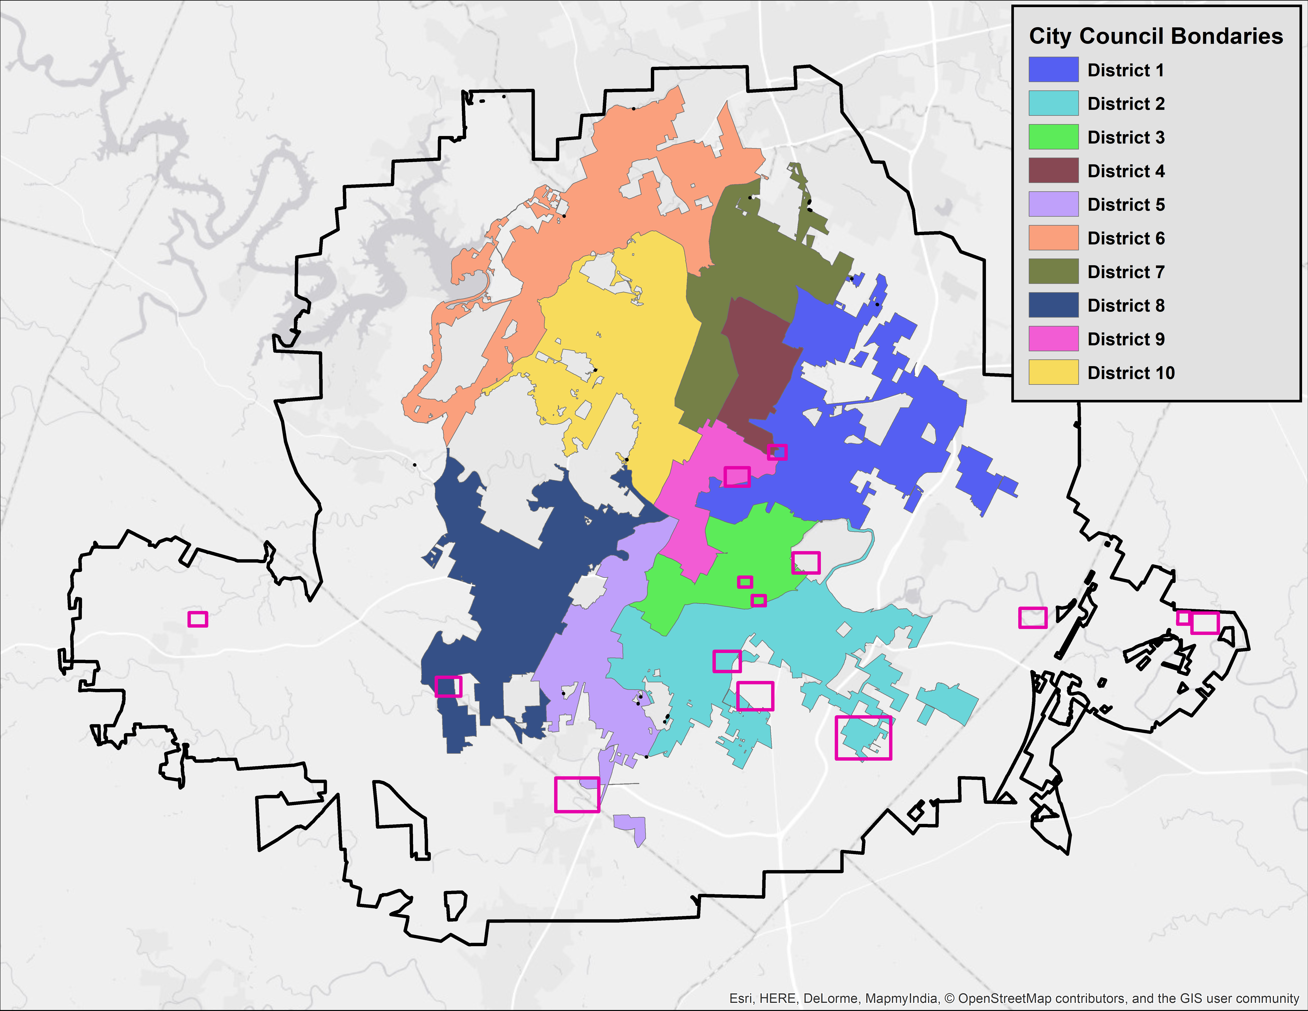
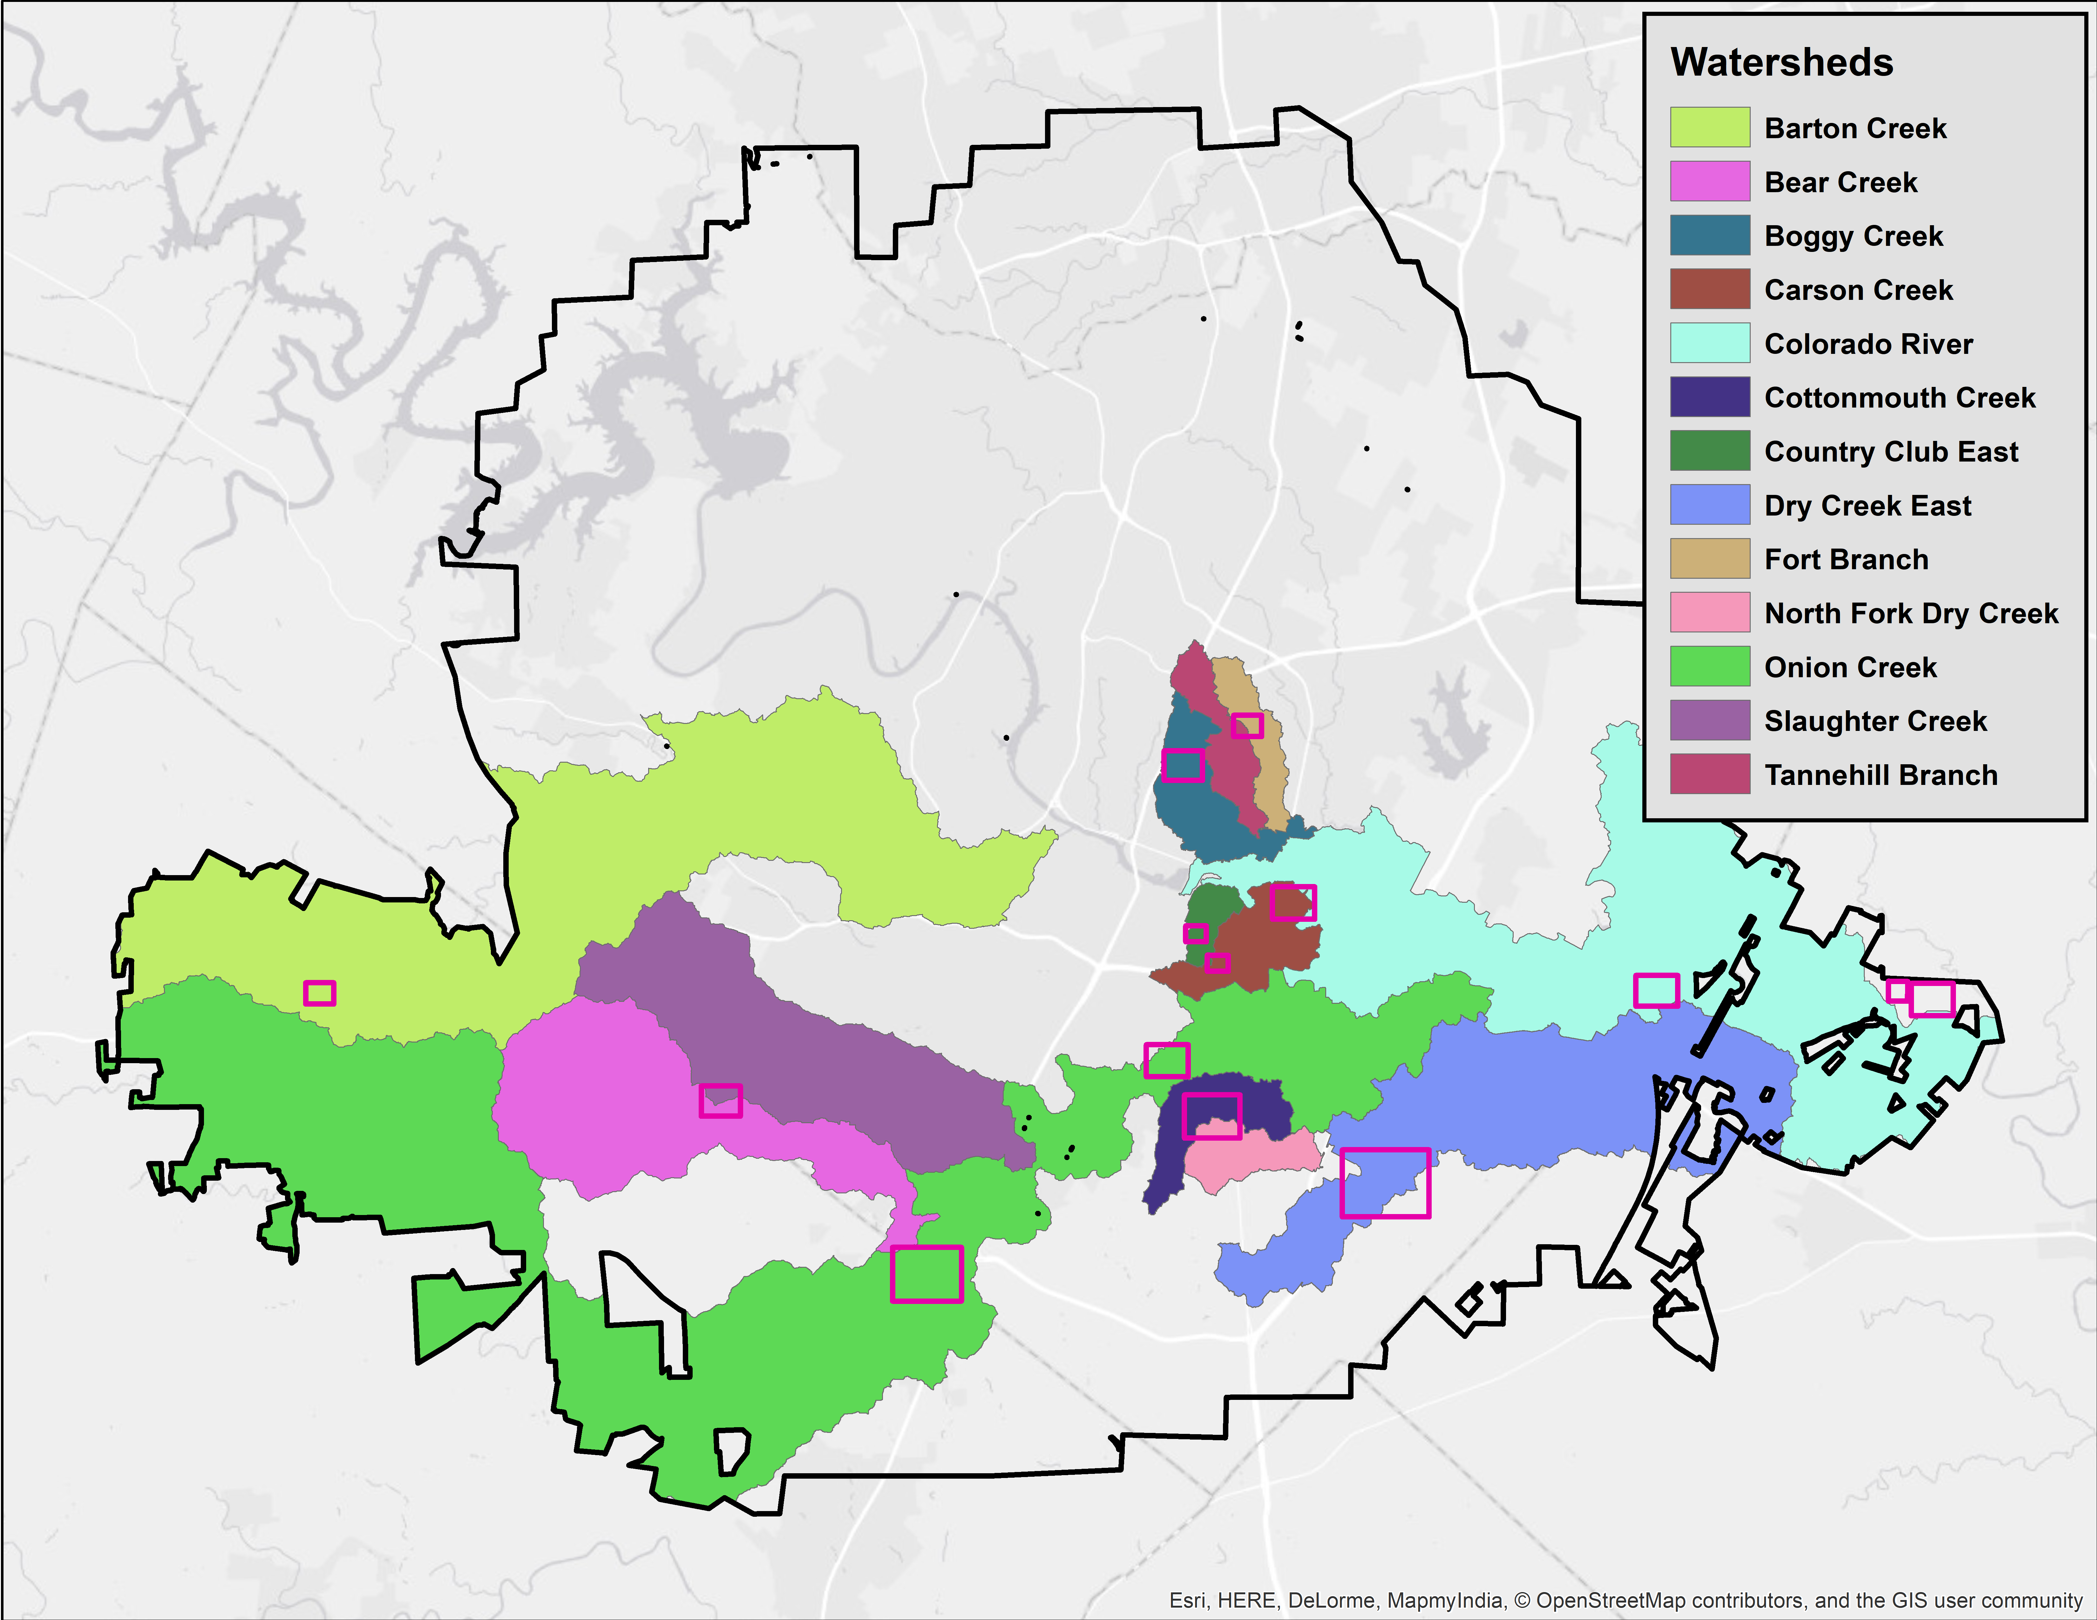
Austin’s Urban Forest Canopy
Prepared by: Erin Rand, Cory Sibley, Steven Green
Texas State University
Summary
Data
Methodology
The City of Austin Urban Forestry Program is a division of Austin Parks and Recreation that is dedicated to improving the quality of life for Austin residents by supporting the long term health and vitality of public urban forest resources, which provide environmental, social, and economic enrichment. This semester Texas State University has worked with the City of Austin Urban Forestry Program to evaluate urban canopy change between the years of 2010 and 2014 using aerial imagery of canopy cover.
Purpose
Results
This study uses raster overlay of canopy cover between 2010 and 2014 to compare the change with features such as land use data, political boundaries, and watersheds. This study discusses the potential relationship between canopy change and the aforementioned features. Using this information, we recommend priority areas for tree planting and distribution programs. We represent the study findings in standard map form, and additionally we have created a story map using ArcGIS Online to demonstrate this change interactively, which is intended to be used by the City of Austin for urban forestry advocacy.
Scope
Our scope includes the Greater Austin area including the ETJ as delineated in the extent of the data provided. The canopy datasets were recorded in 2010 and 2014, and reflect the change during that period. This final report is the culmination of our work during the fall semester of 2017.
Data Source:
The City of Austin
Department of Agriculture
State of Texas

