Slide 1
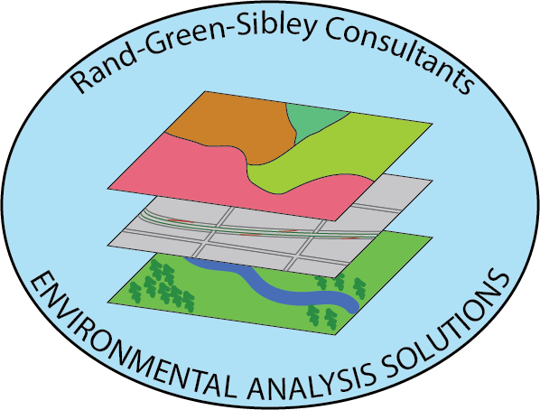
Austin’s Urban Forest Canopy
Erin Rand, Steven Green, Cory Sibley

Slide 2
Introduction
Client: City of Austin Urban Forestry Program
Why are urban forests important?
Economic Benefits
Social/Psychological benefits
Environmental Benefits

Slide 3
Purpose
Purpose:
Illustrate canopy change between 2010 and 2014
Create a story map telling the story of the canopy over a 4 year period
Interpret these results to suggest areas of focus for tree planting initiatives

Slide 4
Data
City of Austin canopy cover
Spatial limits: data boundary
Data type: raster (TIFF)
Time period: 2010 and 2014

Slide 5
Change of Plans: Original Plans
Formatting for analysis: Raster to Vector
Canopy change illustration: Statistical Analysis
Regression over time
Potential correlations between land use, political districts, and watersheds
Hot spot analysis to show areas of greatest canopy change

Slide 6
Change of Plans: Complications
Incompatible data: 2006 was vector, 2010 and 2014 were raster
Large file sizes that made conversions difficult, and processes very slow
Unable to acquire 2006 raster; data was corrupted on client server
Time constraints did not allow for the conversions and processes needed
Focus shifted to interpretation and visual representation via StoryMap

Slide 7
Pre-formatting Processes
Acquisition of data from City of Austin
Clipped data to common extent
Projected to State Plane Texas Central
Created categorical maps for variables: land use, watersheds, and political districts

Slide 8
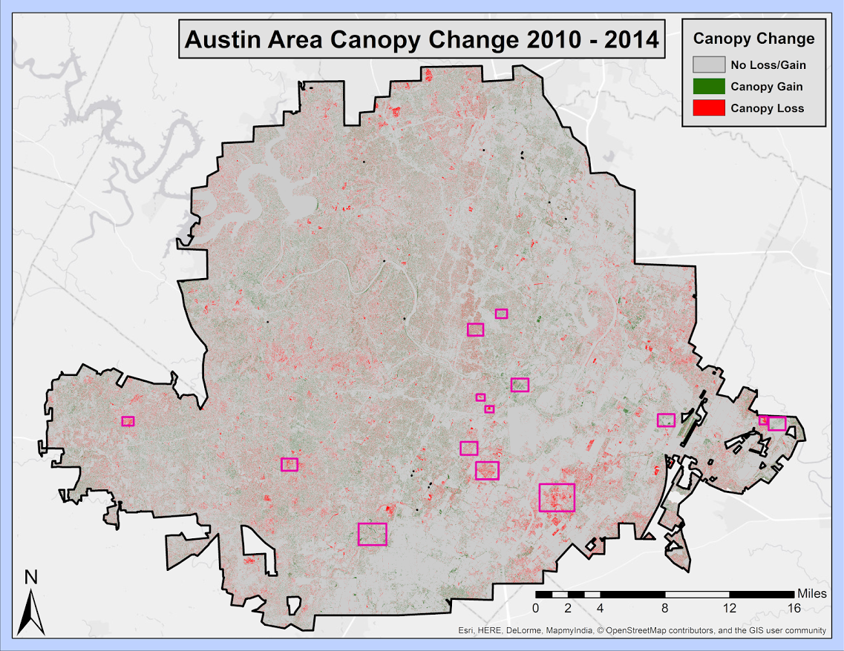

Slide 9
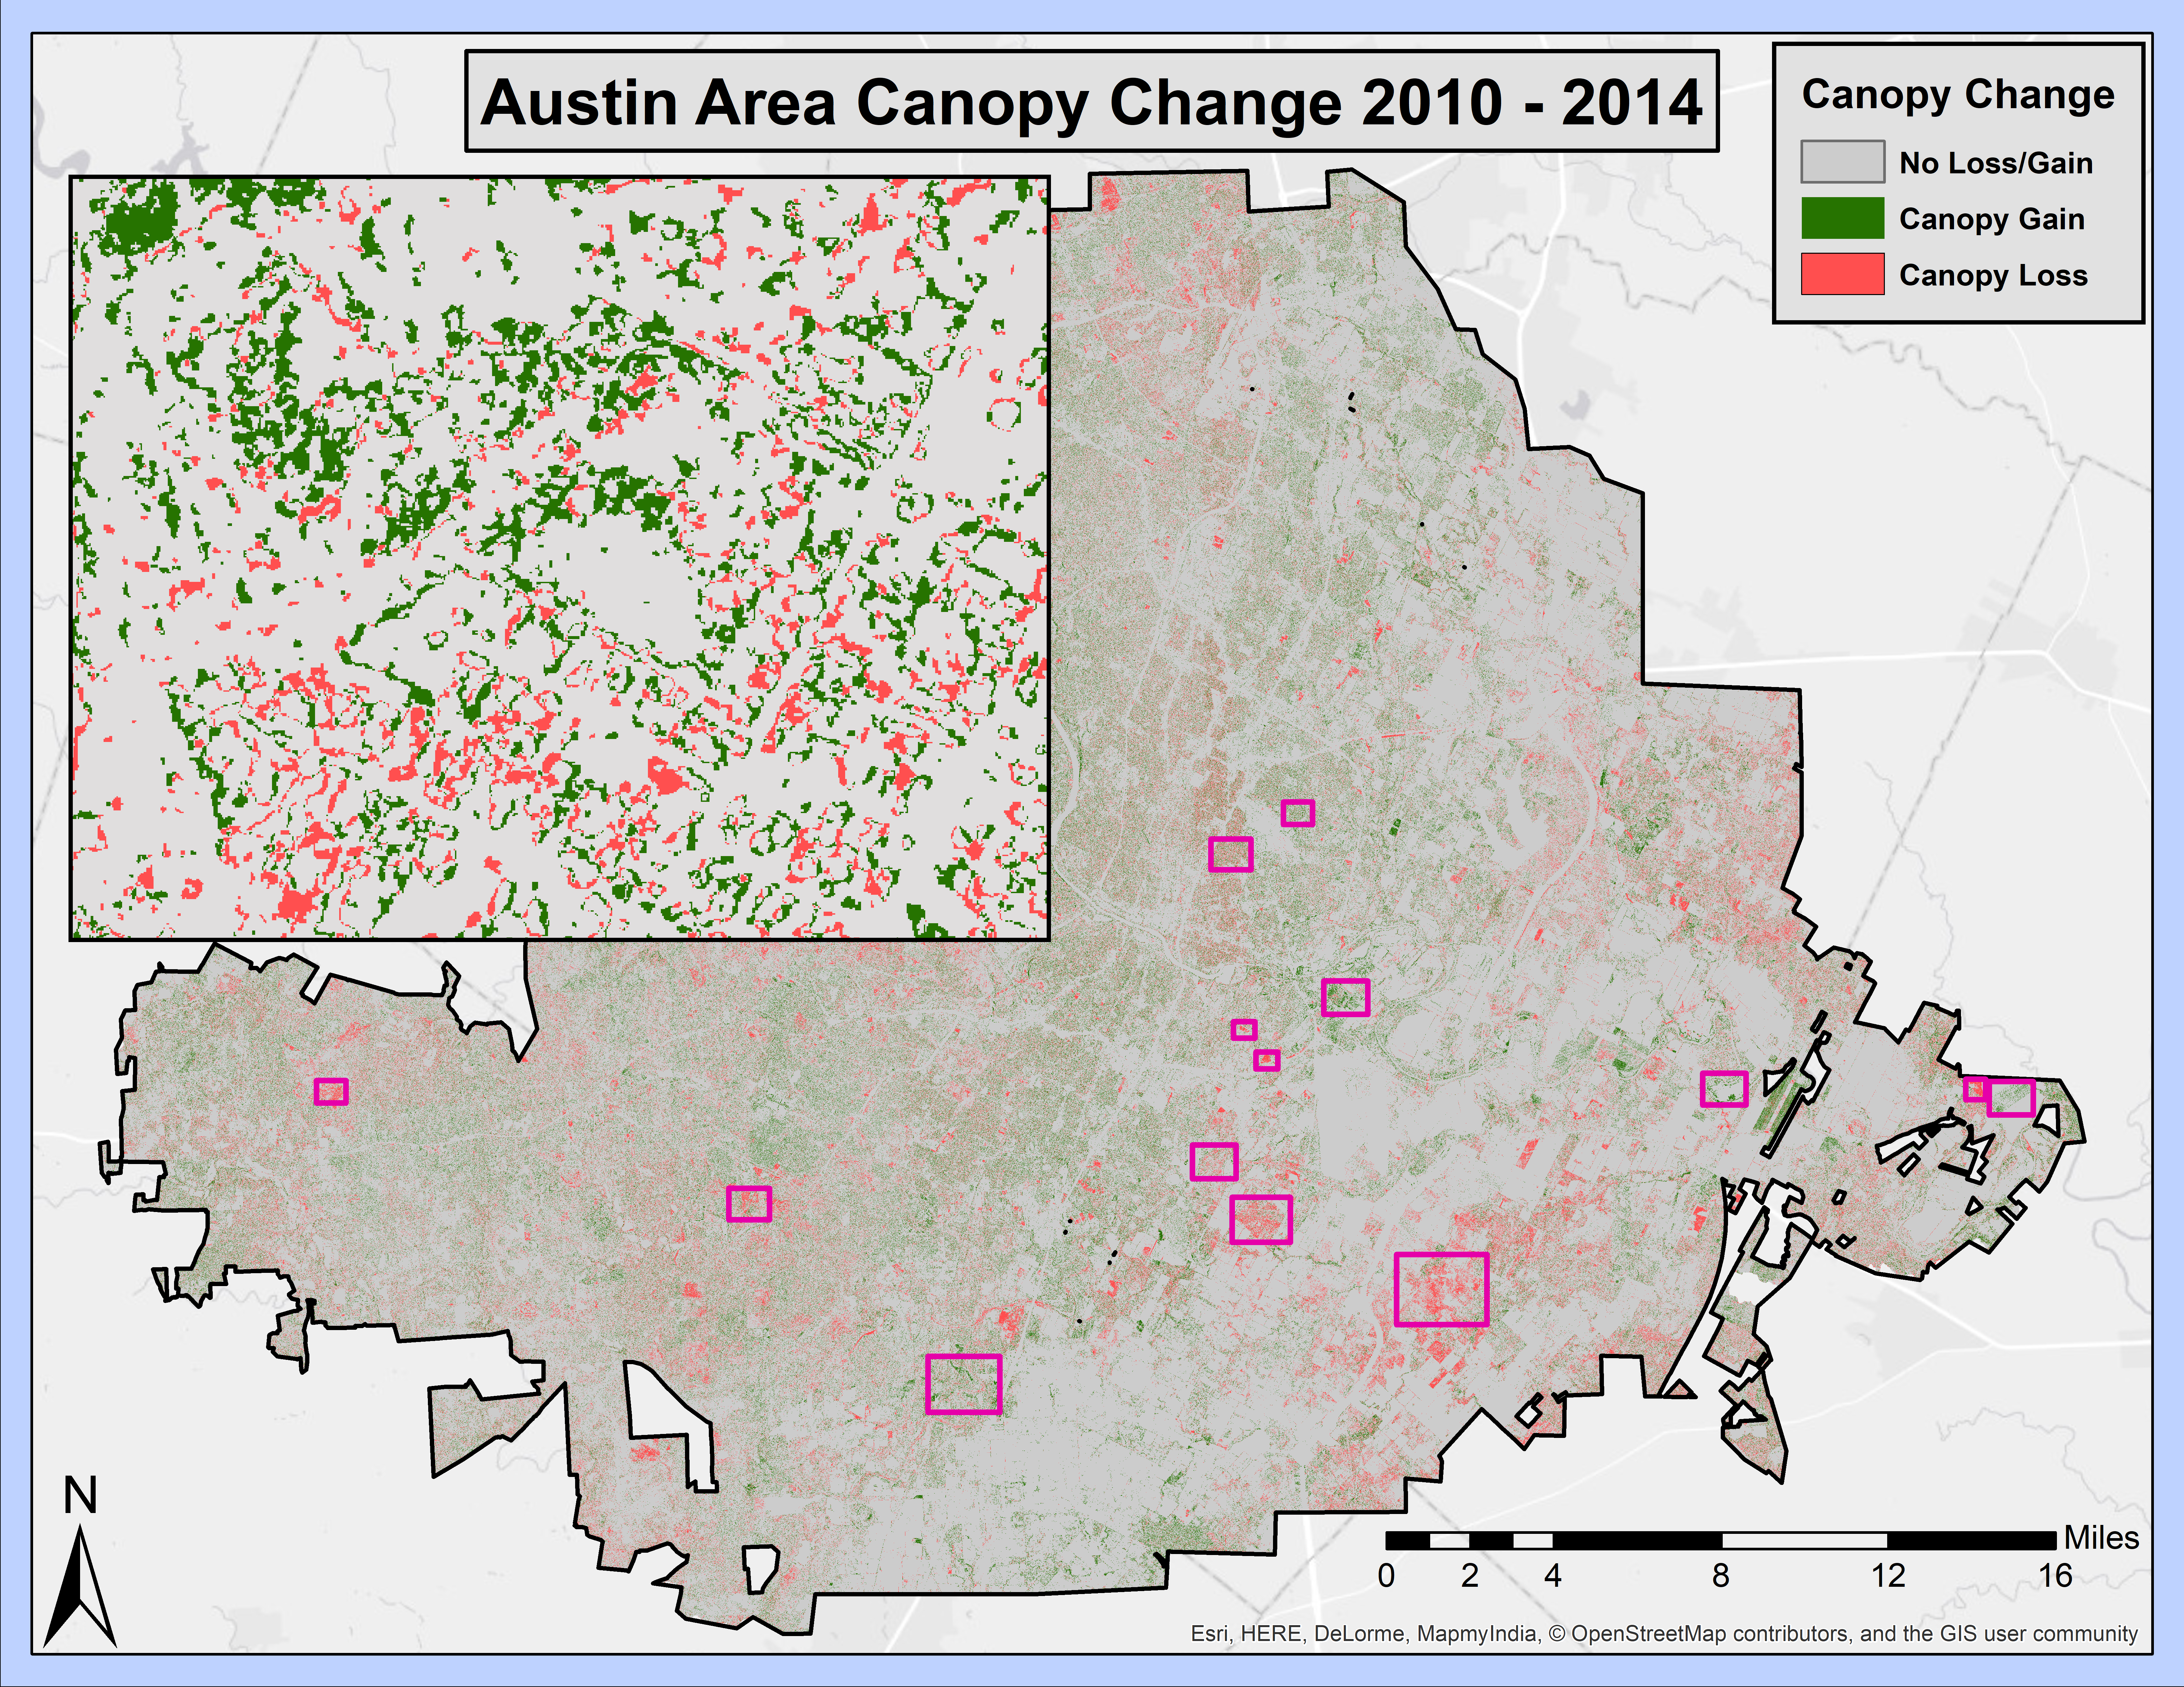

Slide 10
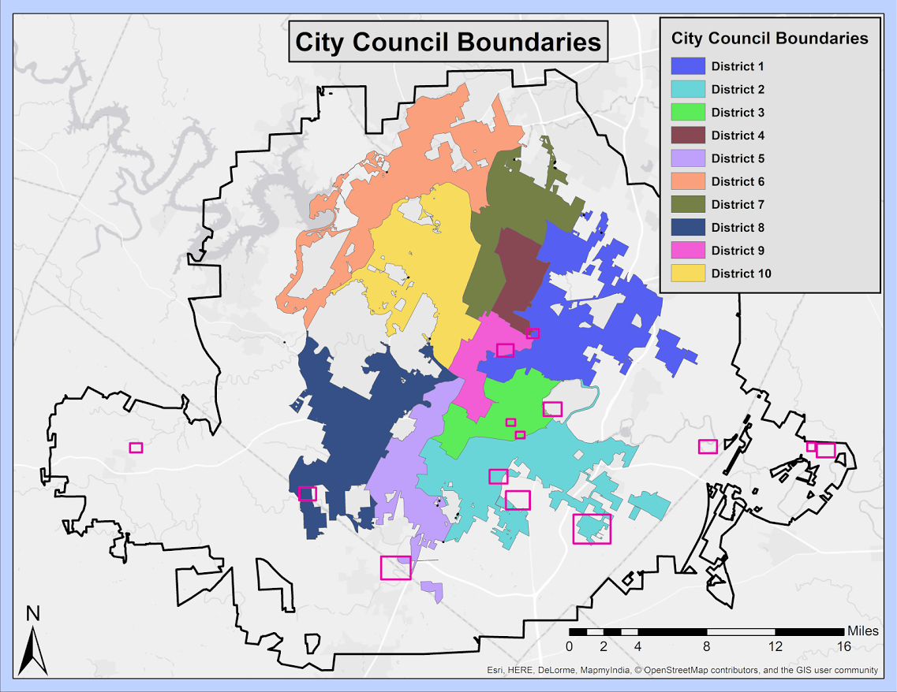

Slide 11
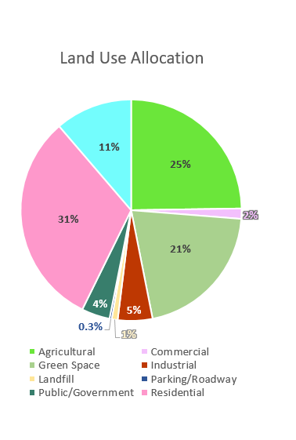

Slide 12
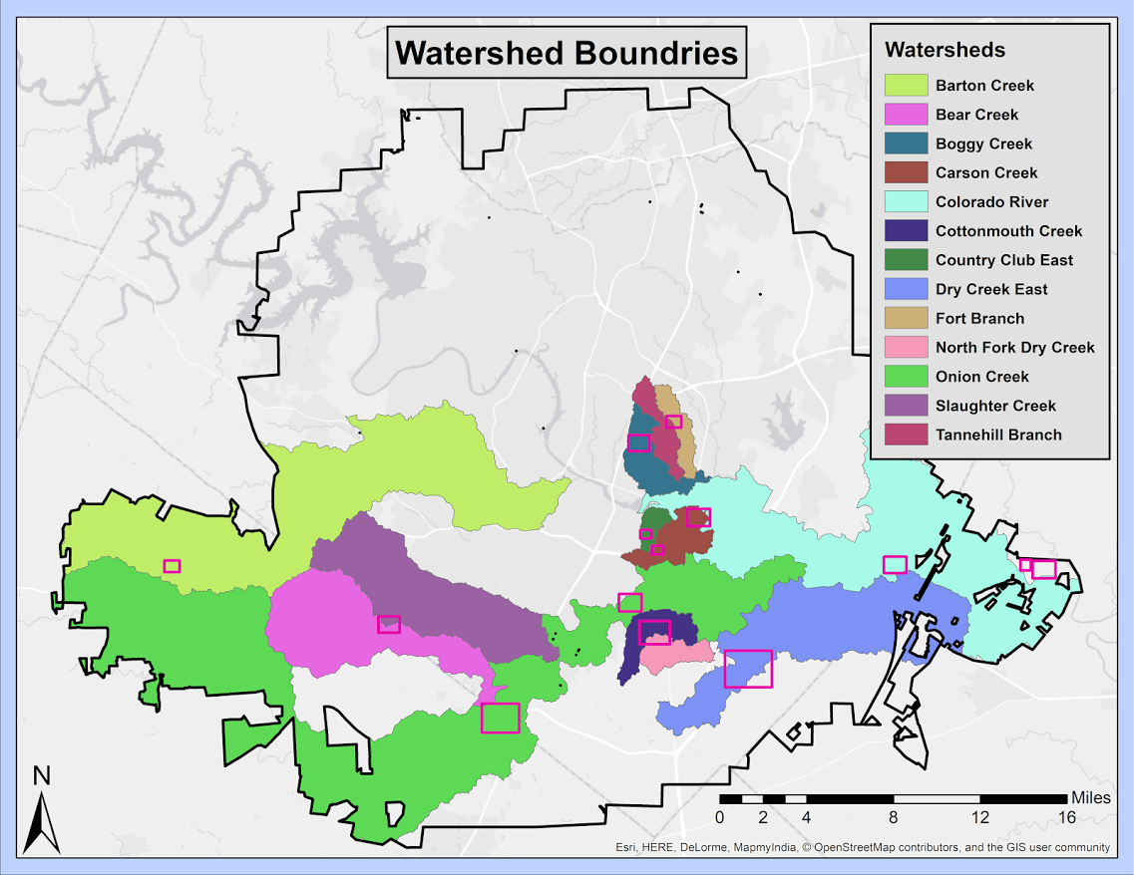

Slide 13
Story Map Tour

