Slide 1
Digitization of Austin, TX District 9 Safety Barriers
Project Manager: William Shannon
Reese Rasberry
Jason Garcia

Slide 2
Recap
Digitize traffic safety barriers
District 9: city of Austin
Composition analysis of barrier material (i.e. wood, metal)
Geographic analysis of new barrier locations

Slide 3
Internal Preview
Data
What data we used
Who provided the data
Deliverables
Discussion
Overview of our work
Problems encountered
Conclusion

Slide 4
Provided Data
Data | Provider
Existing digitized safety barriers | City of Austin
Stream crossings | City of Austin
Near Map Imagery | City of Austin/Near Map
High crash areas | City of Austin
Single member districts of Austin | City of Austin

Slide 5
Produced Data
Data | Provider
Existing digitized safety barriers | City of Austin
Proposed barriers | RGS
Hotspot Analysis | RGS

Slide 6
Deliverables
1. Added 57 existing barrier locations that were not previously digitized
2. Edited digitizing errors to the provided .shapefile
3. Barriers follow major roadway intersection as well as stream crossings

Slide 7
Digitized 57 new barriers
Added material composition
Statistical analysis of composition

Slide 8
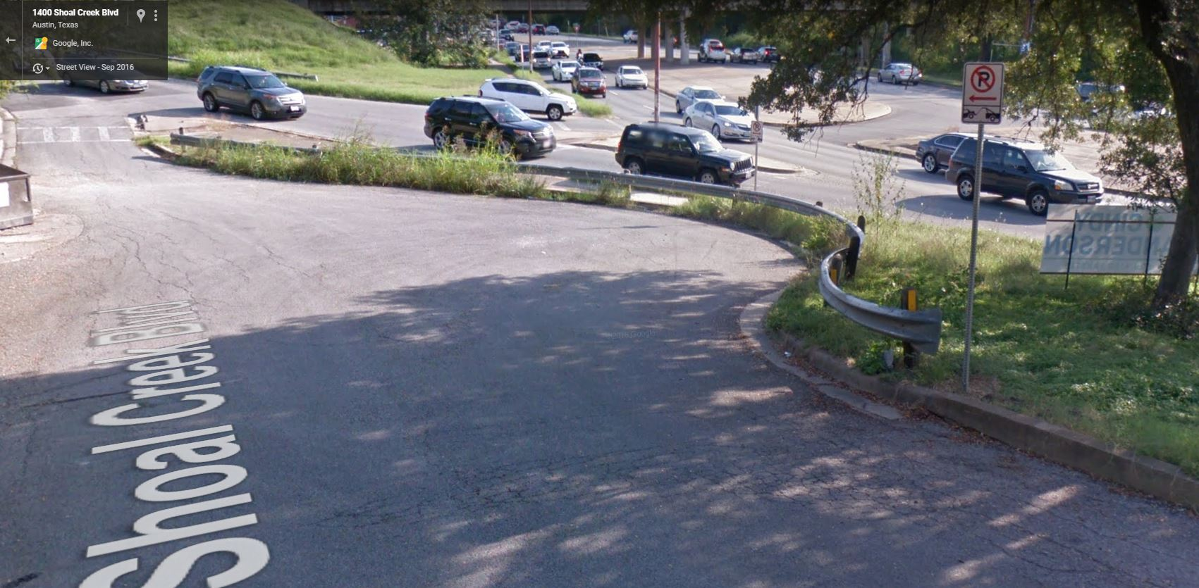
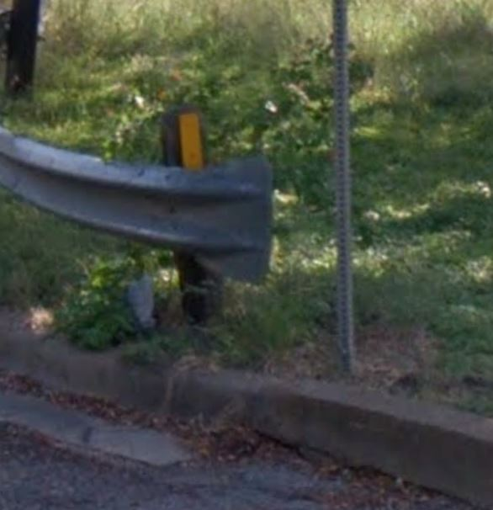
GUARDRAILING
RAILING-BRIDGE_CLASS
FISHTAIL_END

Slide 9
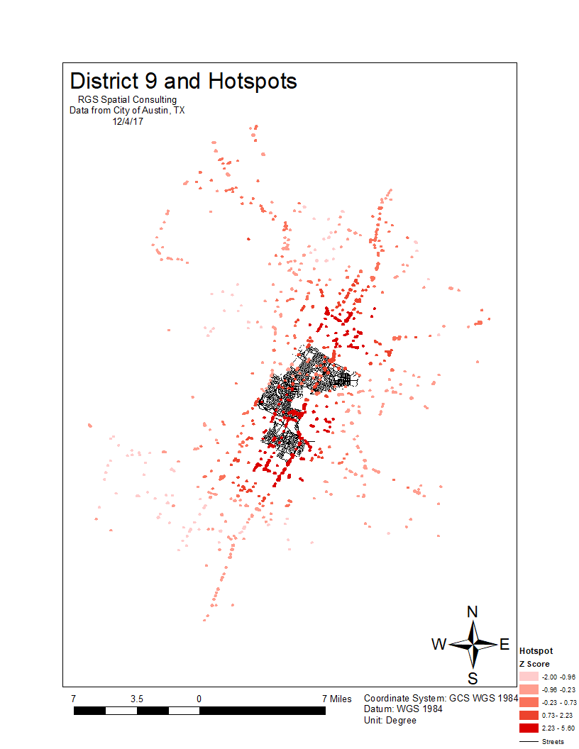
Hotspot analysis based off of crash data
Mirrors the road network
Z-score directly correlated with downtown population

Slide 10
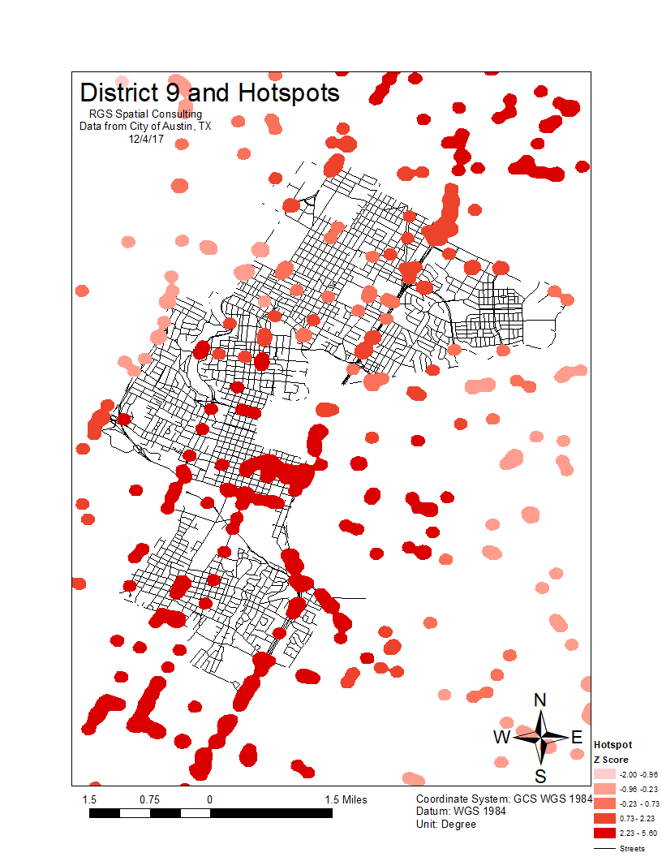
Hotspot analysis based off of crash data
Mirrors the road network
Z-score directly correlated with downtown population

Slide 11
Boundary of district 9
Proposed 8 new barrier locations/ 15 in total
No barriers in downtown area
No barriers along U.S. Int. I-35

Slide 12
Discussion
What we learned
Project management
Highs and lows
Team bonding

Slide 13
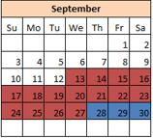
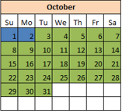
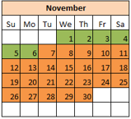
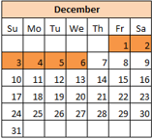
Timeline
Time Chunks
 | Project proposal
 | Proposal presentation
 | Client update
 | Final presentation

Slide 14
Conclusions
Completed GIS inventory of district 9
Improved safety barrier database
Hot spot analysis
Proposed new locations
Compositional analysis of current barriers

