Slide 1
Analyzing Inlets, Outfalls, and Land Cover Using Spatial and Network Analysis Within the San Antonio Sewershed
Aspen Navarro, Project Manager, GIS Analyst
Michael Jones, Assistant Project Manager, GIS Analyst
William Perry, Project Designer, GIS Analyst

Slide 2
Outline
Introduction
Data and Methodology
Budget
Time Table
Expected Results and Conclusion

Slide 3
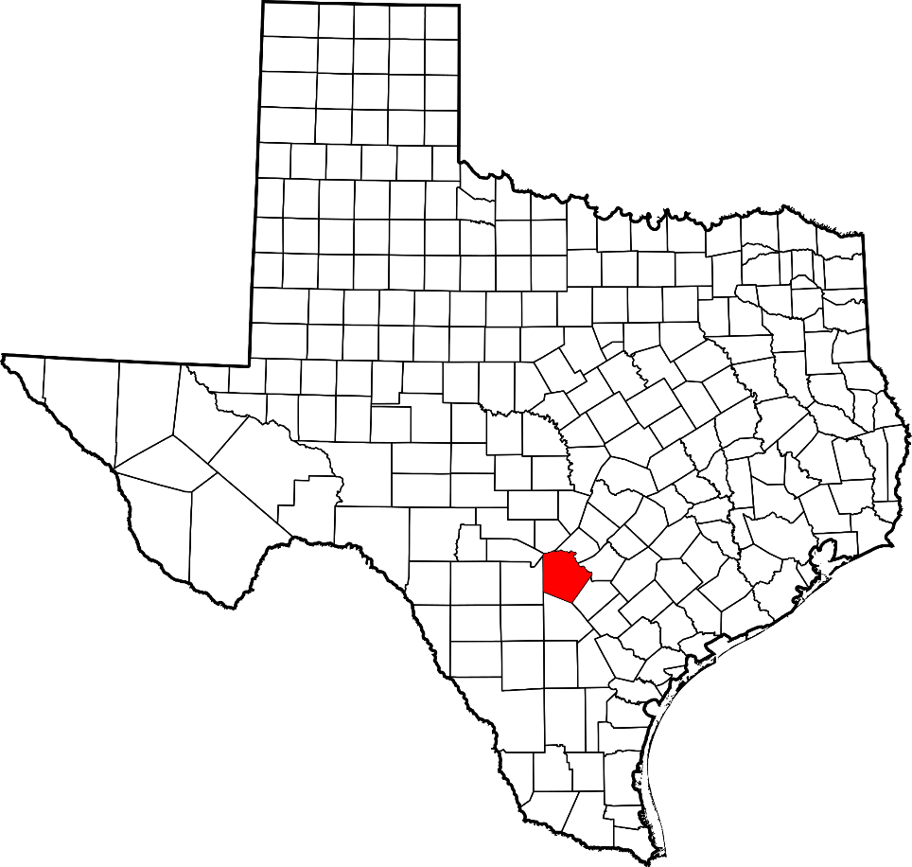
Introduction
The San Antonio River Authority (SARA)
Project objectives
-Areas contributing to pollution
-Pollution reduced
Project goal
-Better pollution management
https://www.sara-tx.org/wp-content/uploads/2015/06/SARA-Logo-side-RGB-72-300x88.png
https://upload.wikimedia.org/wikipedia/commons/thumb/b/b0/Map_of_Texas_highlighting_Bexar_County.svg/12473px-Map_of_Texas_highlighting_Bexar_County.svg.png
Notes:
SARA as it states, is a river authority located in San Antonio, Texas. Now why might a river authority be important (ask questions)?—The city of San Antonio is the 7th most populated city in America, and is ranked in the top 10 for the fastest growing cities in the US. Each year, SA is bringing in new residents, visitors, and new development. Therefore, it is ESSENTIAL to have groups like SARA managing the health of all rivers/creeks/waterways.
SARA has reached out to Pollution Solutions to implement a GIS to locate areas along Westside Creeks (in Bexar County) that are contributing to pollution. Identifying areas that are contributing to high amounts of pollution can help reduce the amount of waste spilling into SA waterways, as well as identify where the main sources of pollution are occurring.
The ultimate goal is to locate areas that are in need of better pollution management, to ensure the health of rivers and creeks.

Slide 4
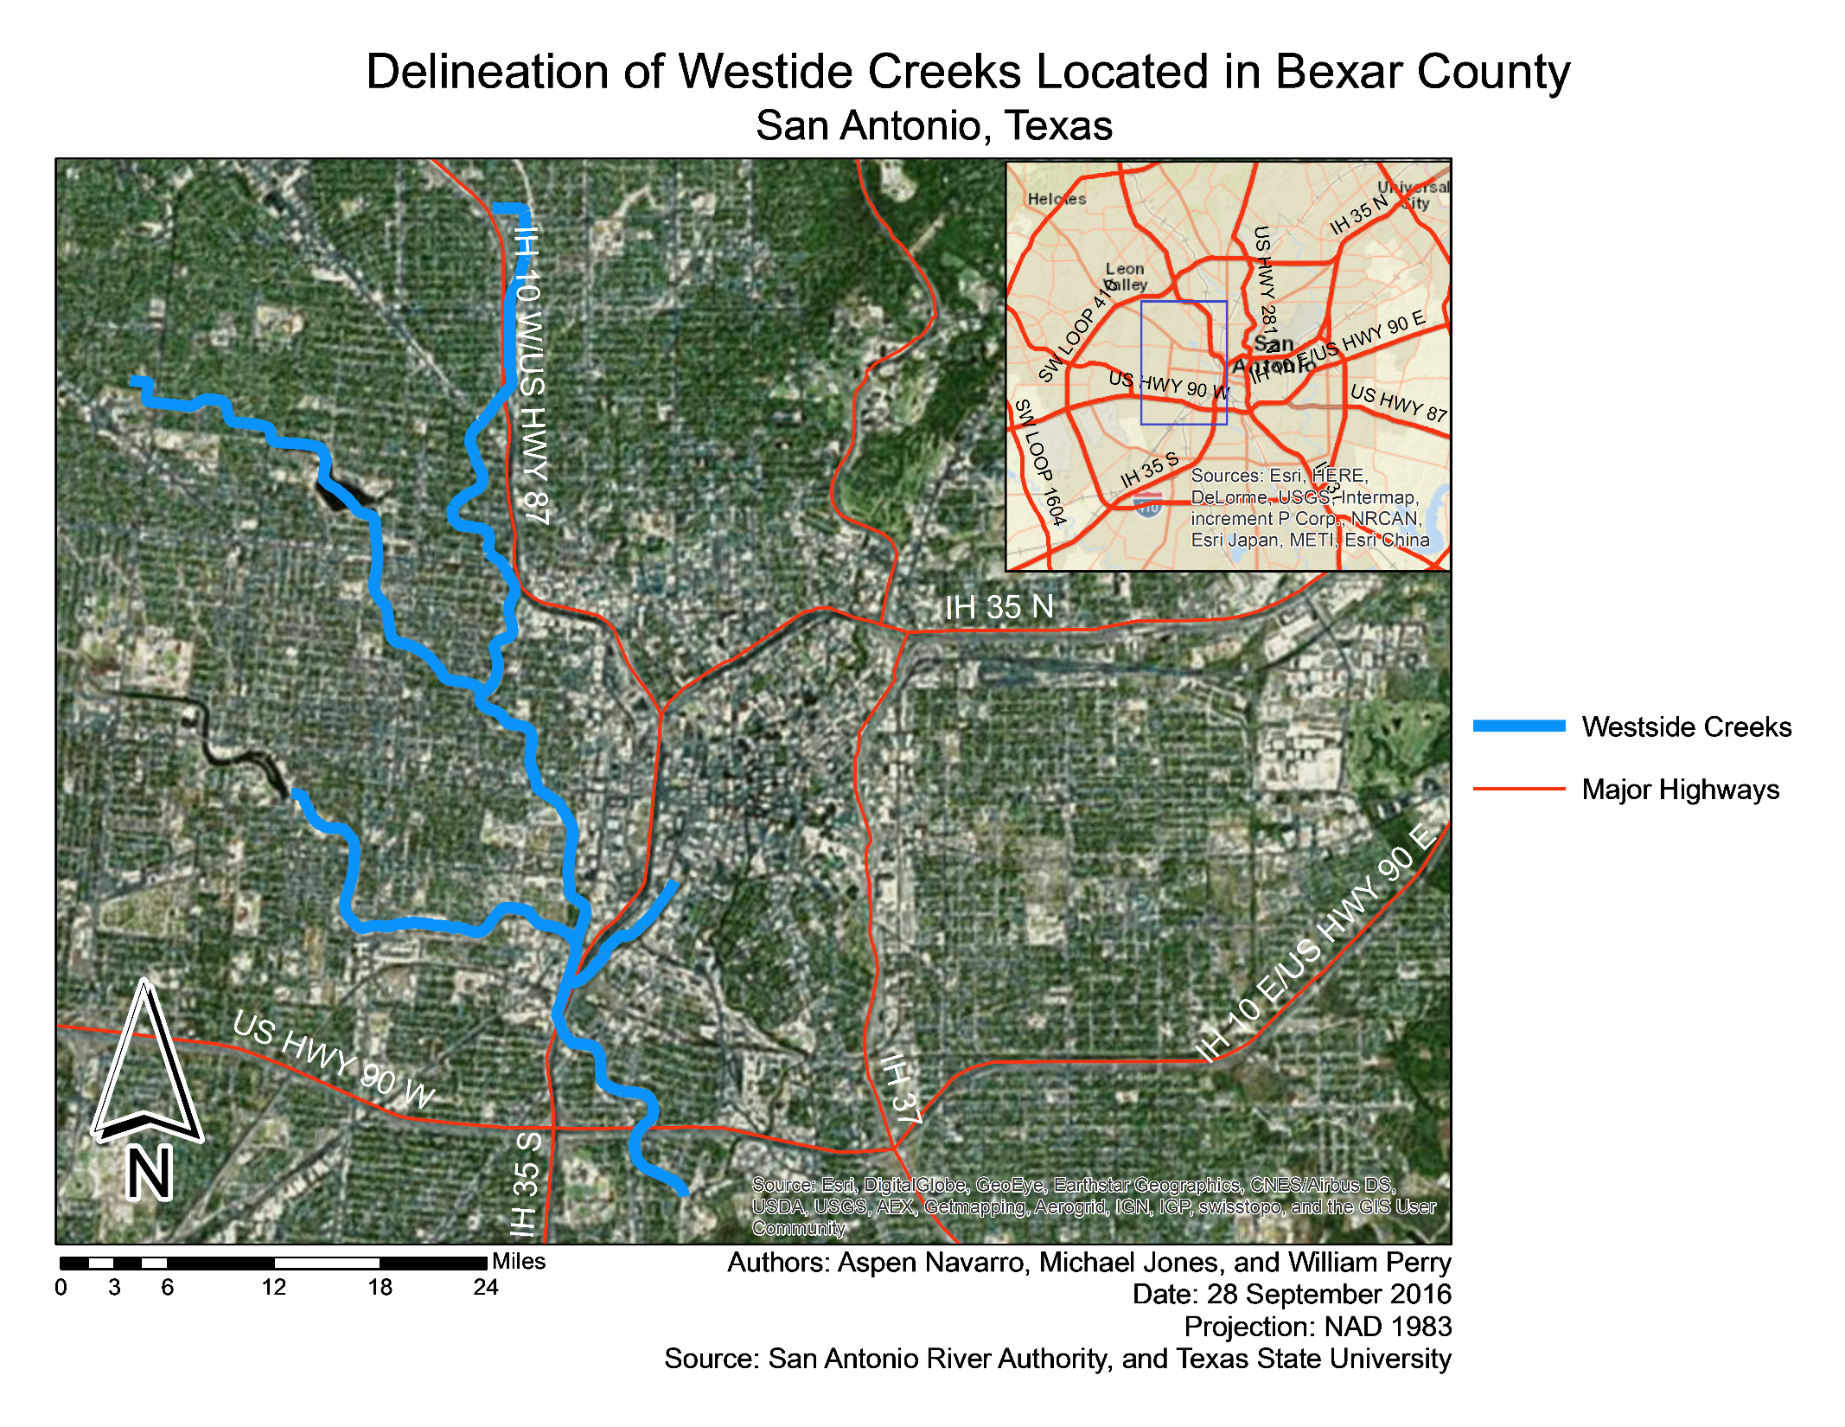
Notes:
Graph showing the scope of the project. West of San Antonio in Bexar county

Slide 5
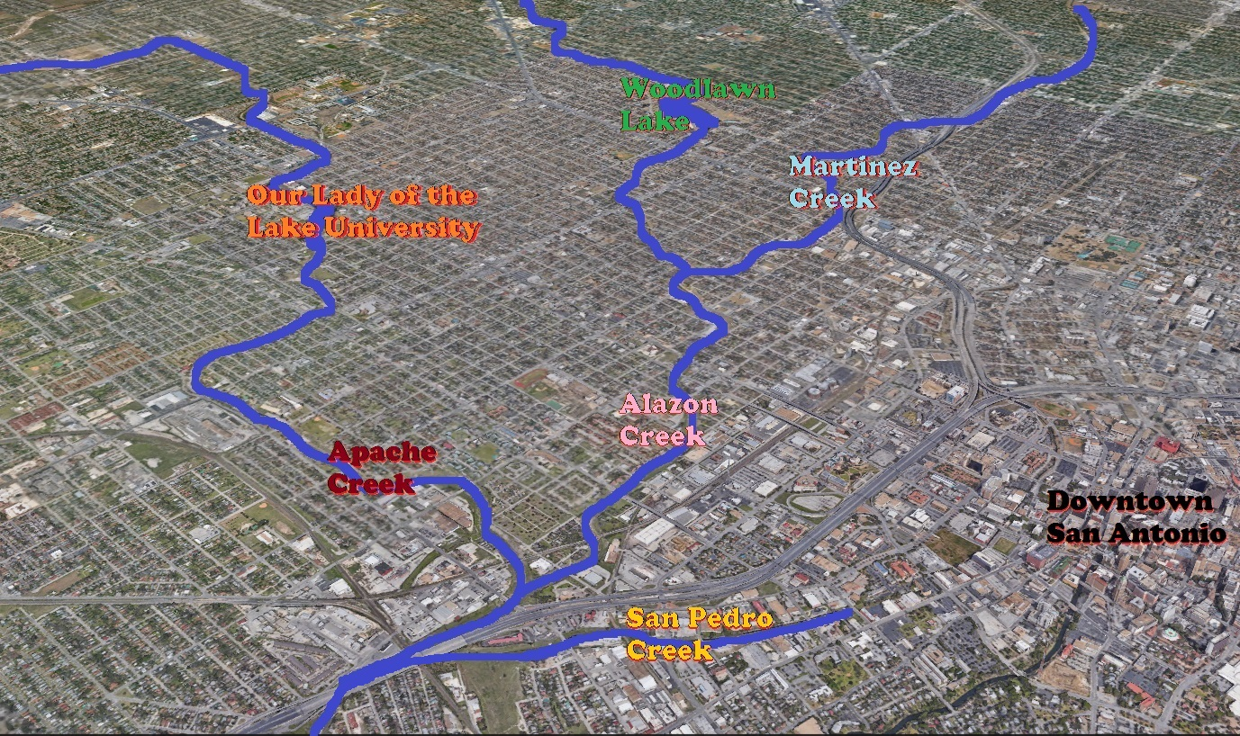
Notes:
A closer view of the creeks, noting the development that can be easily seen

Slide 6
Data
Source: United States Geological Survey
Layer | Contents/Attributes
Channels | Names, adjacent streams, length type
Roads | Names, types, directions, adjacent, length
Boundary | Boundary shapefile of the study area
Source: San Antonio River Authority
Layer | Contents/Attributes
Inlets | Point data counting all inlets in the San Antonio sewershed
Outfalls | Point data counting all outfalls in the San Antonio sewershed
DEM | 1m Resolution DEM of Westside Creeks
Land Use/Land Cover | Polygon data containing land use of plots

Slide 7
Methodology
Inlets/Outfalls
Geographic vs Spatial
Land Use
DEM
Point Pattern Analysis
Flow/Watershed Analysis
Dot map with Land Use
Sewershed (ArcGIS Online)
Notes:
Network Analysis:
1. Construct Basic Geometric Network from Inlet and Outfall Points
2. Vectorize the Stream Channels with the Sewershed Grids
3. Use the 1m DEM to Compute the Flow Direction and Flow Accumulation
*Assumption: Surface Slope = Sewer Slope
Spatial Analysis:
4. Assemble Land Cover Polygons Together to Create a Complete Data Layer
5. Develop a Visual Representation of Land Types Where Inlets Exist

Slide 8
Budget
Services:
Position | Hourly Rate | Hours (30 days) | Sub-Total
Project Manager | $36.00 | 130 | $4,680.00
Assistant Manager | $26.00 | 130 | $3,380.00
GIS Analysts/Design | $24.00 | 130 | $3,120.00
Service Sub-Total: $11,180.00
Supplies and Software:
Equipment | Amount Per | Quantity | Sub-Total
Computers | $200.00/station | 3 | $600.00
Workstations | $100.00/station | 3 | $300.00
ArcGIS Subscription | $2,500.00/year | 1 | $2,500.00
Supplies and Software: $3,400.00
Overall Total: $14,580.00
Notes:
The Accumulation of all this data and services requires some monetary funding on the part of SARA or any other funding Subsidies. First we will be need to be given around eleven thousand for staff charges, given present salary and service quotes, keeping at one rate because we are only acquiring data and processing in the same seats. The next costs are of services. The first of which being Computers and workstations looking at nine hundred in all. While the Arc GIS Subscription is going to run the bulk at two thousand five hundred. Below is the accumulation of all the costs in the process:

Slide 9
Fall 2016 Timeline
Data Collection and Intro stage
-Weeks 1 - 2 we will be compiling the data aspects of the project and organizing the project plan.
Pre- Processing
-Weeks 3 - 5 we will be running pre processing techniques on the DEM and Point pattern.
Data Analysis
-Weeks 5 - 12 We will perform analysis and create Deliverables
Data Interpolation
-Weeks 13 - 15 We will take data and create a report on our findings of the area.

Slide 10
Conclusion
Expected Results
Land development > pollution
Track polluted areas
Improve accessibility of waterways
http://southbostontoday.com/wp-content/uploads/2013/08/iStock_000018654007Large.jpg
Notes:
Pollution Solutions predicts that areas with more development will contribute to pollution more than less urbanized areas.
This project will help SARA to continue to track down areas that are contributing to pollution in SA waterways, especially as the city continues to develop. Minimizing the amount of pollution in SA waterways will improve the rivers overall accessibility, ensuring waterways are healthy for the natural ecology present, as well as river users.

Slide 11
http://launchany.com/wp-content/uploads/2016/01/idea.jpg

