Slide 1
Proposal for Geodatabase on 5 Mile Dam Soccer Complex
Daniel Cohen – Project Manager
Samuel Boesch – Assistant Manager
Mathew Riggan – GIS Consultant

Slide 2
Summary
The Soccer Complex needs a database.
The City of San Marcos needs a method.
We will create and provide all solutions.

Slide 3
Purpose
-The project needs a digital database with a focus on collecting GPS and attribute data for requested features.
GIS Information and Mapping in Austin (Hardy,2015)
-It also needs a methodology for collecting features which can be used for future city projects and modeling the layout geospatially.
High-Tech Advance Make Smarter City Parks (Stephens,2015)

Slide 4
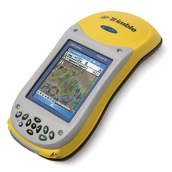
Objectives 1 and 2
1) Collect GPS and attribute data for all requested features.
2) Establish a data collection methodology.
Field to computer

Slide 5
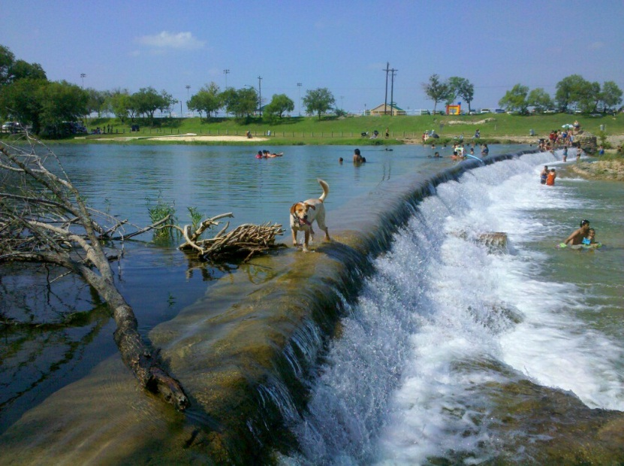
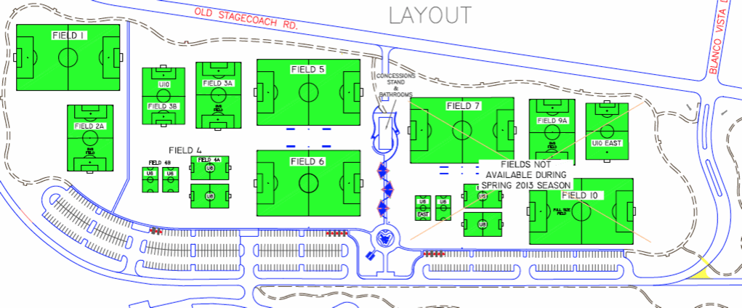
Objectives 3 and 4
Create a geodatabase file for the Five Mile Dam Soccer Complex
Model the Layout of the Soccer Complex

Slide 6
Data Dictionary
Data Dictionary
The table was created for the Trimble GPS unit to use when gathering points at the complex.
Feature | Data Type | Primary Attributes | Secondary Attribute
Field | Polygon | Usage | Active, Inactive
Parking Lot | Polygon | Usage | Active, Inactive
Sprinkler System | Point | Usage | Active, Inactive
 |  | Material | Plastic, Metal, Other
 |  | Type | Valve Box, Sprinkler Head
Stationary Garbage Receptacles | Point | Usage | Recycling
 |  |  | Non-Recycling
Trail | Line | Type | Running
Building | Polygon | Name | (Text Box) – Concession Stand

Slide 7
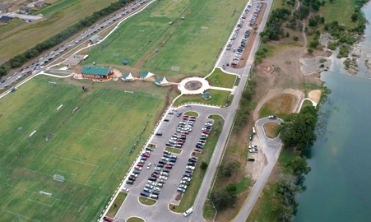

Slide 8
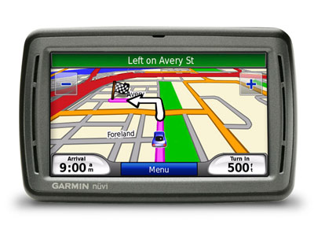
Methodology - GPS
The collection of requested data points are within 1 meter accuracy
-Multiple points (up to 50) are taken for each feature to help ensure precise accuracy.
The GPS points help make the map
-Submeter Accuracy
-Important for finding sprinkler heads

Slide 9
Methodology – Future Guidelines
The methodology used to gather geodatabase points can be used for future parks which the city of San Marcos can use

Slide 10
Methodology - Efficiency
The usage of a geodatabase enables efficiency when maintaining the soccer complex features
This allows for time conservation when working, which saves both time and money.

Slide 11
Map
Budget
Will include of reference map of Five Mile Dam Soccer Complex.
-all amenities
-detailed/ well organized
-Will serve as a visual reference of the complex

Slide 12
Budget
Budget
Data Collection
Total Hours | 2(10 hours for 2 weeks) | 40
Hourly Pay | Assistant | $25
Hourly Pay | Consultant | $20
Total |  | $900
Data Analysis
Total Hours | 2(10 hours for 2 weeks) | $40
Hourly Pay | Manager | $30
Hourly Pay | Assistant | $25
Total |  | $1,350
System Management
Project Manager
 | Total Hours | 50
 | Hourly Pay | $30
 | Pay | $1,500
Assistant Manager
 | Total Hours | 40
 | Hourly Pay | $25
 | Pay | $1,000
GIS Consultant
 | Total Hours | 40
 | Hourly Pay | $20
 | Pay | $800
 | Total Pay | $3,300
Travel Expenses
Automobile Travel | 50 miles @ $0.20/mile | $10
Total Costs
 |  | $8,060
The budget consists of payment to each individual based upon their pay grade.
Our proposed budget is projected to cost less than $10,000.

Slide 13
Time Table
Important Dates
January 21 - First Day of Class
January 26 - Receiving RFP
February 2 - Client Day
February 23 - Proposal Due
February 25 - Proposal Presentation
March 30 - Progress Report Due
May 4 - Last Day of Class
May 8 - Project Presentations
 | Sun | Mon | Tues | Wed | Thu | Fri | Sat
January |  |  |  |  | 1 | 2 | 3
 | 4 | 5 | 6 | 7 | 8 | 9 | 10
 | 11 | 12 | 13 | 14 | 15 | 16 | 17
 | 18 | 19 | 20 | 21 | 22 | 23 | 24
 | 25 | 26 | 27 | 28 | 29 | 30 | 31
February | 1 | 2 | 3 | 4 | 5 | 6 | 7
 | 8 | 9 | 10 | 11 | 12 | 13 | 14
 | 15 | 16 | 17 | 18 | 19 | 20 | 21
 | 22 | 23 | 24 | 25 | 26 | 27 | 28
March | 1 | 2 | 3 | 4 | 5 | 6 | 7
 | 8 | 9 | 10 | 11 | 12 | 13 | 14
 | 15 | 16 | 17 | 18 | 19 | 20 | 21
 | 22 | 23 | 24 | 25 | 26 | 27 | 28
April | 29 | 30 | 31 | 1 | 2 | 3 | 4
 | 5 | 6 | 7 | 8 | 9 | 10 | 11
 | 12 | 13 | 14 | 15 | 16 | 17 | 18
 | 19 | 20 | 21 | 22 | 23 | 24 | 25
May | 26 | 27 | 28 | 29 | 30 | 1 | 2
 | 3 | 4 | 5 | 6 | 7 | 8 | 9
 | 10 | 11 | 12 | 13 | 14 | 15 | 16
 | 17 | 18 | 19 | 20 | 21 | 22 | 23
 | 24 | 25 | 26 | 27 | 28 | 29 | 30
 | 31
Time Line
1-2 Project Assessment
3-6 Data Collection
7-8 Organizing Data
9 Spring Break
10-11 Data Analysis
12-13 Data Interpretation
14 AAG Meeting
15-16 Final Markups

Slide 14
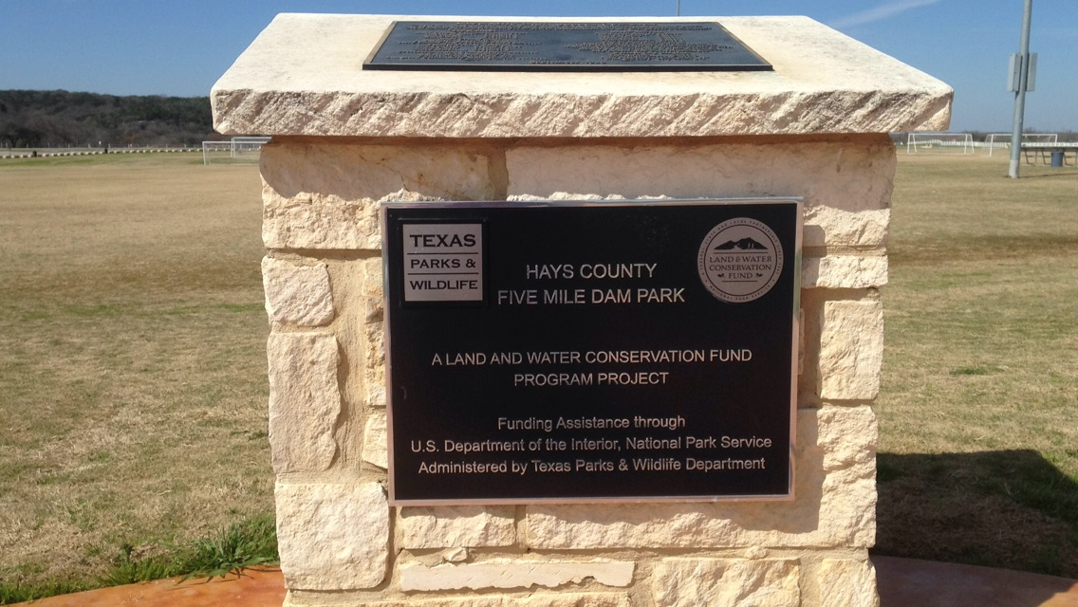
Final Deliverables & Implications
Final Deliverables
-Geodatabase
-Reference Map
-Scientific Method
Implications
-Provide the city of San Marcos with an easily updateable, visual model.
-Five Mile Dam’s many amenities as well as the attributes of each of these amenities.
-Ensure that maintenance of the complex is carried out at the highest level of efficiency.

Slide 15
Conclusion
When we have completed this project the City of San Marcos will be better equipped to maintain the Five Mile Dam Soccer Complex’s original functionality and aesthetic beauty for decades to come.
G.R.A.M.

