Slide 1
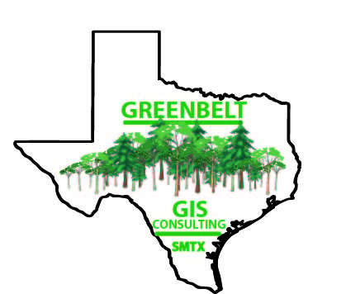
Progress Report
Project Manager-Clancy Taylor
GIS Analyst/Web Designer-Will Johnston
GIS/Remote Sensing Analyst-Michael Amaral
GIS/Remote Sensing Analyst-Megan Branam

Slide 2
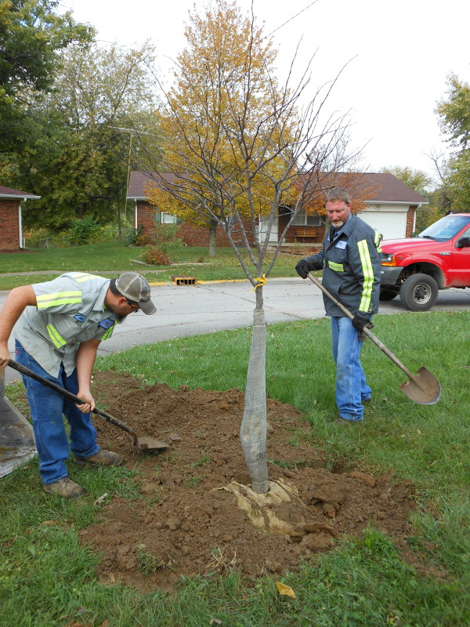
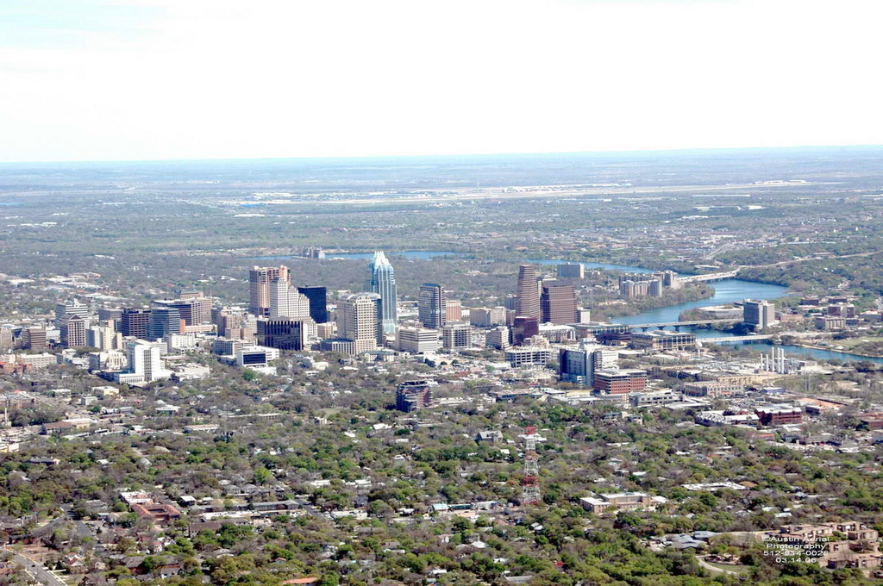
Introduction
Austin, Texas
NeighborWoods Tree Planting Program
Mitigation of Urban Heat Island Effect
Effectiveness of Program

Slide 3
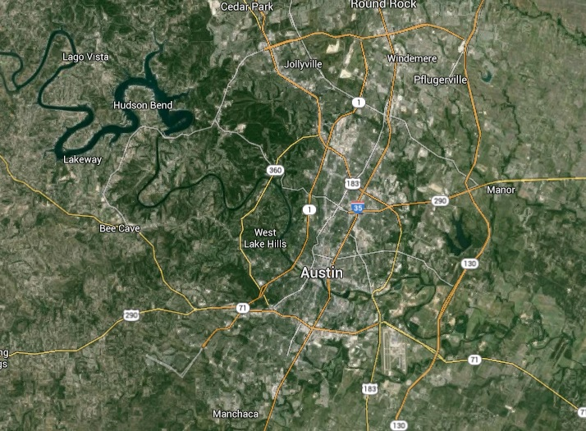
Summary
Analyze the efficacy of NeighborWoods Program in mitigating UHI
2002-2014
Using surface temperature data (LANDSAT images)
Use point data about trees planted during program
Create a website that lays out final deliverables

Slide 4
Tasks
Convert remote sensing images from USGS→ TIFF files for usage in ArcMap
Analyze surface temps & locations to NeighborWoods trees in ArcMap to visually analyze changes in temp and land cover
Provide statistical analysis of the significance of the effect of NeighborWoods trees on surface temp.
Then quantify energy savings created by the NeighborWoods trees

Slide 5
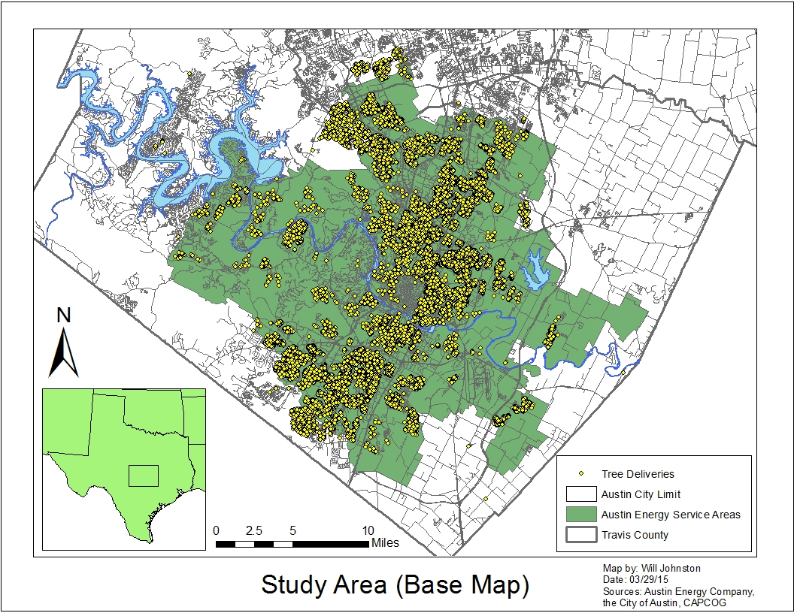
Work Completed
3 out of the 4 LANDSAT images are manipulated (4,5,7, still working on 8)
Base map created on ArcMap, ready for analysis

Slide 6
Problems
Complexity of ERDAS Imagine
Program producing different results with same inputs

Slide 7
Work Scheduled
Finish converting LANDSAT 8 image into a surface temp image
Start work on GIS analysis
Web Design
Data interpretation and quality control
Prepare final copies of deliverables

Slide 8
Updated Timeline
April
May
Sun | Mon | Tues | Wed | Thurs | Fri | Sat
29 | 30 | 31 | 1 | 2 | 3 | 4
5 | 6 | 7 | 8 | 9 | 10 | 11
12 | 13 | 14 | 15 | 16 | 17 | 18
19 | 20 | 21 | 22 | 23 | 24 | 25
26 | 27 | 28 | 29 | 30
Sun | Mon | Tues | Wed | Thurs | Fri | Sat
 |  |  |  |  | 1 | 2
3 | 4 | 5 | 6 | 7 | 8 | 9
10 | 11 | 12 | 13 | 14 | 15 | 16
17 | 18 | 19 | 20 | 21 | 22 | 23
24 | 25 | 26 | 27 | 28 | 29 | 30
31
Data & Statistical Analysis
Data Interpretation & Quality Control
Final Deliverables
Presentation
Data & Statistical Analysis
Web & Map Development
Web & Map Development
Data Interpretation & Quality Control

Slide 9
Conclusion
Because of difficulties, schedule has been updated and adjusted accordingly
Original deadlines will still be met
Final deliverables will be complete May 4th
Final presentations held May 8th

