Slide 1

Katy Morris: Project Manager
Nick Down: Assistant Manager
Travis Hamel: GIS Analyst

Slide 2
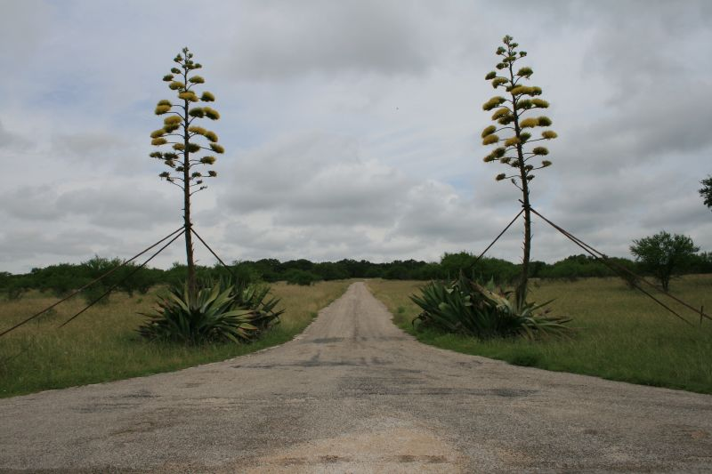
Freeman Ranch Flood Prediction Model
Image Credit: Art Arizpe
Prepared by GeoTrek – The Next Generation

Slide 3
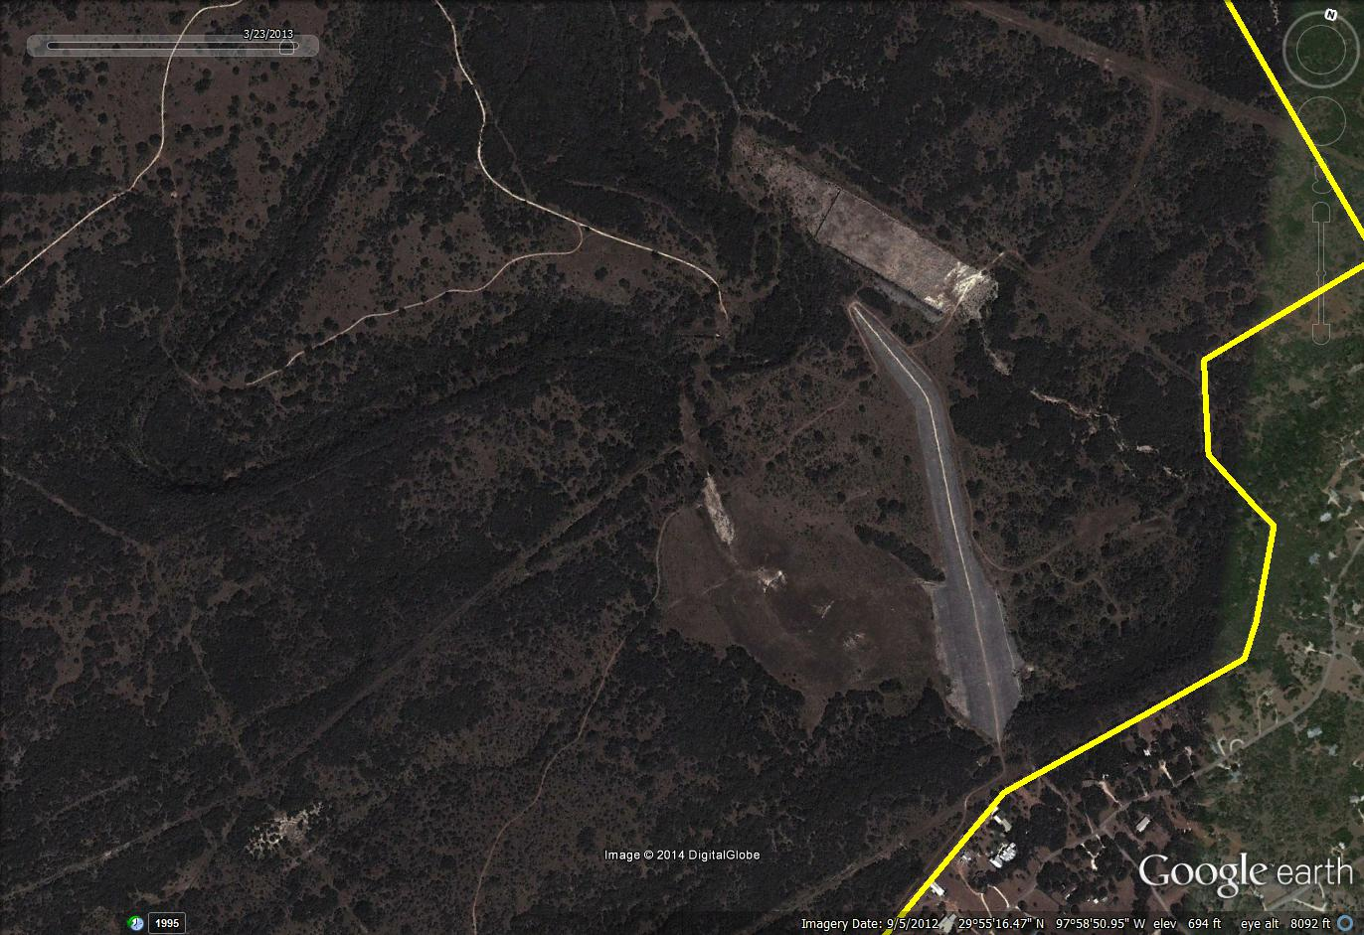
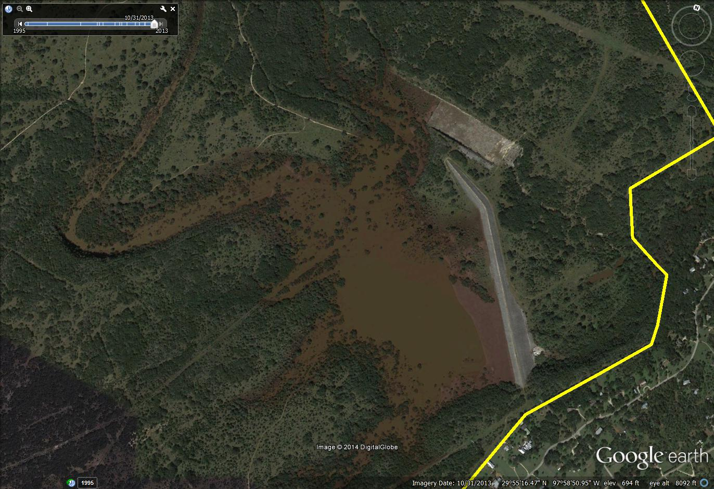
Introduction
October 31st, 2013 Rain Event
Freeman Center inundated with water from flood

Slide 4
Purpose and Goals
GeoTrek: TNG was tasked with creating a model and tool for the Freeman Center to predict water levels on the ranch.
The tool will use a GIS and take the estimated rates of rainfall and the estimated length of the event in order to predict how quickly areas will become inundated with water
By doing this ranch officials will be able to more accurately predict where areas of risk are during a rain event and respond adequately

Slide 5
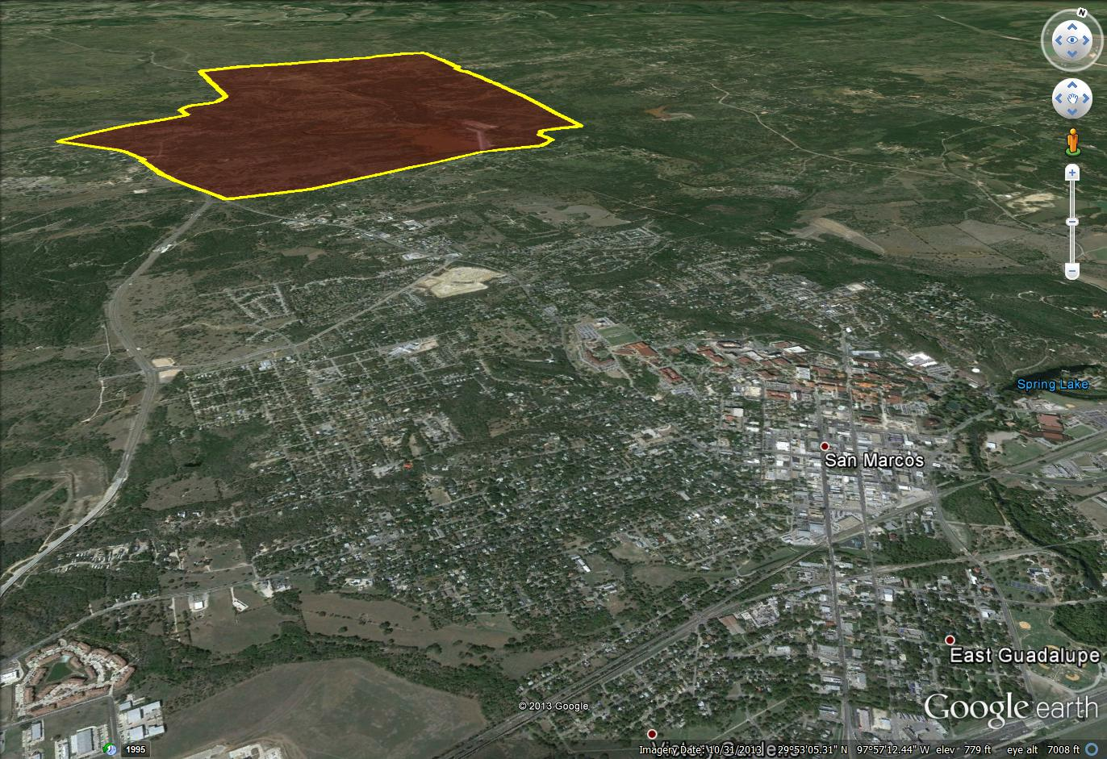
Scope

Slide 6
Literature Review
Central Texas Flood research
Hydrologic Modeling of an Extreme Flood in the Guadalupe River in Texas. JAWRA Journal of the American Water Resources association
GIS Flood Prediction Modeling Research
Flood Modeling and Vulnerability of Settlements in the Adamawa State Floodplain Using GIS and Cellular Framework Approach.

Slide 7
Data
In order to create the inundation model GeoTrek acquired two main sets of data for the project:
  Terrain Data (Digital Elevation Model) – Texas State Department of Geography
  Freeman Ranch Geodatabase (Road, Fences, and other Infrastructure) – GeoTrek Geodatabases
DEM was manipulated to create and calculate the drainage characteristics and watershed of the property

Slide 8
Methodology
In order to create a flood-model GeoTrek: The Next Generation needed to:
Delineate the Watershed
Create an Initial State
Create a Spread Model
Compare Iterations
Create a Rise Model
Determine High-risk Zones
Automate the Process

Slide 9
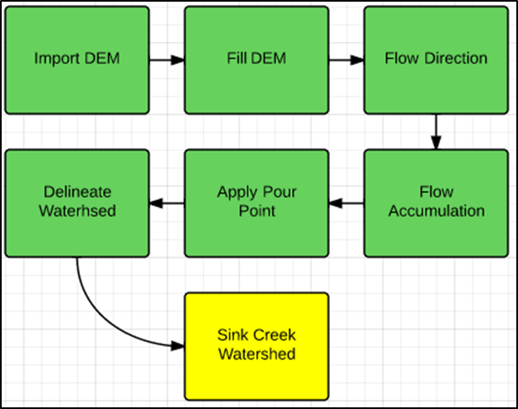
Delineate the watershed

Slide 10
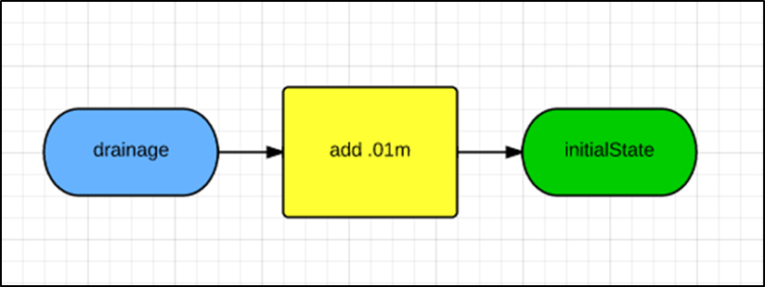
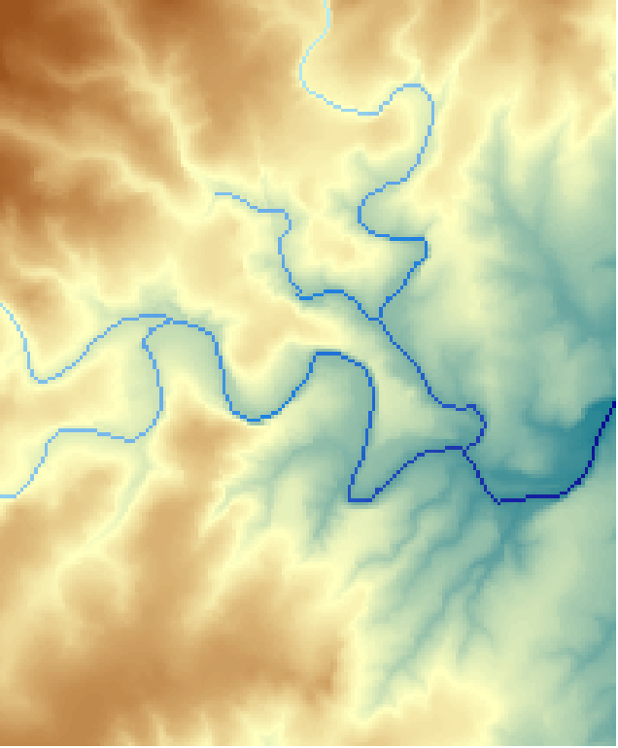
Create an initial state

Slide 11
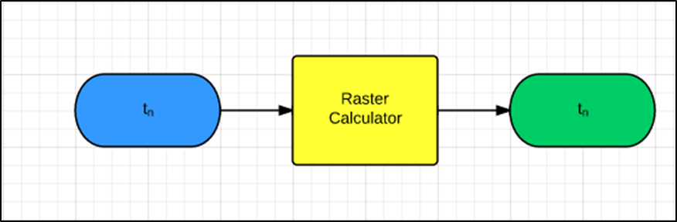
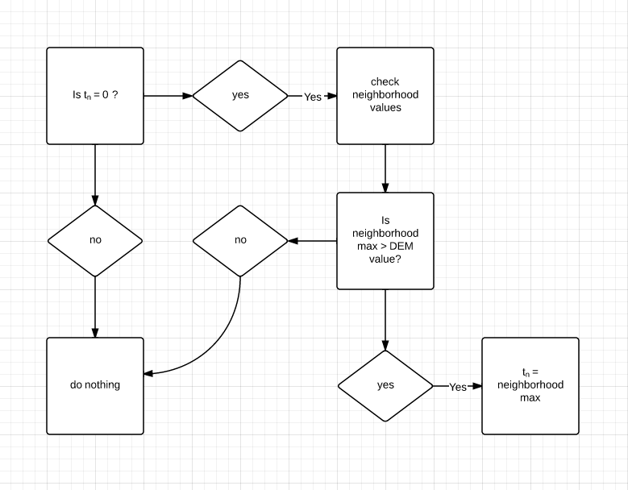
Create a spread model

Slide 12
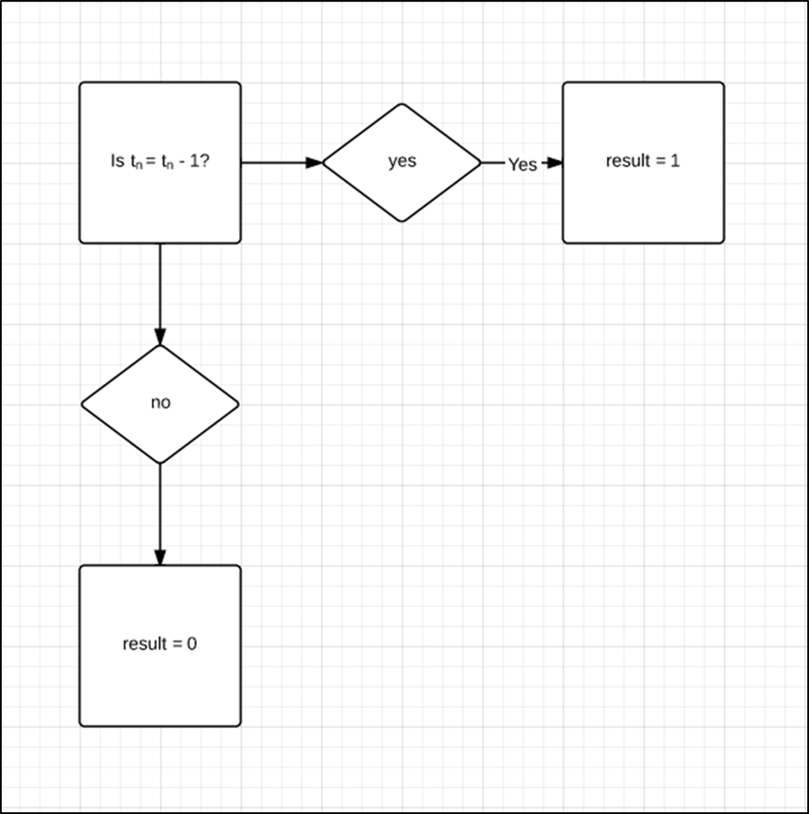
Compare iterations

Slide 13
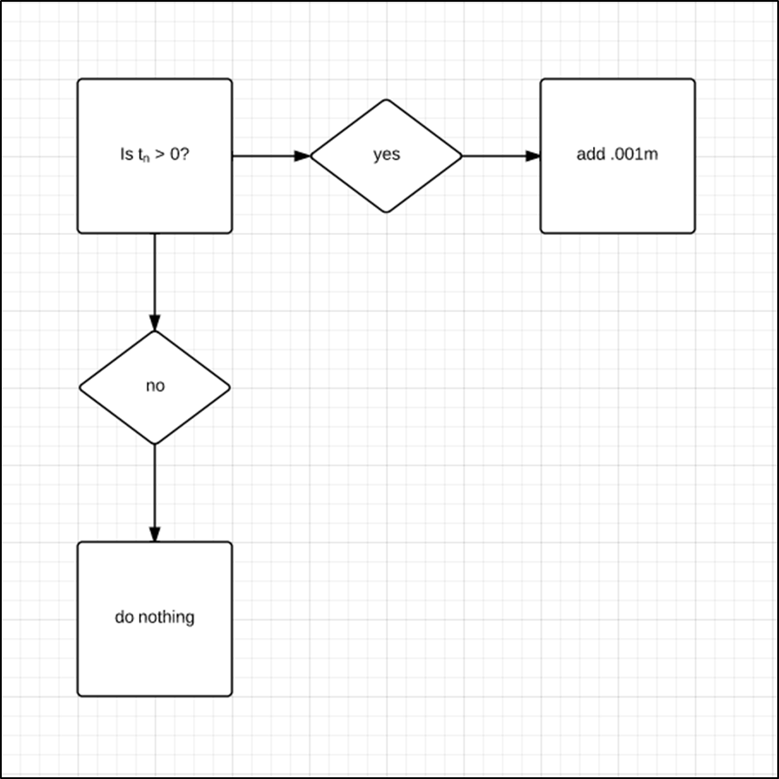
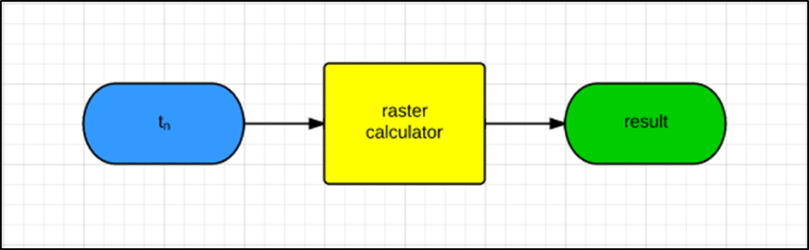
Create a rise model

Slide 14
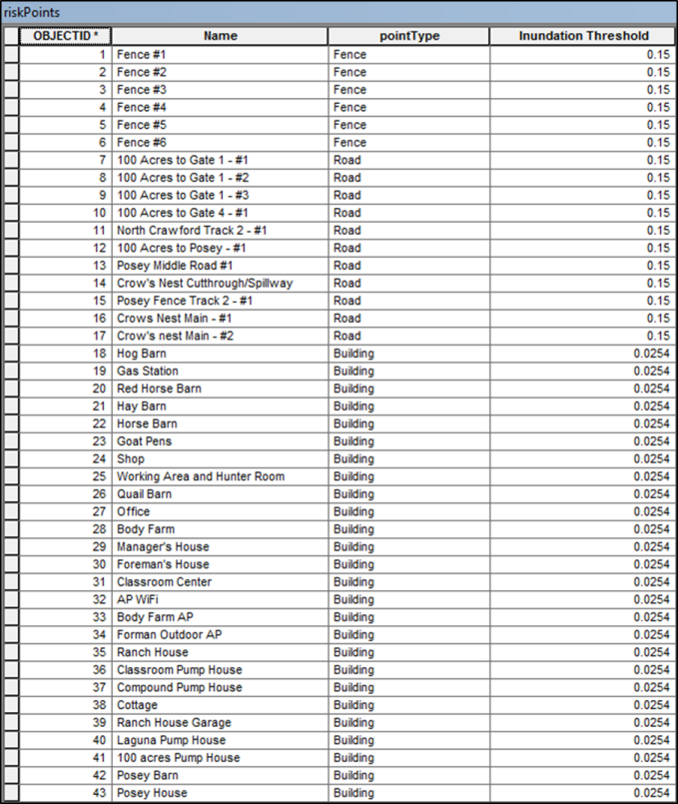
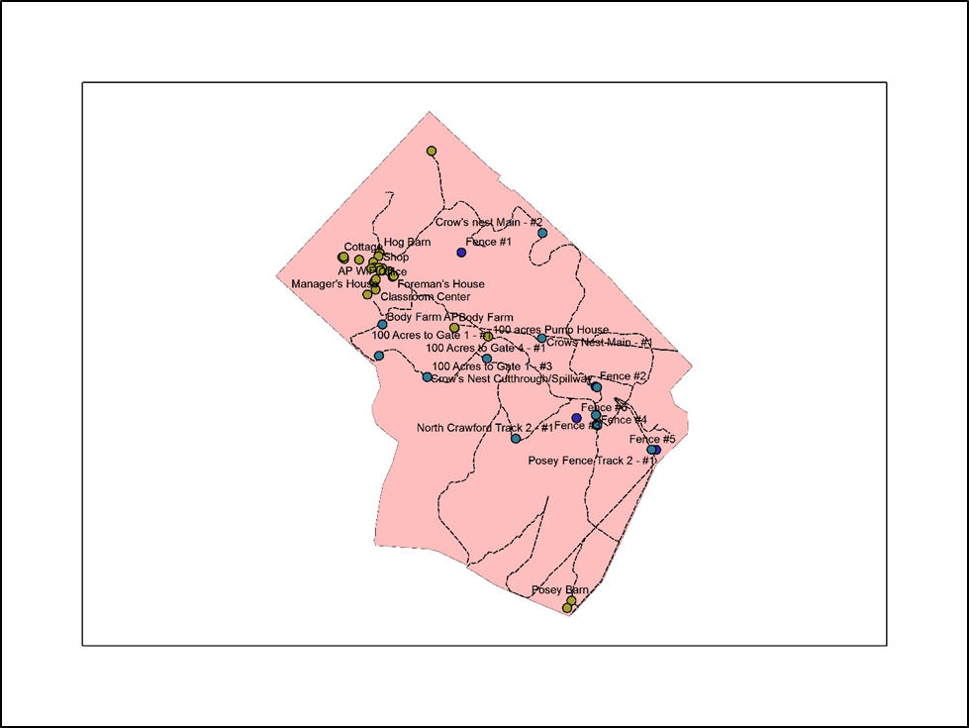
Determine high-risk zones

Slide 15
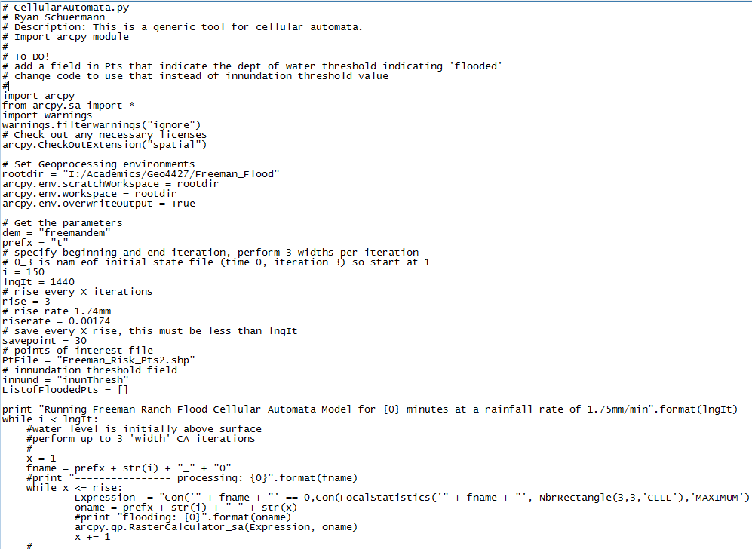
Automate the process

Slide 16
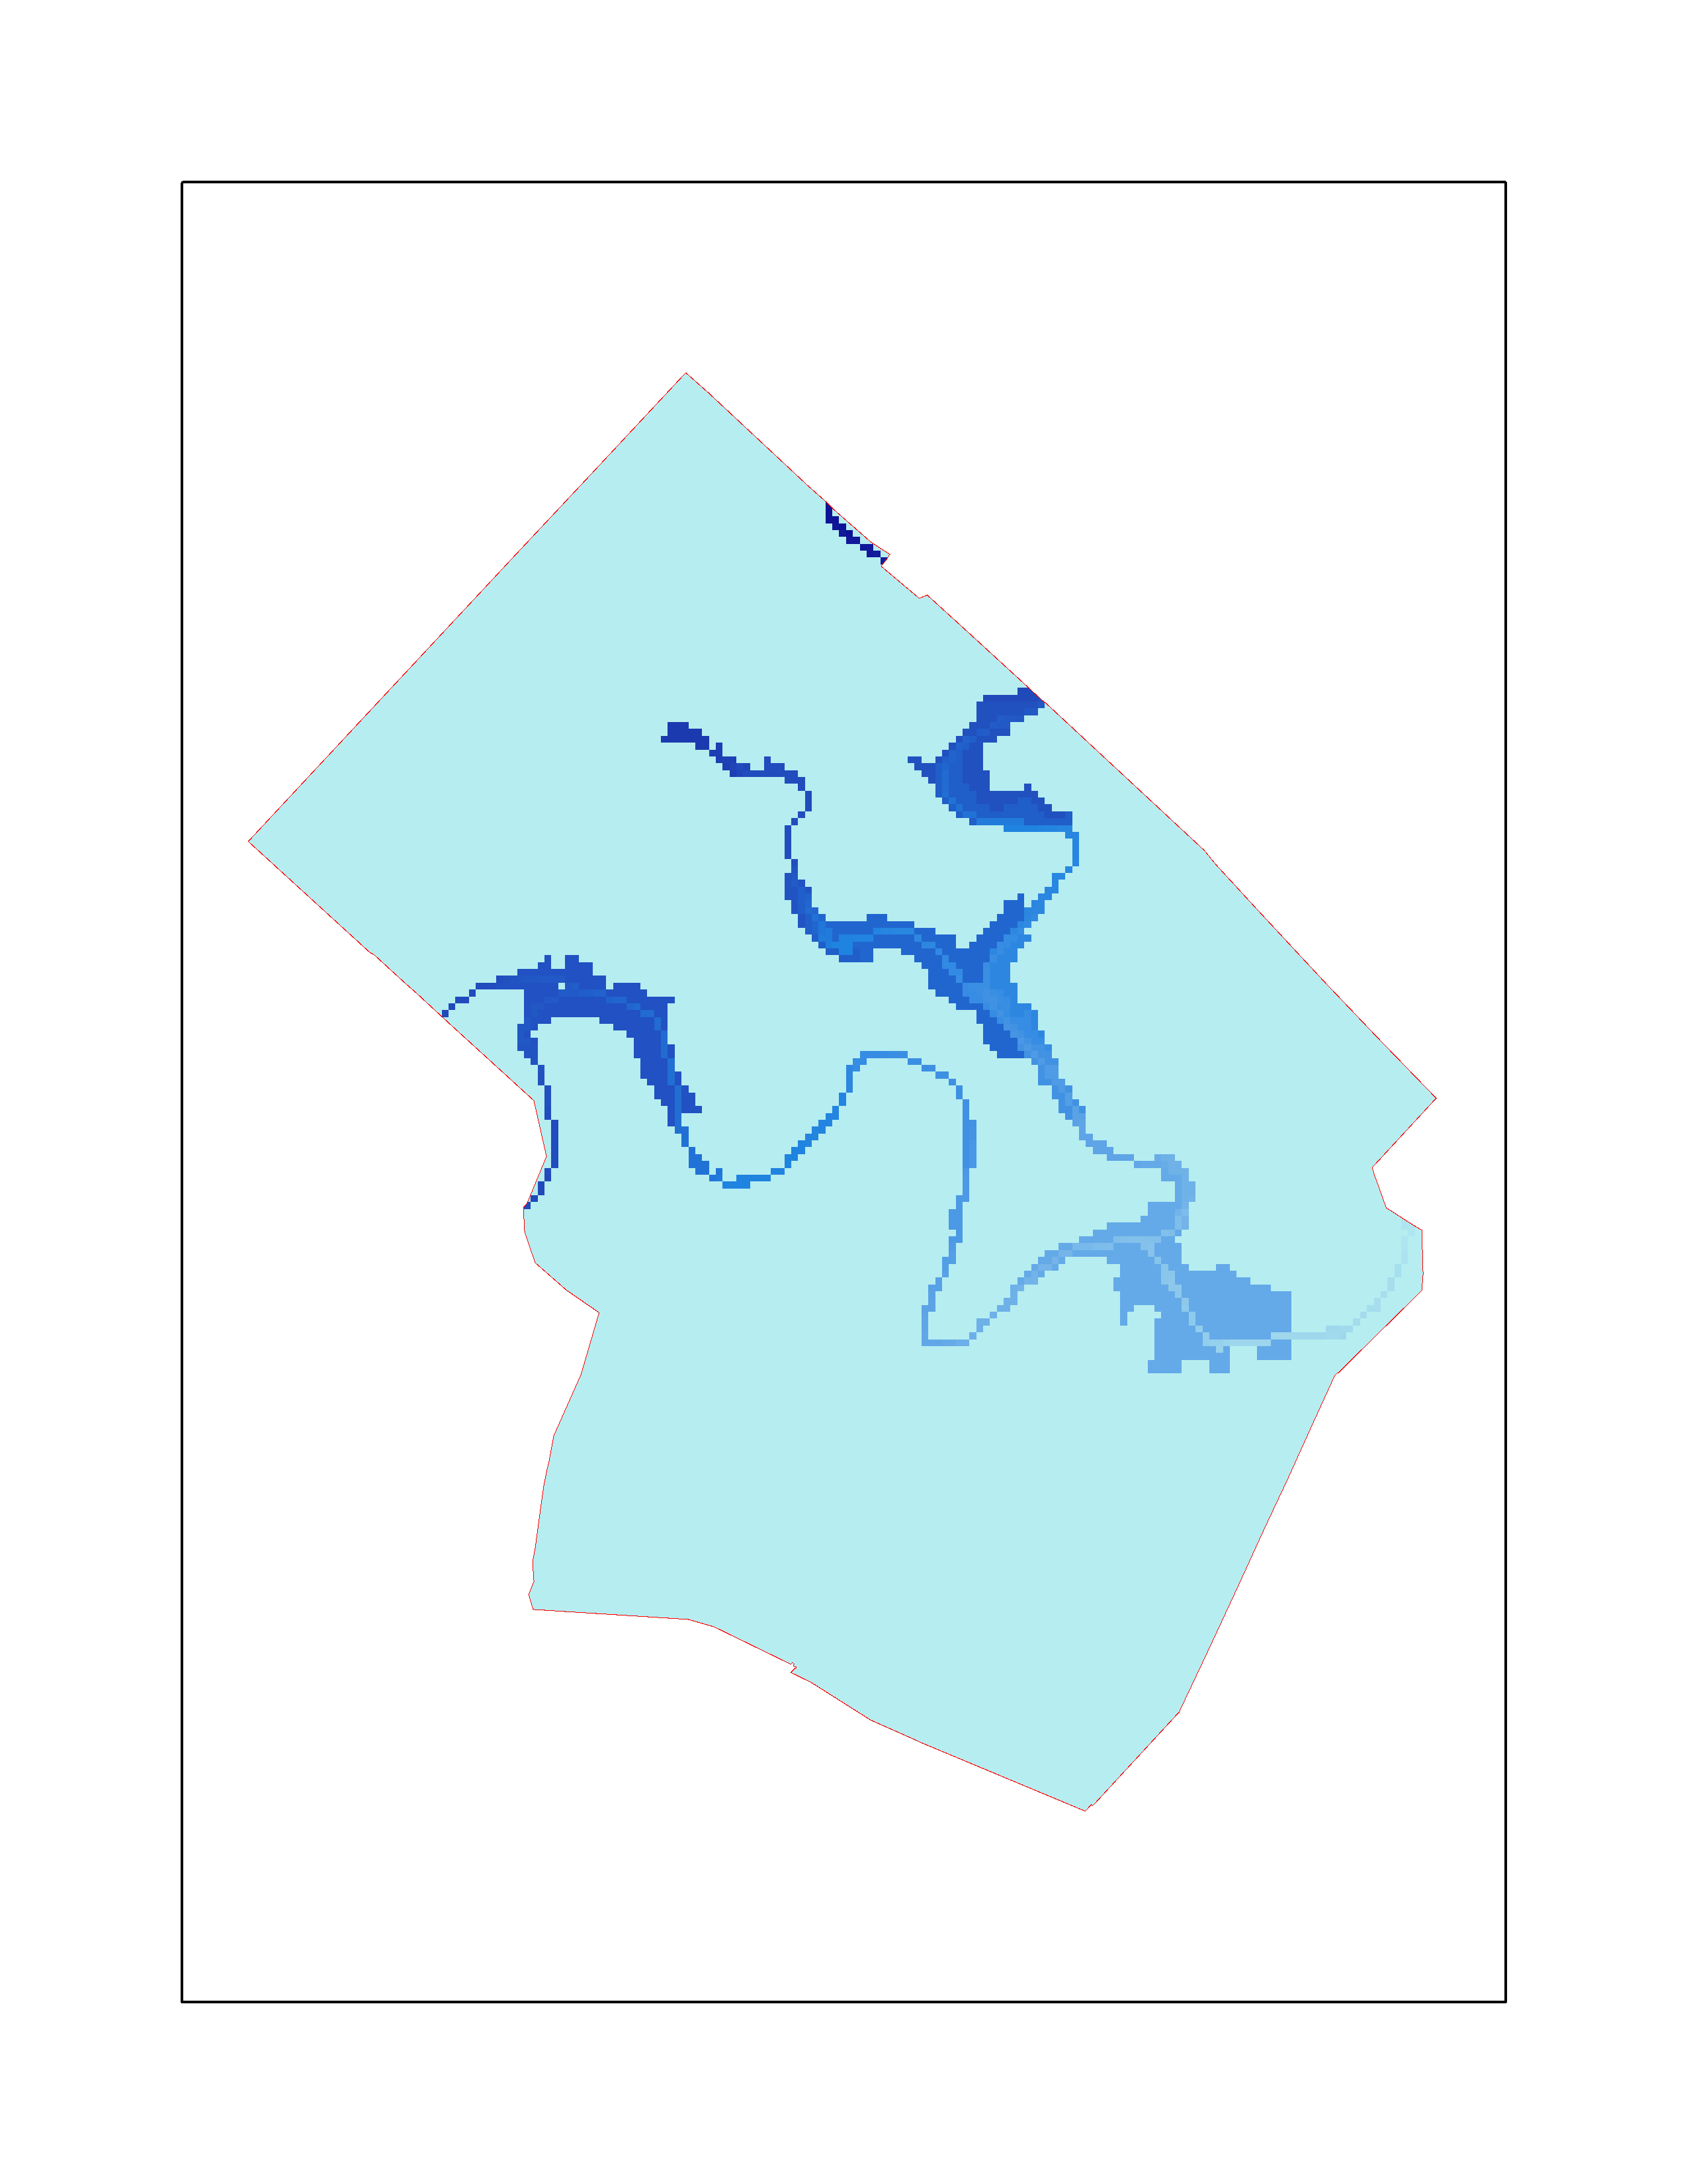
Results
Simple flood-prediction model

Slide 17
Results
Warnings generated for inundated infrastructure

Slide 18
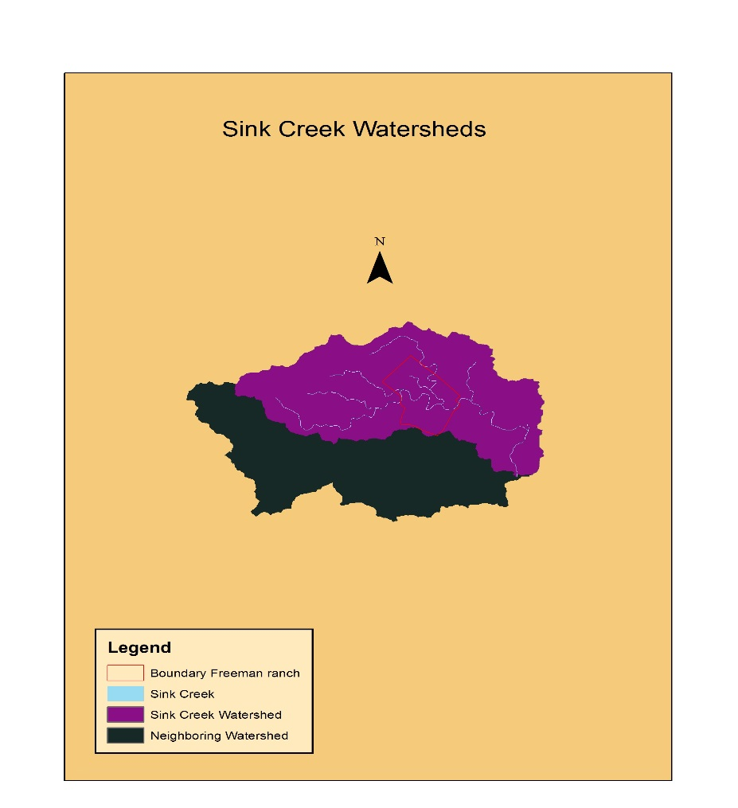
Discussion
Scope and Capabilities
Sink Creek Watershed and Freeman Ranch

Slide 19
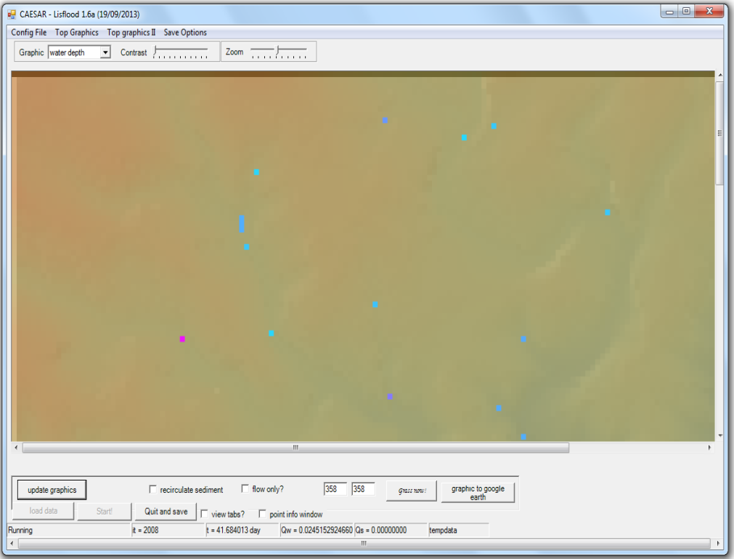
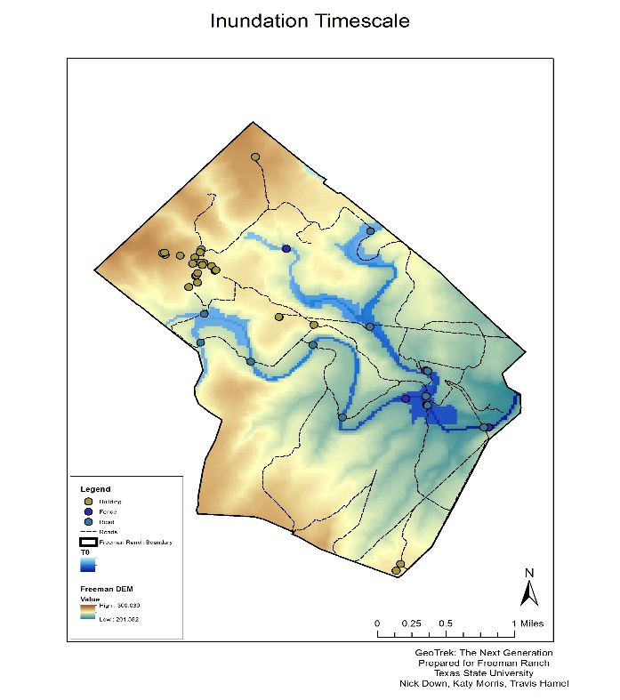
Discussion
Similar Projects
CAESAR (Cellular Automation Evolutionary Slope and River)
A program to study river catchments and sediment deposits.

Slide 20
Discussion
Future construction projects
Our model uncovers high risk areas
Helps locate suitable places for construction projects
Shows which fence lines and roads are in high risk zones and need to be strengthened with flood resistant fence line or more structurally sound roads.
Help make Freeman Ranch safer and more flood resistant.

Slide 21
Conclusion
Freeman Ranch is located in the Sink Creek watershed
Prone to flash flooding
GeoTrek: The Next Generation created a flood inundation model for Freeman
Users will be able to visualize a rough estimation of when a flood will affect infrastructure
Freeman Ranch will become a safer place for both livestock and humans during potential flash flood events

