Slide 1

San Marcos Fire Station Location Analysis
-Progress Report-
Andrea Nieto, Bryan Heisinger, Nadine Oliver Matthew Mitchell

Slide 2
Purpose
The purpose of this report is to present to the City of San Marcos the status of the fire station location analysis project.

Slide 3
Background
To meet the demand of an increasing growth trend, the City of San Marcos is proactively developing a plan to construct a new fire station. A GIS implementation would enable the San Marcos Fire Department to provide an even distribution of fire response services across the city.

Slide 4
Project Description
We will preform calculations on the following factors to complete our analysis:
parcel area
parcel value
day/night time population
square footage of buildings
value of improvements
conflagration potential
wildlife urban interfaces

Slide 5
Total Parcel Area
To determine the area of parcels in each grid cell, we clipped the parcels layer by the grid boundary and summated the acreage in the attribute table.

Slide 6
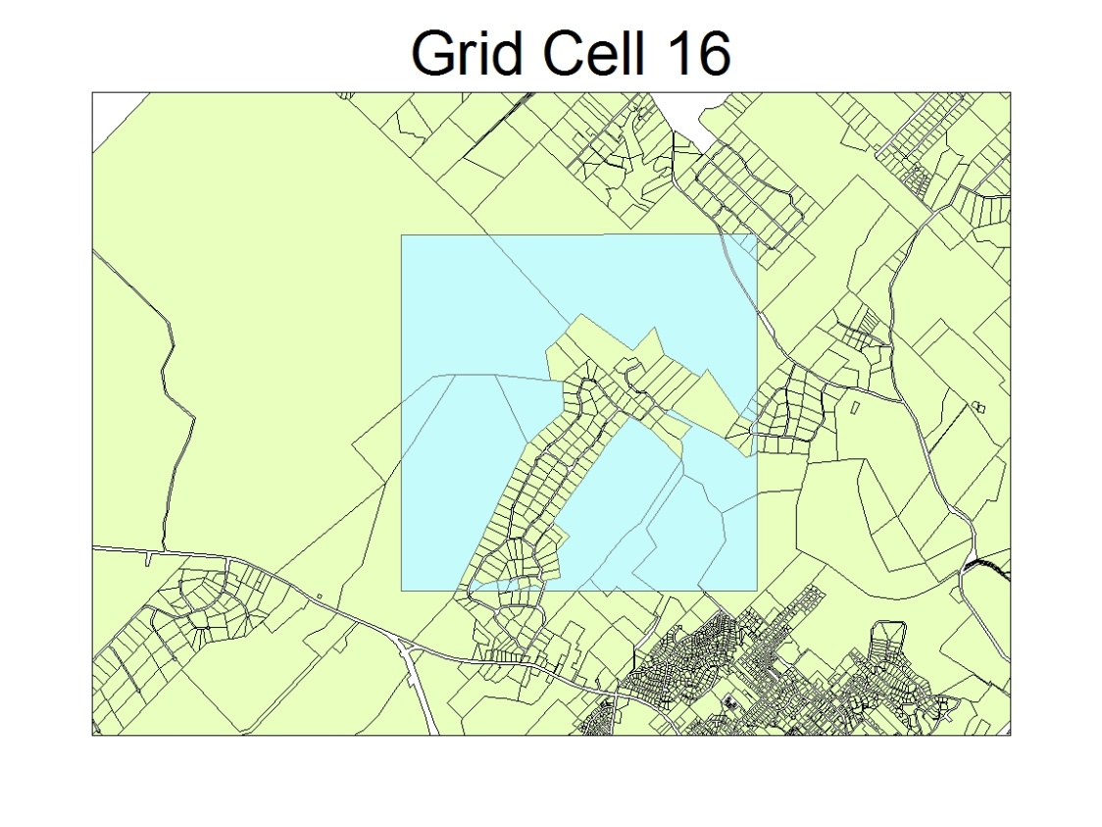
Developed, Vacant, Multifamily, & Total Parcel Value
Took into account the clipped parcels when calculating parcel values.
Used the Vacant field & Buildings layer to determine if the parcel was developed or undeveloped.
Used the SUB_CATEGO field in the attribute table of the buildings layer to determine if the parcel was multifamily.

Slide 7
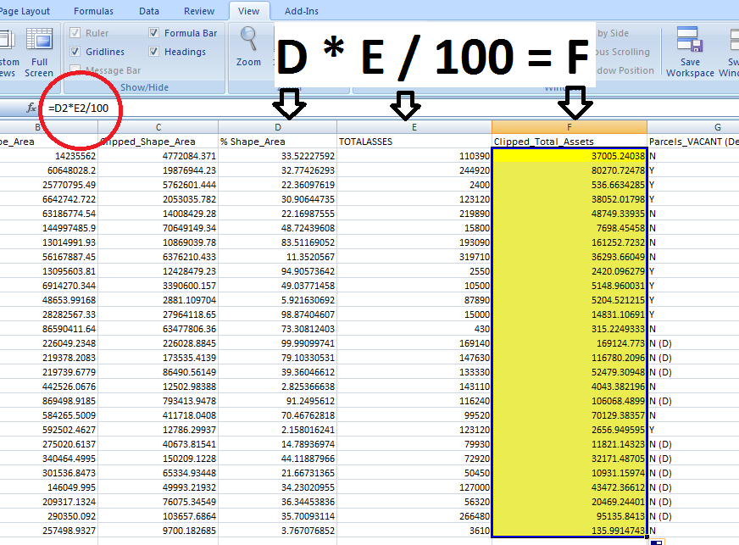
Parcel Value Cont.

Slide 8
Value of Improvements
Also took into account the clipped parcels when calculating the value of improvements.
Added each parcel's TOTALIMPMK value together within the given grid cell boundary to find the total VOI.
Grid cells 8, 13, and 16 complete

Slide 9
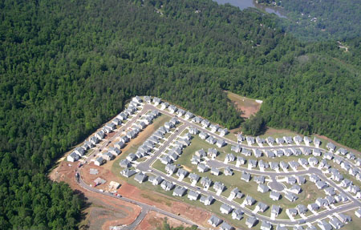
Wildlife/Urban Interface
The Wildland/Urban Interface will be calculated upon the completion of the developed/undeveloped parcel classification.
We will then be able to determine the total boundary length in a grid where undeveloped and undeveloped parcels meet.

Slide 10
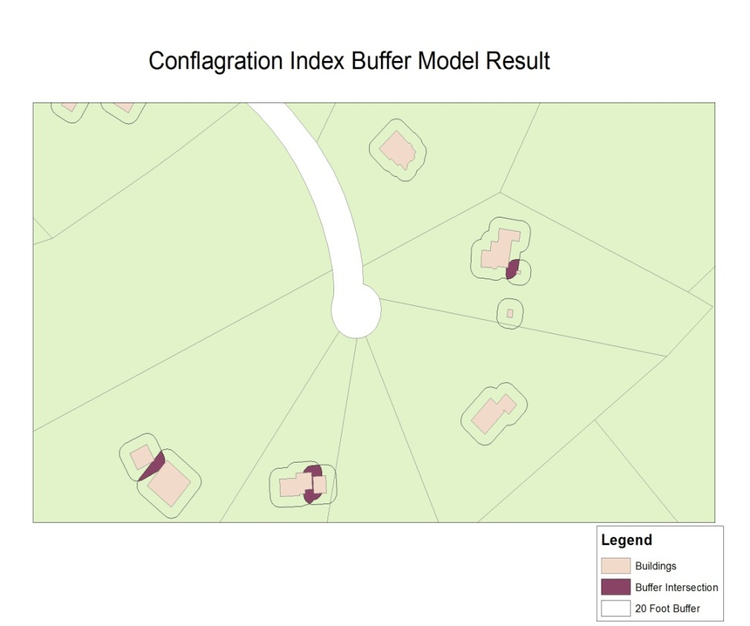
Conflagration Index
Factors
1. Proximity of Buildings
-successful model built
2. Wildland-Urban Interface
-to be completed after classification
3. Building Height
-data quality issues

Slide 11
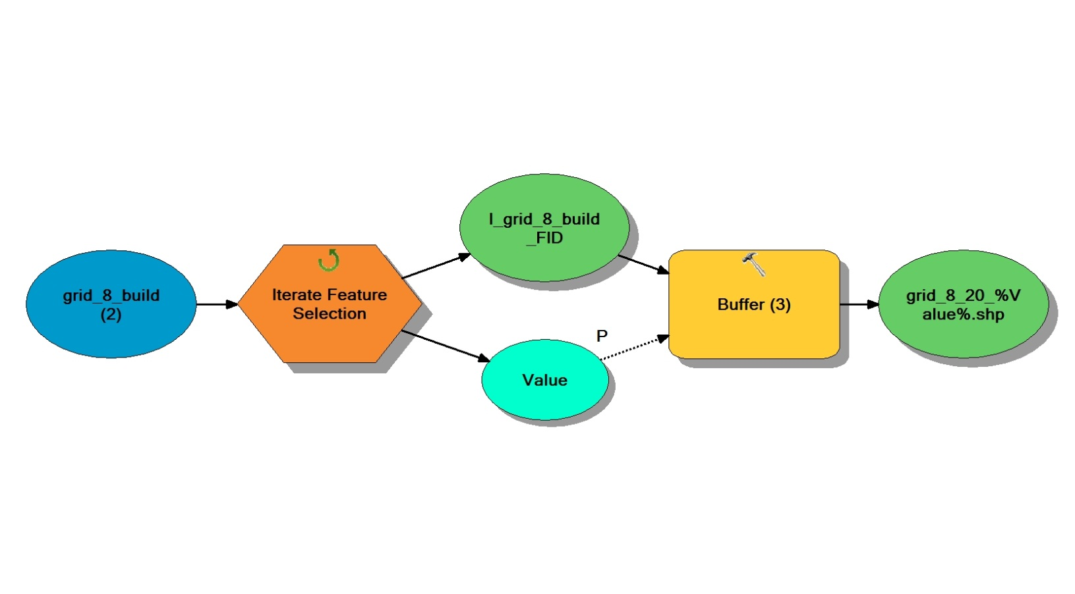
Buffer Reiterated Model
Create Buffer from Buildings layer
Merge shapefiles
Intersection

Slide 12
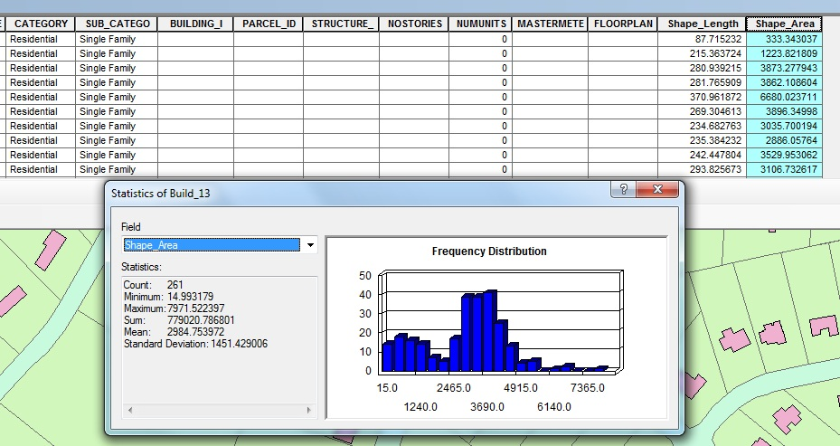
Square Footage of Buildings
This calculation is relatively simple to complete and we already have values for the two grids we have worked with the most.

Slide 13
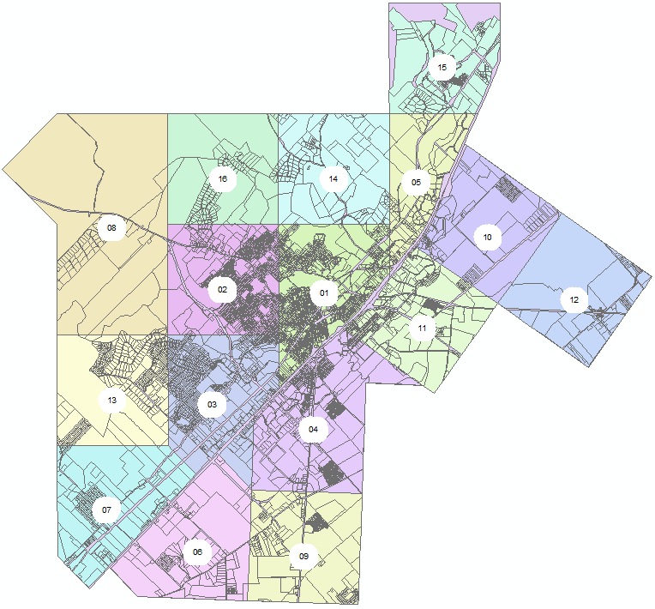
Population
Finding the population has proved to be one of our biggest challenges.
Most of the population data that has been provided to us is not an accurate representation of the parcel layer’s true population values.
Due to the incompleteness of the population data we intend to estimate these values based on the parcel zoning codes.

Slide 14
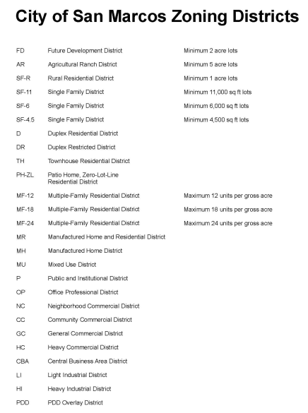
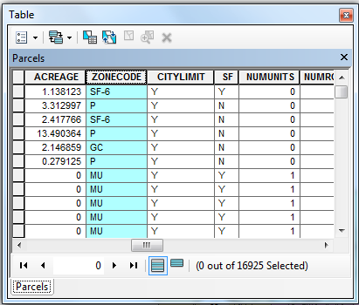
Population Cont.
We will determine whether a parcel is commercial, industrial, or residential by looking at its associated zoning code.
These zoning codes will help us estimate the day and night time population of the parcels.

Slide 15
Timetable
Our group is approaching week 8 in the timetable. We have made considerable progress overall, and our major challenges have been addressed and dealt with accordingly.
By week 10 our analysis will be complete and we will begin the preparation of the final deliverables.

Slide 16
Summary of Project
Overall our project is going quite well, despite some unsuspected challenges and revisions.
We hope that this discussion has provided you insight on the work that is currently being done by our group in order to complete this comprehensive analysis.
We are looking forward to the final results of this project and anticipate future use of this study by the City of San Marcos to expand upon our maps, models, and spreadsheets to meet their evolving needs as the city grows.

Slide 17
Questions?

