Slide 1
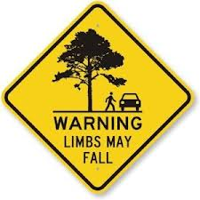
T.E.E.G.S
Transportation, Emergency, and Environmental GIS Services
Matt Smith
Budget analyst: Project design:
Introduction: Project management:
Conclusion
Lauren Bender
Data analyst: Project management:
Literature review: Implications:
Introduction: References
Amanda Magera
Budget/Data Analyst: Literature Review:
Introduction: Timetable: Methodology:
Final deliverables
Aaron Gore
Data Analyst: Methodology:
Project design: Conclusions:
Project management
Rank-Ordering Proactive Tree Maintenance for Emergency Response Routing for the City of Austin Urban Forestry Program

Slide 2
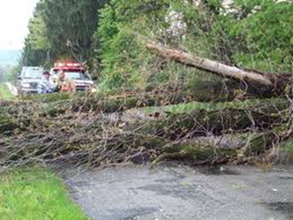
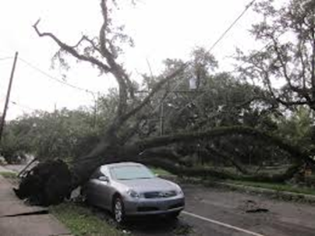
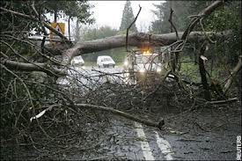
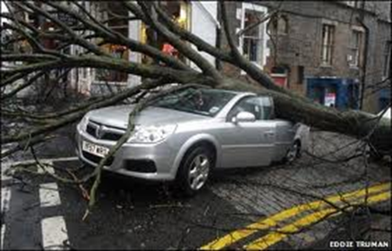
Summary
The Back Story…….. The record drought of 2011 severely weakened the structural integrity of an unknown number of trees in and around the city of Austin. Structurally weekend trees pose a potential and unnecessary hazard to both emergency and municipal response services.

Slide 3
Austin Parks and Recreation Department
The City of Austin Parks and Recreation Department wishes to be proactive and not reactive in the identification and subsequent removal of potential tree hazards from the city of Austin’s roadways. The identification and removal of potential tree hazards will help optimize the cities tree removal services and clear potential hazards for emergency service vehicles.

Slide 4
Purpose
The purpose of this project is to generate a comprehensive tree hazard inventory for the city of Austin Parks and Recreation department.
A ranking system will be used to highlight areas with the greatest threat potential in order to prioritize preventative tree maintenance.
T.E.E.G.S. will accomplish this by utilizing a GIS to analyze the existing tree shade index and identifying areas of high tree density which intersect or overlay with emergency service routes.

Slide 5
Scope
City of Austin
City limits

Slide 6
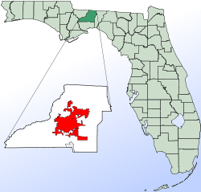
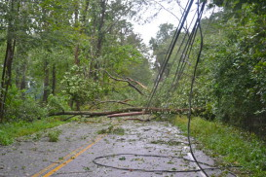
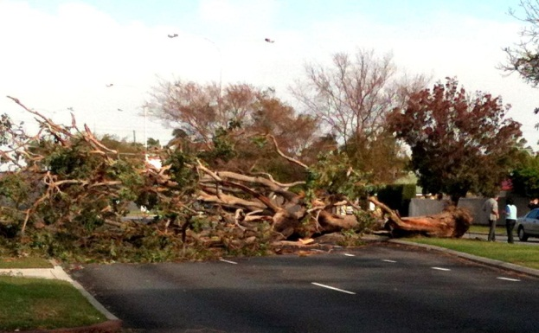
Literature Review
Study 1: Leon County, Tallahassee, FL
Objective: Determine locations for emergency goods distribution centers in the event of an emergency
Process: Traffic Analysis Zones (TAZ)
Results: People in certain TAZs were cut off from the rest of a network. Links that were disabled impacted how relief services were provided
Notes:
Notes:
Study done by Mark Horner and Michael Widener
Important to our study because after a storm, there will be failed network linkages throughout an area as a function of down trees and limbs and debris
Process: chose locations relative to populations
Leon county divided traffic analysis zones each containing a portion of the population
TAZs are represented in point format by computing their geometric centroids; these are then connected to the road network using 30 synthetic links for each TAZ to ensure each one had a functional route
Results: showed scenarios where people at certain TAZs were cut off from the rest of a network and unable to get to the goods distribution center
This is important to our analysis because our goal is to prevent citizens and emergency personnel from being completely blocked or trapped on road networks because of fallen trees/limbs

Slide 7
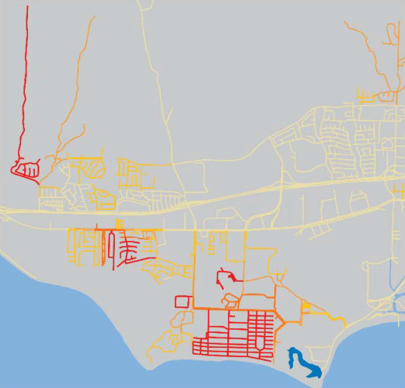
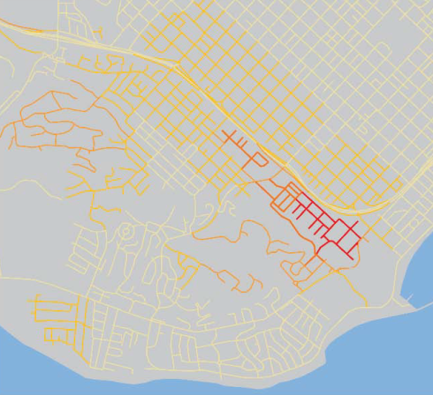
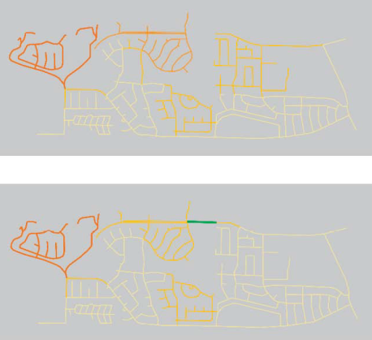
Literature Review
Study 2: Application of GIS in regional evacuation analysis
Objective: Evacuation vulnerability mapping
Process: Thiessen Polygons
Results:
Red = relatively high ratio of residents to exiting lanes
Green = low ratio of residents to exiting lanes
Notes:
Notes:
Study done by Thomas Cova
Process: people are assigned to the nearest intersection in the network using Theissen Polygons.
The links connecting this set of nodes to the rest of the network are considered the exit choice set for that particular evacuation
We also suggested using Theissen polygons in our study
Cova used census data and road networks to determine population per exit for each evacuation route
Results: maps from example city Santa Barbara, CA showing evacuation vulnerability with streets in red with a relatively high ratio of residents to exiting lanes and streets in green showing a low ratio
This is the same concept we intend to show with our study. Showing the streets with the highest priority of tree removal/trimming in red and the streets with the lowest priority in green, with yellow in the middle

Slide 8
Data
LAYER | SOURCE
Road Network - Major Arterials - Core Transit Corridors - Neighborhood Streets | City of Austin
Locations of Facilities -Hospitals - EMS Stations - Police Stations - Shelters - Fire Stations - Power Stations - Activity Centers - Schools (TEA) | City of Austin Texas Education Agency (TEA)
Police Precincts | City of Austin
Tree Canopy Cover/Shade Index | Urban Forestry Program
Austin City Limits | Capital Area Council of Governments (CAPCOG)
Census Data | Census Bureau

Slide 9
Methodology
In order to assist the city of Austin Urban Forestry Department prioritize where proactive tree maintenance will help maximize the city’s emergency response our group will develop a city wide weighting system to determine these maintenance areas.
This weighting system will be made up of two parts:
First we will use our street network to perform a Network Buffer around our Emergency Service locations in order to identify where their nearest connection is. We will rank this by identifying the 1st connection priority and weight these road segments using it’s corresponding tree shade index.

Slide 10
Example

Slide 11
Example

Slide 12
Methodology
We will use point to point travel along our road network to simulate travel from an ES location to a point of interest and back to an ES location.
These two weighting systems will be combined in order to ensure ES personnel are both able to leave their stations as well as travel unrestricted by tree debris when responding during a severe weather event.

Slide 13
Example

Slide 14
Budget
Data Collection
Total Hours (10 hours/week * 5 weeks * 2 consultants +
7 hours/week*5 weeks * 1 consultant + 5 hours/week *
5 weeks *1 consultant) 170
Hourly Pay $30.00
Total $5,100.00
Data Analysis
Total Hours (10 hours/week * 5 weeks * 2 consultants +
7 hours/week*5 weeks * 1 consultant + 5 hours/week *
5 weeks *1 consultant) 170
Hourly Pay $45.00
Total $7,650.00
System Management
Project Manager
Total Hours 50
Hourly Pay $80.00
Pay $4,000.00
Assistant Manager
Total Hours 30
Hourly Pay $60.00
Pay $1,800.00
Total Management $5,800.00
Equipment Costs (for 10 weeks)
Supplies ($150/workstation * 4 workstations) $600.00
Maintenance ($200/workstation * 4 workstations) $800.00
Depreciation ($100,000 [total value of equipment]/36
[equip life in month] * 2.5 [months equipment will be
in exclusive use for project) $6,944.44
Total Equipment Costs $8,344.44
Data
Purchased Data
Software License for 10 weeks $5,000.00
Total Data Costs $5,000.00
Travel Expenses
120 miles @ $0.40/mile $48.00
Total $48.00
TOTAL COSTS $31,942.44

Slide 15
Timeline
Data Collection
Pre-Processing of Data
Data Analysis
Data Interpretation
Important Dates:
February 20th:
Presentation of Project Proposal to Client
March 25th:
Progress Report and Presentation
May 3rd:
Final Project Presentations
Week | February
 |  |  |  |  | 1 | 2 | 3
 | 4 | 5 | 6 | 7 | 8 | 9 | 10
 | 11 | 12 | 13 | 14 | 15 | 16 | 17
1 | 18 | 19 | 20* | 21 | 22 | 23 | 24
2 | 25 | 26 | 27 | 28
Weeks 1-4
Weeks 4-5
 | March
 |  |  |  |  | 1 | 2 | 3
3 | 4 | 5 | 6 | 7 | 8 | 9 | 10
4 | 11 | 12 | 13 | 14 | 15 | 16 | 17
5 | 18 | 19 | 20 | 21 | 22 | 23 | 24
6 | 25* | 26 | 27 | 28 | 29 | 30 | 31
Weeks 6-8
Weeks 9-11
 | April
7 | 1 | 2 | 3 | 4 | 5 | 6 | 7
8 | 8 | 9 | 10 | 11 | 12 | 13 | 14
9 | 15 | 16 | 17 | 18 | 19 | 20 | 21
10 | 22 | 23 | 24 | 25 | 26 | 27 | 28
11 | 29 | 30
 | May
11 |  |  | 1 | 2 | 3* | 4 | 5
 | 6 | 7 | 8 | 9 | 10 | 11 | 12
 | 13 | 14 | 15 | 16 | 17 | 18 | 19
 | 20 | 21 | 22 | 23 | 24 | 25 | 26
 | 27 | 28 | 29 | 30 | 31

Slide 16
Implications
A comprehensive ranking system for Tree maintenance on Austin city streets
Proactive Maintenance
Reactive Clearing
Maintenance Schedules
A map of which streets are most heavily utilized by emergency services
Rerouting during emergency situations
Road maintenance, etc.

Slide 17
Expected Findings
Deliverables
Table containing Block Ranking for Tree Maintenance
Map of top 10% most important blocks for Proactive Tree Maintenance
Map of High to Low Priority areas for the City of Austin
Map of streets more highly utilized by emergency services

Slide 18
Results
Example:
Map of High to Low Priority areas for the City of Austin
Areas with high priority tree removal will be shown in red
Areas with lower priorities will be shown in yellow and green
Santa Barbara, CA

Slide 19
Conclusion
Structurally weakened and damaged trees falling onto and around city roadways presents an unnecessary obstacle to the City of Austin’s emergency response services. T.E.E.G.S. possesses the Geographic Information Systems (GIS) experience and expertise necessary to help the City of Austin Parks and Recreation Department successfully manage and mitigate potential tree hazards in the future.

Slide 20
References
• Horner, Mark, and Michael Widener. "The effects of transportation network failure on people’s accessibility to hurricane disaster relief goods: a modeling approach and application to a Florida case study." 59.3 (2011): 1619-1634. Web. 10 Feb. 2013.
• Cova, T.J. (1999) GIS in emergency management. In: Geographical Information Systems: Principles, Techniques, Applications, and Management, P.A. Longley, M.F. Goodchild, D.J. Maguire, D.W. Rhind (eds.), John Wiley & Sons, New York, 845-858.
• Philippines. Philippine Information Agency. Confab highlights GIS use for disaster risk reduction. 2012. Web. 10 Feb. 2013. <http://www.pia.gov.ph/news/index.php?article=1141353427298

Slide 21
Questions

