Slide 1
Construction of Geodatabase with Analysis of New Braunfels’ Drainage System
Project Proposal By Genius, Inc.

Slide 2
Project Team Members
Scott Christensen
Project Manager
Brad Dillashaw
Assistant Project Manager
Sam Ortega
GIS Analyst
Kelly McGauhey
GIS Analyst
Jacqueline Carrillo
GIS Analyst, Web Developer

Slide 3
Summary
New Braunfels growth (10-year)
14.6 sq. miles
21,246 residents
Growth leads to new infrastructure needs
Several floods in recent years
Broadway, 1998 and 2002
June 9, 2010

Slide 4
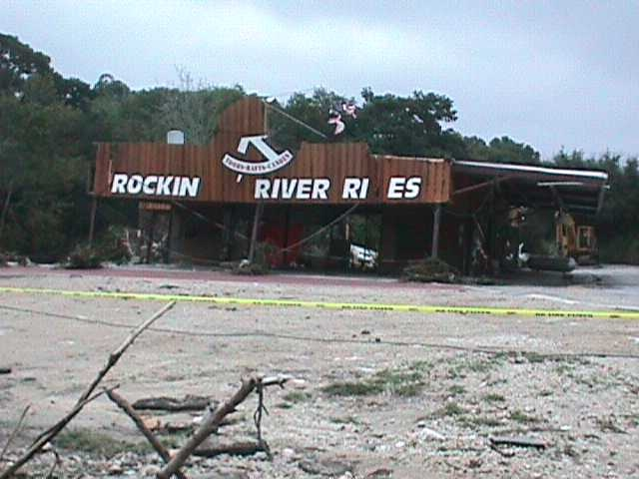
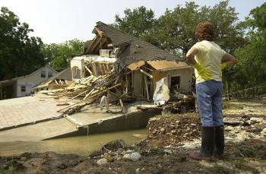
Broadway, 1998 & 2002
Broadway flood, 2002
Broadway flood, 1998

Slide 5
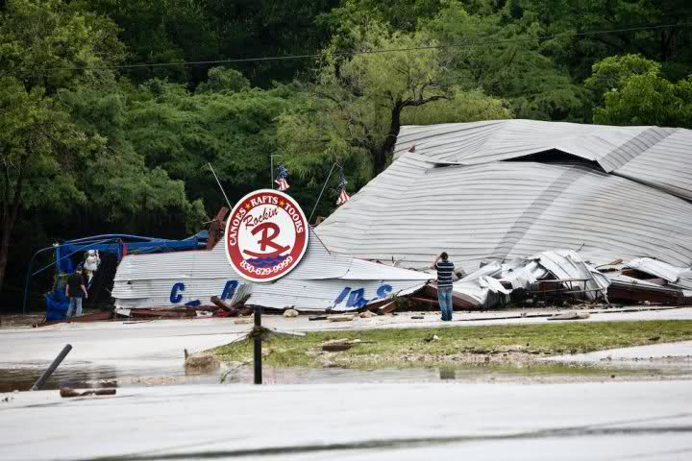
June 9, 2010

Slide 6
Purpose
Proposed geodatabase to help meet needs
Centralized record-keeping
Organized data
Mapping capability
Will bring clarity and efficiency to financial and engineering decisions in the future
Detail geodatabase design and demonstration

Slide 7
Scope
Primary Scope
5 block area along W. San Antonio Street
North extent: State Highway 46
South extent: Santa Clara Road
Secondary Scope
Time Permitting
Expand study area meeting

Slide 8
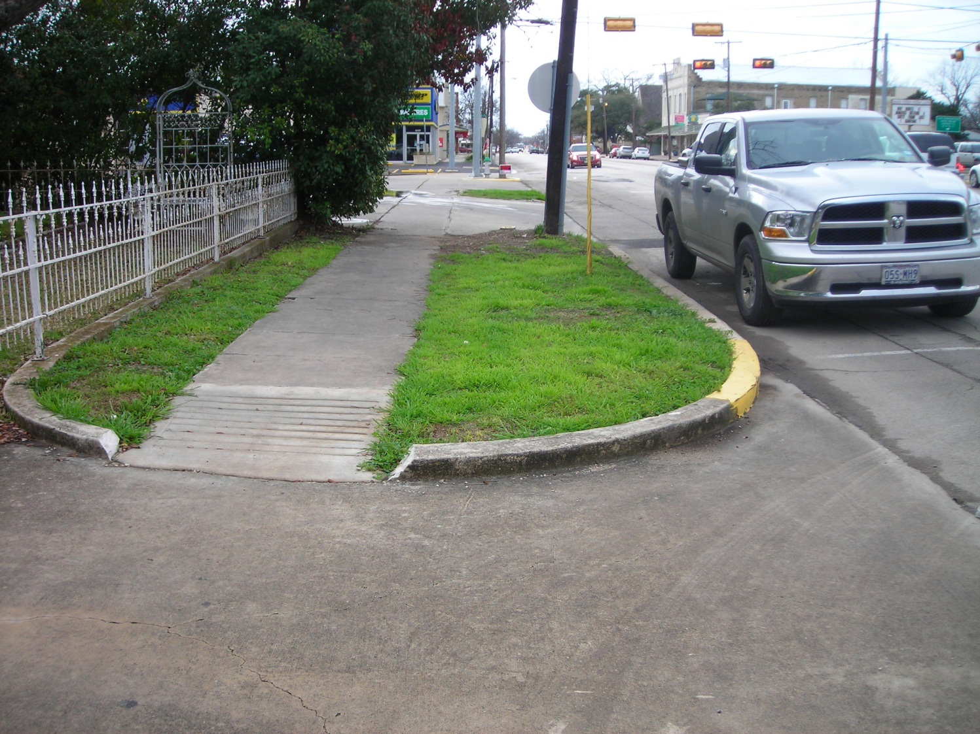
Walkthrough

Slide 9
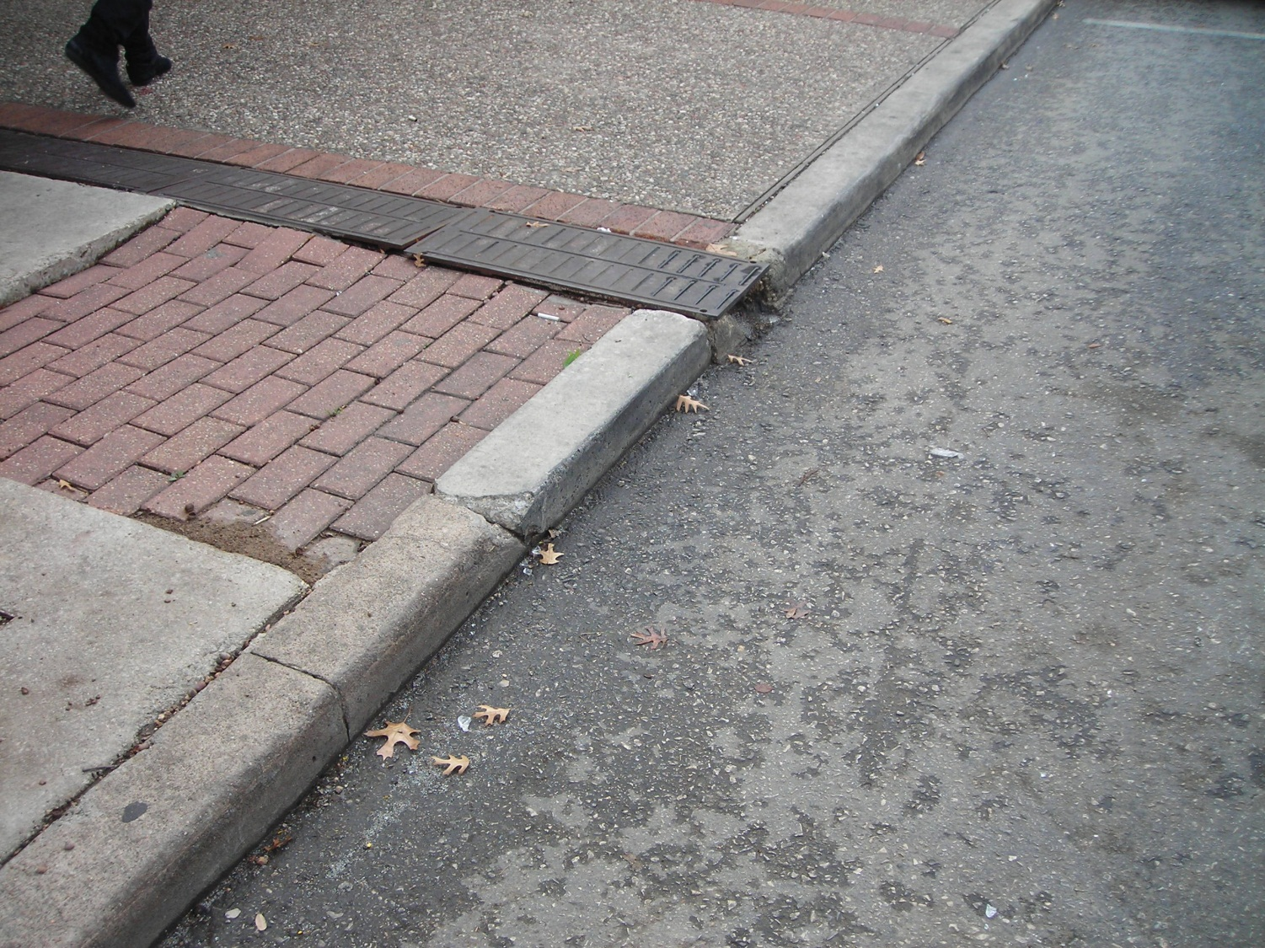
Walkthrough (cont.)

Slide 10
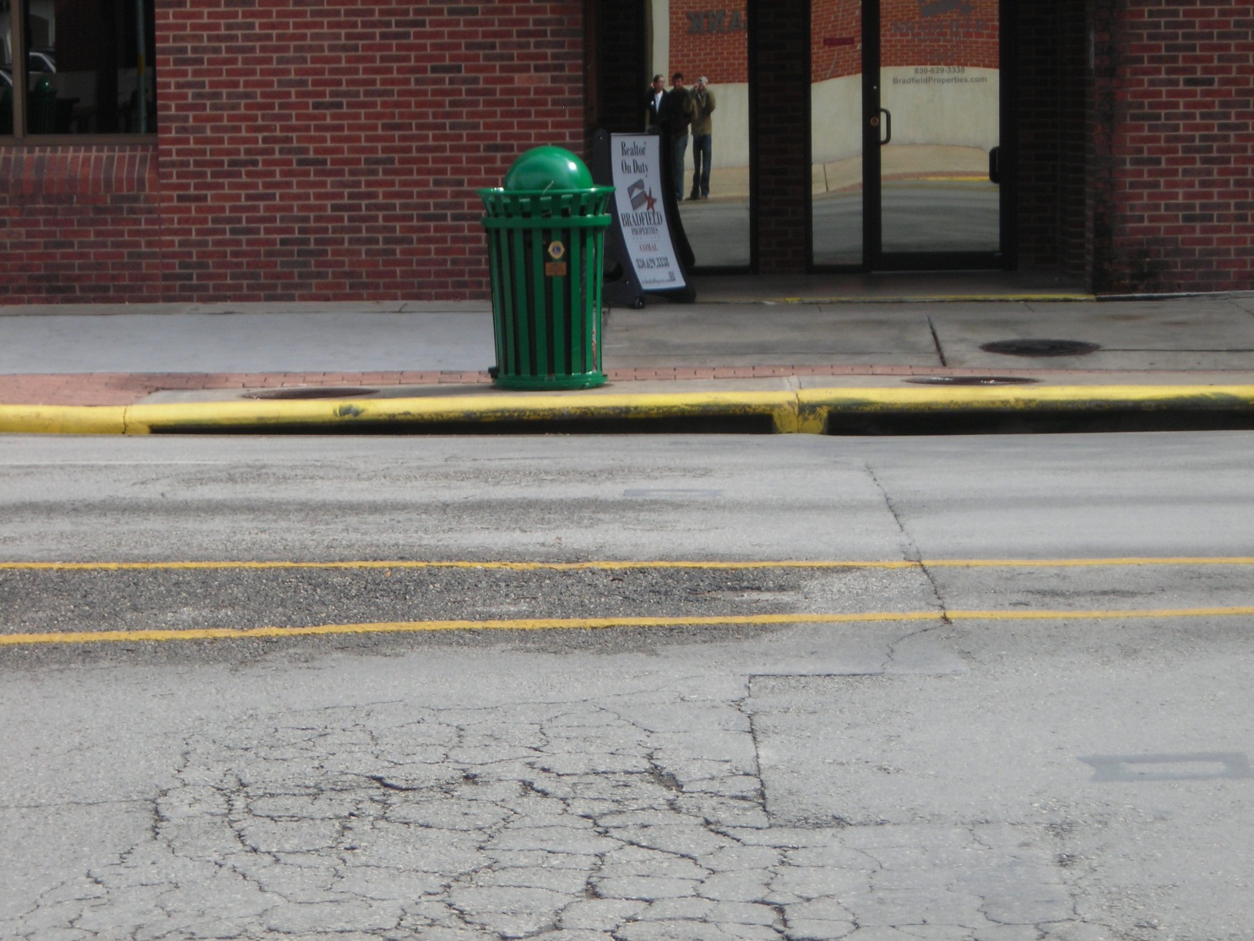
Walkthrough (cont.)

Slide 11
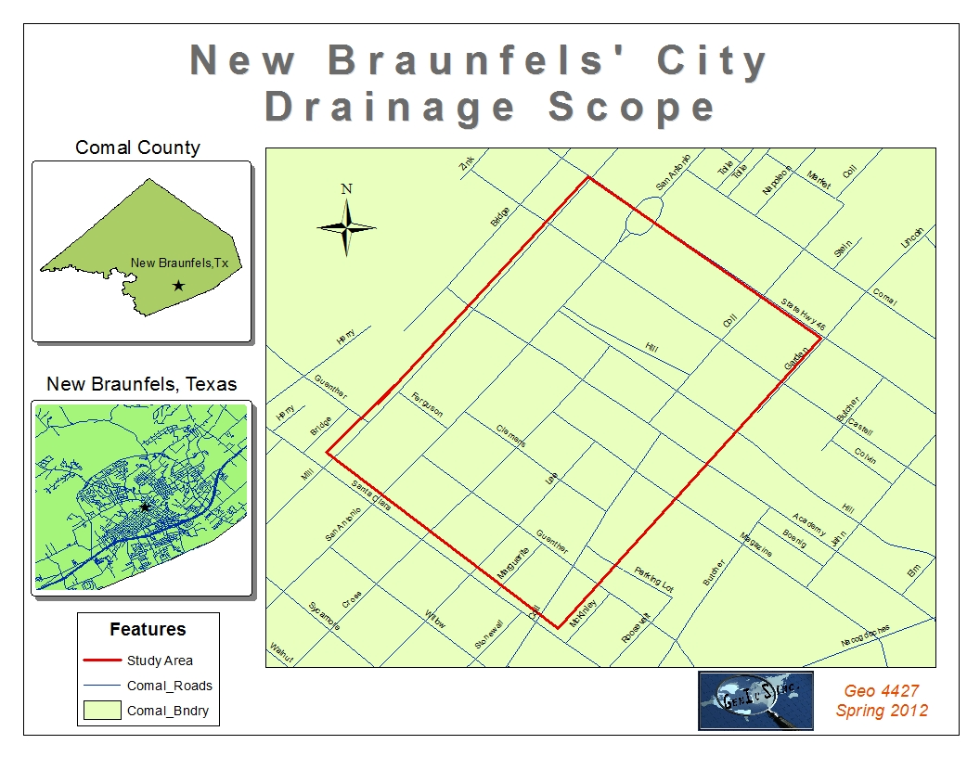
Scope Map

Slide 12
Scope Purpose
Use to Populate
Geodatabase
Manage Data
Collect Data
Develop/
Explore
Test/Run

Slide 13
Data
New Braunfels city data
Street centerline
City limits
Building parcels
Digital Elevation Model (DEM)
Street Rating Score database
Pictometry & Remote Sensing Images

Slide 14
Methodology
ArcGIS Database Design
Feature classes:
Sidewalks
Crosswalks
Curb & Gutter
Ditches
Storm Drains
Attributes
X-Y coordinate georeference
Street Centerline georeference
‘Condition’
Other attributes

Slide 15
Methodology (cont.)
Data Input Design
Street centerline reference
Drop-down menus
Didactic fields
Notes field with image option
Data Collection
Field data
Remote imaging / pictometry
Database Population and Demonstration

Slide 16
Budget
TASK | TOTAL HOURS | COST ($) | TOTAL COST ($)
Design Databases | 168 | 25 | 4,200
Data Collection | 100 | 20 | 2,000
Analyze Pictometry & Aerial Photography | 10 | 25 | 250
Populate Databases | 100 | 25 | 2,500
Finalize & Prepare Deliverables | 42 | 20 | 840
Project Management: Project Manager | 50 | 50 | 2,500
Project Management: Assistant Project Manager | 30 | 40 | 1,200
Equipment Cost |  |  | 2,406
Software Cost |  |  | 5,328
Travel Cost |  |  | 73
TOTAL COST |  |  | $21,297

Slide 17
Timeline
TASKS | WEEKS
 | 2/20 – 2/24 | 2/27 – 3/2 | 3/5 – 3/9 | 3/12 – 3/16 | 3/19 – 3/23 | 3/26 – 3/30 | 4/2 - 4/6 | 4/9 – 4/13 | 4/16 – 4/20 | 4/23 – 4/27 | 4/30 – 5/4
Proposal | X
Data Collection |  |  |  |  | X | X | X | X | X
Analyze Pictometry |  |  |  |  |  | X
Progress Report |  |  |  |  |  |  | X
Design Databases | X | X | X | X
Populate Databases |  |  |  |  | X | X | X | X | X
Finalize & Prepare Deliverables |  |  |  |  |  |  |  |  |  | X
Presentation |  |  |  |  |  |  |  |  |  |  | X

Slide 18
Deliverables
File geodatabase
ArcGIS database
Data input form
Instruction manual
Final report
Poster
Website
Comprehensive CD
All data and metadata
Electronic copies of all deliverables

Slide 19
Purpose of Website

Slide 20
Conclusion
Project Results
Initial creation and structure of geodatabase
Populate and demo geodatabase
Implications
Develop and add to database
Identify and record future drainage issues
Analysis of future drainage infrastructure needs

Slide 21
Questions?
Point of contact: Brad Dillashaw, bd1197@txstate.edu

