Slide 1

Geographic Analysis of San Marcos Housing Affordability

Slide 2
TexGIS Employees
Manager: Chase Chapman
Assistant Manager: Ryan Hilliard
GIS Analyst: Marques Green
Web Master: Jason Snyder

Slide 3
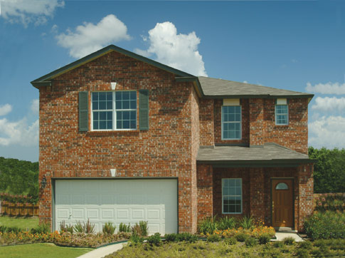
Introduction
Affordable housing in San Marcos, TX is in short supply.
Housing is unavailable for certain income levels.
The ratios between rent-occupied and owner-occupied housing are disproportional.

Slide 4
Summary
This study will provide the City of San Marcos information regarding zoning, household income, and types of occupancy to help develop a comprehensive housing policy that promotes particular types of single-family housing and homeownership.

Slide 5
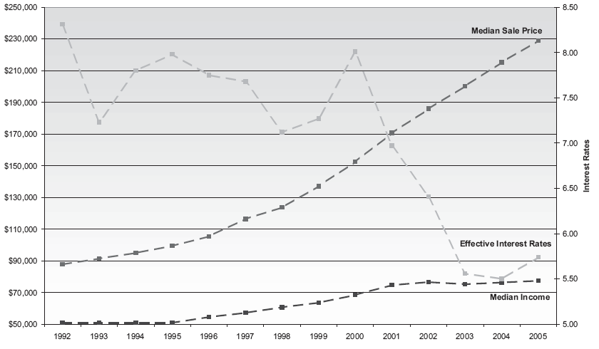
Median Sales Price/Effective Interest Rate/Median Income
Source: Jeff Allen, Minneapolis Area Association of Realtors

Slide 6
Purpose
Analyze housing values and income distributions in the San Marcos area.
Compare the housing values of renter-occupied units with those of owner-occupied units.
Conclude whether the housing supply in San Marcos meets the economic make-up of its residents.
Analyze neighborhood associations to see their impact on their respective housing values.
The results of this study will aid the city in developing a comprehensive housing policy.

Slide 7

Scope
The geographic extent of our study area is the San Marcos city limits, in particular, the several neighborhoods within the city. We will look at data between 2000 and present in particular.
Retrieved Feb. 23, 2009 from http://www.texfiles.com/sanmarcostexas/leftA.jpg

Slide 8
Housing Category Thresholds
Housing Category | Lower Limit Value | Upper Limit Value
Entry (50% - 80% AMI) | $82,400 | $131,800
Workforce (80% - 120% AMI) | 131,800 | $164,700
Upper-Level (120% - 150% AMI) | $164,700 | $197,700
Executive (more than 150% AMI) | $197,700 | Unlimited
Area Median Family Income (AMI)

Slide 9
Data
San Marcos
  City Limits
  Zoning
  Land Parcels
  Neighborhoods
  Mobile Homes
  County Boundaries
Census Data
  2000

Slide 10
Data Continued
Tax Data
  2008
  Home Values

Slide 11
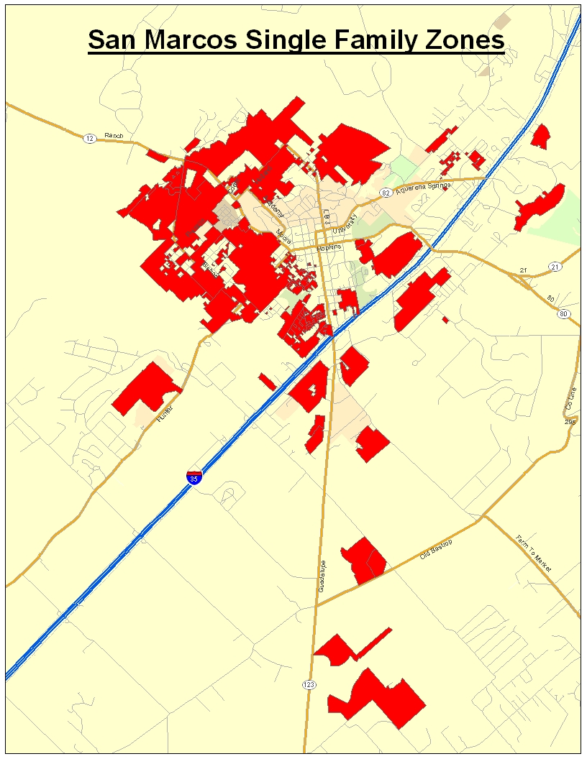

Slide 12
Methodology
Compare housing values between different neighborhoods and among renter and owner-occupied housing.
Compare this information with census data, mainly average household income, to see if the current San Marcos housing stock fits with its residents.
Conclude whether neighborhood associations have an effect on their respective housing values.
Analyze the effect renter-occupied housing has on surrounding housing values.
All of our findings will be displayed on a website and with color-coded maps displaying homes with their market values in accordance with their respective categories (SF-R, SF-11, SF-6, SF-4.5, TH, PH-ZL, PDD).
All of our analysis will be done using ArcGIS.

Slide 13
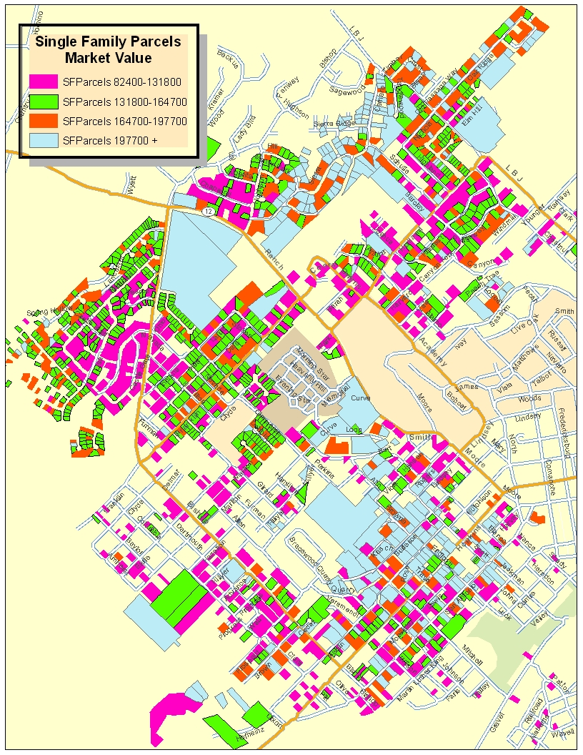
Market Value
Sample

Slide 14
Timetable

Slide 15
Budget
Data Collection
Manager: (8 hours/week * 5 weeks) 40/hr.
Assistant Manager: (7 hours/week * 5 weeks) 35/hr.
Developers: (10 hours/week * 3 weeks * 2 consultants) 60/hr.
Total Hours 135
Hourly Pay $25.00
Total $3375.00
Pre-Processing Data
Manager: (5 hours/week * 2 weeks) 10/hr.
Assistant Manager: (7 Hours/week * 2 weeks) 14/hr.
Developers: (10 hours/week * 4 weeks * 2 consultants) 80/hr.
Web Master: (7 hours/week * 3 weeks * 1 consultant) 21/hr.
Total Hours 125
Hourly Pay $25.00
Total $3125.00
Data Integration
Manager: (5 hours/week * 3 weeks) 15/hr.
Assistant Manager: (7 hours/week * 3 weeks) 21/hr.
Developers: (10 hours/week * 3 weeks * 1 consultant) 30/hr.
Web Master: (7 hours/week *3 weeks * 1 consultant) 21/hr.
Total Hours 87
Hourly Pay $25.00
Total $2175.00

Slide 16
Budget cont…
Website Development
Webmaster: (3 hours/ week * 6 weeks * 1 consultant) 18/hr.
Hourly Pay $30.00
Total $540.00
System Management
Project Manager: (5 hours/week * 10 weeks)
Total Hours 50/hr.
Hourly Pay $35.00
Pay $1750.00
Assistant Project Manager: (3 hours/week * 10 weeks)
Total Hours 35/hr.
Hourly Pay $30.00
Pay $1050.00
Total $2800.00
Equipment Costs (for 10 weeks)
Supplies ($150/workstation * 4 workstations) $600.00
Maintenance ($125/workstation * 4 workstations) $500.00
Depreciation ($12,000 [Total value of equipment] / 36 $833.33
(equipment life in months) *2.5 (months equipment will be in use for project) Total Equipment Costs $1934.00

Slide 17

Budget cont…
Data
Purchased Data $2500.00
  Software License for 10 weeks $5000.00
  Software License (Manifold) $625.00
  Total Data Costs $8125.00
Travel Expenses 200 Miles @ .38 cents/mile $76.00
TOTAL PROJECT COST $22,150.00

Slide 18
Final Deliverables
Report
Poster
CD
  Final Report
  Maps and Final Poster
  Data
  Resources
  Sources
  Metadata

Slide 19
Sources
U.S. Bureau of the Census.
United States. http://www.census.gov/ . (February 9, 2009)
  Census Information regarding to San Marcos
U.S. Department of Housing and Urban Development.
United States. http://www.hud.gov/ .(February 5, 2009)
  Housing Category Thresholds

Slide 20
Sources Continued
U.S. Urban Land Institute.
United States. http://www.uli.org/ . (2009)
  Definition of Low-Income Families
Inflation Data
http://www.inflationdata.com/inflation/Inflation_Rate/CurrentInflation.asp
  Inflation rates and the state of economy

Slide 21
Progress
Isolated SF housing from data
  Categorized based on predetermined value thresholds
Formulated a plan of action to categorize and analyze our data

Slide 22
Conclusion
Inadequate affordable housing in San Marcos is a growing concern of the local government.
Our study stands to help develop a housing policy that garners affordable and owner-occupied housing.

Slide 23
Participation
Chase Chapman
  Purpose
  Scope
  Data
  Methodology
  Assemble proposal
  Ryan Hilliard
  References
  Timeline
  Jason Snyder
  Logo
  Budget
  Maps
  Marques Green
  Summary
  Implications
  Conclusion
  Income Inflation Rates

Slide 24

Questions?

