Slide 1
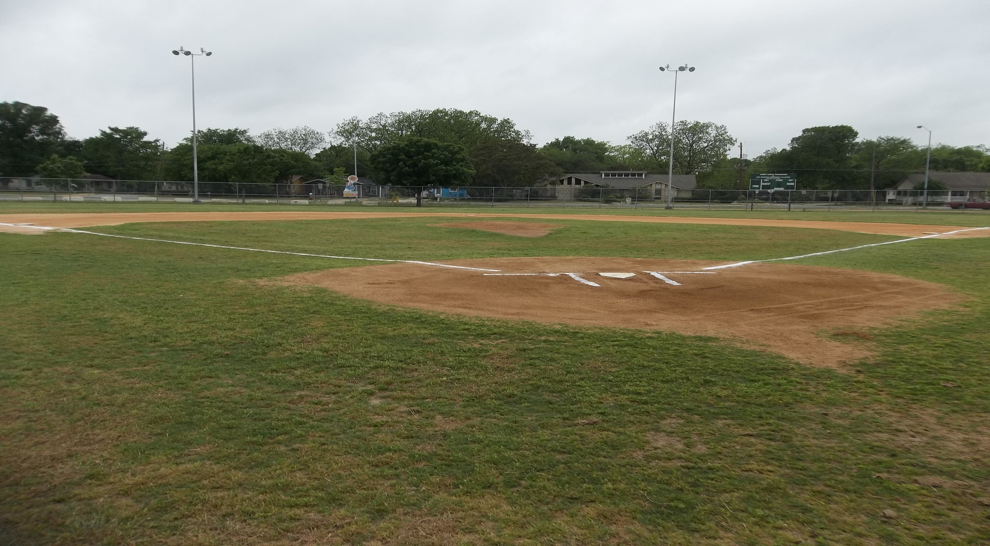

GPS Inventory & Impervious Cover Mitigation
Ramon Lucio Park and Baseball Fields

Slide 2
Introduction
City of San Marcos fastest growing city for 3rd consecutive year.
Portions of San Marcos River designated State Scientific Area.
City commitment to sustainable growth with respect to natural environment and citizens.
Park and Recreation Facilities Inventory.
Impervious cover, runoff and water quality.

Slide 3
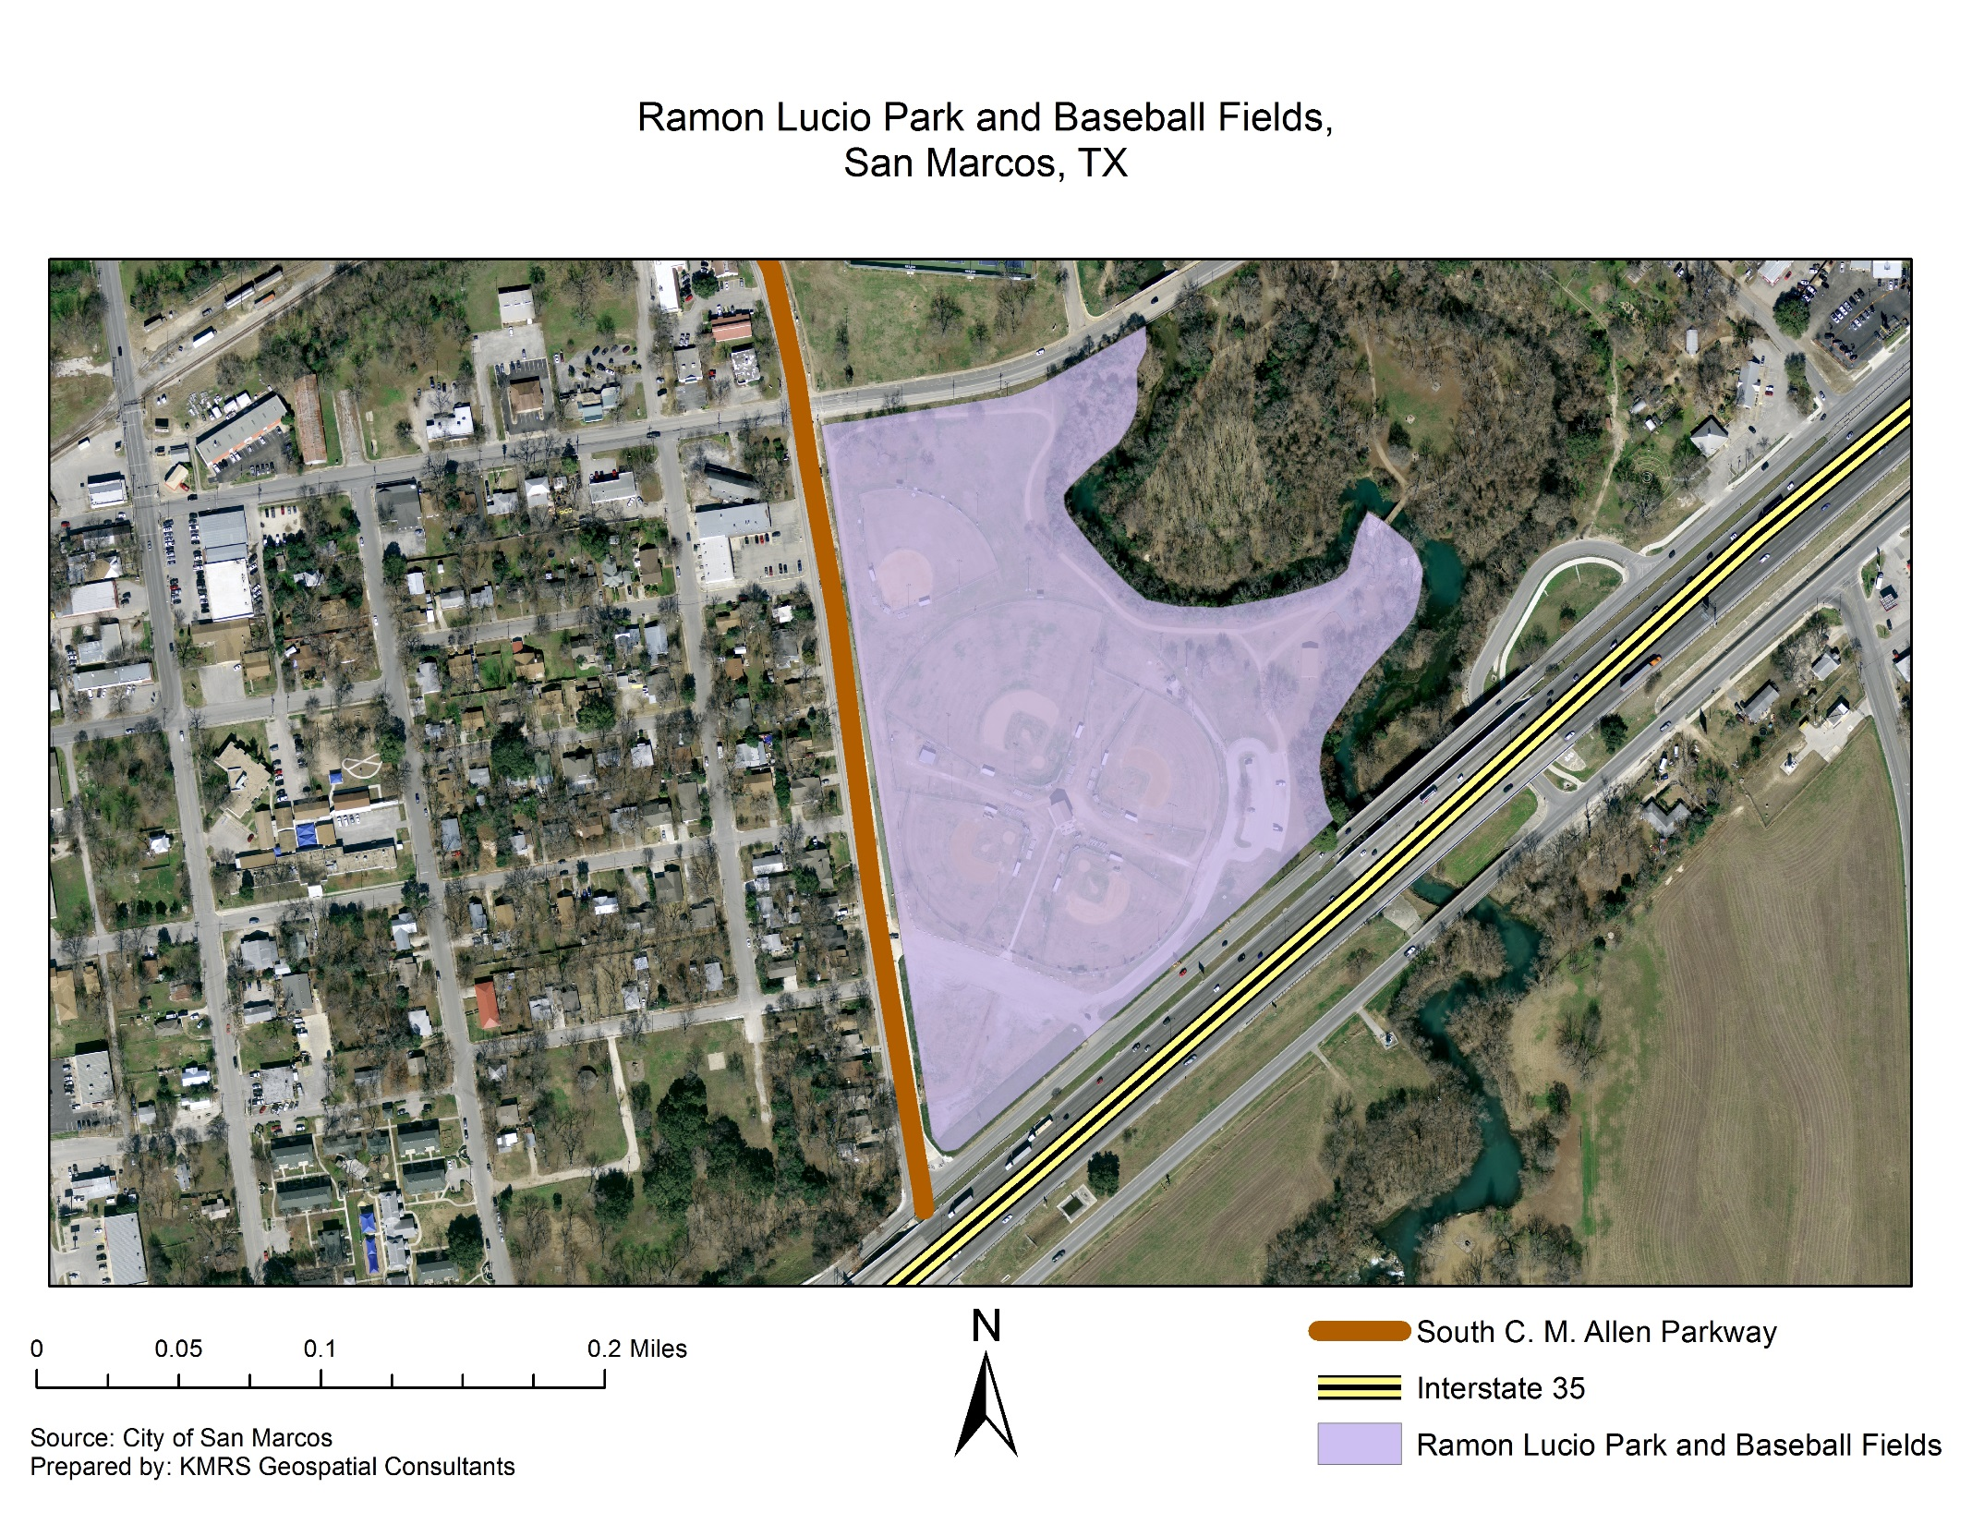


Slide 4
Purpose
Determine spatial and attribute data of park amenities.
Create geodatabase modeling Ramon Lucio Park boundaries and features.
Evaluate impervious cover.
Propose plan for mitigation of impervious cover.

Slide 5
Data
Ramon Lucio Park Base Map:
Buildings
Streets
Park boundaries
GPS monuments
San Marcos River
Ramon Lucio Park Aerial Image
Ramon Lucio Park Features:
Parking Spaces
Illumination
ADA
Trash
Youth Baseball and Softball Fields
Irrigation
Fences

Slide 6

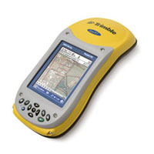

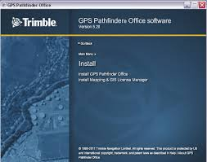
Software
ArcMap
Trimble GeoXT GPS
Adobe Creative Cloud
GPS Pathfinder

Slide 7
Methodology
Evaluation/Update of Rio Vista Park GDB.
Create Data Dictionary (illumination/points, trails/lines, parking lots/polygons, etc).
Data collection in the field:
Some features contain uniquely identifying attributes (illumination).
GPS unit for data collection: Trimble GeoXT (submeter accuracy) prop. of Texas State Univ.
Merge data with the Rio Vista Park data into single GDB containing both parks.
Determine quantity and location of impervious cover.
Propose mitigation plan according to city code.

Slide 8
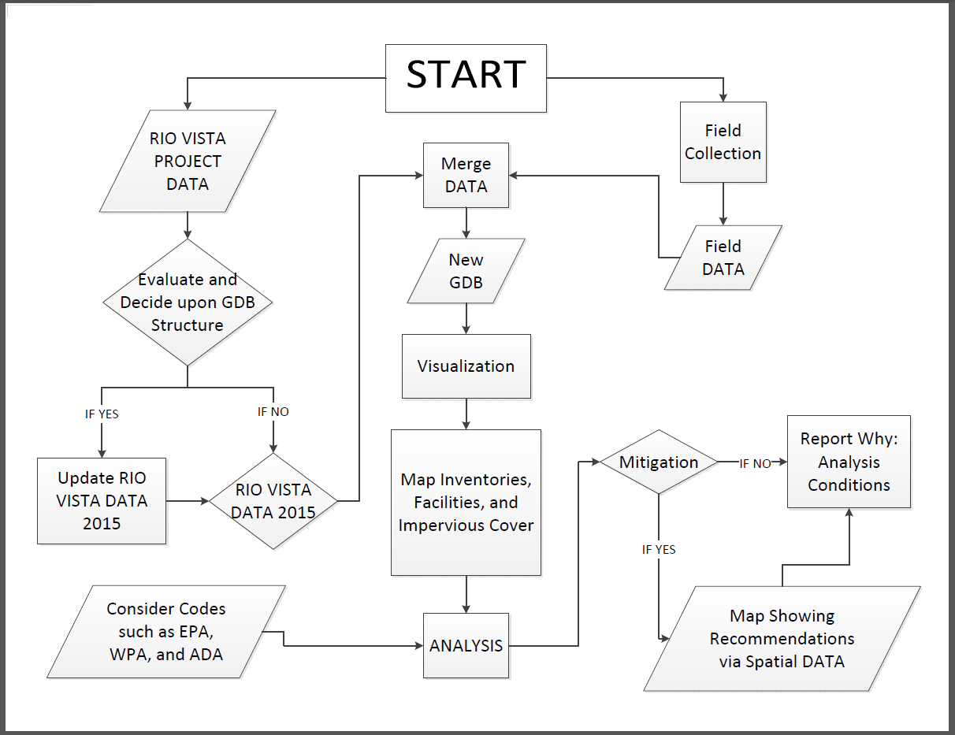

Slide 9
Timeline
Wed, September 2nd – Discuss project guidelines and needs.
Mon, September 7th – Identify main objective and tasks.
Wed, September 9th – Review previous project data provided by client.
Mon, Sept 14th / Wed, Sept 16th – Preliminary site survey.
Mon, Sept 21st / Wed, Sept 23rd – Prepare project proposal.
Mon, September 28th – Present Proposal to City of San Marcos.

Slide 10
Timeline
Wed, Sept 30th / Mon, Oct 26th – Begin inventory at Park.
Wed, October 28th – Report progress with City.
Mon, Nov 2nd / Wed, Nov 18th – Continue Park Inventory.
Mon, Nov 23rd / Mon, Nov 30th – Compile data and analyze impervious cover.
Wed, December 2nd – Present and handoff final deliverables.
GDB Analysis
Sep. 2 -
Sep 14
Proposal Prep
Sep. 14 - Sep. 28
Data Collection
Sep. 28 - Nov. 2
Compiling & Analysis
Nov. 2 -
Nov. 30
Report & Present
Nov. 30 -
Dec. 2

Slide 11
BUDGET
Services/ Salaries | Supplies, Equipment, and Overhead
Project Manager | ArcGIS subscription: $600
$4500 for 20 days work | Trimble GPS rental: $3750
Web Master/ Researcher | Workstation rental: $7500
$4300 for 20 days work | Office supplies: $500
GIS Technician | Insurance: $5000
$4300 for 20 days work | Transportation: $1000
Researcher/ Editor
$4300 for 20 days work
Salaries Subtotal: $17,400 | Equipment Subtotal: $17,850

Slide 12
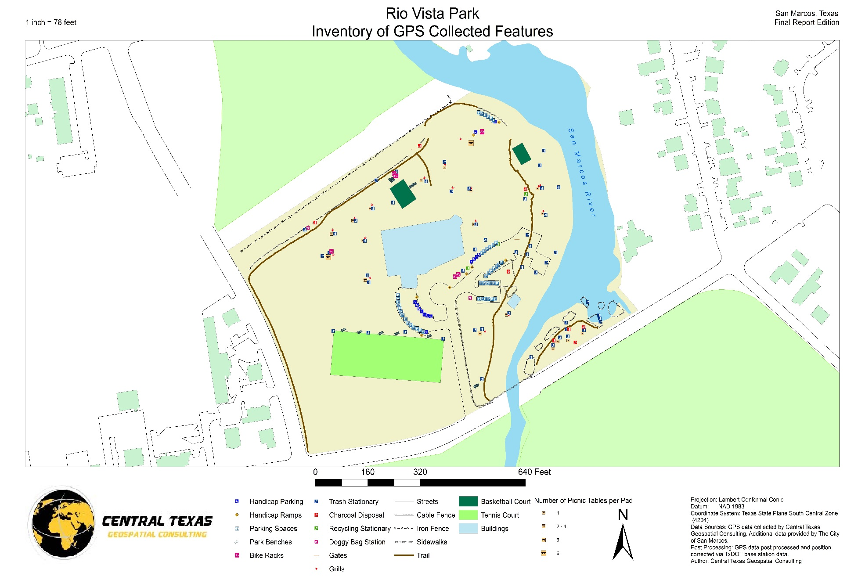
Deliverables
Visual representation of Ramon Lucio Park and Baseball features.
Map showing amenities and impervious cover locations.
CD containing all relevant data and files.
Merged geodatabase containing Ramon Lucio Park & Rio Vista Park.
Plans for mitigating impervious cover.
Final Report and detailed poster.

Slide 13
Conclusion
KMRS Geospatial Consultants will:
Collect GPS & attribute data for requested features at Ramon Lucio Park.
Create integrated GIS merging Rio Vista Park and Ramon Lucio Park data.
Propose changes mitigating impervious cover within Ramon Lucio Park.

Slide 14
References
Janzen, Eric; and Beausoleil, Sofia; 2015. San Marcos is nation’s fastest-growing city. KXAN-TV Austin Austin, TX, May 20. http://kxan.com/2015/05/20/san-marcos-is-nations-fastest-growing-city/ Last accessed 24 Sep 2015.
Gofrey, Andria N.; and Guerra, Jonathan; 2010. Endangered Species – San Marcos Prepared as part of a National Park Service Trails and Rails project in partnership between Amtrak, Inc, and the Department of Recreation, Park and Tourism Sciences at Texas A & M University, 2010.
Texas Parks & Wildlife (2012). San Marcos River State Scientific Area Information Sheet. San Marcos, TX.
Flinker, Peter; 2008. The Need To Reduce Impervious Cover to Prevent Flooding and Protect Water Quality. Rhode Island Department of Environmental Management, 2008, revised 2010.
Schueler, Thomas R.; Fraley-McNeal, Lisa; and Cappiella, Karen; 2009. Is Impervious Cover Still Important? Review Of Recent Research Journal of Hydrologic Engineering, ASCE, April 2009.
UNCC Press Release, 2015. University partners with city, county on Web-based Quality of Life Explorer University of North Carolina – Charlotte http://inside.uncc.edu/news-features/2015-06-15/university-partners-city-county-web-based-quality-life-explorer#sthash.1Jnjppz5.dpuf Last accessed 24 Sep 2015.

