Slide 1
Texas State (San Marcos) Campus Map Visualization, c. 1900-2015
Project Manager:
Christian T. Hartnett
GIS Analysts:
Corby Schaub
Dylan Epley
Johnnie German
Final Presentation by

Slide 2
Introduction
Nmotion GIS is collaborating with the Texas State University Archives to develop a “unified map collection and a visualization to see how the physical San Marcos campus has developed over time”
Attempting to tell the story of Texas State University through spatial data

Slide 3
Tasks/Major Milestones
Task 1 - Data mining of data provided by Texas State University Archives and facilities offices
Task 2 - Produce a video showing the changes to campus through the use of ArcGIS’ time slider function
Task 3 - Produce a web map that allows users to choose different eras of Texas State University’s development spatially with interactive pop ups of pictures and historical facts and perform statistical analysis of the relationship between campus size and student population.
Task 4 - Final deliverables, reporting/analysis, spatial data, and poster presentation

Slide 4
Data Collection/Issues with the Data
Focused on organizing data/identifying exact construction/demolition dates where possible
Problems with some buildings having no identifiable construction date, having been moved
Some known buildings not present in the datasets

Slide 5
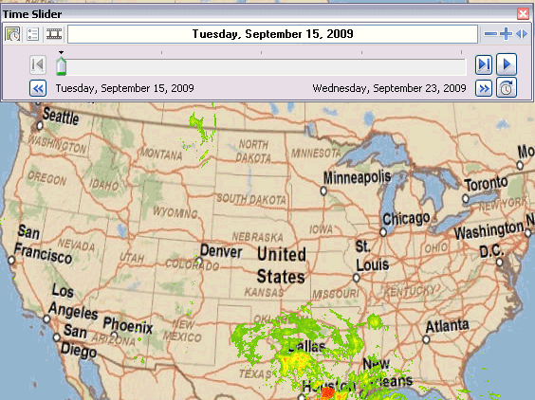
Results - Time Slider Video: ArcGIS Time Slider function explained

Image Source: http://www.esri.com

Slide 6
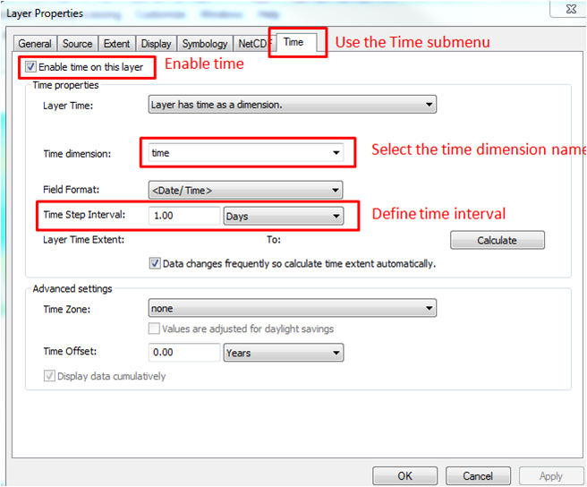
Results - Time Slider Video: ArcGIS Time Slider function enabling
Image Source: http://disc.sci.gsfc.nasa.gov

Slide 7
Interactive Web Map
ESRI Story Maps explained
Online web page construction tool that leverages ArcGIS Online and social media
Allows you to create a map that tells a story through spatial data
Accessible through any web browser or mobile phone
Link to the Texas State Map Visualization Project Story Map
http://arcg.is/1Myytin

Slide 8
Comparisons
Student Population
Date Range | Population | Percent of Growth
1903-1909 | 3,007
1910-1919 | 6,308 | 110%
1920-1929 | 9,718 | 54%
1930-1939 | 11,874 | 22%
1940-1949 | 12,210 | 3%
1950-1959 | 18,702 | 53%
1960-1969 | 54,796 | 193%
1970-1979 | 130,553 | 138%
1980-1989 | 184,935 | 42%
1990-1999 | 211,172 | 14%
2000-2009 | 266,697 | 26%
Average Percentage of Growth |  | 66%
Standard Deviation |  | 97,711
Student Population per Decade
Land Acquisition
Date Range | Total Acres | Percent of Growth
1903-1909 | 12
1910-1919 | 14 | 17%
1920-1929 | 23 | 64%
1930-1939 | 78 | 239%
1940-1949 | 90 | 15%
1950-1959 | 119 | 32%
1960-1969 | 126 | 6%
1970-1979 | 212 | 68%
1980-1989 | 310 | 46%
1990-1999 | 336 | 8%
2000-2009 | 436 | 30%
Average Percent of Growth |  | 53%
Standard Deviation Acres |  | 145

Slide 9
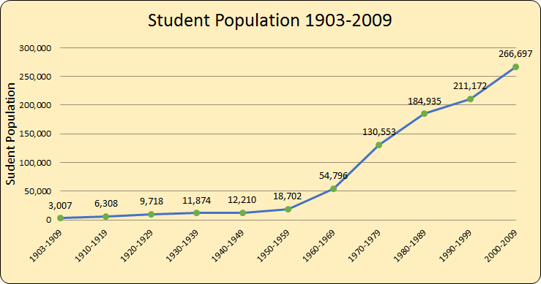
Student Population 1903-2009

Slide 10
Land Acquisition 1903-2009

Slide 11
Correlation Analysis
Pearson’s R of 0.98

Slide 12
Further Research and Project Expansion
Aquarena Springs and Meadow Center
The Aquarena Springs area could be further examined as it has a history of being one of the oldest continuously occupied areas in North America. This area also has relatively recent history of being used as a theme park.
Sewell Park
The area of the San Marcos River that flows through Sewell Park was channeled and deviated from the original location to the current location. Further research could be done to show a spatial representation of the original water flow along with historical information about the park itself.

Slide 13
Further Research and Project Expansion
• Individual Building’s History
Users of the story map may find the history of certain buildings interesting.
• Buildings built after 2010
The shapefiles we were given do not include many buildings built after 2010.
•Building Footprints
The purpose of these building footprints will show the changing locations of building construction through time and increase the visualization of campus change.

Slide 14
Further Research and Project Expansion
Geofencing and Smartphone Voice Campus Tour Application
A voice smartphone application of geofenced buildings would enhance the campus touring experience, and allow Texas State University to conduct campus tours at any time without the need for guides.
Statistical Analysis
A continued analysis of Texas State University student population and land acquisition with a complete up to date data set should be considered.

Slide 15
Conclusions/Summary
Nmotion has produced a series of deliverables that tell the story of Texas State University through spatial data
Time enabled video
Interactive web map
Conducted statistical analysis that links student population with the university’s land acquisition
Created the basis for future research projects that can be used by researchers and students to be better understand Texas State University

Slide 16
QUESTIONS?
Project Manager:
Christian T. Hartnett MSc, RPA, GISP
GIS Analysts:
Corby Schaub
Dylan Epley
Johnnie German

