Slide 1
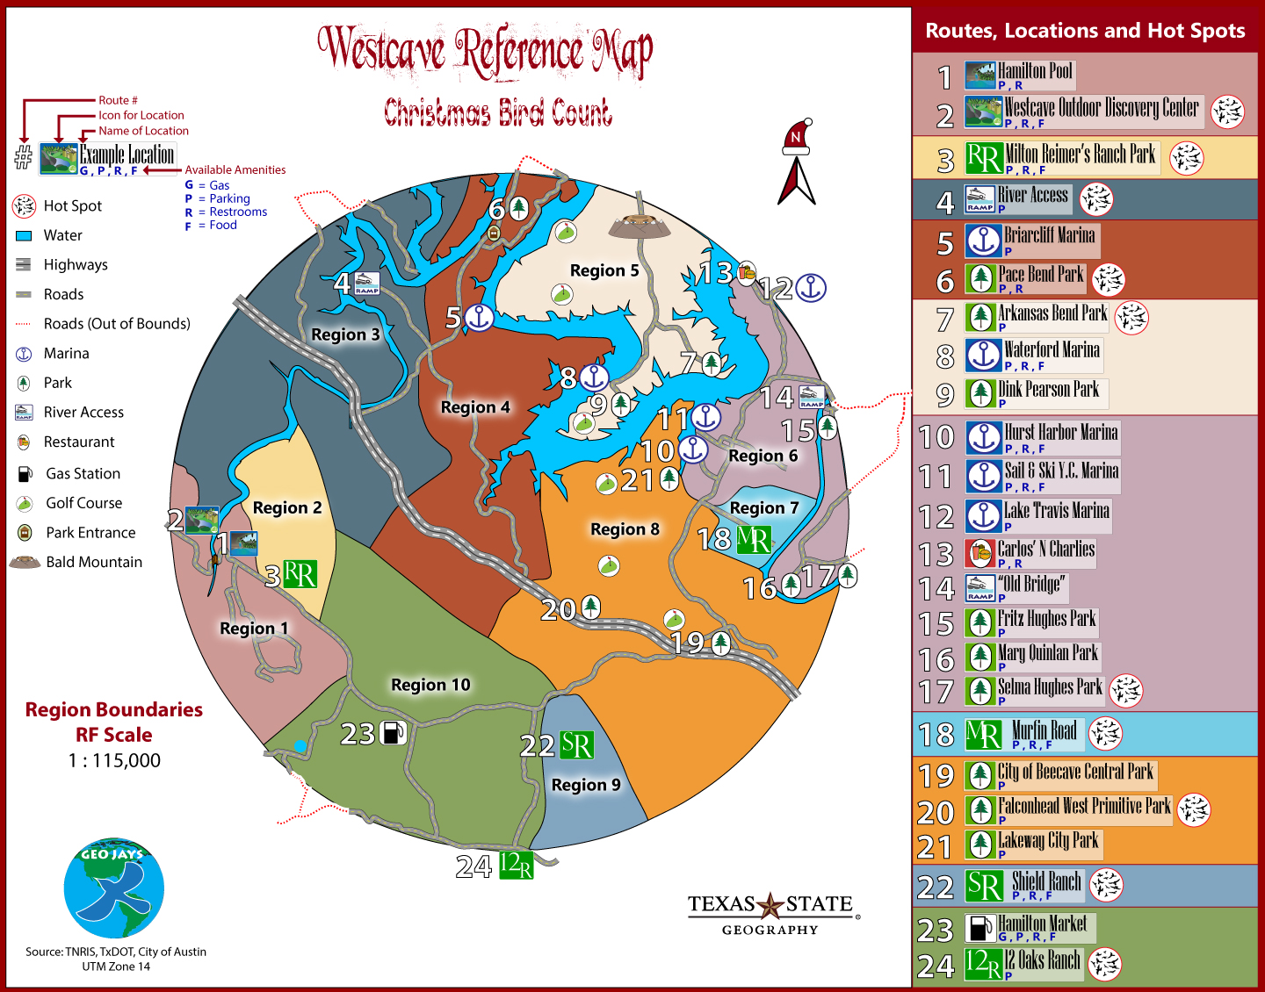
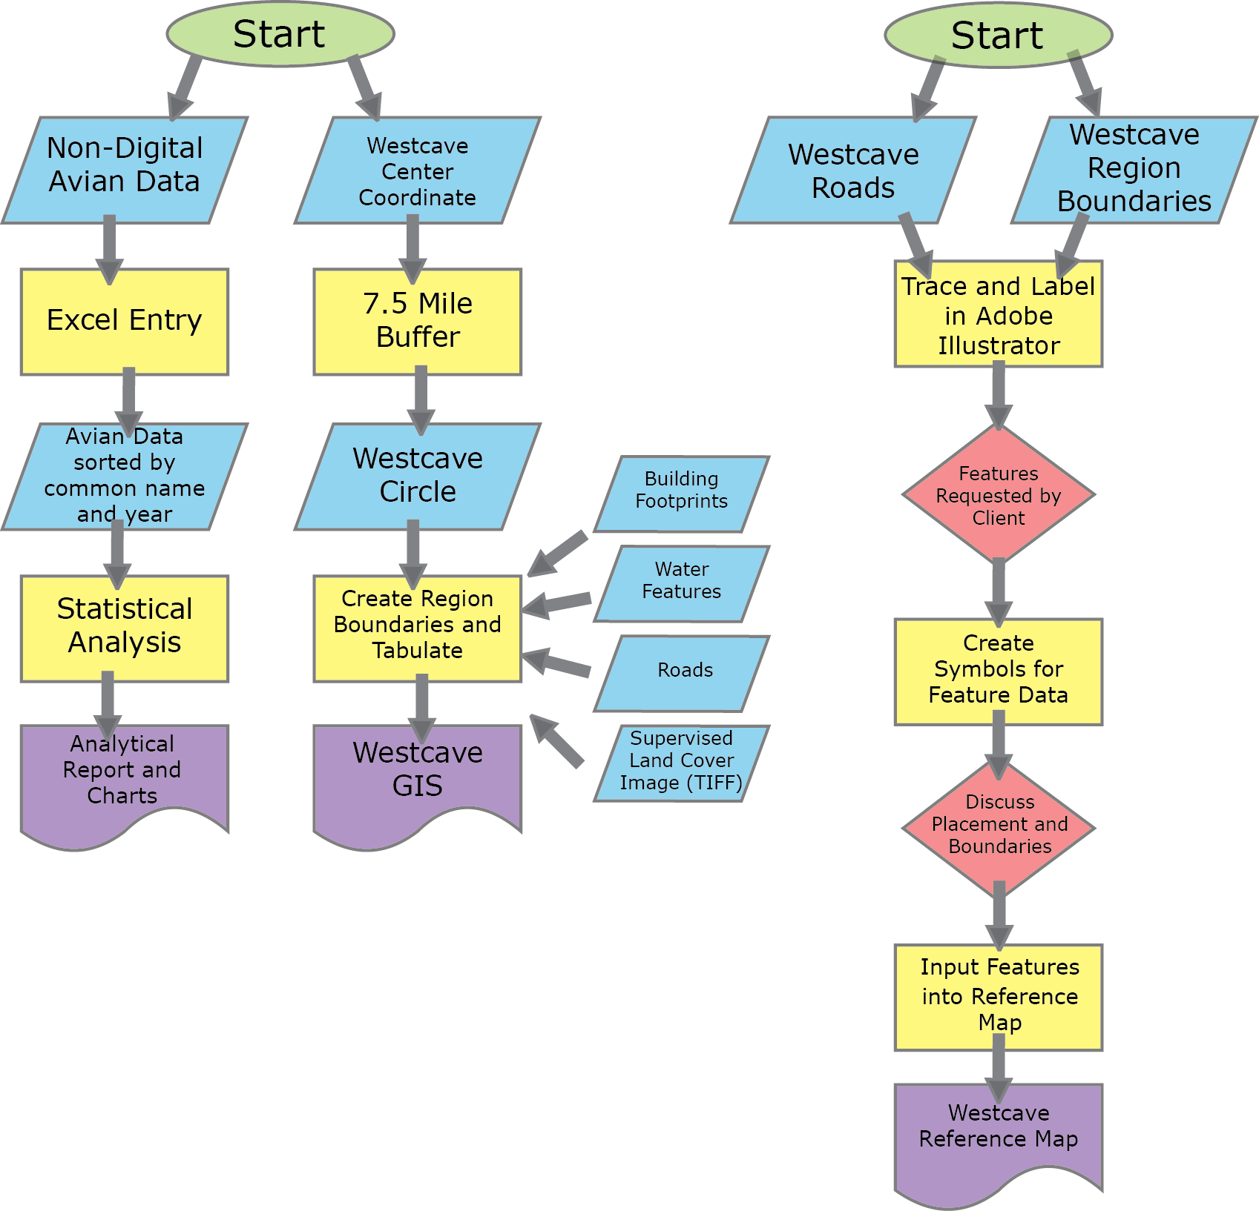
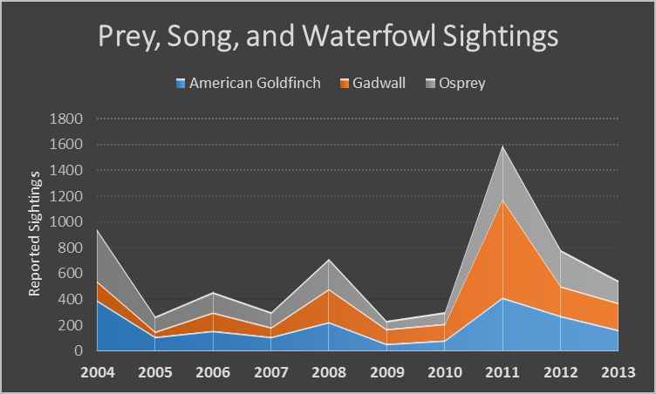
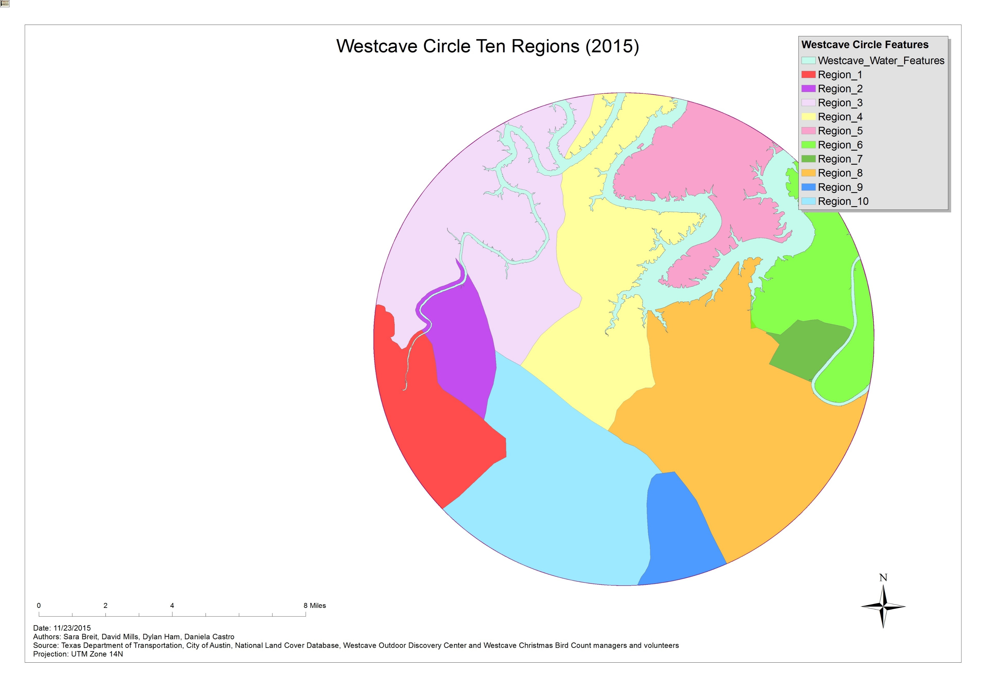
Mapping Avian data for Westcave Circle Christmas Bird Count
Background
The Christmas Bird Count (CBC) has been a tradition for birders with the Audubon Society for almost 110 years. It is a chance for the scientific community to team with volunteers to acquire information on the prevalence of bird species and populations in various regions. Birds are an important indicator species to a whole slew of human-environmental factors such as habitat fragmentation, food or water shortage, and pollution levels.
Methodology
Summary
The GeoJays have the opportunity to add a spatial dimension to this data using Geographic Information Systems (GIS) to assist the volunteers in finding their way around Westcave CBC. Our group has focused on providing a detailed reference maps that will help the volunteers find the nearest natural areas and features that will provide optimal bird sightings and count opportunity. Also, we will set the framework for statistical analysis for bird count data.
Results
There is no linear regression pattern of increasing or decreasing numbers, however when we sort the avian species into categories of Songbirds, Birds of Prey, and Waterfowl, there are peaks and declines during certain years.
Above: Westcave Reference Map. Created in Adobe Illustrator.
Below: Westcave Circle Ten Regions. Bottom Left: avian species attribute data in ArcMap.
Objectives and Tasks
The following are tasks we perform in this study:
Process avian sighting data comprehensively and according to region
Regional Boundary delineation
Coordination with client for additional map elements, hot spots, and details
Post-processing reference map features in reference map and GIS
Statistical summarization on avian species data
Discussion and Conclusion
We hope to see CBC participants using GPS units as a tool for marking the areas where uncommon or rare birds have been sighted or where a significant amount of birds are being seen, in the near future. Adding a spatial dimension to bird counts will create more complex datasets, but will also aid interested parties in seeing patterns of movement, inequalities in resource abundance or scarcity, and will be useful for extrapolation and prediction of where the most avian sightings will occur in later CBC events. The GeoJays have laid a framework for future in-depth analyses of statistical patterns, and for additional features such as hotspots and trails to be incorporated into the reference map at a later date.
Authors: Sara Breit, David Mills, Dylan Ham, Daniela Castro GEO 4427 Fall 2015
11/30/2015
Sources:
National Land Cover Database, Texas Department of Transportation, City of Austin, National Audubon Society, and the Christmas Bird Count managers and volunteers of Westcave Circle

