Slide 1
San Marcos Municipal Airport Airspace Planning Project
Prepared for:
Texas Department of Transportation

Slide 2
Our Team
Jason Ford: Project Manager / GIS Analyst
Patricia Michel: GIS Analyst
Grayson Jones: GIS Analyst
Casey Carpenter: GIS Analyst

Slide 3
Contents
Introduction
Background
Purpose
Scope
Literature Review
Data and Software
Methodology
Implications
Budget
Timetable
Conclusion
Questions

Slide 4
1984 San Marcos Airport Hazard Zoning Map

Slide 5
Background
Last hazard zoning map created in 1984
Increased growth and development
Increased airport usage
Regulations required to preserve airspace

Slide 6
Purpose
To assist San Marcos enact hazard zoning regulations
Two primary goals
Create 3D imaginary surfaces and hazard zoning map
Create interactive screening tool

Slide 7
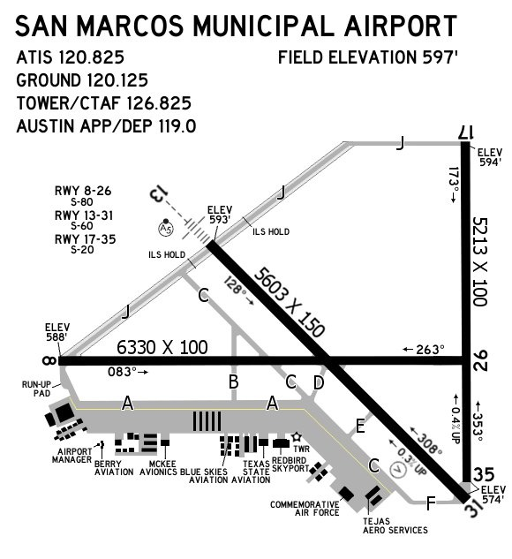
Scope
Geographic extent is centered on the San Marcos Municipal Airport
Extent is concerned with both ground and airspace of the surrounding areas

Slide 8
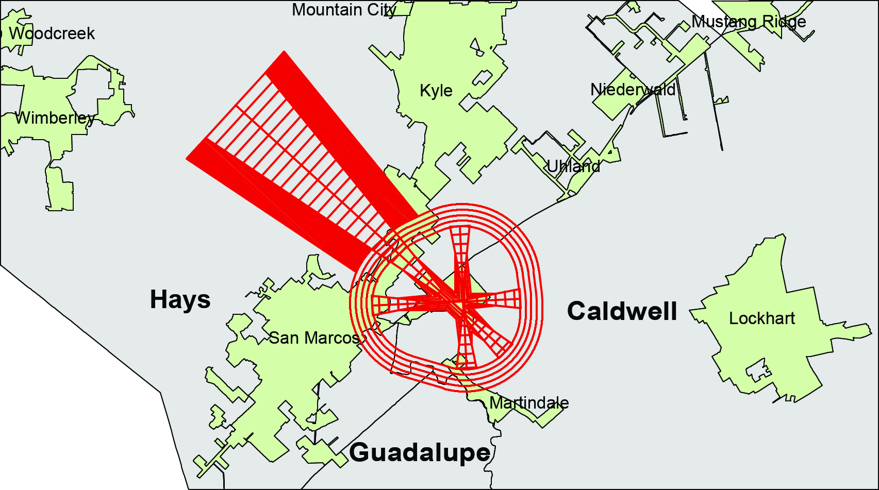
Scope cont.

Slide 9
Literature Review
Past projects conducted for the New Braunfels Airport and San Marcos Airport
Title 14, Code of Federal Regulations, Part 77 - Safe, Efficient Use, and Preservation of the Navigable Airspace
Texas local government code Title 7 Subtitle C Chapter 241 – Municipal and County Zoning Authority around Airports
Airport Cooperative Research Program (ACRP) Report 38 – Understanding Airspace, Objects, and their effects on Airports

Slide 10
Data
14 CFR 77 (e-Code of Federal Regulations)
DEM or NED (USGS)
Shapefiles for San Marcos Facilities (TxDOT)
Obstruction Point Data (TxDOT)
3D imaginary surfaces (produced in-house)
World Street Map (ESRI – reference only)
County Boundaries (TNRIS – reference only)

Slide 11
Software
ArcScene and/or Google SketchUp
ArcGIS (for analysis and map creation)
Manifold (for web development)

Slide 12
Analysis/Methodology:
Interactive Map content
Create an interactive map tool to be used by the City of San Marcos.
We will create 3D imaginary surfaces
Compare them with elevation models
Determine highest allowable building heights within each imaginary surface zone…

Slide 13
Interactive Map content continued…
Our interactive map will contain a continuous layer of allowable heights even for areas where multiple zones overlap
Allow users to select any location on the map to find accurate maximum building height for that individual location.

Slide 14
Obstructions Analysis:
Identify obstacles penetrating imaginary surfaces
Import obstruction point data and assign it appropriate elevation values (based on ground elevation and height of obstruction)
Compare obstruction elevation with elevation at same location on imaginary surface to determine if the obstruction is penetrating the surface and by how much

Slide 15
Implications
Establish a new 2013 hazard-zoning map
Minimize encroachment
Possibility of increased economic traffic
Automated screening tool
Allowable heights
Obstructions penetrating through airspace

Slide 16
Budget
Service Costs
Data Collection and Processing
$2,415
Data Analysis
$2,415
Web Development
$1,620
Map Development
$1,560

Slide 17
Budget cont.
Equipment and Software Costs
Data Interpretation
$1,575
System Management
$1,600
Equipment Costs
$1,955.56
Software Costs
$2,050
Total $15,190.56

Slide 18
Timetable
Oct
Nov
Dec
7 Oct
21 Oct
11 Nov
2 Dec
Start 30 Sep
Complete 6 Dec
Data Collection and Processing ( 3 weeks )
Data Analysis ( 3 weeks )
Web and Map Development ( 3 weeks )
Data Interpretation ( 1 week )

Slide 19
Final Deliverables
Automated screening tool
Updated airport zoning map
Final report
Poster
Power point presentation
Metadata

Slide 20
Conclusion
San Marcos and surrounding areas are rapidly growing
We will provide tools to help plan and enact regulations
We will deliver
Interactive screening tool
Updated airport hazard zoning map

Slide 21
Questions?

