Slide 1
San Marcos Municipal Airport Airspace Planning Project
Prepared for:
Texas Department of Transportation

Slide 2
Our Team
Jason Ford: Project Manager / GIS Analyst
Patricia Michel: GIS Analyst
Grayson Jones: GIS Analyst
Casey Carpenter: GIS Analyst

Slide 3
Contents
Introduction
Purpose
Scope
Project Tasks
Task 1
Task 2
Task 3
Issues
Revised Timeline
Appendix: Figures
Questions

Slide 4
Introduction
Project Start Date: September 30, 2013
Reminder of this planning study’s purpose and scope
Detailed information about the progress of this planning study
Work completed, work in progress, work planned
Revised task list that breaks down the original tasks for more information
Revised timeline

Slide 5
Purpose
Goal: Provide the city of San Marcos with the tools and information required to enact zoning regulations that will protect and preserve the air space surrounding the San Marcos Municipal Airport.
Task 1: To create an updated hazard-zone map for the San Marcos Municipal Airport
Task 2: Create specialized GIS layers and 3D visualization reference imagery
Task 3: Develop a user-friendly interactive screening tool using Manifold that can identify maximum allowable heights and current penetrations in imaginary surfaces.

Slide 6
Scope
Geographic extent is centered on the San Marcos Municipal Airport
Reference point is 29°53’34” N 97°51’47”
Operational runways are 8/26, 13/31, and 17/35
Planning study extent is concerned with both ground and airspace of the surrounding areas
Primarily concerned with all areas that fall within the zones that are created by the imaginary surfaces
Also concerned with areas surrounding the zones created by the imaginary surfaces in reference to any future regulation
Cities that may be affected or fall into the scope of this study are San Marcos, Martindale, Kyle, Wimberley, and Lockhart

Slide 7
Task 1: Updated Hazard-Zone Map
Create an updated hazard-zone map for San Marcos Municipal Airport.
Work Completed:
Data collection completed for all tasks
County, City, Street, Digital Elevation Models, National Flight Data Survey, and GIS Survey Data
Imaginary surfaces created in ArcMap and ArcScene (viewable in both 2D and 3D)
Referenced Federal Aviation Administration Code of Federal Regulations 14 part 77 and AutoCAD line data

Slide 8
Task 1 (cont.)
Work in Progress: Design the layout of the final deliverable hazard-zone map and creation

Slide 9
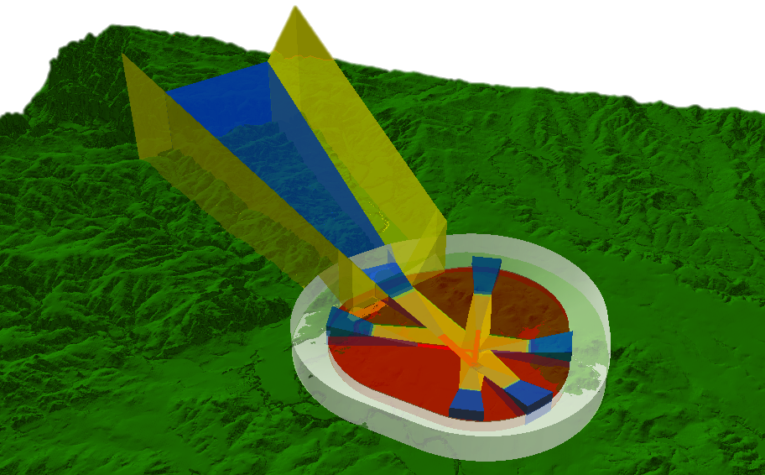
Task 1 (cont.)
Imaginary Surfaces extruded in 3D
10x vertical exaggeration

Slide 10
Task 2: Create specialized GIS layer and 3D Visualization
Work in Progress
Create allowable height raster covering all imaginary surfaces
Develop imaginary surface volumes for imaginary surfaces for 3D visualization purposes

Slide 11
Task 2 (cont.)
Work Scheduled
Create point class feature penetrations within imaginary surfaces
Create point class feature identifying those obstructions in and around the airport hazard zones not penetrating imaginary surfaces

Slide 12
Lowest Elevations of Imaginary Surfaces
10x vertical exaggeration

Slide 13
Imaginary Surface Volumes
Primary and Transitional Surfaces
Horizontal and Conical Surfaces
10x vertical exaggeration

Slide 14
Imaginary Surface Volumes (cont.)
Approach Surfaces
10x vertical exaggeration

Slide 15
Task 3: Interactive Mapping Tool
Work Planned:
Decide the layout of the interactive screening tool. This will include design decisions regarding cartographic properties like color schemes, legend, scale, and labeling.
Determine which layers will be included in the interactive screening tool. Layers will be included based on their significance to the overall goal.
Determine overall tool functionality. This will include deciding how queries are made, zoom extent and functionality, layer transparency, and how layers will be toggled on and off.
Determine the method of displaying user queried information and error messages for invalid queries.

Slide 16
Issues

Slide 17
Issues
Proper shape after Merge,
Union and conversion
to Multipatch
Surfaces are intersecting
and passing through each other

Slide 18
Issues
noticeable vertical walls and
plateaus instead of a consistent slope
Proper slope after converting to TIN

Slide 19
Timetable
Oct
Nov
Dec
4 Nov
25 Nov
2 Dec
Start 30 Sep
Complete 9 Dec
Data Analysis ( 3 weeks )
Web and Map Development ( 3 weeks )
Data Interpretation ( 1 weeks )
Contingency ( 1 week )

Slide 20
Conclusion
Ahead of schedule!
Work to be completed: Specialized GIS layers, configuring 3-D visualization, and developing our interactive mapping tool.
Confident to meet our deadline on December 9, 2013.

Slide 21
Questions?

