Slide 1
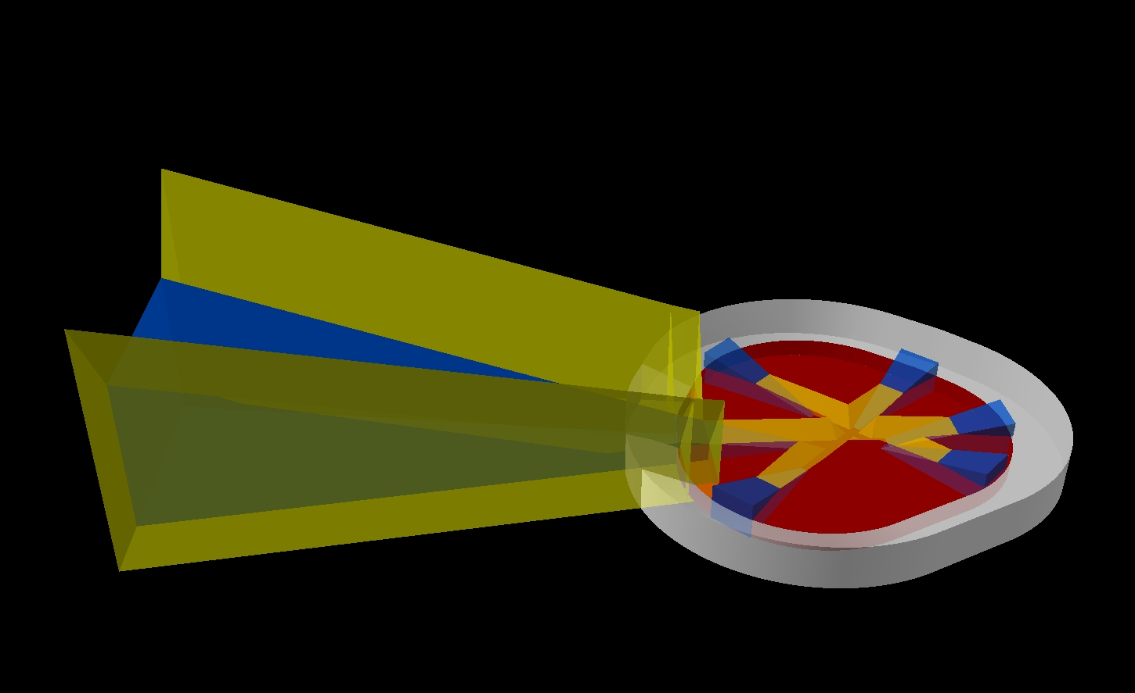
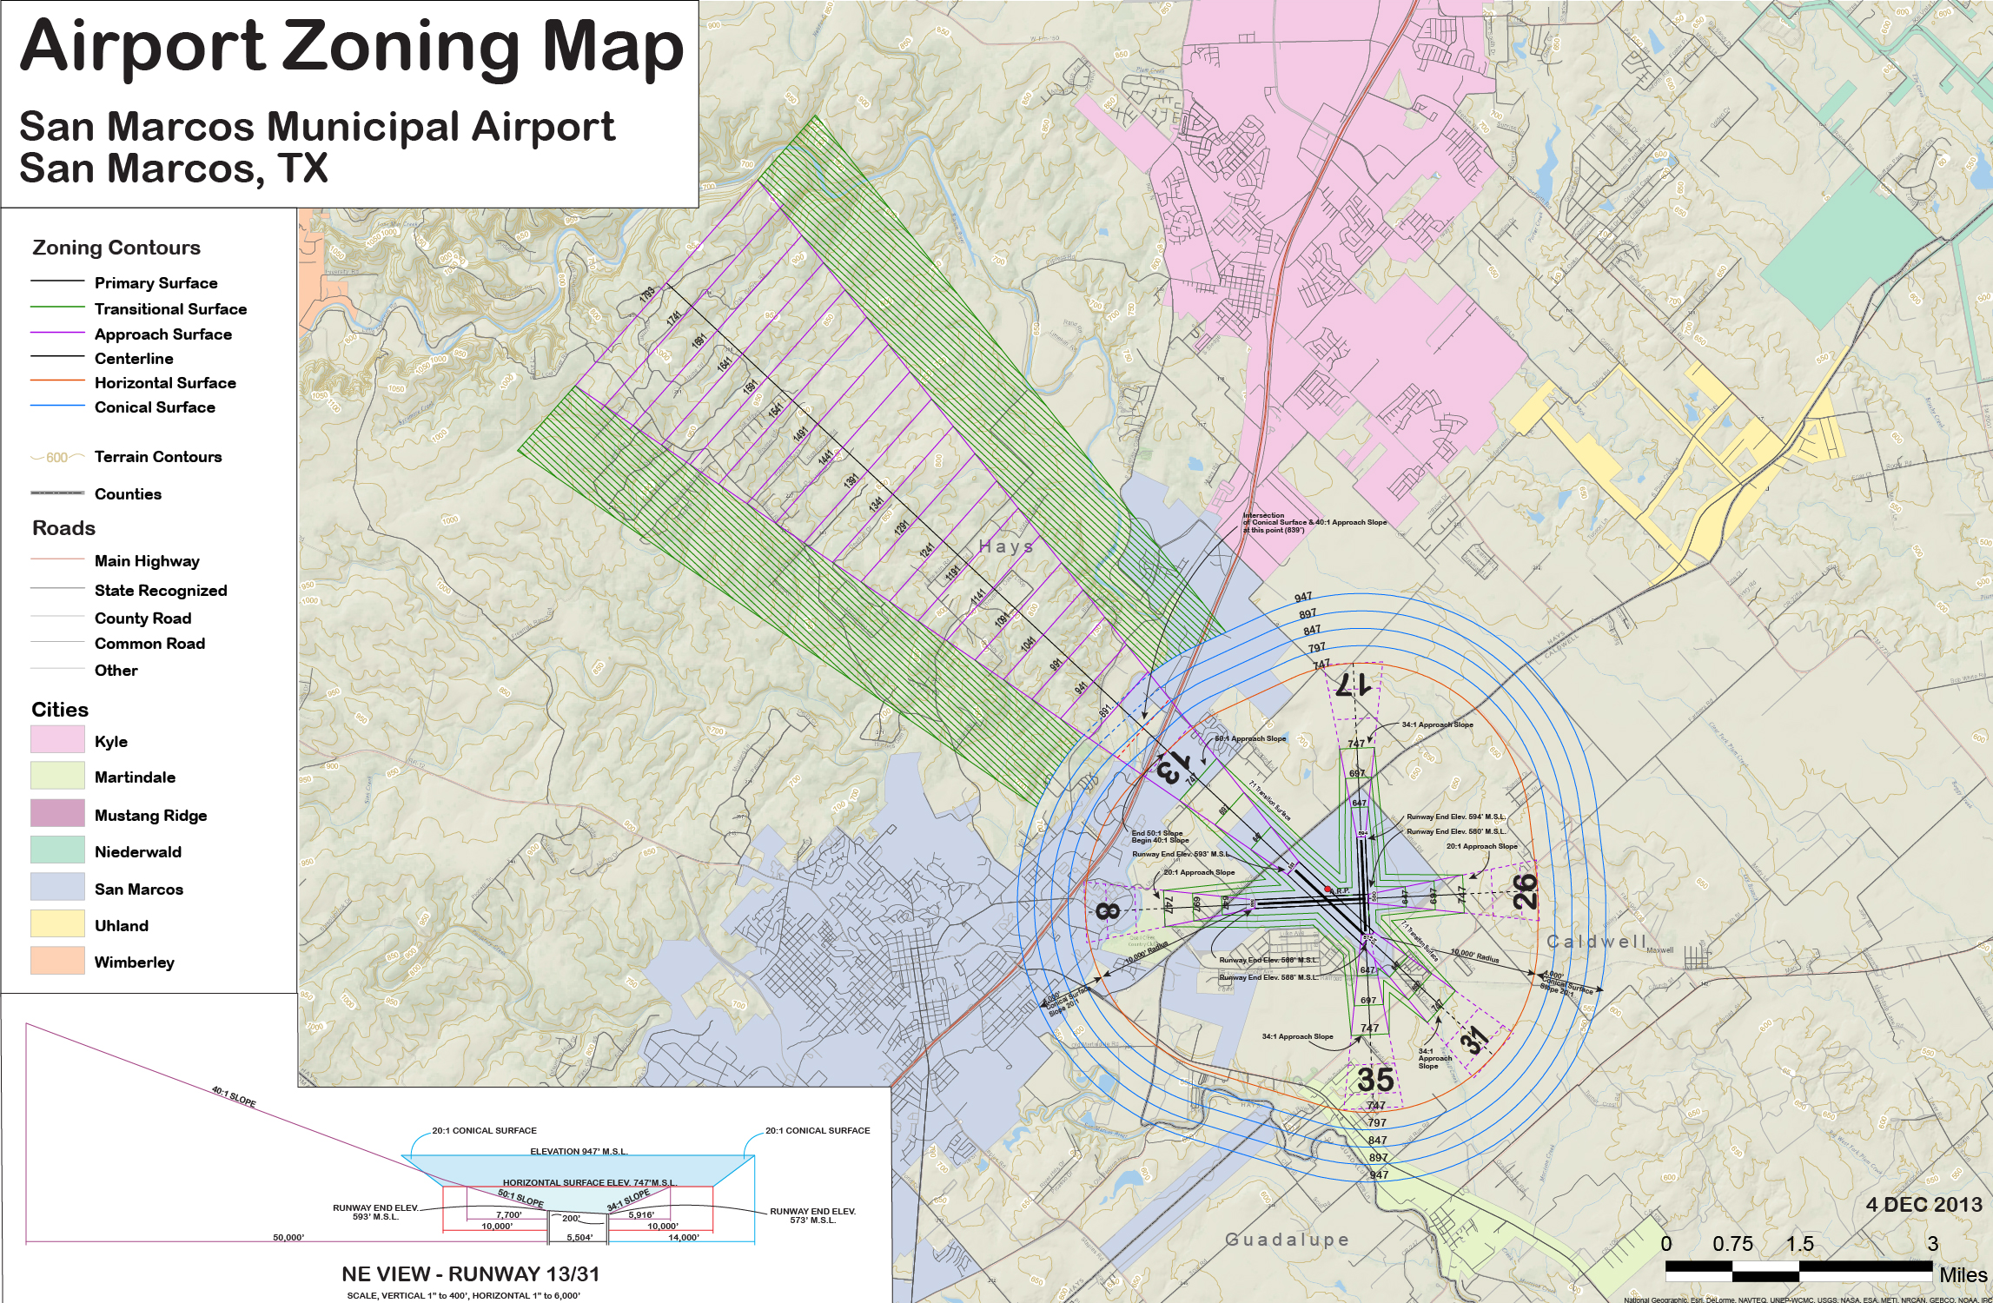
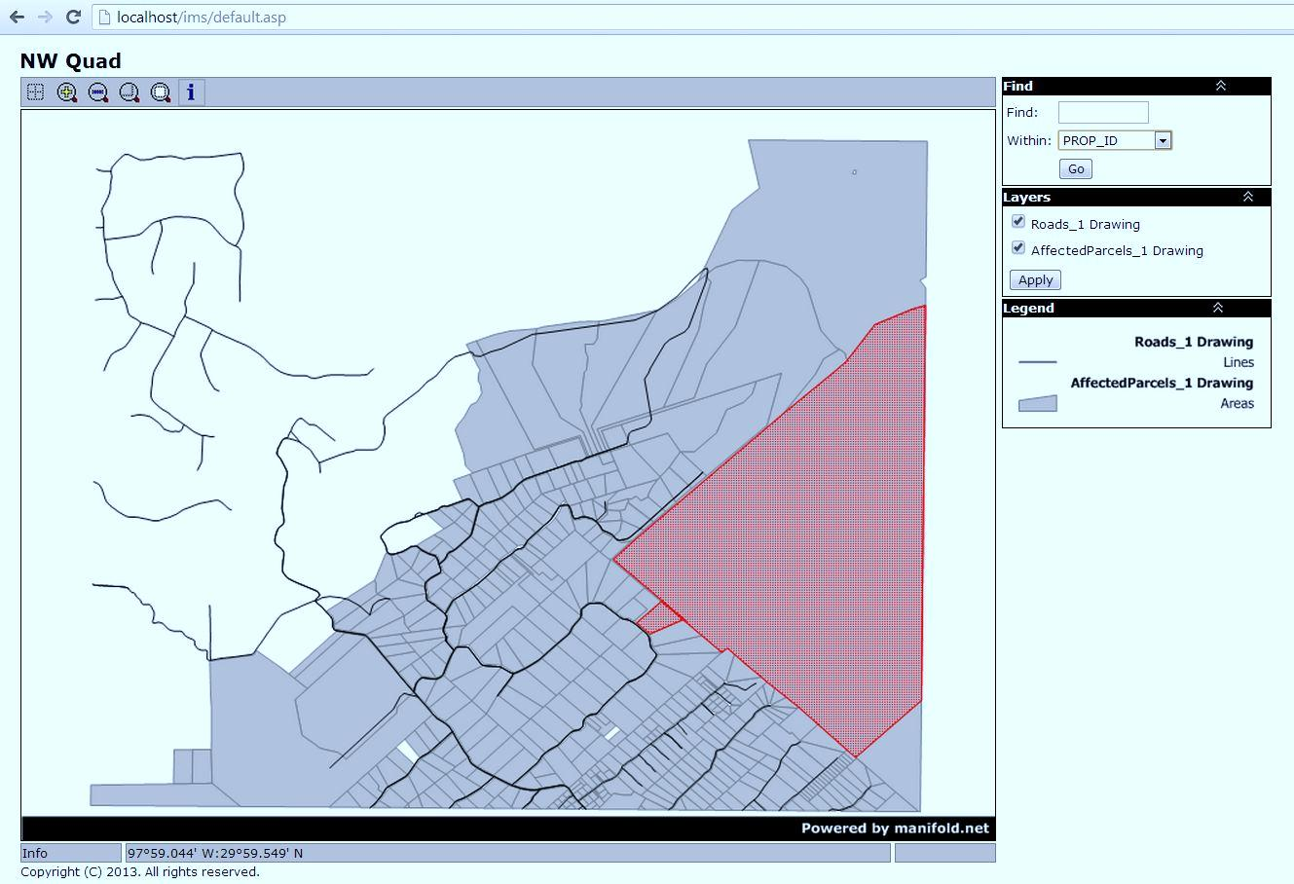
San Marcos Municipal Airport Airspace Planning Project
Texas State University Geography – GIS Design and Implementation
Specialized GIS Layers
Hazard Zoning Map
Purpose
Provide the city of San Marcos with the tools and information required to adopt zoning regulations that will protect and preserve the air space surrounding the San Marcos Municipal Airport and ensure its growth.
Task 1: Create specialized GIS layers
Task 2: Develop a user-friendly interactive screening tool using Manifold that can identify maximum allowable heights and current penetrations in imaginary surfaces
Task 3: Create an updated hazard-zoning map for the San Marcos Municipal Airport
Imaginary Surface Polygons Methodology: To create our maximum allowable height raster we began by creating polygon representing each imaginary surface based on imported CAD files. We edited the vertices of each polygon to have Z values equal to that surfaces height and slope.
Interactive Tool
Includes:
Base Layer from National Geographic
Terrain Contours
Counties
Cities
Roads
Created:
Specialized GIS Zoning Layers
50’ Zoning Contours
Developed user friendly symbology and annotations
Interactive Tool Features:
Includes county boundaries, city boundaries, and county parcels, penetrating obstacles, and the imaginary surfaces
Users will be able to zoom in and out, query, toggle layers (on/off)
Ability to identify the maximum allowable height within the imaginary surfaces
Pop-up windows can display data such as elevation, latitude, and longitude for penetrations
Users will be able to query parcels in the regulated airspace in order to find out if they fall within the hazard zones as well as the maximum and minimum allowable heights for parcels within the zones
Conclusion
Example of Parcel Query from Interactive Tool
The specialized GIS layers created can be used by TxDOT and the City of San Marcos for future projects.
The interactive tool allows the general public to view their parcel and see if it is affected by regulated airspaces. This tool will aide the City if San Marcos in drafting zoning regulations to prevent new buildings or other obstructions from penetrating the regulated airspace.
Updated a draft map to a digital hazard zoning map with current active runways and surrounding regulated airspace. An electronic version will support future updates as the needs of San Marcos grows.
Maximum Allowable Height Raster Methodology:
Polygons to Triangulated Irregular Network to interpolate elevation values for entire regulated airspace
Converted TIN layers to raster format
Combined raster layers into one layer that contains the lowest elevation
Calculated the difference between lowest elevation layer and ground elevation layer
Each cell value in this raster represents the height (in feet) from the ground to the lowest civil airport imaginary surface.
Data Sources & Acknowledgements
Acknowledgements: Mr. Daniel Benson, Texas Department of Transportation, Dr. Yongmei Lu, and Ryan Schuermann
Our Team: Jason Ford, Patricia Michel, Grayson Jones, and Casey Carpenter
Data Sources: Federal Aviation Administration Code of Federal Regulation Title 14 Part 77, TNRIS, Texas Department of Transportation, City Of San Marcos, Geo-Air Consulting

