Slide 1
San Marcos Municipal Airport Airspace Planning Project
Prepared for:
Texas Department of Transportation

Slide 2
Our Team
Jason Ford: Project Manager / GIS Analyst
Patricia Michel: GIS Analyst
Grayson Jones: GIS Analyst
Casey Carpenter: GIS Analyst

Slide 3
Contents
Introduction
Background
Purpose
Scope
Literature Review
Data
Methodology/Results
Discussions
Conclusions

Slide 4
Purpose
Goal: Provide the city of San Marcos with the tools and information required to adopt zoning regulations that will protect and preserve the air space surrounding the San Marcos Municipal Airport and ensure its growth.

Slide 5
Considerations
Previously adopted hazard zoning map created in 1984
Increased growth and development in the surround cities and counties require updated planning tools
Airports are important for business, aviation education, and travel.
Regulations help preserve airspace and ensure sufficient room for growth

Slide 6
Project Tasks
Task 1: Create an updated hazard-zoning map for the San Marcos Municipal Airport
Task 2: Create specialized GIS layers
Task 3: Develop a user-friendly interactive mapping tool using Manifold that can identify maximum allowable heights and current penetrations in imaginary surfaces.

Slide 7
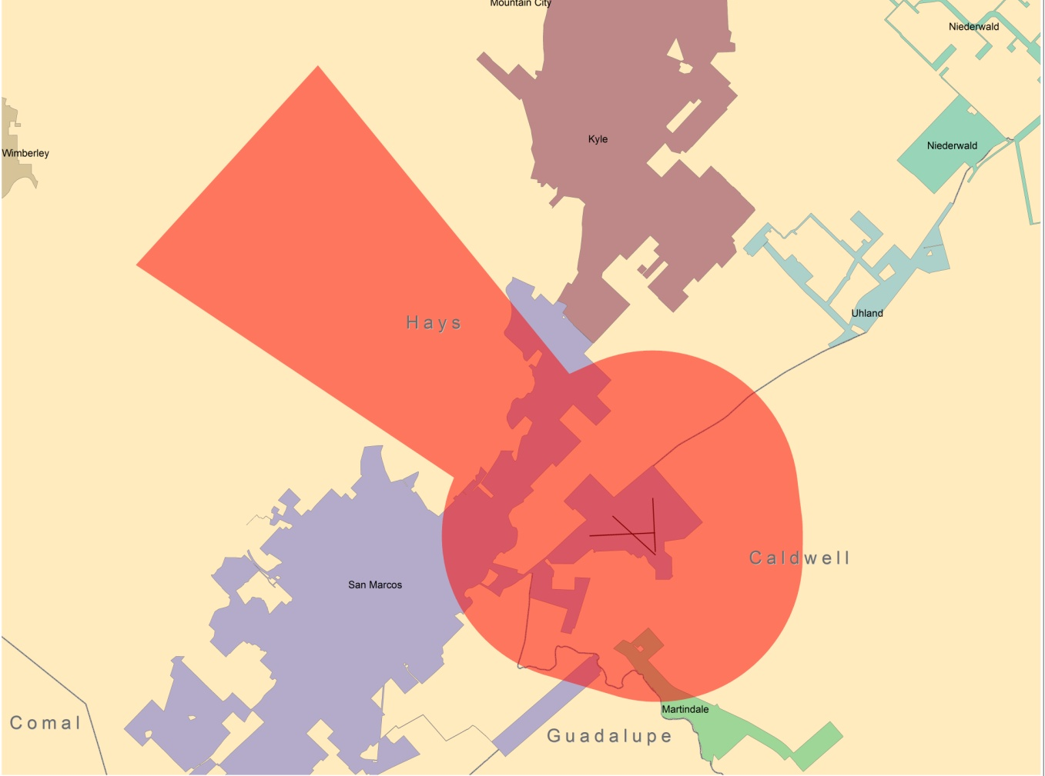
Scope
Focused on the San Marcos Municipal Airport
Operational runways are 8/26, 13/31, and 17/35
Planning study extent is concerned with both ground and airspace of the surrounding areas

Slide 8
Literature Review
Title 14, Code of Federal Regulations, Part 77 - Safe, Efficient Use, and Preservation of the Navigable Airspace
Past projects conducted for the New Braunfels Regional Airport and San Marcos Municipal Airport
Examples of interactive mapping tools (available on the web) from the cities of Houston and New Braunfels focused on airport hazard zoning.

Slide 9
Data- Hazard Zoning Map
TxDOT
- CAD and shapefiles: Mr. Benson provided us with CAD references for the imaginary surfaces and runways.
TNRIS
- Digital Elevation Model, County and City Boundaries, and roads stratmap.

Slide 10
Data- GIS layers and Interactive tool
TNRIS
- Digital Elevation Model to show accurate height
TxDOT
- GIS survey for penetration analysis
Lone Star Geospatial
- Constructed imaginary surface polygons based on F.A.A Title 14 CFR Part 77
City of SanMarcos
- Hays and Caldwell county parcel data
Geo Air Consulting
- Guadalupe county parcel data

Slide 11
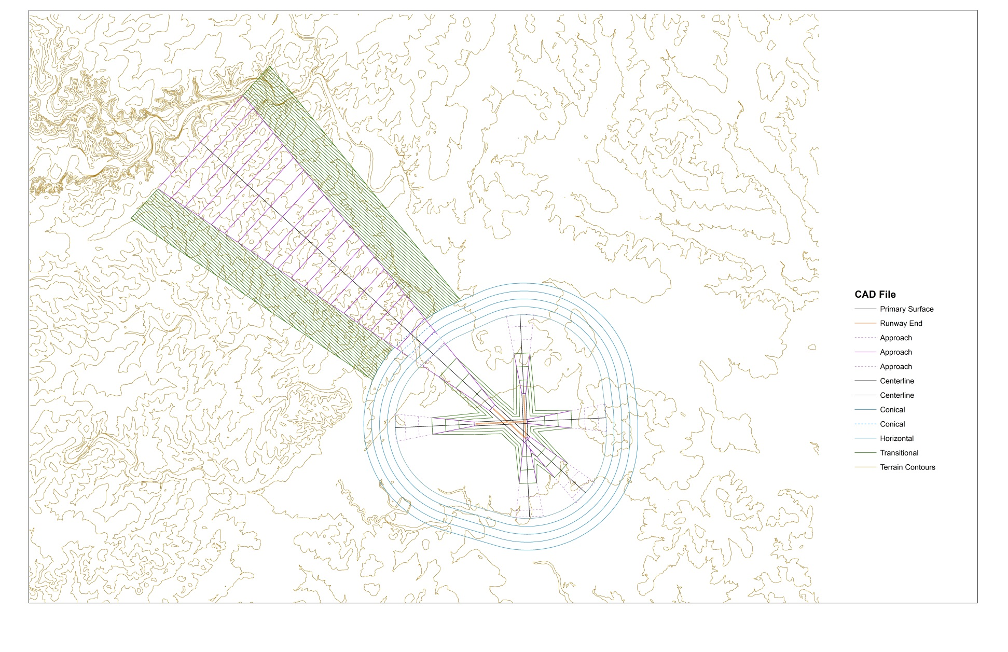
Hazard Zoning Map Creation

Slide 12
Results - Hazard Zoning Map
An updated Airport Hazard Zoning Map that correctly reflects the currently support runways
Clearly labeled civil airport imaginary surfaces
Current county and city political boundaries
Includes terrain and imaginary surface contours for reference

Slide 13
Results - Hazard Zoning Map

Slide 14
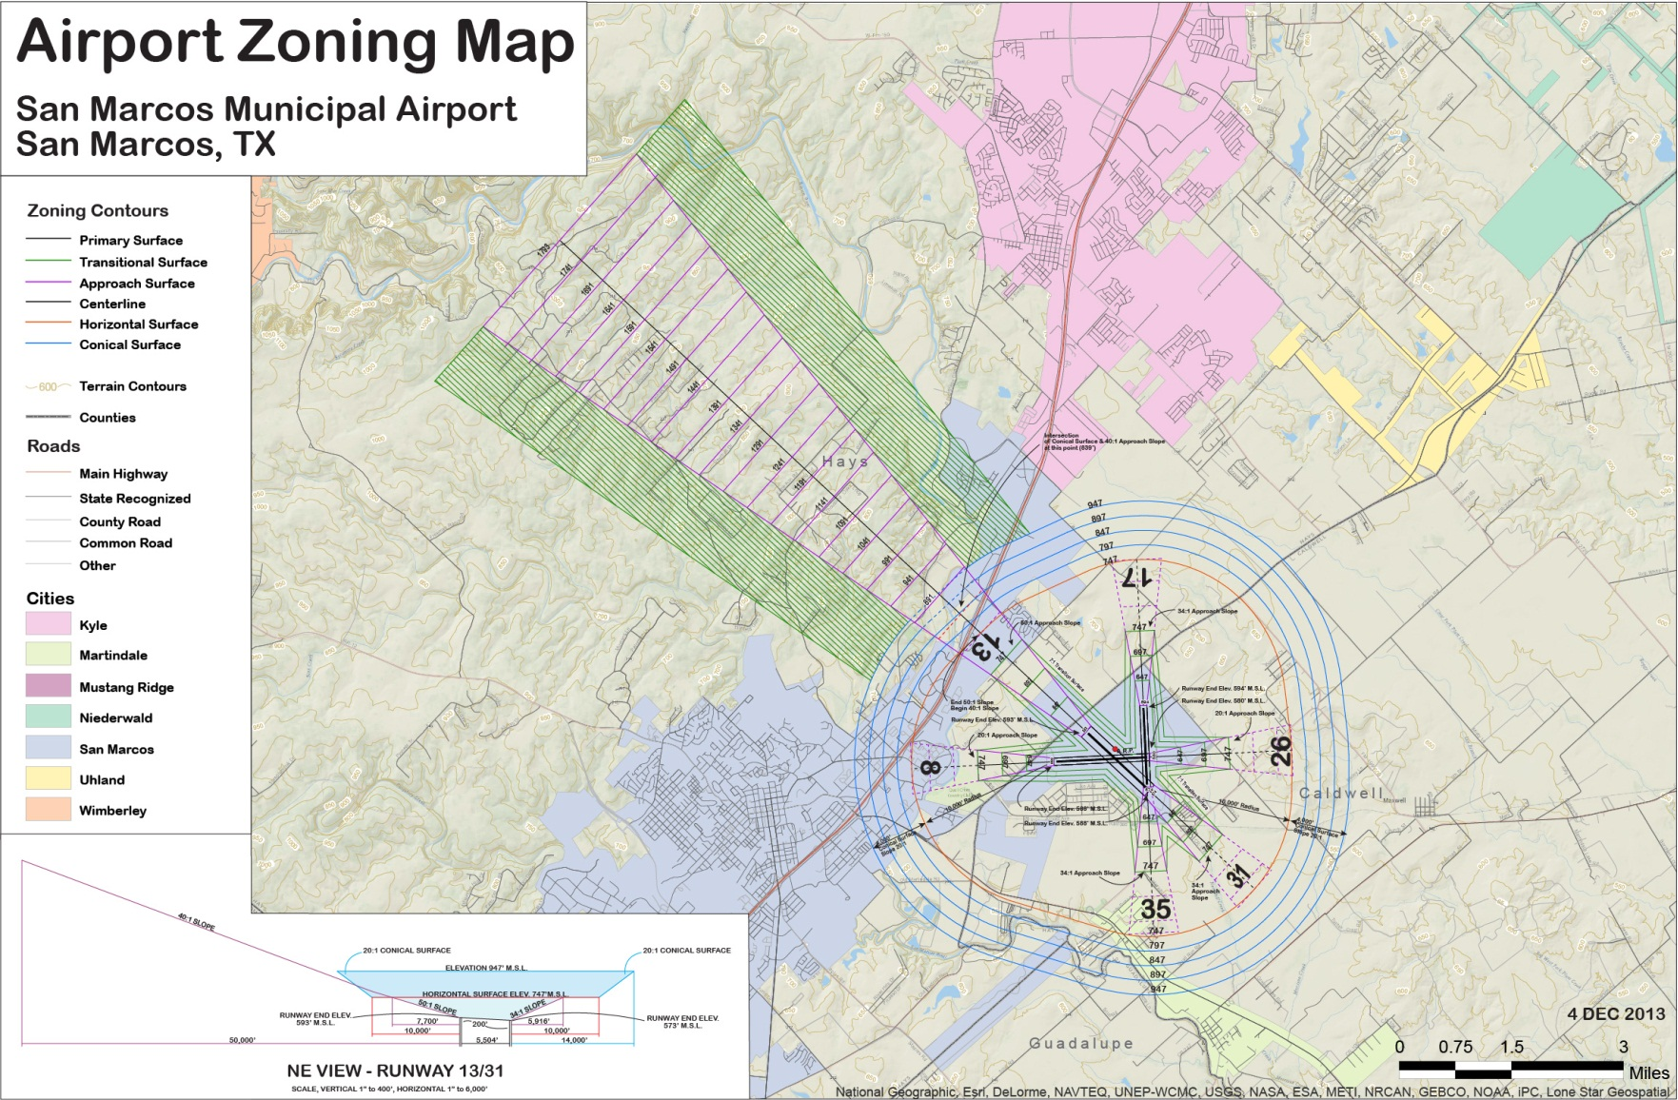
Results - Hazard Zoning Map

Slide 15
Methodology – Maximum Height Analysis Layer

Slide 16
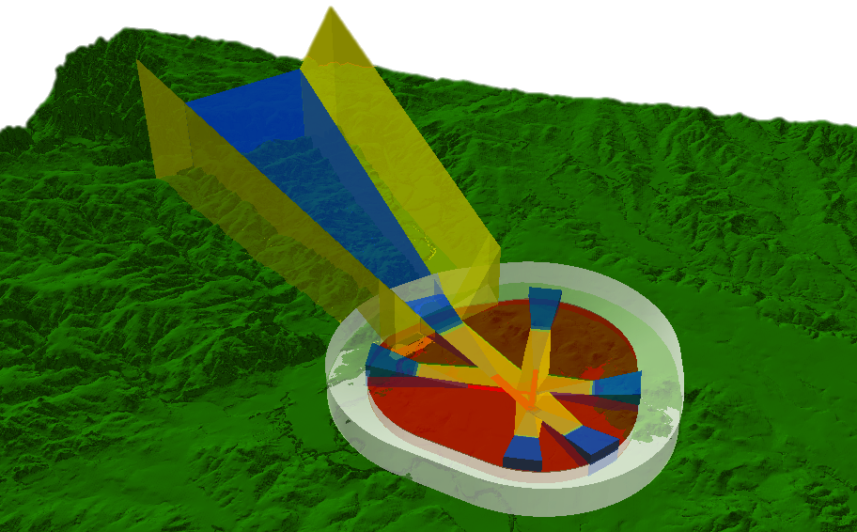
Methodology – Maximum Height Analysis Layer
Imaginary Surfaces Polygons extruded in 3D
10x vertical exaggeration

Slide 17
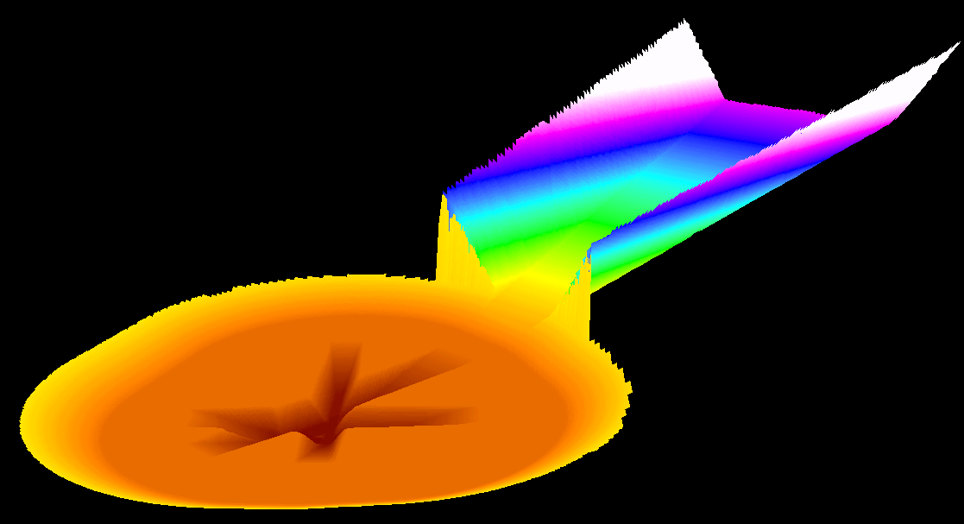
Methodology – Maximum Height Analysis Layer
Raster representing the lowest elevations of imaginary surfaces
10x vertical exaggeration

Slide 18
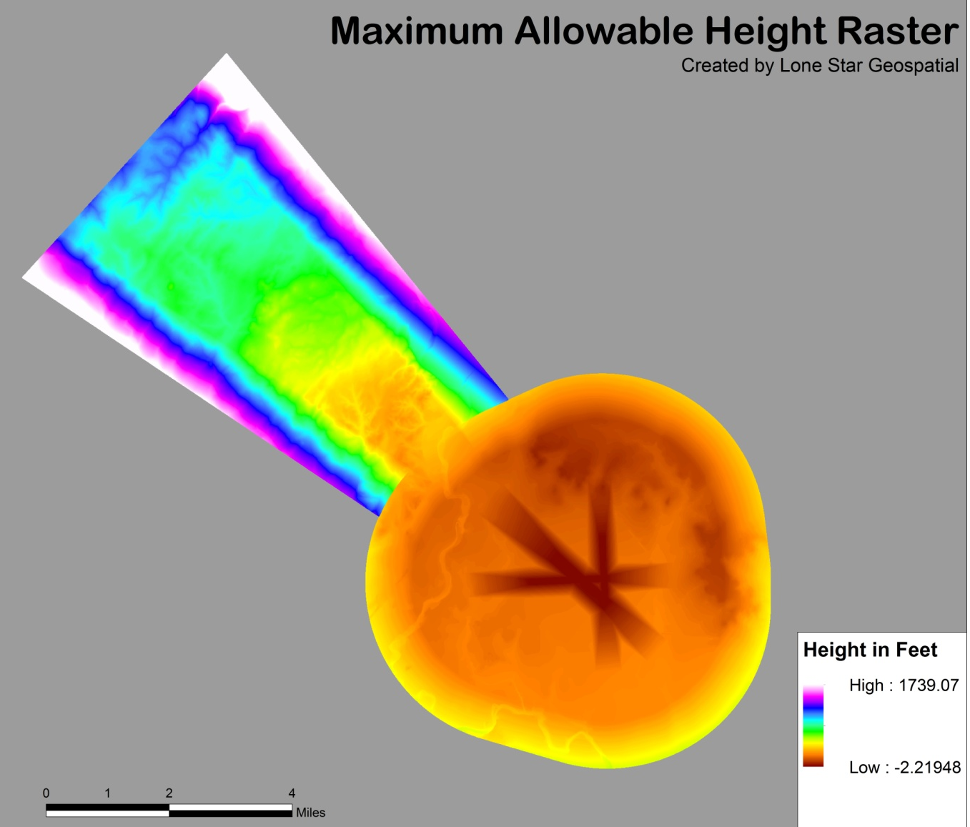
Methodology – Max Height Analysis Layer
Each value in this raster is the maximum allowable height for that cell

Slide 19
Methodology – Max Height Analysis Layer
Converted Maximum Allowable Height Raster to a lattice of point features containing elevation data
Converted lattice point feature to a polygon fishnet which allows users to find maximum allowable height data

Slide 20
Methodology – Max Height Analysis Layer

Slide 21
Methodology – Max Height Analysis Layer

Slide 22
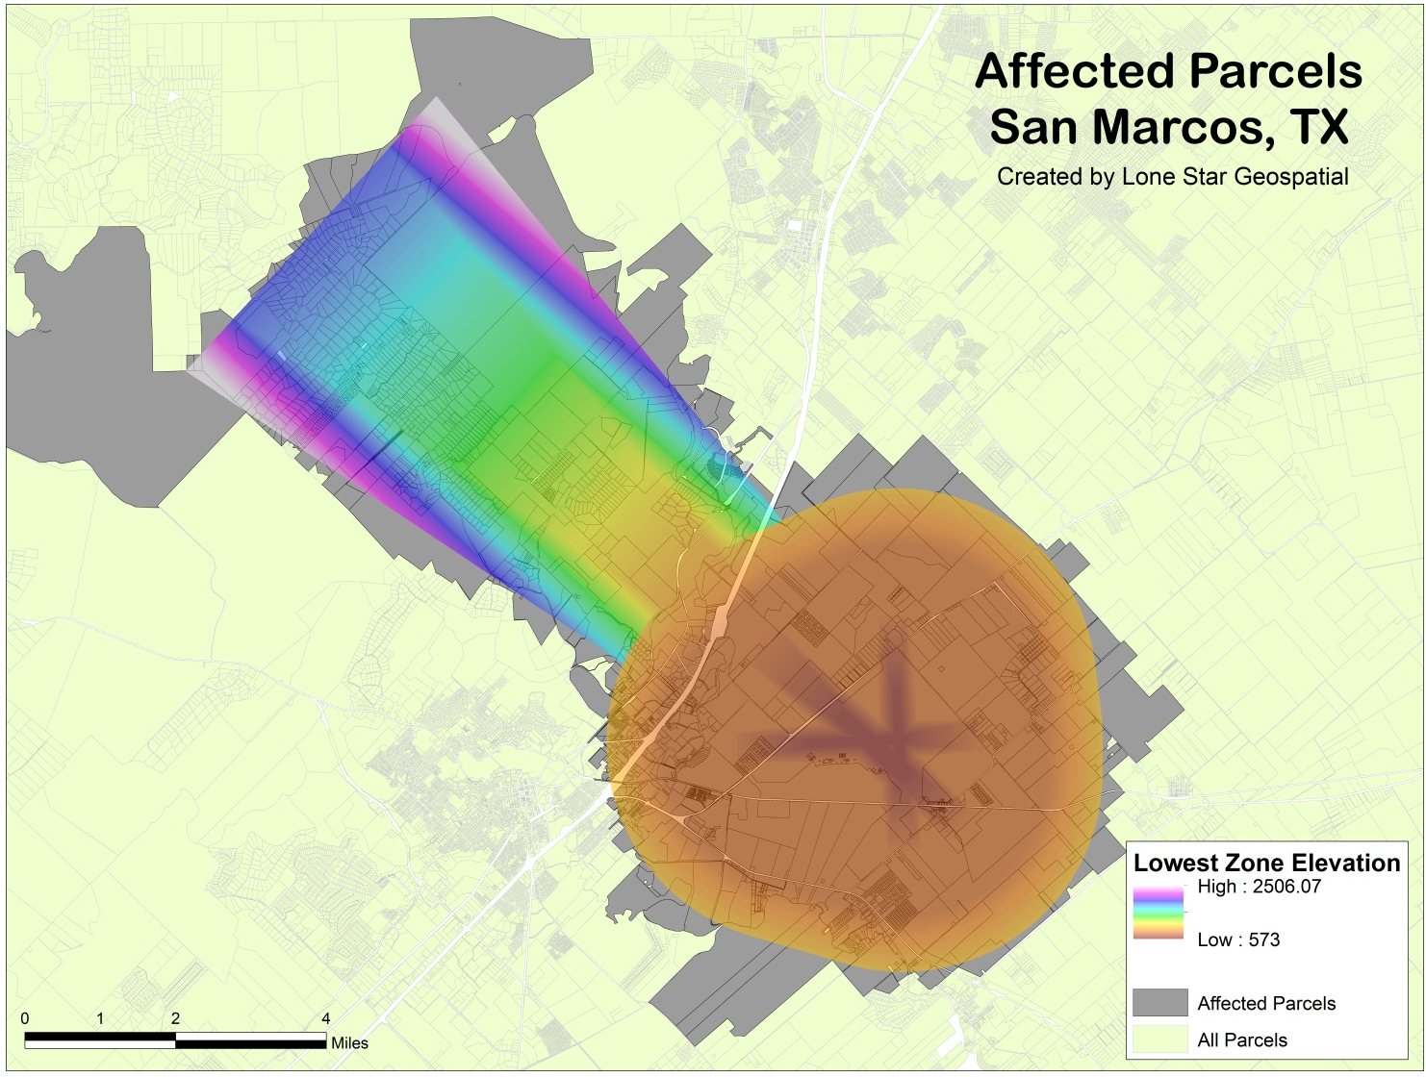
Affected Parcels Layer

Slide 23
Methodology – Penetrations

Slide 24
Methodology – Penetrations

Slide 25
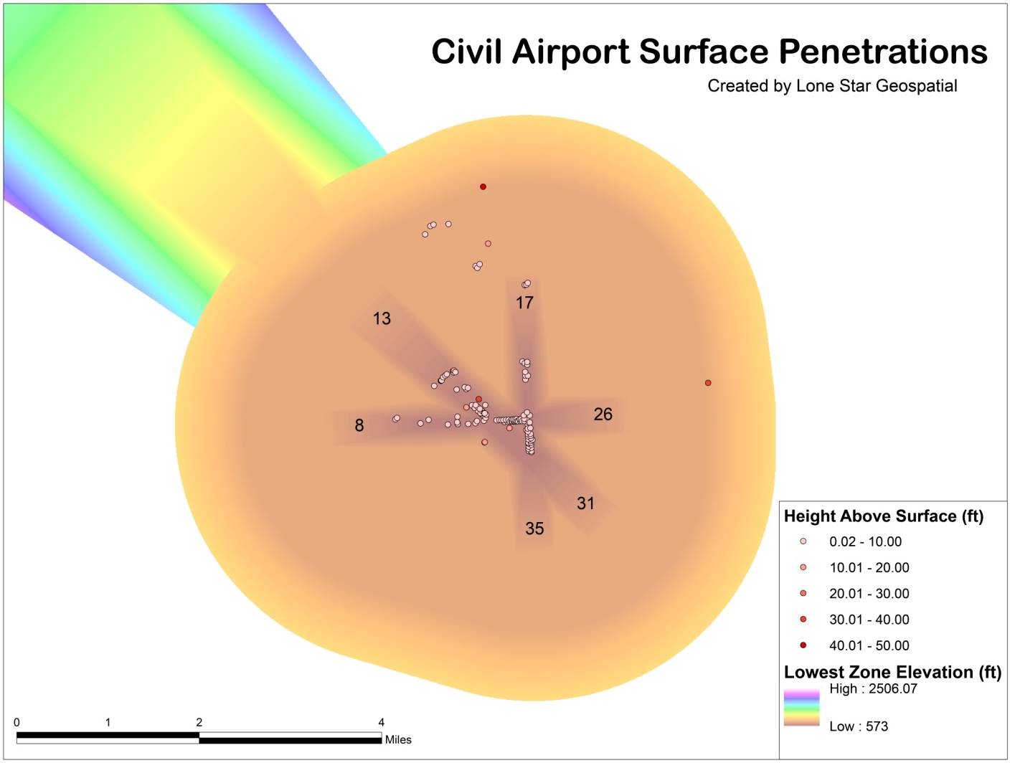
Results – Penetrations
Final layer displays 127 penetrations

Slide 26
Methodology - Interactive Screening Tool

Slide 27
Results - Interactive Screening Tool
Users can identify maximum allowable height within the airport imaginary surfaces
Displays surface penetration information
Users can query their parcels in order to find out if they fall within the hazard zones
Identifies maximum and minimum allowable heights per parcels within the hazard zones

Slide 28
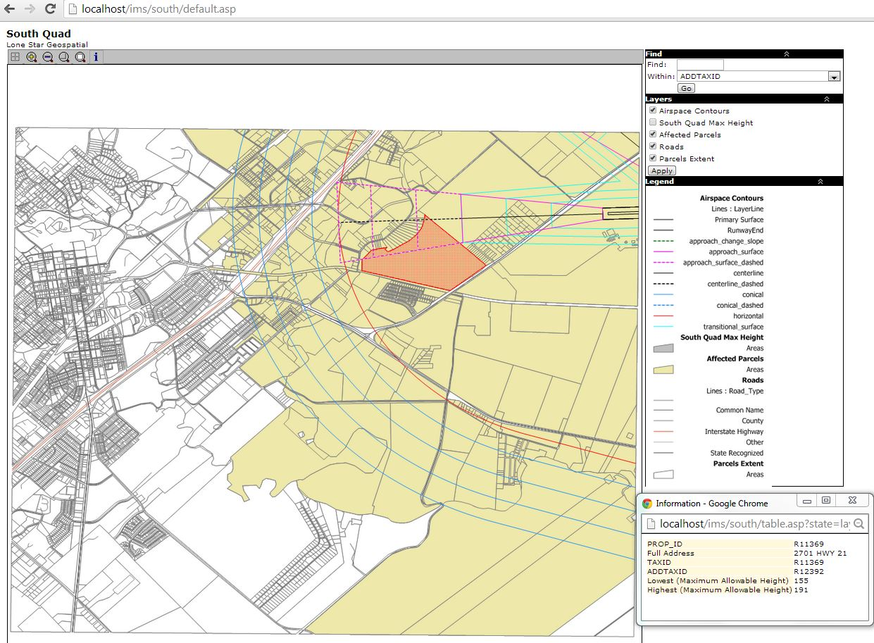
Results - Interactive Screening Tool

Slide 29
Discussions
Capabilities and Limitations
Capabilities
GIS allowed us to create accurate layers which can be shared and altered as needed
Limitations
Size of data produced and capabilities of web delivery prompted a grid delivery system for interactive tool
Data accuracy
Outdated or old data
Unable to obtain data with as much detail as we would have liked

Slide 30
Discussion (cont.)
Future Projects or extended uses of our research include:
Possible planning for runway extension to accommodate increased traffic
Could use interactive tool to assist in land suitability analysis for airport expansion
Access to more powerful software or tools could increase the capabilities of the interactive mapping tool

Slide 31
Conclusion
Our study was successful, and can be used for many other projects in the future
In the future, we would include a programmer in the budget to help with extra functionality for the mapping tool
Also, it would have been nice to have better data for the parcels layer from the city and county.

Slide 32
Questions?

