Slide 1
Progress Report

Slide 2
Project Description
Purpose: The goals of this project are to build a geodatabase and create a brochure with a map atlas for the Freeman Center. Another task our team will be taking up is a land cover classification for weesache. This project is designed to enable future research and assist in the maintenance required to keep up the ranch. The map atlas and brochure will also be used to help navigate the ranch to visitors, research partners, and stakeholders.

Slide 3
Task1: Creating a Geodatabase of cultural features and physical features

Slide 4
Work completed:
Determining included features
Data collection
Creation of feature classes for layers that will be used producing maps
Populating the geodatabase
Georeferencing features
Creating and specifying rules for the topology

Slide 5
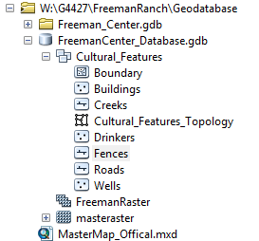
Work completed:
Cultural Features
Roads
Boundary
Fences
Creeks
Buildings
Pastures
Wells
Drinkers

Slide 6
Work completed:
Specifying topology rules.

Slide 7
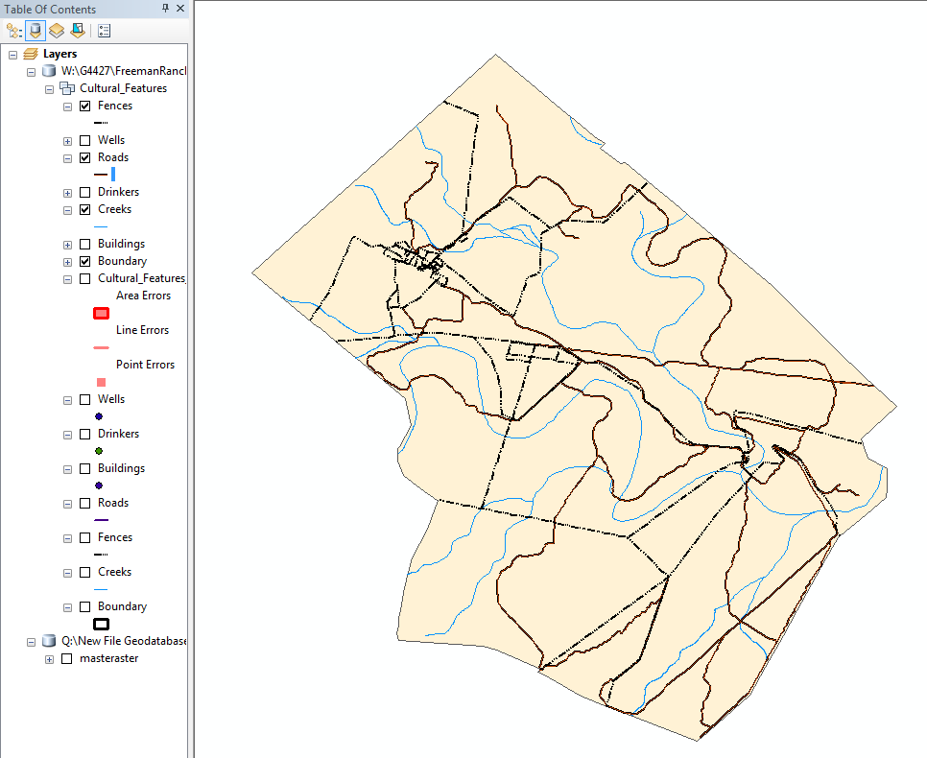
Line features

Slide 8
Point Features

Slide 9
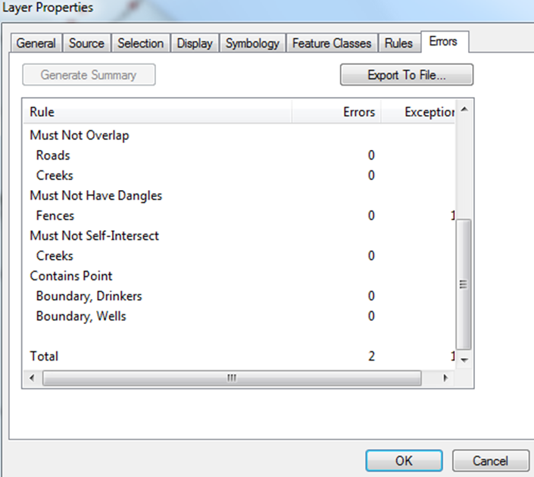
In-Progress:
Topology editing and validation
Fixing topology errors
Editing attribute tables

Slide 10
Topology layer

Slide 11
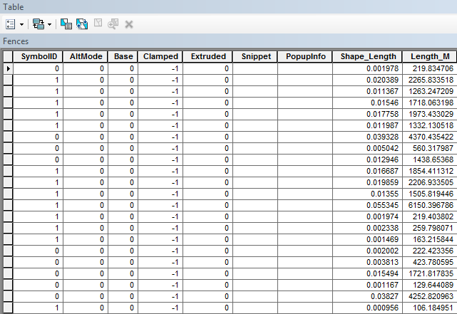
In-Progress:
Attribute table editing-
i.e. changing degree units to to linear units

Slide 12
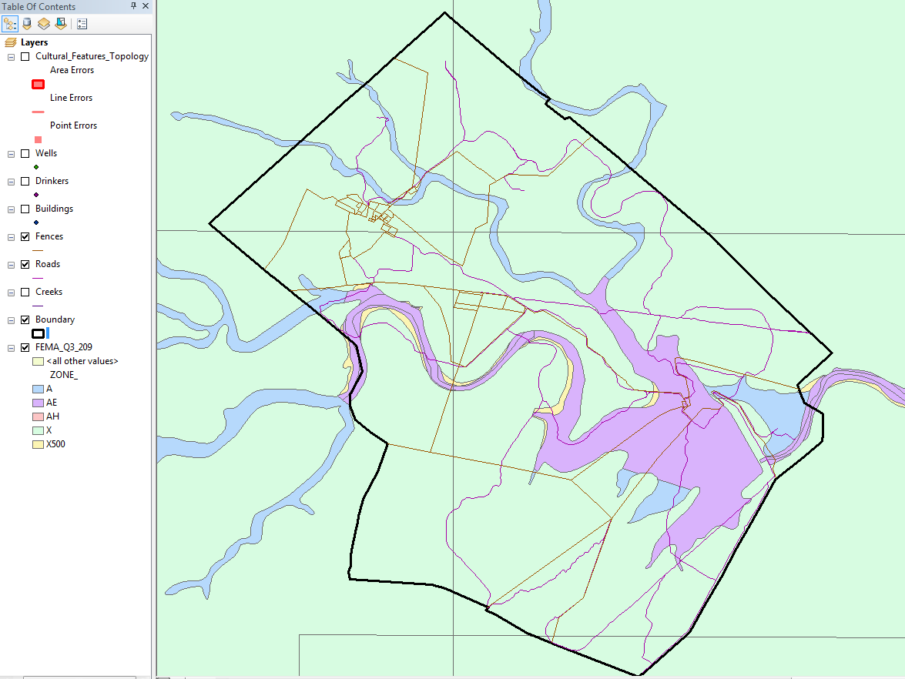
In-Progress:
Image of FEMA flood-zone shapefile with boundary –layer

Slide 13
Future Work:
Create polygons for pastures and buildings
Create stand-alone tables for soil, geology, and watershed (sub-basin)
Cartographic design
Map atlas creation
Brochure

Slide 14
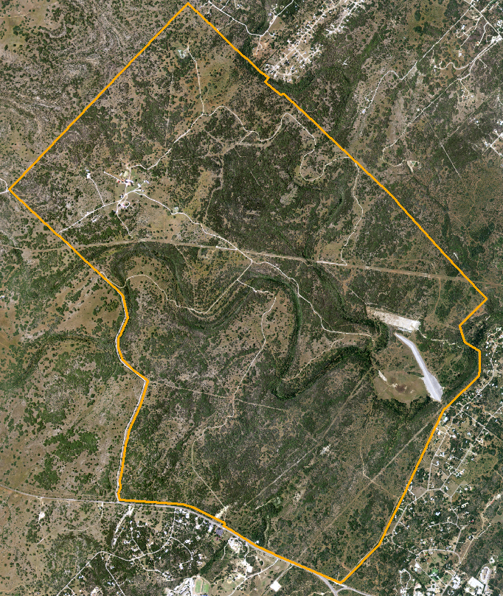
Task 2: Remote Sensing Applications for Assistive Ranch Management
Weesatch Land-Cover Classification

Slide 15
Work Completed
Gather Digital Ortho Quarter Quadrants (DOQQ’s) of the study area for 2008 and 2012
Mosaic of DOQQ’s and clipping of Area of Interest (AOI)
Tasseled Cap Transformation
Normalized Difference Vegetation Indices (NDVI)

Slide 16
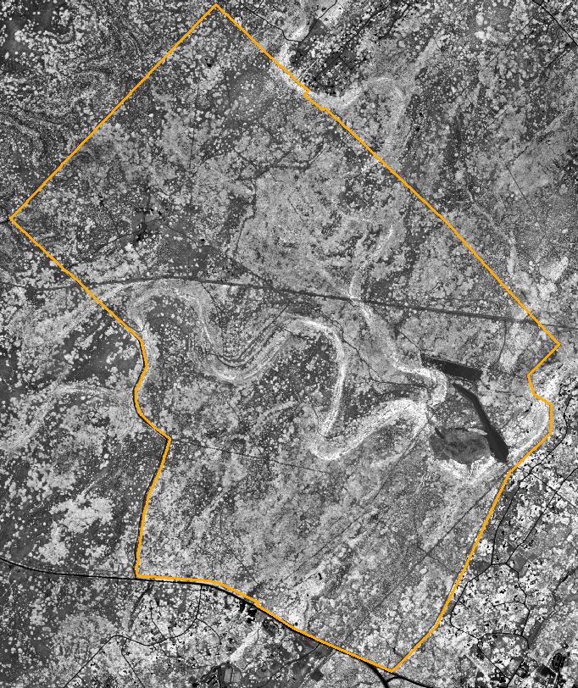
Work Completed

Slide 17
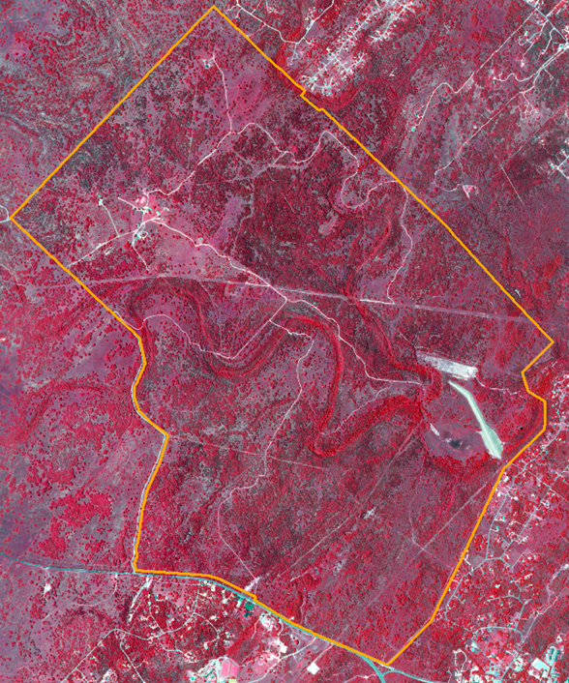
In-Progress
Gather Weesatch Training Data
Supervised Classification for Weesatch using Training Data

Slide 18
Future Work
Evaluate accuracy of the supervised classification for Weesatch
Reformulate design for classification as necessary
Perform change detection for Weesatch classification between 2008 and 2012 images
Appropriate detailed soil classification data

Slide 19
Problems:
Task 1:
Due to the extent of the study area and the lack of variety for many of the physical features such as soils watershed and geology, a dataset for these features will not be created. In substitution Geotrek will create a standalone table that features common varieties for geology, soils, and watershed delineation.
We will also need to acquire a proven formula to change area from degrees to meters.

Slide 20
Problems:
Task 2:
Lack of spectral separability between Weesatch and Mesquite
The key to success in this endeavor is to use multiple methods of classification to find the best (most accurate) classification.
Suggested additions to improve accuracy is using ancillary data like soil type/texture, interpolation of all available bands (rather than just the Near Infra-red) and the generation of an NDVI image to use in classification rather than the false-color composite image of the AOI.

Slide 21
Conclusion
The project to build a geodatabase for the Freeman Center is going well. The problems that have been found as previously described have been accounted for and a solution has been created for all. We can foresee no other major problems that will keep us from completing this project by the submit date of December 5. As a whole the project is coming along great, we are on schedule for all tasks. Full details on the project will be present in the final report.

