Slide 1
Mapping & Analysis of Wastewater Spills in the Barton Springs and Southern Segments of the Edwards Aquifer
Consultants:
Project Manager: Katie Tritsch
Asst. Project Manager: Eric Schroeder
Web Developer/ GIS Analyst: Katie Steele
GIS Analyst/ Graphic Design: Kevin Taylor

Slide 2
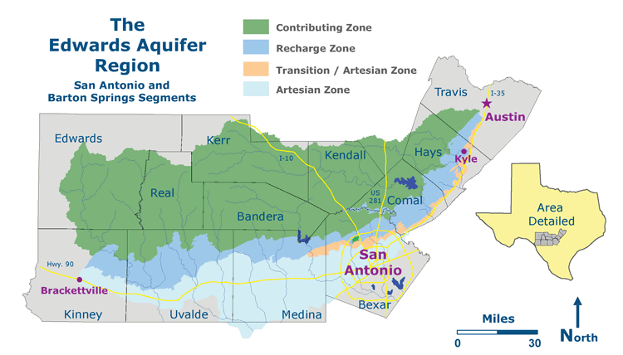
Introduction
Wastewater spills on Edwards Aquifer
Recharge and Contributing Zones
Barton Springs and Southern segments
Primary focus: Hays & Travis counties

Slide 3
3 Main Aspects:

Slide 4
3 Main Aspects
Make an interactive map of the spills
Vulnerability analysis
Locational & qualitative analyses

Slide 6
Data: Online Downloads
Collect basic shape files: Sources:
Roads TSDC
Rivers TWDB
Cities TNRIS
Counties TSDC
Groundwater Conservation Districts CAPCOG
TCEQ Region 11 TCEQ
Wastewater and MUD Facilities TCEQ, CAPCOG
Edwards Aquifer Zones EAA

Slide 7
Data: Spill Info Request
Acquire data on wastewater spills
Q: From who?
A: TCEQ
Q: How?
A: Email and Calling
Q: In what form?
A: Excel Table
Table of When, Where, How, Volume, Duration

Slide 8
Methodology: Part 1
Download shape files
Get spill data from TCEQ
Process data
Geocode spills
Interactive Map (Manifold) (http://geosites.evans.txstate.edu/g4427/S12/GEAA/maps.html)

Slide 9
“Processing” data…

Slide 10
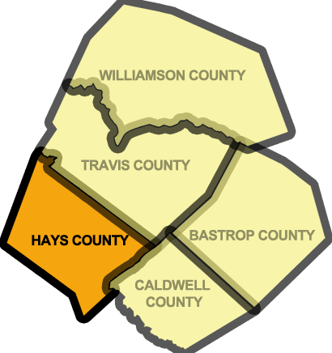
Methodology: Part 2
Vulnerability Analysis
Hays & Travis
What MUDs & GCDs contain spills
How many spills? A lot? Not many?
How are they distributed?

Slide 11
Methodology: Part 3
What we hope to have time to further study:
Locational & Qualitative Analyses
Population development trends
Causal patterns
Repeat Process on more TCEQ Region 11 Counties

Slide 12
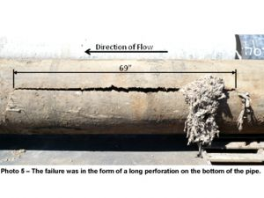
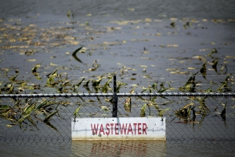
Expected results
Correlation between population and spills
Spill data clustered around larger cities, ie) Austin
Some inadequate data
Improving the context; why?
Cluster around certain MUDs (?)

Slide 13
BUDGET
Data Acquisition and Processing
2 Analysts (10 hrs/wk over 3 weeks) 60 1 Analyst (7 hrs/wk over 3 weeks) 21 1 Analyst (5 hrs/wk over 3 weeks) 15 Hourly Rate $26.00 Subtotal $2,496.00
Data Analysis
2 Analysts (10 hrs/wk over 4 weeks) 80 1 Analyst (7 hrs/wk over 4 weeks) 28 1 Analyst (5 hrs/wk over 4 weeks) 20 Hourly Rate $32.00 Subtotal $4,096.00
Website Development
1 Developer (2 hr/wk over 10 weeks) 20 Hourly Rate $25.00 Subtotal $500.00
Project Management
1 Project Manager (5 hrs/wk over 10 weeks) 50 Hourly Rate $44.00 1 Assistant Project Manager (3 hrs/wk over 10 weeks) 30 Hourly Rate $39.00 Subtotal $3,370.00
Software Costs
ESRI License Fee $5,200.00 Manifold Enterprise Edition $475.00 Subtotal $5,675.00
Equipment Costs
Workstations (4 units * $150/unit) $600.00 Technical Support and Maintenance (4 units * $100/unit) $400.00 Depreciation ($8000/36 * 2.5) $555.56 Subtotal $1555.56
Total Cost $17,692.56

Slide 14
ARI Timetable
 | Week 1 | Week 2 | Week 3 | Week 4 | Week 5 | Week 6 | Week 7 | Week 8 | Week 9 | Week 10*
Start date | 1-Oct | 8-Oct | 15-Oct | 22-Oct | 29-Oct | 5-Nov | 12-Nov | 19-Nov | 26-Nov | 12/3-12/10
Data Acquisition & Processing
Data Analysis & Interpretation
Integration with Manifold
Website Publication
Final Deliverables
*Week 10 is lengthened due to Final Deliverables due date

Slide 15
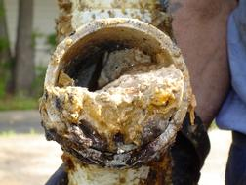
Conclusion
Methodology for vulnerability
Increased public awareness and involvement
Increasing accountability of responsible parties
Future regulations
Improving the context of spills

Slide 16
Questions?
Comments?
Concerns?

