Slide 1

Basin Conservation: The Environmental Health of the San Marcos Watershed
BaCon Makes Everything Better!

Slide 2

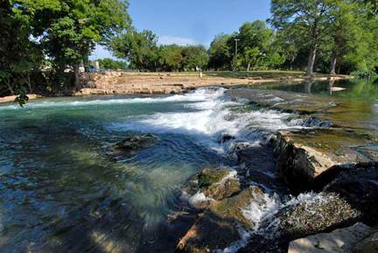
Sizzling Speakers
Ekaterina Troudonochina
Julian Montejano
Mark Hiler
Veronica Gentile
Team Manager
Webmaster, GIS Analyst
GIS Analyst
Pwpt Designer, GIS Analyst

Slide 3
Contents
Summary
Purpose
Scope
Data
Software
Analysis
Implications
Budget
Timeline
Final Deliverables
Conclusion
References

Slide 4
Summary
San Marcos is a growing city; increase in impervious cover
Reason why it is important:
  Aquatic Systems’ health and effect on chosen Endangered Species
Goal:
  Balancing protection of San Marcos River Watershed and city development

Slide 5
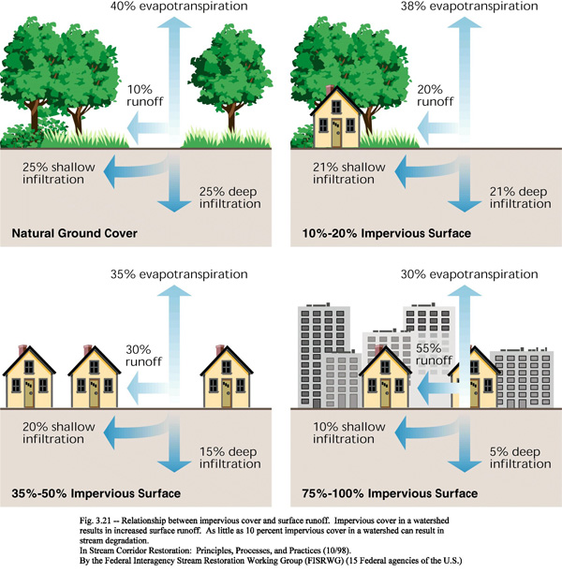
Impervious Cover

Slide 6
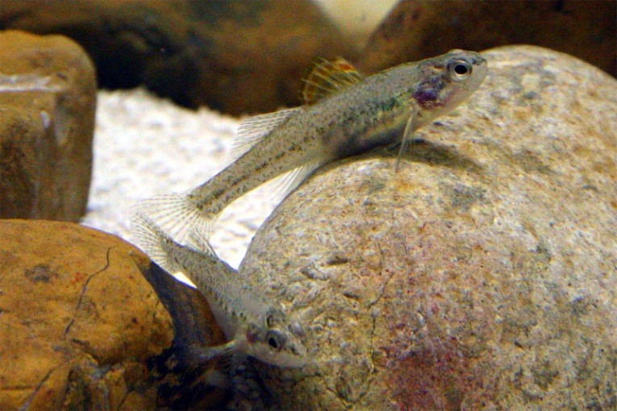
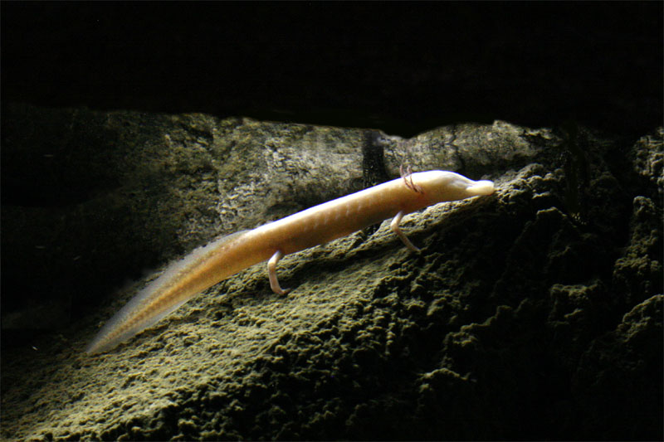
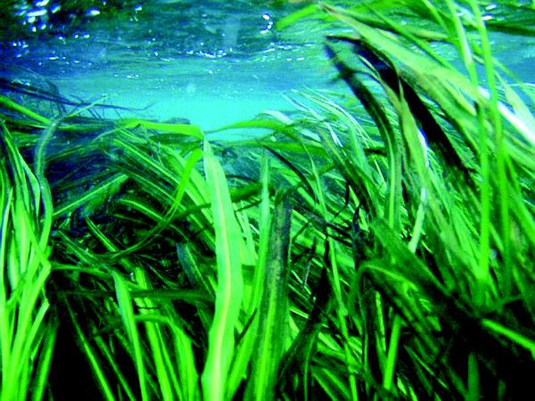
Endangered Species
Fountain Darter
Texas Blind
Salamander
Texas Wild Rice
Notes:
FD- is located on Springruns of Comal and San Marcos Springs. Water from Edwards Aquifer. Important because controls aquatic insect larvae and small crustaceans. Threatened by: Water drying up.
Salamander - is located in Hays County area of the San Antonio segment of the Balcones Fault Zone Edwards Aquifer. Important because is Top predator. Threatened by: groundwater pollutants
and lower water levels.
Wild Rice - is located in Springruns San Marcos Springs. Important because only location in World. Threatened by: decreased spring outflow from Edwards Aquifer

Slide 7
Purpose
Create a geospatial dataset
Use ArcMap and BASINS
  HSPF
Run several theoretical scenarios to see how impervious cover affects the watershed

Slide 8

Scope
Upper San Marcos River Watershed
All of the watershed going into the San Marcos River
  Spring Lake
  Until its confluence with the Blanco river
Western city development through the year 2035

Slide 9
Scope Map

Slide 10
Data
GIS Data:
  County boundaries (GLO)
  Digital Elevation Model (TNRIS)
  Streams (Meadows)
  Point Sources (obtained after analysis)
  Downloaded with BASINS (EPA)
    Land Use Land Change
    Weather Stations locations
    Water Quality Stations locations
    USGS Stream Gauge Stations locations
  Other Data:
    Weather (NOAA)
    Water Quality Guidelines (TCEQ)
    Map of the new comprehensive plan
  (COSM)

Slide 11
Software
ArcGIS 10:
  Used to spatially show the environmentally sensitive areas affected by development
BASINS:
  System created by the EPA for use in watershed/water-quality analysis
  HSPF (Hydrologic Simulation Program – FORTRAN)
      Model used to simulate runoff processes.
      Results shows the runoff flow rate, sediment load, and nutrient/pesticide concentrations and non-point source pollution

Slide 12
Analysis
Study acquired data, Collaborate with Meadows Center
Research/Compare Fountain Darter, Texas Blind Salamander, and Texas Wild Rice
Apply information to ensure acceptable water standards
  Want clean clear water
  Use endangered species research
Comparison of current to potential impervious cover for San Marcos 2035
  Using BASINS watershed modeling, ArcGis tools, and a digitized version of City of San Marcos Comprehensive Plan
  Create theoretical build out scenarios
Assessment of Environmental Impact

Slide 13
Implications
Show potential growth in San Marcos
  Emphasis on West Side
  Impervious cover and clean water connection
Show growth’s potential harm to environmentally sensitive areas
  Awareness for careful development in certain areas (mainly Edwards Aquifer Recharge Zone)

Slide 14
Budget
Job Title | Hourly Pay | Total
Data Acquisition | $10.00 | $700.00
Data Analysis | $25.00 | $3,500.00
Manager | $55.00 | $2,750.00
Webmaster | $35.00 | $875.00
Web Design/Presentation | $15.00 | $938.00
BASINS Training | $9.00 | $315.00
 | Labor Subtotal | $9,074.00

Slide 15
Budget (Cont.)
Supplies | Costs
Arc GIS License | $5,210.00
Depreciation | $560.00
Basic Supplies | $500.00
Maintenance | $700.00
 | Supplies Subtotal | $6,970.00
 | Grand Total | $16,048.00

Slide 16
Timeline
Calendars Include:
  Data Acquisition (Orange)
  BASINS training (Yellow)
  Data Analysis (Light Green)
  Web design and preparing the final presentation (Dark Green)
  Final Editing (Blue)

Slide 17
Final Deliverables
Detailed Final Report
Poster
Used Data: Metadata, BASINS Output, any External Resources
CD with the above listed Data, Instruction File, and Readme File
Website with Interactive Capabilities
Hard Copies of Significant Maps

Slide 18
Conclusion
Result of our Work:
  Acquired/Used all data, information, or technology necessary
  Demonstrated potential impacts of City of San Marcos Development Plan (2035) on San Marcos River Watershed
    increased land use
    suggested best management practices
  Explain potential harm to San Marcos River Watershed
  Highlight environmentally sensitive areas

Slide 19
References
City of San Marcos, Texas State University. Request for Proposal.
Meadows Center for Water and the Environment Website. Texas State University. Retrieved September 5, 2012, from http://www.meadowscenter.txstate.edu/
EPA (04/05/2012). BASINS. United States Environmental Protection Agency. Retrieved September 5, 2012, from http://water.epa.gov/scitech/datait/models/basins/index.cfm
Water Web server Team (01/12/2010). HSPF Hydrological Simulation Program – Fortran. USGS. Retrieved September 5, 2012, from http://water.usgs.gov/software/HSPF/
PowerPoint Photos obtained through Google Image searches. Retrieved September 25-30, 3012 from https://www.google.com/imghp?hl=en&tab=wi
(endangered species sites) http://www.edwardsaquifer.net/species.html and http://www.eardc.txstate.edu/about/endangered.html#top

Slide 20


