Slide 1



The City of New Braunfels Parks and Recreations Asset Management Project

Slide 2

GIS Consultants
  Project Manager/GIS Analyst: Kevin Sardino
  Asst. Manager/GIS Analyst/Web Master: Nathan Andrews
  GIS Technician/Data Specialist: Jenkins Barkley
  GIS Analyst/Technical Writer: Mukarram Kamran

Slide 3
Background
The G.A.M.E.S is presenting a progress report for the City of New Braunfels Parks and Recreation Asset Management Project.
Purpose:
  Utilizing data provided by the City of New Braunfels.
  Conducting a needs assessment with the Parks and Recreation Dept.
  Creation an asset GIS database.
  Synchronization GIS database from ArcGIS to Accela.

Slide 4
Scope
Needs Assessment narrowed the scope.
Parks and Recreation Dept. provided multiple spreadsheets of what our target is for the project.
See Appendix A & B

Slide 5
Appendix A
Appendix A |  | Park Boundaries Attribute Table Example
OBJECTID * | Shape | AssetID | Park Name | Address | Park Type | Council Districts | Acreage | COMMENTS | Year Acquired | Shape Length | Shape Area
8 | Polygon | 1 | Ernest Eikel Field Park | 250 S Grape Street | Neighborhood | 1 | 4 | <Null> | 1969 | 1712.602289 | 174397.266
30 | Polygon | 10 | Cypress Bend | 503 Peace Avenue | Community | 5 | 18.1 | <Null> | 1927 | 4323.803926 | 788424.3398
19 | Polygon | 11 | Fischer Park | 1820 Old McQueeny Rd | Regional | 6 | 62.53 | <Null> | 2007 | 7967.584455 | 2723847.181
23 | Polygon | 12 | Hinmann Island | 350 Elizabeth Avenue | Community | 3,5 | 5.9 | <Null> | 1958 | 5196.295427 | 257017.3562
33 | Polygon | 13 | West Loop Park | 1184 Landa Street | Community | 3 | 13.2 | Need to check the extent of park and make sure it is correct | 2010 | 3202.58549 | 574961.1877
20 | Polygon | 14 | Prince Solms Parks | 100 Liebscher Drive | Community | 5 | 15.53 | <Null> | 1970 | 7643.000054 | 676266.7036
27 | Polygon | 15 | Landa Park | 164 Landa Park Drive | Regional | 3 | 56.92 | <Null> | 1936 | 18938.43195 | 2479368.512
11 | Polygon | 16 | HEB Soccer Fields | 515 Live Oak | Special Use Areas | 1 | 14.4 | <Null> | 1973 | 4016.306303 | 627410.7607
16 | Polygon | 17 | Fredricksburg Field | 689 Fredricksburg | Special Use Areas | 3 | 5.47 | <Null> | 1954 | 1966.878997 | 238256.1654
22 | Polygon | 18 | Landa Golf Course | 180 Golf Course Drive | Special Use Areas | 3,4,5 | 114.58 | <Null> | 1936 | 19351.97281 | 4991291.225

Slide 6
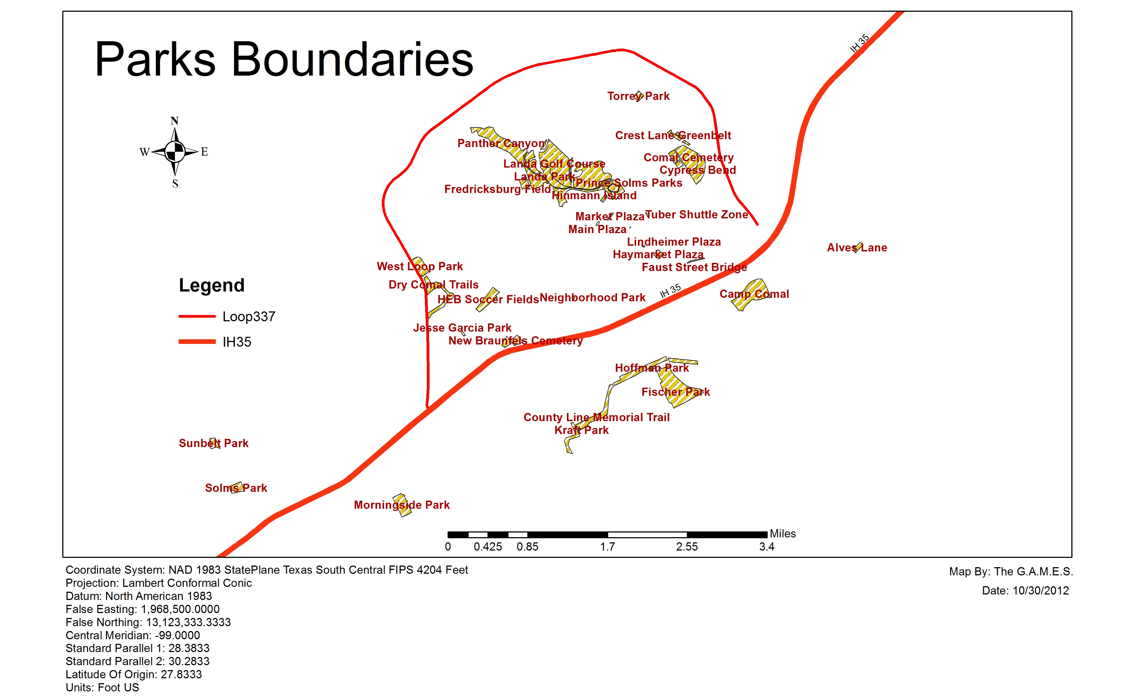

Slide 7
Appendix B
Appendix B |  | Landscape Maintenance Attribute Table Example
OBJECTID * | Shape * | AssetID | Property Type | Property Description | Address | Property Classification | Basic Mowing | Shredding | Turf Fertilization Granular | Trim Ground Cover | Prune Shrub Hedges | Maintain Flower Beds
81 | Polygon | 1 | City Facility | City Hall | 424 S Castell Ave | A | 36 | 0 | 0 | 36 | 12 | 12
66 | Polygon | 2 | City Facility | Civic Center | 375 S Castell Ave | A | 36 | 0 | 1 | 36 | 12 | 12
68 | Polygon | 3 | City Facility | Fire Station # 1 | 169 S Hill Ave | C | 24 | 0 | 0 | 4 | 4 | 12
14 | Polygon | 16 | Parks | Cypress Bend Park | 503 Peace Avenue | B | 36 | 0 | 0 | 0 | 0 | 0
7 | Polygon | 17 | Parks | Ernest Eikel Field | 250 South Grape | C | 36 | 0 | 0 | 0 | 0 | 0
16 | Polygon | 18 | Parks | Faust Street Bridge | Faust/Porter Street | B | 12 | 0 | 0 | 0 | 0 | 0
78 | Polygon | 33 | Roads and Medians | County Line Road Medians | FM 725 to FM 1044 | C | 18 | 0 | 0 | 0 | 0 | 0
83 | Polygon | 34 | Roads and Medians | Tubers Shuttle Zone | 100 E Lincoln | B | 24 | 0 | 0 | 0 | 4 | 0
77 | Polygon | 35 | Roads and Medians | Walnut Extension Medians | County Line Road to Klein Road | B | 36 | 0 | 0 | 6 | 4 | 36
41 | Polygon | 81 | Undeveloped/Flood Property | Fischer Property | 1820 McQueeny Road | C | 24 | 0 | 0 | 0 | 0 | 0
48 | Polygon | 82 | Undeveloped/Flood Property | Landa Plaza | 345 Landa Street | C | 24 | 0 | 0 | 0 | 0 | 0
63 | Polygon | 83 | Undeveloped/Flood Property | Morningside Park | 3737 Morningside Dr | D | 0 | 6 | 0 | 0 | 0 | 0

Slide 8
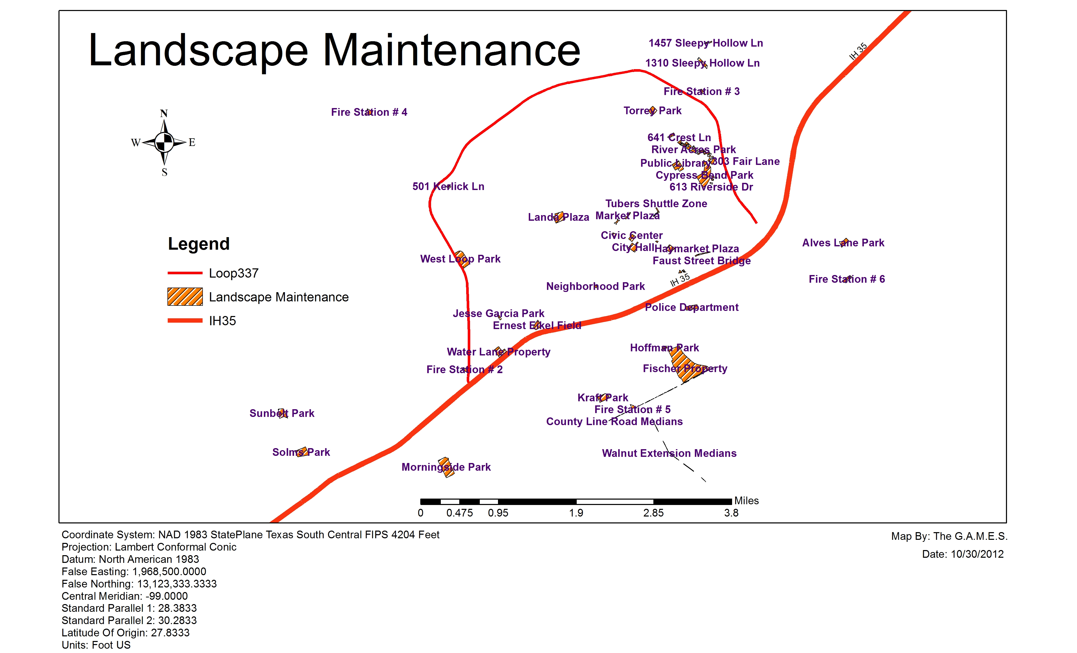

Slide 9
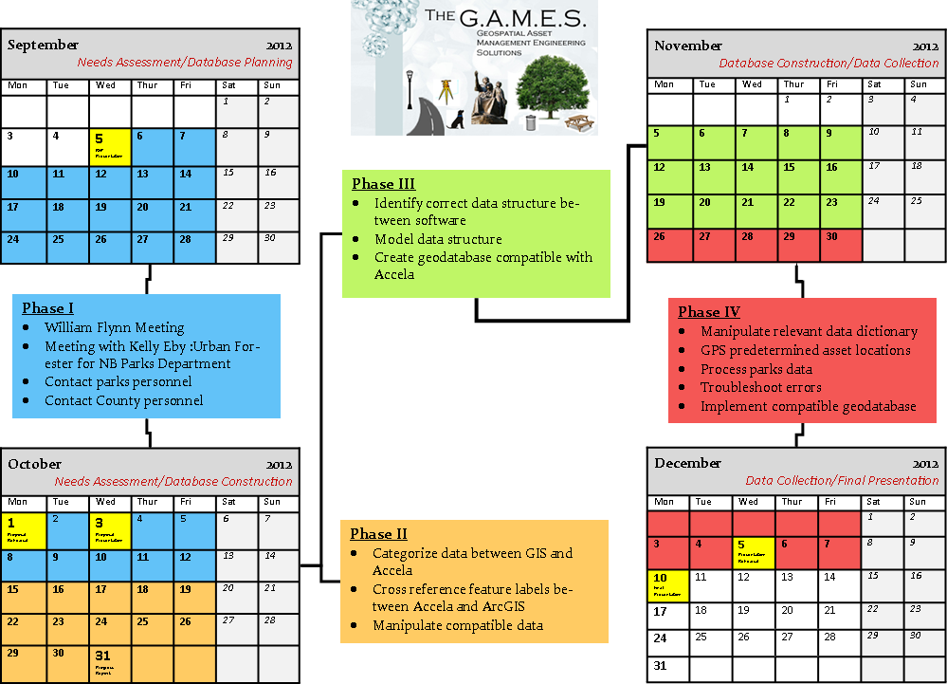
Revised Time Table

Slide 10
Tasks
Phase I: Needs Assessment
Completed/On-going
Parks Department added water features, water fountains, pavilions, historical markers, trees, and flower beds.
Phase II: Evaluating Existing Data
Completed/On-going
The team researched and classified data that could be utilized in the integration of GIS and Accela
Phase III: Database Modeling/Construction
Ongoing
Phase IV: Data Collection
Future

Slide 11
Conclusion
The data will be based off a GIS geodatabase that will synchronize with Accela software.
The project will help design and create an effective asset management system for the Parks Department of the city of New Braunfels.
Employees can use the AMS to create work orders
The AMS can generate preventitive maintainence
The effective asset management system can be presented to city council and possibly used in all other city departments.

Slide 12
Final Deliverables
Final Deliverables
Detailed Final Report (2 Copies)
Professional Poster for display in the Geography Department
CD (2 Copies) containing:
o All Data
o Metadata
o Report
o Poster
o PowerPoint Presentation
o Instructions on how to use the CD
§ Readme file
§ Link to our website
Note that testing will be conducted to ensure no corruption will occur and that all data is usable.

Slide 13
References
City of New Braunfels, Request For Proposal, City of New Braunfels, Texas, August 2012.
Dan Saltzman. Portlandonline.com. Total Asset Management, July 2006. Web. September 20, 2012. http://www.portlandonline.com/parks/index.cfm?a=151131&c=38306
Image 1: http://www.esri.com/news/arcnews/spring12articles/spring12gifs/p16p1-lg.jpg
Image 2 : http://www.newbraunfelsfunthingsinlife.com/
Joel Hillhouse. ESRI.com. ArcNews, Spring 2012. Web. September 29, 2012. http://www.esri.com/news/arcnews/spring12articles/city-of-las-vegas-implements-parkpad-for-mobile-asset-management.html
Lemer, A. (1998). Progress Toward Intergrated Infrastructure Asset Management Systems: GIS and Beyond. APWA International Public Works Congress, 1-18.

Slide 14
Questions? Or comments?

