Slide 1
Potential Scenic Sites Analysis for the Hill Country Conservancy
Nancy A. Heger, Manager Gene Sipes, Assistant Manager
Matt Broadaway, GIS Analyst Matt Gray, Web Master
Image source: http://www.philadelphianstours.com/

Slide 2
Progress Report
Brief Project Description
Past Work
Current Work
Work Completed
Future Work
Final Deliverables
Conclusions

Slide 3
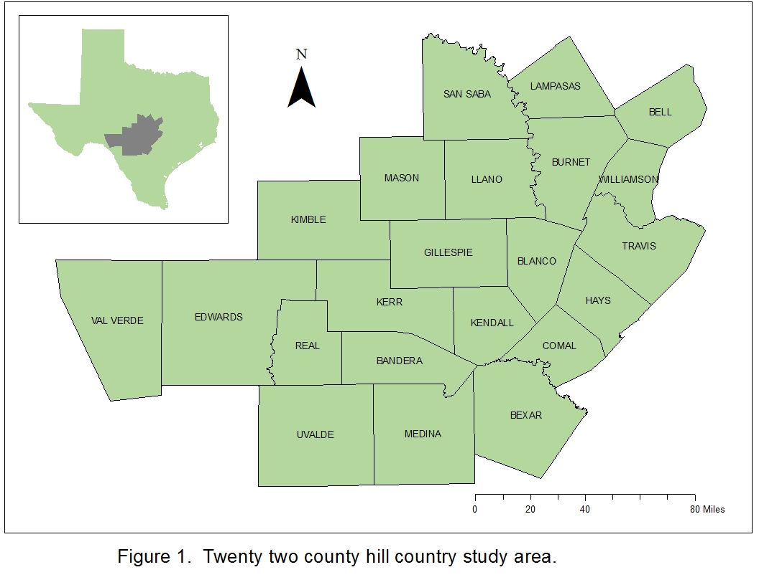
Purpose
Identify potential sites for future preservation by the Hill Country Conservancy (HCC)
Identify areas that are “scenic” as defined by factors such as topographical relief, proximity to water bodies, and vegetation.
Provide a map of potential scenic sites that HCC can use to identify areas for future preservation
SCOPE
Study region - 22 county area in
Hill Country
Will take approximately 3 months
(6 Sept. to 13 Dec.)

Slide 4
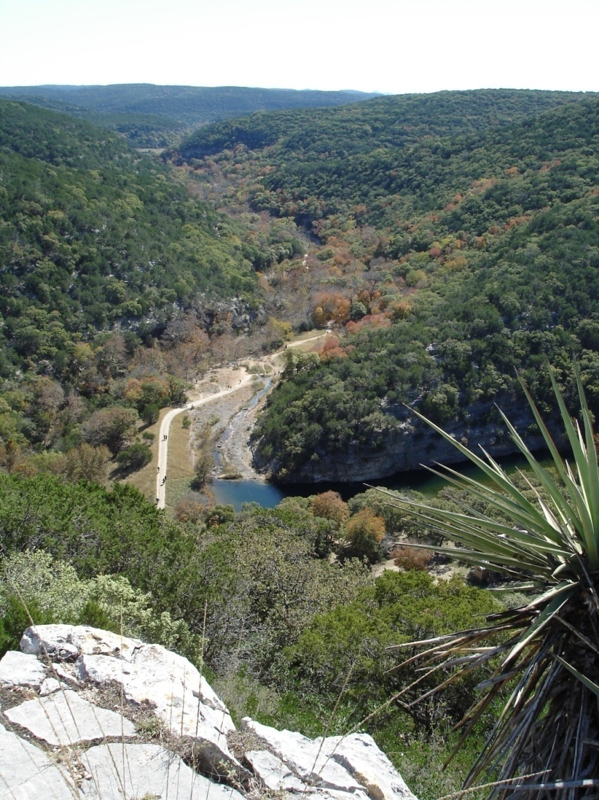
Past Work - Model Criteria
Road Buffer
3 mile buffer around roads
Topographic Variation i.e. slope
Areas with more relief preferred
Distance from streams
Areas closest to streams preferred
Distance from State Parks/Historic Sites
Areas closest to State Parks preferred
Distance from unique natural feature
e.g. Enchanted Rock
Areas near these features preferred
Land Use
Areas with preferred vegetation types

Slide 5
Current Work
Current Model Criteria:
Distance from streams
Areas closest to streams preferred
Land Use
Omit all urban areas
Topographic Variation i.e. slope
Areas with more relief preferred
Reassessment of current suitability model and viewshed analysis
Testing of revised model and refinement of viewshed analysis

Slide 6
Work Completed
Data collection and preparation
Pilot study run on Hays County using scenic suitability model
Viewshed Tests

Slide 7
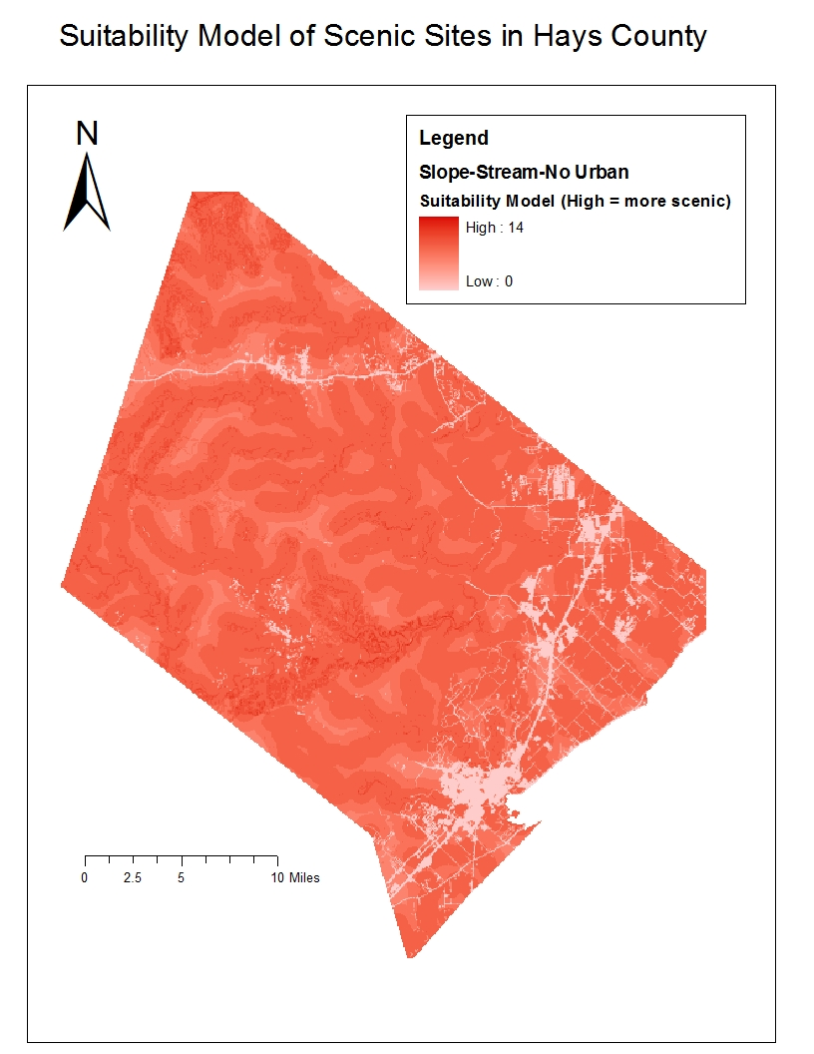
Hays County Pilot Study
Model needs refinement
Scoring changes
Weighting
Variables used

Slide 8
Creation of Tools to View Results
Toolbar demo

Slide 9
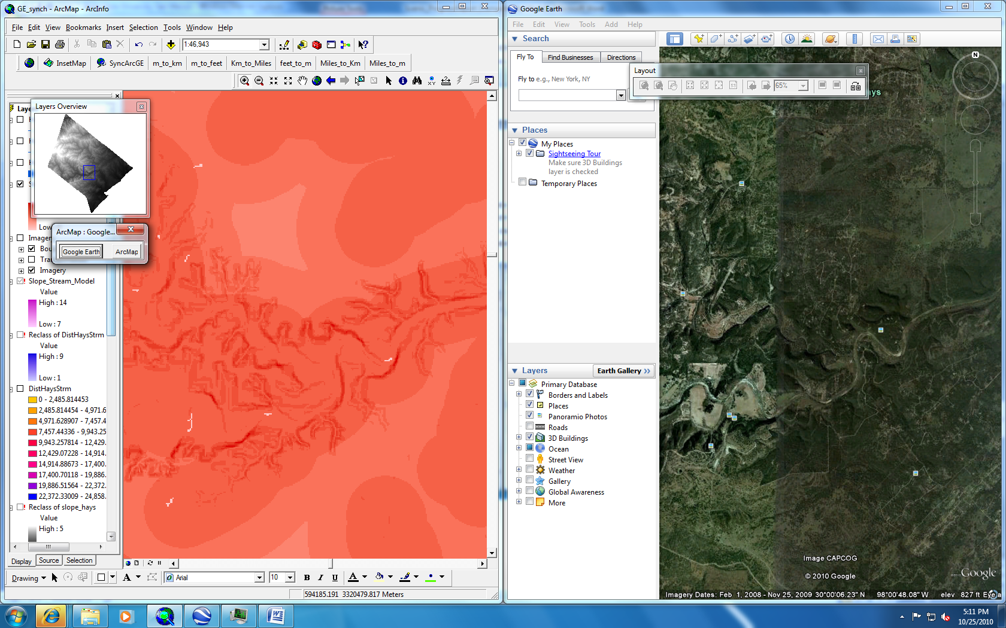
Creation of Tools to View Results

Slide 10
Viewshed Tests by County

Slide 11
Viewshed From Rivers

Slide 12
Future Work
Use visualization tools to validate model
Refine model and scoring system
Mosaic county viewsheds and run model on viewable area
Use Arc Scene - ESRI product that allows 3-D visualization

Slide 13
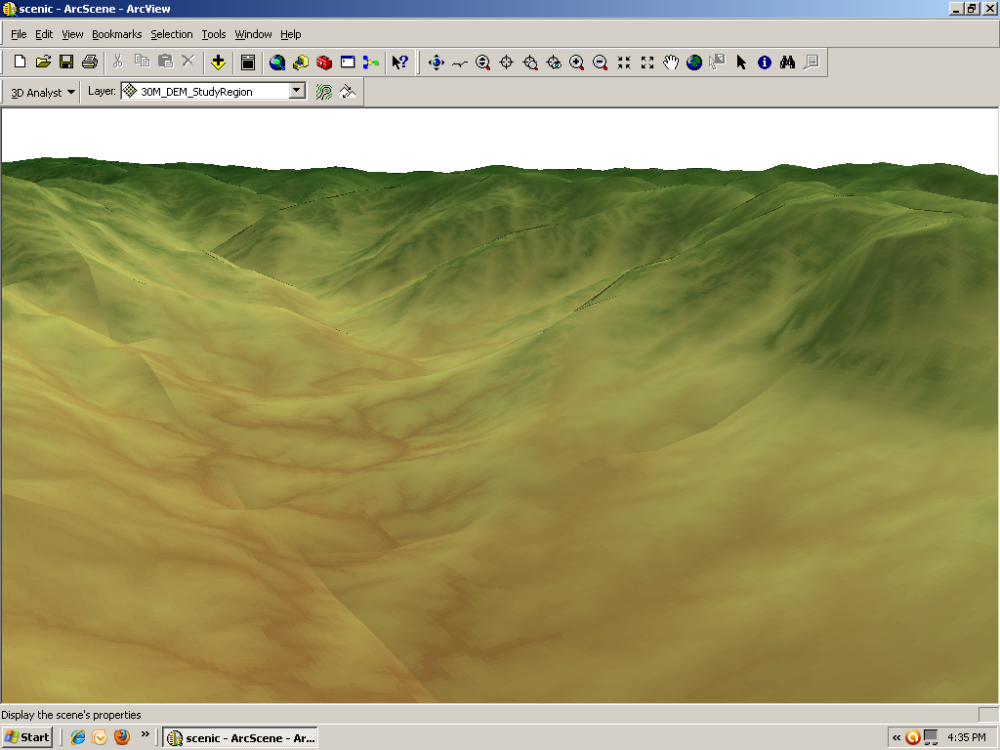
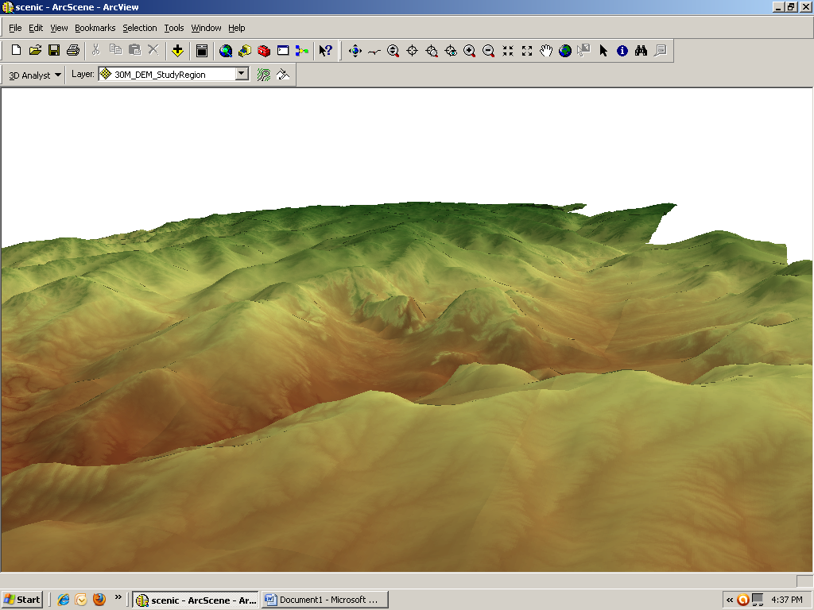
Arc Scene

Slide 14
Final Deliverables
Final deliverables will include:
A Detailed Final Report (2 copies)
Professional Poster for display in the Geography Department
Website
CD (2 copies) containing
All data
Metadata
Proposal, Progress, and Final reports
Poster
Power Point presentation
Instructions on how to use CD (readme file)

Slide 15
Conclusions
Need model refinement
In the process of revising model scoring, weighting, and criteria used to identify scenic areas
Model validation
Once model is refined, it will be validated using SyncArcGE tool
Viewshed analysis on a smaller scale may be do-able
Currently running county viewsheds, which will be combined to access scenic value of viewable areas.
Other potential viewing
Arc Scene
Outcome
Model will be created that can be used in other areas to determine scenic beauty.

