Slide 1
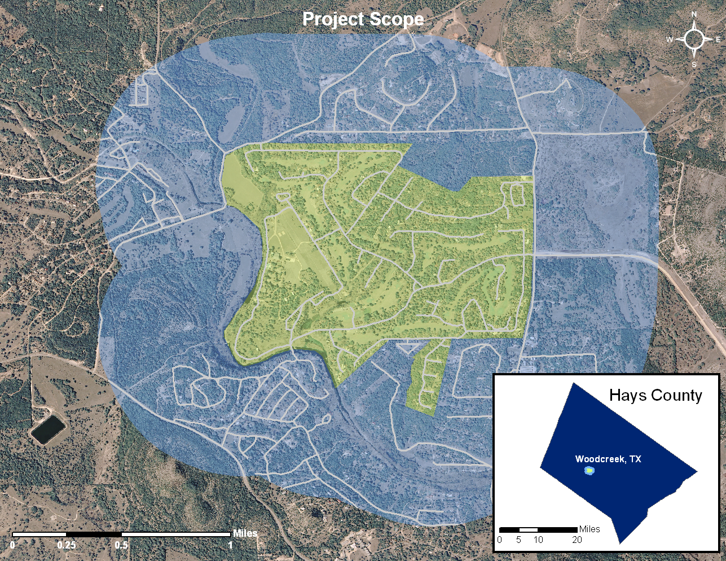
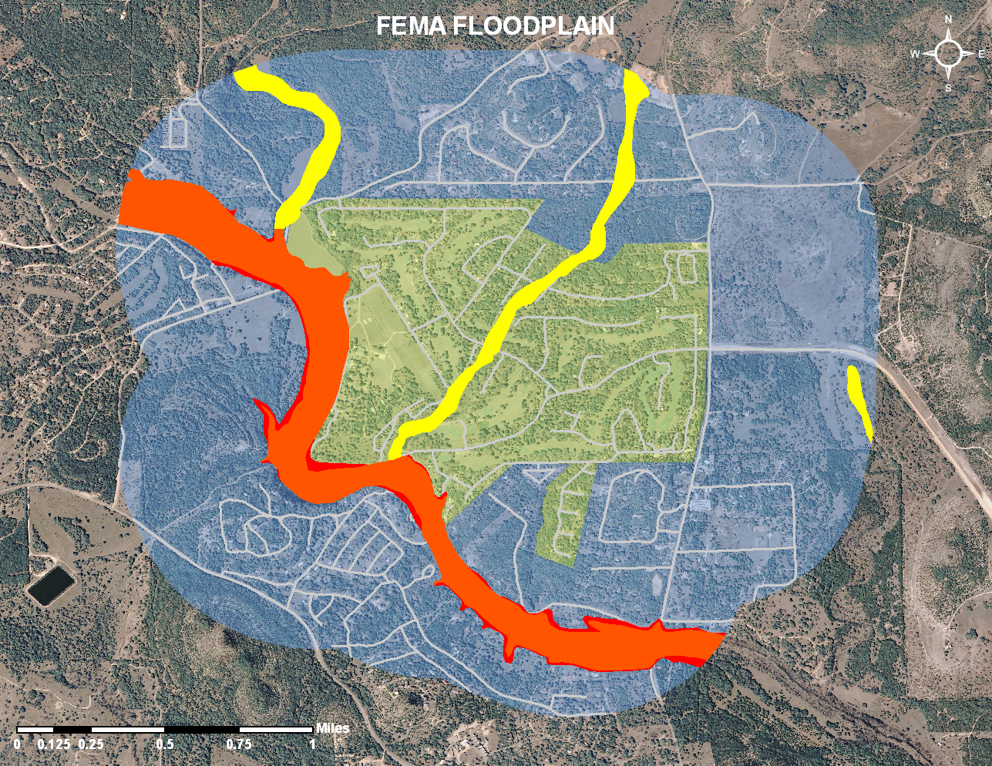
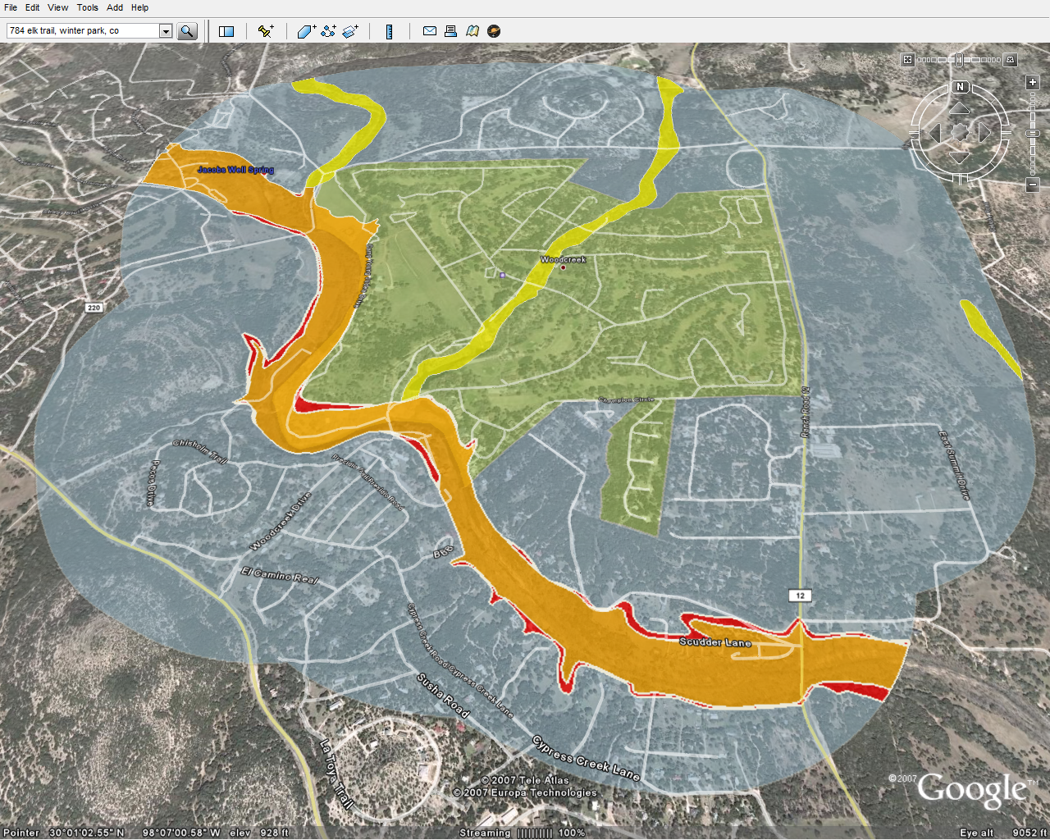
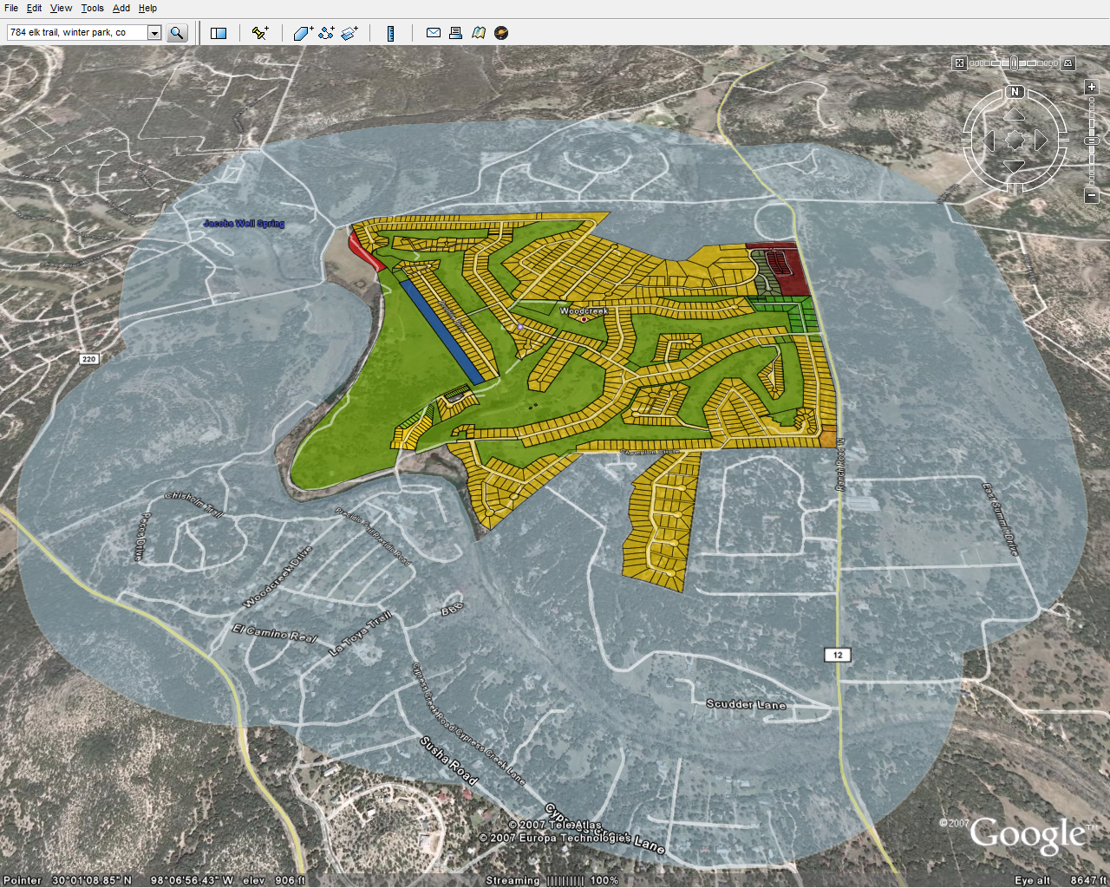
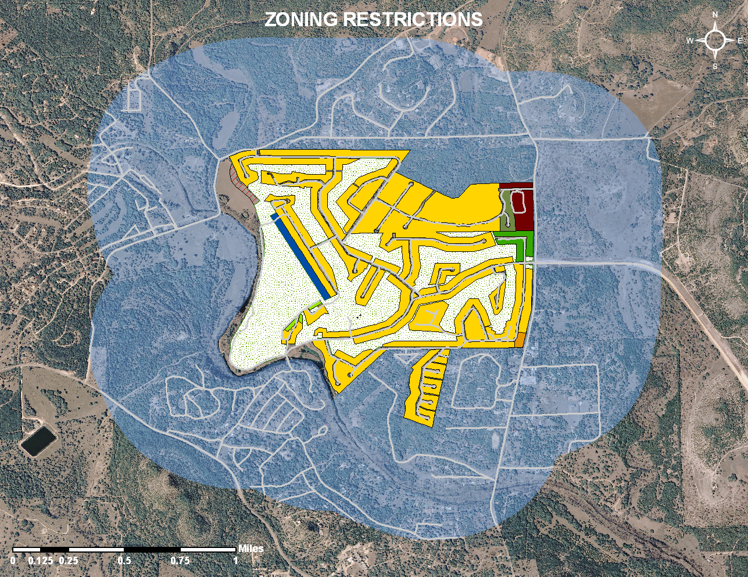

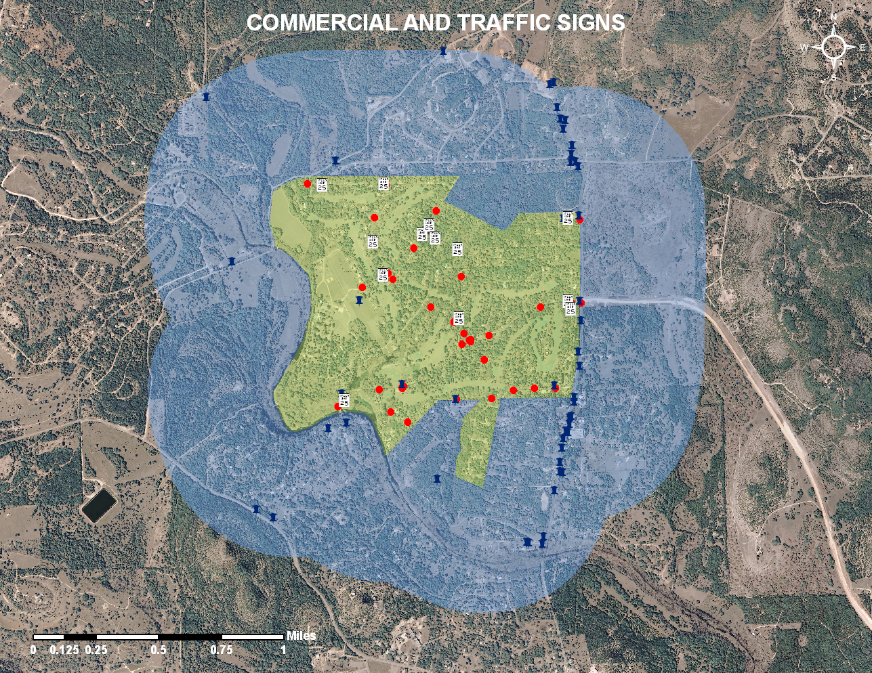
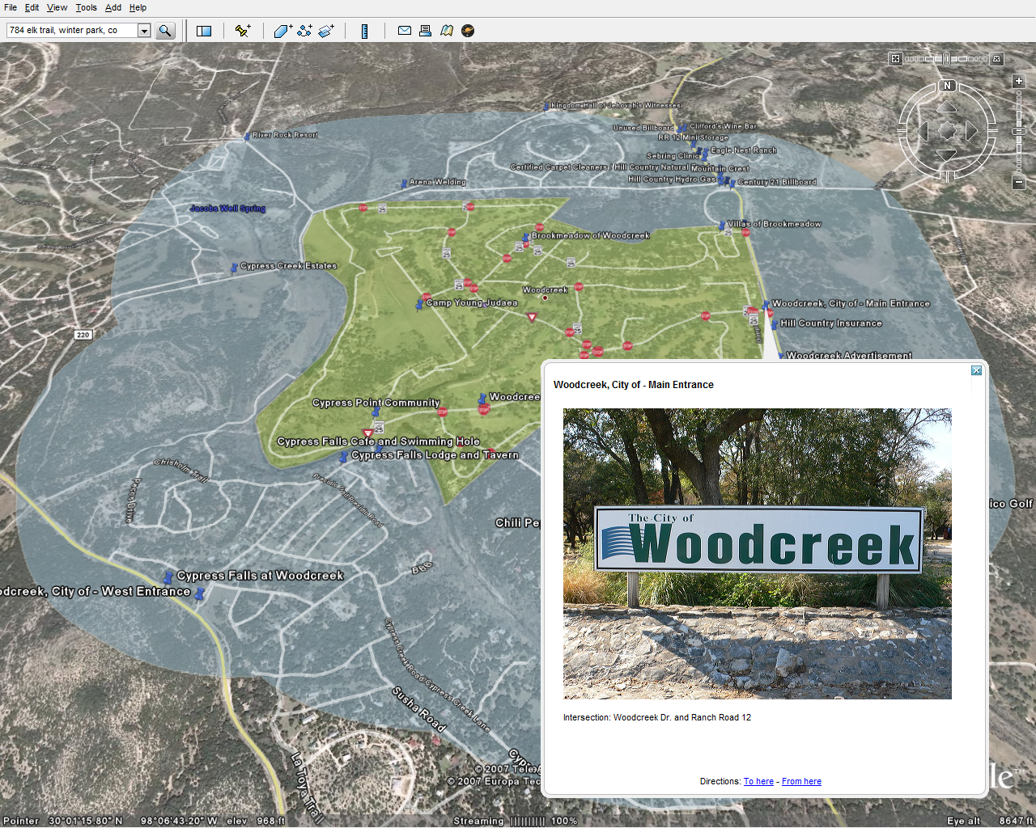




GIS Development and Implementation:
City of Woodcreek, Texas
Texas State Geography Department
Spatial Consulting Services
James Thomas Chris Faulkner Paul Kaiser Logan Weller-Alexander Jordan Stanley
SUMMARY
SCOPE
DATA
Woodcreek, Texas is a small city located in Hays County just northwest of Wimberley. It was incorporated in 1984 with a population of 600. As the city has grown in population, it has become apparent that there is a need for a formal mapping system to organize the city’s infrastructure and map documents. Geographic Information Systems (GIS) is a powerful tool that can be used to design a spatial database for Woodcreek. The city requested that Spatial Consulting Services (SCS) update map products that are more professional and useable than current documents. In addition to updated maps, SCS has developed an interactive map viewer through the use of Google Earth. This viewer will allow Woodcreek officials and citizens to view and make maps quickly and accurately. With this system, citizens of Woodcreek will be able to report any future problems with infrastructure or signage to city officials.
The scope of our study area focuses upon the central Texas City of Woodcreek, located within Hays County. The city limits encompass 686 acres and the extraterritorial jurisdiction (ETJ) extends one half mile beyond the incorporated boundaries.
Both primary and secondary data were used for this project.
Primary data was collected by SCS using a handheld Global Positioning System (GPS). There were four major sources for secondary data:
  Capital Area Council of Governments (CAPCOG)
  Texas Natural Resource Information System (TNRIS)
  City of Woodcreek
  Hays County
PURPOSE
ARCMAP AND GOOGLE EARTH EXAMPLES
CONCLUSIONS
The purpose of our project was to build a formal mapping system for the City of Woodcreek by developing a GIS database. This mapping system displays zoning regulations, administrative boundaries, and infrastructure status. The system will greatly increase the efficiency of city functions.
A Geographic Information System has been created by Spatial Consulting Services for the City of Woodcreek, TX. The GIS mapping system was created utilizing the tools in ESRI’s ArcMap. The Data consists of topographic information, administrative boundaries, zoning regulations, infrastructure status, and commercial sign locations. Future modifications to these documents are made available through the use of Google Earth. In addition to physical map documents that display the city’s attributes, we have designed a database which encompasses these features. The system has organized the city’s information in a way to be functional for the user. The user can look at many different data layers on a single map and decide which information to display. Overall, the functionality of presenting Woodcreek has been greatly enhanced. Visually enhancing the city’s ability to see its area will help in implementing positive changes to Woodcreek.
Lastly, Spatial Consulting Services is very proud of the work it completed for Woodcreek. We would like to thank the City of Woodcreek for the opportunity to bring GIS to their community. This opportunity served as an invaluable learning experience to the members of SCS as well assist Woodcreek’s future development.
METHODOLOGY
Map originals, provided by Woodcreek were digitized and geo-referenced. Heads up digitizing was utilized in the creation of the point layers for: Fire Hydrants, Speed Signs, Stop and Yield Signs. Points were snapped to a 15 foot buffer, originating from the street centerlines. Finally, each location was spatially joined to the street centerlines to provide accurate road associations for identification purposes and greater functionality.
Attributes were applied to the street centerlines reflecting the Road Repair History and Future Road Repairs within the dataset.
The Extraterritorial Jurisdiction definition was created by applying a 0.5 mile buffer to the City Limits layer obtained from Hays County.
The visual representation of current Zoning Restrictions was accomplished through the addition of zoning attributes to the Parcels layer obtained from CAPCOG. Additional modifications to the zoning regulations may be made by updating the attributes in the dataset.
Hays County Floodplain data was obtained from the TNRIS website and modified to display the entire scope of the Woodcreek project. The dataset was then overlaid on aerial imagery from CAPCOG.
Commercial Signage waypoints, inside the Woodcreek scope, were collected utilizing GPS field methods. Additionally, digital photographs were taken of each sign location. The waypoints and digital photographs were saved using standard naming conventions, for employment in a simple script to geographically match each location
Google Earth functionality was accomplished through a conversion process, altering all data layers into the appropriate KML format.
ACKNOWLEDGMENTS
Spatial Consulting Services would like to thank the following:
Dr. Yongmei Lu
Texas State University – Geography Department
Dr. Sally Caldwell – Mayor Pro Tem of Woodcreek, TX.

